Slide 2
SeNtinel Application Platform
&
Scientific Toolbox Exploitation Platform
Fabrizio Ramoino [SERCO c/o ESA-ESRIN]

Slide 3
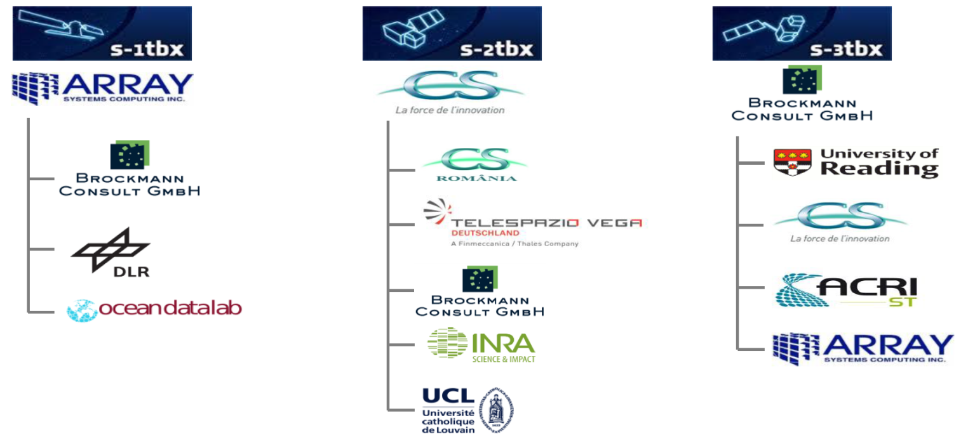
SNAP/STEP SNAP Overview
The common architecture for all Sentinel Toolboxes and SMOS Toolbox is called Sentinel Application Platform (SNAP)

Slide 4
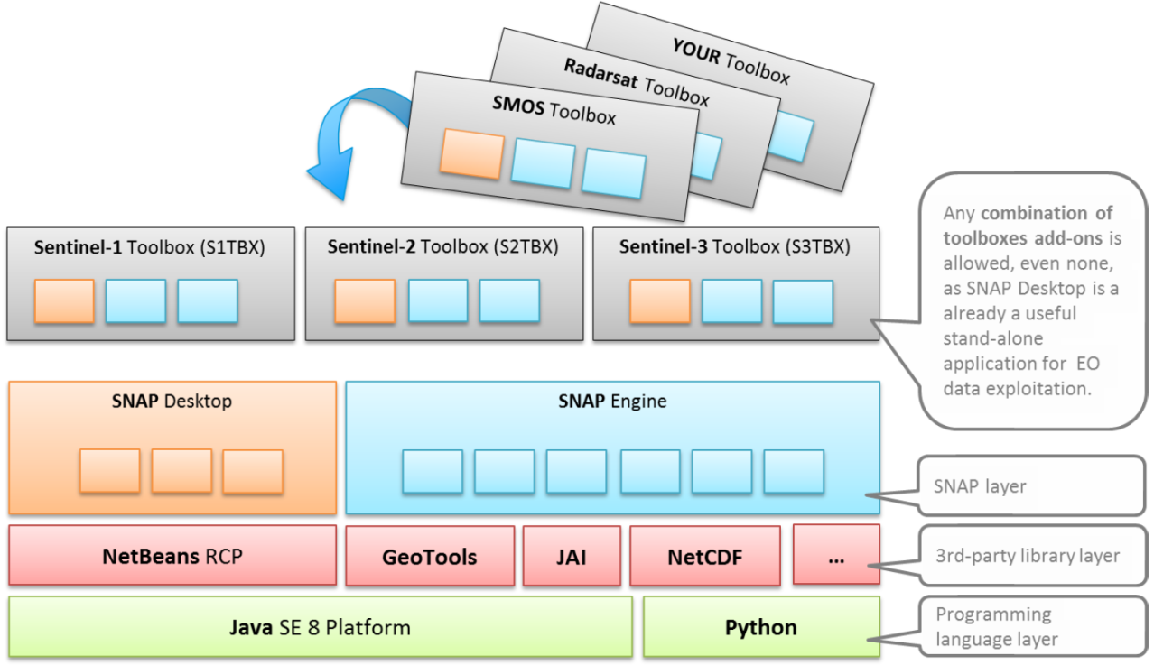
SNAP/STEP SNAP Benefits
Developed as open source software
Common Java core framework
Joint development plan for Sentinel toolboxes
Interchangeable Java/Python plugins
Portable engine to Cloud infrastructure
Single installer

Slide 5
SNAP/STEP SNAP Free & Open Source
Freely downloadable in http://step.esa.int/main/download
“Free as in Freedom”
Run it anywhere you want
Make copies
Distribute it
Study the code
Change it, Improve it, Distribute your modifications

Slide 6
SNAP/STEP SNAP Cardinal Requirements
SNAP, the common architecture for all Sentinel Toolboxes, is ideal for EO data processing and analysis due the following technological innovations
Open Source
Extensibility & Modularity
Portability
Multi Mission Toolbox
Generic EO Data Abstraction
Tiled Memory Management
Graph Processing Framework

Slide 7
SNAP/STEP SNAP Core Features
Common architecture and data model for all Toolboxes
Develop your own application (cli or gui)
Very fast image display and navigation even of giga-pixel images
Advanced layer management allows adding and manipulation of new overlays such as images of other bands, images from WMS servers or ESRI shapefiles
Graph Processing Framework (GPF)
Generic Operators
Flexible band arithmetic using arbitrary mathematical expressions
Reprojection to common map projections
Resampling
Subset
Supervised classification algorithms
Random Forrest, KNN, KDTree KNN, Maximum Likelihood, Minimum Distance
Automatic SRTM DEM download and tile selection
Multithreading and Multi-core processor support

Slide 8
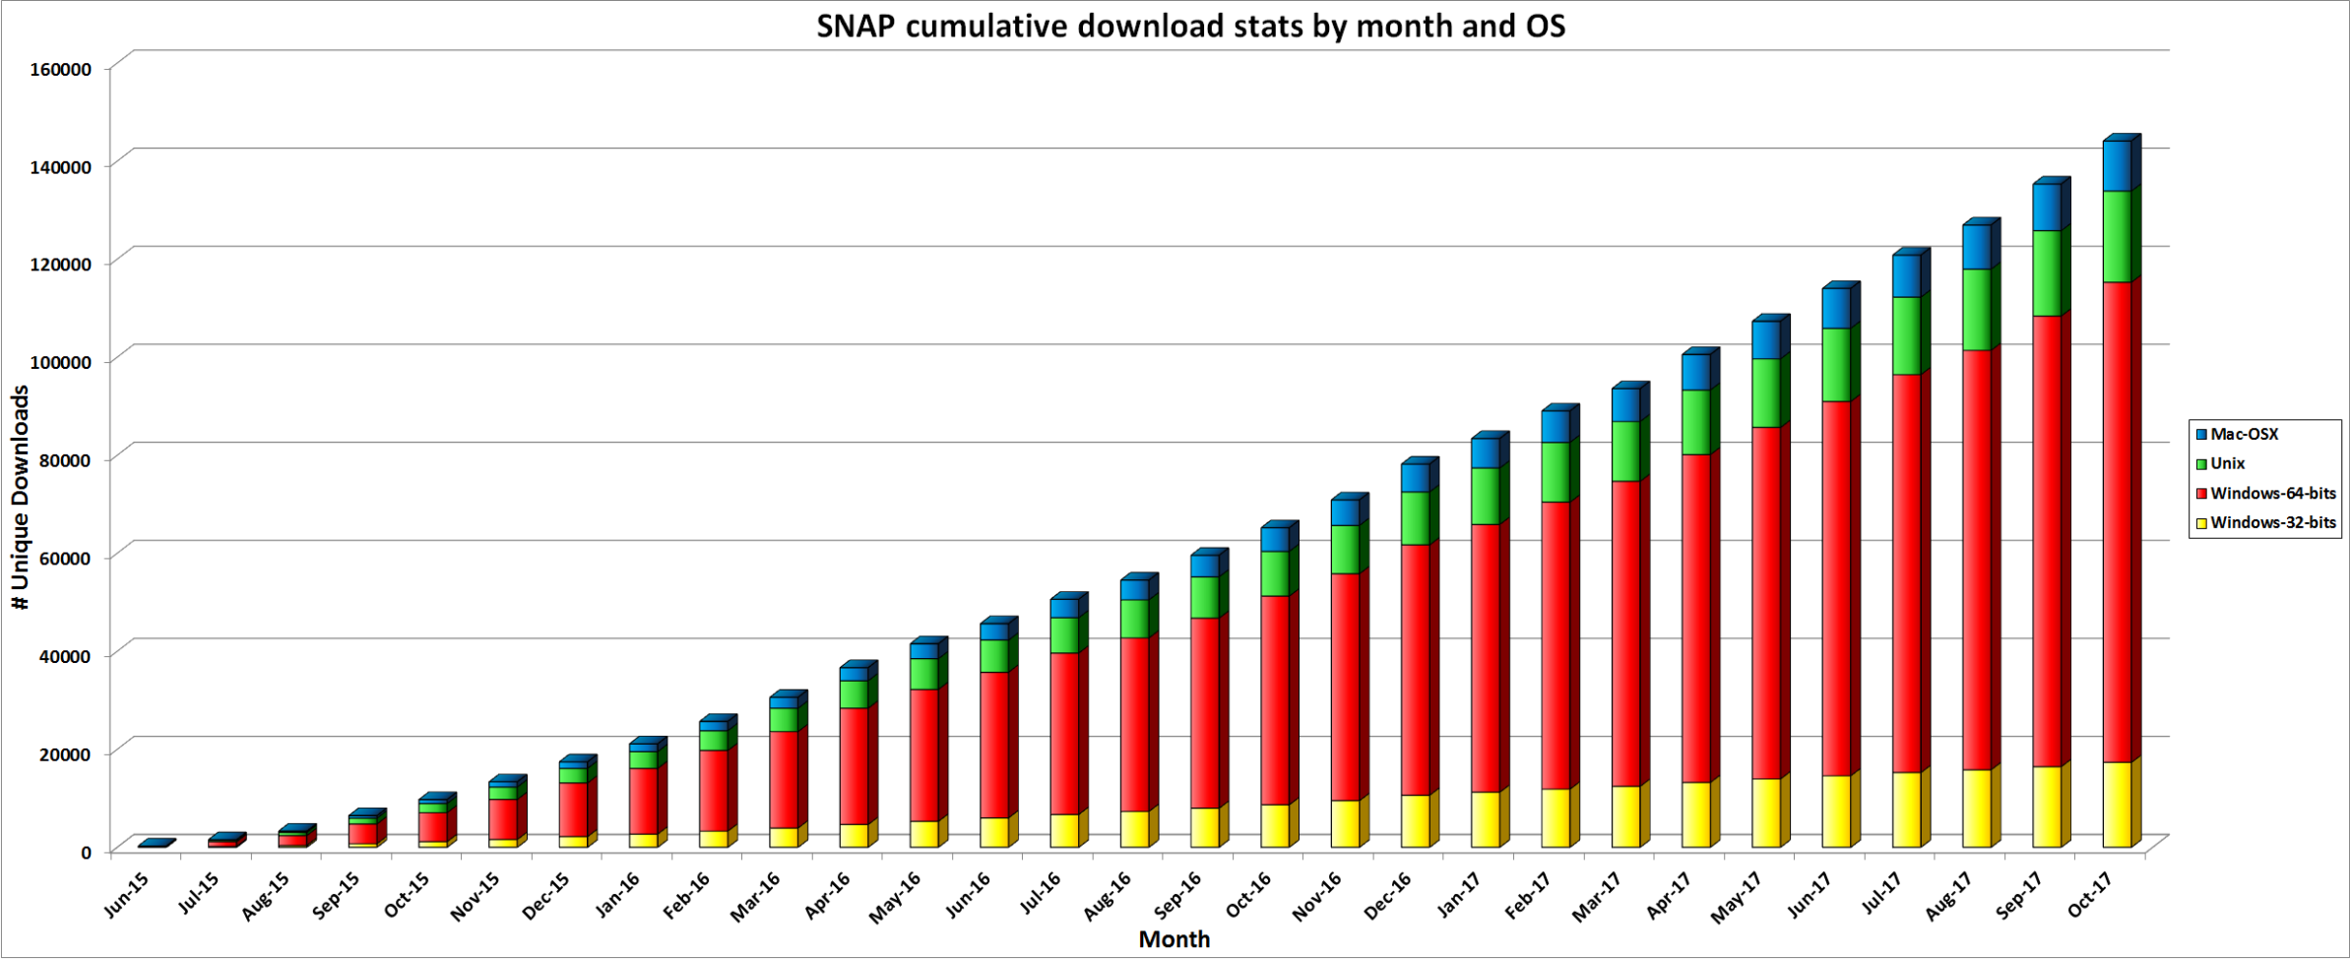
SNAP/STEP SNAP Download Statistics
SNAP download exceeded 140.000 from June 2015 until today

Slide 9
SNAP/STEP STEP Overview
Science Toolbox Exploitation Platform (STEP) is the ESA community platform for accessing the software and its documentation, communicating with the developers, dialoguing within the science community, promoting results and achievements as well as providing tutorials and material for training scientists using the Toolboxes.
step.esa.int
Come and tell us:
What you need?
How/for what you use it?
Describe your use cases, showcase your results: we are happy to publish them on STEP Gallery

Slide 10
SNAP/STEP STEP Rational & Benefits
Evolving towards EO Science 2.0
Using state of the art technology
Gathering user feedback
Having a forum
Providing statistics
Animating the community
Facilitating the open source benefit and approach
Raising the profile of the STBX
Communicating on results
Showcasing examples imagery (with S1, S2 and S3)

Slide 11
SNAP/STEP STEP Community
A number of resources are available for end users and developers to get their hands on SNAP and the Sentinel Toolboxes.
Forum - is maintained by the Sentinel Toolboxes project teams who will answer your questions, if not done by other community members. Collaborate, share your knowledge and learn from other users.
Blog - here you will find the latest news about SNAP and the Sentinel Toolboxes software.
Stay tuned!
Developers - As an open source software, the maintainers of SNAP and the Sentinel Toolboxes welcome code contribution and bug fixes.
Issue Reporting - You just found a bug? Or maybe you want to report about this excellent idea you just had for a future release? We welcome reports for issues and feature requests.

Slide 12
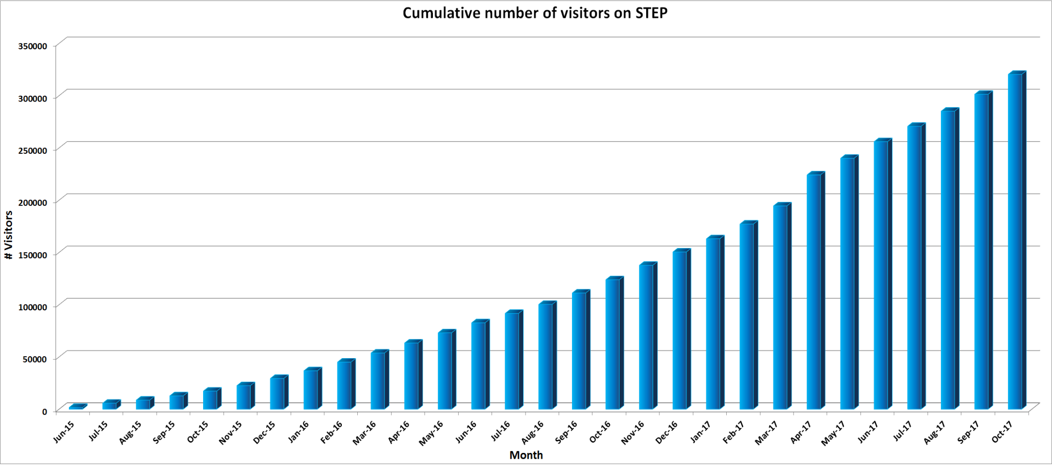
SNAP/STEP STEP Statistics
STEP website reached more than 300.000 visit sessions from June 2015 until today

Slide 13
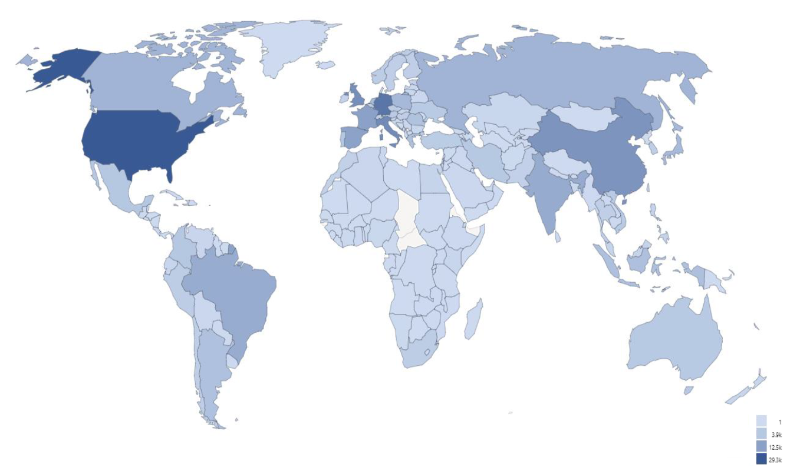
SNAP/STEP STEP Statistics

Slide 14
SNAP/STEP STEP Overview
Sentinel-2 Toolbox
Fabrizio Ramoino [SERCO c/o ESA-ESRIN]

Slide 15
Sentinel-2 Toolbox Overview
The SNAP extension for HR data
Sentinel-2 data readers: L1B, L1C, L2A
Multi-mission: new land-products readers
Landsat, Spot 1-7, RapidEye, Deimos
More to come in the future: UK-DMC, Pleiades, Ingenio/SEOSAT, EnMAP, …
Sentinel-2 oriented scientific processors
Sen2Cor: Atmospheric correction for S2-MSI L1C
Sen2Three: multi-temporal synthesis of L1C/L2A
L2B processor: biophysical products from L2A
Reflectance to Radiance Processor
IdePix Processor (pixel classification)
Radiometric Indices (vegetation, soil and water)
Water processors (FLH/MCI)
Deforestation detection processor
Maximum Chlorophyll Index Processor
OTB Tools: Pansharpening, Rasterization, Segmentation, …
Generic Region Merging segmentation processor

Slide 16
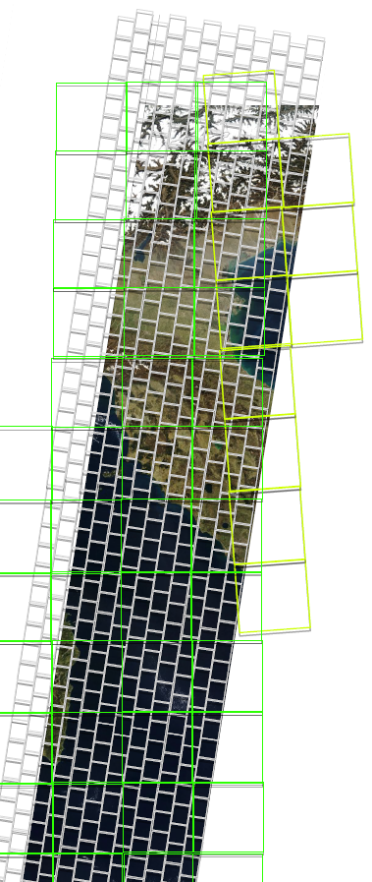
Sentinel-2 Toolbox Sentinel-2 Reader
Optimized multi-resolution viewing/processing
JPEG2000 decoding through OpenJPEG library
GDAL readers / writers
Internal cache of JP2 decoded tiles for performance
Exploitation of high resolution optical data

Slide 17
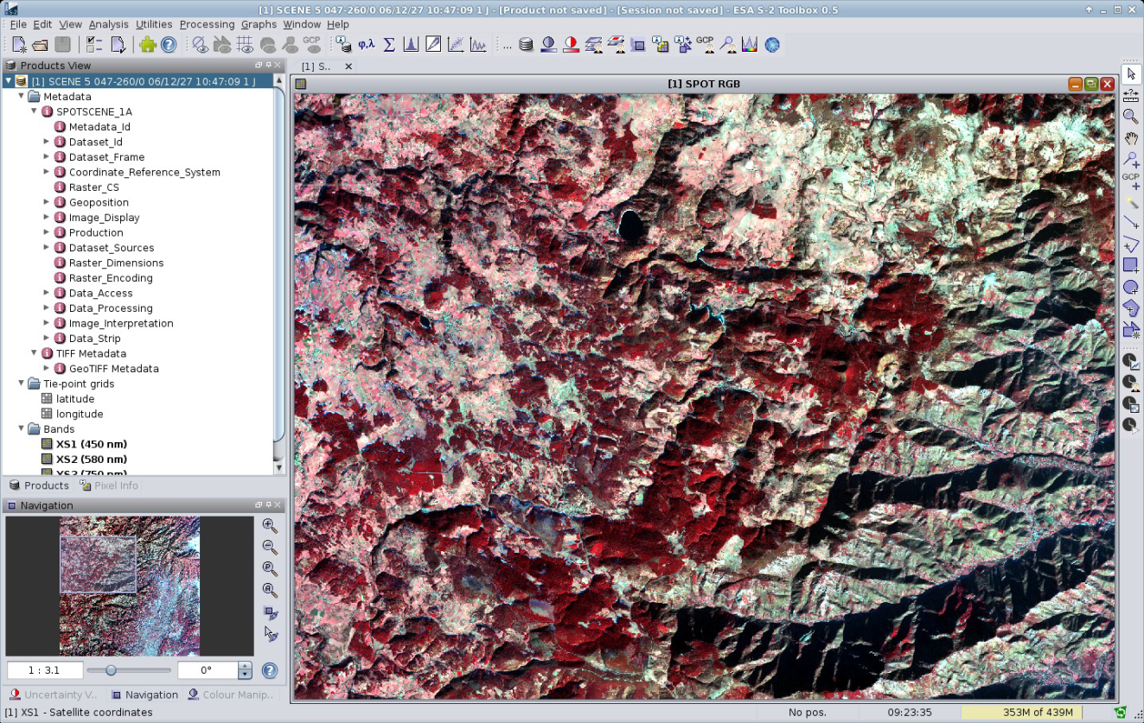
Sentinel-2 Toolbox New Land-Oriented Products Reader
Landsat
SPOT 1-7
RapidEye
Deimos
SPOT4/5 Take5
ALOS AVNIR
…

Slide 18
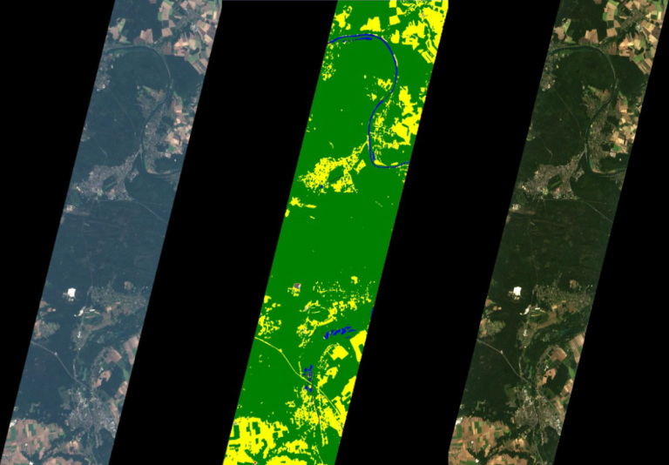
Sentinel-2 Toolbox Level-2A Processor – Sen2Cor
BOA reflectance in cartographic projection developed by Telespazio Vega
Integration in SNAP via the Standalone Tool Adapter
Additional data
Scene Classification Map
Water Vapour Map
Aerosols Optical Thickness Map
Algorithm
Cloud/Cloud shadow detection
Cirrus correction
Slope effect correction
BRDF effect correction
Seamless integration in SNAP
GUI provided
Level-2A product reader
L1C
Classification
L2A

Slide 19
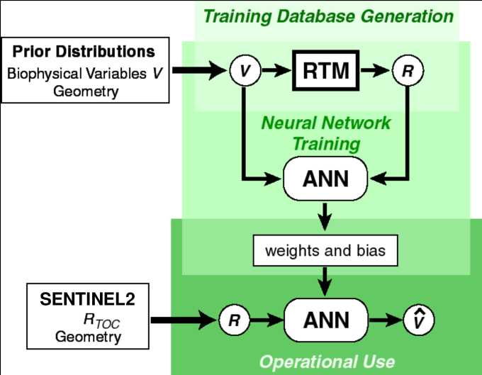
Sentinel-2 Toolbox Level-2B Processor – Biophysical Products
Automatic generation of L2B products from L1C/L2A
LAI - Leaf Area Index
fAPAR - fraction of photosynthetically active radiation absorbed by the green elements of the canopy
FVC - the Cover Fraction, used to separate vegetation and soil in energy balance process
CCC - the Canopy Chlorophyll Content, good indicator of stresses including nitrogen deficiencies
CWC - the Canopy Water Content used also as a proxy for the water status of the plant
Algorithm developed by INRA

Slide 20
Sentinel-2 Toolbox LAI – Amazon Forest
Sentinel-2A Leaf Area Index (LAI) over Amazon Forest

Slide 21
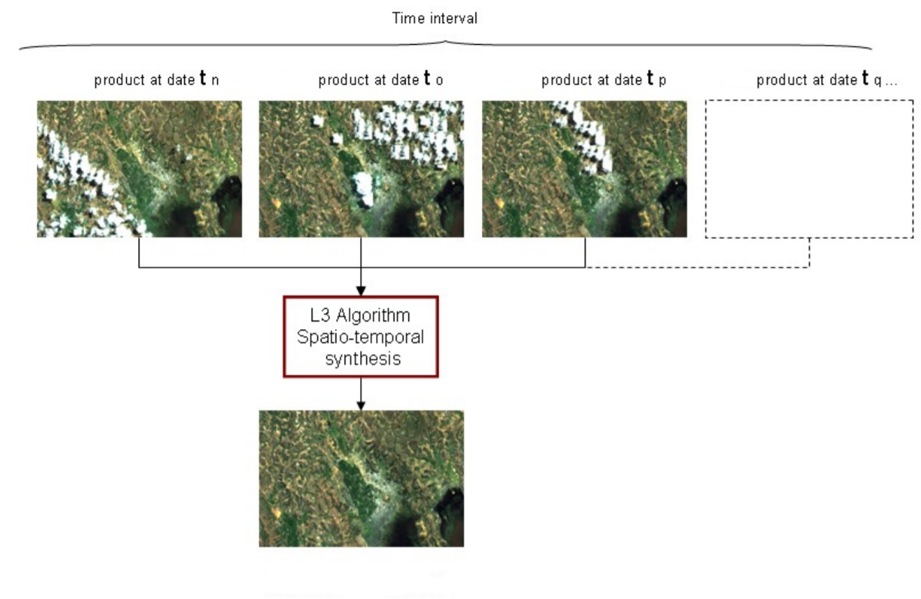
Sentinel-2 Toolbox Level-3 Processor – Sen2Three
Multi-temporal cloud-free composites generation from Sentinel-2 data

Slide 22
Sentinel-2 Toolbox Radiometric Indices Processor – Sen2Rad
Radiometric indices are quantitative measures of features that are obtained by combining several spectral bands
Vegetation indices
Soil indices
Water indices
DVI, RVI, PVI
BI
NDWI
NDVI, WDVI, TNDVI, GNDVI
BI2
NDWI2
SAVI, TSAVI, MSAVI, MSAVI2
RI
MNDWI
GEMI
GEMI
NDPI
ARVI
NDTI
NDI45
MTCI, MCARI, PSSRa
S2REP, REIP, IRECI

Slide 23
Sentinel-2 Toolbox NDWI2 – Gulf of Gaeta
Aqua-Culture – S2A NDWI2 Index over Gulf of Gaeta (Italy)

Slide 24
Sentinel-2 Toolbox NDWI2 – Gulf of Gaeta
Aqua-Culture – S2A NDWI2 Index over Gulf of Gaeta (Italy)

Slide 25
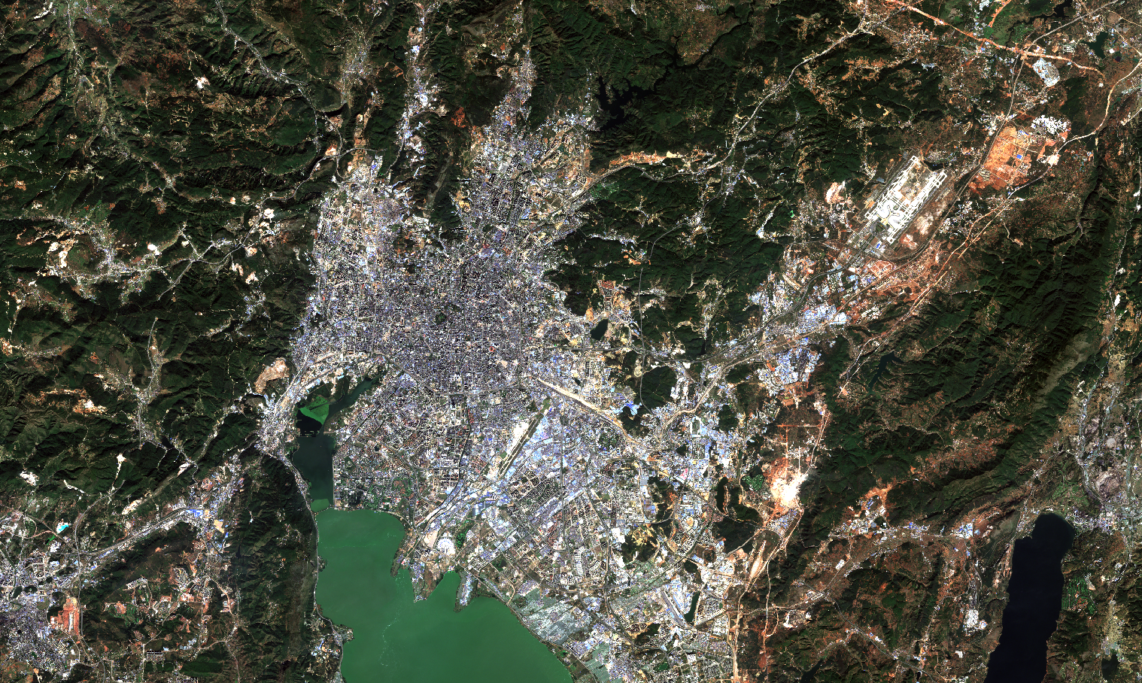
Thank you
for your attention

