Slide 1
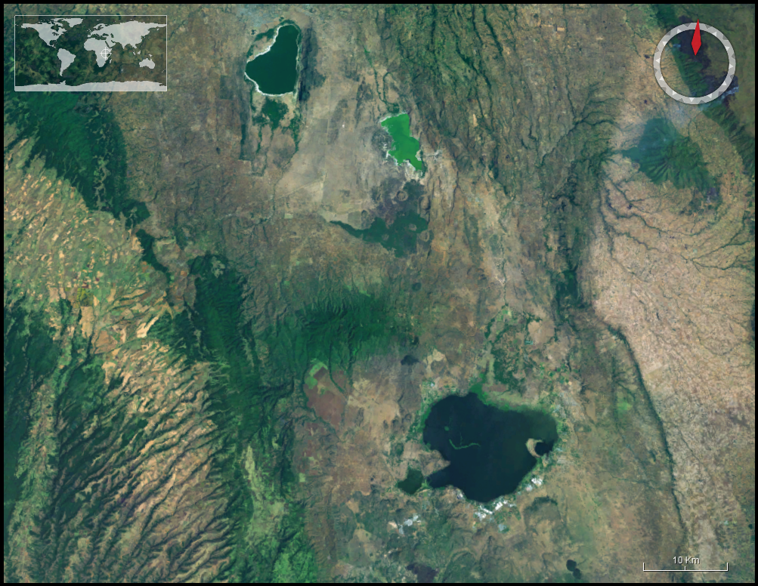
EOIA Naivasha project
Earth Observation (EO)
Integrated Assessment (IA) Modeling
Indicators of sustainability
Stakeholder meetings and communication
Hydrology study
Socioeconomic study
Governance study
Limnology study
Ecology study

Slide 2
EOIA project approach
Defining the project
problem, system, indicators, scenarios
x,t scales
Stakeholder process (I)
Database
Modeling and assessment
Models
Stakeholder process (II)
Evaluation of results and
Visualization
Indicator maps (GIS)

Slide 3
PostgreSQL – PostGIS
Scientists
Stakeholders
discussions
Research focus
determines
Data base
Graphical user interface
Models
Maps – Web services
ABM – OpenMI

Slide 4
Some developments
Geo-database
Numeric data
Geographic data
Images (aerial photos and remote sensing)
Website ‘Naivasha Consortium’
Data exchange (objectivity and transparency!)
Scientific publications available to all
Information exchange on projects logistics and plans
A first setup of an Integrated Model is made

Slide 5
We had to start from collecting BasiC data
Lake levels
Land use
Sattelite image and aerial photos
Groundwater
Soils
Bathymetry
Population sensus
Etc…

Slide 6
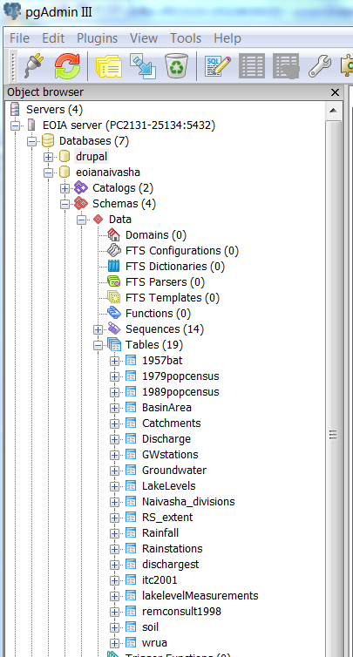
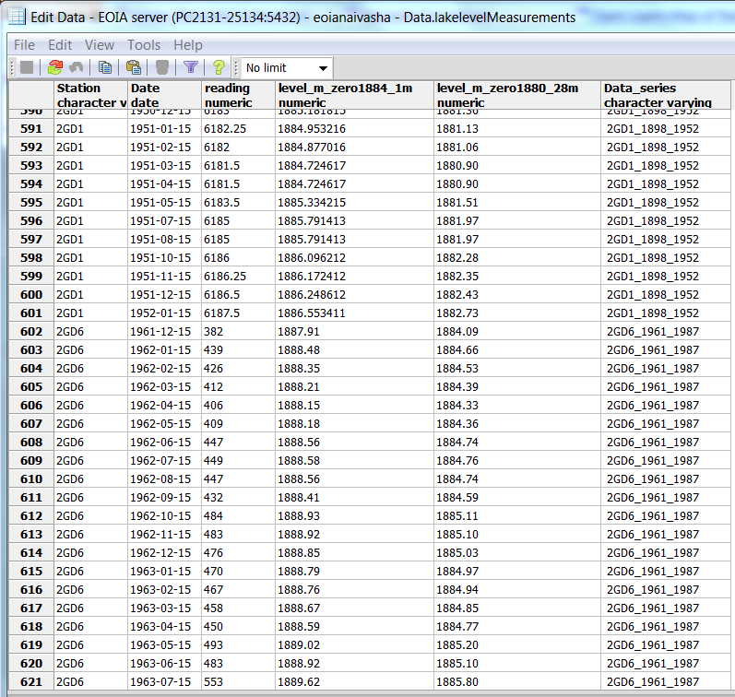

Slide 7
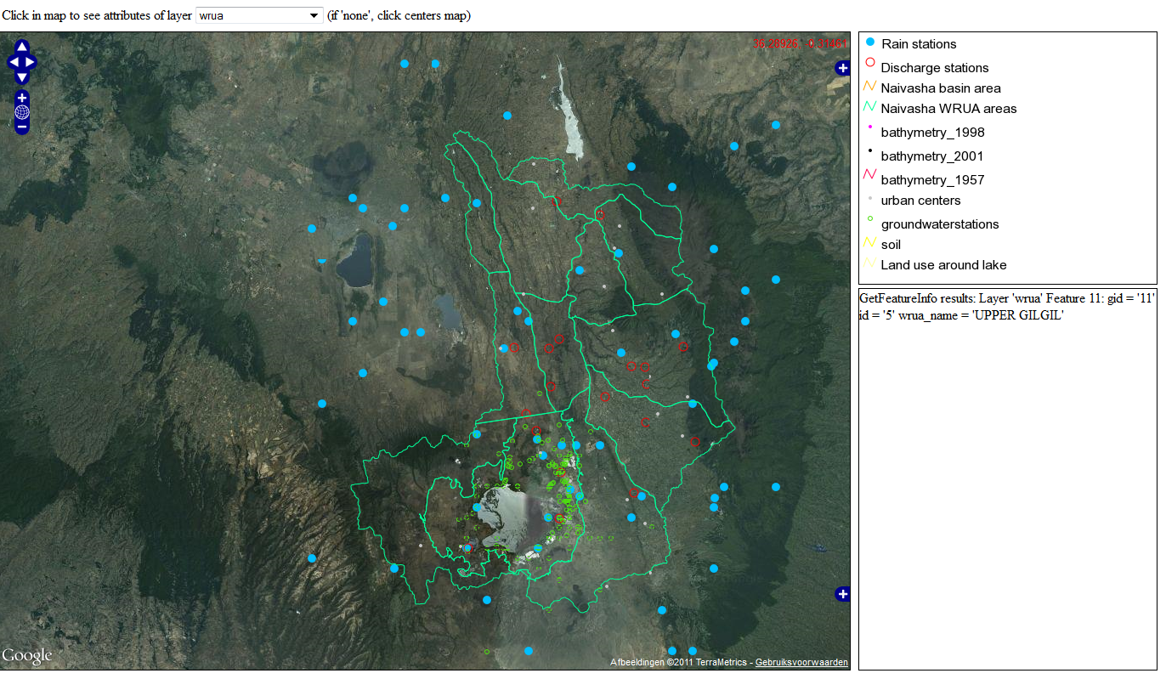
Openlayers Data view FOR geodatabase

Slide 8
Images

Slide 9
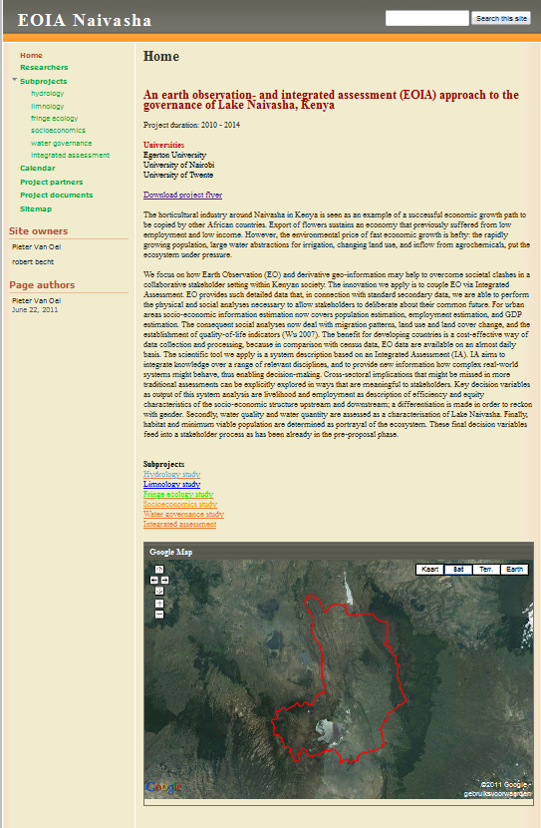
https://sites.google.com/site/naivasharesearch

Slide 10
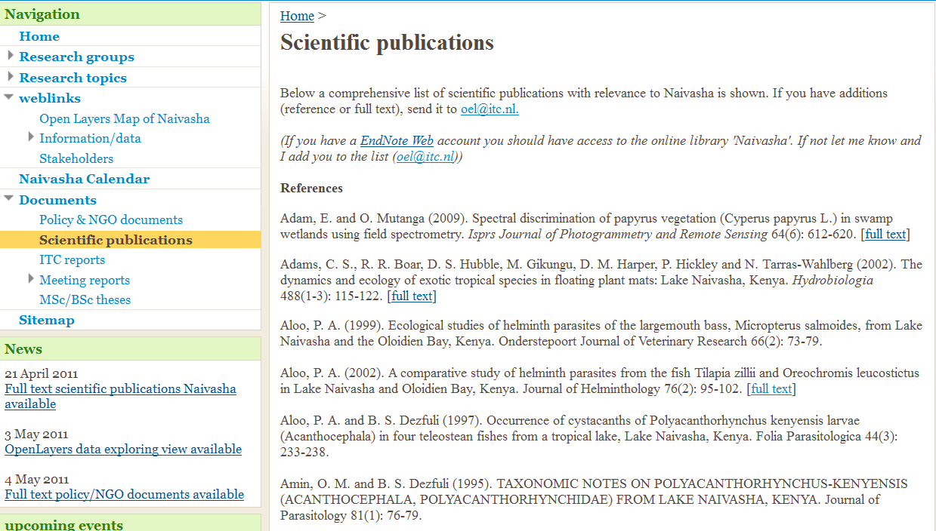
Scientific publications full text

Slide 11
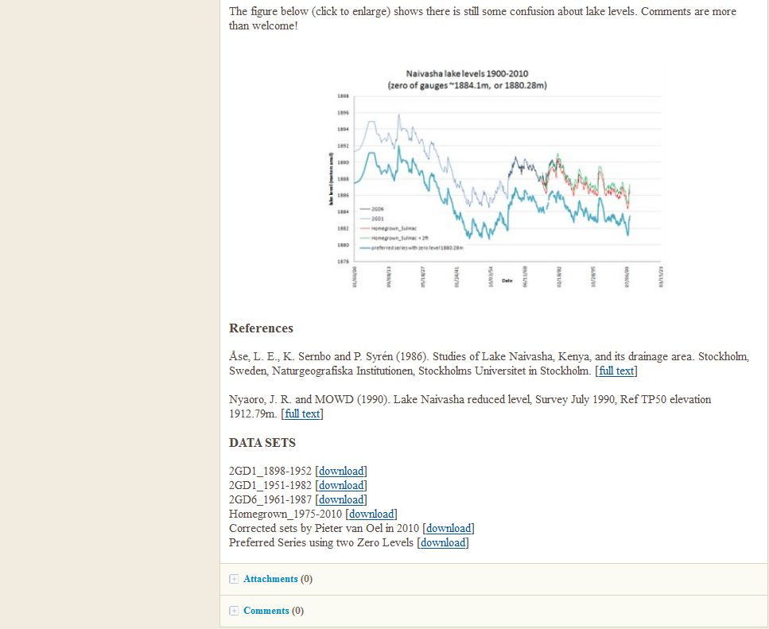
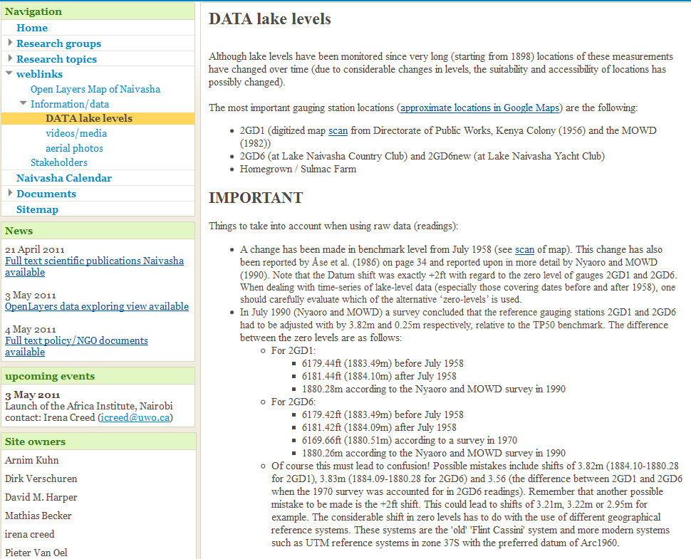

Slide 12
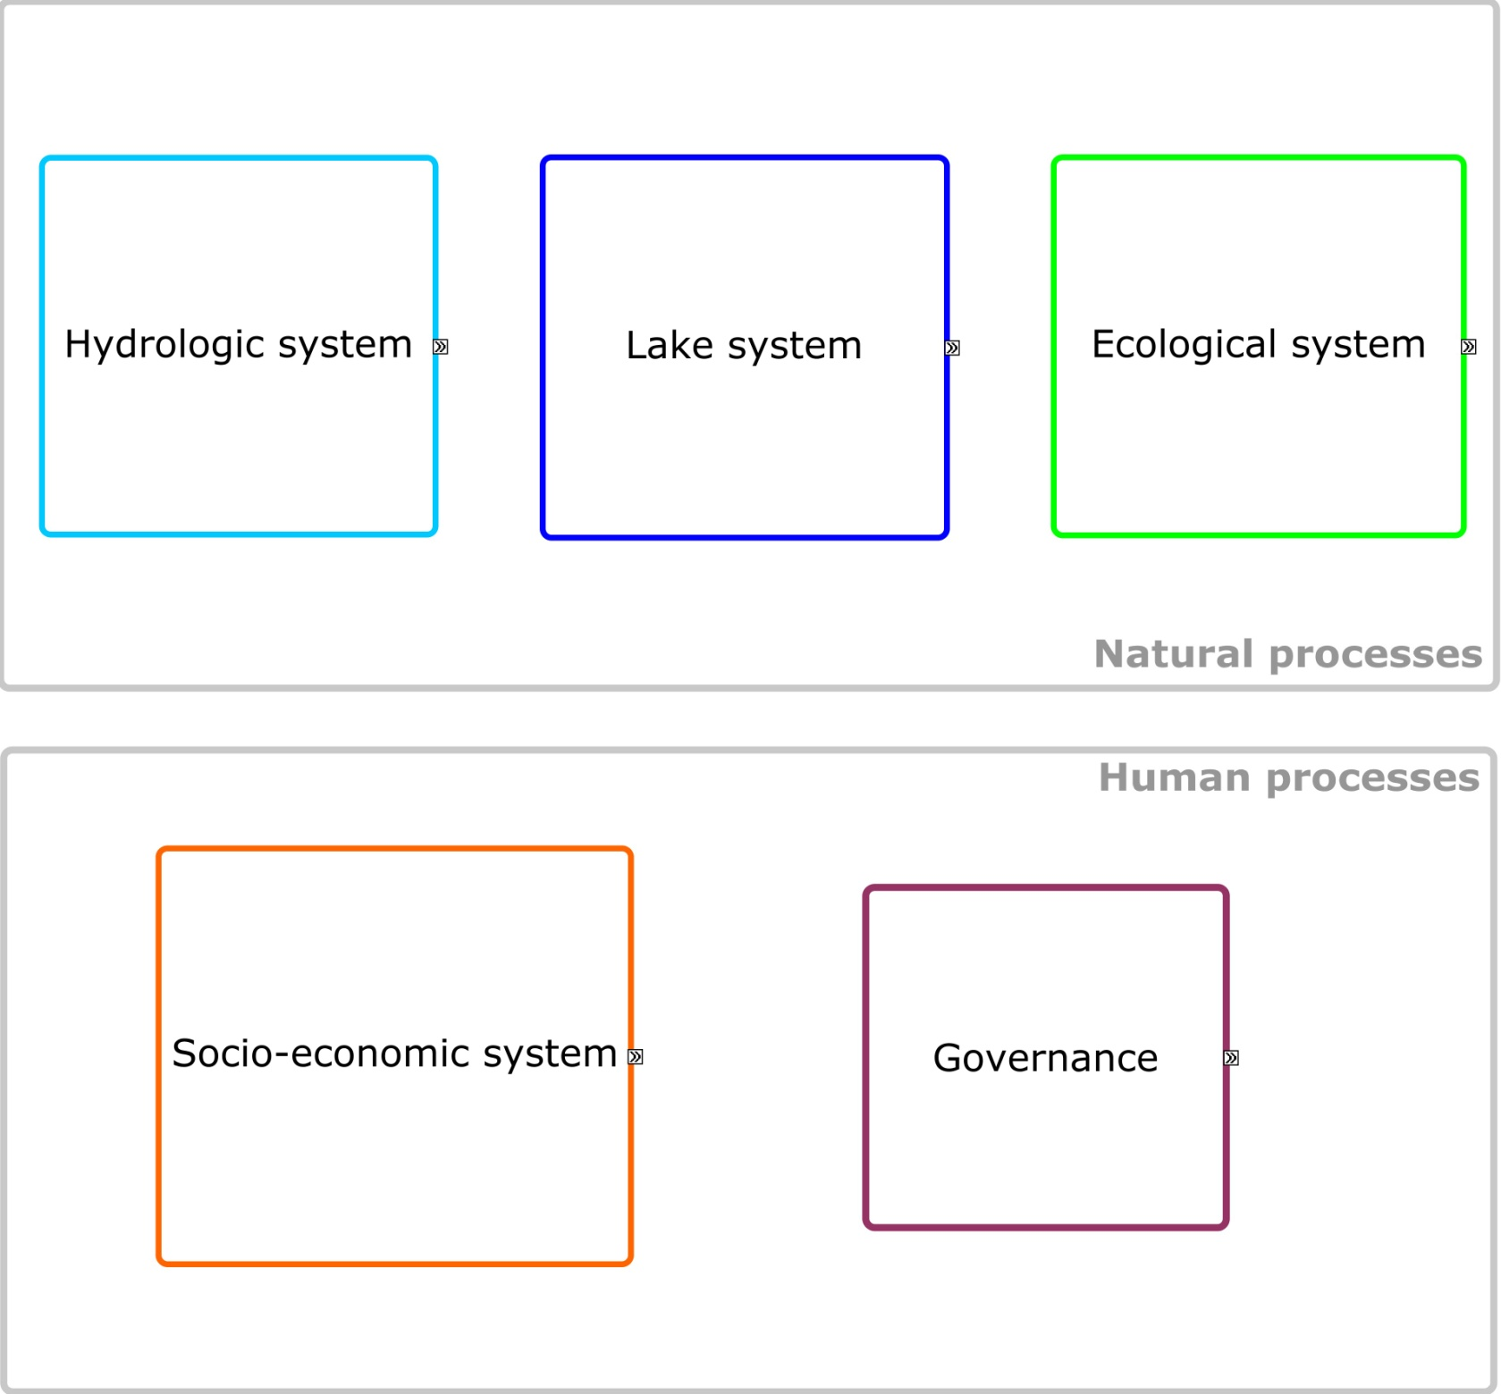

Slide 13
model
model
model
model
Maps

Slide 14
Integrated Assessment

Slide 15
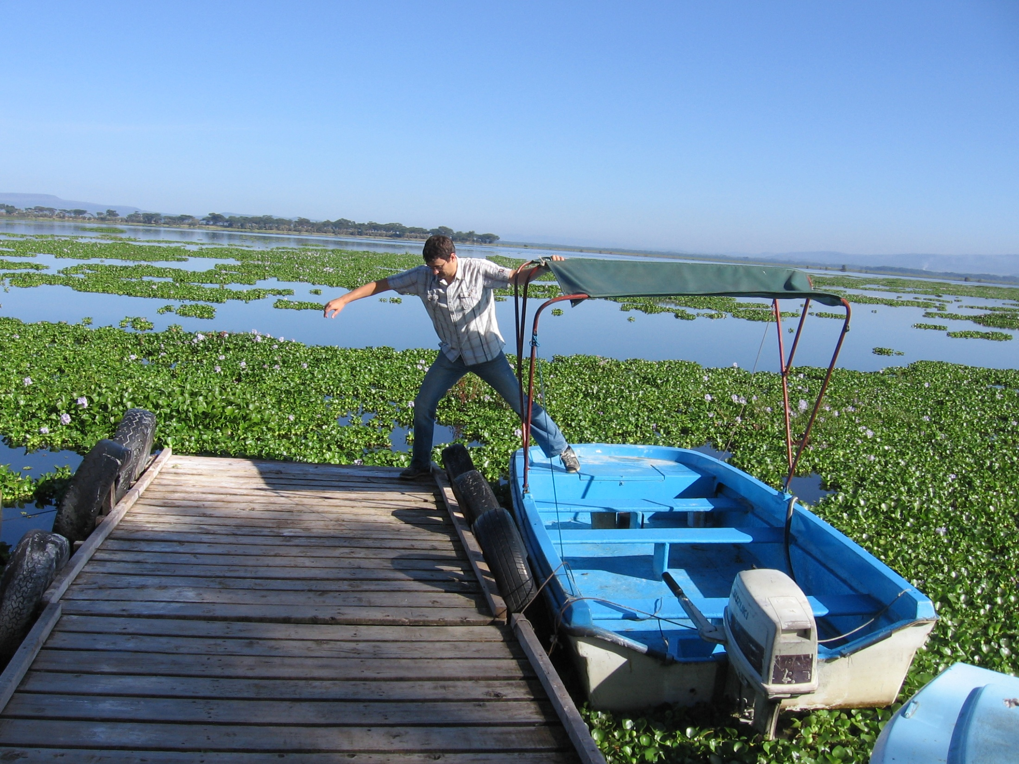

Slide 16
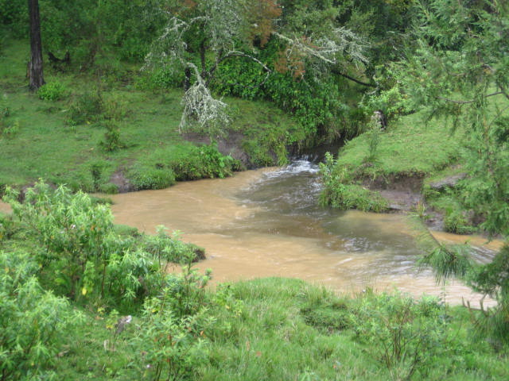
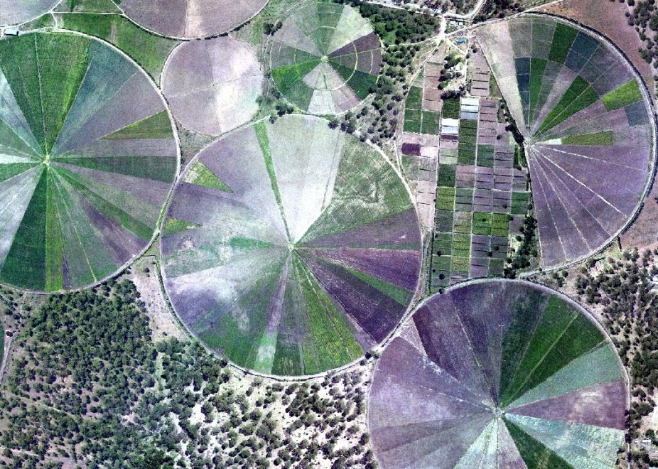
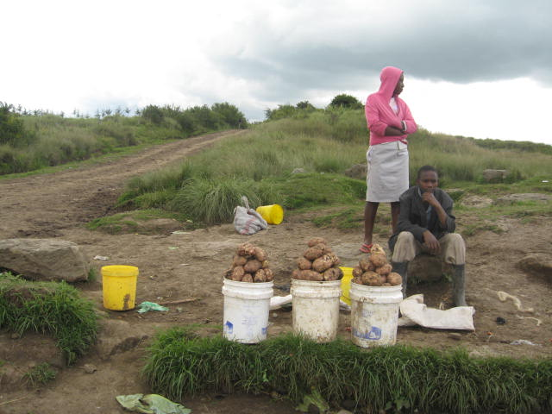
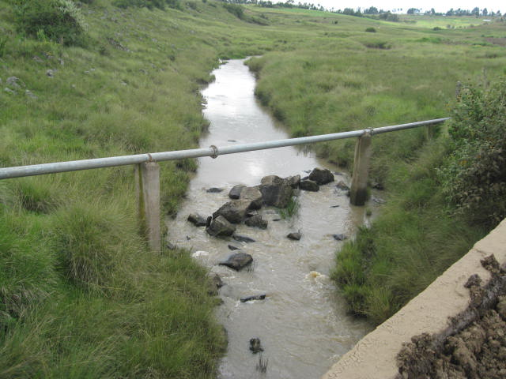
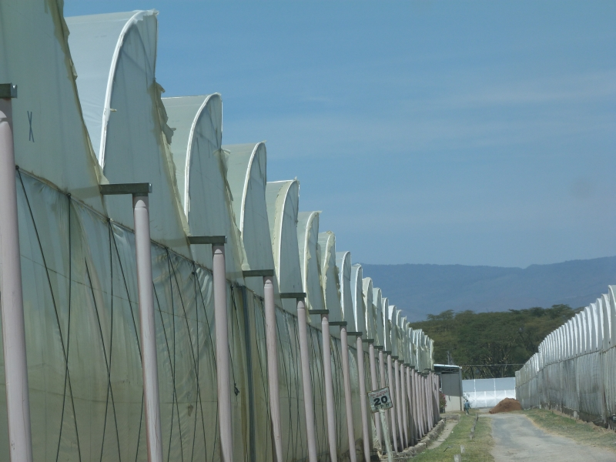

Slide 17
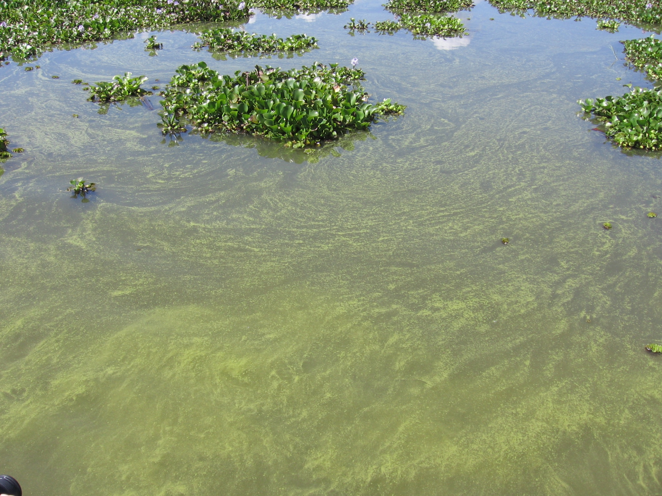
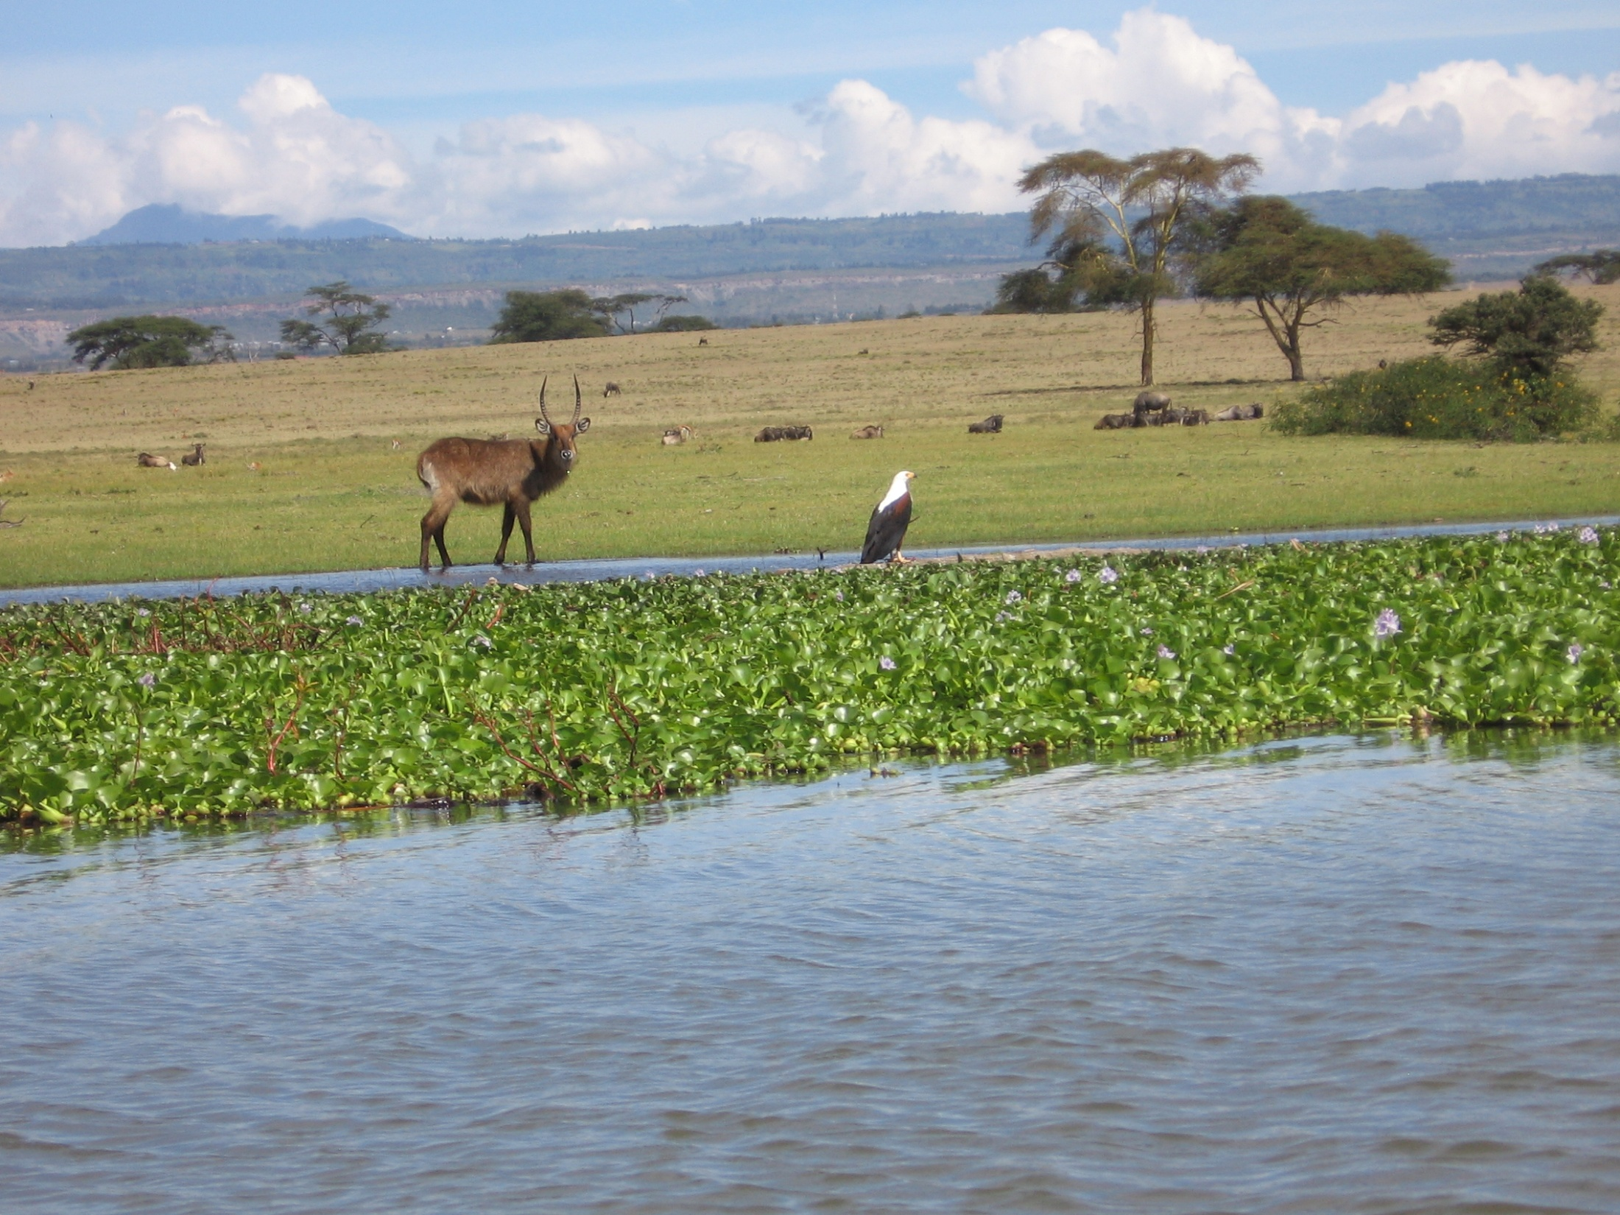
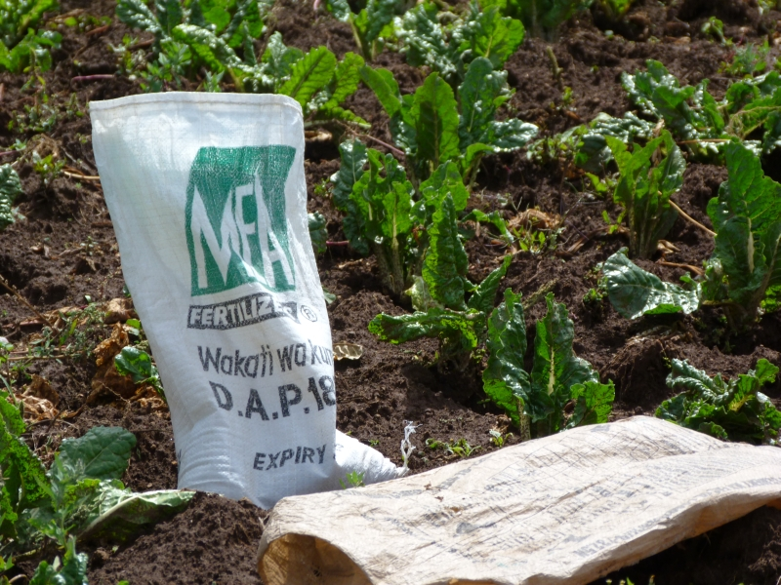

Slide 18
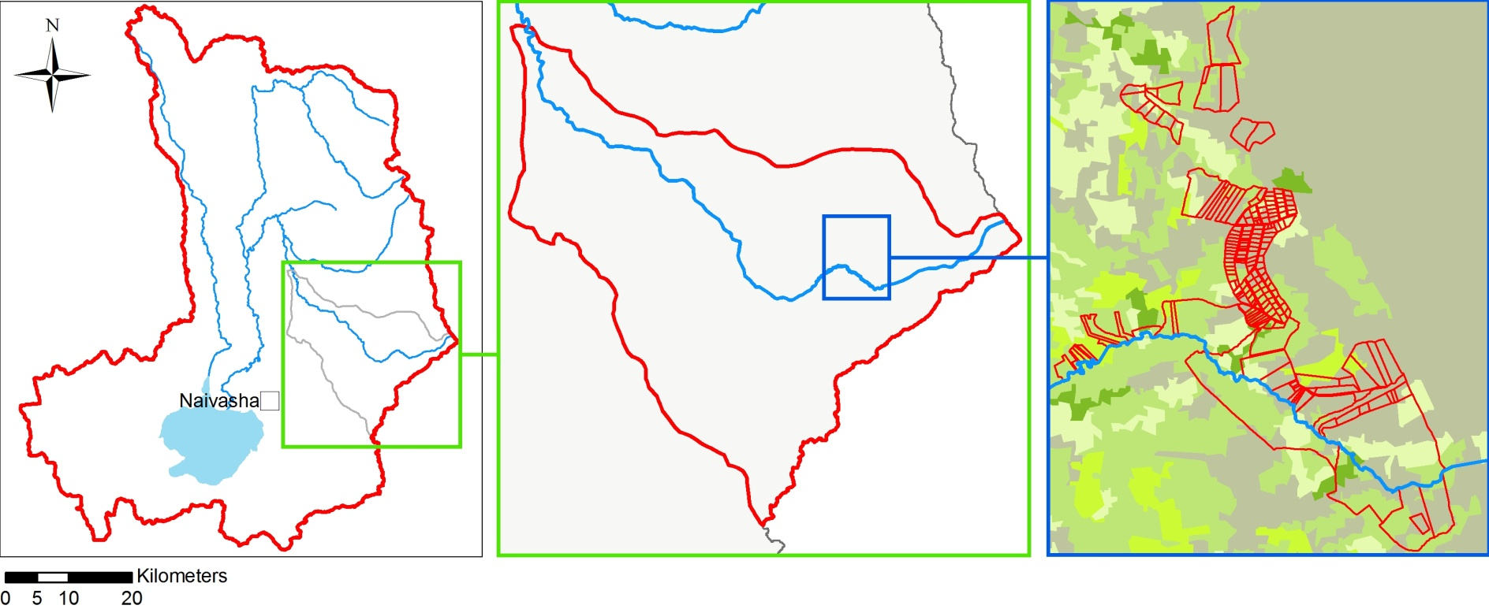
Levels of water governance decision-making
Basin level authority
Sub basin level (user associations)
Local level (resource users)
WOTRO EOIA project Naivasha
18

Slide 19
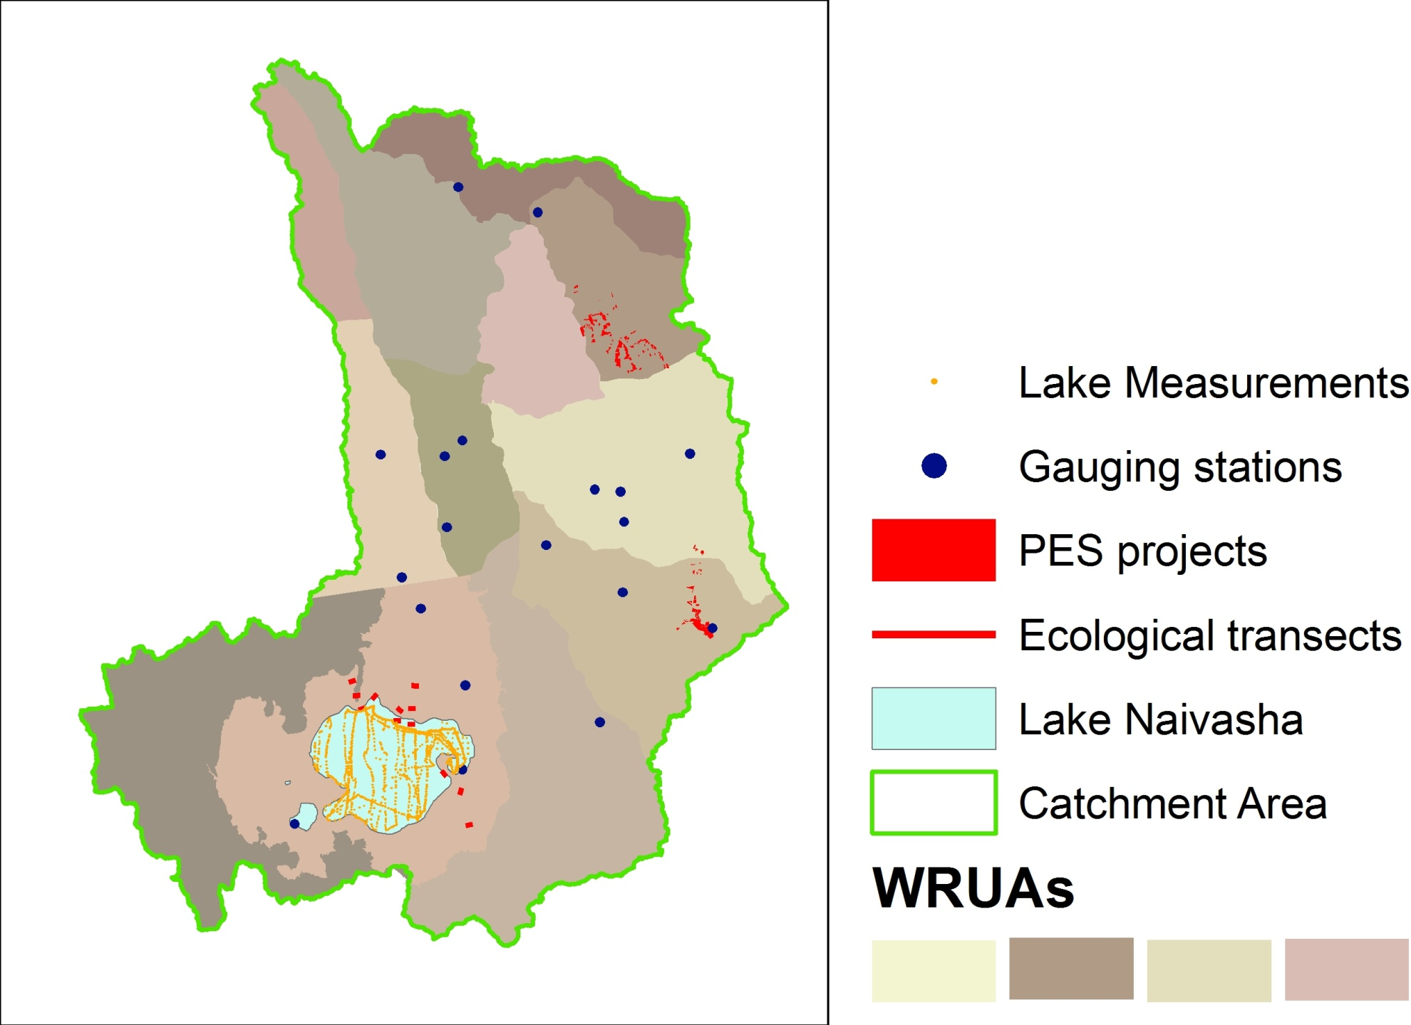
Fieldwork locations

Slide 20
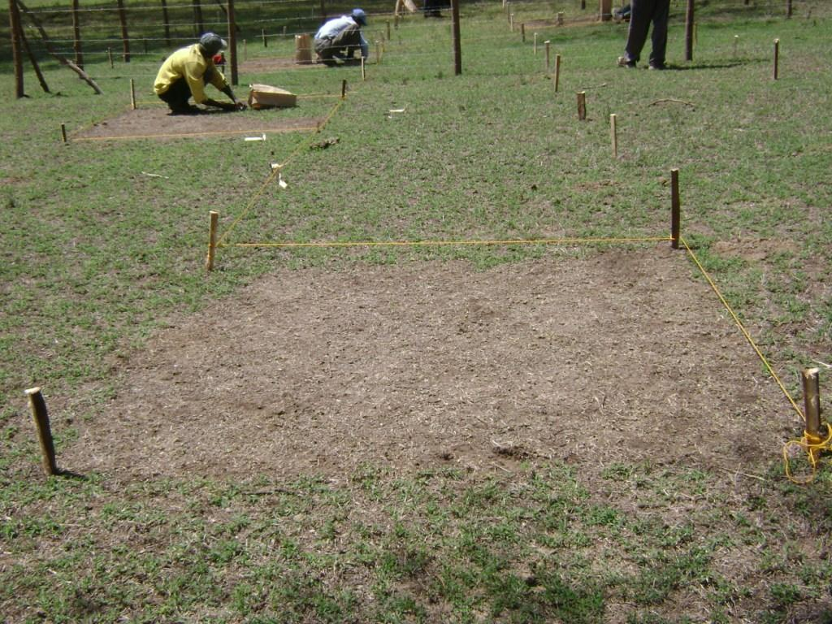
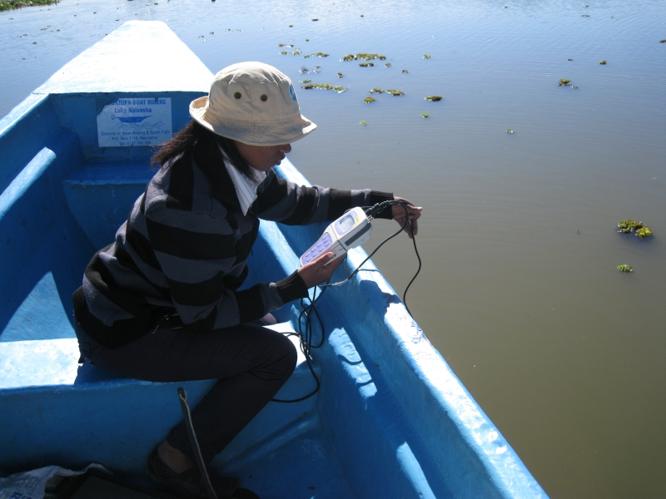
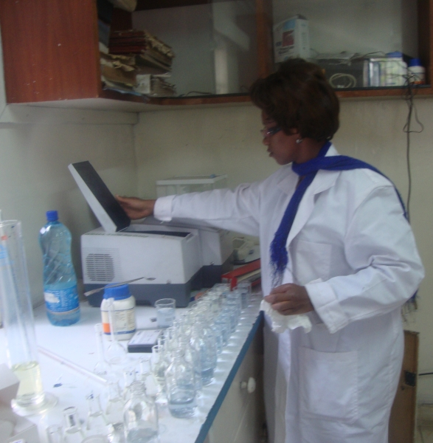
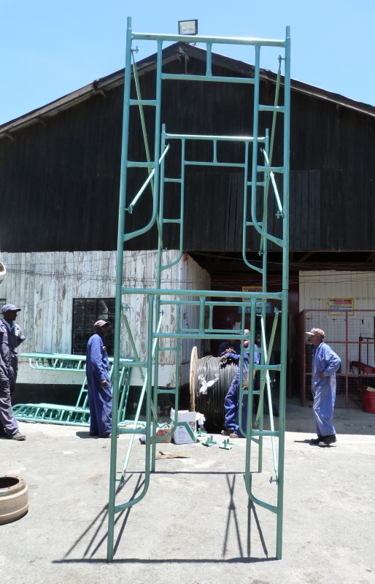

Slide 21
First step in Integrated Assessment modeling

Slide 22
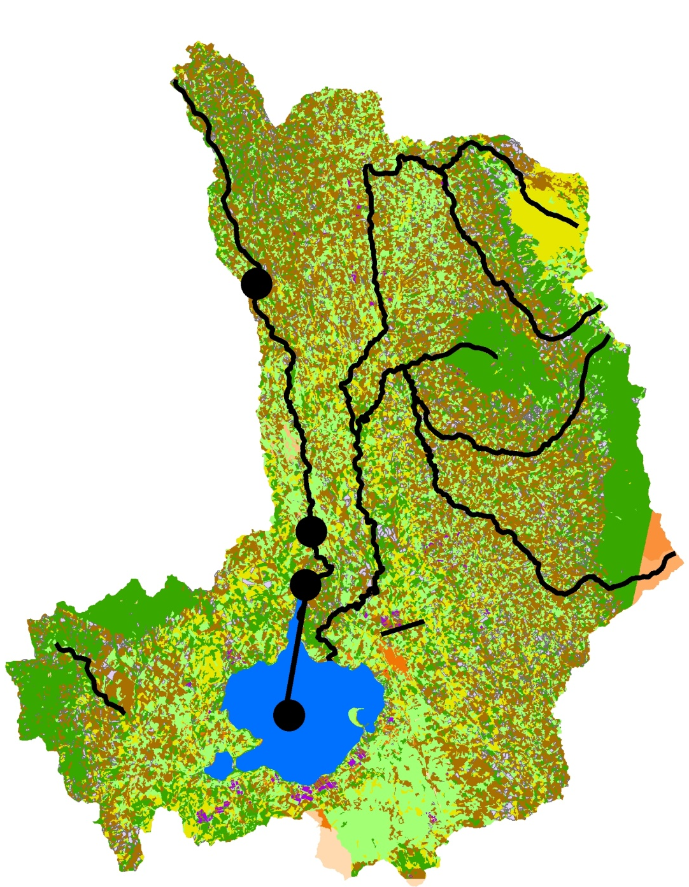
Q
W
R
R
P
ET
S
P
E
Inundation
zone

Slide 23
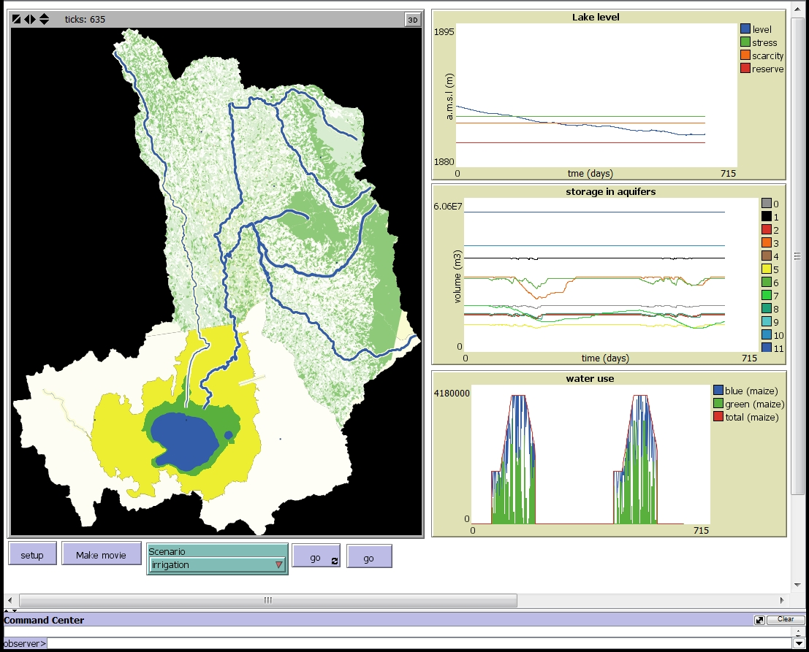
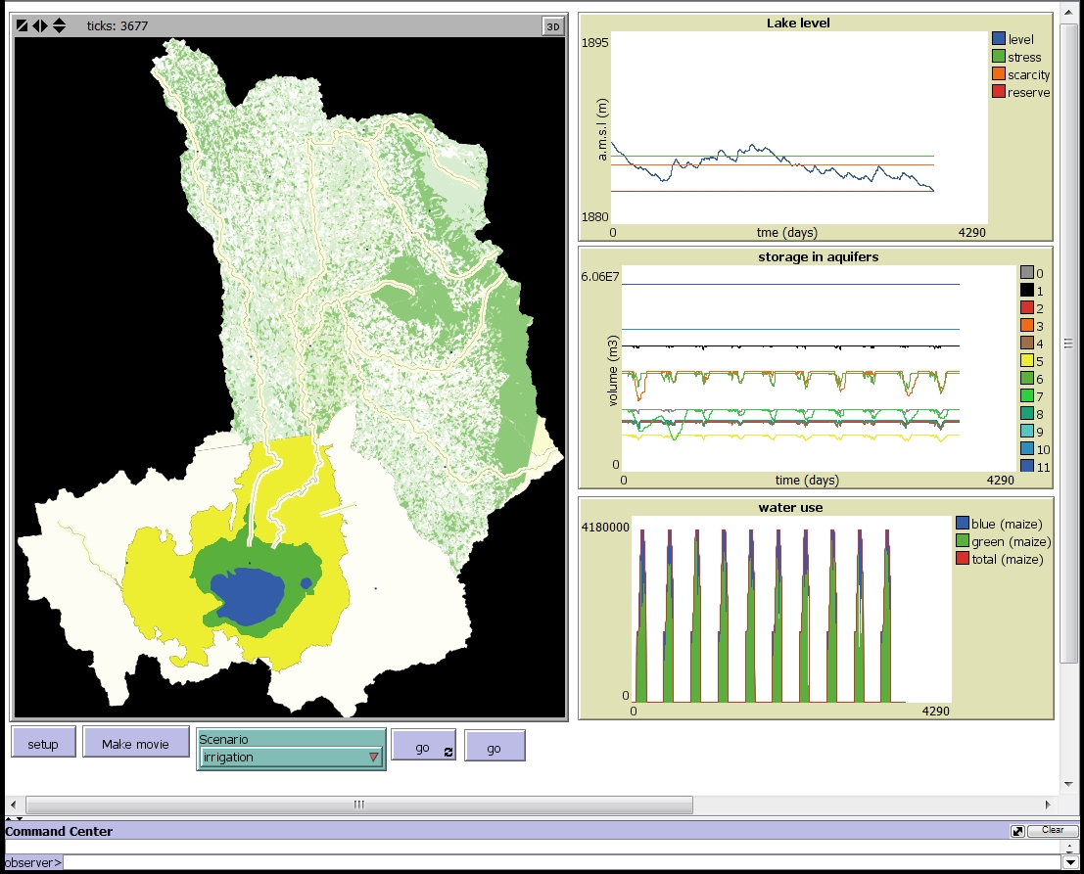
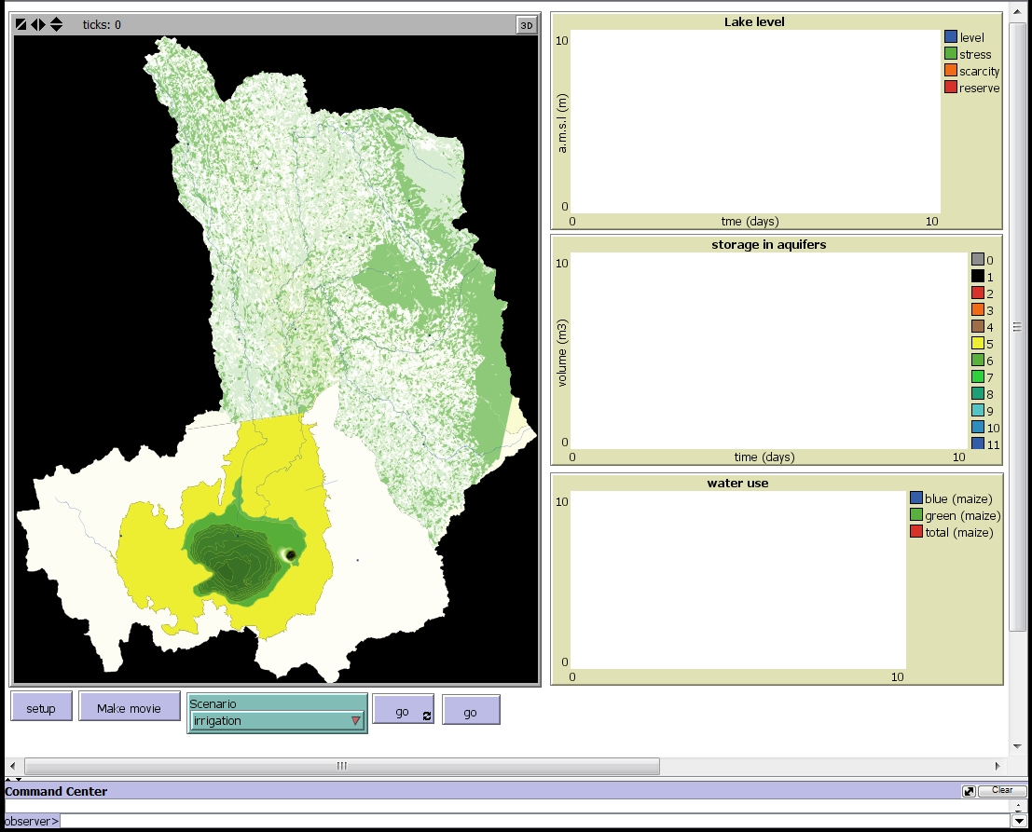
ABM model

Slide 24
Thank you!

