Slide 1
h2.0 Inform and Empower Initiative Human Sensor Web project

Slide 2
h2.0
The h2.0 Inform and Empower initiative is one of Google’s five new initiatives aimed at using the power of information and technology to address global challenges, such as climate change and poverty.

Slide 3
Inform and Empower to Improve Public Services
Empowered Citizens and Communities
Informing individuals and communities of their rights, entitlements, choices, and quality of public services
Providing tools and information to increase access to and use of available services
Supporting civil society organizations that strengthen links between communities and policy makers.
Responsive Providers
Increasing transparency in local budgeting and performance for improved resource allocation
Improving data quality to inform planning
Expanding service delivery with innovative information-based tools
Informed Decision-Makers
Developing local capacity for data collection and analysis to inform decision making
Making existing information more public and useful for planning and advocacy
Generating evidence on "what works" and sharing this widely

Slide 4
Inform and Empower to Improve Public Services
Empowered Citizens and Communities
Informing individuals and communities of their rights, entitlements, choices, and quality of public services
Providing tools and information to increase access to and use of available services
Supporting civil society organizations that strengthen links between communities and policy makers.
Responsive Providers
Increasing transparency in local budgeting and performance for improved resource allocation
Improving data quality to inform planning
Expanding service delivery with innovative information-based tools
Informed Decision-Makers
Developing local capacity for data collection and analysis to inform decision making
Making existing information more public and useful for planning and advocacy
Generating evidence on "what works" and sharing this widely

Slide 5
IDEA: The Human Sensor Web
The aim of the “human sensor web activity” is to develop a community driven service for geo-referenced monitoring of public services
We define a Human Sensor Web as a composition of
a community of individuals who report observations by making use of mobile communication techniques and
a set of (web) services which provides means for disseminating observations made by the community and provide feedback to individuals, specific user groups or the public.

Slide 6
The pilot phase is …
critically reviewing the social, economic, cultural, institutional, political, and technical conditions
developing a prototype of the Human Sensor Web for the collaborative generation and interoperable dissemination of well-defined water supply information.

Slide 7
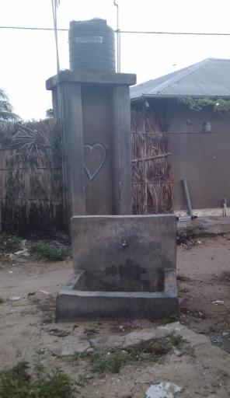
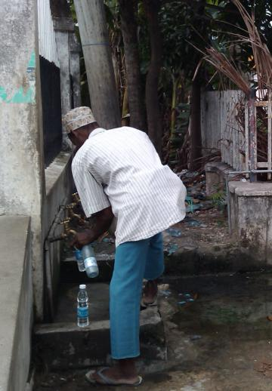
Zanzibar public water taps

Slide 8
Communication is key
Major tool for communication in Africa: the cell phone
Cell phone technology is accessible to the a broad population
Goal: Develop a generic mobile telephone based protocol for participatory data collection and communication

Slide 9
Assumptions for HSW
Currently cell phones are already widely used in East-Africa.
All cell phones can be used to collect data through voice or text service
In near future most cell phones owners will possess a “smart phone”
“smart phones” will offer a wide variety of interactive data collection methods. Proposal for a second project

Slide 10
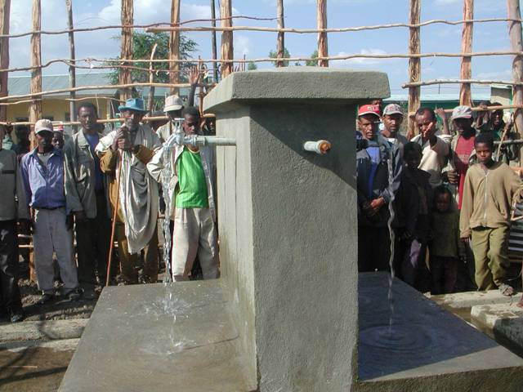
NO WATER? sms “MAJI A 999” to 0778 700 700

Slide 11
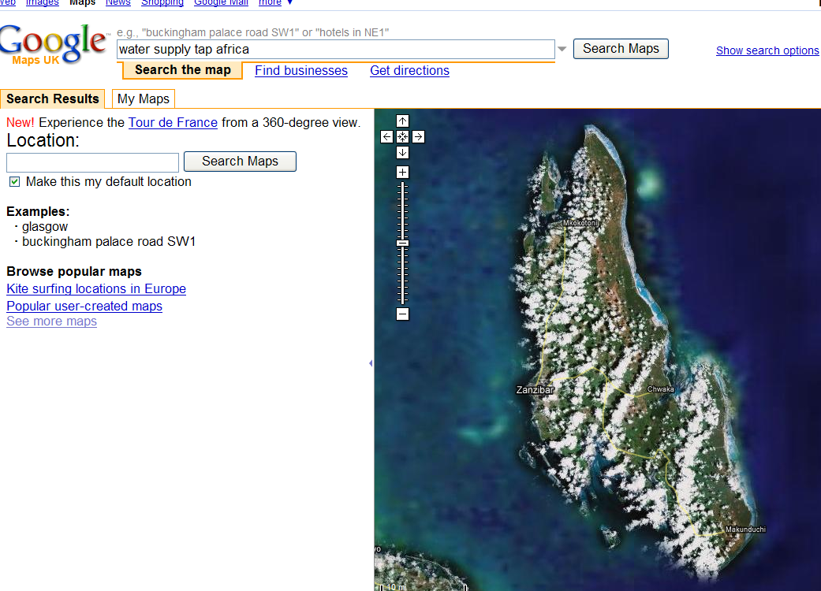
June 2009
No water
1
10
Web server Processing
June 2009
Dirty water
1
10
Google community
NO WATER? sms “MAJI A 999” to 0778 700 700
SMS alert community

Slide 12
Project Setup
Building the system (hardware/software)
System Analysis
System Design
Coordination with Google
Programming/coding
Testing
Embedding the system
Study socio-economic situation related to water and sanitation
Institutionalisation
Field testing
Link and integrate with other H2.0 components
Implementing the system
Communicating the system
Preparation of user manuals, reports, etc.
Dissemination

Slide 13
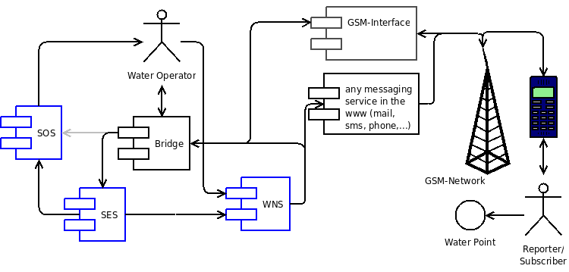
HSW Architecture

Slide 14
Sign boards at 50 water points

Slide 15
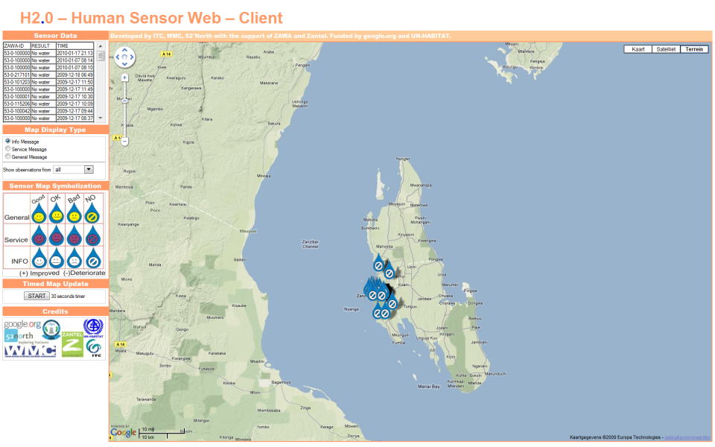
Live map interface for HSW

Slide 16
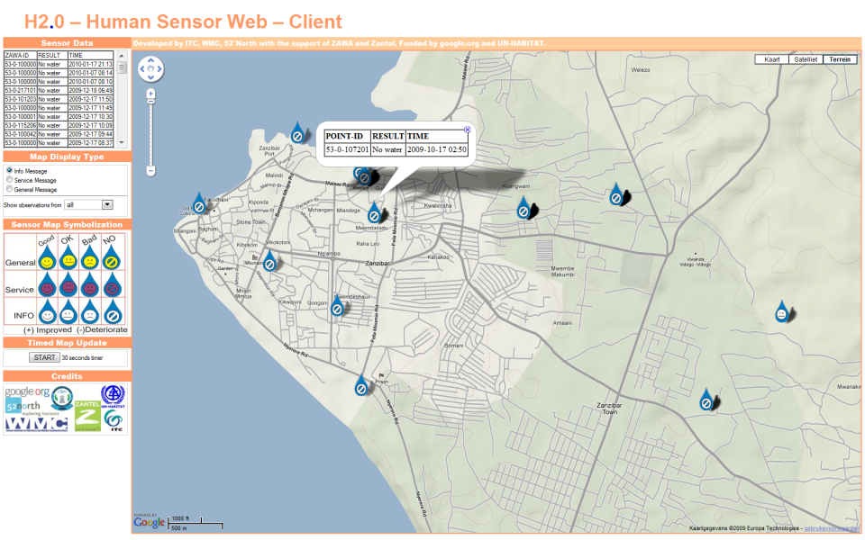
Live map interface for HSW

Slide 17
Participatory Research issues
Who “owns” the system?
Google.org
UN-Habitat
ITC
ZANTEL
ZAWA
Shehia leaders
Water consumers
Project owner
Project owner
Research owner
Facilitator
Problem/Institutional owner
Institutional owner
Problem/purpose owner

Slide 18
Participatory Research issues
Who “owns” the information?
Google?
UN-Habitat?
ZAWA?
Consumers?
General public?

Slide 19
Participatory Research issues
Who benefits?
UN-Habitat?
ZAWA?
Sheha?
Consumers?

Slide 20
Participatory Research issues
Who pays?
UN-Habitat
ZAWA?
Consumer!

Slide 21
Participatory Research issues
What are incentives to participate?
Research driven, no tangible benefits (“the future is bright”)
Visualization of problems for agenda setting and prioritization
Future:
Live response system to available water
Live “blaming and shaming” of negligent providers
MDG monitoring tool?

Slide 22
Phase 2 ideas
Phase 1 deployment is technically limited to a small and relatively static set of observables and a small number of predetermined locations
The challenges of a second Phase are to scale-up the human sensor network (number of users) and to handle a larger, dynamically extendable set of observables at arbitrary locations (not limited to fixed-point locations).

Slide 23
Project future
A generic mobile telephone (SMS) based communication system to be truly participatory.
Such a “human sensor web” could yield spatial and temporal continuous information on:
Environment
Socio-economics
Disasters
Access to services (health, education, water, transport etc)
Could be easily integrated with already exiting participatory approaches and tools.

Slide 24
External points “to do”
Frank Rijsberman, Google.org:
Demonstrate that community scale monitoring of affordable and accessible water and sanitation services is feasible at a national scale and can be cost-effective
Open up the data in an open platform, so anyone can analyse, add, update etc. – and data can be found – and data can be accessed effortlessly by the public

