Slide 1
from
Pen & Paper to
Pen and Computer
by
Jeroen Verplanke, ITC
February 2010

Slide 2
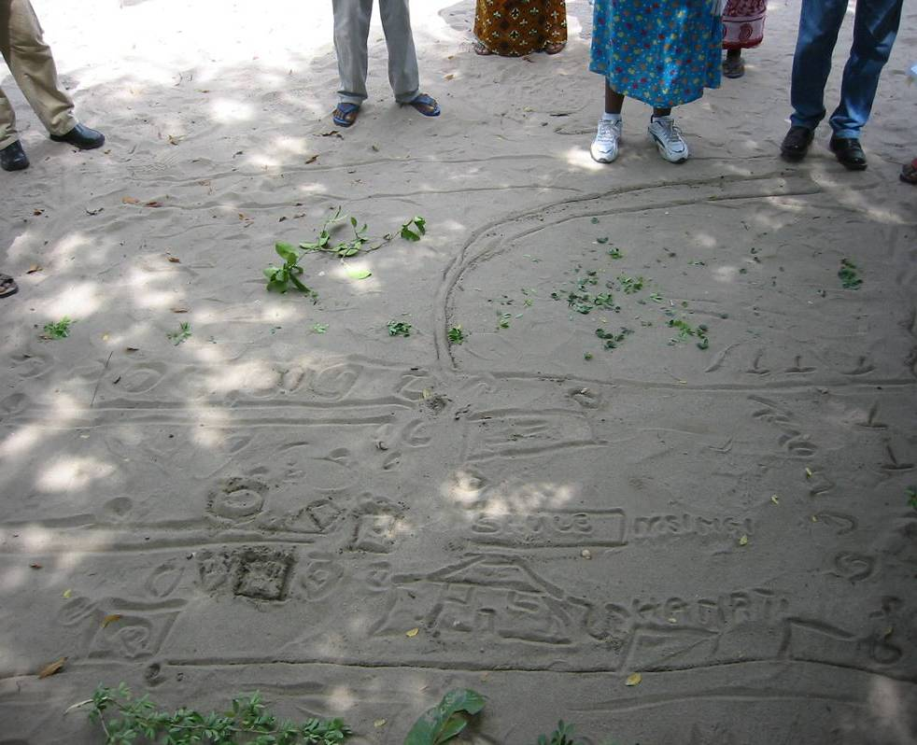

Slide 3
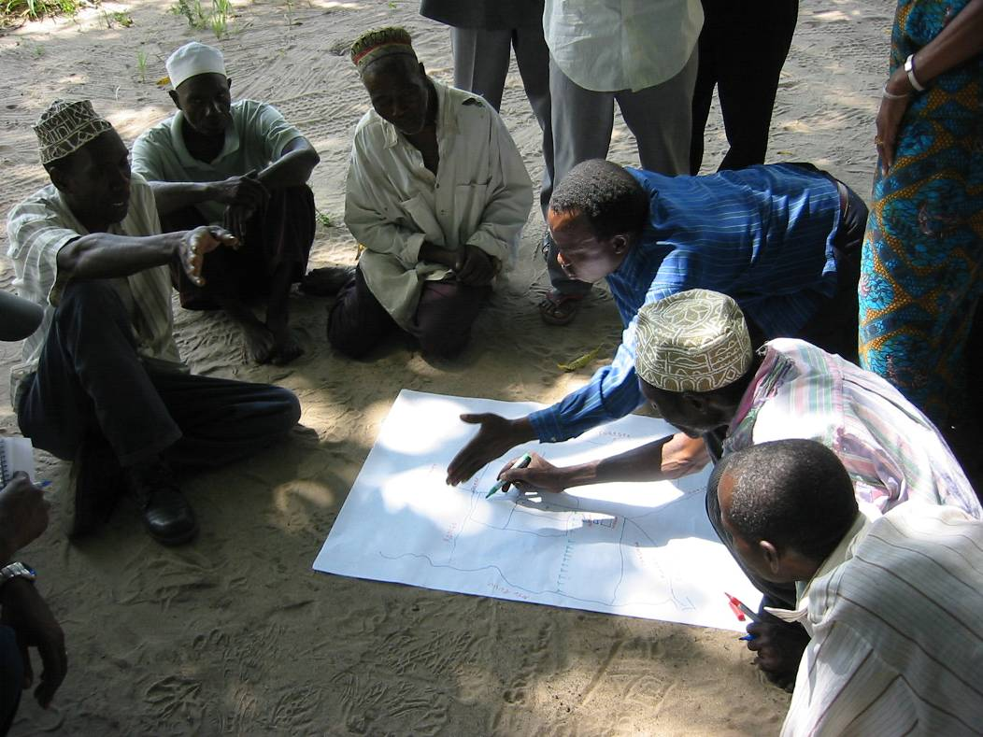
Redrawing = Re-discussing

Slide 4
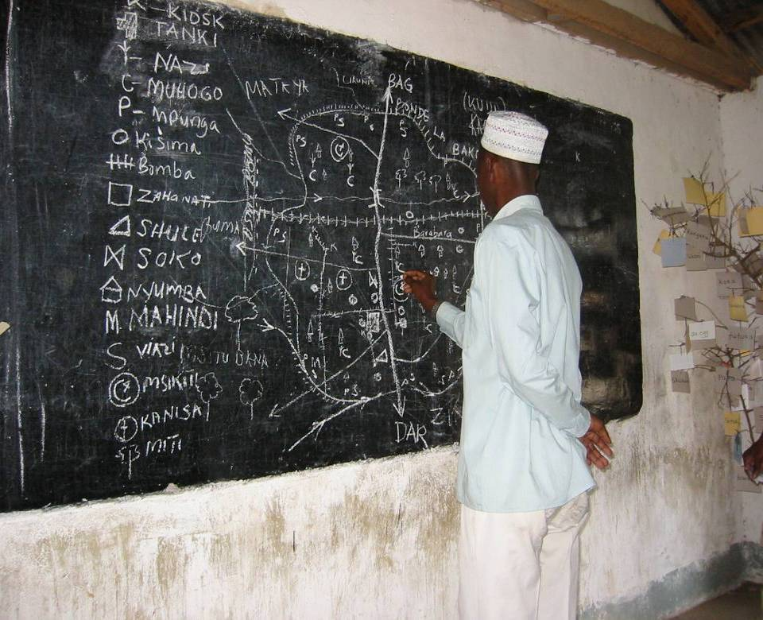
North arrow, scale bar, legend,
standard cartographic symbols, …

Slide 5
Mapping Local Spatial Knowledge
Mapping onto existing layers of information
Topographical maps (different scales)
Aerial Photography (Hi-res)
Satellite imagery (Med-res, >10m)
Examples:

Slide 6
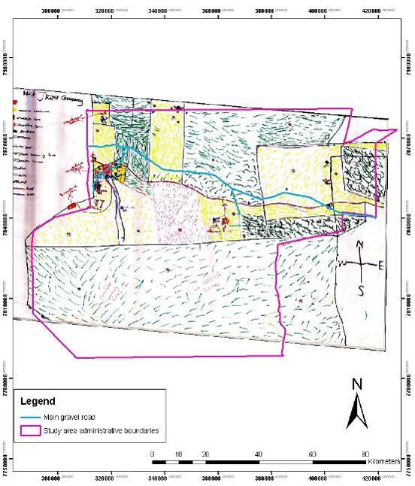
Namibia

Slide 7
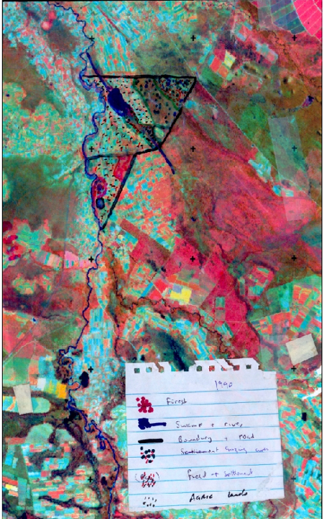
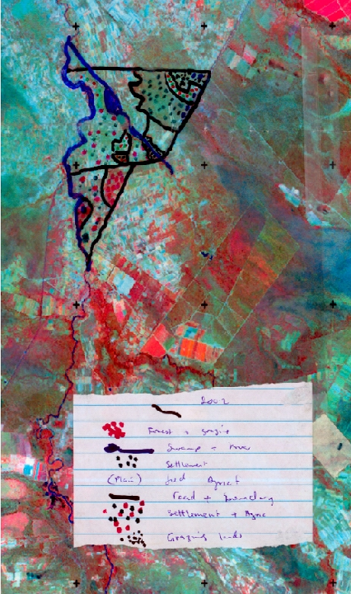
1990 2002

Slide 8
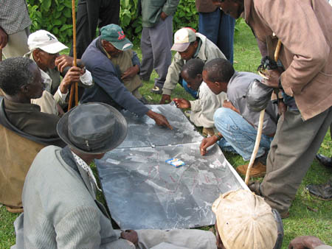
Kenya, Mau forest

Slide 9
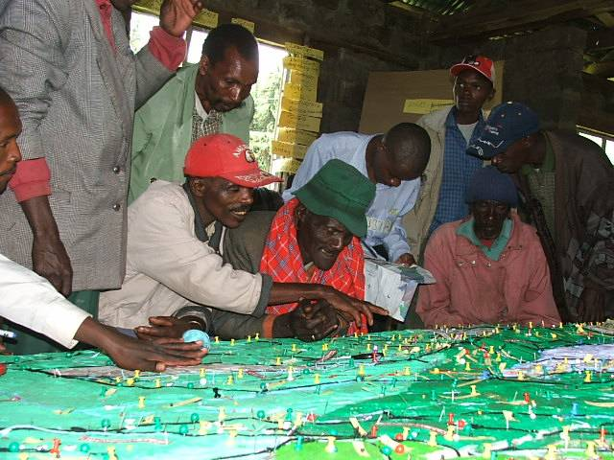
Kenya

Slide 10
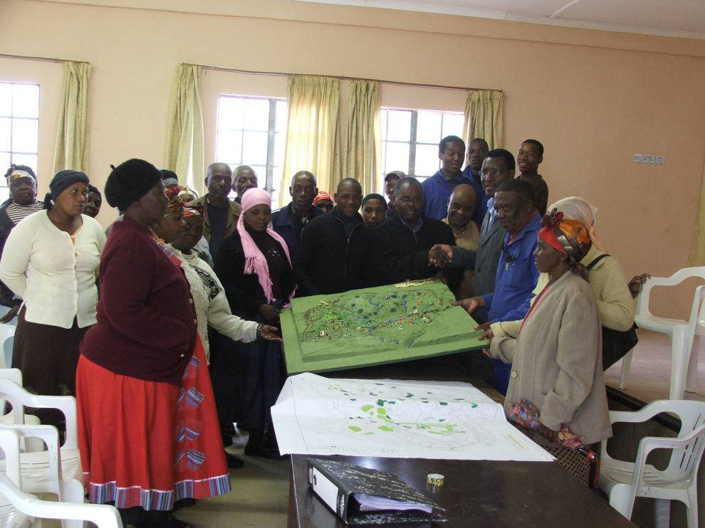

Slide 11
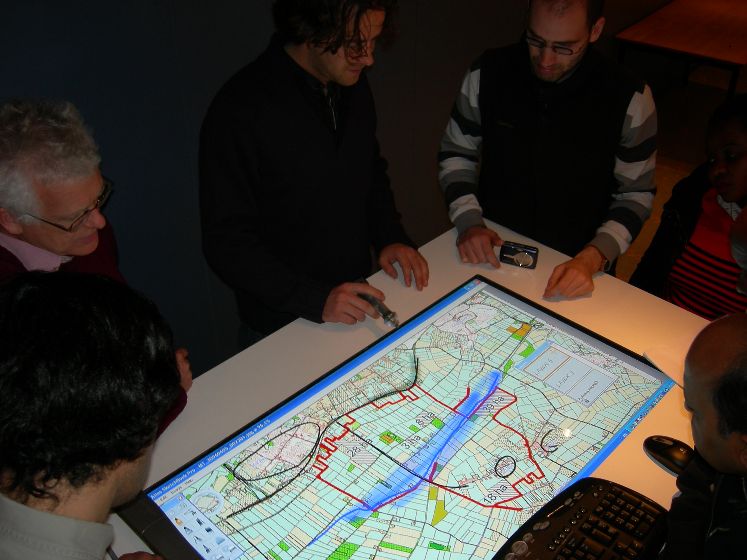
Large screen for group interaction

Slide 12
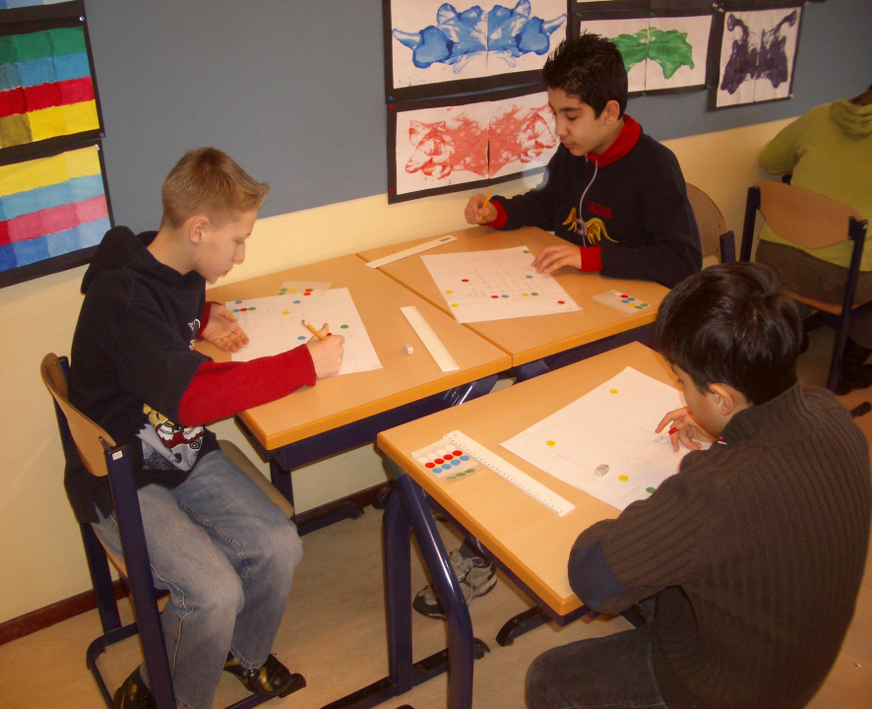

Slide 13
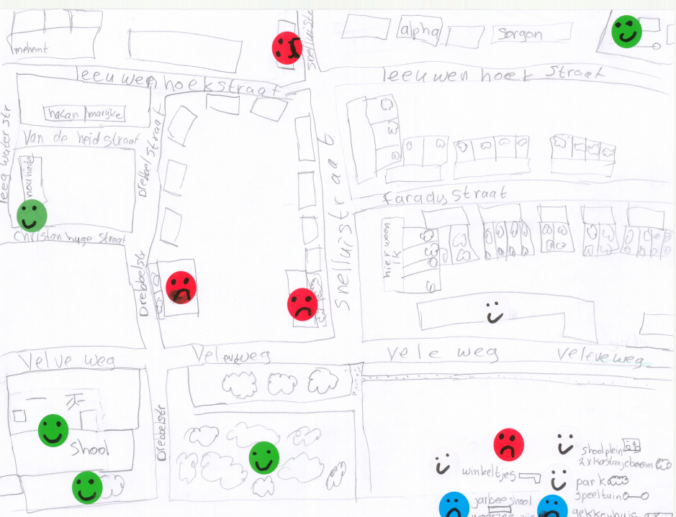

Slide 14
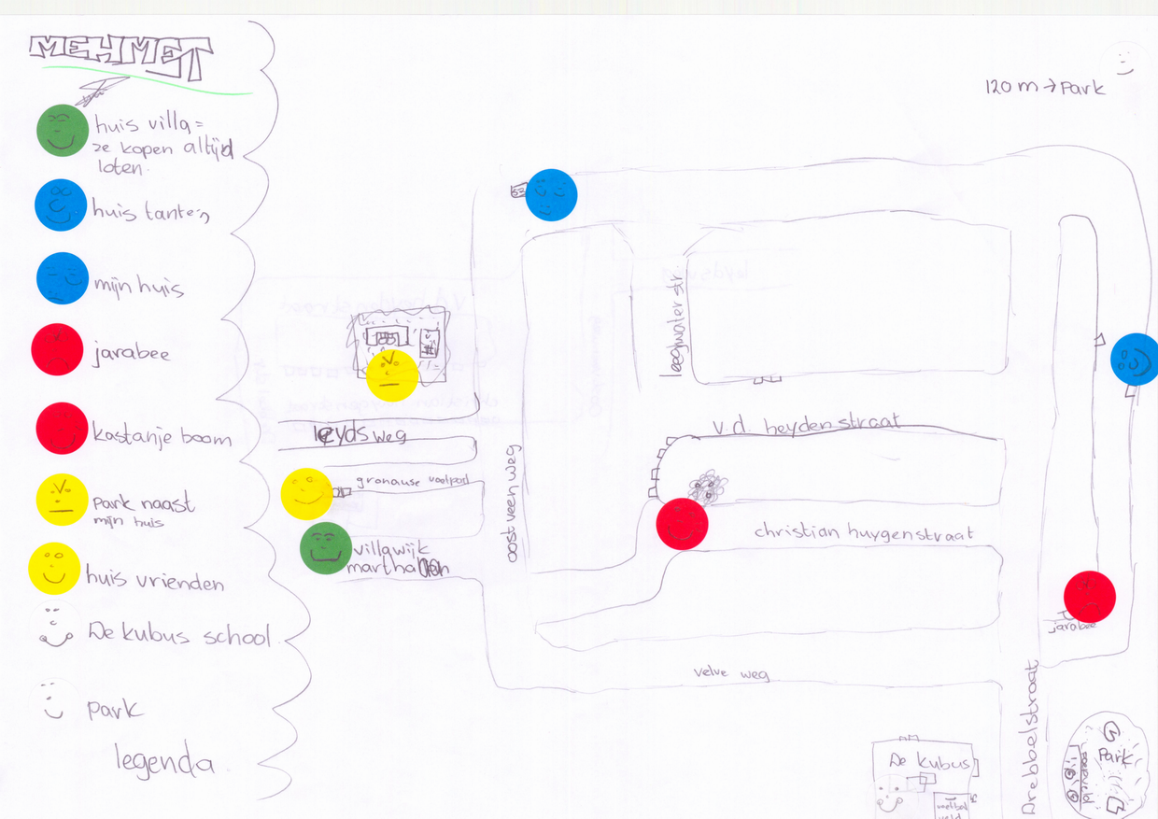

Slide 15
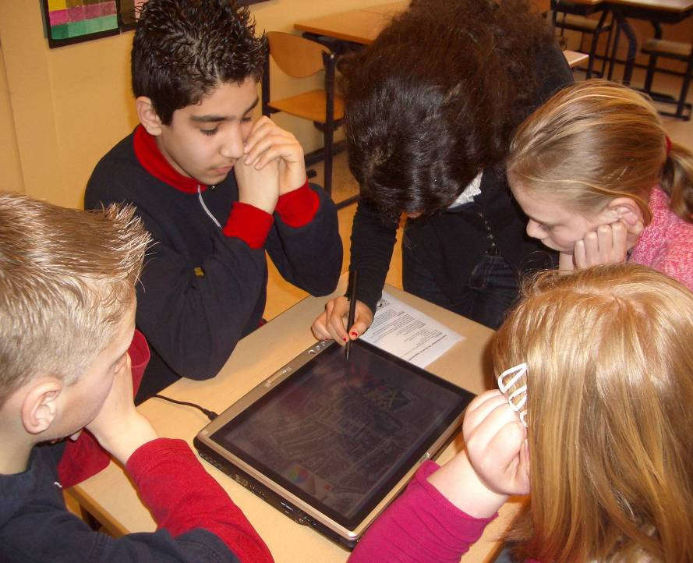
Smaller screen for small groups

Slide 16
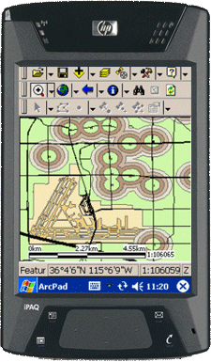
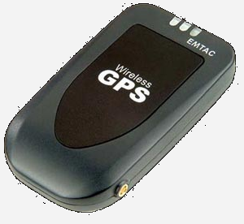
Small screen for individuals?

Slide 18
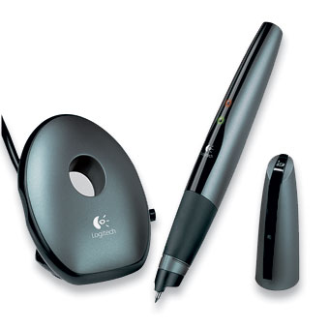
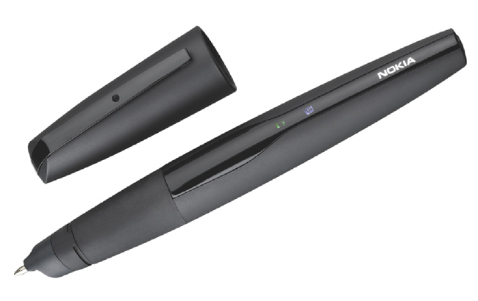
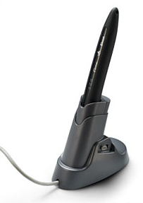
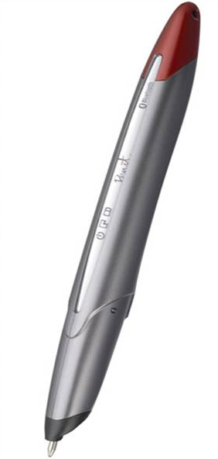
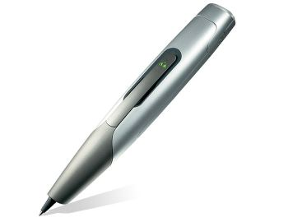
Digital pen

Slide 19
Capturx – Penx from Adapx
Print any ArcGIS map and feature legend on paper
Collect feature class data from the field, making annotations to your paper map
Updates geodatabase by simply docking the digital pen to your PC
Integration with ESRI GIS software.

Slide 20

Capturx
Commercial
Conference presentation

Slide 21
How does it work?
Capturx adds a fine pattern to your map layout which is unique for each print
A camera in the pen registers the pattern and
matches this to
the right map
You can work on
different maps
without informing
the pen…

Slide 22
Accuracy
the digital pen has a sensor which is activated when the pen writes. The sensor reads the unique encoding of dots, identifies the precise page, and pinpoints the position of the writing on that page within 0.3mm.

Slide 23
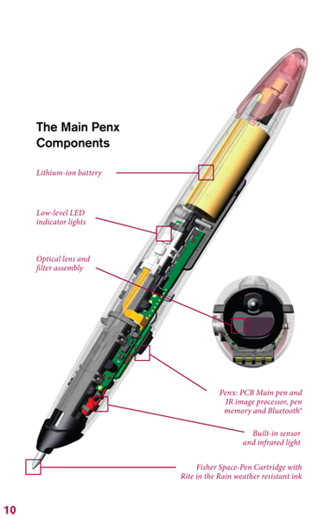
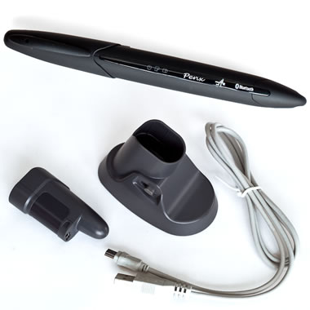
Hardware

Slide 24
Battery life
The pen has a rechargeable lithium-ion battery with up to 10 days of use before re-charging.
For data transfer and recharging, the digital pen uses a standard USB connection.

