Slide 1
Participatory information collection, analysis and planning
- an introduction to GIS and PGIS
by
Jeroen Verplanke, ITC
June 2010

Slide 2
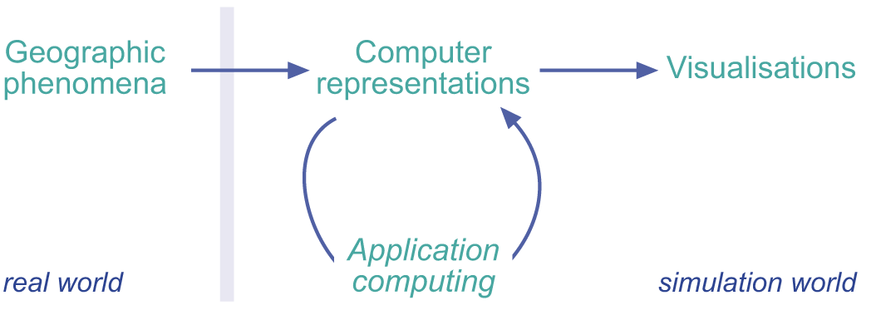
Introduction
GIS
Figure 2.1
Chapter 2: p.37

Slide 3
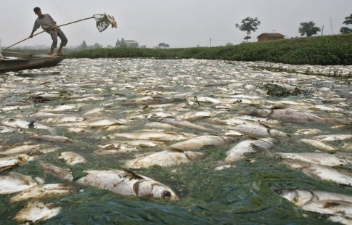

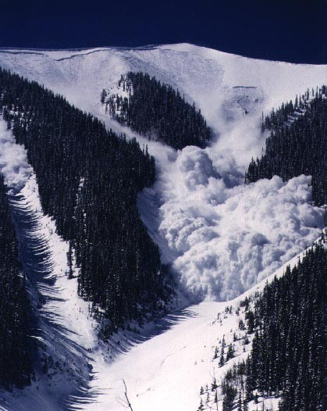

Geographic phenomena
Chapter 1.1.1: p.20

Slide 4
Natural phenomena
Chapter 1.1.1: p.20

Slide 5
Man-made phenomena
Chapter 1.1.1: p.20

Slide 6
Mixed phenomena
Chapter 1.1.1: p.20

Slide 7
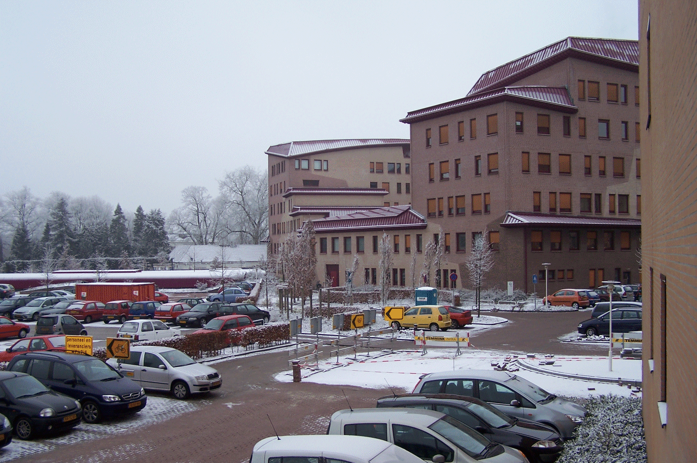
Geographic phenomena
are the study objects of a GIS
exist in the real world
are man-made, natural or a mix of both
are visible
or invisible
Air temperature
Building
Humidity
Forest
Parking lot
Soil temperature
Bushes
Chapter 2.1: p.38

Slide 8
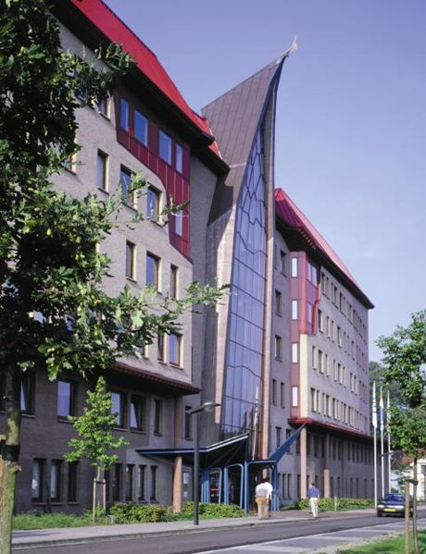
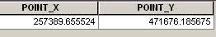
Geographic phenomenon defined
A geographic phenomenon can be
named or described
geo-referenced
assigned a time (interval) at which it is/was present
Description: ITC building
Geo-reference:
Built in: 1996
Chapter 2.1.1: p.38-39

Slide 9
Geographic phenomena: Fields
Formal definition
a (geographic) field is a geographic phenomenon for which, for every point in the study area, a value can be determined.
Example
Elevation
Chapter 2.1.2: p.39-40

Slide 10
Geographic fields: Continues fields
Formal definition
In a continuous field, the underlying function is assumed to be continuous.
Example
Slope
Chapter 2.1.3: p.40-42

Slide 11
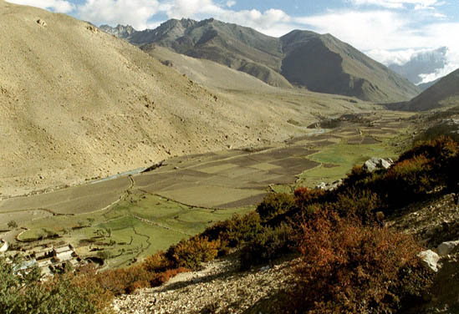
Geographic fields: Discrete fields
Formal definition
Discrete fields cut up the study space in mutually exclusive, bounded parts, with all locations in one part having the same value
Example
Land use
bare lands
agriculture
shrubbery
Chapter 2.1.3: p.40-42

Slide 12

Geographic Objects
Formal definition (geographic) objects populate the study area, and are usually well distinguishable, discrete, bounded entities. The space between them is potentially empty.
Example
Rocks
Chapter 2.1.2: p.39-40

Slide 13

Geographic Objects continued
The position of an object in space is determined by a combination of one or more of the following parameters:
    Location
    Shape
    Size
    Orientation
    Example
Bridge
Chapter 2.1.4: p.42-43

Slide 14

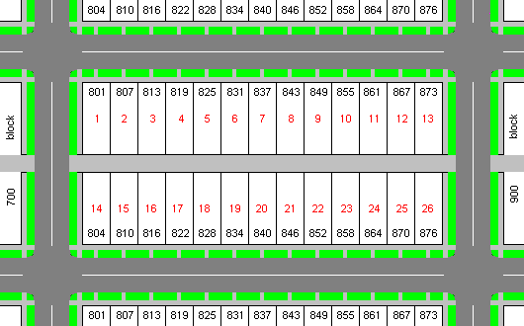
Geographic Objects continued
We usually do not study objects in isolation (a single object) but collections of objects
Chapter 2.1.4: p.43-44

Slide 15
Geographic objects
Geographic object types
  Point feature
  Line feature
  Area feature
  (Volume feature)
Usually not considered in isolation
  as collections of objects, viewed as a unit
  Different objects do not occupy the same location
Collection of objects can represent phenomenon at higher aggregation level
  Forest plots form a forest
  Roads form a road network

Slide 16
Different types of geographic phenomena
Fields
Objects
Continuous
Discrete
Elevation
Landuse
Buildings

Slide 17
Different kinds of data values
Nominal or categorical data
  Values provide a name (identity)
    E.g. ‘valley’, ‘deciduous forest’, ‘Paris’
Ordinal data
  Values can be put in a natural sequence or order
    E.g. income level categories low-medium-high
Interval data
  natural sequence of values with equal intervals, but with arbitrary zero point
    E.g. temperature
Ratio data
  Values have a natural zero point, allow for computation
    E.g. distance, weight

Slide 18
Boundaries
Both discrete fields and objects have boundaries
bare lands
agriculture
shrubbery

Slide 19
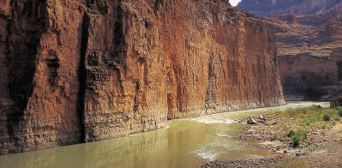

Boundaries
Both discrete fields and objects have boundaries
Two different types of boundaries:
Crisp
Fuzzy
Boundary ?
Boundary
44

Slide 20

Crisp boundaries
A crisp boundary is one that can be determined with almost arbitrary precision
more common in man-made phenomena
Road Centerline

Slide 21

Fuzzy boundaries
Fuzzy boundaries contrast with crisp boundaries in that the boundary is not a precise line, but rather an area of transition.
More common in natural phenomena
Forest type B
Area of transition between A and B
Forest type A

Slide 22
Summary geographic phenomena
 | Coverage | Boundaries | Type of boundaries | Characteristics
Continuous Fields | cover the total space | have no boundaries
Discrete Fields | cover the total space | have boundaries | crisp or fuzzy
Collection of Objects | have gaps in between | have boundaries | crisp or fuzzy | have a location, size, orientation, shape

Slide 23

Computer representations
Read section 2.2 of Principles of GIS
GIS

Slide 24
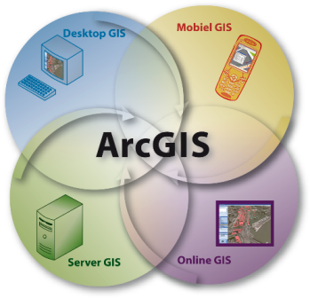
ArcGIS
ArcGIS Desktop
ArcInfo
ArcEditor
ArcGIS Desktop Extensions
ArcView

Slide 25
Vector versus Raster

Slide 26
Topology and spatial relationships
Topology
  A branch of mathematics that deals with properties of space that do not change under certain transformation
  Dealing with spatial relationships

Slide 27
Topological space: Simplices

Slide 28
Spatial data as Topological invariants

Slide 29
Topological relationships
intersection of boundaries
intersection of interiors
upper and under
A
B

Slide 30
Eight spatial relationships
A
B is disjoint from A
B covered by A
B
A
B
B meets A
B contains A
A
A
B
B
B is equal to A
A
B
A
B
B covers A
B is inside A
B
A
A
B
B overlaps A
56

Slide 31
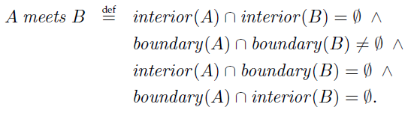
Spatial Relationship: Example
A
B

Slide 32
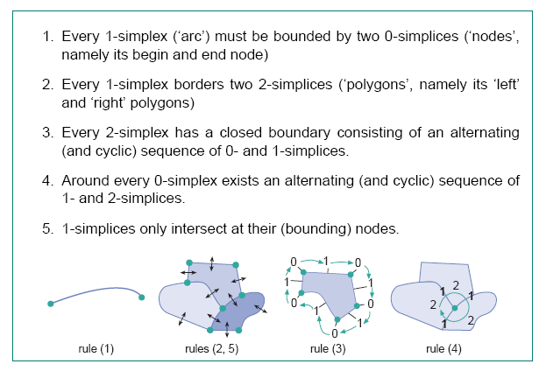
Topological consistency rules

Slide 33
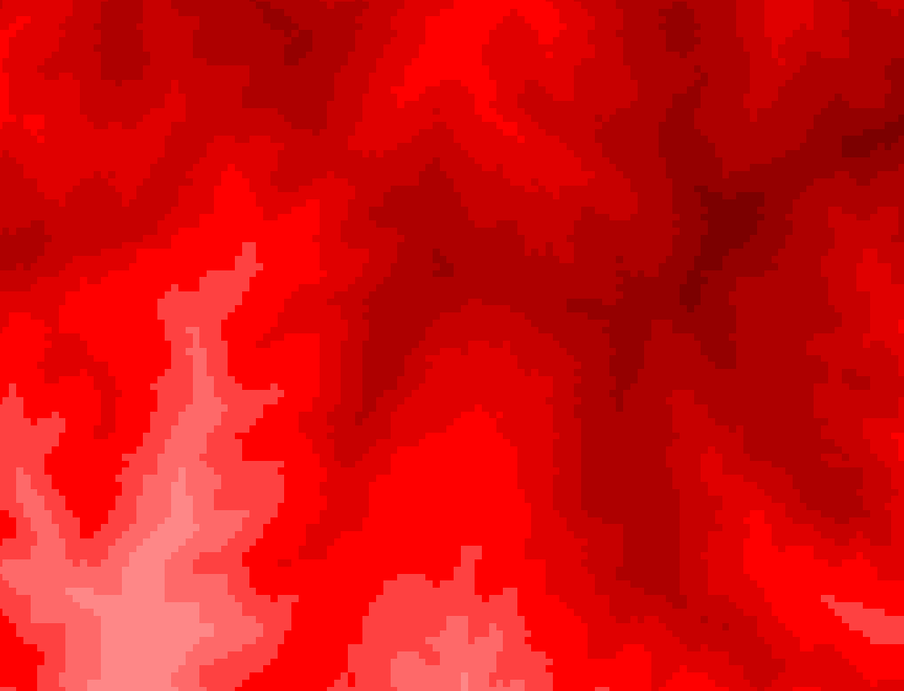
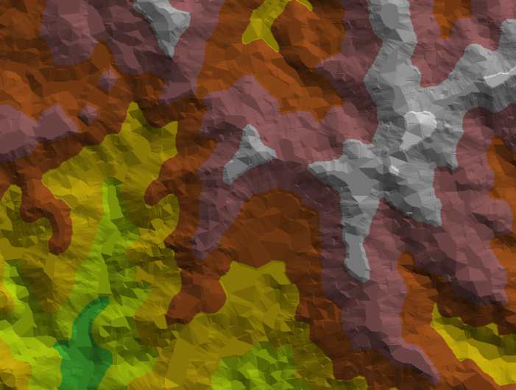
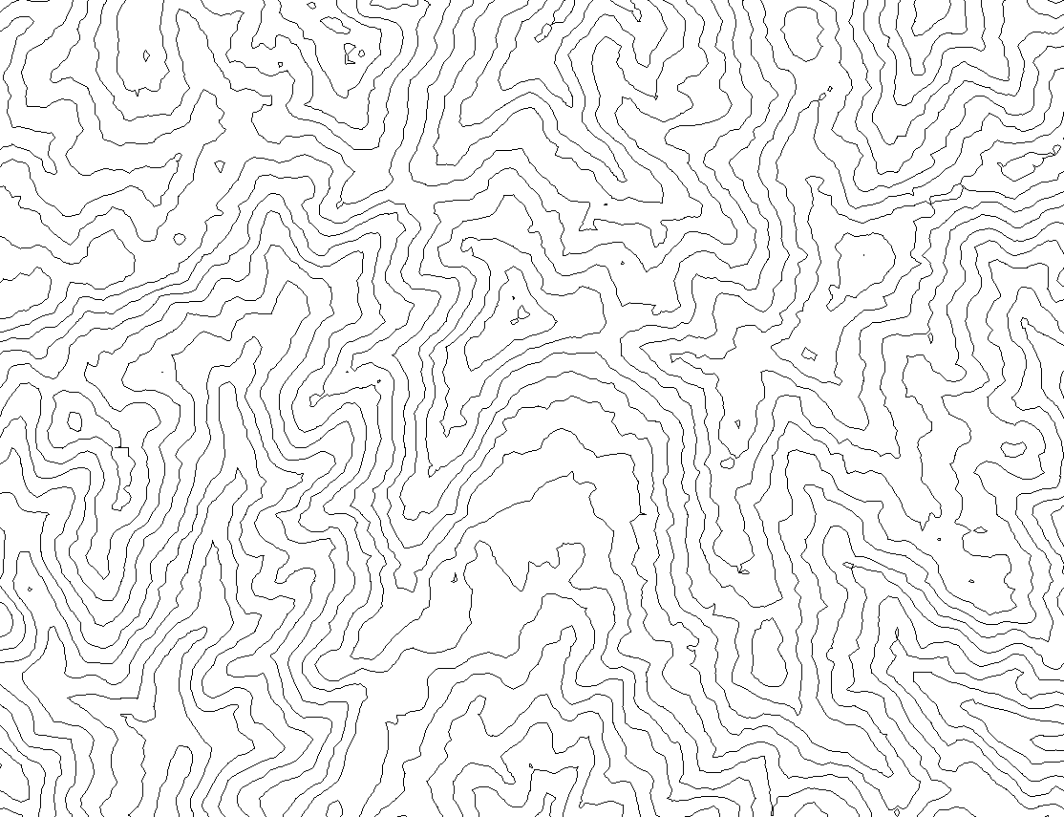
Representation of geographic fields
Field
Tessellation
TIN
Vector representation
Chapter 2.2.6: p.58-59

Slide 34
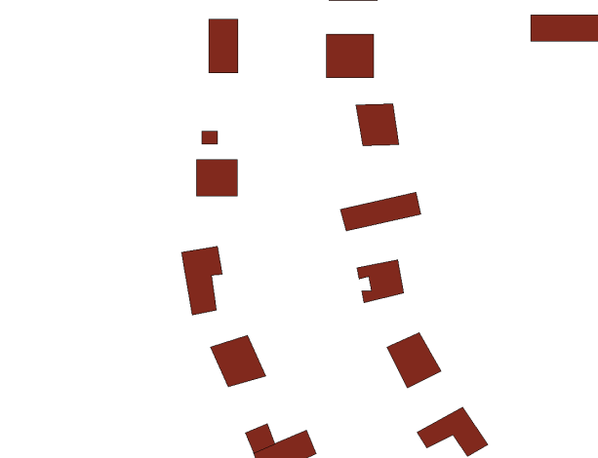
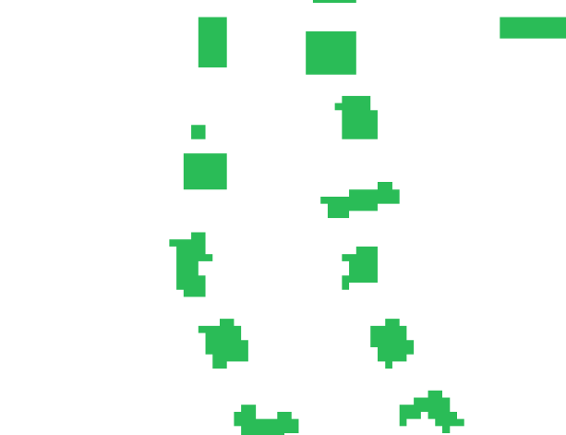
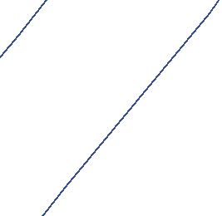
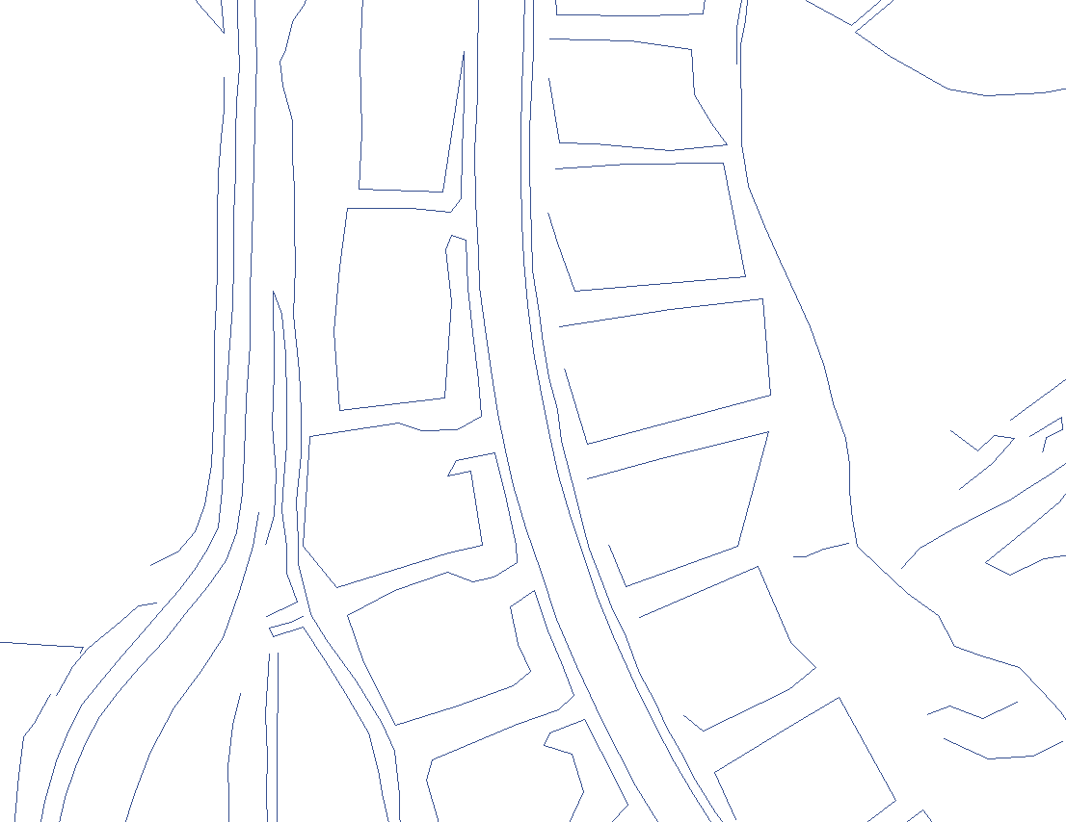
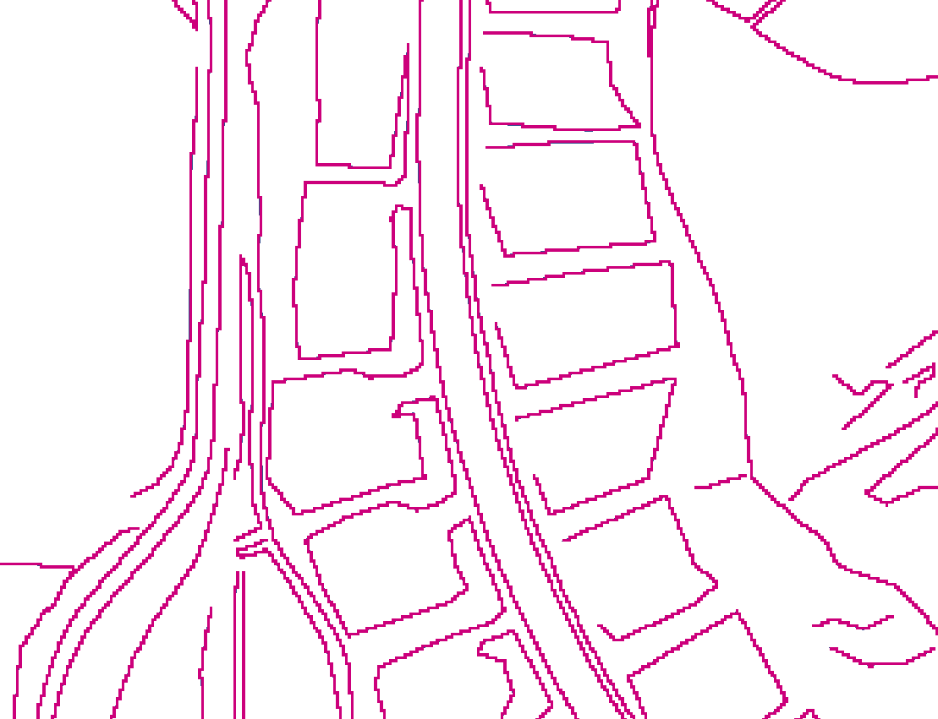
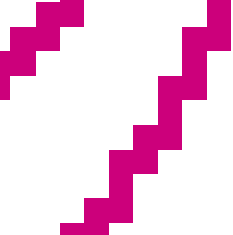
Representation of geographic objects
Vector
Raster
Chapter 2.2.7: p.59-61

Slide 35
PGIS?
Participatory Geo-Information System
Participatory GI Science?
So is it about GIS (databases/software)?
NO!
Maybe a better name:
“Participatory use of spatial knowledge”
PPGIS? = Public Participatory GIS

Slide 36
A Description of Participatory GIS
Participatory GIS (PGIS) is a practice in its own right, developed out of participatory approaches.
PGIS combines a range of Geo Information tools and technologies to represent peoples’ spatial knowledge.
PGIS implies generating and communicating spatial information, therefore making GIT&S available to groups in society in order to enhance their capacity …

Slide 37
A Description of Participatory GIS
It promotes interactive participation of stakeholders in generating and managing spatial information and it uses information about specific landscapes to facilitate decision making processes that support effective communication and community advocacy…

Slide 38
A Description of Participatory GIS
If appropriately utilized, the practice could exert profound impacts on community empowerment, innovation and social change.
Special purpose: placing control of access and use of (culturally sensitive) spatial information in the hands of those who generated them, to protect traditional knowledge and wisdom from disappearing or from external exploitation.

Slide 39
A Description of Participatory GIS
GIS is ‘only’ one of the tools in the PGIS toolbox.
PGIS is about (local) spatial knowledge
PGIS is about eliciting and communicating of different types of spatial information
PGIS is about ownership of information
PGIS is all about purpose
→ The 3 P’s

Slide 40
What is Participatory GIS? (P-GIS)
P-GIS as form of ‘participatory spatial planning’ (PSP) which makes use of maps and GI output, especially GIS.
  Core is ‘degree of participation’ in planning,
  essential issues are: processes, activities, instruments, and procedures that involve participation?
P-GIS is ‘doing (technical) GIS with some degree of people’s participation –
  Participation could be simply data collection, or , choice of data inputs, data layers, analysis, data queries.
  Core activity is the GI outputs (maps, etc.),

Slide 41
‘P’ is about interaction
Demands
Community
Government
Interaction
Needs & expectations

Slide 42
Do we make a small or large ‘P’?
Adding “P” to GIS (pGIS)
  Conformal
  Suitable output
  Less community oriented
Adding GIS to “P” (Pgis)
  Non-conformal
  Community oriented
  Likely to get unsuitable output

Slide 43
PGIS split between multiple purposes
Demands
Community
Interaction
Government
Needs & expectations
LSK
PGIS
Mainstream Science & Technology
Acceptation
Validation
Suitability for community purposes
Suitability for government purposes

Slide 44
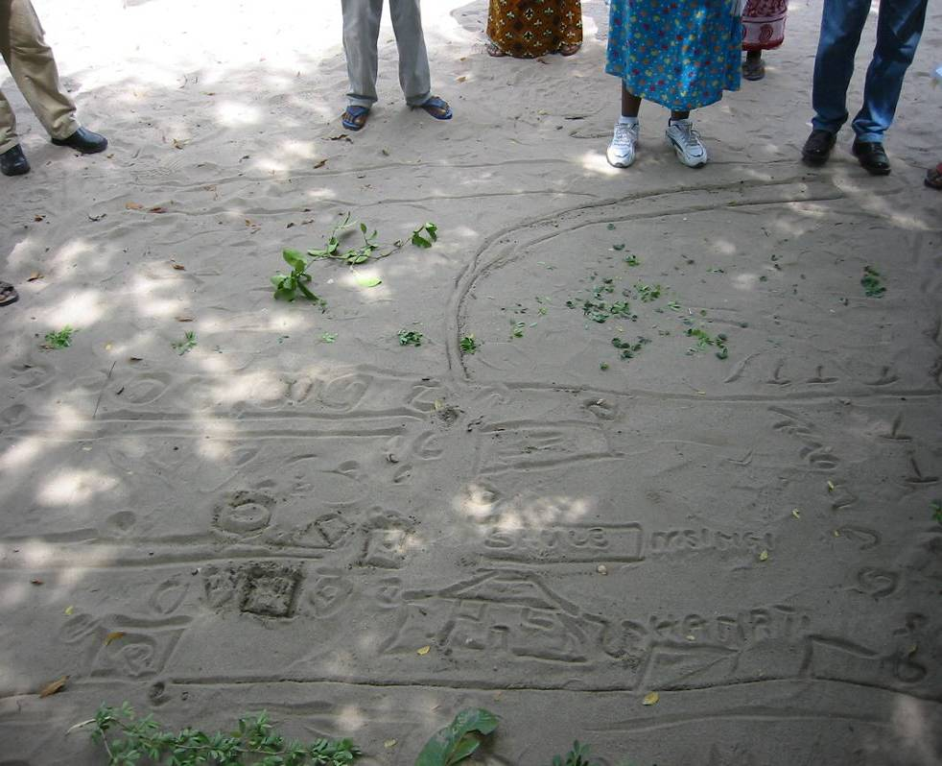
Participatory collection of spatial information

Slide 45
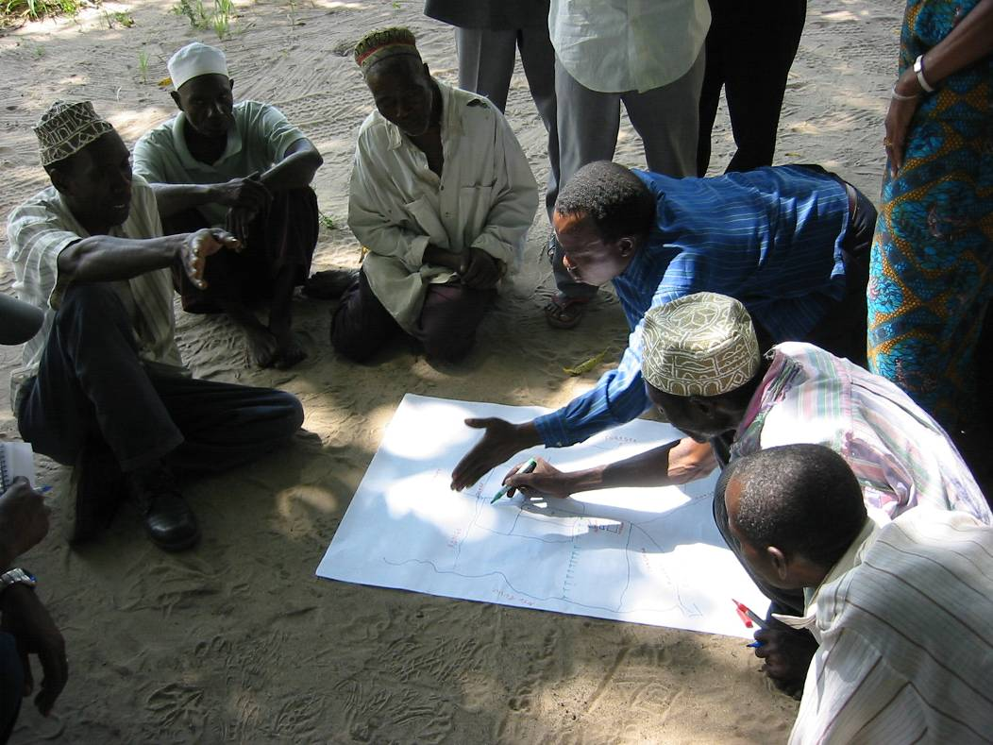
Redrawing = Re-discussing

Slide 46
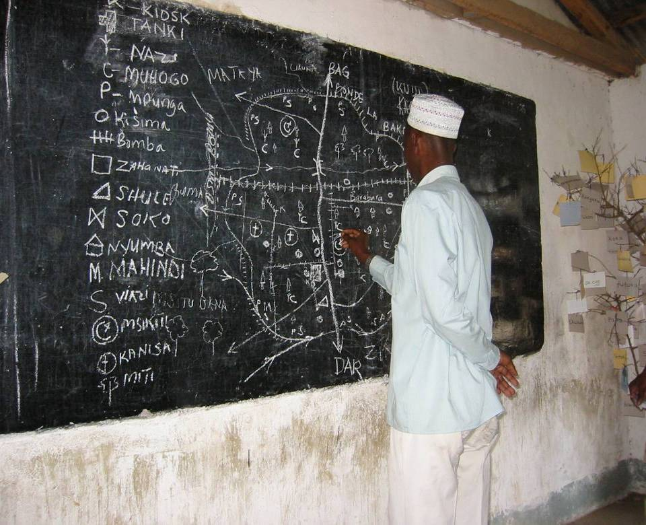
North arrow, scale bar, legend,
standard cartographic symbols, …

Slide 47
Mapping Local Spatial Knowledge
Mapping onto existing layers of information
Topographical maps (different scales)
Aerial Photography (Hi-res)
Satellite imagery (Med-res, >10m)
Examples:

Slide 48
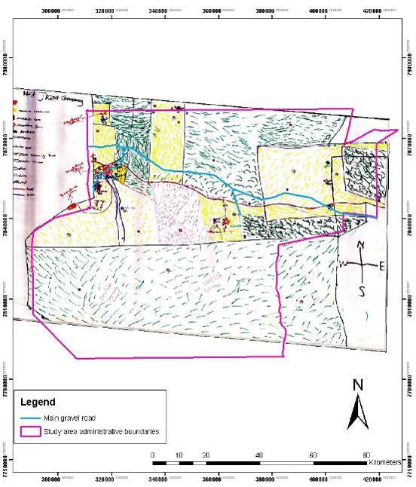
Namibia
Using existing maps as background.

Slide 49
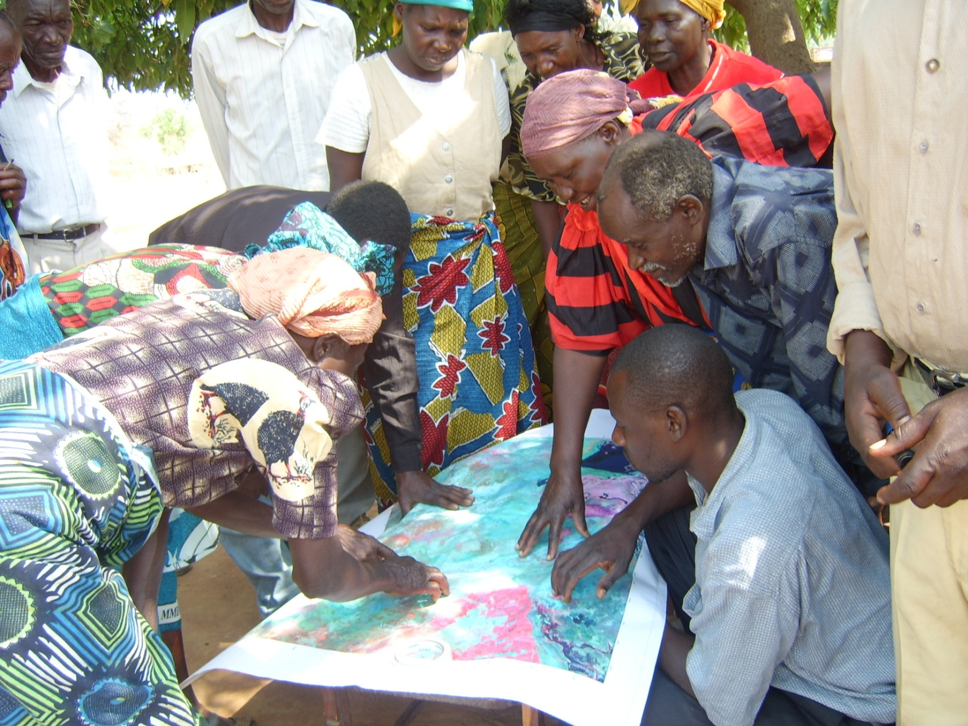
Zambia – using satellite images

Slide 50
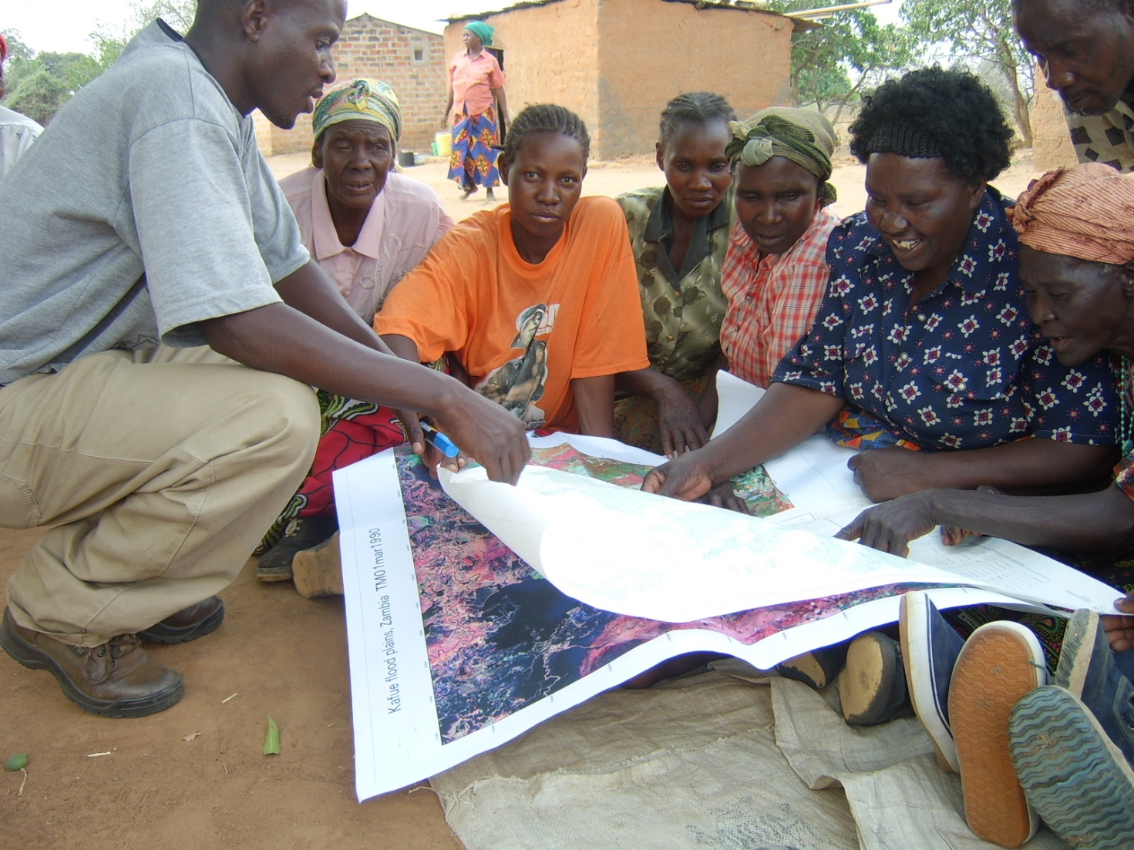
Zambia – using satellite images

Slide 51
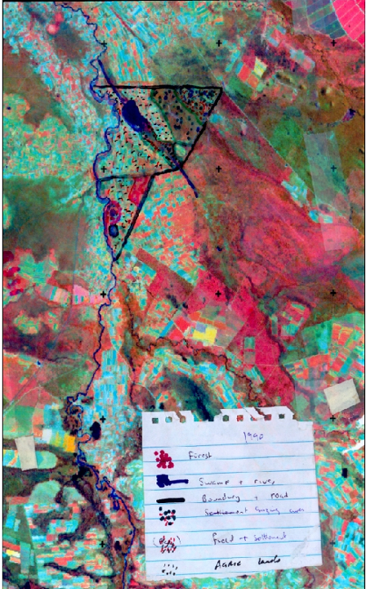
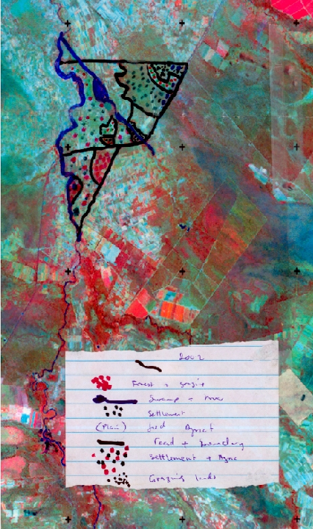
1990 2002

Slide 52
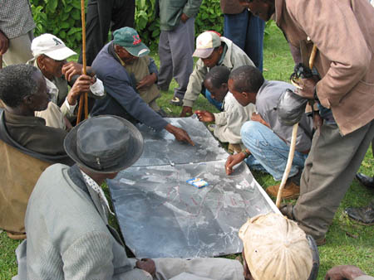
Kenya – Aerial photographs

Slide 53
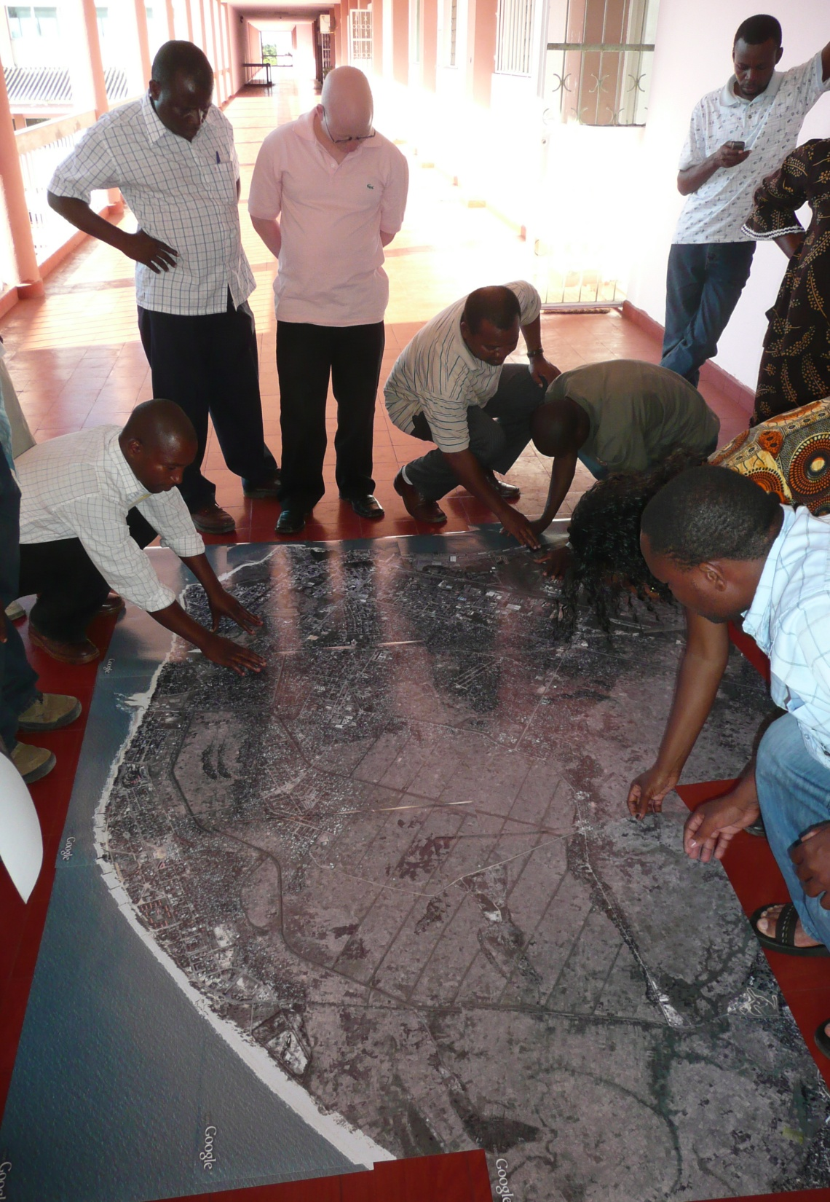
Mozambique
Making a mosaic of Google images

Slide 54
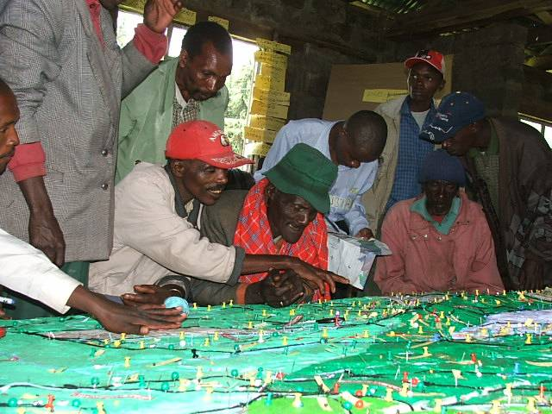
Kenya
Kenya – Making 3D models

Slide 58
Kenya

Slide 59
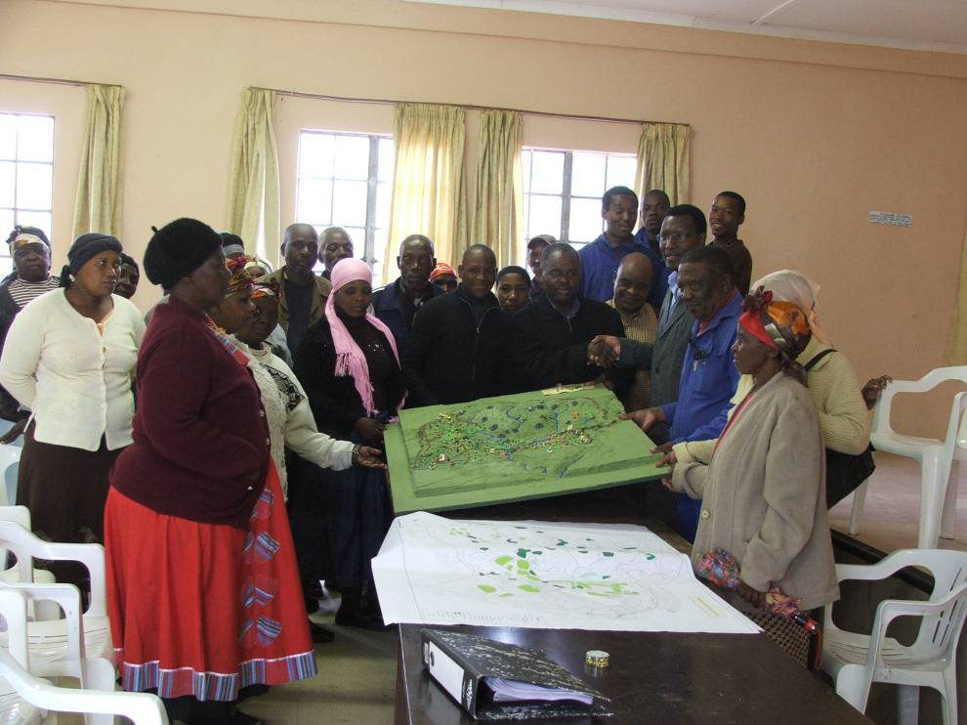
South Africa – making 3D models

Slide 60
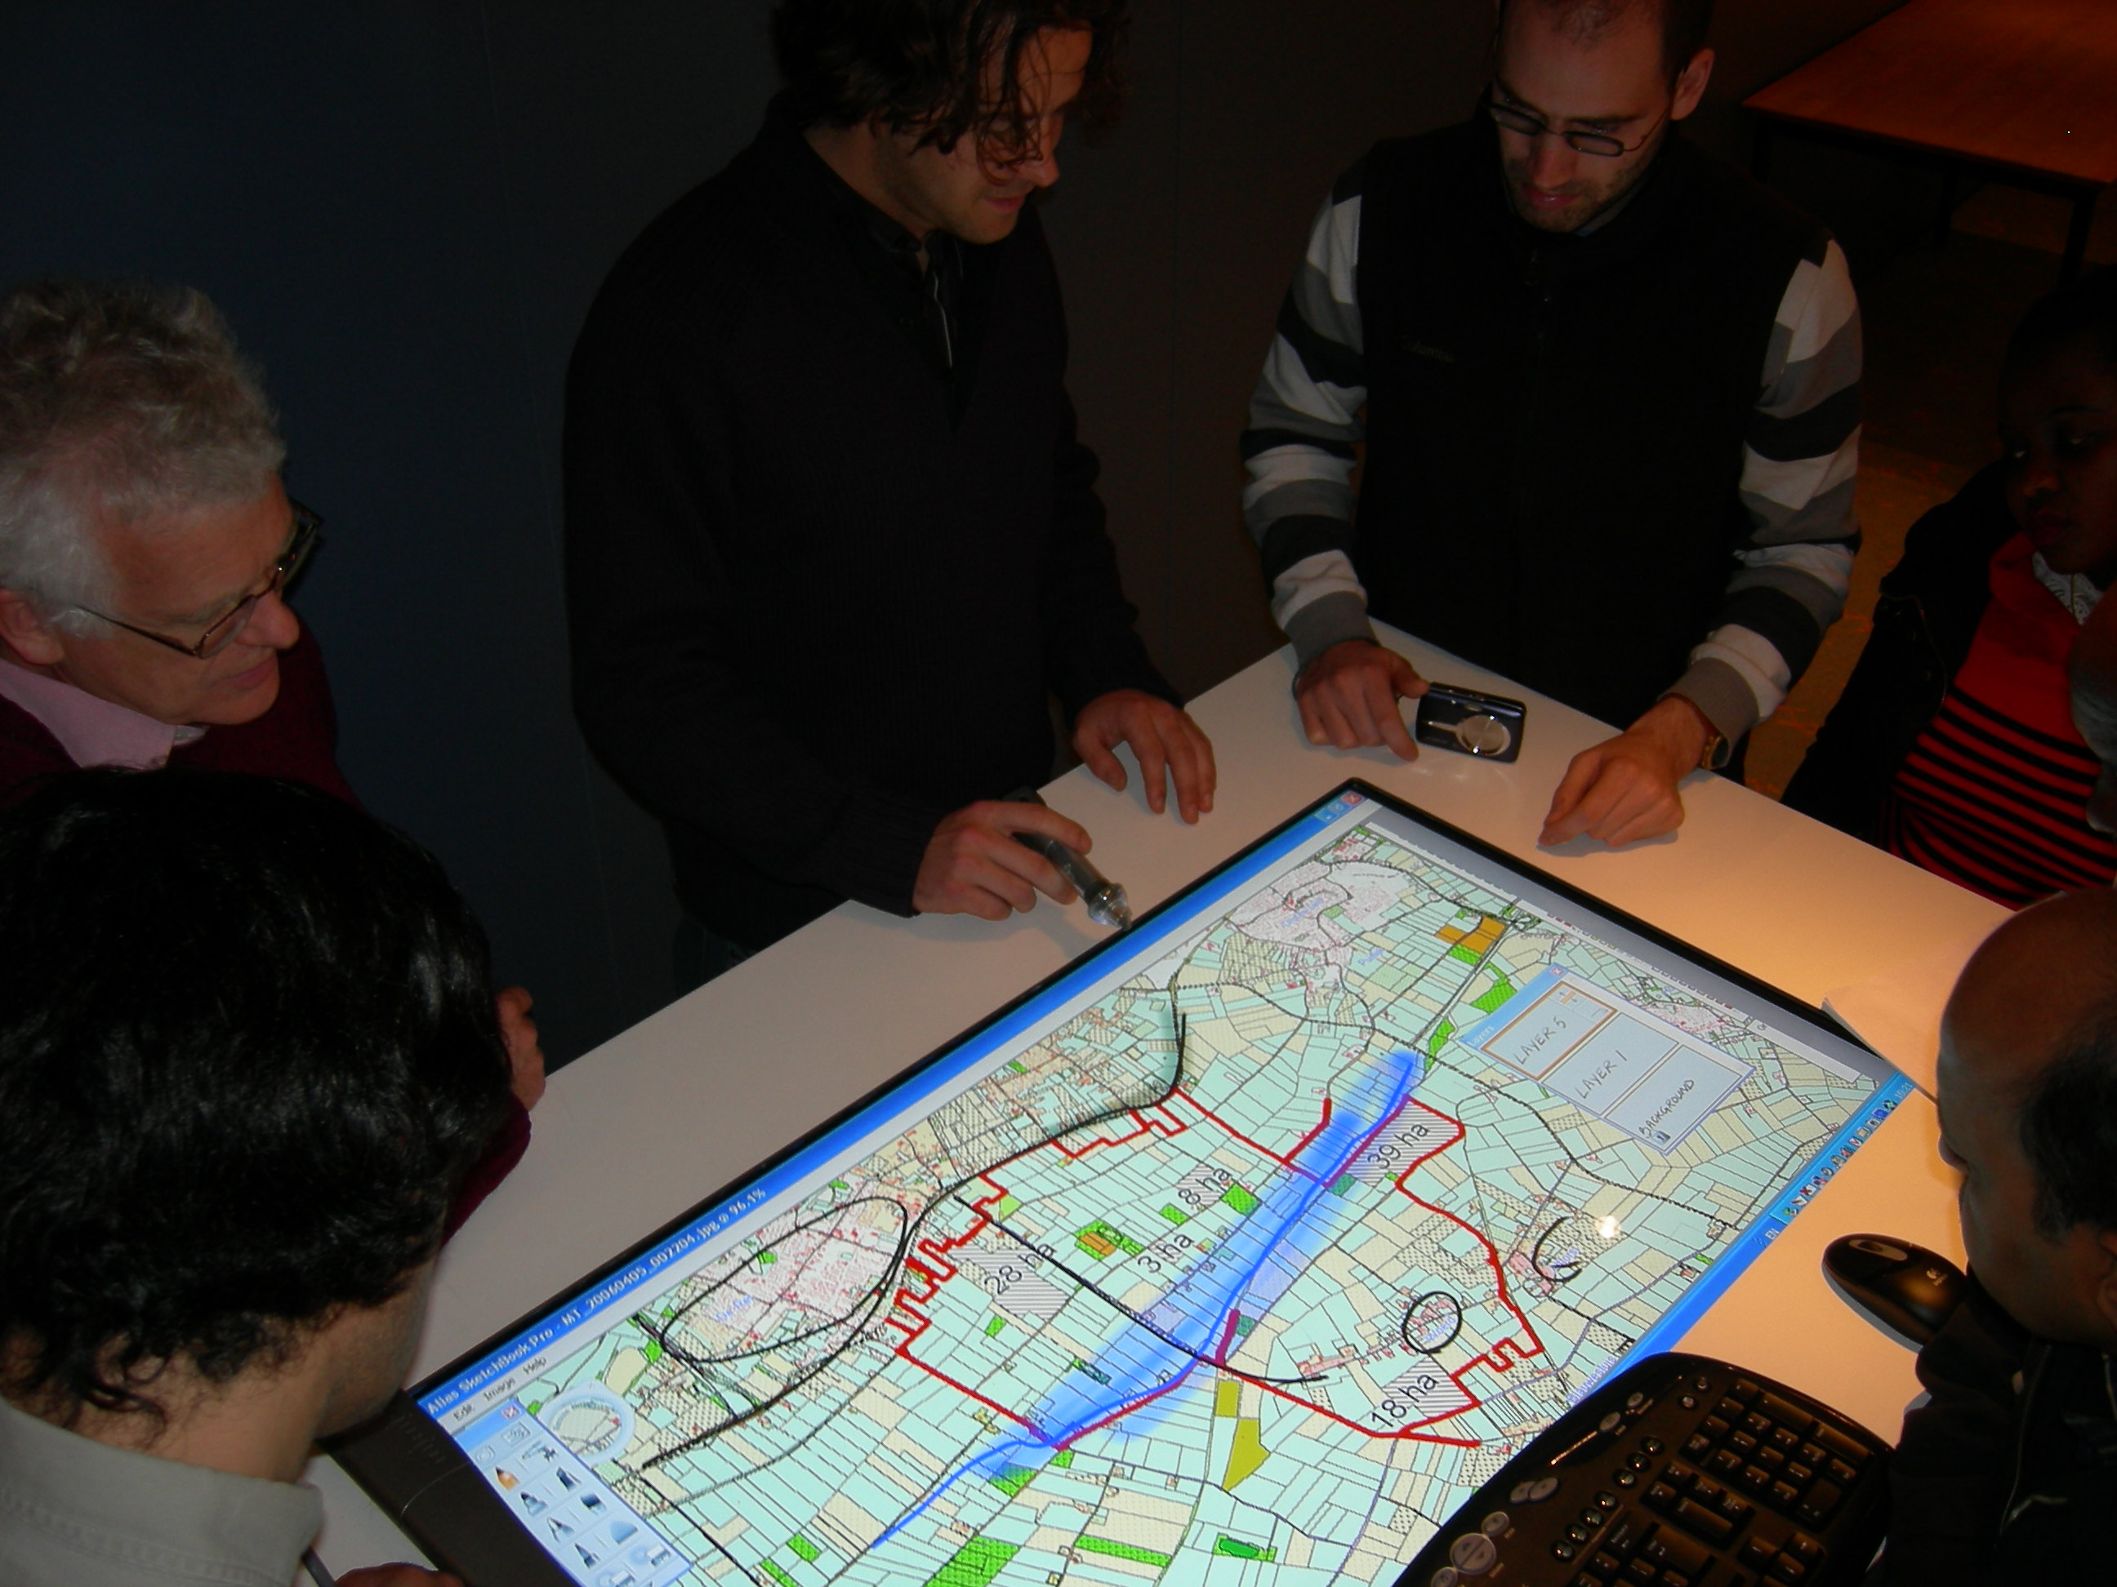
Collaborative decision-making with interactive displays

Slide 61

Children mapping urban safety

Slide 62
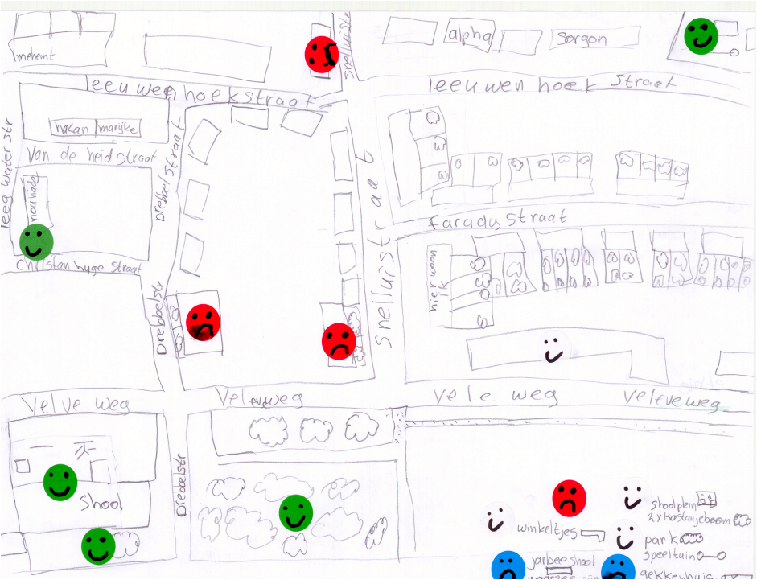

Slide 63
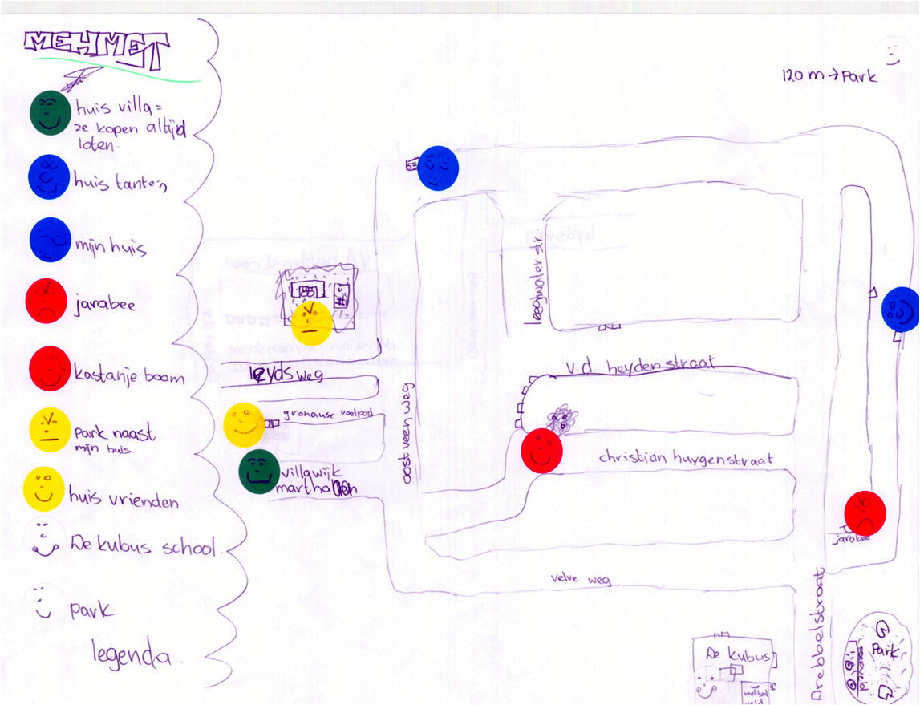

Slide 64

Active screen for small group collaboration

Slide 65
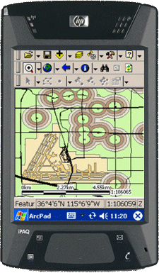
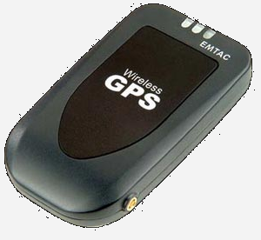
Small screen for individuals?

Slide 67
Capturx – Penx from Adapx
Print any ArcGIS map and feature legend on paper
Collect feature class data from the field, making annotations to your paper map
Updates geodatabase by simply docking the digital pen to your PC
Integration with ESRI GIS software.

Slide 68
How does it work?
Capturx adds a fine pattern to your map layout which is unique for each print
A camera in the pen registers the pattern and
matches this to
the right map
You can work on
different maps
without informing
the pen…

Slide 69
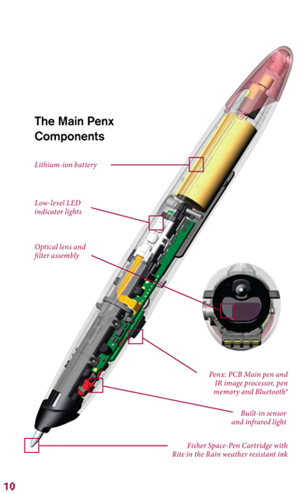

Hardware

Slide 70
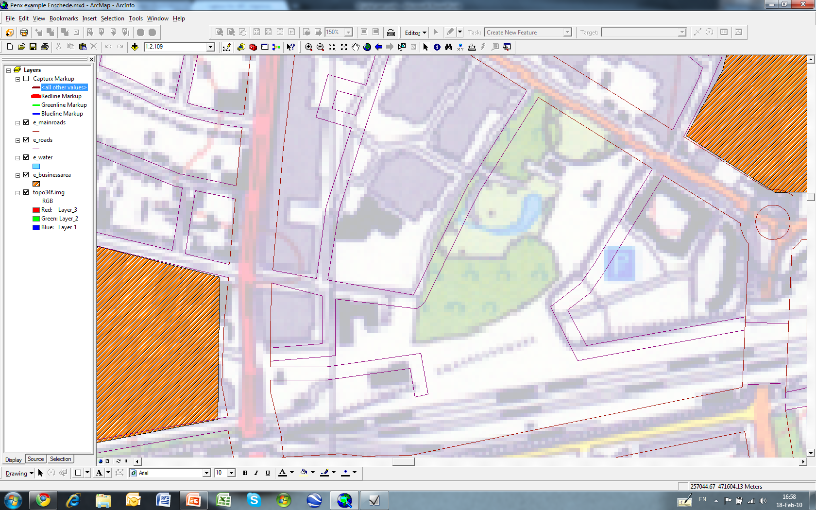

Slide 71
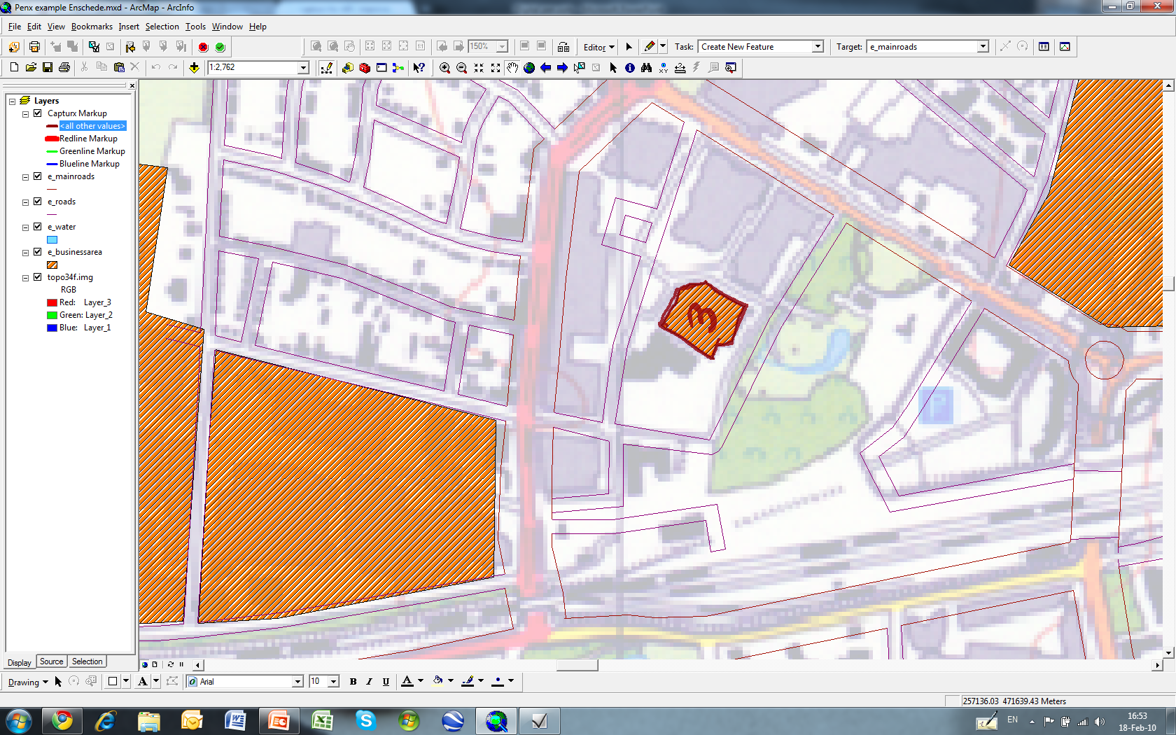

Slide 72
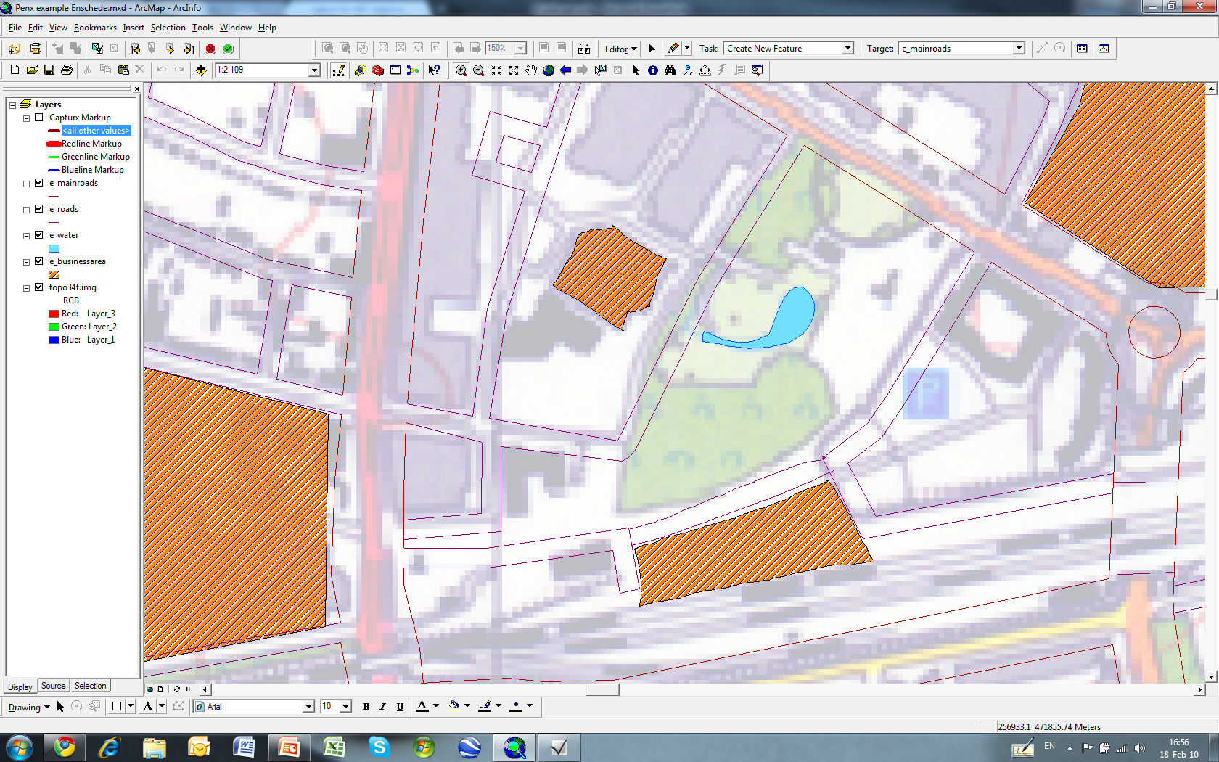

Slide 73
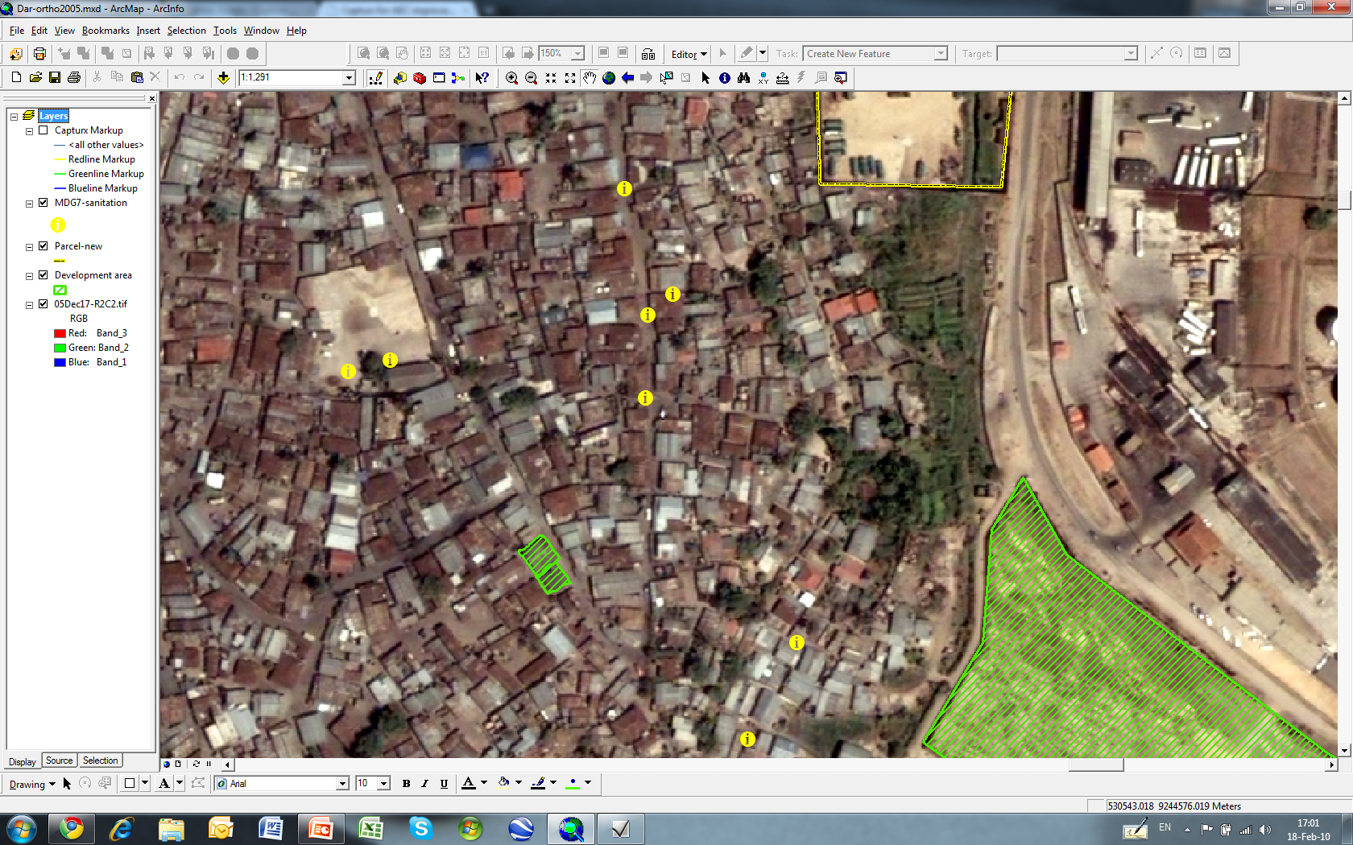

Slide 74
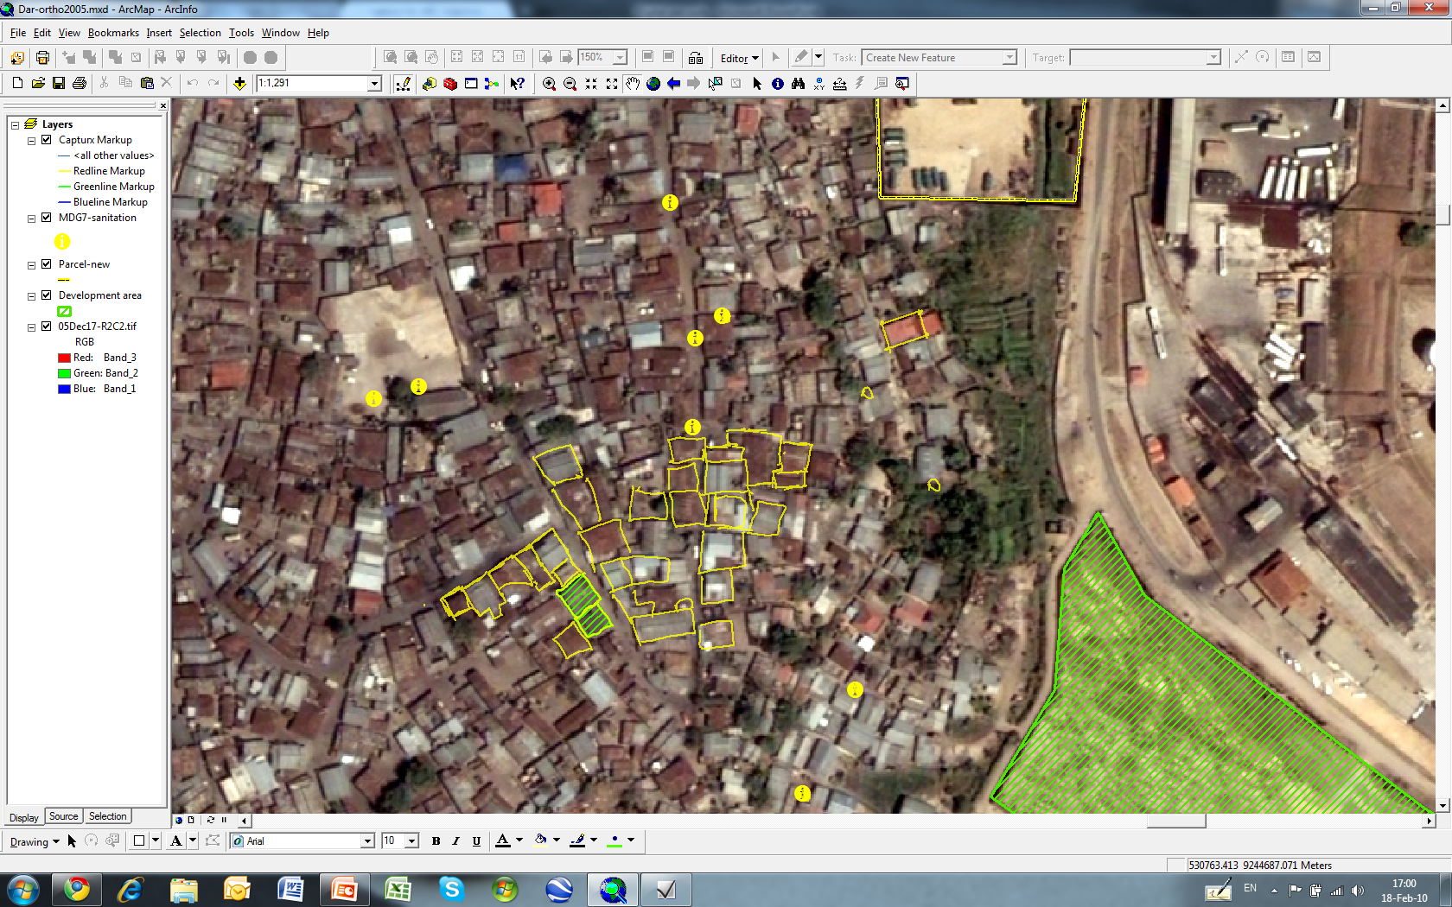

Slide 75
1. Examples of projects to understand the scope of "participatory GIS approach"
2. Is there any study on whether the use of ICT in mapping exercises can increase the impact of the activity (for instance, using a mobile phone vs. using a classical paper map).
3. Methodologies and approaches to participatory GIS.
4. Low-cost or DIY (do it yourself) gadgets.
5. Best practices for optimisation of data display. Sometimes when you have the whole set of data, rendering the map on line becomes very slow. I have seen some approaches as using layered set of data in relation to zoom options but I don't know what else is there.
6. Best practices for linking data from web resources. When deploying web solutions we are often duplicating data that exists somewhere else. Resulting from this that often one of the data sets will end up outdated. For example the contact address, in the institutional web site of the organisations and the same data in the mapping tool.

Slide 76
Why ‘Participation’?
building trust
‘the public’ has useful ideas
inclusiveness and ownership
groundwork for sustainability?
it ‘must’ be done …
Then how can we be ‘participatory’?

Slide 77
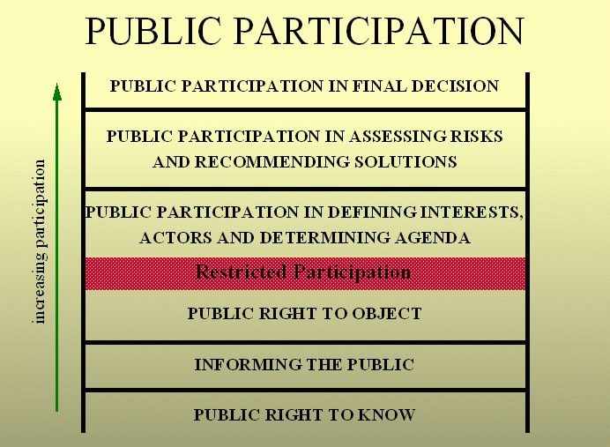
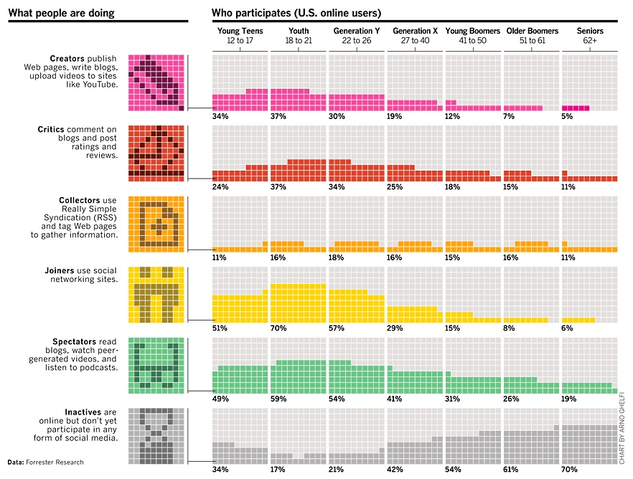

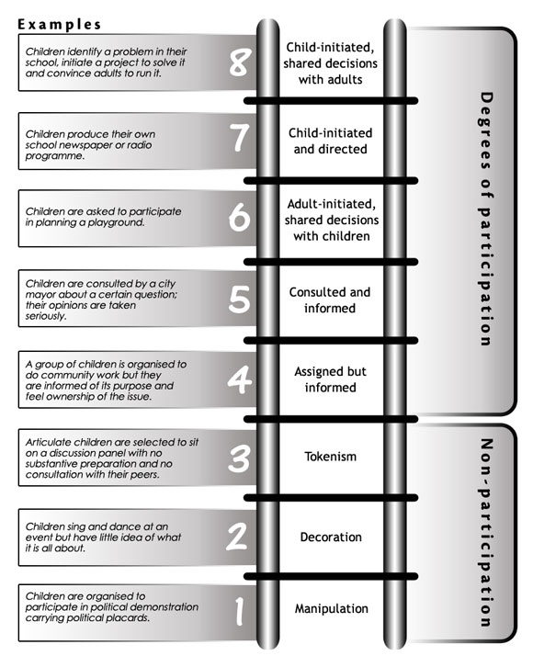
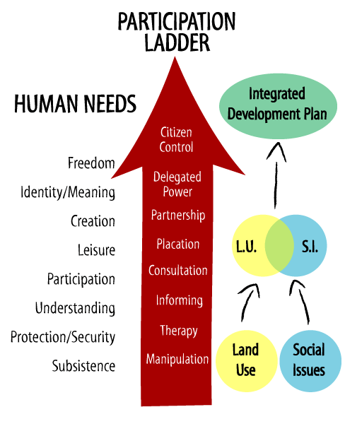
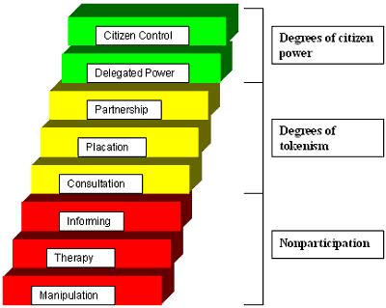

Participation ladder

Slide 78
Intensity of Participation - “Ladder”
Information Sharing,
  communication between outsiders and local people, primarily technical information, e.g. needs assessment.
Consultation
  Outsiders refer certain issues to local stakeholders, for further details, or refinement, or e.g. for prioritising.
Involvement in Decision-making by all actors,
  Involve local people in decision-making, policy-setting.
Initiating Actions
  Initiatives of local people who are empowered
  e.g. self-mobilisation to perform activities

Slide 79
The Project Cycle
The generic project cycle has six phases:
  Programming
  Identification
  Formulation
  Financing
  Implementation
  Evaluation
The details of what occurs during each phase differ between institutions, reflecting differences in procedures.
Source: EC –Project Cycle Management Handbook, 1999

Slide 80
Commonalities in Project Cycles
Within all institutions the cycle shares three common themes:
  The cycle defines the key decisions, information requirements and responsibilities at each phase.
  The phases in the cycle are progressive – each phase needs to be completed for the next to be tackled with success.
  The cycle draws on evaluation to build experience from existing projects into the design of future programmes and projects.

Slide 81
Programming Phase
During the Programming phase, the situation at national and sectoral level is analysed to identify problems, constraints and opportunities which development cooperation could address. This involves a review of socio-economic indicators, and of national and donor priorities. The purpose is to identify and agree the main objectives and sectoral priorities for development cooperation, and thus to provide a relevant and feasible programming framework within which projects can be identified and prepared. For each of these priorities strategies will be formulated that take account of the lessons of past experience.

Slide 82
Identification Phase
During the Identification phase, ideas for projects and other development actions are identified and screened for further study. This involves consultation with the intended beneficiaries of each action, an analysis of the problems they face, and the identification of options to address these problems. A decision can then be made on the relevance of each project idea (both to the intended beneficiaries and to the programming framework), and on which ideas should be further studied during the Formulation phase

Slide 83
Formulation Phase
During the Formulation phase, relevant project ideas are developed into operational project plans. Beneficiaries and other stakeholders participate in the detailed specification of the project idea that is then assessed for its feasibility (whether it is likely to succeed) and sustainability (whether it is likely to generate longterm benefits for the beneficiaries). On the basis of this assessment, a decision is made on whether to draw up a formal project proposal and seek funding for the project.

Slide 84
Financing Phase
During the Financing phase, project proposals are examined by the funding agency, and a decision is taken on whether to fund the project. The funding agency and partner country agree the modalities of implementation and formalise these in a legal document which sets out the arrangements by which the project will be funded and implemented.

Slide 85
Implementation Phase
During the Implementation phase, the project is mobilised and executed. This may require the tendering and award of contracts for technical assistance or works and supplies. During implementation, and in consultation with beneficiaries and stakeholders, project management assesses actual progress against planned progress to determine whether the project is on track towards achieving its objectives. If necessary the project is re-oriented to bring it back on track, or to modify some of its objectives in the light of any significant changes that may have occurred since its formulation.

Slide 86
Evaluation Phase
During the Evaluation phase, the funding agency and partner country assess the project to identify what has been achieved, and to identify lessons that have been learned. Evaluation findings are used to improve the design of future projects or programmes. Although in the generic cycle the evaluation phase comes after implementation, it is common practice also to conduct a mid-term evaluation during implementation, to identify lessons that can be applied during the remaining life of the project.

Slide 87
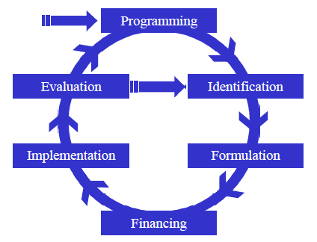
Project Cycle
Where/when and how to Participate?
1 ?
6 ?
2 ?
3 ?
5 ?
4 ?

Slide 88
Project Cycle
When to involve the local community?
1
6
2
3
5
4

Slide 89
Obstacles to Participation in Spatial Planning.
breadth of needs, priorities, opinions, etc. between actors in the local community is too wide.
serious time constraints involved in processes of participation.
participation may be costly.
minorities - e.g. ethnic groups, castes, - are frequently excluded.
women especially are frequently excluded from early stages of decision-making, etc.
unequal distribution of access to power - ultra-poor, elderly, children, handicapped, refugees, inarticulate.

Slide 90
Questions
?

Slide 91
Should PGIS serve two “masters”?
Why pGIS or Pgis? → purpose!
PGIS is not a tool it’s a Practice
Maybe better named:
“Participatory use of spatial knowledge”
It depends on the “master” and the “purpose”

Slide 92
Not an acronym but more a verb
Whether p-GIS or P-gis…
I wish you
much “PGIS-ing”
in the future

