Slide 1
Public Participation and Map making
A critical review with ethics
By
Mike McCall, UNAM / ITC
Jeroen Verplanke, ITC
January 2010

Slide 2
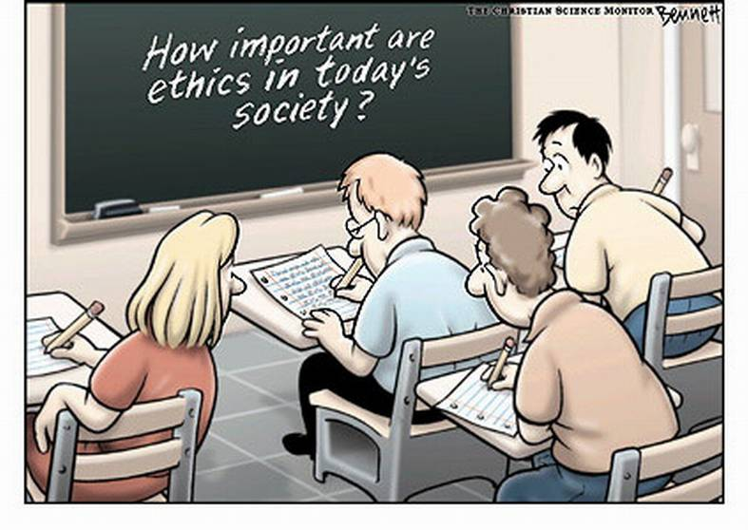

Slide 3
ETHICS of the RESEARCH
Ethical issues & Values in:
Choice of the Topic itself
Relationship between the scientist & people who provide the sources of data - i.e. responsible data collection
Survey methods & testing techniques used
Use & application of the results
Availability & dissemination of the results
Transparency of the whole process.

Slide 4
Ethical Behaviour in P-GIS Activities
Ethics in the purpose & intentions of the P-mapping / P-GIS
Usefulness of the research for larger society?
Problem-driven identification of the topic?
Beneficence - maximising good outcomes for humanity & individuals involved, while minimising or avoiding unnecessary harm, risk or wrong.

Slide 5
Ethical Behaviour in P-GIS Activities
Ethics in the P-GIS procedures
Not socially damaging?
Justice and non-coercion and non-manipulation.
Ethics related to types of data included in P-mapping / P-GIS
Justice – ensuring reasonable, fair & non-exploitative procedures; fair distribution of costs & benefits among people (e.g. those who bear any risks of the research should equitably benefit from it).

Slide 6
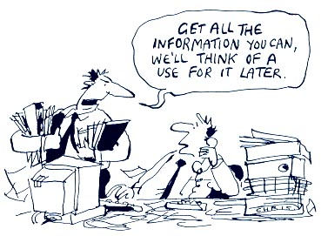

Slide 7
Ethical Behaviour in P-GIS Activities
Ethics and the use made of the P-GIS outputs
Purposive (Instrumental) – intervening to change?
Support for moral values & (democratic) institutions – commitments to equality, and liberty; acting against oppression and injustice. Taking into account relative social and cultural values.
Ownership of the original data and GIS / mapping outputs.
Intellectual property rights - cf. Code of Ethics for acquisition of indigenous knowledge; WIPO. Returning results (data and analysis) to the providers.

Slide 8
PMapping & PGIS: Prep & planning
Who participates?
Who decides on who should participate?
Who participates in whose mapping?
… and who is left out?
Who identifies the problem?
Whose problems?
Whose questions?
Whose perspective?
… and whose problems, questions and perspectives are left out?

Slide 9
Purpose & Good Practice
PURPOSE – whose? And which?
Research & surveys are not neutral – there is always a degree of interference & interventions
Exploiting people’s knowledge – should you make payments for knowledge inputs?
Don’t rush to start – make sure people understand, appreciate, and – agree
Be open & honest. No false promises.

Slide 10
The mapping process
Whose voice counts? Who controls the process?
Who decides on what is important?
Who decides, who should decide, what to visualise and make public?
Who has visual and tactile access?
Who controls the input of information?
And who is marginalised?

Slide 11
Who decides the map legend?

Slide 12
Tranquility mapping = NIMBY-mapping?
Are P-maps always biased?
Can “the public” be objective?
Do we know enough of the personal motivation for Participation?

Slide 13
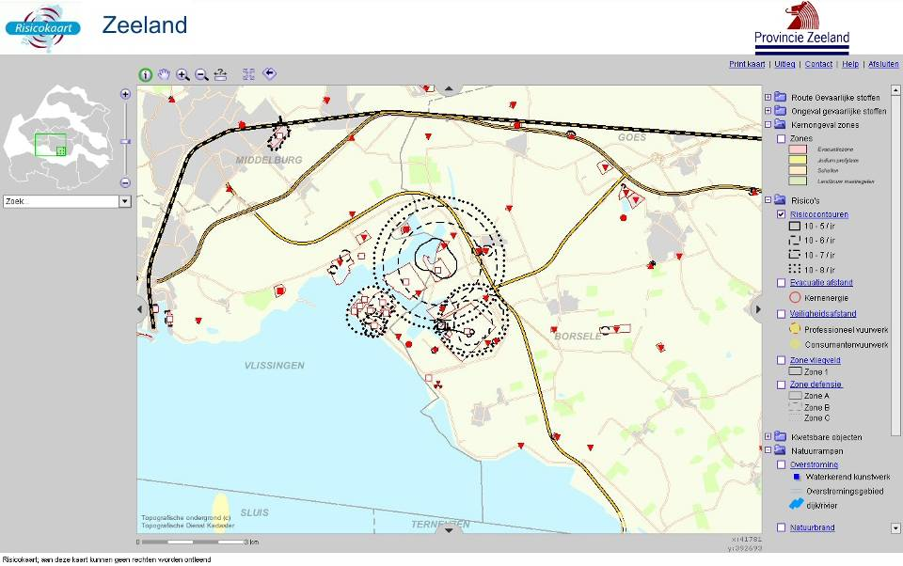
Risk map (www.risicokaart.nl)
Hazard contours

Slide 14
“Maps are never value-free images.. both in the selectivity of their content and in their signs and styles of representation, maps are a way of conceiving, articulating and structuring the human world which is biased towards, promoted by, and exerts influence upon particular sets of social relations.” (Harley 1988)

Slide 15
Opportunity knocks
Community mapping provides inclusive graphic framework for people to affirm and pool their experiences & knowledge about home place.
Community Mapping relies on active engagement of participants.
see Google Earth Communities

Slide 16
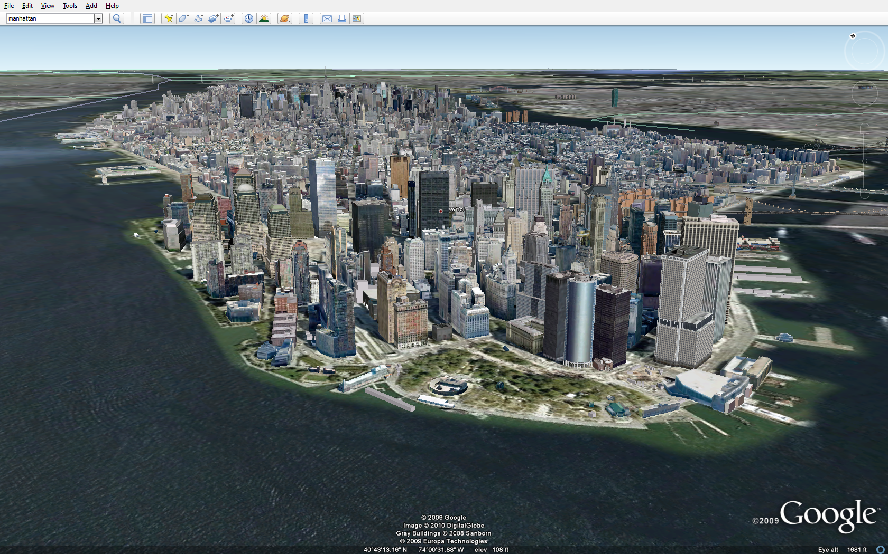
Google Earth

Slide 17
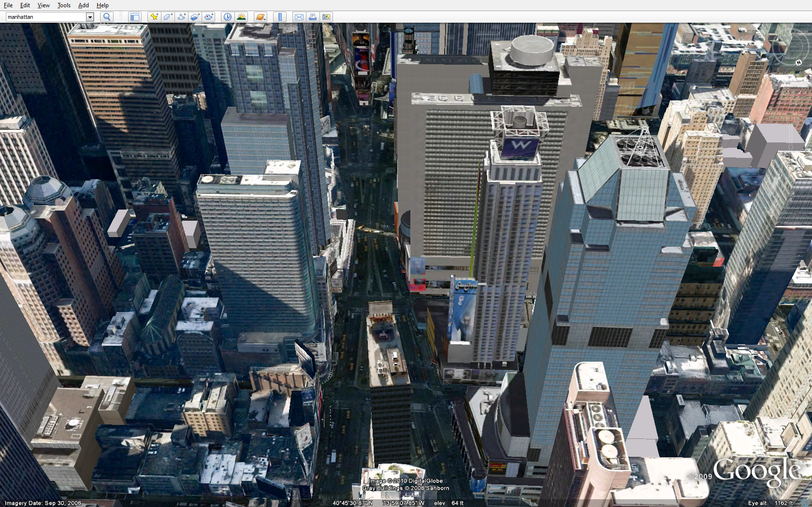
High quality of information

Slide 18
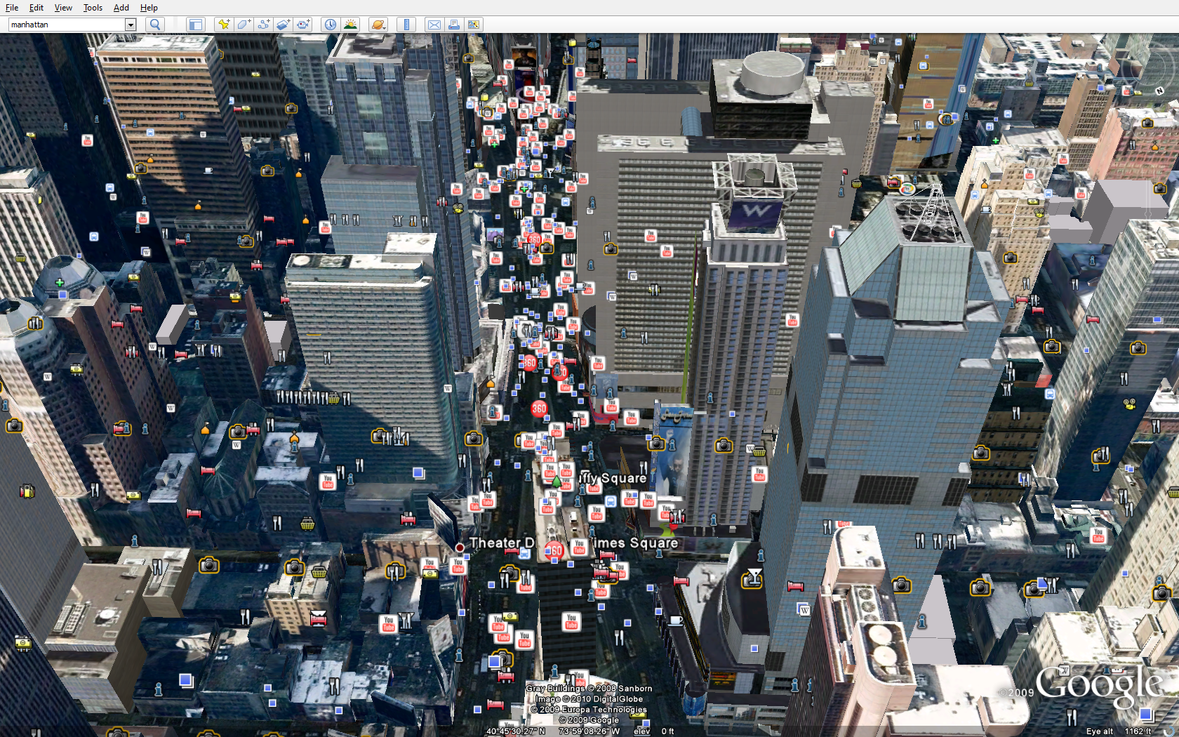
High quantity of information

Slide 19
The question of quality?
Map making mandate (legitimacy)
Map making purpose
Map transparency (meta data)

Slide 20
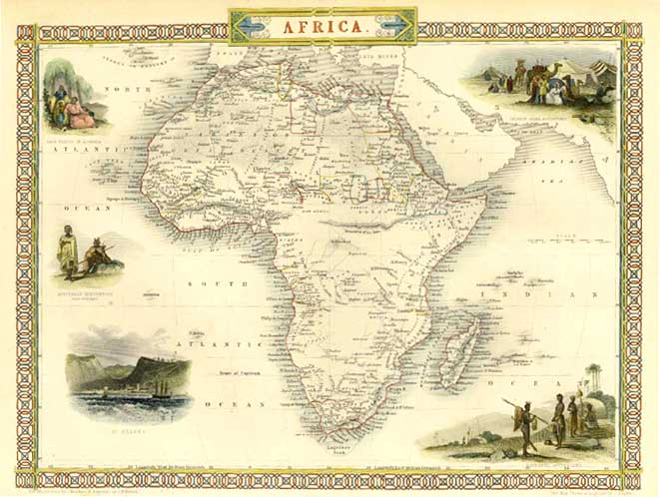
Legitimacy of what is put on the map
“By ignoring indigenous names, and barely alluding to the presence of local settlements, maps produced by European explorers in effect declared the land to be empty and available” (Poole, 1998).
Source: G.Rambaldi, 2005

Slide 21
‘ .cartographers are far from automatons “objectively” omitting “less important features” … Instead by clarifying geographical patterns, create knowledge, knowledge that by definition is instrumental.
In such a context legibility is less a matter for the eye than for the mind, make what legible? “ (Wood 1992)

Slide 22


Purpose of mapping …
“Maps are inseparable from the political and cultural contexts in which they are used” key theme of ‘Indigenous Mapping: Mapping for Indigenous Advocacy and Empowerment’ Conference, Vancouver, 2004.
Source: G.Rambaldi, 2005

Slide 23
“society that use the map to subdue the land to their purposes deny both their own and the map’s role in this process (“nobody subdued anything and the map just recorded things the way they were”) in order to reap the rhetorical (and political) advantages of passing the status quo off as natural, that is to say, as inevitable (so why resist?).”
(Wood, 1992)

Slide 24
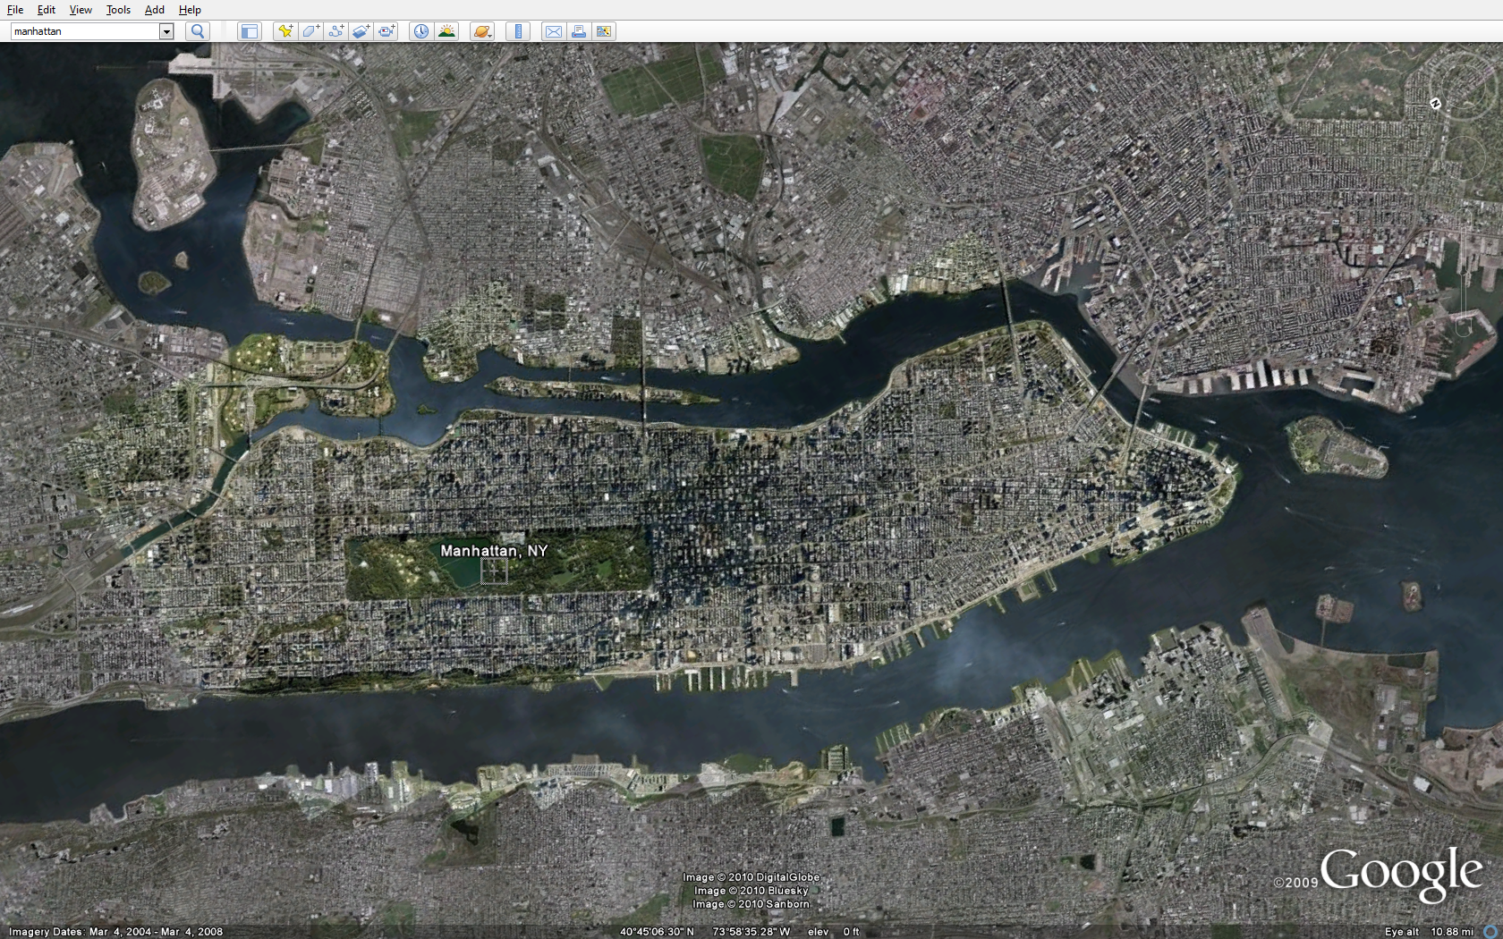
High quality platform offers opportunity for …

Slide 25
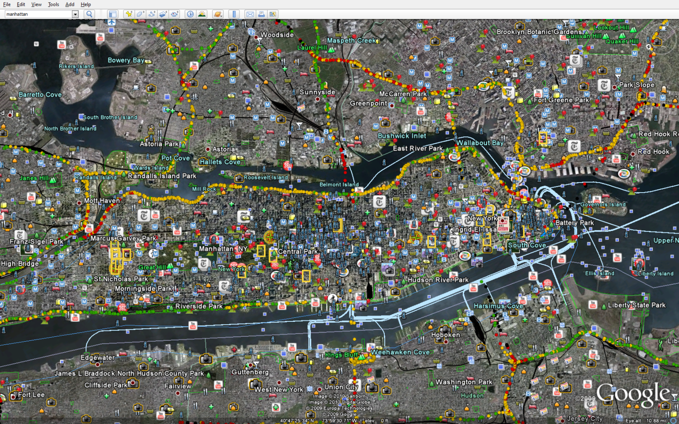
Information overload – no transparency

Slide 26
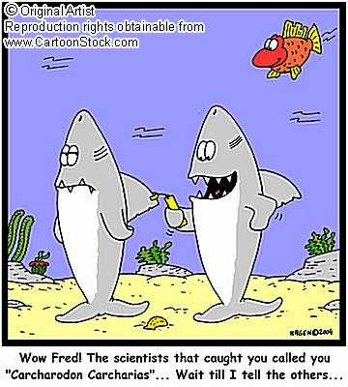
How useful is the Information?
For whom?

Slide 27
“The intentional meaning …is ..to locate areas and assign coordinates to them. The implication lies in .. resource inventory, identification, allocation, and purchase of private property; property protection and access through thousands of miles of barbed-wire fencing and pavement; manifest destiny; and the geometry of American society.
The act of designing and producing a map is an action of subjugation and appropriation of nature. (a basic value of American society,) not merely the reification of an idle curiosity in recording dimensions.” (Rundstrom 1990)

Slide 28
the mapping process – whose reality?
Whose reality? And who understands?
Whose reality is expressed?
Whose knowledge, categories, perceptions?
Whose truth and logic?
Whose sense of space and boundary conception (if any)?
Whose (visual) spatial language?
Whose map legend?
Who is informed what is on the map? (Transparency)
Who understands the physical output? And who does not?
And whose reality is left out?

Slide 29
Respect in P-GIS Activities
Ethics of interaction between outsiders and community members
Not socially damaging?
Respect – protecting the autonomy of persons, with courtesy & respect for individuals, including those who are not ‘autonomous’ – (small children, elderly, handicapped, maybe females)
Non-coercion and non-manipulation – not using force, threats, tricks, bribery, etc. to manipulate participants & related actors.

Slide 30
Cultural Relativity
What to do about locally-accepted ‘traditional’ activities which you find ‘undesirable’ ?
Researcher may not agree with :
Smoking
Smacking children
Deference to elders
Genital mutilation OR female circumcision OR cultural practice

Slide 31
Feedback
Ownership of the raw data & processed results – who ‘owns’?
Intellectual property – whose?
Delivery responsibilities - to whom?
Give Feedback in formats which are appropriate for the people
What are the ‘impact measures’ ?

Slide 32
Information control, disclosure and disposal
Who owns the output?
Who owns the map(s)?
Who owns the resulting data?
What is left with those who generated the information and shared their knowledge?
Who keeps the physical output and organises its regular updating?

Slide 33
Information control, disclosure and disposal
Whose analysis and use?
Who analyses the spatial information collated?
Who has access to the information and why?
Who will use it and for what?
And who cannot access and use them?

Slide 34
Ultimately …
What has changed?
Who benefits from the changes?
At whose costs?
Who gains and who loses?
Who is empowered and who is disempowered?

Slide 35
Ethics in GI.
Giacomo Rambaldi, Robert Chambers, M.K. McCall, and Jeff Fox (2006) Practical Ethics for PGIS practitioners, facilitators, .. researchers Participatory Learning & Action 54, 106-113.
Miller, R. (1995) Beyond method: beyond ethics integrating social theory into GIS & GIS into social theory. Cartography & GIS 22(1) 98-103.
Rundstrom, Robert A. (1993) The role of ethics, mapping, and the meaning of place in relations between Indians and Whites in the United States. Cartographica 30 (1) 21-28.
Rundstrom, Robert A. (1995) GIS, indigenous peoples and epistemological diversity. Cartography & GIS 22 (1) 45-57.
Wood, Denis (1993) The Power of Maps. London: Routledge.
Brealey, Kenneth G. (1993) Networks of power: Cartography as ideology. Western Geography 3, 15-50.

