Slide 1
Should PGIS serve two masters?
AARSE 2008

Slide 2
PGIS is about communicating knowledge
Interaction between stakeholders
Interaction between levels

Slide 3
The “master” is defined by purpose
Demands
Community
Government
Interaction
Needs & expectations

Slide 4
About PGIS
Effective in eliciting LSK
Many methods (toolbox)
“participatory practice”
Needs of the community come first
Purpose and output defined by community
Outputs are useful for the community

Slide 5
Knowledge ≠ information
Example: Urban expansion,
traditional/customary land rights being converted to formal land rights
in Accra, Ghana (Kwasi Asare, 2008)

Slide 6
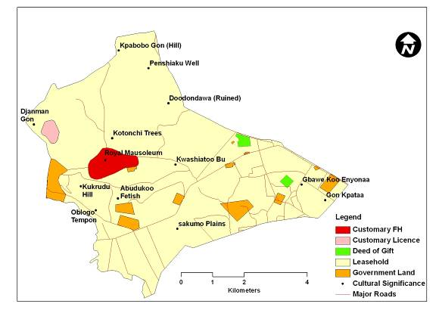
Customary knowledge of land rights

Slide 7
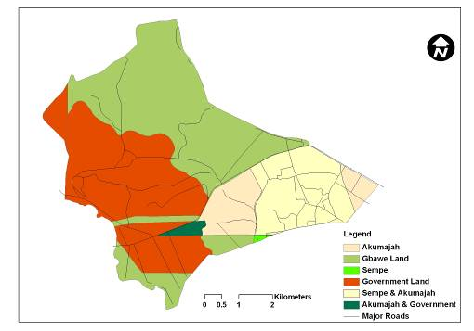
Government information of land rights

Slide 8
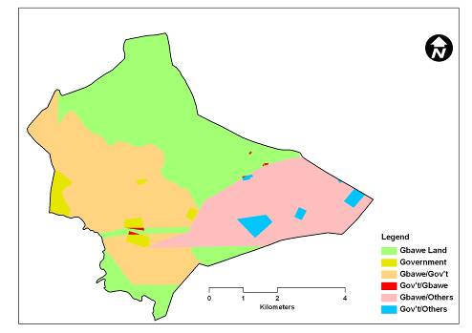
Conflicting knowledge and information

Slide 9
PGIS between two “masters”
Needs & expectations
Demands
Community
Interaction
Government
Local
Spatial
Knowledge
PGIS
Conformal
Geo-Information
Acceptation
Validation
Check
suitability for community
purposes
Check
suitability for government purposes

Slide 10
Putting “P” into practice
PGIS is not by definition conformal to mapping/GI standards
So what if the demand comes from the “formal” side?
Can PGIS function or deliver conformal/useful product
→ Can PGIS serve two masters?

Slide 11
Dilemma
Difficult to serve two masters without compromising on the participatory practice
Choosing between best output and best LSK?
→ Should PGIS serve two masters?

Slide 12
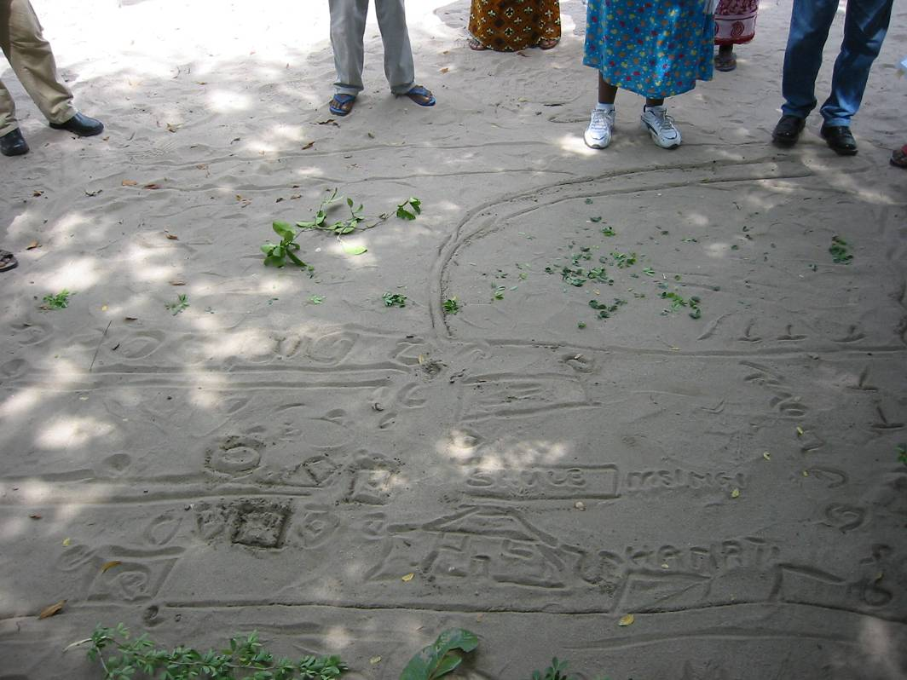
Little GIS much “P”

Slide 13
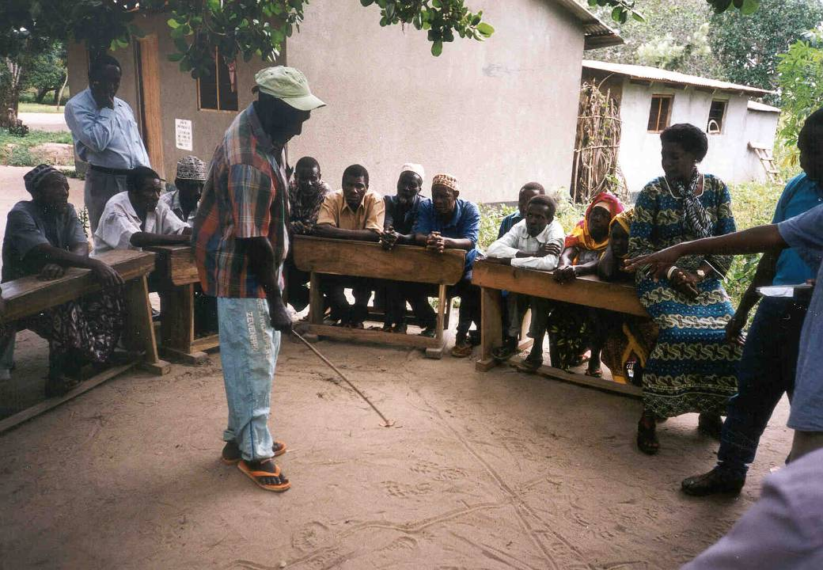
Little GIS much “P”

Slide 14
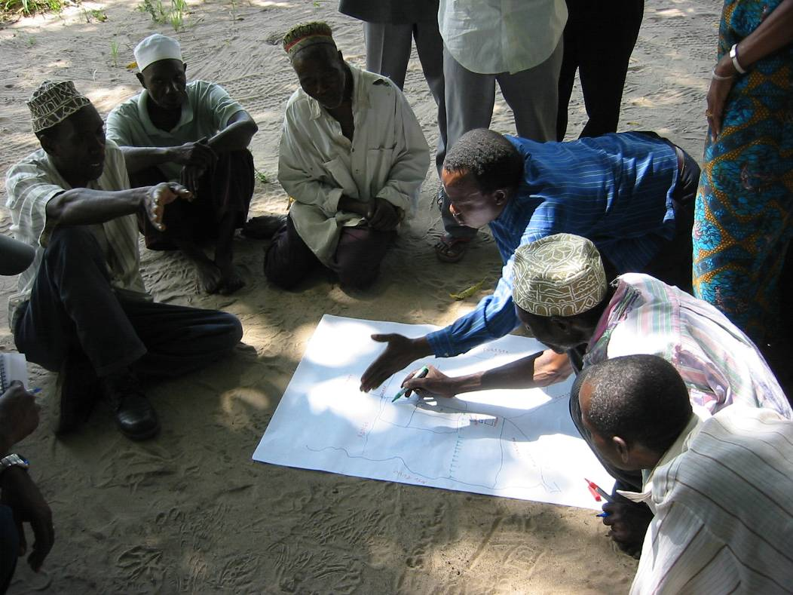
Even more “P”

Slide 15
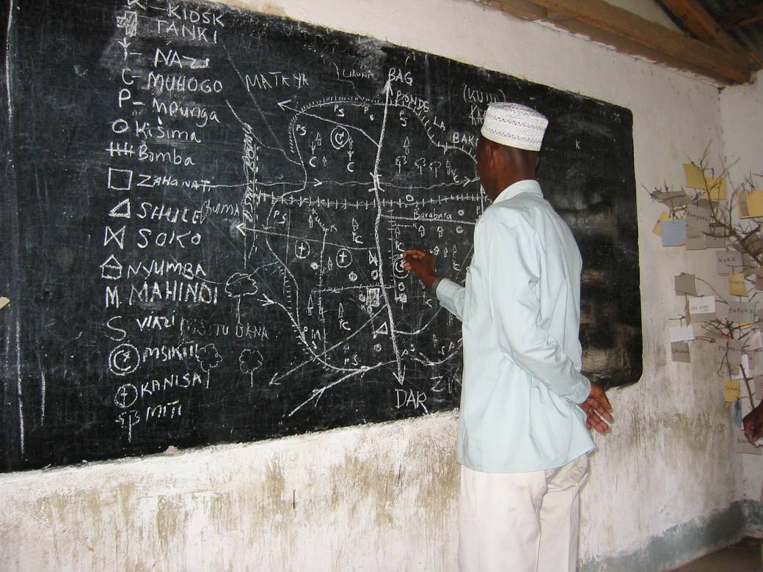
More GIS less “P”

Slide 16
Putting “P” into practice
Adding “P” to GIS (pGIS)
  Conformal
  Suitable output
  Less community oriented
Adding GIS to “P” (Pgis)
  Non-conformal
  Community oriented
  Likely to get unsuitable output

Slide 17
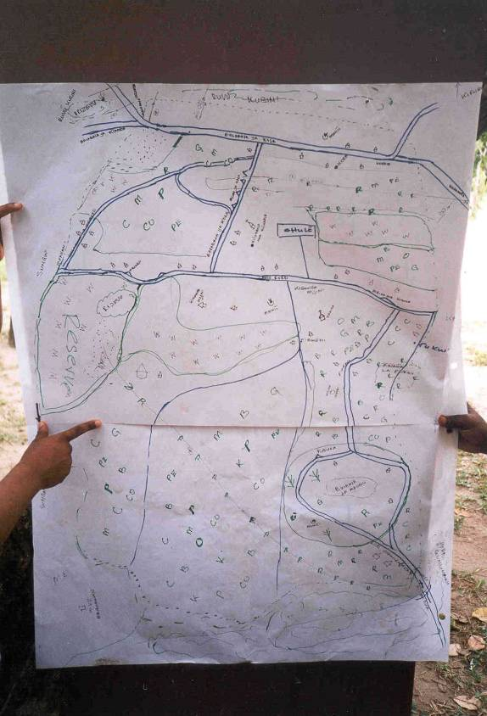
Sketch maps show:
Perceptions of
distance
and
importance

Slide 18
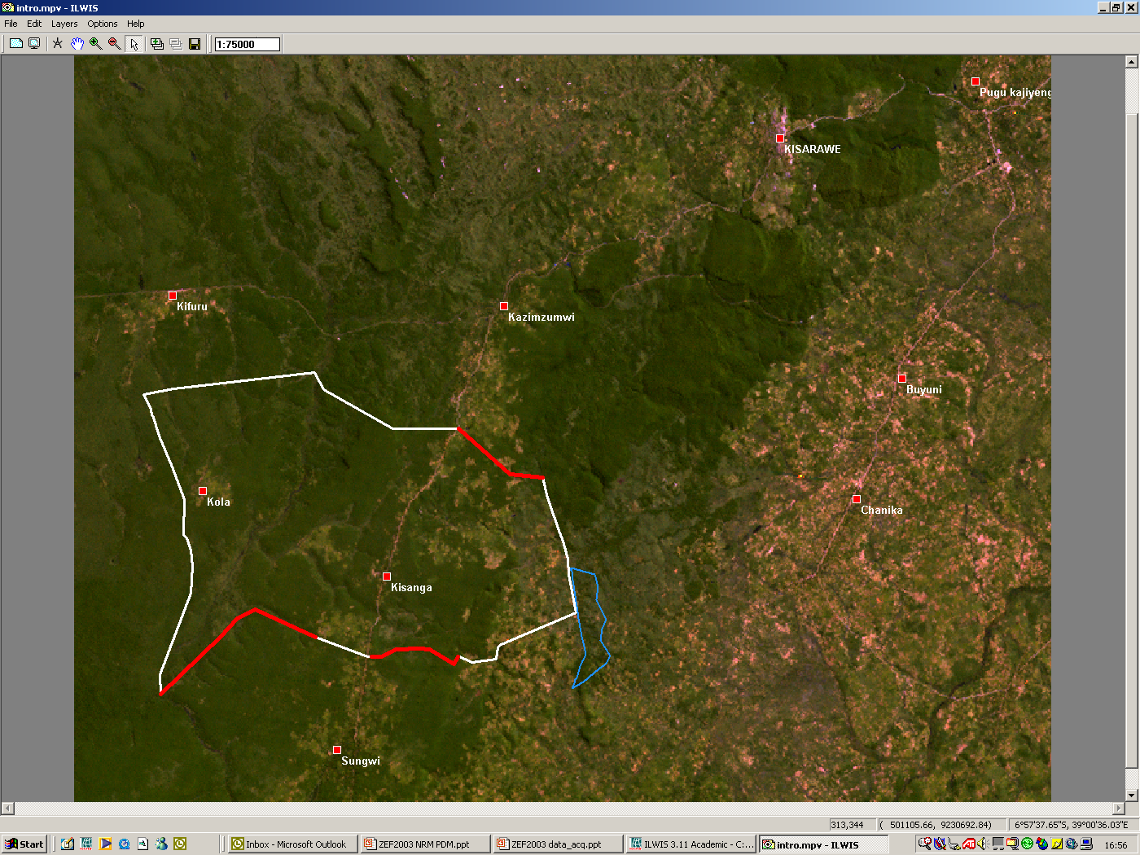
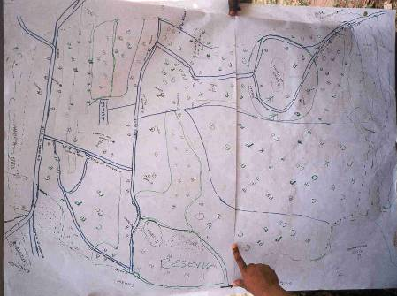
Reality vs. perception

Slide 19
Mapping Local Spatial Knowledge
Mapping onto existing layers of information
Topographical maps (different scales)
Aerial Photography (Hi-res)
Satellite imagery (Med-res, >10m)
Examples from Ghana, Kenya, Namibia and Zambia

Slide 23
Kenya

Slide 24
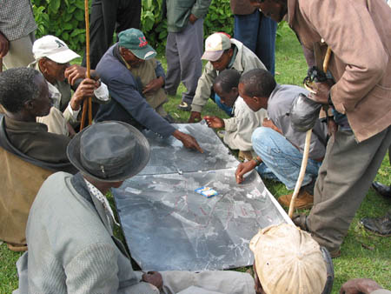
Kenya, Mau forest

Slide 25
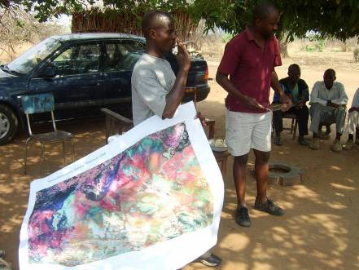
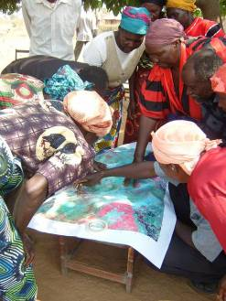
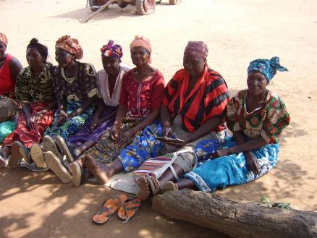
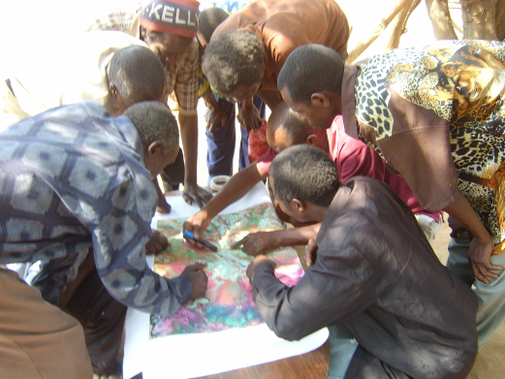
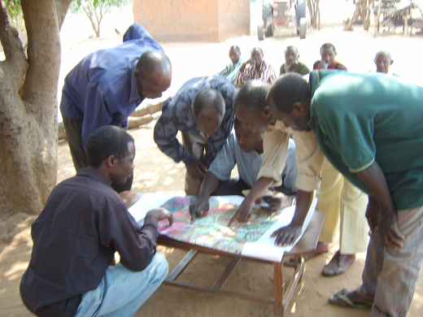
Zambia

Slide 26
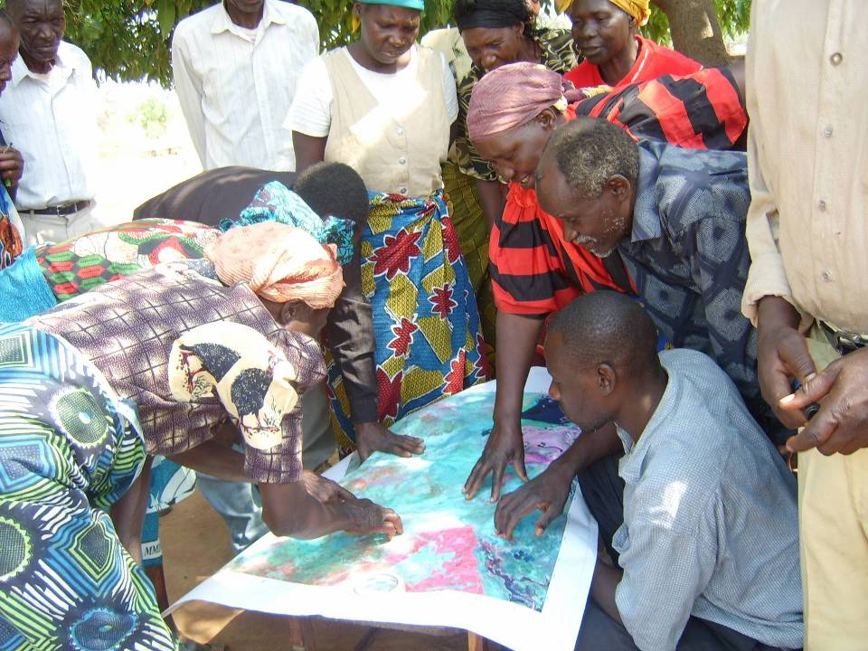

Slide 27
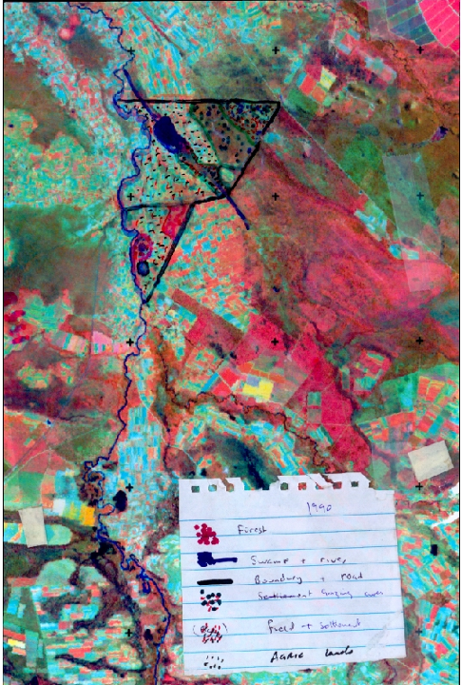

1990 2002

Slide 28
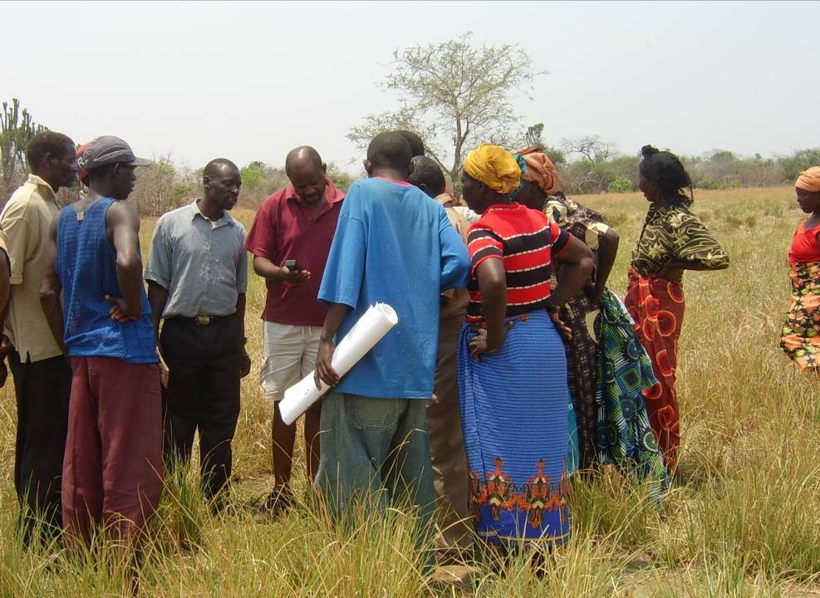

Slide 29
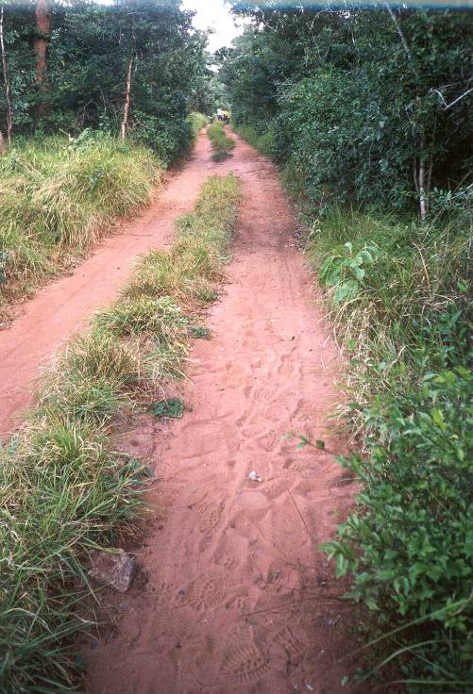
Verification
Need local knowledge
GPS coordinates

Slide 30
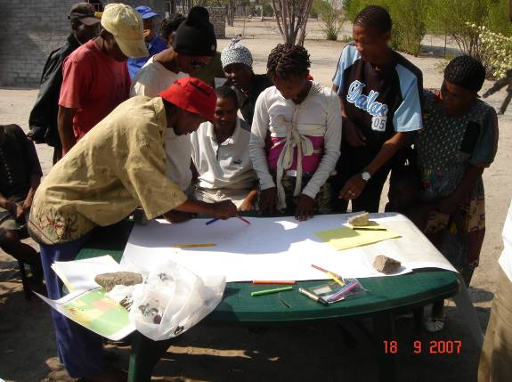
Namibia

Slide 31
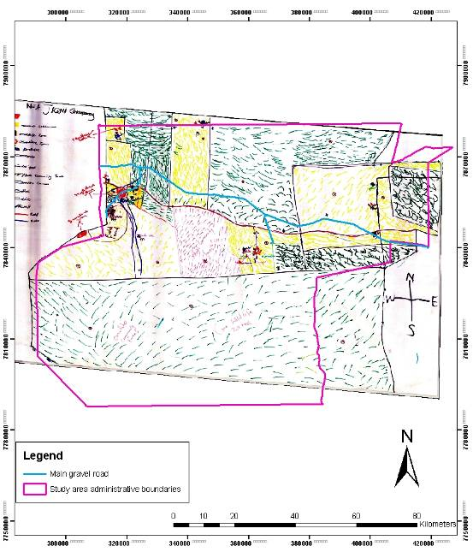
Namibia

Slide 32
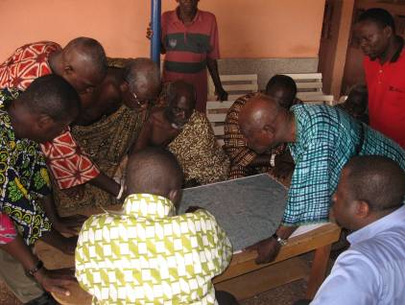
Ghana

Slide 33
Mapping LSK
Different levels of participation
Different time
Different Purpose (different “Master”)
Different socio-cultural conditions
But:
Same result: Hi-res images/photo’s elicit the most precise and accurate information

Slide 34
PGIS between acceptation and validation
Demands
Community
Interaction
Government
Needs & expectations
LSK
PGIS
Established Science & Technology
Acceptation
Validation
Suitability for community purposes
Suitability for government purposes

Slide 35
Should PGIS serve two “masters”?
Why pGIS or Pgis? → purpose!
PGIS is not a tool it’s a Practice
Maybe better named:
“Participatory use of spatial knowledge”
It depends on the “master” and the “purpose”

Slide 36
Not an acronym but more a verb
Whether p-GIS or P-gis

Slide 37
Not an acronym but more a verb
Whether p-GIS or P-gis…
I wish you
much “PGIS-ing”
in the future

