Slide 1
PGM Department ITC University of Twente
VGIRisk Workshop
ITC, University of Twente, Enschede
7 – 8 April 2011

Slide 2
PGM Department in ITC
The Faculty of Geo-Information Science and Earth Observation of the University of Twente has a heritage of 60 years of research, education and capacity development in acquiring, analysing and applying geospatial information in a development context.

Slide 3
PGM Department in ITC
PGM is the Department of Urban and Regional Planning and Geo-Information Management
Primary interests in governance and geo-information, environmental policy, urban and regional planning, transport and infrastructure and land administration
Research theme: PLUS People, Land, and Urban Systems

Slide 4
Staff in the VGIRisk Field
Yola Georgiadou
Javier Martinez
Michael McCall
Gianluca Miscione
Richard Sliuzas
Jeroen Verplanke
governance & geo-spatial information
urban indicators
participatory planning
Governance
urban planning, informal development
Participatory sensing and VGI

Slide 5
Capabilities and Expertise
GIS analysis and applications
Remote sensing applications
Participatory social research methodology, participatory GIS
Analysis of governance in geospatial information
Citizen Science
Urban social planning & management
Environmental & Disaster Risk analysis
Policy analysis

Slide 6
Experiences and Practice
Human Sensor Webs, domestic water supply
Participatory GIS, Disaster Risk Management
Participatory mapping urban local information – children’s environments, urban hazards
Urban Quality of Life indicators
Health information systems participatory design
success/failure of SDI / Digital Earth
E-commerce East Africa
E-grievance redressal systems

Slide 7
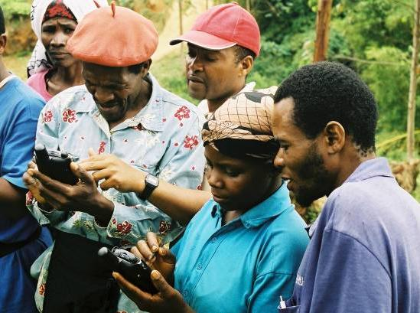
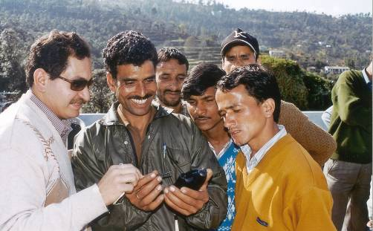
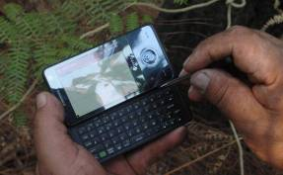
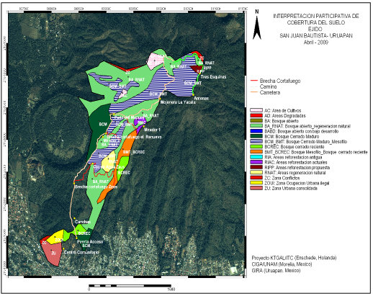
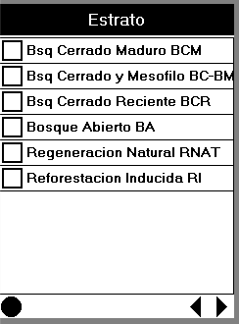
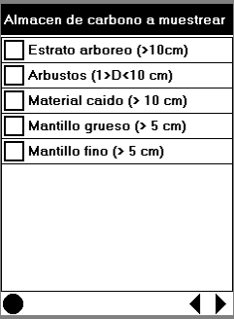
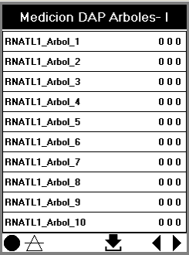
PGM’s growth into VGI and CO
23
18
13
37
12
12
12
15
12
12

Slide 8
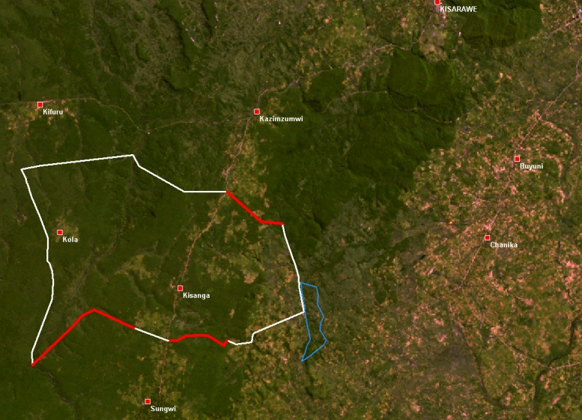
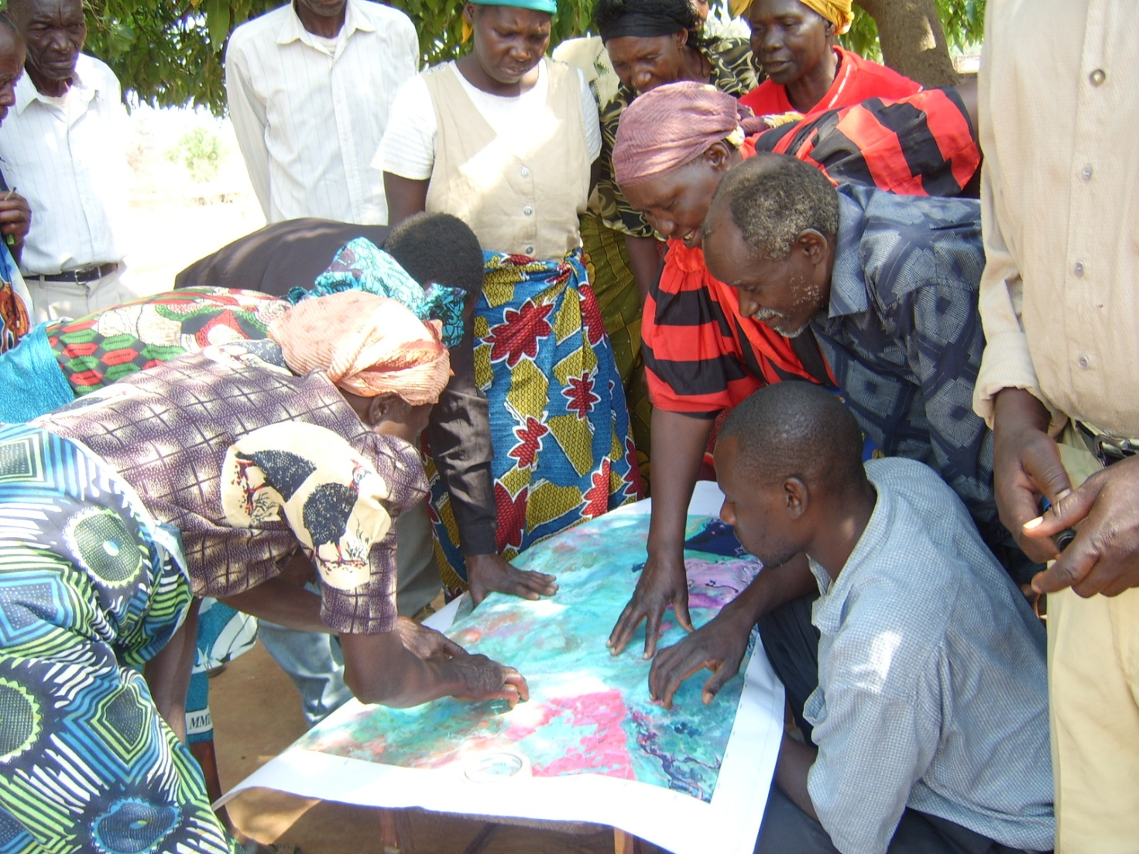
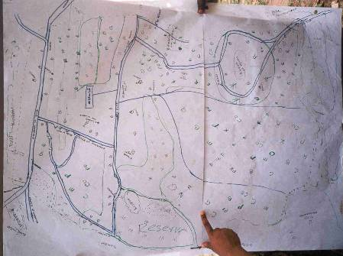
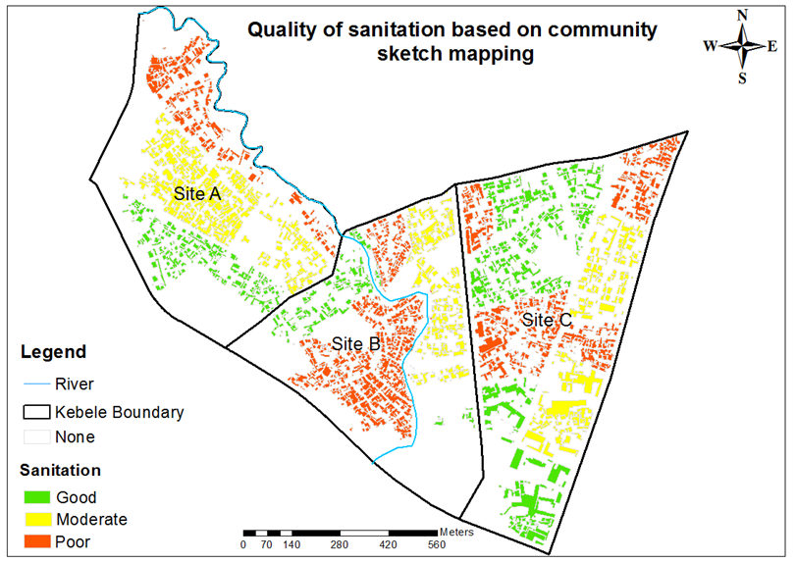
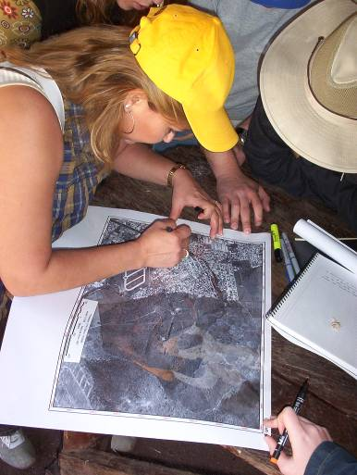
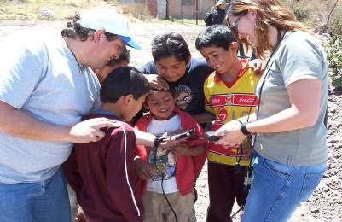
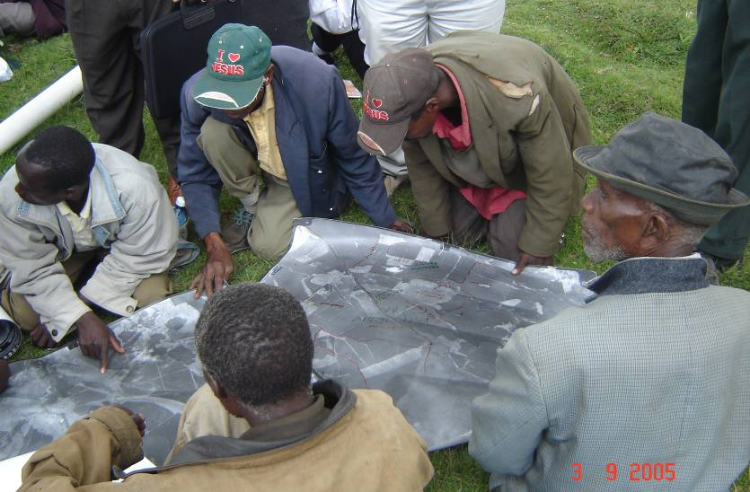
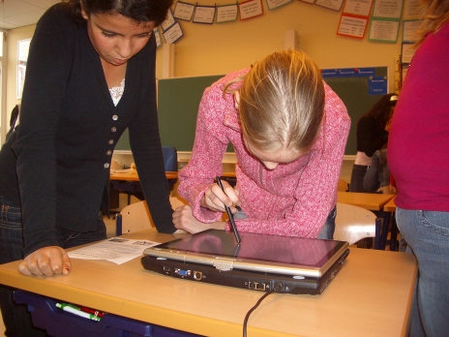
PGM’s growth into VGI and CO

Slide 9
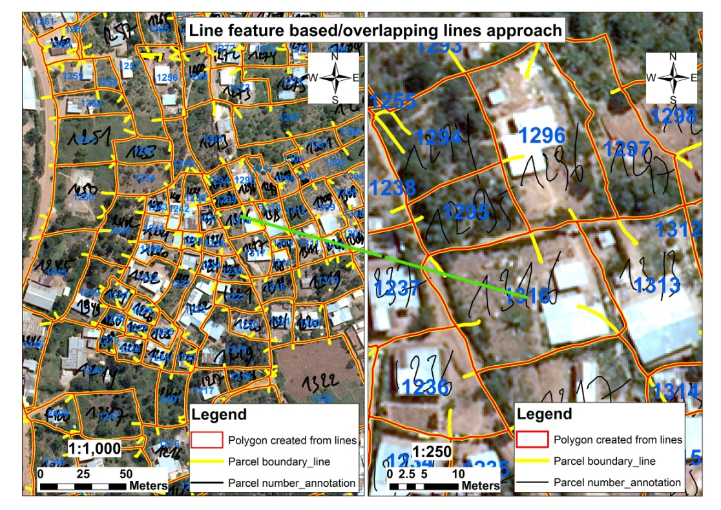
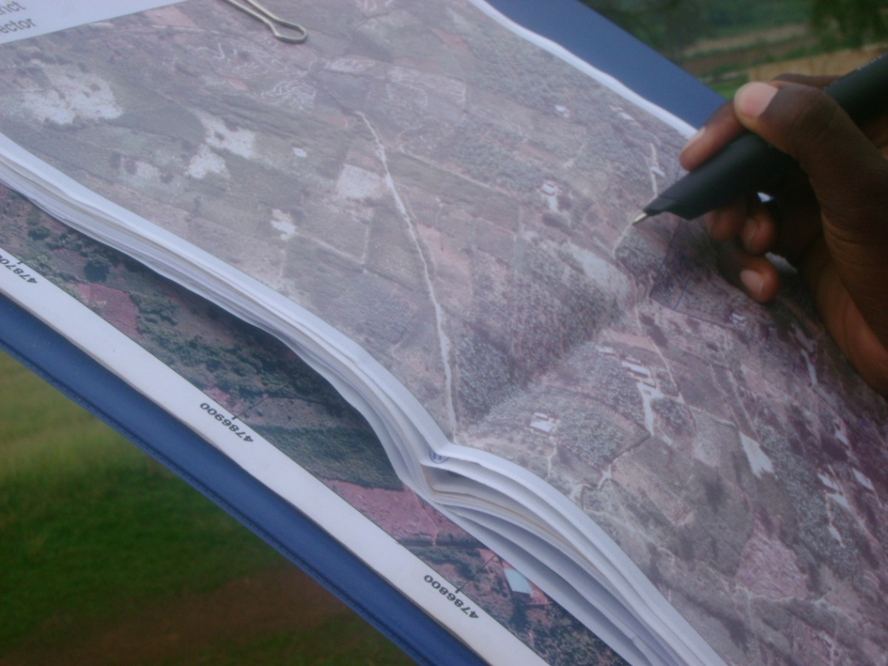
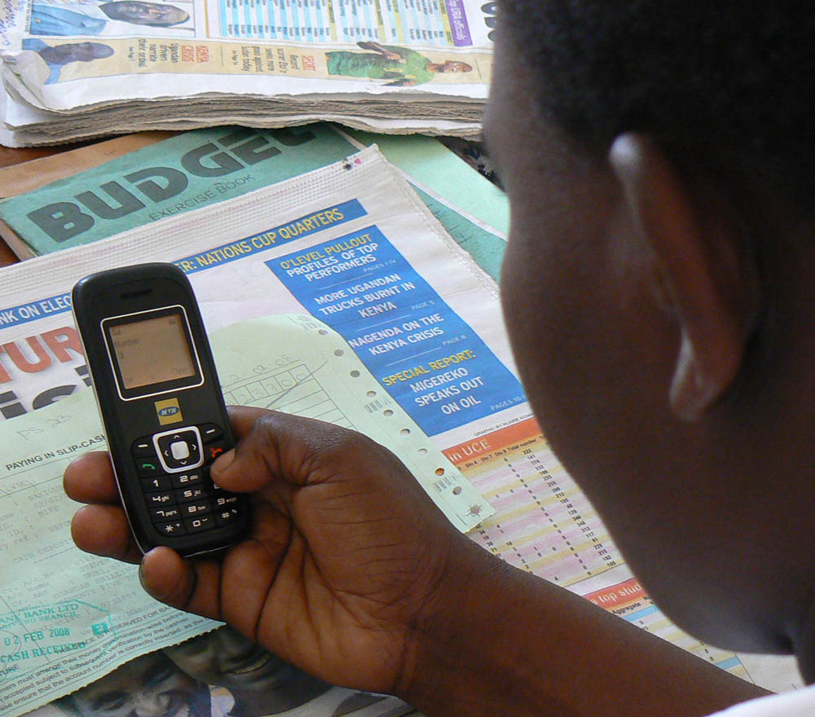
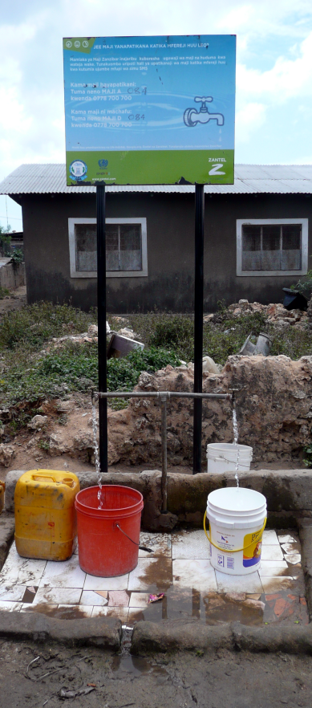
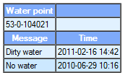
PGM’s growth into VGI and CO

Slide 10
Interests in the two Calls
Analyse characteristics of local spatial knowledge transfer and understanding in VGI /CO situations
Comparative qualities of geospatial knowledge transfer– via sensors, human sensors, participatory mapping, remote sensing
Design of VGI and CO systems for understanding, for validity, and effectiveness
Policy issues
Applications to urban environmental issues: urban risk and hazards, QoL

Slide 11
analytical problems
analyse “participation” eg. who provides the information? who are the ‘volunteers’? Who are ‘excluded’?
appropriate ‘degree of participation’ for tasks
Human sensors vis-a-vis PGIS vis-a-vis physical sensors (remote & ground)
determine criteria for appropriate standards in VGI / CO.
how measure reliability / validity of the information received? what criteria ?

Slide 12
Citizenship
who are the clients for the information from COs / VGI?
public govt., or private, or citizens groups? focussed or open access to the information?
problem-focussed or ‘open-destination’ delivery ?
how to measure trust in both directions? how to strengthen trust?,

Slide 13
Questions?

