Slide 1
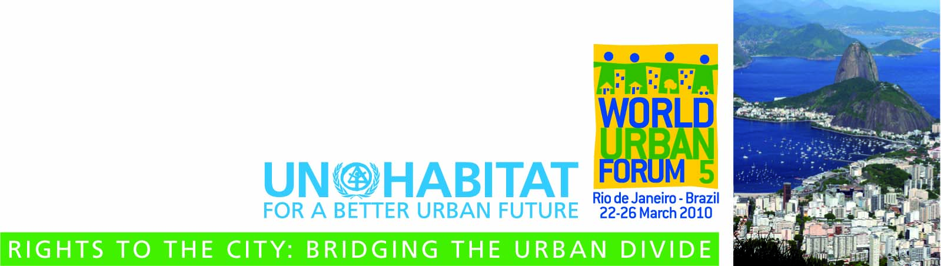



How to use Participatory GIS for targeting vulnerability and inequality at neighbourhood-city level
Notes:
GRACIELA ADD THE LOGO OF YOUR INSTITUTION

Slide 2
Outline of this event
Introduction & objectives
About vulnerability & inequality
Role of Participatory GIS
Discussion
Spatial data availability
Using free ware to map Inequality and Vulnerability
Spatial data collection:
  Transect walk in the City
  Virtual transect walk in Google Earth
Discussion
Notes:
INTRODUCTION (15 MINUTES)

Slide 3
Who we are
Graciela Peters-Guarin
(IRPUD - TU Dortmund, Germany)
Jeroen Verplanke
Javier Martínez
(ITC - University of Twente, the Netherlands)
...
Notes:
INTRODUCTION (15 MINUTES)
How do we introduce the participants.? Maybe intro per group

Slide 4
What do we want to achieve?
The overall aim of the training is
to promote a critical and reflective use of (participatory) spatial information and mapping technologies
to identify, analyze and target both social and environmental vulnerability using a bottom-up and multiple scale approach
Notes:
INTRODUCTION (15 MINUTES)

Slide 5
What do we want to achieve?
Skill 1: How to identify and discuss relevant aspects of socio-environmental vulnerability and inequality in a participatory way
Skill 2: How to acquire and scale up information that is relevant to analyse vulnerability and inequality from neighborhood to city level
Skill 3: How to prioritize and make decisions to bridge the identified gaps making use of geo-information
Notes:
INTRODUCTION (15 MINUTES)
In the first phase and during a participatory transect walk, participants will learn how to use (participatory) geo-information tools and techniques (e.g. cyber tracker + Google earth + ArcGIS), to identify, discuss and georeference issues at community level.
In the second phase, participants will learn how to scale up at city level the prioritized indicators indentified during phase one at community level.
In the last phase and in a plenary discussion, it will be examined how the information obtained can be implemented (e.g. in area based policies) to bridge the gap between different inequality and vulnerability aspects identified and mapped along the whole process.

Slide 6
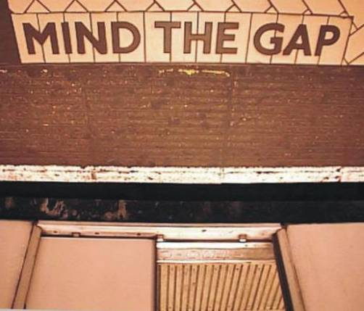
Inequalities
To achieve an “Inclusive Sustainable Urbanization”,
to “Bridge the Urban Divide” and,
to implement effective remedy policies,
we need to be able to recognize, identify and monitor urban inequalities
Notes:
MINI LECTURE (3 minutes)
JAVIER
- Mini lecture on the whole exercise and the justification of the workshop in the context of Inclusive Sustainable Urbanization
and Bridging the Urban Divide.

Slide 7
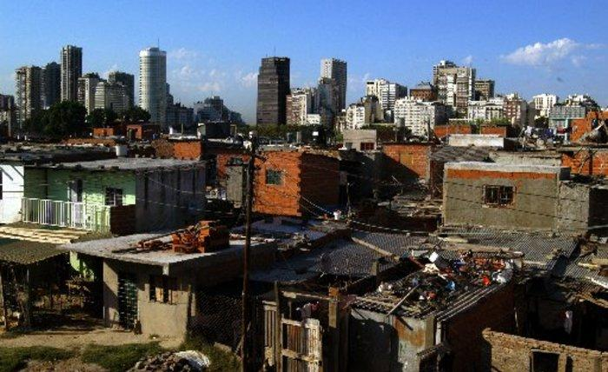
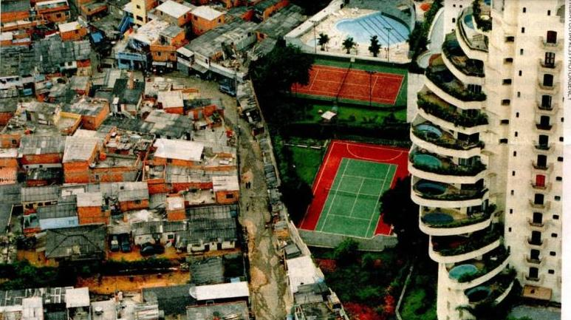
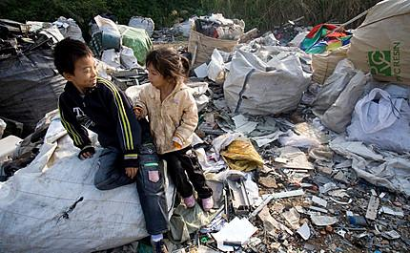
Inequality as a global problem
What are urban inequalities?
Notes:
MINI LECTURE (3 minutes)
JAVIER
- Mini lecture on the whole exercise and the justification of the workshop in the context of Inclusive Sustainable Urbanization
and Bridging the Urban Divide.

Slide 8
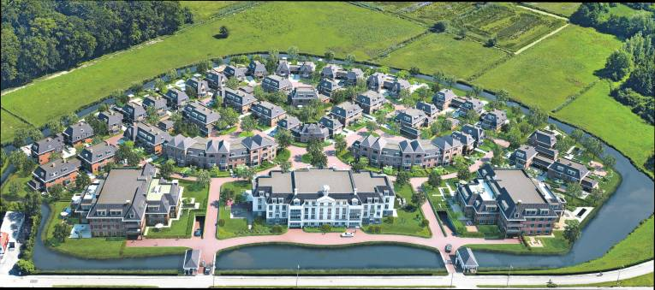
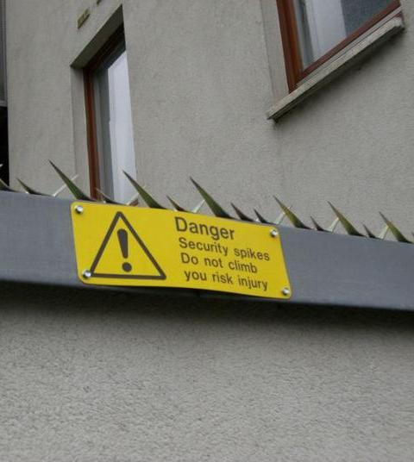
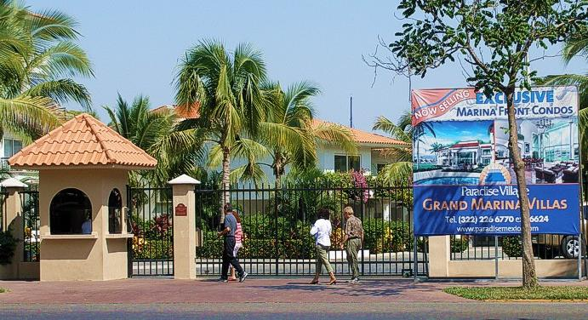
Inequality as a global problem

Slide 9
The spatial dimension of inequalities
Inequalities are particularly evident and more problematic in cities in developing countries, where there is a permanent state of growth, urban poverty and vulnerability
  Unequal Quality of Life Conditions,
  Inadequate habitat conditions, unemployment,
  Unequal access to physical and social infrastructure...
What all these problems have in common is a spatial dimension, since they all occur and tend to be concentrated in specific areas of the city
Notes:
MINI LECTURE (3 minutes)
JAVIER
- Mini lecture on the whole exercise and the justification of the workshop in the context of Inclusive Sustainable Urbanization
and Bridging the Urban Divide.

Slide 10
Cities at Risk
Urban areas provide a number of socio-economic opportunities for jobs and income generation
but are also simultaneously becoming increasingly risky places to live, especially for low-income residents of cities in developing countries.
Exposure to environmental risk and hazard is a result of physical processes (i.e. poor building construction, lack of urban planning, lack of infrastructure), and human processes (i.e. lifestyle choices and consumption) that renders the more informal parts of cities particularly vulnerable

Slide 11
What does Urban Vulnerability mean?
The characteristics and circumstances of a community, system or asset that make it susceptible to the damaging effects of a hazard (ISDR).
Urban vulnerability to natural (i.e earthquakes, floods, hurricanes) or man-made (global warming, chemical spills, contamination) events is a function of human behavior.
It describes the degree to which socioeconomic systems and physical assets in urban areas are either susceptible or resilient to the impact of environmental hazards.
Notes:
11
MINI LECTURE (3 minutes)
GRACIELA

Slide 12
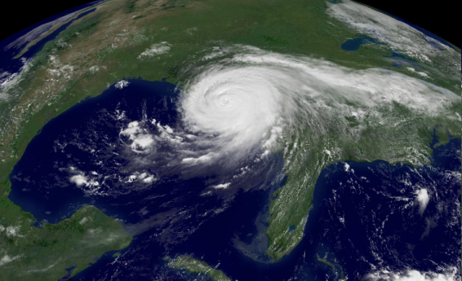
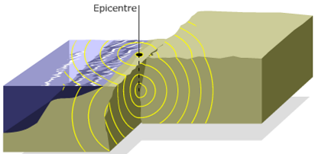
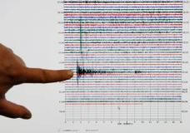
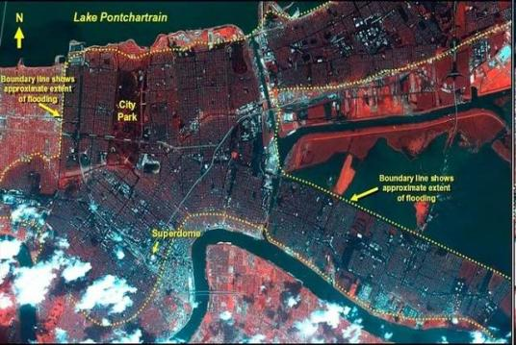
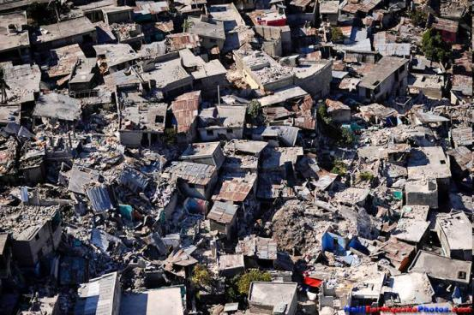
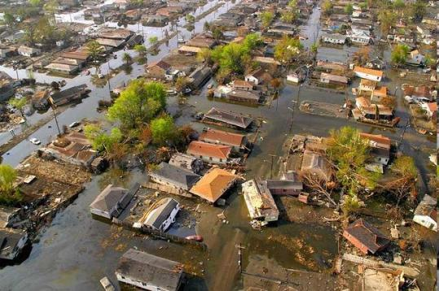
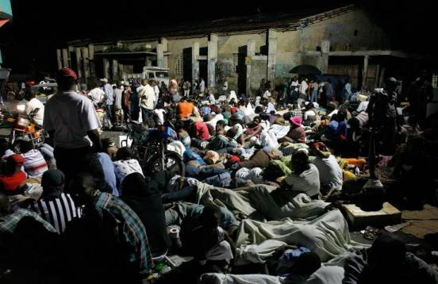
Hurricane Katrina - 2005
Hurricane Katrina - 2005
Natural
event
Environmental Hazard
+
Vulnerable
context
Choluteca – Honduras - 1998
New Orleans - 2005
Port-Au-Prince, Haiti 2010
economic loss and social disruption = Disaster

Slide 13
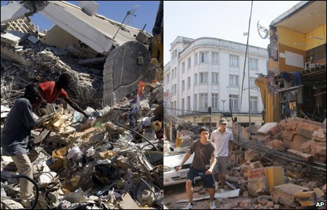
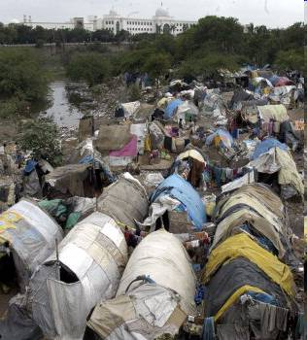
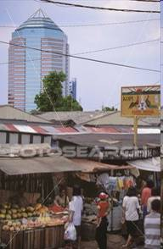
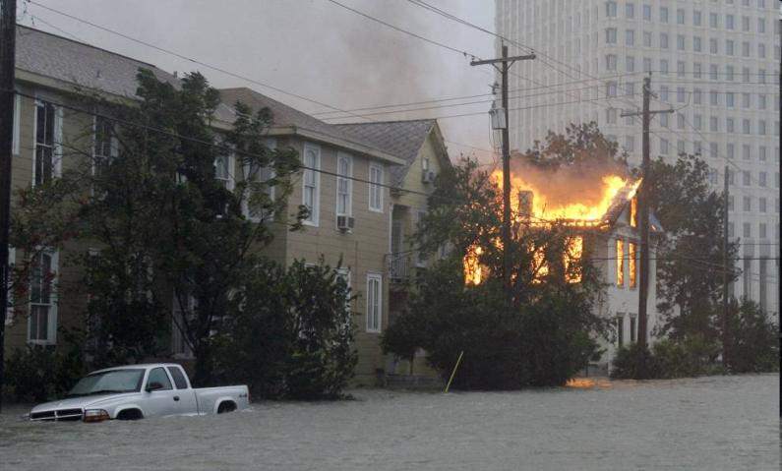
forms and severity of Vulnerability vary remarkably among different areas and groups of people

Slide 14
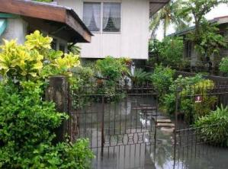
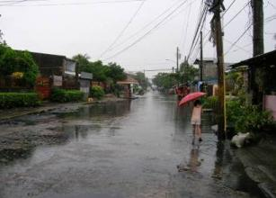
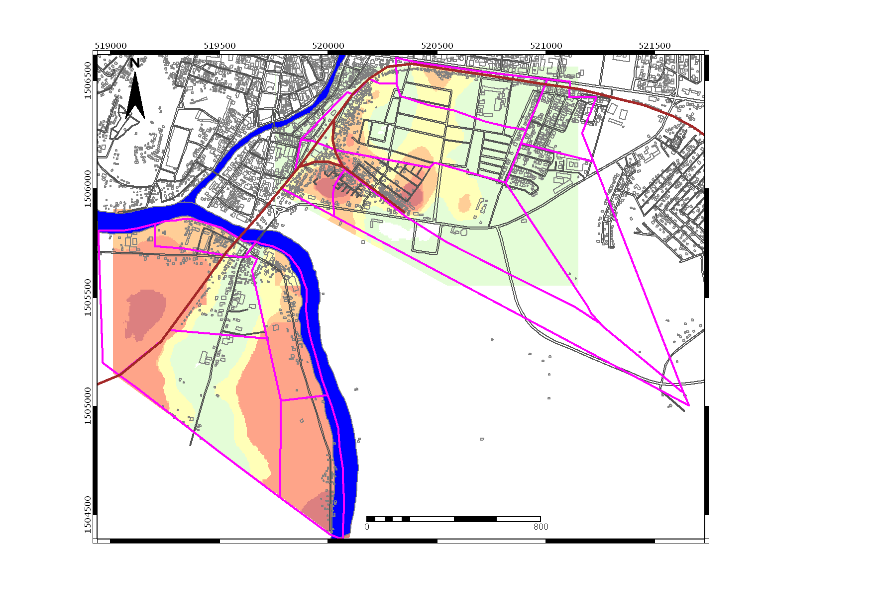
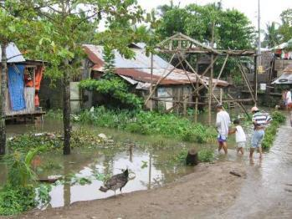
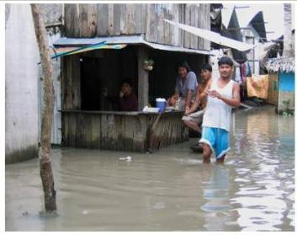
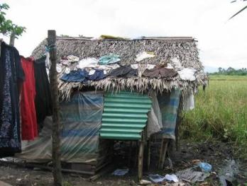
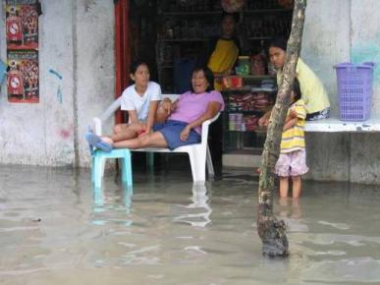
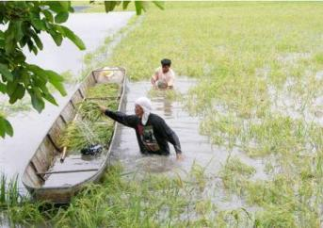
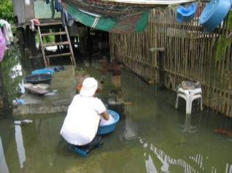
… and even within any local community…
Spatial distribution of differential flood vulnerability:
Naga River
Z7
Z4
Z1
Z5
Z3
Z2
Z6
Z2
Z4
Z1
Z3
Z6
Community-based hazard categories
No flood
Bicol River
Normal
Z5
Manageable
Highly disturbing
Unmanageable
Disastrous

Slide 15
Inequity and ‘vulnerability’ are spatial problems
can be assessed through a combination of ecological factors associated with the physical conditions of the geographic space where the urban community is located (i.e. where you are), and the social conditions of the population in that place (i.e. who you are).
In many cities the segregation patterns of ethnicity and socio-economic classes, accompanied by successive waves of economic restructuring and population expansion, are reflected by the built environment, urban infrastructure, road and facilities networks.

Slide 16
PGIS can help to target Inequity and ‘vulnerability’ at urban level
It helps to identify and target factors such as environmental stress, poverty, inequality, health status and various aspects of governance (Adger et al., 2004).
Allows the involvement of different perspectives regarding prevention, vulnerability and risk reduction.
multi-criteria modeling using indicators may help to identify the status of the system before the hazardous event occurs characterized by unequal access to safe conditions or the “vulnerability” that may lead the system to crisis.

Slide 17
Participatory GIS (PGIS)
PGIS (PPGIS) is NOT a software or a “kind of GIS”
A ‘practice’ combining Participatory tools and spatial information.
Tools mainly known from PRA, RRA, PLA
Spatial information coming from external and in particular local sources

Slide 18
PGIS & P-Mapping Applications:
Land & Resource Claims
Local Spatial Planning
Community/neighbourhood action
Community Risk Assessment

Slide 19
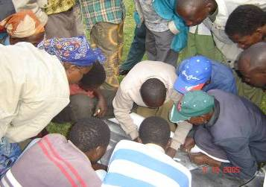
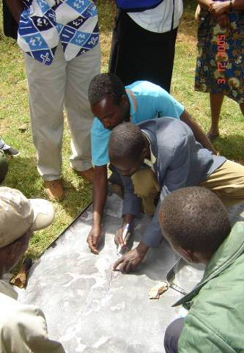
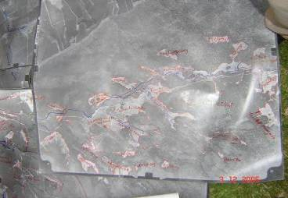
Mapping Land Claims using Aerial Photographs & LK

Slide 20
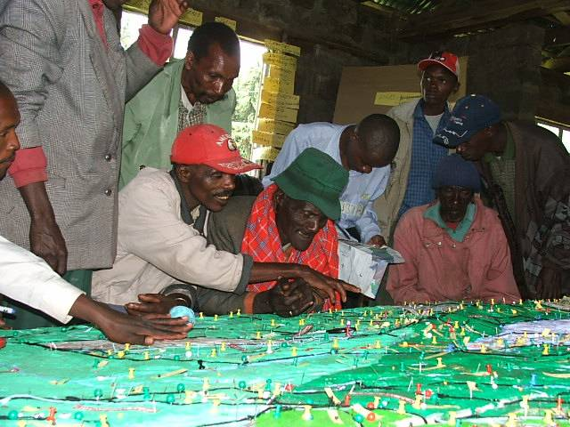
Kenya

Slide 21
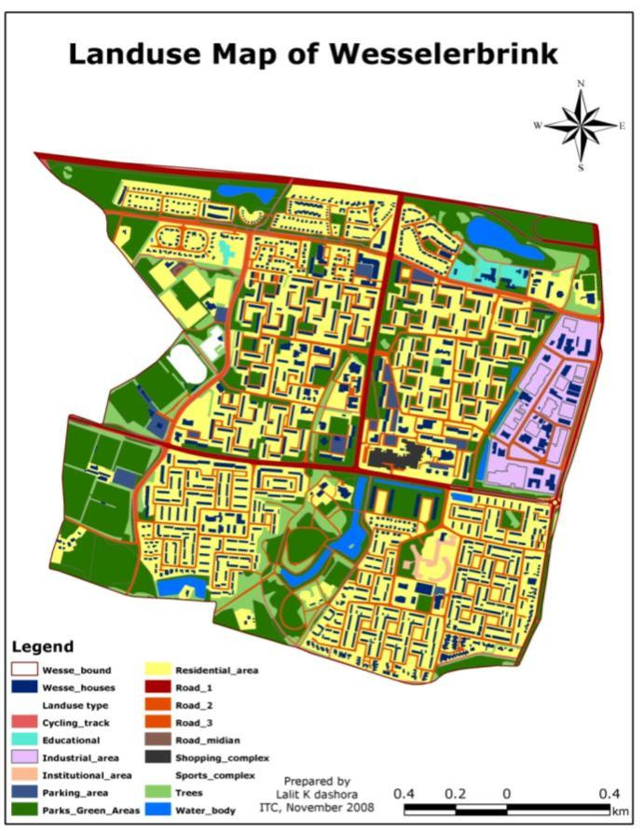
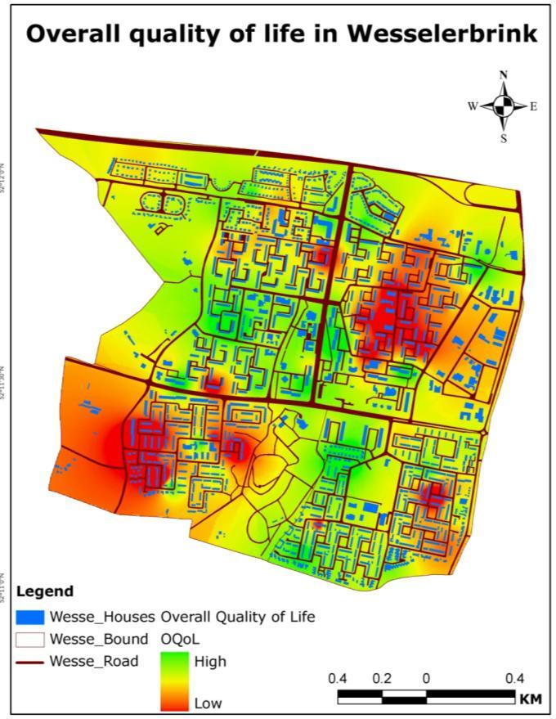
Priorities for local spatial planning
Overall Quality of life
Overall Quality of life
Land use map
High
Low
Average

Slide 22
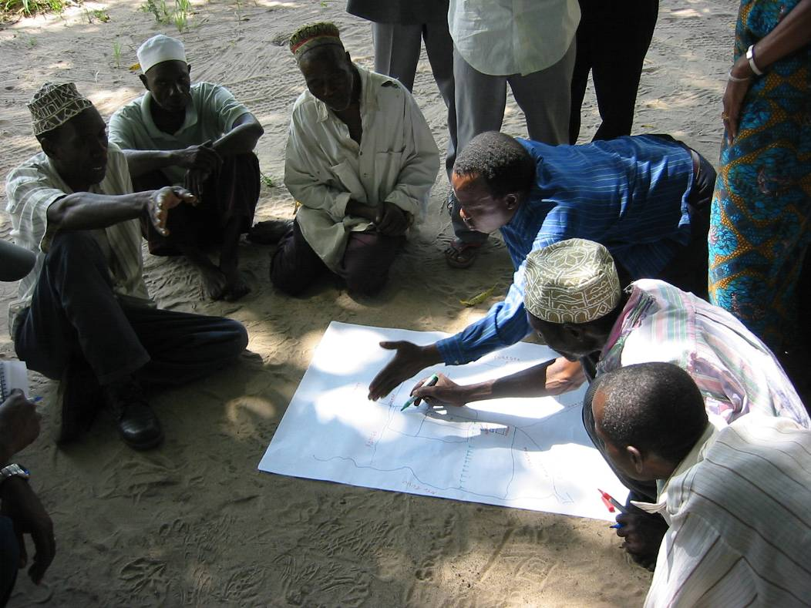
Community Action

Slide 23
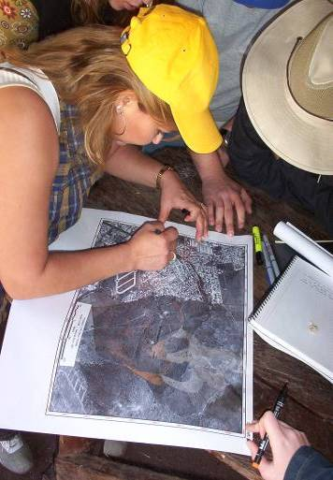
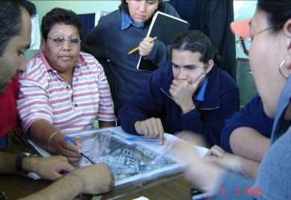
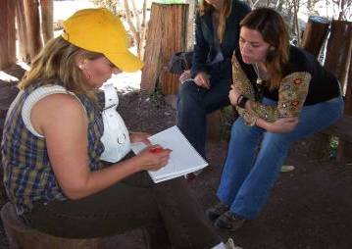
Mapping Urban Security with Aerial Photos

Slide 24
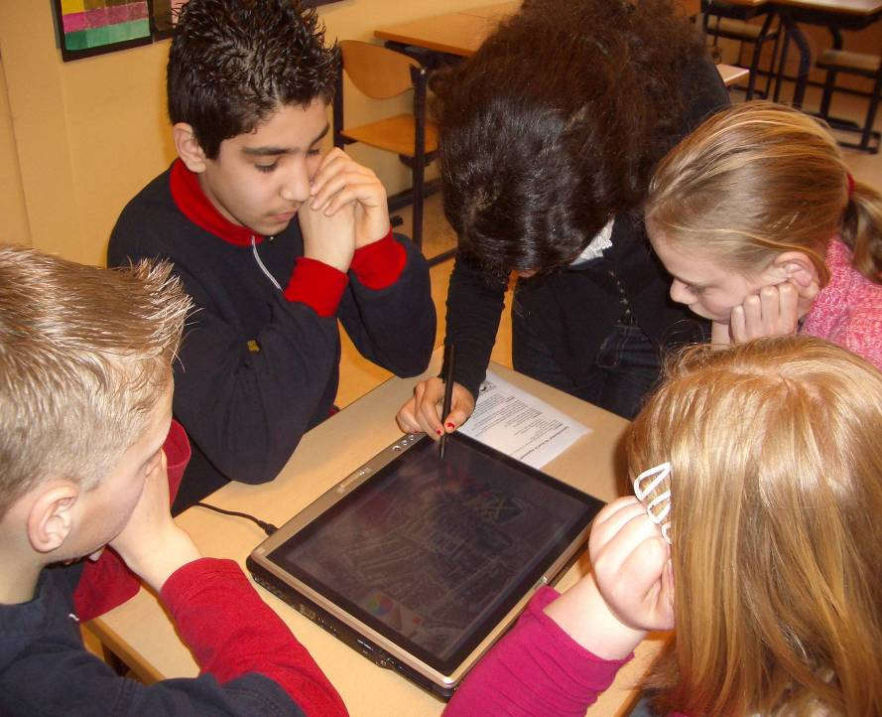
Involving Children

Slide 25
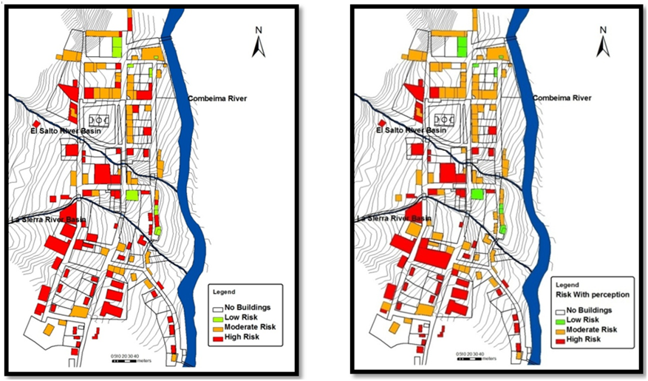
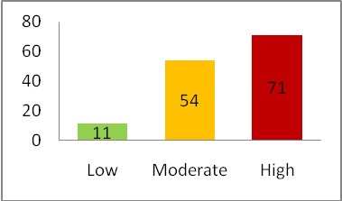
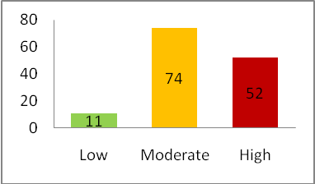
Community Risk Assessment
Without Perception of Debris Flow Risk
Including Perception of Debris Flow Risk
Source: E. Garcia, 2009

Slide 26
Using the Web (1.0)
Information access to the public
Assists transparency
Enables communities to formulate their own plans
Not very participatory although it offers the opportunity to add local and qualitative information.

Slide 27
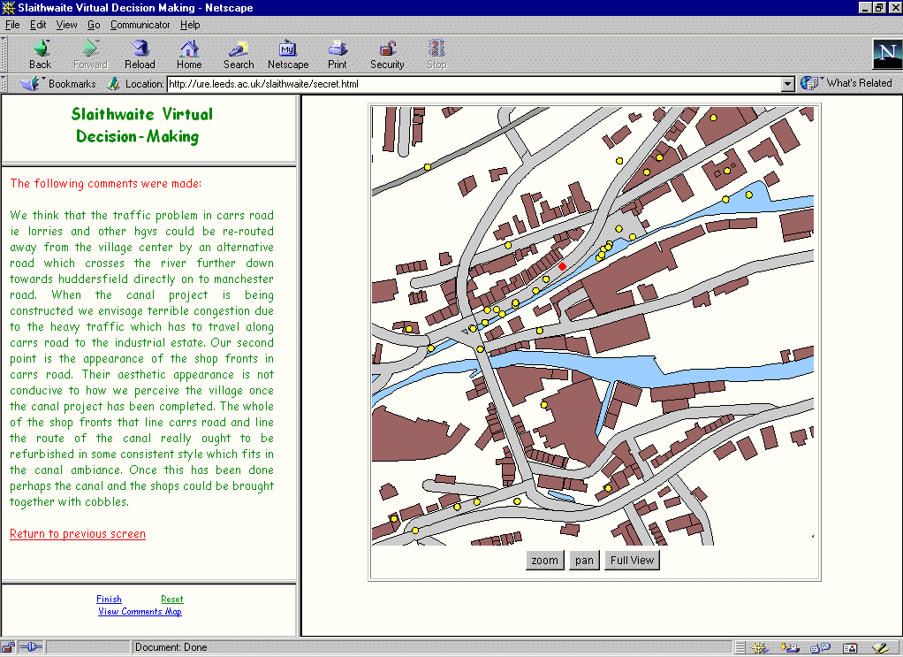

Slide 28
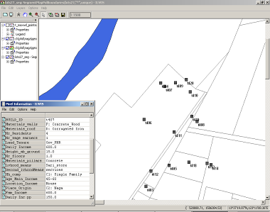
Mr B’s is a four member family composed by father (62) mother (54) and two daughters (19 and 20) in high school. Main family income is derived from a sari-sari (small grocery) store located in the same dwelling which in turn is one-storey, made of wood and with no pillars to avoid flooding. In this zone the land is property of the Philippine National Railroad (PNR) and even though they have been settled in this place for 24 years they do not have land tenure entitlements. Because of the possibility of eviction they cannot invest in safer materials for building (such as concrete) therefore their house’s structural vulnerability to floods remains high. They use to experience moderate flooding at least once a year because this use to be a natural swamp for water-retention during flooding. During typhoon Rossing (1995) this place experienced 5 to 6 feet flooding, the house was destroyed and besides they have to consume the few products they were able to save from the store. They lost their investment in the store which came from Mr B pension fee. Even if they got some relief from the Local government (some wood and nippa leaves for roofing) to be able to rebuild the house they had to go for a loan with their relatives and start diversifying their livelihood by selling fish in the market. They considered the effects of the typhoon as disastrous because their house and their means of livelihood were disrupted, they didn’t have too much to eat during several days and afterwards they had a debt. It took them nearly one year to recover from the effects derived from the flooding. They decided to settle here because they cannot afford to pay for safer land in other area and besides is close to Mr L work place and their children high school as they also cannot afford to pay for transportation.
More than maps..

Slide 29

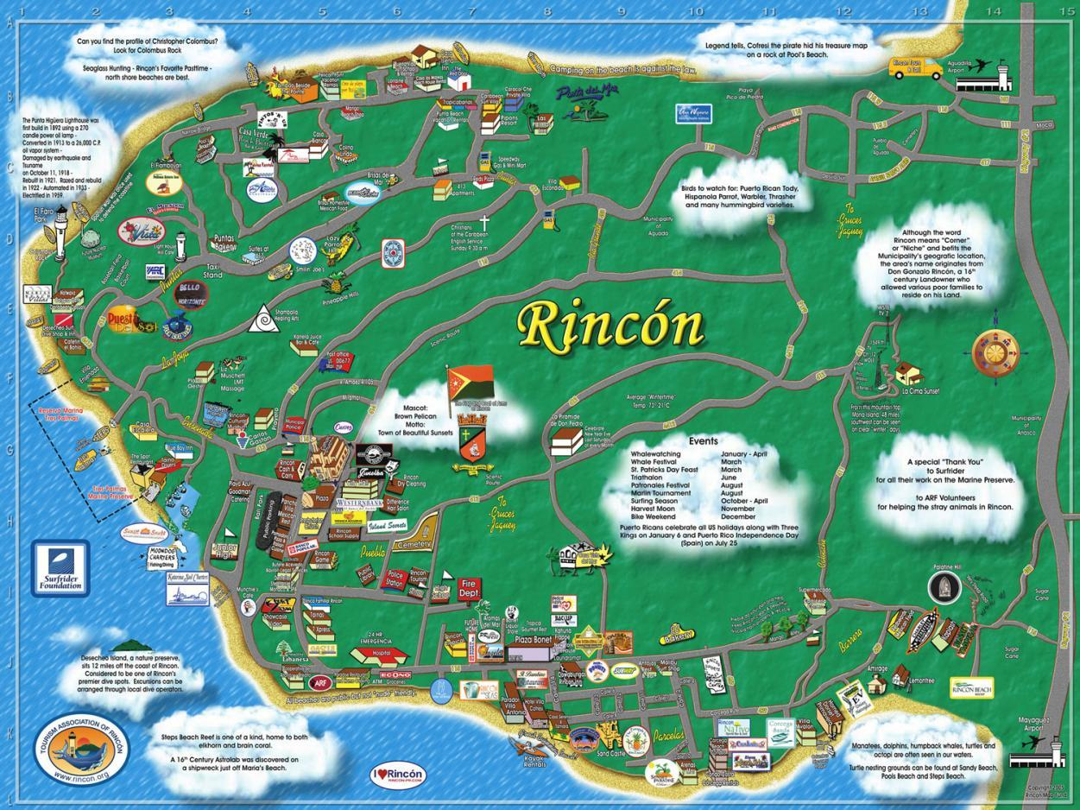
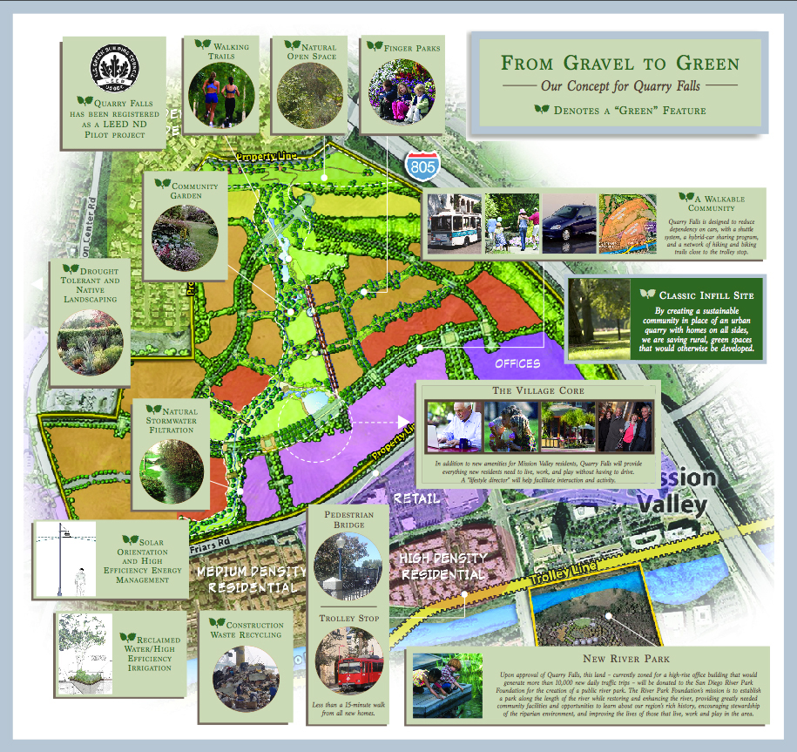
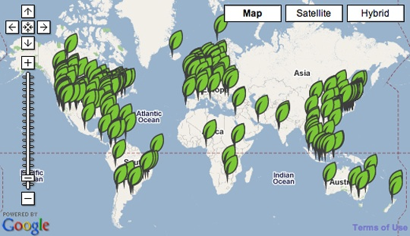
Greenmap.org

Slide 30
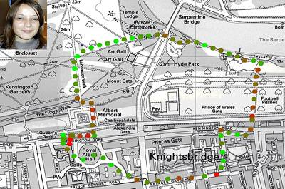
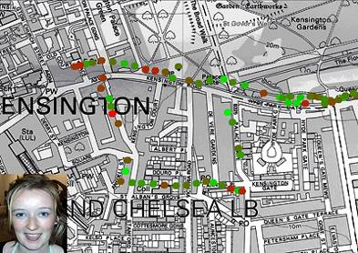
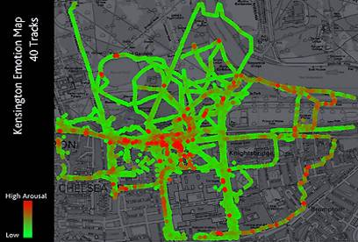

BioMapping.net

Slide 31

Gawker’s New York City Subway Smell Map
http://gawker.com/maps/smell/

Slide 32
Web 2.0 as a planning tool?
Web 2.0 is known for it’s communication add-ons to the www.
Opportunity to interact live, including voice and image.
web-based communities such as social-networking sites, video sharing sites, wikis and blogs.

Slide 33
Web 2.0
Two way information access for the public
Feedback for decision makers
Assists transparency
Enables communities to promote their own plans
See Google Earth Communities

Slide 34
Opportunity knocks for PGIS
Community mapping provides inclusive graphic framework for people to affirm and pool their experiences & knowledge about home place.
Community Mapping relies on active engagement of participants.
see Google Earth Communities

Slide 35
Opening Discussion
what are the typical issues you are faced with when it comes to targeting vulnerability and inequality at city level?
Which are the typical areas where the most disadvantaged and vulnerable are located in the city?
Which tools do you use to identify these areas?
Notes:
15 MINUTES
- Discussion on what are the typical questions you are faced when it comes to target vulnerability and inequality at city level? E.g. where are the most disadvantaged and vulnerable located in the city?; whether there are differences between urban areas?

Slide 36
(Spatial) data availability
“Top-Down”
Mostly highly aggregated
Census data
Administrative data with geo reference
Sometimes available online
A few examples:
Notes:
Max 5 minutes
Limitation of top down data: e.g. census 5 to 10 years validity
Data is already saved as KML for direct integration with Google Earth.

Slide 37

UrbanInfo / DevInfo
Notes:
Example with international coverage/.

Slide 38

UrbanInfo / DevInfo

Slide 39

UrbanInfo / DevInfo > Google Earth

Slide 40


UrbanInfo / DevInfo > Google Earth

Slide 41

Web applications (IBGE)
Notes:
National coverage > not exportable

Slide 42


Web applications (www.cidades.gov.br)

Slide 43

Census data (source: IBGE)

Slide 44
Participatory mapping and Information Technology:
Using free ware to support spatial mapping of Inequity and Vulnerability
Notes:
44
Max 5 minutes
Demonstration of cybertracker tool with previous case study example(s).
-Introduction to the group work (3 groups of 10 participants and 1 facilitator per group / mixed by gender and nationality)

Slide 45





Basic data can be collected at local level using friendly IT tools and community-based approaches

Slide 46




Free Software that can be used in an IPAQ or smart phones for collecting several types of data
CyberTracker enables to conduct geo-referenced (rapid) surveys to identify diverse phenomena and its location

Slide 47

Some screen features that support (geo-referenced) data capture
Panels to post information/reminders useful for the data capture process
GPS
Saving geo-referenced information for point location (i.e plot central trees)

Slide 48


Reports: Tables and views to assist displaying and manipulation of data

Slide 49



Community Mapping & Profiling: Perception of hazards, vulnerabilities and capacities from different groups (Colombia)

Slide 50




Mapping of hazards: Transects with IPAQS & Cybertracker for identifying coastal erosion, hazardous infrastructure and environmental threats (Colombia)

Slide 51

Mapping of hazards: Hazard-prone areas identified while transecting and discussing with local people displayed in Google Earth

Slide 52
Practical Exercise: Transecting & Mapping Perception of Urban Quality at local level using Cybertracker
Indicators of Urban Public and Environmental Quality
Quality of the Building Environment
Quality of Public Open Space
Perception of Pedestrian Safety
Environmental Quality of Open Space

Slide 53


Practical Exercise: Transecting & Mapping Perception of Urban Quality at local level using Cybertracker
Step 1. Screens for general data

Slide 54


Step 2. Screens for setting a timer for geo-referenced track
Option 1: The user defines the time span

Slide 55



Option 2: using a pre-defined time span

Slide 56



Step 3: Mapping of perception status at community level
Saving geo-referenced information for point location
Screen to assist taking field notes

Slide 57

Step 4A: Verification of Geo-referenced data Acquisition while transecting
Latitude
Longitude
Altitude a.s.l.
GPS Precision
Local Time (user must set it before synchronising PC with PA).
Tracking Velocity (km/h)

Slide 58


Step 4B: Verification of satellite status
ON
ON

Slide 59


Step 4C: Verification of location
Fieldwork map of WUF Venue
Fieldwork map at different scales

Slide 60

Step 5: Checking and editing data during fieldwork
Editing of data input
verification of data input

Slide 61
Introduction to transect walk
10 groups of max. 4 participants
  Group 1 + 2 / Building quality
  Group 3 + 4 / Public space quality
  Group 5 + 6 / Perception of pedestrian safety
  Group 7 + 8 / Environmental-open space quality
  Group 9 + 10 / Perception of pedestrian safety (gender)
1 facilitator per 3/4 groups
Duration: 30 minutes
Instruments for the transect:
  PDAs / GPS (Digital Camera optional)
Notes:
10 MINUTES (ENDS @ 60 MINUTES)
GRACIELA + ALL
-Introduction to the group work (6 groups of 5 participants and 1 facilitator per 2 groups / mixed by gender and nationality)
Resources: 5 laptops / 10 pdas
We look for indicators that reflect housing / building quality, environmental quality and public space quality (physical indicators)

Slide 62

Participatory transect walk area
Notes:
40 MINUTES
ALL
- Participatory transect walk (waterfront Warehouses of the Rio de Janeiro Harbor, WUF 5 venue).
- Use of (participatory) geo-information tools and techniques (e.g. cyber tracker + Google earth + ArcGIS), to identify, discuss and georeference issues at community level.

Slide 63


Participatory transect walk area
Notes:
40 MINUTES
ALL
- Participatory transect walk (waterfront Warehouses of the Rio de Janeiro Harbor, WUF 5 venue).
- Use of (participatory) geo-information tools and techniques (e.g. cyber tracker + Google earth + ArcGIS), to identify, discuss and georeference issues at community level.

Slide 64



Participatory transect walk area
Notes:
40 MINUTES
ALL
- Participatory transect walk (waterfront Warehouses of the Rio de Janeiro Harbor, WUF 5 venue).
- Use of (participatory) geo-information tools and techniques (e.g. cyber tracker + Google earth + ArcGIS), to identify, discuss and georeference issues at community level.

Slide 65


Participatory transect walk area
Notes:
40 MINUTES
ALL
- Participatory transect walk (waterfront Warehouses of the Rio de Janeiro Harbor, WUF 5 venue).
- Use of (participatory) geo-information tools and techniques (e.g. cyber tracker + Google earth + ArcGIS), to identify, discuss and georeference issues at community level.

Slide 66


Participatory transect walk area
Notes:
40 MINUTES
ALL
- Participatory transect walk (waterfront Warehouses of the Rio de Janeiro Harbor, WUF 5 venue).
- Use of (participatory) geo-information tools and techniques (e.g. cyber tracker + Google earth + ArcGIS), to identify, discuss and georeference issues at community level.

Slide 67


Slide 68
Tips for transect walk
Dynamic of the transect
Walk > Observe > Stop > Input Data > Walk
When to stop?
Distance: regularly (at least every 200 meters)
Time: regularly (at least every 5 minutes)
Object: change in conditions (natural breaks)
collect 4 to 5 points in total
What to observe?
Mostly concentrate on the issues related to the group topic and indicators
Notes:
40 MINUTES
ALL
- Participatory transect walk (waterfront Warehouses of the Rio de Janeiro Harbor, WUF 5 venue).
- Use of (participatory) geo-information tools and techniques (e.g. cyber tracker + Google earth + ArcGIS), to identify, discuss and georeference issues at community level.

Slide 69
Download data from Cybertracker
Steps for downloading the transect data:
  Connect PDA to your computer
  Open cybertracker software
  Go to reports and export to Shapefile format
  Export Shapefile to Google Earth format (KML)
  View file in Google Earth
Notes:
10 MINUTES
GRACIELA
Cyber Track
-Return to the workshop room and download the data, prepare reporting.

Slide 70

Results from transect walk

Slide 71
Demo Google Earth / Street View
Visualize in Google Earth the Data downloaded from Cybertracker
Possibilities to overlay more info
  Compare multi-temporal images
  Census data
  How to create new data: polygons and point
  No time?
Virtual Transect using Street View ...
Notes:
10 MINUTES (ENDS @ 120 MINUTES)
JEROEN
-Participants will learn how to scale up at city level the prioritized indicators indentified during phase one at community level.

Slide 72
Exercise / Hands On Google Earth
Virtual Transect Walk
  Open Google Earth
  Fly to Iztapalapa, Mexico DF
  Which indicators from the transect walk can work with Google Earth and StreetView?
Notes:
25 MINUTES
JEROEN
-Compare data collected with other “top down” indicators and data at city and sub-city level (e.g. census data or HDI).
Areas in Mexico DF that are better off and worst off.
Better-off: gated communities (e.g. Real de Comas?)

Slide 73
Exercise / Hands On Google Earth
Social and economic conditions
Total population
Population younger than 24 yrs
Population not born in D.F.
Education level of population above 15 years old
Unemployment level
Income level in minimum monthly wage
Physical conditions
Quality of wall and roof
Access to infrastructure (water, sewage, electricity)
Toilet within the dwelling unit
environmental quality and public space quality
Source: Análisis sobre la violencia social en la Delegación Iztapalapa; Delegación Iztapalapa: Perfil Sociodemográfico; A.Arango Durán, C.Lara Medina

Slide 74
Exercise / Hands On Google Earth
Virtual Transect Walk
  Open the “Indicators” folder (under Places)
  these contain official census data
  Have a look a these 12 layers and zoom in to the different classes
  Try to find indicators in Google Earth (using StreetView) that are evidence of the class differences in the map overlays

Slide 75
Exercise / Hands On Google Earth
Do you think that both sources of information complete each other?
What are reasons for discrepancy?
Notes:
25 MINUTES
JEROEN
-Compare data collected with other “top down” indicators and data at city and sub-city level (e.g. census data or HDI).
Areas in Mexico DF that are better off and worst off.
Better-off: gated communities (e.g. Real de Comas?)

Slide 76
Group and plenary discussion
How will you apply the skills obtained to bridge the gap between different inequality and vulnerability aspects?
Which decision-making processes would benefit most from the methods you learned?
What are the limitations of these methodologies?
Notes:
15 MINUTES
ALL
- Group and plenary discussion.
- How can you apply and implement the information and skills obtained (e.g. in area based policies) to bridge the gap between different inequality and vulnerability aspects identified and mapped along the whole process?

Slide 77
Closing / further resources
Next steps
www.itc.nl
www.iapad.org
www.devinfo.org
www.cybertracker.org
ftp.itc.nl/pub/pgis/wuf
Please fill in the evaluation form!
Notes:
CLOSING (5 minutes) ENDS @ 180 MINUTES
- Provide list and briefly show some example of post-course follow-up resources (weblinks, articles, blogs, discussion fora, etc.)
New insights gained during this training will contribute to a more participatory and efficient use and application of spatial information and mapping technologies in the context of socio-environmental vulnerability and inequality and consequently to ways to improved interventions to reduce the gap. Exchange of experiences and contributions from the participants themselves will help to sustain the new acquired insights.

Slide 78



The end
Thank you!
Photo: © Gerard Kuster
Photo: © Bart krol
Photo: © Gerard Kuster

Slide 79

Google Earth Demo

Slide 80

Google Earth Demo

Slide 81

Google Earth Demo

Slide 82

Google Earth Demo

Slide 83

Google Earth Demo

Slide 84

Google Earth Demo

Slide 85

Google Earth Demo

Slide 86

Google Earth Demo

Slide 87

Google Earth Demo

