Slide 1
Course Introduction
Magdalena Fitrzyk, Espen Volden (ESA/ESRIN)

Slide 2
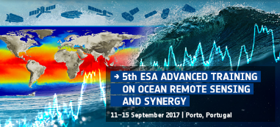
Why ESA Advanced Training Courses?
Action of ESA's Earth Observation Envelope Programme (EOEP)
Objectives:
Training the next generation of scientists and professionals on remote sensing for land surfaces, with the focus on agriculture
Explaining the theoretical principles, processing algorithms, data products and their use in agriculture applications
Introducing tool and methods for the exploitation of EO satellite data, in particular the Sentinels
Stimulating and supporting the exploitation of EO data for agriculture remote sensing science and operational applications using the ESA Sen2-Agri system and Food Security Thematic Exploitation Platform
.

Slide 3
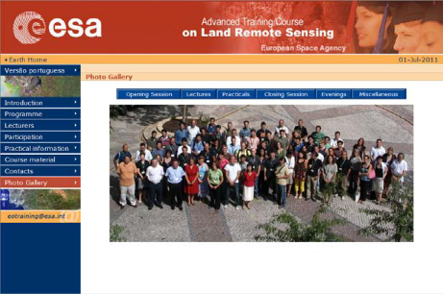
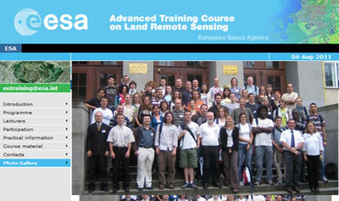
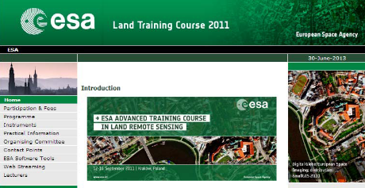
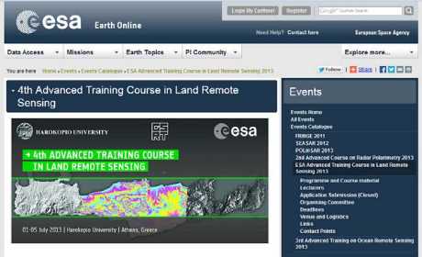
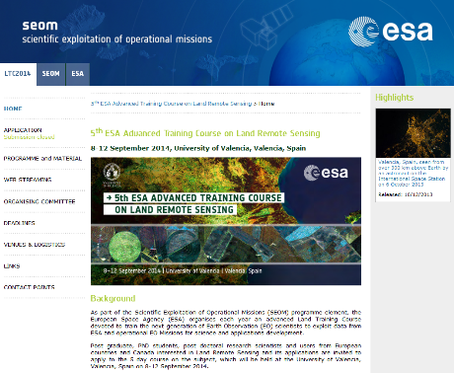
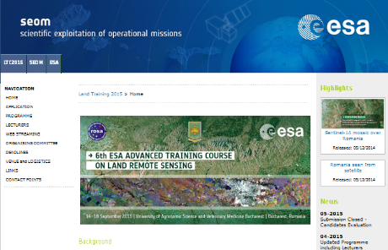
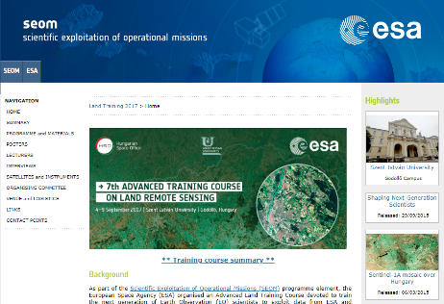
Previous Editions
Lisbon 2007
Prague 2009
Krakow 2011
Athens 2013
Valencia 2014
Bucharest 2015
Gödöllő 2017
Leicester 2018

Slide 4
Behind The Course
Organising Committee
European Space Agency (ESA)
Espen Volden
Diego Fernandez
Magdalena Fitrzyk
Irene Renis
Sabrina Lodadio
Université catholique de Louvain (UCLouvain)
Pierre Defourny
Sophie Bontemps
Partners
Belgian Federal Science Policy Office

Slide 5
Behind The Course
International team of top-notch lecturers
Dr. Sophie Bontemps (UCLouvain, Belgium)
Dr. Mirco Boschetti (National Research Council, Italy)
Cosmin Cara (CS, Romania)
Dr. Martin Claverie (UCLouvain, Belgium)
Dr. Raphaël d'Andrimont (Joint Research Center, Italy)
Thomas De Maet (UCLouvain, Belgium)
Mathilde De Vroey (UCLouvain, Belgium)
Prof. Pierre Defourny (UCLouvain, Belgium)
Dr. Magdalena Fitrzyk (RSAC c/o ESA/ESRIN)
Prof. Ramon Hanssen (TU Delft, Netherlands)
Céline Lamarche (UCLouvain, Belgium)
Philippe Malcorps (UCLouvain, Belgium)
Dr. Markus Muerth (VISTA, Germany)
Albert Olioso (French National Institute for Agricultural Research, France)
Dr. Julien Radoux (UCLouvain, Belgium)
Fabrizio Ramoino (Serco c/o ESA/ESRIN)
Tom van Roey (VITO, Belgium)
Dr. Espen Volden (ESA/ESRIN)
Dr. Marie Weiss (French National Institute for Agricultural Research, France)

Slide 6
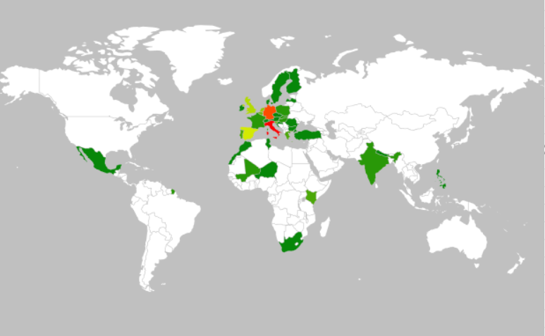
Some statistics…
227 applications
94 selected participants
35 countries of affiliation

Slide 7
Some statistics…
40 nationalities
73 post graduate, PhD students, post-doctoral research scientists
21 experts from national and international agencies

Slide 8
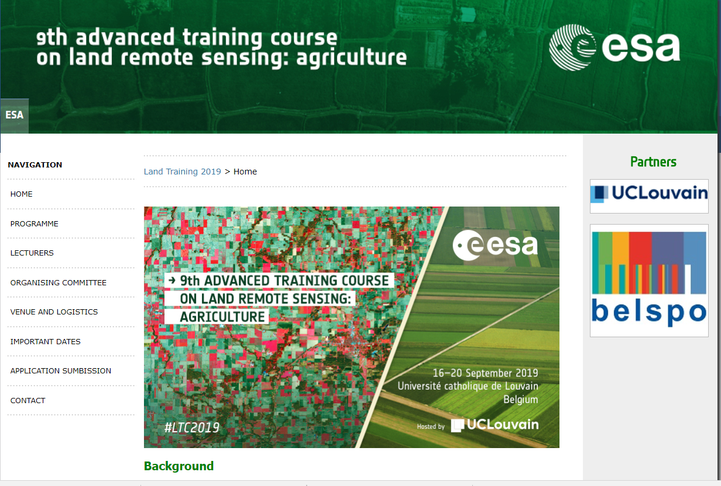
Course Website
Updated programme
Materials

Slide 9
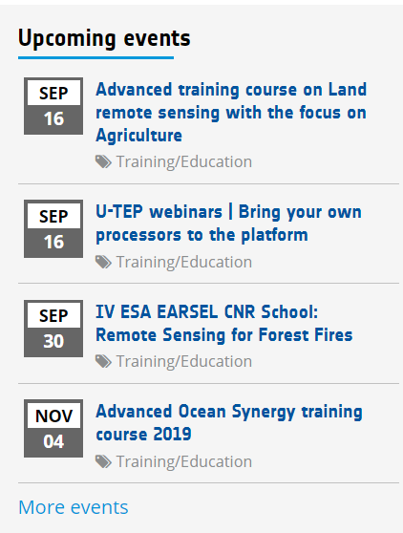
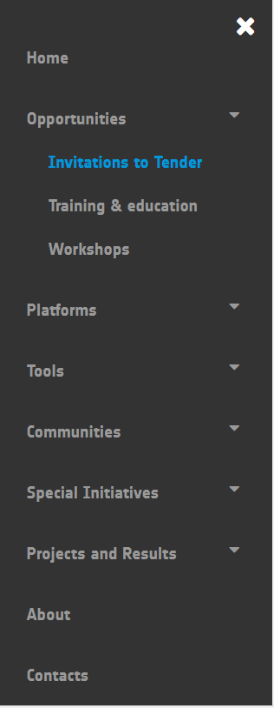
eo4society.esa.int

Slide 10
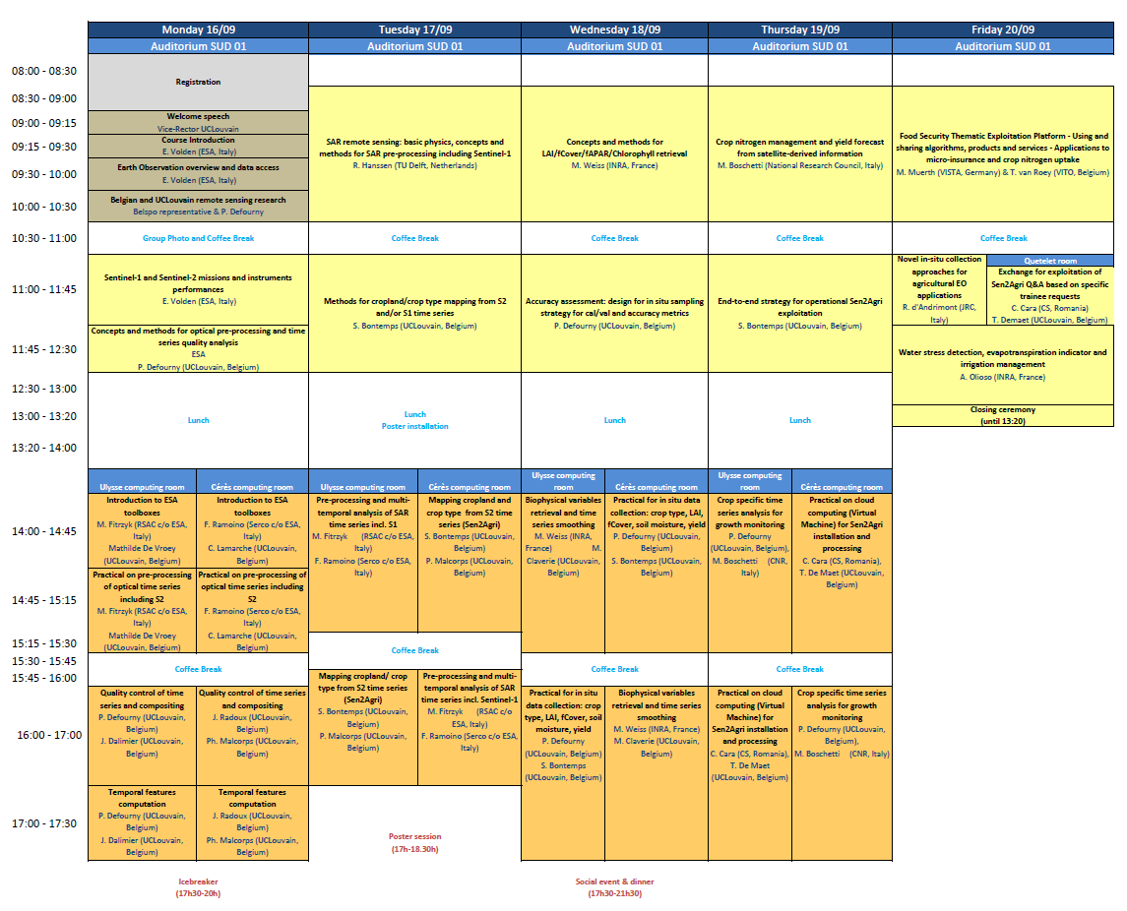
Course Overview
Opening, context, data, tools and recent results

Slide 11
Course Overview
Theoretical background

Slide 12
Course Overview
Practical exercises

Slide 13
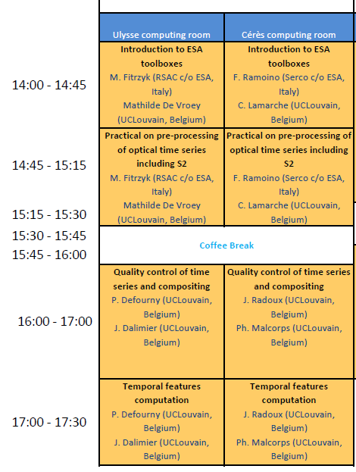
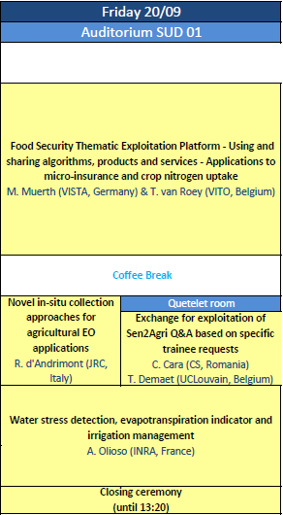
Course Overview
Group 1 Group 2
No parallel sessions, no need to choose (except one lecture on Friday)
Computer practicals take place in two groups in two computer rooms
Once you choose your group please don’t change it
Practicals repeated for each group

Slide 14
Course Overview
Poster session
Social events

Slide 15
Course Overview
Conclusions, delivery of the Certificate of Attendance, Closing

Slide 16
Good to Know
Certificate of Attendance
To get a certificate, attendance is mandatory for all lectures and practical classes
Not enough to attend one or two lectures or to pick and choose from the programme
Attendance lists will be in circulation during the week
Certificates will be awarded during the closing ceremony on Friday
ECTS Credits
Will be awarded by UCL on request
Please contact organisers if interested
Online Course Evaluation
To provide feedback to improve for future courses
10 minutes to complete
The questionnaire is anonymous
Link to website will be provided by email (by the end of the course)
Course material will be made available on course website end of September/beginning of October

Slide 17
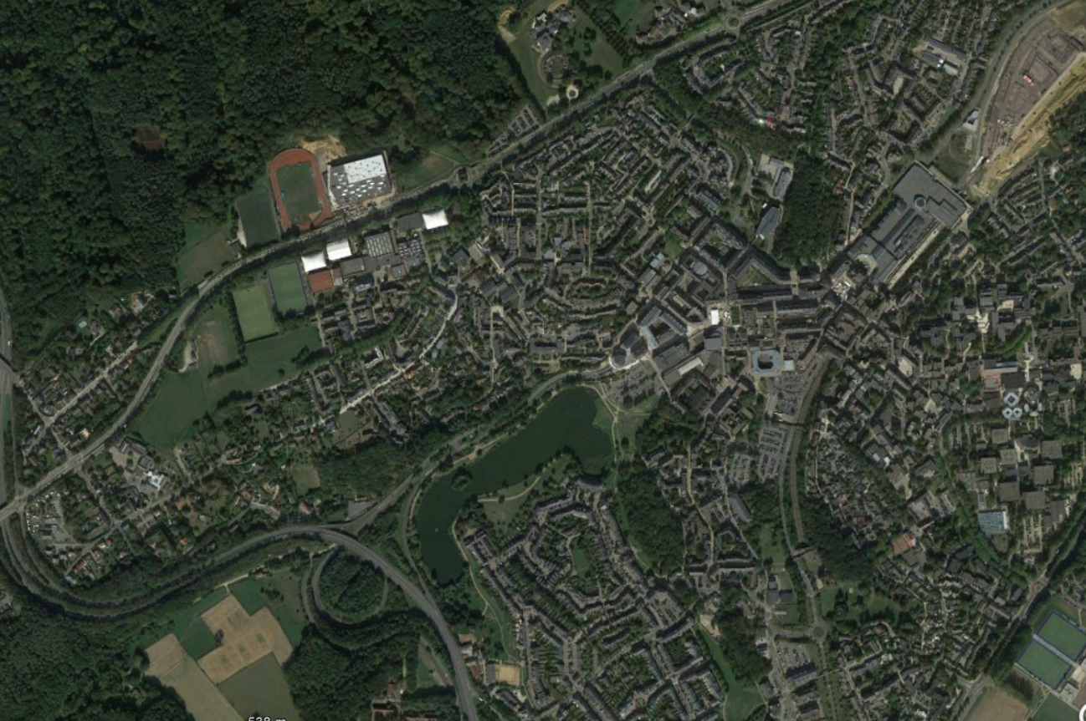
#LTC19
Have a pleasant stay and a successful Training Course!

