Slide 1
Introduction to ESA toolboxes
Magdalena Fitrzyk & Fabrizio Ramoino ESA/ESRIN

Slide 2
SNAP
SNAP
SeNtinel Application Platform
Download it at
step.esa.int
Sentinel-1 Toolbox
Free and open source software
Common Java core framework
Joint development of SNAP platform for Sentinel and other toolboxes
Interchangeable Java/Python plugins
Portable engine to Cloud infrastructure
User friendly: single installation, intuitive GUI, online help, tutorials, active user forum
Sentinel-2 Toolbox
Sentinel-3 Toolbox
SMOS Toolbox
PROBA-V Toolbox

Slide 3
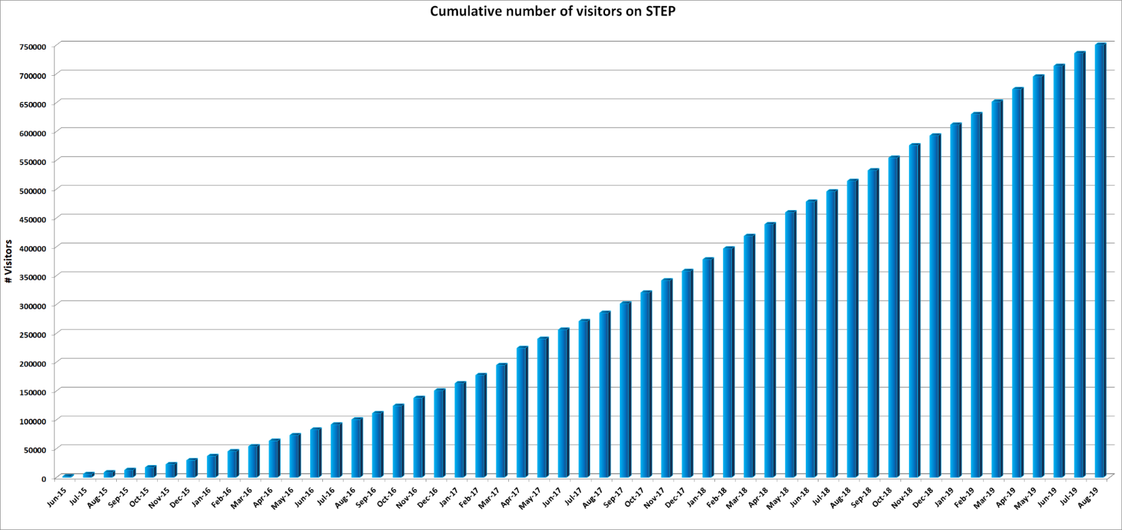
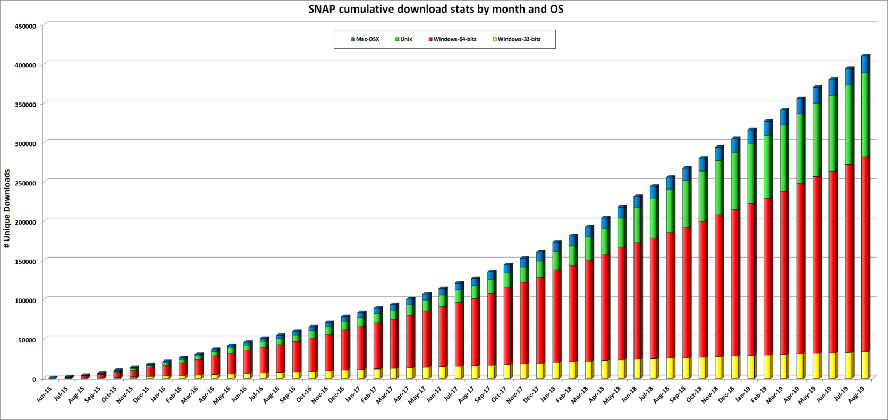
Scientific Toolboxes - SNAP
STEP website exceeded 755.000 visit sessions from June 2015 until today
SNAP download exceeded 410.000 from June 2015 until today

Slide 4
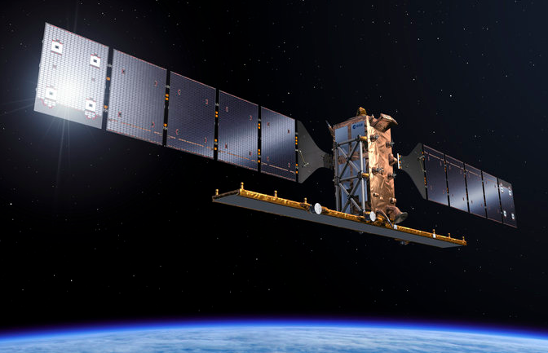
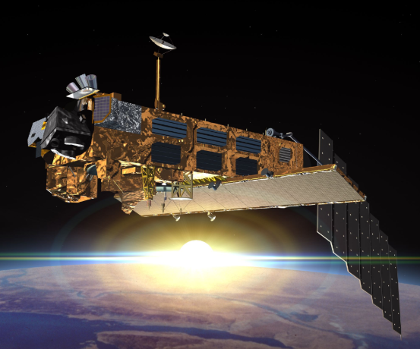
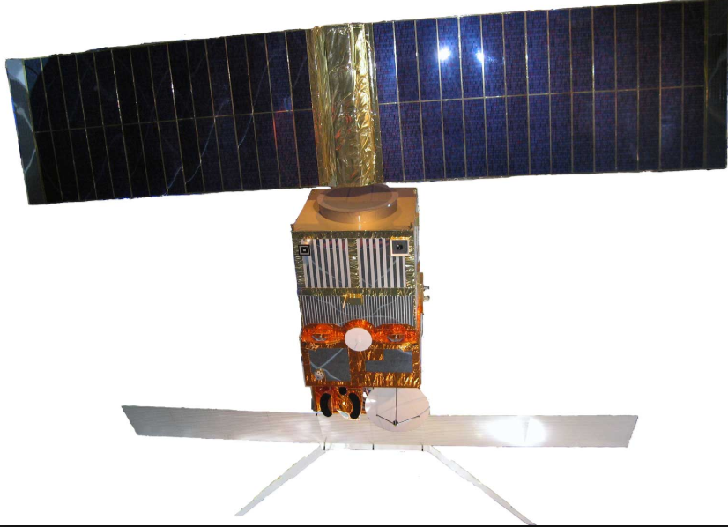
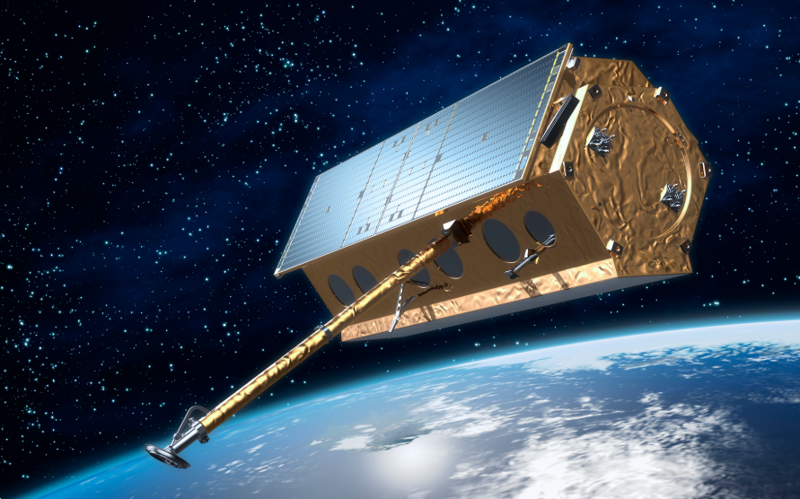
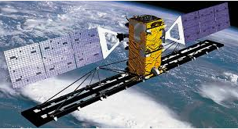
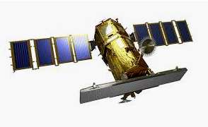
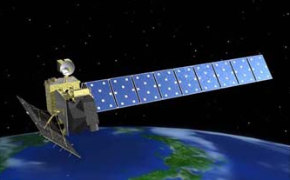
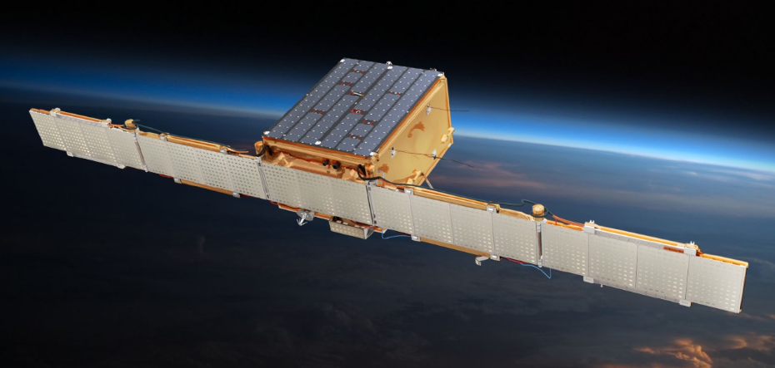
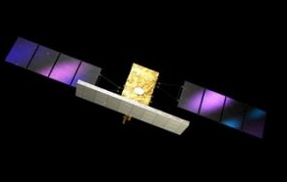
SNAP & SAR (Sentinel-1 Toolbox)
Sentinel-1
ENVISAT
ERS-1
TerraSAR-X
RADARSAT
KOMPSAT-5
ALOS 1&2
ICEYE
COSMO-SkyMed
Main features: Absolute calibration, Multilooking, Speckle filtering, Precise orbits handling
Coregistration of detected and complex products
Full support of Sentinel-1 TOPS interferometry, debursting, slice assembly
Terrain Correction
SAR simulation and Layover and shadow masks
Applications: oil spill detection, ship detection, wind field estimation etc.
Fully integrated and featured InSAR tools for Stripmap and Zero-Doppler focused data
Compatibility with PolSARpro Toolbox (Reader, Writer)
Integrated Export to SNAPHU (interferometric phase unwrapping) and STAMPS (PS InSAR)

Slide 5
Sentinel-1 characteristics
Main features:
C-band (5.4 GHz) SAR
Daily coverage of high priority areas;
Bi-weekly global coverage;
12 days repeat cycle (6 days with both Sentinels 1A and 1B operational);
7 years design life time (consumables for 12 years).
Applications:
Ice and marine/land monitoring;
Mapping in support of humanitarian aid in crisis situations.

Slide 6
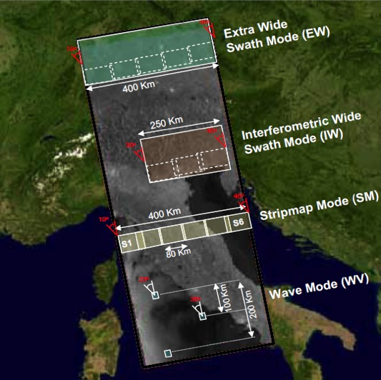
Sentinel-1 Operational Modes
Main mode over land
Resolution (1 look) | Swath Width | Polarisation
20 x 40 m² | > 400 km | HH+HV or VV+VH
5 x 20 m² | > 250 km | HH+HV or VV+VH
5 x 5 m² | > 80 km | HH+HV or VV+VH
5 x 5 m² | 20 x 20 km² at 100 km spacing | HH or VV

Slide 7
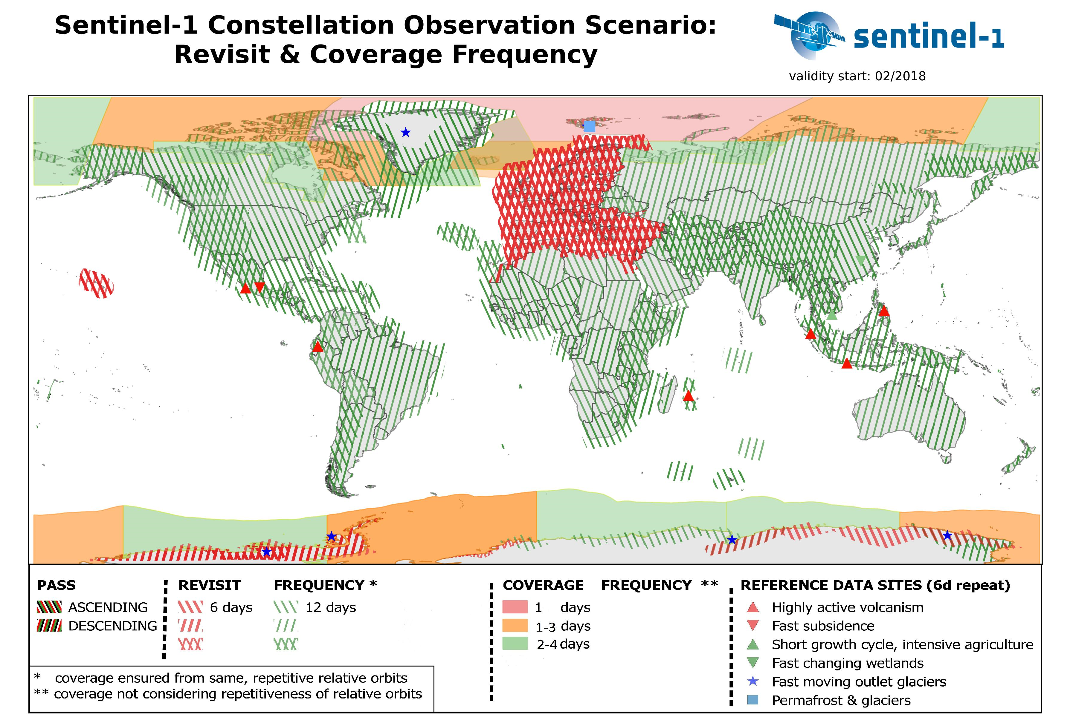
Sentinel-1 A & B Data
Available products
Level 0 (L0-RAW)
Level 1 Ground Range, Multi-Look, Detected Medium Resolution (L1-GRDM) and High Resolution (L1-GRDH)
Level 1 Single-Look Complex (L1-SLC)
Level 2 Ocean (L2-OCN)
2018
S-1 A/B
S-1 A/B
1,304,078 published products
(2.3 PB)
S-1 A/B
S-1 A/B
3,282,679 published products
from start of Ops to the end Y2018 (~5.8 PB)
Notes:
Heatmap – number of Sentinel1 products (excluding OCN) published since the start of operations

Slide 8
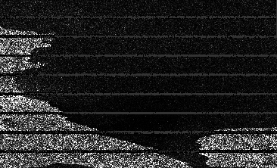
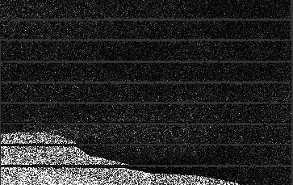
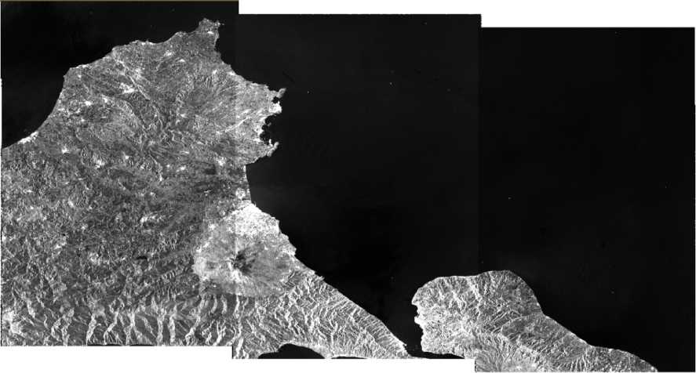
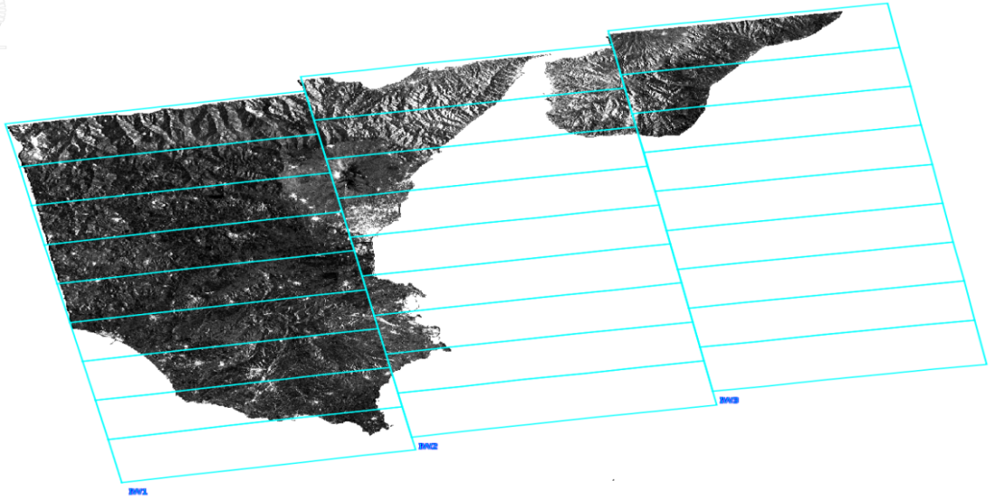
Sentinel-1 TOPS Data Handling and Processing
Bursted IW SLC
Terrain Correction
Geocoding
Deburst and Subswath merge

Slide 9
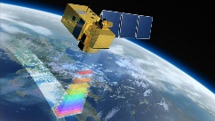
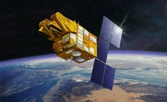
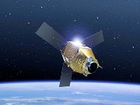
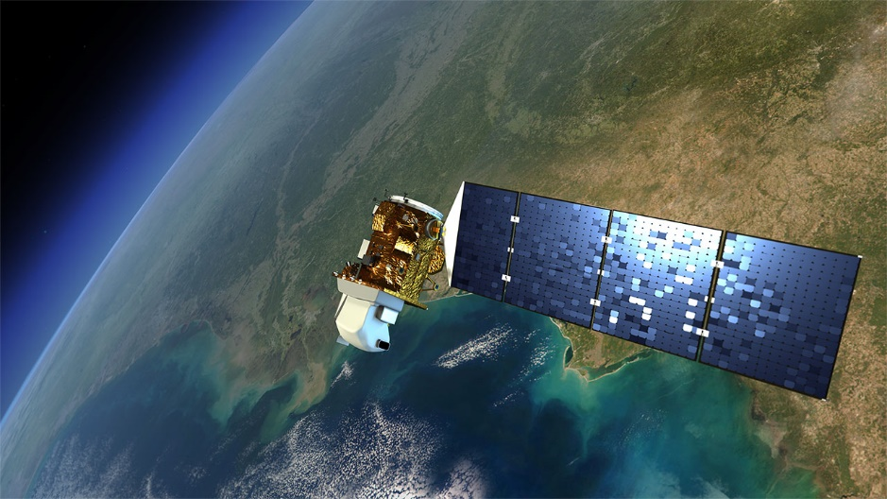
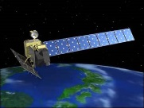
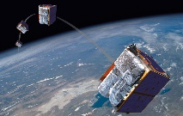
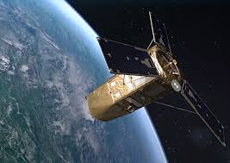
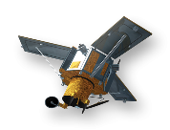
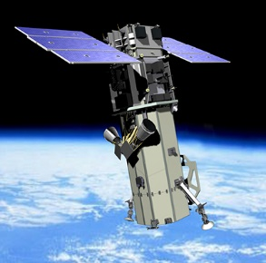
SNAP & Optical HR (Sentinel-2 Toolbox)
……
Sentinel-2
SPOT
Pleiades
Landsat
ALOS AVNIR
RapidEye
Kompsat
Ikonos
Worldview
Main features:
Sen2Cor and i-Cor for Atmospheric Correction
L2B biophysical processor (LAI, fAPAR, …)
Reflectance to Radiance Processor
Radiometric Indices
Vegetation indices: DVI, RVI, PVI, IPVI, WDVI, TNDVI, GNDVI, GEMI, ARVI, NDI45, MTCI, MCARI, REIP, S2REP, IRECI, PSSRa
Soil indices: SAVI, TSAVI, MSAVI, MSAVI2, BI, BI2, RI, CI
Water indices: NDWI, NDWI2, MNDWI, NDPI, NDTI
IdePix Processor: pixel classification
OTB tools: Pansharpening, Rasterization, Segmentation, …

Slide 10
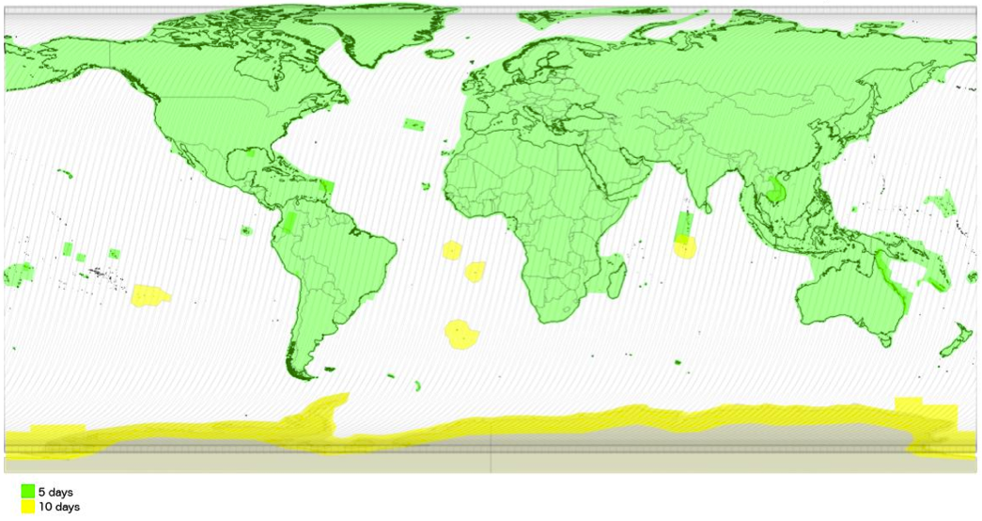
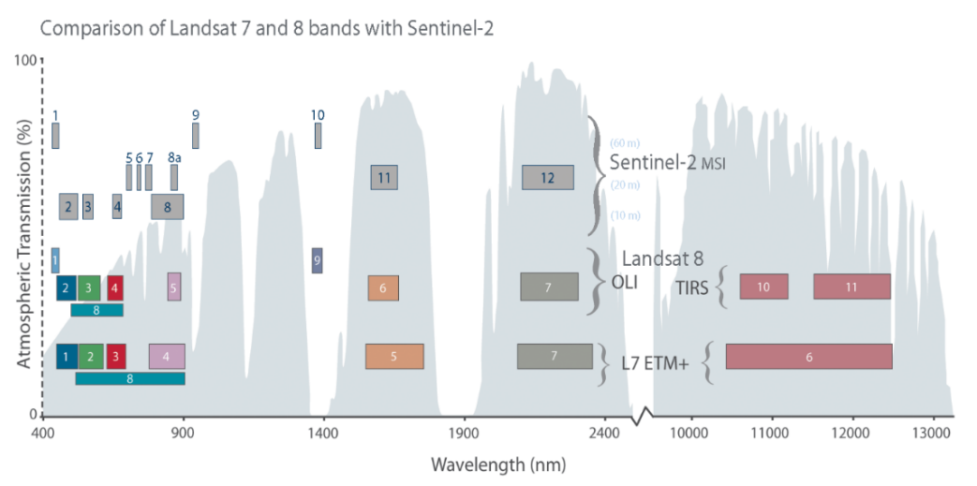
Sentinel-2 characteristics
Optical mission for the monitoring of land and coastal regions
Main features:
Constellation of two satellites (Sentinel-2A and Sentinel-2B)
Multi-Spectral Instrument (MSI)
Polar, sun-synchronous orbit at 786km and LTDN 10h30
10 days repeat cycle (5 days with both Sentinels 2A and 2B operational)
Swath of 290km

Slide 11
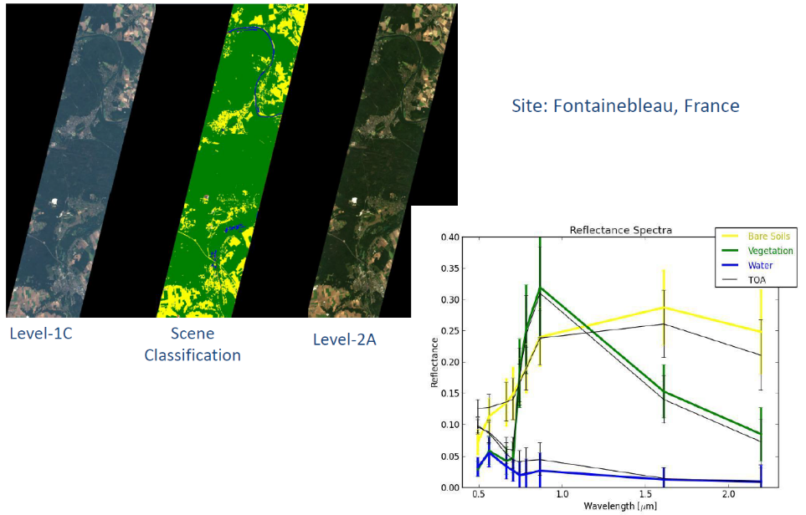
Sentinel-2 products
SENTINEL-2 products available for users (either generated by the ground segment or by the SNAP) are:
Level-1C
Top-Of-Atmosphere reflectances in cartographic geometry
Systematic generation and online distribution
~600MB (each 100km x 100km)
Level-2A
Botton-Of-Atmosphere reflectances in cartographic geometry
Systematic and on-User side (using SNAP)
~600MB (each 100km x 100km)
Products are a compilation of elementary granules of fixed size, along with a single orbit. A granule is the minimum indivisible partition of a product (containing all possible spectral bands).
For Level-1C and Level-2A, the granules, also called tiles, are 100x100 km² ortho-images in UTM/WGS84 projection.

Slide 12
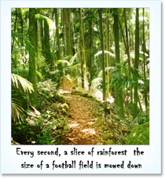
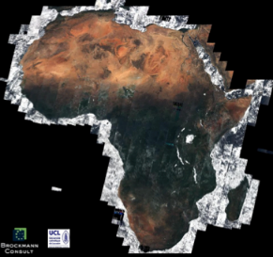
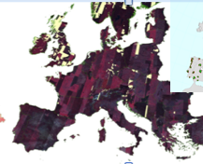
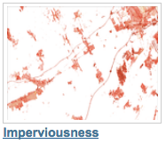
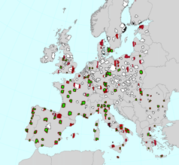
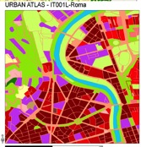
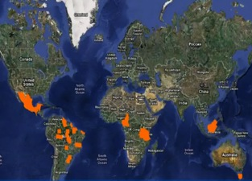
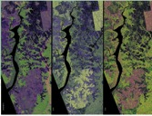
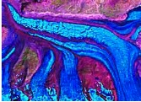
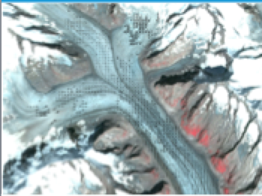
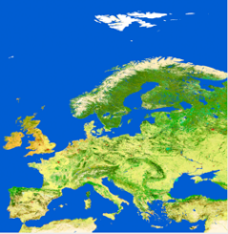
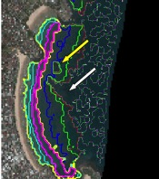
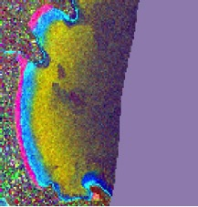
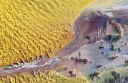
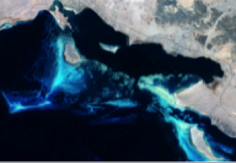
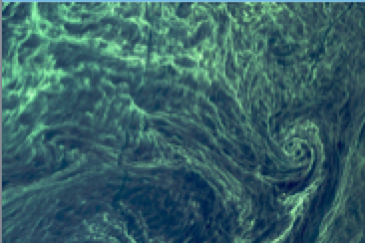
Sentinel-2 applications
Agriculture, Forests & Carbon, Vegetation monitoring
Land cover classification, high resolution layers & change.
Regional to Urban Applications
Global Land use
& change
Emergency management
Glaciers & Ice
B11
Band 11
Geology
Water quality
Coastal zones/bathymetry

Slide 13
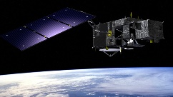
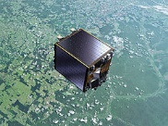
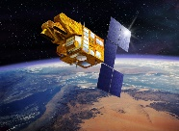
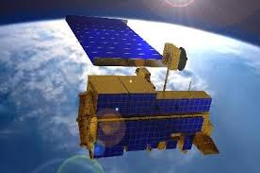
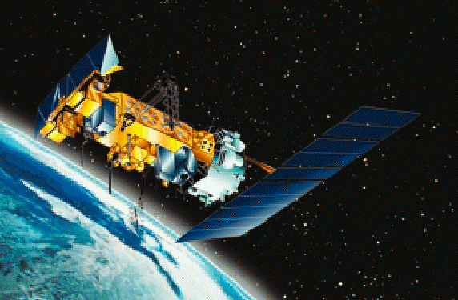
SNAP & Optical/Thermal MR (Sentinel-3 Toolbox)
……
Sentinel-3
ENVISAT
ERS
Proba-V
SPOT VGT
MODIS
AVHRR
VIIRS
Main features:
Visualizing spectrum of pixels
Uncertainty visualization and propagation of uncertainty in BandMaths
Pixel extraction tool
Specific sensor processors:
S3 OLCI Radiometry, S3 SLSTR PDU stitching
AATSR/SLSTR Regridding
Performs radiometric corrections on MERIS
Optical water type classification based on atmospherically corrected reflectances
FU (Forel-Ule) Classification used to derive the hue angle and FU value
IdePix Processor: pixel classification
FLH (Fluorescence Line Height) / MCI (Maximum Chlorophyll Index) retrieval
FUB/WeW processor

Slide 14
Sentinel-3 products
Sentinel-3 is an ocean and land mission and provides data continuity for the ERS, ENVISAT and SPOT-VGT satellites.
SENTINEL-3 makes use of multiple sensing instruments to accomplish its objectives:
SLSTR (Sea and Land Surface Temperature Radiometer)
OLCI (Ocean and Land Colour Instrument)
SRAL (SAR Altimeter)
DORIS (Doppler Orbitography and Radiopositioning Integrated by Satellite)
MWR (Microwave Radiometer)

Slide 15
Access to Sentinels data
The Copernicus Open Access Hub provides complete, free and open access to Sentinel-1, Sentinel-2 and Sentinel-3 user products.
Go to https://scihub.copernicus.eu/

Slide 16
Example for SAR data
Live demo based on Sentinel-1
opening GRDH product: metadata, bands, image inspection
Introduction to tools: navigation panel, world view, double windows management
Review of functionalities for SAR
Short exercise: subset, radiometric calibration, multilooking, band math, RGB
Opening SLC product: metadata, bands, image inspection

Slide 17
Example for Optical HR data
Live demo based on Sentinel-2
opening S2 L1C product: metadata, bands, image inspection
Introduction to tools: navigation panel, colour manipulation, double windows management, pixel info
Review of functionalities for optical
Short exercise: resampling, subset, radiometric indices, band math, RGB
Opening S2 L2A product: metadata, SCL mask, image inspection

