Slide 1
Accuracy Assessment : strategy for calibration/validation and accuracy metrics
Pr. Pierre Defourny – UCLouvain, Belgium

Slide 2
Outline
Components of the uncertainty of a EO-derived product
Why assess quantitatively the accuracy of EO products ?
Thematic map accuracy – case of continuous variables (biophysical variables)
Thematic map accuracy – case of categorical variables (classes like crop type)
  4.1 Sampling design
  4.2 Response design
  4.3 Analysis
Best practices for in situ data collection
Area estimate/ Conflation –crowdsourcing / opportunistic / raph

Slide 3
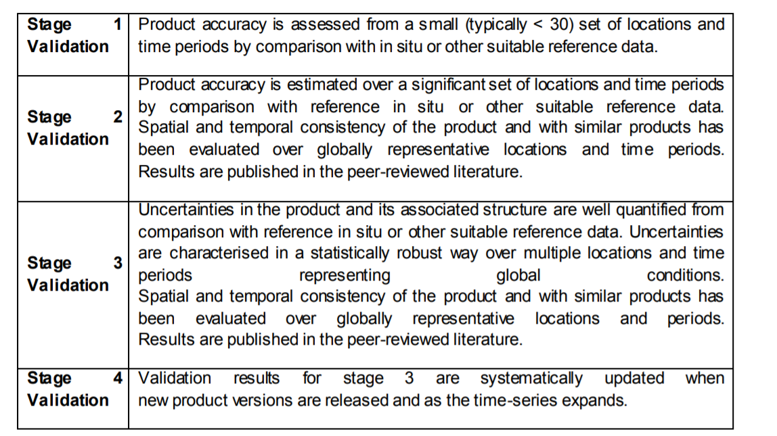
CEOS Working Group on Calibration/Validation – 4 stages

Slide 4
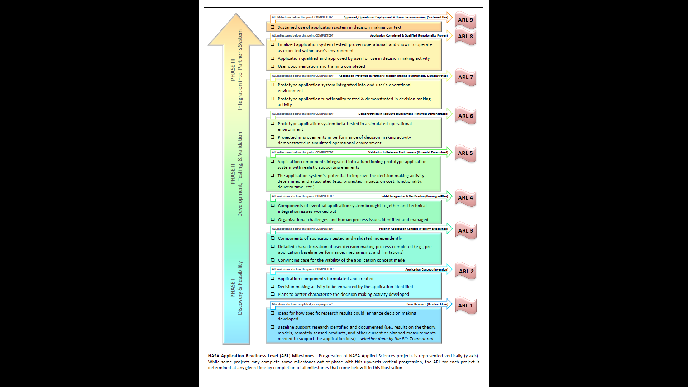

ARL7 for the Sen2-Agri system in the NASA
Application Readiness Level (ARL) Milestones

Slide 5
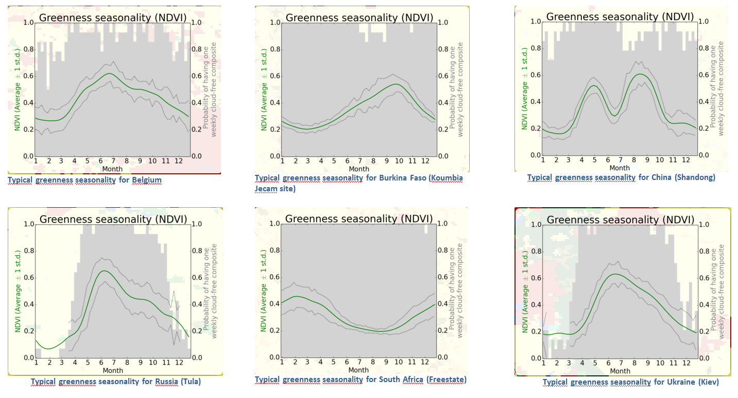
8 Uncertainty components of a EO-derived map | Main sources
1. Spatial resolution of the map, defining the level of details for the class boundary delineation | EO data: effective spatial resolution
2. Time span of the map, which usually corresponds to the acquisition period of the input data | EO data: observation duration
3. Information gap, due to missing input data or areas not mapped for various reasons | EO data: quantity of valid observation
4. Minimum mapping unit (MMU), corresponding to the minimum area required to be depicted on the map | Cartographic standards: map specification
5. Precision of the definition of each category or variable, which is supposed to be exhaustive and mutually exclusive | Cartographic standards: legend quality or variable definition
6. Thematic resolution, defined by the number of categories included in the legend and effectively reported on the map - an associated thematic distance is sometimes used to describe the semantic proximity between categories (e.g. fuzzy approach) | Cartographic standards and image processing algorithms: legend level and discrimination capabilities
7. Geolocation accuracy, referring to the error in the geographic coordinates with regard to the absolute coordinate system selected for the map projection - this is often measured as the positional error (horizontal or planimetric error and vertical error) | Image processing algorithms and EO input data: geometric correction
8. Thematic map accuracy, which is usually referred to as the map accuracy or the EO-derived product accuracy assessment | Image processing algorithms and cartographic standards: map specifications matching
(modified from Defourny et al., 2012)

Slide 6
8 Uncertainty components of a EO-derived map | Main sources
1. Spatial resolution of the map, defining the level of details for the class boundary delineation | EO data: effective spatial resolution
2. Time span of the map, which usually corresponds to the acquisition period of the input data | EO data: observation duration
3. Information gap, due to missing input data or areas not mapped for various reasons | EO data: quantity of valid observation
4. Minimum mapping unit (MMU), corresponding to the minimum area required to be depicted on the map | Cartographic standards: map specification
5. Precision of the definition of each category or variable, which is supposed to be exhaustive and mutually exclusive | Cartographic standards: legend quality or variable definition
6. Thematic resolution, defined by the number of categories included in the legend and effectively reported on the map - an associated thematic distance is sometimes used to describe the semantic proximity between categories (e.g. fuzzy approach) | Cartographic standards and image processing algorithms: legend level and discrimination capabilities
7. Geolocation accuracy, referring to the error in the geographic coordinates with regard to the absolute coordinate system selected for the map projection - this is often measured as the positional error (horizontal or planimetric error and vertical error) | Image processing algorithms and EO input data: geometric correction
8. Thematic map accuracy, which is usually referred to as the map accuracy or the EO-derived product accuracy assessment | Image processing algorithms and cartographic standards: map specifications matching
(modified from Defourny et al., 2012)

Slide 7
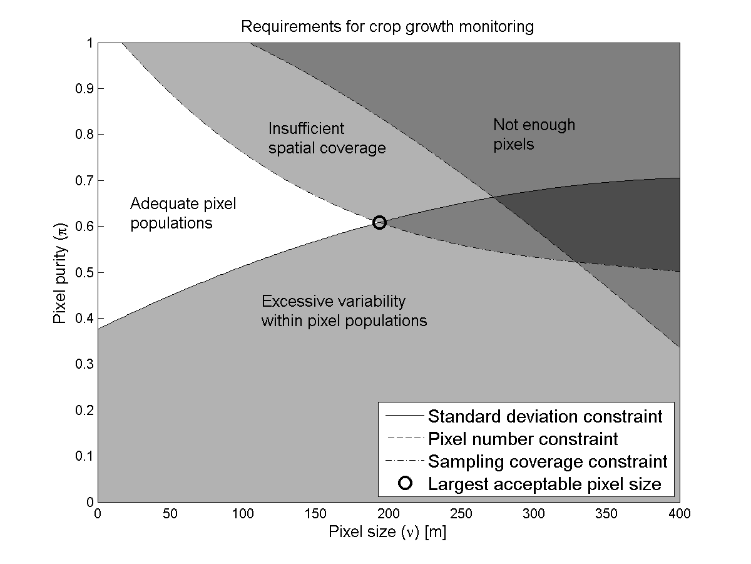
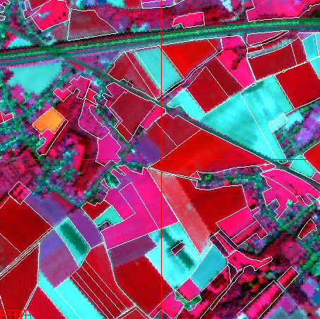
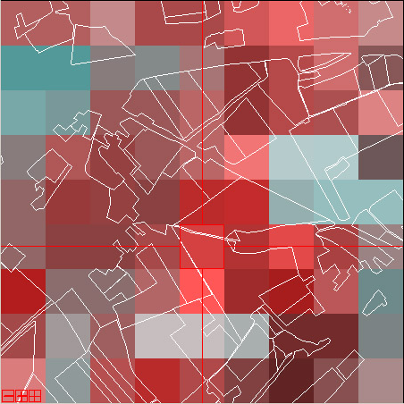
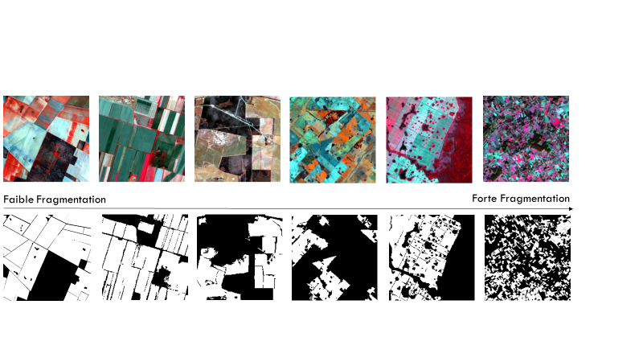
Spatial resolution of the map constrained by EO input data
Spatial resolution requirement to capture the agricultural patterns
depending on the landscape fragmentation
depending on the local crop diversity (indeed adjacent
small fields of the same crop with crop calendar can be merged
as a macro-parcel – often relevant in small holder farming systems ! )
Low fragmentation High fragmentation
Duveiller & Defourny RSE2010

Slide 8
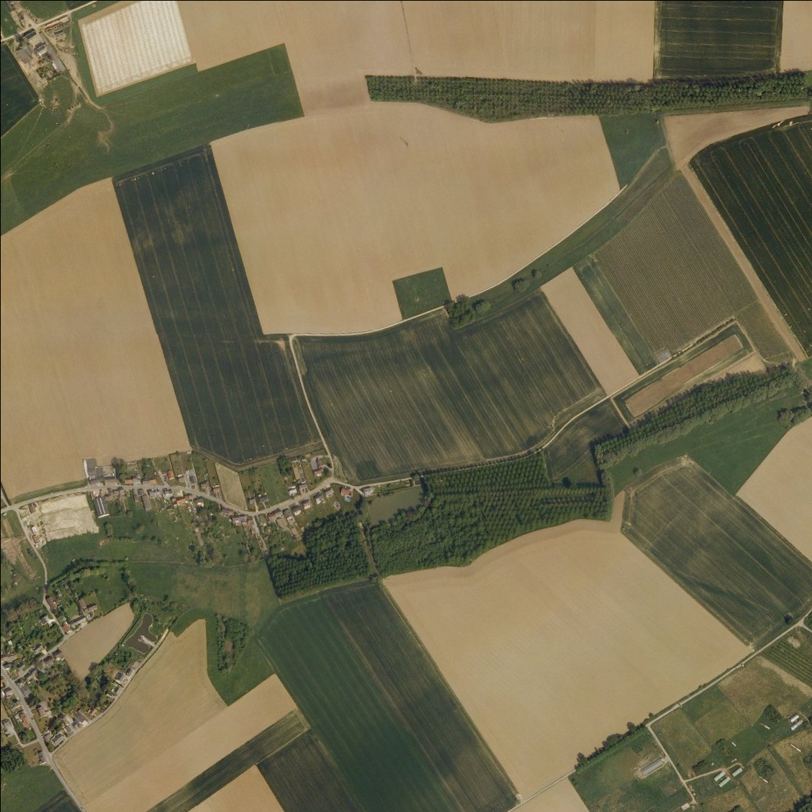
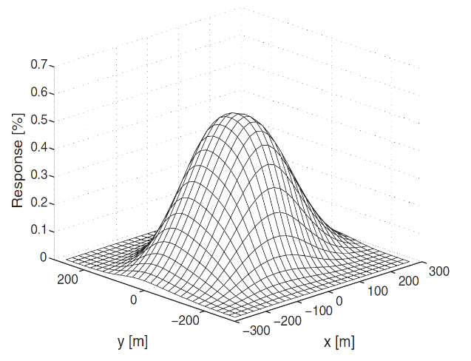
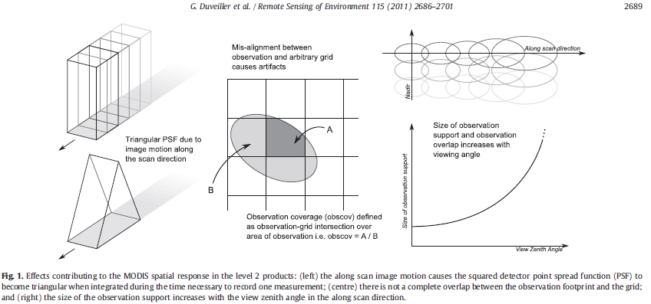
Actual footprint of any EO instrument has a spatial response larger (from 1,5 to 3 pixels) than the image spatial resolution
Image spatial resolution ?
What many people THINK is in a pixel
Point Spread function
More on S2 in Radoux et al., RS2016
Modis spatial response – 250 m
What may actually be in a pixel
MODIS ~250 m L2G grid
Notes:
Detection or resolution power also depends on the spectral resolution and the local constrast (airport strip visible at 10 m even with 3 m width !)

Slide 9
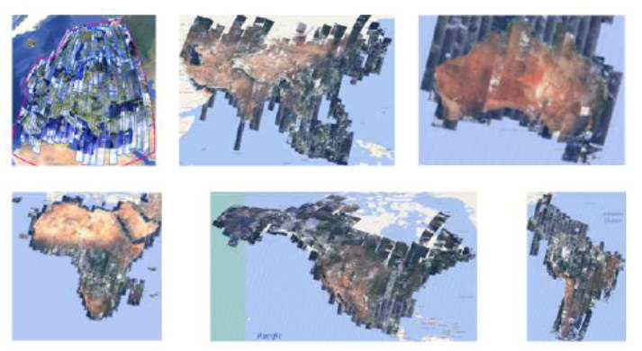
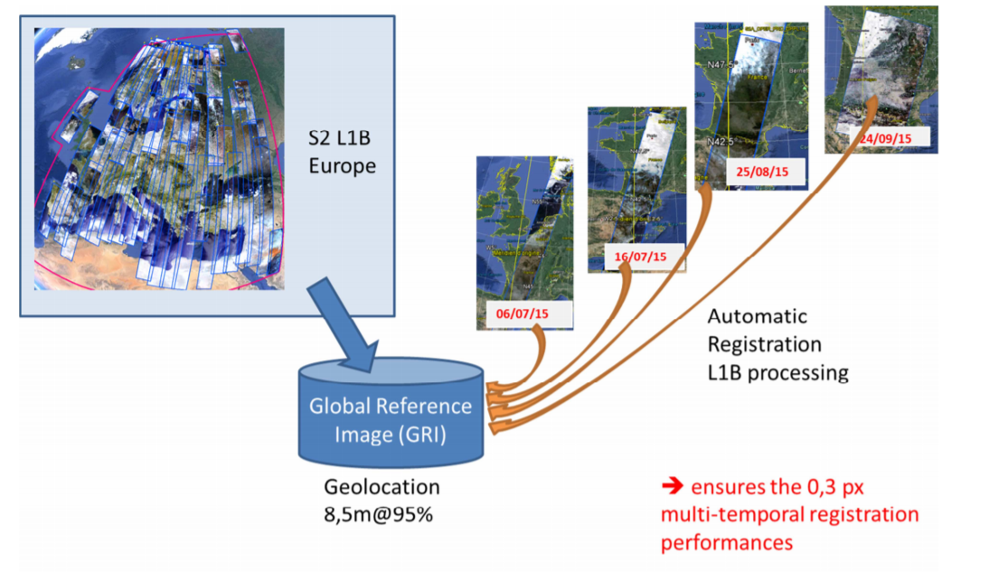
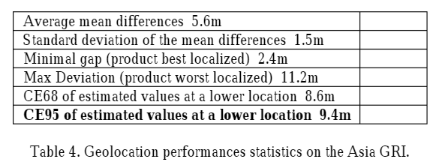
Geolocation accuracy - 10m Global Reference Image for Sent.-2
Absolute geolocation error (~0,8 pixel)
Multi-temporal coregistration (~0,3 pixel)
Global Reference Image
(Gaudel et al., 2017)
9,5 m @ 95 %
GRI still to be implemented in the operational L1C processing chain to reduce current geolocation error

Slide 10

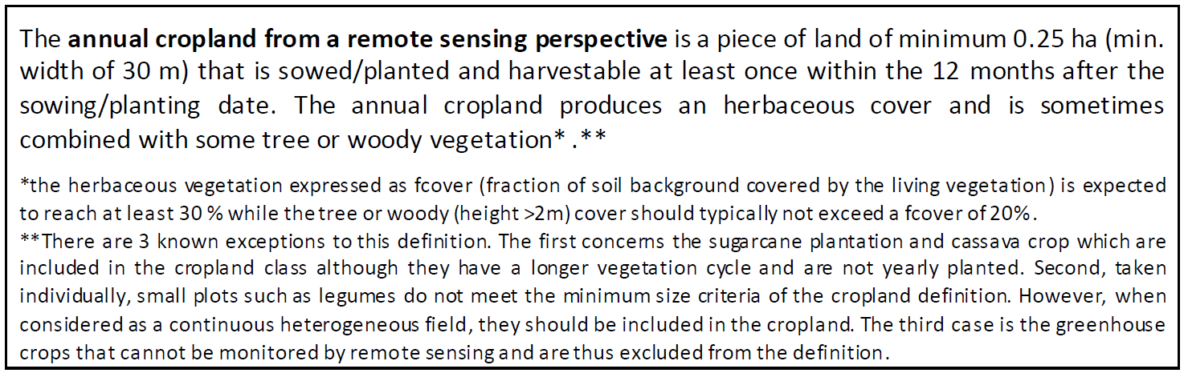
Thematic resolution – example of JECAM cropland definition
Joint Experiment for Crop Assessment and Monitoring Guidelines - http://www.jecam.org/

Slide 11
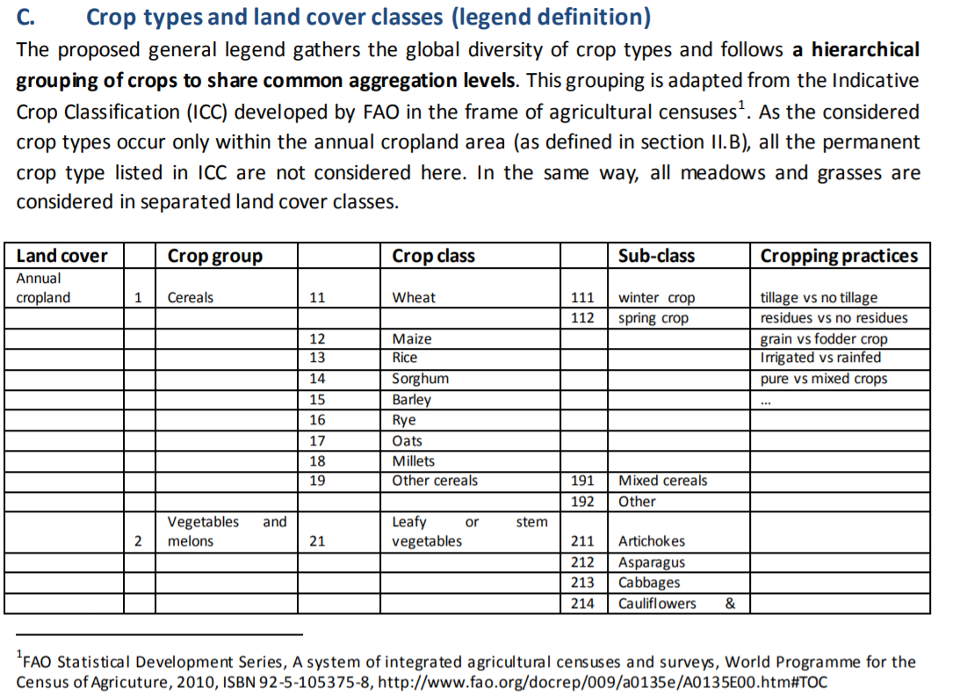
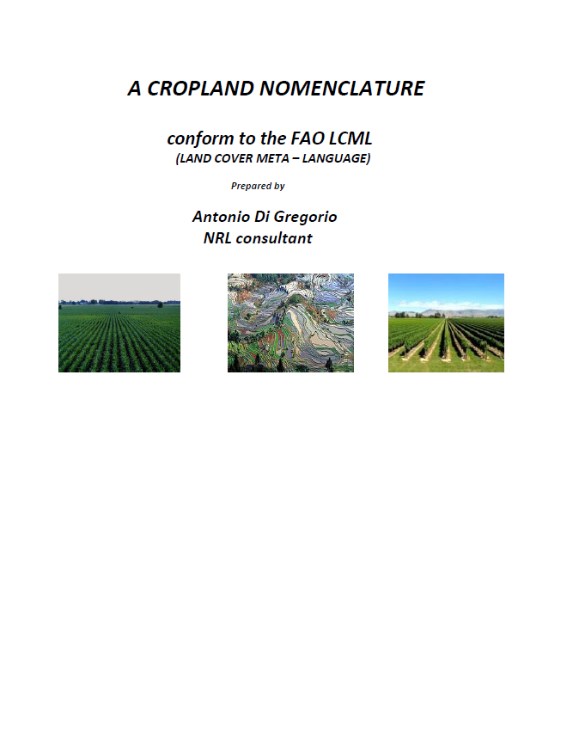
Thematic resolution –JECAM crop type grouping and coding
http://jecam.org/wp-content/uploads/2018/10/JECAM_Guidelines_for_Field_Data_Collection_v1_0.pdf
…/…

Slide 12
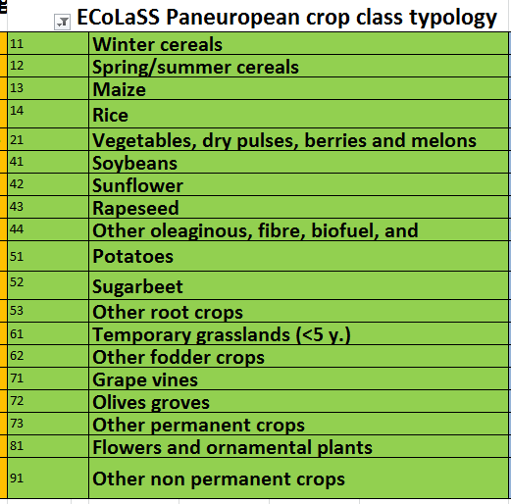

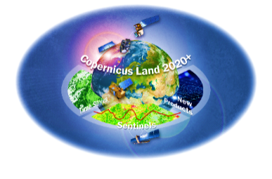




Thematic resolution – ECOLASS Paneuropean crop typology (19)
Comparison with LUCAS legend, JECAM typology, H2020 Sensagri (16 cl.) and FAO-stat document (2010)
H2020 ECoLaSS

Slide 13
2. Why assess quantitatively the accuracy of EO products ?
« Model or method verification » can be based calibration dataset only
to evaluate the performance of a classification model or an inversion algorithm
=> to support model parametrization, model calibration, etc. or as quality control procedure
« Model, method or product benchmarking » based on reference data targeting disagreement areas to compare the performances of different processing methods/products
=> to support the selection of a model or of a method
« EO product or map accuracy assessment (validation) » based on validation dataset to quantify the accuracy of the information based on a statistically-sound strategy
=> to support the decision to be made from this EO product
Decision based on maps with unknow accuracy might lead to serious surprises !

Slide 14
« Model or method verification » can be based calibration dataset only
to evaluate the performance of a classification model or an inversion algorithm
=> to support model parametrization, model improvement, etc. or as quality control procedure
Example: calibration assessment of Random Forest model for crop type mapping
All available training samples are used to train the RF model
Confusion matrix using the training samples to assess the model performance
and/or the training dataset performances (i.e.in Sen2Agri: 100 % in situ for calibration)
=> evaluation of the features set used as input,
=> evaluation of the model parametrization,
=> identification of poor representativity of training data for some classes,
=> assessment of the classification of marginal or less frequent classes

Slide 15
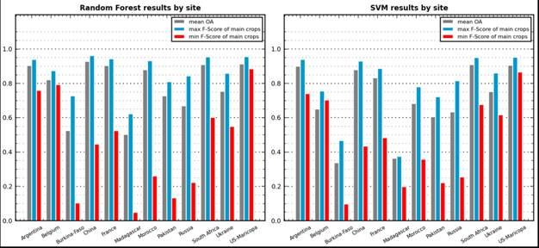

How can I map crops with remote sensing ?
« Model or method verification »
Results of the RF verification and benchmarking exercise between Random Forest and SVM over 12 sites
The RF classifier yields better results for most of the sites. SVM produces good results comparable to RF when the number of classes is small, as shown by the results of Argentina and China, and specially in South-Africa where results are much better.
However, as the SVM is very sensitive to a balanced share of samples between the classes, it has to be parameterized in such a way that all classes are equally represented. This means that majority classes will be under-sampled. For this reason and for these classes, lower results are obtained if they are compared with the RF results, whilst for minority classes results may be better.

Slide 16
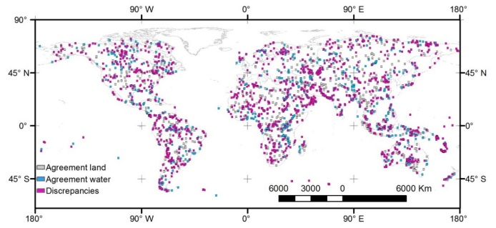
« Model, method or product benchmarking » targeting disagreement areas
to compare the performances of different processing methods/products
Example: comparison of four global waterbodies maps
Stratification according to the disagreement between products:
Stratum 1: high conﬁdence in correctly mapping the land class
=> 25 % of reference points selected by random sampling
Stratum 2 : high conﬁdence in correctly mapping the water class
=> 25 % of reference points selected by random sampling
Stratum 3 : error-prone areas
=> 50 % of reference points selected by random sampling
in the error-prone stratum
=> Total number of reference points : 2110 samples
(Lamarche et al., 2016)
Notes:
If random sampling, mostly land and obvious water =

Slide 17
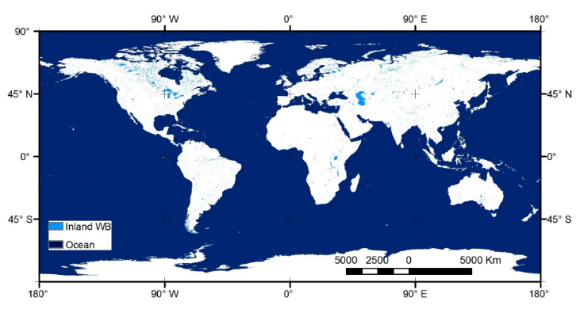
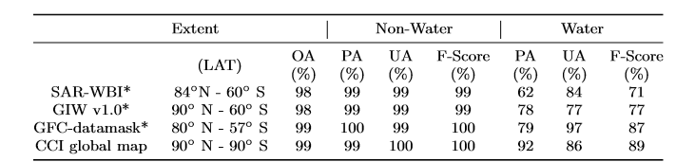
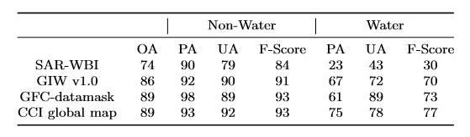
« Model, method or product benchmarking » targeting disagreement areas
Example: comparison of three four global waterbodies maps
Overall Accuracy with all samples (2110 points) => no difference !
Overall accuracy using samples of the error-prone stratum (1030 points) => very discriminant !
CCI global map of open water bodies
(Lamarche et al., 2016)

Slide 18
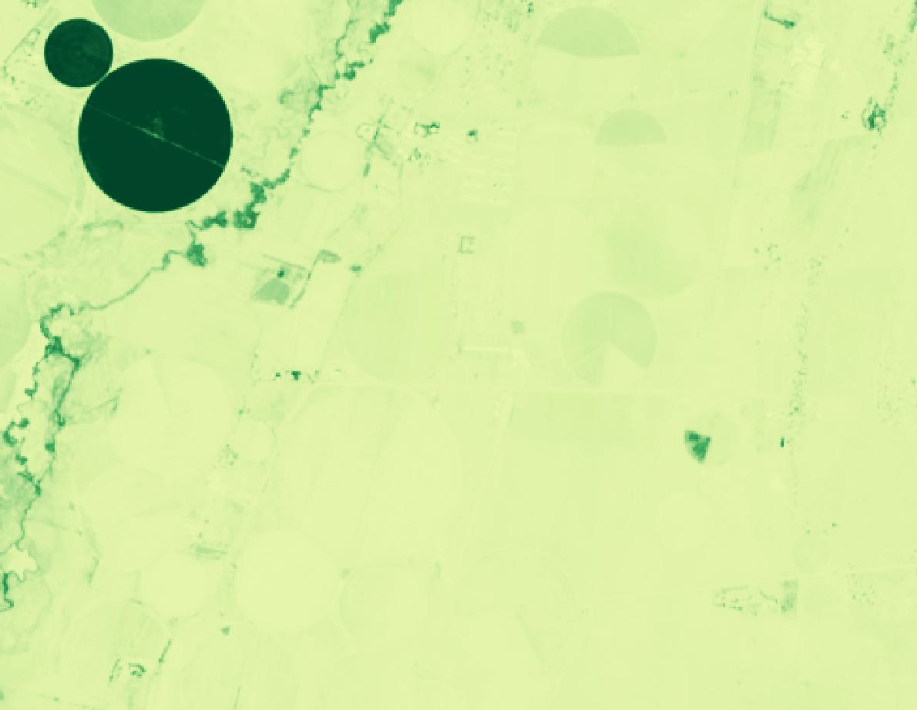

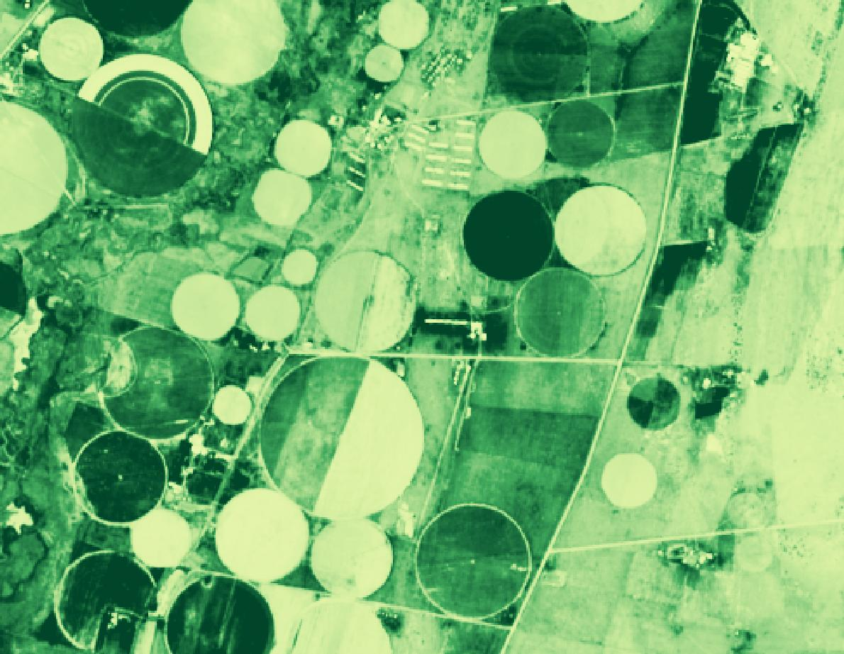
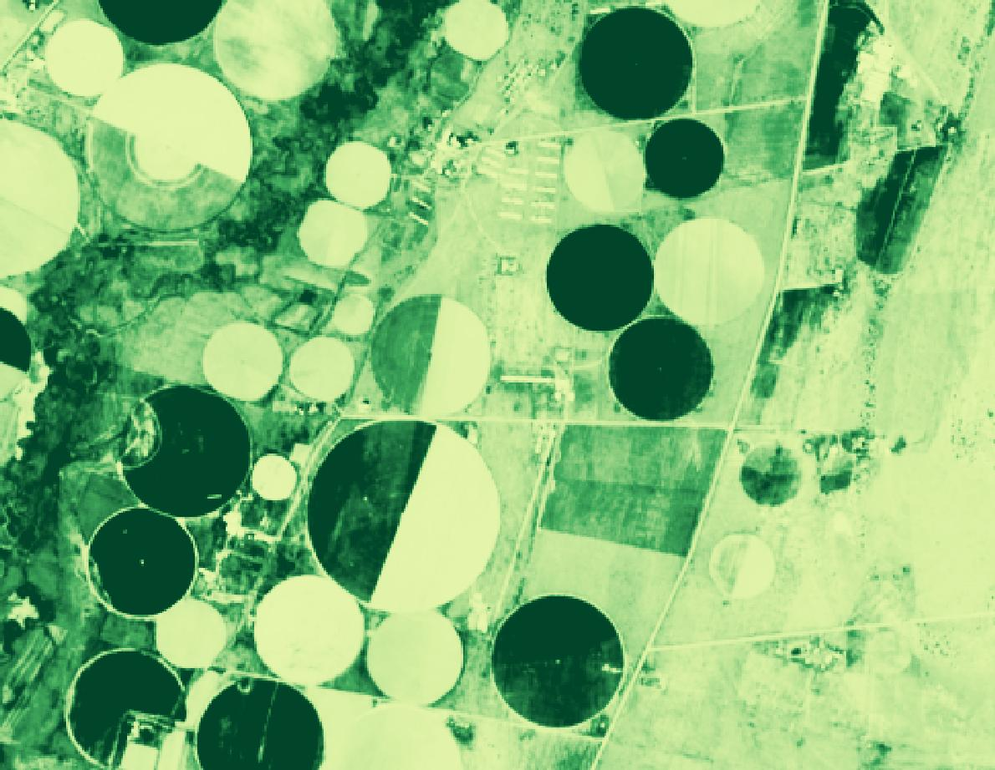
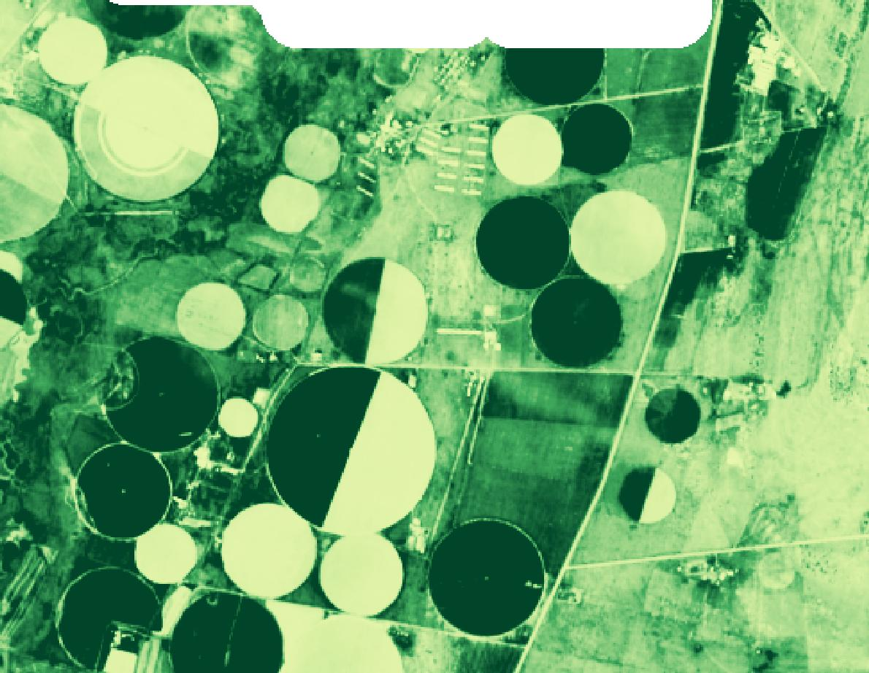
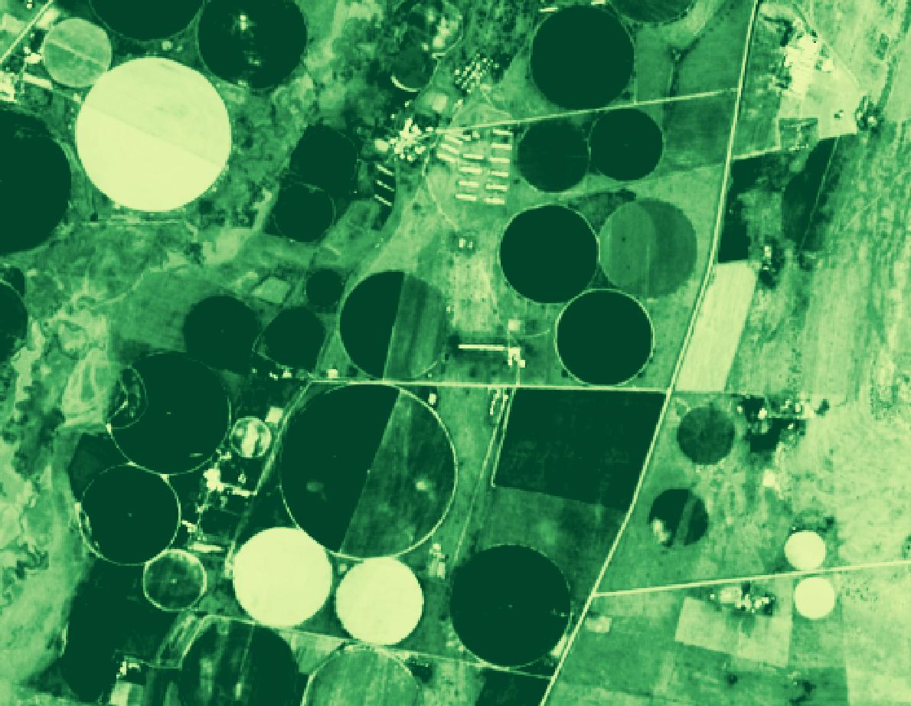

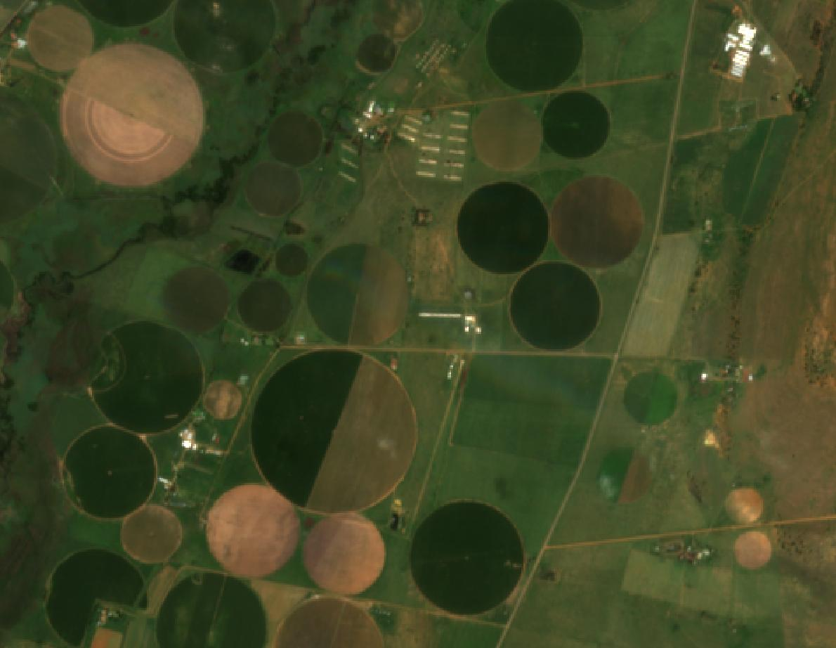
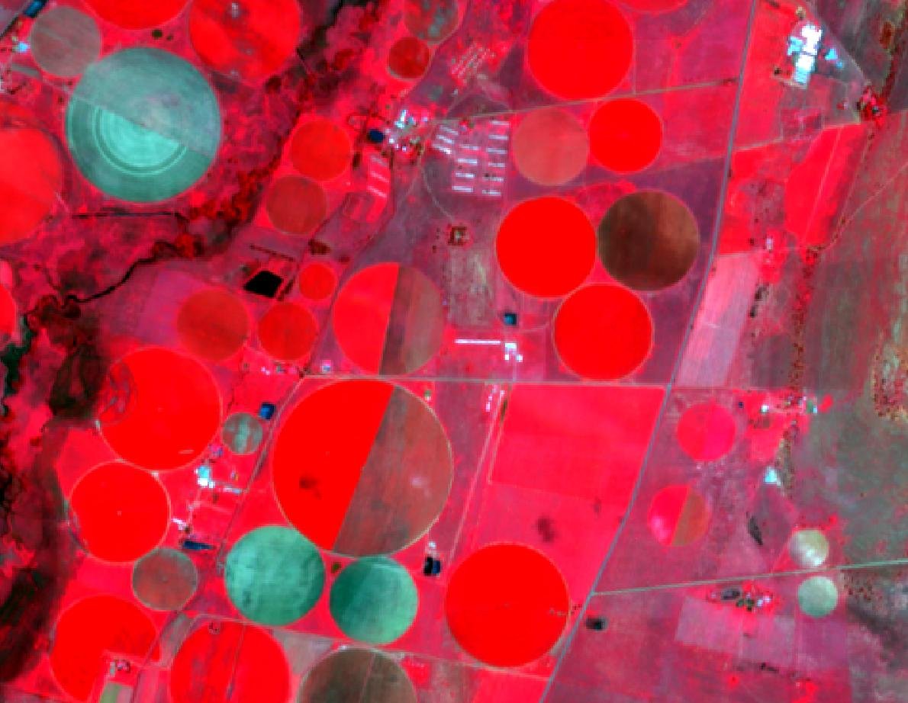

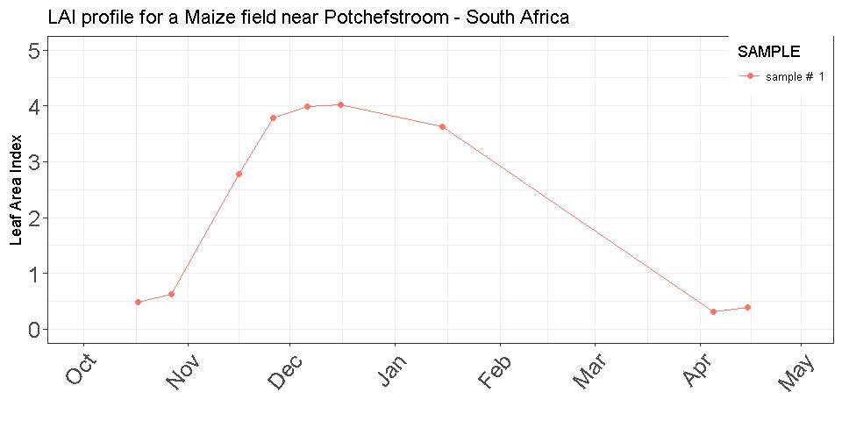
3. Thematic map accuracy – case of continuous variables
Sen2-Agri 2016-2017 Leaf Area Index at 10 m
Qualitative
Assessment:
1. Verification of the
values range
2. Temporal consistency
assessment
Quantitative
Assessment based
on reference data:
RMSE
RelativeRMSE
Mean Absolute Error
Biais
Potchestroom (South-Africa)
16/11/2016
15/01/2017
06/12/2016
27/10/2016
26/11/2016
26/12/2016
14/04/2017
5
4
3
Leaf Area Index
2
1
0

Slide 19
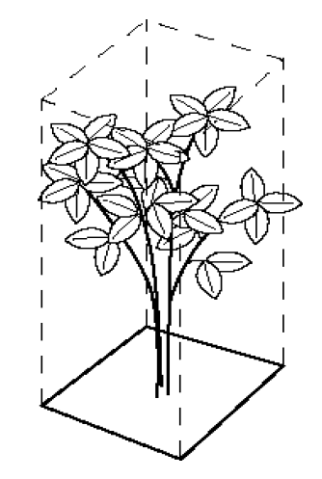
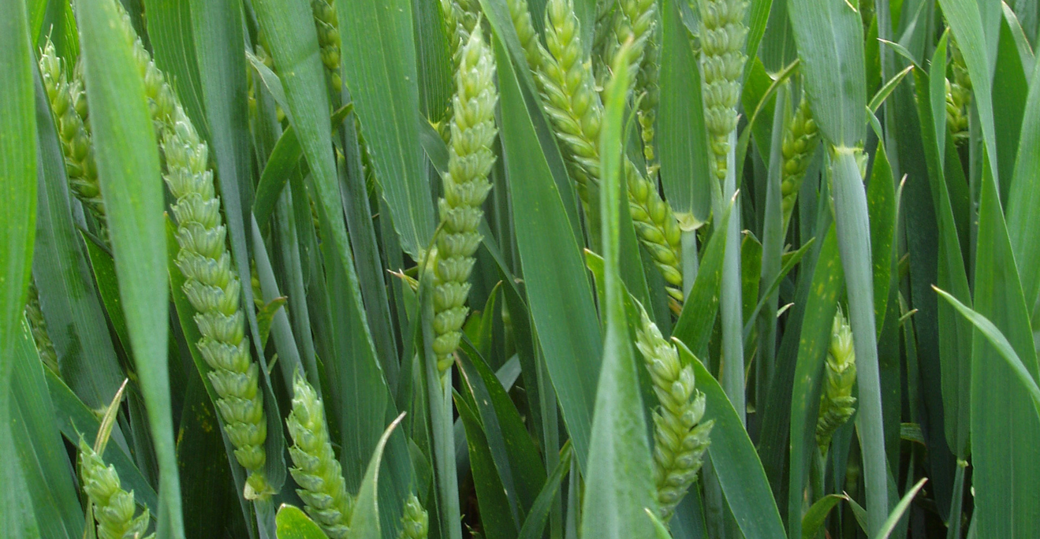
Definition precision also for continuous variables !
Leaf Area Index (LAI)- half the total developed area of green leaves per unit of ground horizontal surface area (Chen & Black, 1992)
But from a EO point of view
in cereals, green photosynthetic tissue is not exclusive to leaves, but also to stems and ears of the plant
Green Area Index = LAI + SAI + EAI
(Duveiller et al., 2010)

Slide 20
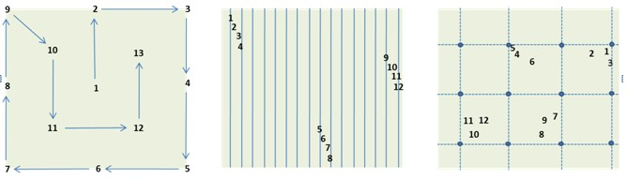
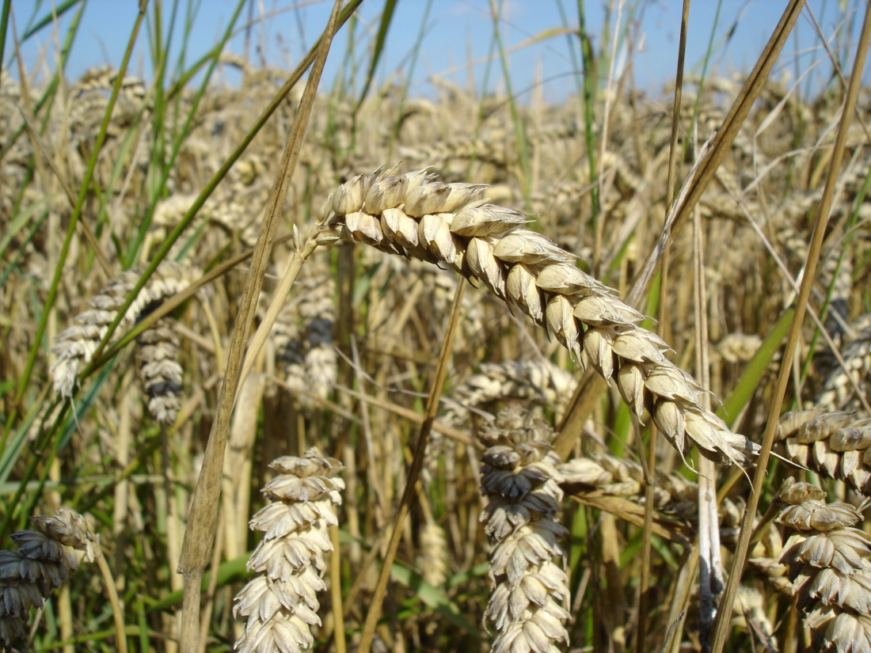
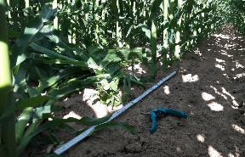
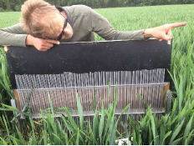
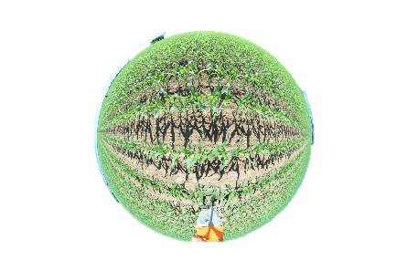
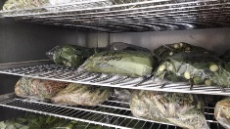

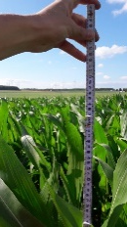
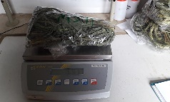
In situ data collection: field campaign protocol
Within field selection of homogeneous plots to measure and geolocate
Leaf Area Index (LAI), Canopy cover
  Dry Matter Content (biomass)
  Yield
  Plant height/density
  BBCH dvlpt stage
  Soil moisture
  Soil roughness
30 m
30 m
Digital Hemispheric Photography (DHP)
8-10 pictures per plot
Treatement in CAN-EYE software

Slide 21
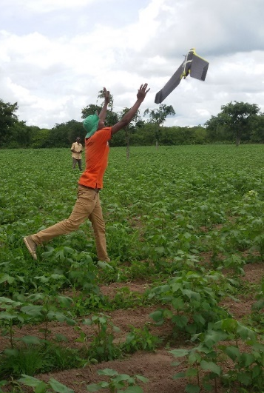
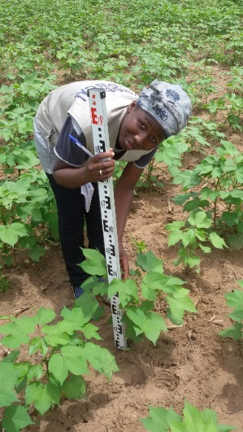
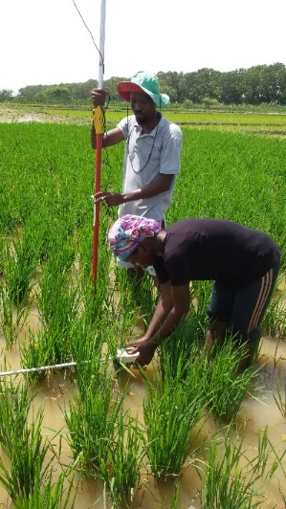
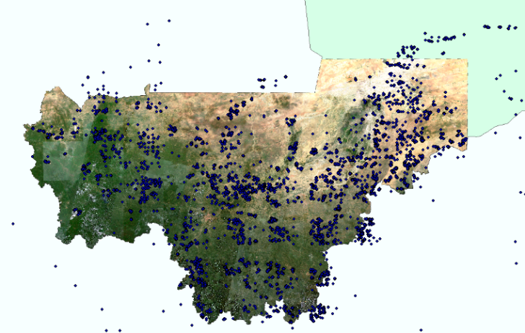
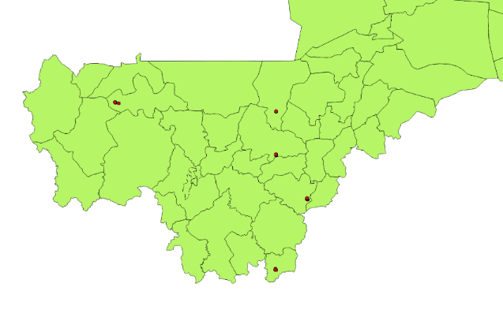
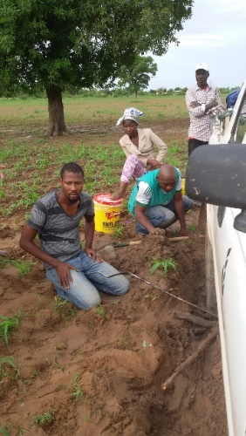
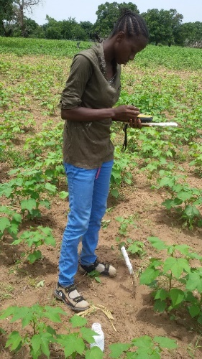
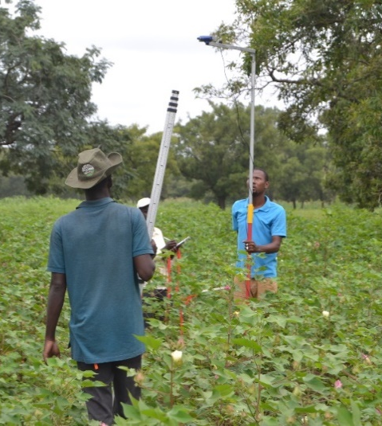
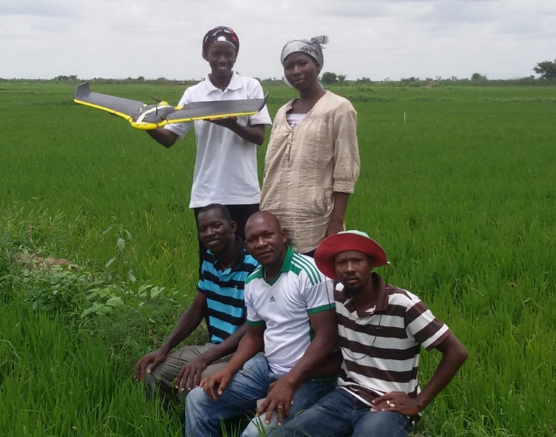
In situ data collection : field campaing in Mali (Sen2Agri 2016)
CPS Annual Survey
for statistics
IER-ICRISAT
CPS Mali

Slide 22



In situ data collection: field campaign protocol
BELSAR Campaign (e.g. SAR bistatic experiment)
10 winter wheat fields visited 6 times along season
10 maize fields visited 6 times along season
Measurements in 3 plots per field
Plots of 30x30m or 15x15 m
At least 30 m between each other
and 30 m from any border of the field

Slide 23


Thematic accuracy – metrics for continuous variables
Validation of LAI retrieved using NN&RTM LAI Validation according to the develop. stage
Duveiller et al. RSE 2011

Slide 24



Thematic accuracy – metrics for continuous variables
Bias and RelativeRMSE of retrieved LAI according to the develop. stage
Duveiller et al. RSE 2011

Slide 25



EU-JRC MARS forecast at NUTS3
Grain maize: R² between fAPAR and yields
Thematic accuracy - metrics results sensitive to aggregation level
Forecasts at NUTS3 level are then aggregated at NUTS0 and compared with official yields
France –
Grain maize
Regression constructed between
  Historical yield data from 1999-2011
  Cumulated fAPAR over a given (optimal) window
Courtesy G. Duveiller

Slide 26





4. Thematic accuracy – case of categorical variables

Slide 27
4. Thematic accuracy – case of categorical variables
Criteria for a valid accuracy assessment of a thematic map:
- Statistically rigorous – thanks to a probability sampling design to quantify the variability of the accuracy estimates using standard errors or confidence intervals.
Quality assured – protocols to evaluate the quality of the reference data (i.e. evaluate consistency of reference class labels obtained by different interpreters by providing several interpreters with a randomly chosen set of sample)
- Independent – the reference samples are strictly independent to the samples used in the EO interpretation process
Reliable – a repetition of the accuracy assessment protocol should produce approximately similar results.
Reporting standard errors or confidence intervals quantify how repeatable the estimates would be over different random outcomes of the sample selection.
Transparent – provide all relevant details, positive or negative, that would inform readers about the quality of the results (incl. any problems with missing data due to cloudy imagery or inability to access sample locations). Any modifications to standard sampling design and analysis protocols should also be documented.
- Reproducible – the methodology of the accuracy assessment should be reproducible given the documentation provided for the sampling design, response design, and analysis

Slide 28
4. Thematic accuracy – case of categorical variables
Preliminary qualitative quality control
Key components of any quantitative accuracy assessment
  The sampling design
  The response design
  The analysis and reporting

Slide 29


Preliminary systematic qualitative quality control
Mostly overlooked while the only check to capture macroscopic errors !
Regular grid
Each cell is:
  Visually checked for landscape pattern delineation and artefacts
  Compared to HR imagery
  Compared to existing information for the region
  Grid cell size decreases as landscape heterogeneity increases
Notes:
Systematic quality control – integrated into the classification procedure
Each cell is associated with an alphanumeric identification code providing information about latitude and longitude of lower left corner of the cell to facilitate the record of the errors in a database
The database, internal to the processing chain, is eventually used to target the macroscopic errors, which are then manually corrected during the post-edition processing step.

Slide 30




4.1 Sampling design definition
Criteria to define the sampling design (Stehman and Foody, 2019)
1) satisfies the conditions defining a probability sampling design;
2) easy to implement for both selecting the sample and producing estimates of accuracy;
3) cost effective;
4) readily allows for increasing or decreasing the sample size;
5) precise in the sense that estimates have small standard errors;
6) has an unbiased estimator of variance; and
7) is spatially well distributed across the study area.
Key questions to answer are:
Should strata be used ? Most often yes !
Should clusters be used ? If cost saving, yes !
What selection protocol, simple random or systematic should be used ? Challenging !
Stratification
to reduce
std errors of
accuracy estimate
“The decision of what sampling design to use is not a matter of choosing between what is practical versus what is statistically rigorous, but rather choosing what is practical and rigorous.” (Stehman, 2011)
Notes:
Sampling design guidelines (olofson)
○Stratify by map class to reduce standard errors of class-specificaccuracy estimates.
○If resources are adequate, stratify by subregions to reduce standard errors of subregion-specific estimates.
○Use cluster sampling if it provides a substantial cost savings or if the objectives require a cluster unit for the assessment
○Both simple random and systematic selection protocols are accept-able options

Slide 31


4.1 Sampling design – example of stratification
Stratification according to existing agro-ecological zoning to sample the range of diversity
ex. Ukraine: 4 zones

Slide 32

4. Thematic accuracy – case of categorical variables
Sampling size definition
Commonly used formula (Cochran, 1977)
where z=1.645 for a 90% confidence interval or
z=1.96 for a 95% confidence interval,
d is the desired half-width of the confidence interval
(i.e., the confidence interval is estimated accuracy ±d),
p is the anticipated overall accuracy in the case of simple random sampling
(useful to try several values of p to test the changes in the sample sizes)
Notes:
, applicable to overall accuracy for simple random sampling, or user’s accuracy for stratified random sampling, is as follows.

Slide 33
Sample size allocation to strata (Olofsson, 2014).
  only affects precision (i.e. standard error) of the estimators, not the bias
  The allocation of equal sample sizes to strata favours precise estimation of the user’s accuracy for each class (rather than producer’s accuracy, overall accuracy, or area either). This is justified if all classes are considered equally important (Stehman, 2019).
  The allocation of sample sizes proportionally to the relative area of the strata favours
  precise estimation of the producer’s accuracy and overall accuracy (rather than user’s
  accuracy) (Olofsson, 2014).
  In practice, proportional allocation = post-stratified estimation applied to a simple random
  proportional allocation leads to small sample sizes in the rare classes, and imprecise estimates of user’s accuracy for these rare classes => recommended to increase the sample size for the rarer classes making the sample size per stratum more equitable
  Optimal allocation when the objective is to minimise the standard error of a single accuracy estimate (e.g. OA) or area of one class. Priority classes can be given narrower confidence intervals (i.e. d in the previous equation, i.e. larger sample sizes).
4. Sampling design – sample size
Notes:
, applicable to overall accuracy for simple random sampling, or user’s accuracy for stratified random sampling, is as follows.

Slide 34













4.1 Sampling design – example of sample clustering
Reference sample clusters to save cost and time
JECAM Guidelines – “windshield survey”
by motorized vehicles (car, motorbike) selecting a set of appropriate roads (set 1) and complemented by regular additional transect (set 2) using secondary roads and tracks to try to reduce the spatial bias brought about by roadside sampling.

Slide 35





4.1 Sampling design – JECAM guidelines
Reference sample clusters “windshield survey” validated by JECAM for cropland mapping by comparing results in 4 countries
=> road planning should capture most variability
Notes:
Results showed that data sets obtained from Roadside sampling were significantly less representative than
those obtained from Random sampling but the resulting maps were only marginally less accurate (2% difference).
Transect sampling captured systematically less variability than Random or Roadside sampling which led
to differences in accuracy as large as 15%. The effect of sample size on accuracy varied across sites but generally
leveled off after reaching 3000 pixels. Augmenting the size of Transect samples improved the classification
accuracy but not sufficiently to match the performance of the other sampling strategies. Finally, we found that
Random and Roadside training sets with similar representativeness yield comparable accuracy. Therefore, we
conclude that roadside sampling can be a viable source of training data for cropland mapping if the range of
environmental and management gradients is surveyed. This underlines the importance of survey planning to
identify those routes that capture most variability.

Slide 36




4.1 Sampling design - random or systematic only on screen
Example – CCI Global Land Cover validation – 2-stage stratified random sampling
2600 Primary
Sampling Units
(PSU)
5 Secondary Sampling Units (SSU) per PSU
900m * 900 m =>13.000 potential units
SSU = validation units to be interpreted on screen

Slide 37
4. Thematic accuracy – case of categorical variables
Preliminary qualitative quality control
Key components of any quantitative accuracy assessment
  The sampling design
  The response design
- ground survey from motorbike, car or in the field using apps like GeoODK
- drones (STARS, WFP)
- very light aircrafts (South Africa)
- on screen interpretation
  The analysis and reporting

Slide 38




4.2 Response design – in situ data collection
Field boundaries from PICES air survey
Field observation from field edge (Free State, SA)
Collected data on the ground:
Crop type
Development stage
Location coordinates

Slide 39


4.2 Response design – on screen interpretation
Tools (navigation, NDVI, select object, paint class)
Zooms
Layer box
Legend
UCLouvain Validation tool
Comments
Notes:
Using HR imagery
Confidence (3 levels, for each epoch) ;
Per object – LC interpretation (per epoch)
Comments
User friendly validation web interface, facilitate LC & change interpretation – developed in CCI framework
2010 is reference year for C3S

Slide 40


4.2 Response design – on screen interpretation
Notes:
Using HR imagery
Confidence (3 levels, for each epoch) ;
Per object – LC interpretation (per epoch)
Comments
User friendly validation web interface, facilitate LC & change interpretation – developed in CCI framework
2010 is reference year for C3S

Slide 41

4.2 Response design – on screen interpretation
Example – CCI Land Cover reference sample by experts in their area of expertise only

Slide 42
4. Thematic accuracy – case of categorical variables
Preliminary qualitative quality control
Key components of any quantitative accuracy assessment
  The sampling design
  The response design
  The analysis and reporting

Slide 43

4. Thematic accuracy – case of categorical variables
The Overall Accuracy (OA) is calculated as the total number of correctly classified pixels (diagonal elements of the confusion matrix) divided by the total number of test pixels:

Slide 44

Example of Sen2Agri accuracy assessment
=> cropland masks accuracy reached 1 month after mid-season results for 4 local sites
(Defourny et al., 2019)
Notes:
OA > 80% for both methods in Belgium, China, France, Morocco, Russia, South Africa, Ukraine, where both methods perform good // lower OA in Madagascar (very small fields) and in Argentina and Burkina Faso with unsupervised method
Despite the short duration of the EO time series in Belgium due to cloud coverage, the accuracy reaches 90% => the importance of an appropriate temporal distrbituion to compensate the low frequency

Slide 45


Sen2-Agri 10 m cropland map for Ukraine (July 2016)
Cropland
Non-Cropland
Overall accuracy : 96 %
F-score cropland : 97 %

Slide 46
4. Thematic accuracy – case of categorical variables
Precision or User's Accuracy (UA) for the class i it is the fraction of correctly classified pixels with regard to all pixels classified as this class i in the classified image:
Recall or Producer's Accuracy (PA) for the class i it is the fraction of correctly classified pixels with regard to all pixels of that ground truth class i:
Key criteria - F-Score
The (also known as F-1 score or F-measure) is the harmonic mean of the Precision and Recall and reaches its best value at 1 and worst score at 0:

Slide 47









Example of Sen2-Agri accuracy assessment of crop type map in Mali
S2A&B: 0.82T of L1C and 3.5T of L2A products (S2A : 1239 products, S2B : 572 products)
Field observation : Cropland : 6332 samples, Non-cropland: 2150 samples
Fast learning curve to improve performances
H2020 - ECoLaSS

Slide 48



Slide 49


Cropland product for local site in Northern China without in situ data (trained from global CCI LC map)
4. Thematic accuracy – case of categorical variables
Cropland
Non cropland
Cropland mask, obtained without in-situ data but using the ESA CCI Land Cover map to extract training dataset
(http://maps.elie.ucl.ac.be/CCI/viewer/)

Slide 50

Example of C3S Overall Accuracy 2016:72,3%
4. Thematic accuracy – fuzziness or semantic distance
Overall accuracy values vary with threshold values:
HOM100
-> 72,3% (672 SSU)
HOM90
-> 69,5% (1164 SSU)
Notes:
Using the expert-interpreted validation DB, the accuracy of the 2016 LC map was assessed

Slide 51
5. In practice - In situ data collection: 2 different objectives
In situ data for calibration (training): sampling to cover the diversity of situations existing in the study site (possibly the national territory) in order to represent the range of possible signatures for the different elements of interest (i.e. croplands vs non croplands on one hand and, the five main crop types and the other frequent crops on the other hand).
In situ data for validation to estimate the products accuracy (with a confidence interval) using a statistically-sound sampling to be objective and independent; for logistic reasons, sampling not strictly random but 2-stage sampling (with PSU and ESU) to assess the crop types (one field campaign)
Calibration and validation field campaigns for cropland and crop type can be all combined but the sampling design should be explicitly different to be independent.
Sometimes, 2 field campaigns are needed for early and end of season maps when all
crop types can not be identified during the mid-season campaign (before some crop emergence).

Slide 52
Calibration – 3 steps
1. Stratification according to existing agro-ecological zoning to sample the range of diversity
2. On screen visual interpretation to select samples (min. 1 ha) of land cover types different than cropland on recent aerial photographs, Google Earth or Bing imagery to capture the diversity of the non cropland land cover types. The sample distribution between strata could also consider the stratum size and their respective diversity (~ 15 samples by land cover type by stratum)
  ex. Ukraine : 720 samples for non-cropland (15 samples x 12 land cover types x 4 strata)
  => 5 days in office
3. Ground survey to delineate crop type samples (min. 1 ha but larger is better)

Slide 53

Selection of calibration polygons for each of non cropland class on Google earth
Check the image date (recent!)

Slide 54
Calibration – 3 steps
1. Stratification according to existing agro-ecological zoning to sample the range of diversity
2. On screen visual interpretation to select samples (min. 1 ha) of land cover types different than cropland on recent aerial photographs, Google Earth or Bing imagery to capture the diversity of the non cropland land cover types. The sample distribution between strata could also consider the stratum size and their respective diversity (~ 15 samples by land cover type by stratum)
  ex. Ukraine : 720 samples for non-cropland (15 samples x 12 land cover types x 4 strata)
  => 5 days in office
3. Ground survey to delineate crop type samples (min. 1 ha but larger is better): for each stratum, 75-100 samples for each main crop and 20-30 samples for each minor crop. No strict sampling design but need to capture each crop diversity. Visual delineation could use the most recent color composite. A this time of the year, summer crops are not yet visible.
ex. Ukraine: 2000 samples for major crops (5 major crop types x 100 samples x 4 strata)
840 samples for minor crops (7 minor crop types x 30 samples x 4 strata)
=> 10 days before the mid-season

Slide 55

National demo in Ukraine
Windshield survey
In-situ data set – 7689 parcels
75% for algorithm calibration
25% for products validation
4+3 days, 1 car, 2 persons/car
2 weeks/campaings, including days in the office

Slide 56
Calibration – 3 steps for 2 products
Stratification
On screen interpretation of non cropland samples on GE imagery
Ground survey of 75-100 / 20-30 samples per crop and stratum
CROPLAND MAP
CROP TYPE MAP
Calibration set made of non cropland (on screen) and cropland (ground survey) samples to train each stratum separately and produce the first cropland mask at the mid-season
Calibration set made of crop types (ground survey) to train each stratum separately and produce the first crop type map at the mid-season
=> 1st field campaign data delivery before the mid-season (calibration only)

Slide 57

Validation
Stratification according to existing agro-ecological zoning to sample the range of diversity
Two-stage sampling strategy for crop type validation
  Delineation of large Primary Sampling Units (PSU) based on ancillary data set (typically admin. regions) ex. : Ukraine = around 30 oblasts (districts); local site = 5 to 15 districts
  Random selection of few (2 or 3) PSU distributed in the different strata according to their cropland area (cropland area-weighted sampling probability).
  “Windshield survey” for each selected PSU to identify the crop type for each Elementary Sampling Unit (ESU) along the roads (e.g. tablet onboard of vehicle). ESU corresponds to parcels covered by the same crop/crop association. Delineation should use the best contrasted color composite for parcel identification. The road selection and the ESU selection should be as systematic as possible, unbiased with a min. parcel size larger than 0,25 ha (25 S2 pixels). Typical density of 1 ESU / 100 sq km.
  National case. Ukraine : 2 oblasts/stratum * 4 strata => 8 oblasts => 1600 crop samples
  1 day to reach the selected oblast (PSU), 200 ESUs/day by windshield survey => 16 days campaign
  Local case. 1 district/stratum * 3 strata => 3 districts => 600 crop samples
  200 ESUs/day by windshield survey => 3-4 days campaign
Sampling strategy for non-cropland validation (2 options)
  Collection of non cropland ESU during the windshield survey
  If up-to-date very high resolution imagery (GE) is available for large parts of the area of interest, on screen identification of cropland/non-cropland samples of randomly selected in each stratum.
  Typically 100 – 150 ESUs of 0,25 ha per stratum. => 3 days in the office
JECAM Guidelines

Slide 58
User requirements &
Products specifications
Properties | User Requirement | Product specification
Spatial coverage | Local (over sites) to regional
Time period | Current | with 6 months before the 1st delivery
Temporal frequency | 1 month | 1 month with a 12-month moving window (fully operational after 23 months)
Delivery time | 3 days after the end of each month
Spatial resolution | 10 meters
Legend | Binary (crop – no crop) | focusing on annual croplands
Geometric accuracy | Sub-pixel location error | L1C geometric accuracy
Thematic accuracy | 10 % (maximum error of omission and commission of annual cropland mask) | F1-Score of 50% at the middle of the season and 80% at the end of the season
Quality flags | the number of valid observations the status of the pixel (valid, cloud, cloud shadow, snow, gaps and filled values) | Info split in 4 flags (obs. number, validity, status, gap filled)
Format | Standard raster format (e.g. GEOTIFF) | GEOTIFF
Projection | UTM and WGS84 | UTM-UPS/WGS84
Metadata | Clear metadata, standard data formats | XML file
Products distribution | Open and freely available product (+ documentation and validation)

Slide 59
Challenges for in situ data collection
To capture the entire diversity of the agriculture patterns
To cover the full diversity of the crop types of interest and all the minor crop types (it is important to define the targeted crop types to emphasize the field data collection on them and to capture all the gradients in crop growing conditions of the crop types of interest)
To integrate the control the quality of the in situ data (labeling error, location error, editing error, etc. ) as the in data quality is of paramount importance
To ensure the spatial distribution of the in situ data across the whole study area to avoid a local overfitting of the classification model to specific growing conditions
To use spatially independent in situ data for robust accuracy assessment (closer the calibration and validation data set are in space, more the accuracy metrics represent the quality of the classification model rather than the quality of the entire map); Sen2Agri system delivers accuracy metrics for the entire map when the in situ covers the whole region of interest

Slide 60


Slide 61
Information-based criteria for assessing map accuracy and uncertainty
P. Bogaert and F. Waldner

Slide 62

Back to our synthetic example

Slide 64







Echantillonnage
2110 échantillons
Photo interprétation
Indices de validation

Slide 65

L’estimation des surfaces est une des applications principales de la télédétection.
La méthode la plus commune pour estimer les surfaces est de compter le nombre de pixels appartenant à chaque classe et de le multiplier par la surface d’un pixel.
→ Comptage de pixels
L’estimateur de surface par comptage de pixels est biaisé car il n’y a aucune garantie que les erreurs d’omission et de contamination se compensent.
La résolution décamétrique de Sentinel-2 est une opportunité pour revisiter les estimations de surfaces car le nombre de pixels mixtes diminue.
Comment identifier les zones où les estimations de surface satisfont les exigences de précision?

Slide 66


Simuler une résolution plus faible à partir de données à très haute résolution.
Faible résolution
Agrégation naïve
La valeur du pixel à plus faible résolution correspond à la proportion des pixels de zone cultivée présent à très haute résolution.
Elle correspond à une situation « idéale » car elle modélise un capteur qui a une réponse spatiale parfaite.
Zone non-cultivée
Zone cultivée
Très haute résolution

Slide 67


Les pixels mixtes apparaissent quand on dégrade la résolution.
3 m
10 m

Slide 68

Les pixels mixtes et le biais dû à la résolution
3 m
30 m
30 m

Slide 69

Les pixels mixtes et le biais dû à la résolution
3 m
56 m

Slide 70

Les pixels mixtes et le biais dû à la résolution
3 m
100m

Slide 71

Les pixels mixtes et le biais dû à la résolution
3 m
250m

Slide 72


Slide 73

La fragmentation du paysage comme prédicteur du biais de résolution
La présence de pixels mixtes dépend:
1
de la fragmentation du paysage
de la résolution spatiale
2
L’ indice de Matheron mesure le ratio entre le périmètre total des patchs de cultures et le produit entre l’aire cultivée et l’aire totale:
$$MI=\frac{périmètre cultures}{\sqrt{aire cultures} ∗\sqrt{aire totale}}$$

Slide 74


Les pixels mixtes sont une source De biais incompressible.
L’agrégation à une résolution plus faible introduit des pixels mixtes.
Il faut appliquer un seuil de proportion de zones cultivées pour retrouver une carte binaire.
Ce seuil implique de commettre des erreurs d’omission et de contamination.
Erreur de contamination
25 %
25 %
Erreur d’omission

Slide 75

Les pixels mixtes sont une source De biais incompressible.
L’agrégation à une résolution plus faible introduit des pixels mixtes.
Il faut appliquer un seuil de proportion de zones cultivées pour retrouver une carte binaire.
Ce seuil implique de commettre des erreurs d’omission et de contamination.
Erreur de contamination
50 %
50 %
Erreur d’omission

Slide 76

Les pixels mixtes sont une source De biais incompressible.
L’agrégation à une résolution plus faible introduit des pixels mixtes.
Il faut appliquer un seuil de proportion de zones cultivées pour retrouver une carte binaire.
Ce seuil implique de commettre des erreurs d’omission et de contamination.
Erreur de contamination
75 %
75 %
Erreur d’omission

Slide 77
Les pixels mixtes sont une source De biais incompressible.
En reliant les couples d’erreur liés à chaque seuil, on trace la frontière de Pareto.
La résolution spatiale est source de biais incompressible pour l’estimation des surfaces.
Erreur de contamination
25 %
Frontière de Pareto
50 %
75 %
Erreur d’omission

Slide 78

Identifier l’erreur maximum tolérable
Biais total = Biais de classification + Biais de résolution
Inconnus sans faire de classification
Fonction de la résolution et de la fragmentation
Biais de classification tolérable = Tolérance de l’utilisateur – Biais de résolution
En définissant une tolérance sur la précision de l’estimation de la surface, on obtient l’erreur maximum tolérée d’une méthode de classification.
Waldner, F. and Defourny, P. 2017. Where can pixel counting area estimates meet user-defined accuracy requirements? International Journal of Applied Earth Observation and Geoinformation, 60:1–10.

Slide 79


Cartographier le domaine d’application pour l’estimation des surfaces par comptage de pixels
10 m
30 m
Résolution spatiale

Slide 80

Sauf que
Parfois je reste éveillé la nuit en me demandant “Qu’y-a-t-il vraiment dans un pixel?”.

Slide 81

Le flou introduit par la modélisation de la PSF augmente le nombre de pixels mixtes.
Modéliser la PSF augmente le nombre de pixels mixtes.
Le nombre plus élevés de pixels mixtes entraîne une augmentation le biais de la résolution.

Slide 82


Le flou introduit par la modélisation de la PSF réduit le domaine d’applicabilité.
10 m
30 m
Résolution spatiale

Slide 83














Résolution spatiale
25 cm
10 m
20 m
30 m
250 m
25 cm
10 m
20 m
1 m
10 m
250 m

Slide 84


Compromis entre résolution spatiale et spectrale
Variété
Résolution temporelle
1 an
X
Cartographie à différentes échelles spatiales et temporelles
10 jours
TENDANCE
1 jour
Résolution spatiale
1 m
10 m
250 m
Notes:
Expliquer et dire vous reverez ce schéma plus tard

Slide 85

Thermal time
Plants grow faster over a given temperature range
Yan & Hunt (1999) Annals of Botany

Slide 86


Thermal time
Simple practical approach to change the time axis...
Sum of growing degree days above a given temperature
Or more complicated (but more accurate) approach based on describing the rate of growth using all cardinal temperatures

Slide 87

3 ways to use RS for (Crop) area estimation
To stratify a field survey
Classification + pixel counting (no field data)
  But if accuracy is 80% error is already much higher than requirements of ~2-3% (which can be obtained with a good field survey)
Use RS classification as a proxy variable which is regressed with data from a field survey

Slide 88





Examples of European agricultural landscapes
SPOT-VGT 1km
MODIS 250m
MERIS/OLCI 300m

Slide 89

Source: NASA/GSFC/METI/Japan Space Systems

Slide 90


Slide 91


The balance between pixel size and pixel purity
  Increasing Pixel Size
  Increasing Pixel Purity
Duveiller & Defourny 2010 RSE

Slide 92
The pixel purity–size space
  Increasing Pixel Size
  Increasing Pixel Purity
A pixel population
Duveiller & Defourny 2010 RSE
Notes:
We can define a pixel purity-size space
For each pair of purity and size values corresponds a pixel population

Slide 93




What is a crop map ?
What is a crop ? A crop is any cultivated plant, fungus, or alga that is harvested for food, clothing, livestock fodder, biofuel, medicine, or other uses
Rice
Sugarcane
Corn
Olive tree

Slide 94

How can I map crops with remote sensing ?
3 categories
Radiometric features
  Reflectances, spectral indices
  Texture (local statistics)
Temporal features
  Time descriptors (based on time profiles)
  Phenologic indicators: time descriptors based on prior knowledge about vegetation
Object features: extracted after images segmentation
  Radiometric features
  Shape features
  Adjacency features
Features selection:
Available data
Satellite data
Raw measurements
Preprocessed measurements (calibration, Atmospheric correction ….): Spectral reflectances, radar σ₀,
Combination of bands (e.g. NDVI)
Phenology index
…
Ancillary data:
Previous land cover map(s)
Digital Elevation model
Soil maps
…
Example of phenological descriptors which can be extracted from a temporal profile

Slide 95
How can I map crops with remote sensing ?
Evaluation criteria: the confusion matrix
A confusion matrix, also known as an error matrix is allows visualization of the performance of a classification process. Each column of the matrix represents the instances in a predicted class while each row represents the instances in an actual class (or vice-versa).

Slide 96










System operation for crop mask without in situ data
Before the start of
the monitoring period
Automatic EO data download
Manual in situ data upload
Monitoring period
System initialization
SoS
6M
EoS
SoS
EO data providers

Slide 97

Monthly cropland product performance along the season in Madagascar local site

Slide 98



Slide 99


Sen2-Agri 10 m products : field level

Slide 100

Season 2016 : area indicator per oblast for the 5 main crops

Slide 101


Cropland and rice monitoring in Office du Niger
Notes:
Office du Niger

Slide 102


2016 Cropland mask at 10m resolution for Mali from Sentinel-2 and Landsat 8
System validation:
Overall accuracy: 81 %
F-score cropland: 75 %

Slide 103


Slide 104


Slide 105

Area estimate indicator at harvest time for the
Cellule de Planification statistique (Mali)

Slide 106
Updated accuracy: Increase sample units
Consolidation measures result in an increase in the number of ‘certain’ reference sample points (SSU) used in validation
Validation of the 2016 LC product using only ‘certain’ interpretations:
Before consolidation
After consolidation
HOM100: 72,3% (672 SSU) => 72,6% (774 SSU)
HOM90: 69,5% (1164 SSU) => 71,1% (1352 SSU)

Slide 107

OA 2016: HOM90 and confidence certain
N=1352
Overall Accuracy = 71,08%
Possible improvements:
Bare, Sparse, Grassland, Shrubland
These classes often appear as natural continuous gradient on the ground

Slide 108

Vegetation
Indices (VIs)

Slide 109




Research challenge to deal with the
bidirectional reflectance
Bidirectional ReflectanceDistribution Function (BRDF)
D. Deering

Slide 110



Decametric challenges : volume and diversity of signatures (10m details over large areas)
10 m
30 m

Slide 111


Research challenge to deal with smallhoder farming heterogeneity
To develop methods exploiting (deca)metric time series to capture crop signal in spite of field heterogeneity and practices diversity
Fertilizer impact
Geoye 26 Aug. 14 - Mali
2-m resolution time series capture large field heterogeneity
BMGF – STARS Chomé G., ICRISAT – Blaes X. LPS2016

Slide 112







Research challenge in a data rich environment
Methods to take advantage of existing data flows and mobile devices to improve EO methods to derive timely relevant info with the required accuracy-frequency-reliability!
Notes:
Indeed, this a currently an outstanding achievment for remote sensing researcher to reach 90 % accuracy, very nice paper but not useful for area where the cropland vary within

Slide 113
Sen2-Agri in situ data collection:
Objectives
2 different objectives
In situ data for calibration (training): sampling to cover the diversity of situations existing in the site or the national territory in order to represent the range of possible signatures for the different elements of interest (i.e. croplands vs non croplands on one hand and, the five main crop types and the other frequent crops on the other hand).
In situ data for validation to estimate the products accuracy (with a confidence interval) using a statistically-sound sampling to be objective and independent; for logistic reasons, sampling not strictly random but 2-stage sampling (with PMU and ESU) to assess the crop types (one field campaign) and the LAI
Calibration and validation field campaigns for cropland and crop type can be all combined as long as the sampling design are explicitly different and the samples labelled accordingly.
However, 2 field campaigns are probably needed for early and end of season map products if all
crop types can not be recognized during the first campaign due by mid-season at the latest.

Slide 114
Sen2-Agri in situ data collection:
Calibration (national case)
Stratification according to existing agro-ecological zoning to sample the range of diversity (with up to 12 agro-ecological zones (strata) for nat. case)
  ex. : Ukraine = 4 zones
On screen visual interpretation to select samples (min. 1 ha) of land cover types different than cropland on recent aerial photographs, Google Earth or Bing imagery to capture the diversity of the non cropland land cover types. The sample distribution between strata could also consider the stratum size and their respective diversity.
  ex. : 720 samples for non-cropland training
  (15 samples x 12 land cover types x 4 strata)
  => 5 days in office
Ground survey to delineate at least 30 samples (min. 1 ha but larger is better) for each main crop and for each stratum. No strict sampling design but needs to capture each crop diversity. Visual delineation could use the most recent color composite. A this time of the year, summer crops are not yet visible.
ex. : 1440 samples (30 samples x 12 crop types x 4 strata)
=> 10 days before the mid-season

Slide 115
How can I map crops with remote sensing ?
Choice of the classifier: Results of the benchmarking exercise for Random Forest and SVM over 8 sites
The RF classifier yields better results for most of the sites. SVM produces good results comparable to RF when the number of classes is small, as shown by the results of Argentina and China, and specially in South-Africa where results are much better. However, as the SVM is very sensitive to a balanced share of samples between the classes, it has to be parameterized in such a way that all classes are equally represented. This means that majority classes will be under-sampled. For this reason and for these classes, lower results are obtained if they are compared with the RF results, whilst for minority classes results may be better.

Slide 116

Random Forest model estimation
L2A time series
Construction of the classification model in 3 steps
Splitting polygons for training and testing
  By polygons and not by pixels
Randomly selecting a number of pixel samples for “crop” and “not crop” classes
  Output selection is class consistent (if 33% of crops is soybean, 33% of crop class training samples will also be soybean)
  Needed to reduce the time complexity of the RF classifier
Training model generation
Gap filling
Gap filled L2A time series
Spectral indices computation
Gap filled NDVI, NDWI, brightness time series
Features computation
Temporal features
Statistic features
Features concatenation
In situ data
Concatenated time series of features
RF model estimation
RF model

Slide 117


Benchmarking products 2013
(SPOT 4 Take 5, L8, RE)
Argentina
France
Russia
Belgium
Madagascar
South
Africa
Burkina
Faso
Ukraine
Morrocco
China
Pakistan
United
States

Slide 118


Accuracy assessment (2/2)
Supervised approaches better than unsupervised ones
Unsupervised ones reaching the OA targets
6 months of observations enough to reach the final cropland accuracy
Notes:
OA > 80% for both methods in Belgium, China, France, Morocco, Russia, South Africa, Ukraine, where both methods perform good // lower OA in Madagascar (very small fields) and in Argentina and Burkina Faso with unsupervised method
Despite the short duration of the EO time series in Belgium due to cloud coverage, the accuracy reaches 90% => the importance of an appropriate temporal distrbituion to compensate the low frequency

Slide 119
Thermal time
Simple practical approach to change the time axis...
Sum of growing degree days above a given temperature
Or more complicated (but more accurate) approach based on describing the rate of growth using all cardinal temperatures

