Slide 1
Crop nitrogen management and satellite-derived information for crop monitoring and yield forecast
Mirco Boschetti CNR-IREA

Slide 2
Crop nitrogen management and satellite-derived information for crop monitoring and yield forecast
Part 2b

Slide 3
Presentation outline
Satellite-derived information for yield forecast (1 h)
Theory
  2a: Phenometric from time series analysis
    SoS, Peak, EoS, integral
  2b: Yield estimation and forecast
    Empirical relation with Seasonal – phenology based VIs integral
    EO product in semi-empirical models (radiation use efficiency)
    EO data assimilation in crop model
    Crop Yield Forecasting System

Slide 4
Empirical approaches
“....empirical approach builds a relationship between ground yield survey samples and the remote sensing derived parameters* , and then applies the relationship to remote sensing imagery to map yield over the entire area …”
* e.g., maximum VI (LAI) , integral VI (LAI) from the entire growing season or for specific period

Slide 5
    Empirical relation: VI LAI seasonal metrics
Since early 1980s seasonal biomass proxy (Vis or EO based LAI) are used to estimate crop yield
Tucker et al. 1980 reported that the NDVI for a five-week period (stem elongation to anthesis) explained ~ 64% wheat yield variation. Pinter et al. 1981 summed the NDVI for wheat and barley (heading to full senescence) explaining about 88% of yield. Daughtry et al. 1992 found that single observation of LAI has limited value in predicting corn yield, but the accumulated absorbed solar radiation over the growing season explained ~ 65% yields.
Despite the local validity and limited applicability to different areas or years these methods are simple and effective if ground survey samples are representative and accurate.
In recent year thanks to the availability of satellite data many application have been developed using empirical relationships between yields and various vegetation indices (VIs).
Becker-Reshef et al. (2010) used the maximum NDVI from MODIS and built a generalized regression model for forecasting winter wheat yields. Franch et al. (2015) further improved this approach by adjusting NDVI before the peak date using growing degree day (GDD) information for earlier prediction.*
*This approach has been investigated in GEOGLAM (Group on Earth Observations Global Agricultural Monitoring)

Slide 6
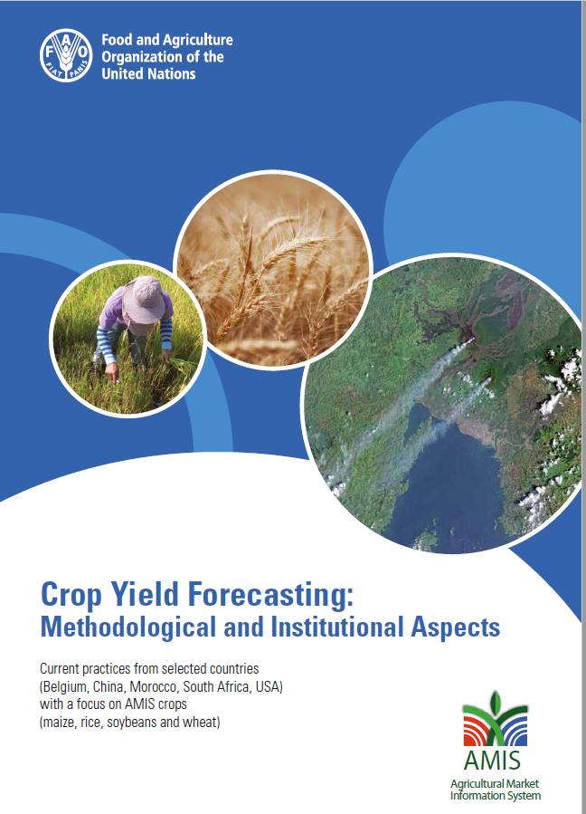
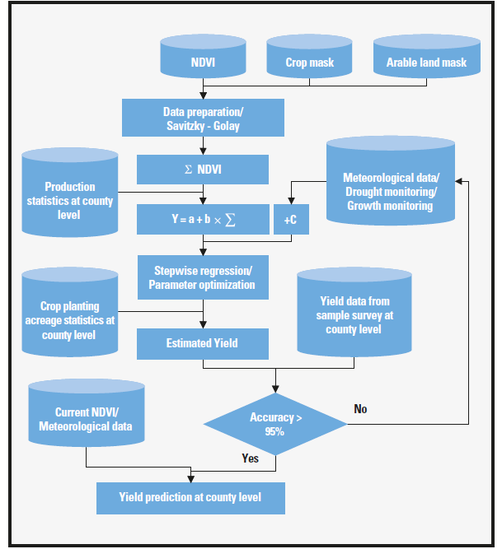
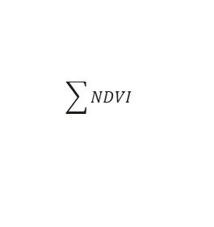
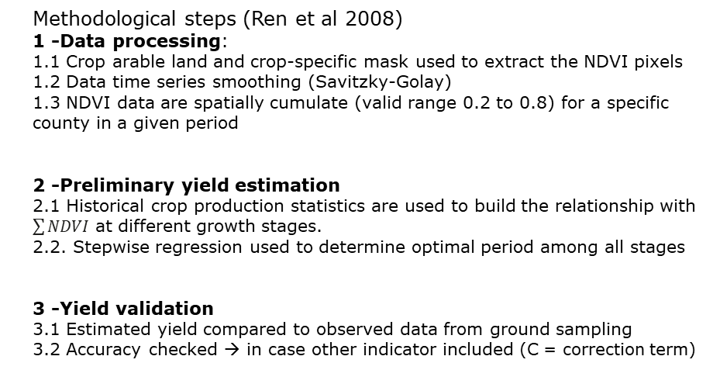

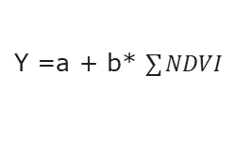
    Empirical relation: example of operational system
Flow chart of NDVI-based statistical model in CHARMS (CHina Agriculture Remote sensing Monitoring System)
Methodological steps (Ren et al 2008)
1 -Data processing:
1.1 Crop arable land and crop-specific mask used to extract the NDVI pixels
1.2 Data time series smoothing (Savitzky-Golay)
1.3 NDVI data are spatially cumulate (valid range 0.2 to 0.8) for a specific county in a given period
2 -Preliminary yield estimation
2.1 Historical crop production statistics are used to build the relationship with $\sum{NDVI}$ at different growth stages.
2.2. Stepwise regression used to determine optimal period among all stages
3 -Yield validation
3.1 Estimated yield compared to observed data from ground sampling
3.2 Accuracy checked → in case other indicator included (C = correction term)
$$\sum{NDVI}$$
Y =a + b* $\sum{NDVI}$
Y =a + b* $\sum{NDVI}+C$

Slide 7
    Empirical relation: Integral with dynamic phenological information
Prob:
relationship between RS data and crop yields vary as a function of time during growing season
Crop planting dates and phenology vary by location and change from one year to the next.
→ using a fixed calendar date to estimate RS -based yield prediction models is not optimal!
Solution:
Use crop phenology info derived from RS to improve estimates of both intra- and inter-annual variability in crop yields.
Calculate “phenologically adjusted” time series by identifying the date of onset of EVI increase “green-up”
Test perfomed
maize and soybean yield estimation in the Central US
Results
Inclusion of information related to crop phenology derived from MODIS significantly improved model performance within and across years.
Bolton and Friedl (2013)

Slide 8
Radiation use efficiency approach
“..vegetation growth (kgDM/ha/day) is defined by the part of the incoming solar radiance that is used for photosynthesis (PAR) and which is absorbed by the plants (APAR, [kJ_{AP}/m²/d]) and an actual conversion efficiency factor ε_{ACT}.”

Slide 9



Radiation Use Efficiency approach: DRY MATTER PRODUCTIVITY (DMP)
Monteith 1972
VI relation OR
from RTM inversion
Par | Description | Unit
NPP | Net primary productivity | gC/m2 /day
DM | Dry matter = NPP / (0.45*0.1) | kgDM/ha/day
GPP | Gross primary productivity | gC/m2 /day
APAR | Absorbed Photosynthetically Active Radiation | kJ_{AP}/m² /d
fAPAR | fraction of APAR) | J_{AP}/J_{P}
R | total shortwave radiation | kJ_{T}/m² /d
ε_{ACT} | actual efficiency | -
Maximum light use efficiency crop dependent
downregulation factor | Description
ε_{T} | Efficiency term limiting the vegetation growth for temperature stress
ε_{H2O} | Efficiency term limiting the vegetation growth for water stress.
ε_{CO2} | CO2 fertilization effect
ε_{AR} | Fraction kept after autotrophic respiration
ε_{res} | Fraction kept after residual effects (pests, lack of nutrients, etc.)
limiting factors
autotrophic respiration
https://land.copernicus.eu/global/sites/cgls.vito.be/files/products/GIOGL1_ATBD_DMP300m-V1_I1.11.pdf

Slide 10
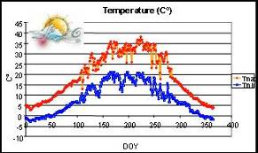
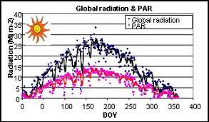
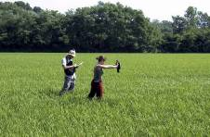
Crop yield from «Radiation Use Efficiency approach»
Harvest Index
(-)
Pheno stages
(DOY)
Photosynthetically
Active Radiation
(MJ x m⁻² x d⁻¹)
Temperature
limitation *
Radiation Use Efficiency
(gDMx MJ⁻¹)
fraction of Absorbed Photosynthetically
Active Radiation
(-)
Meteo station
Experimental data
Satellite derived

Slide 11
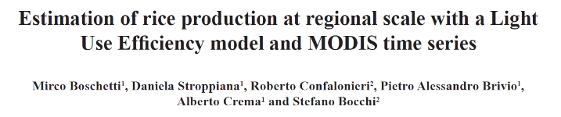
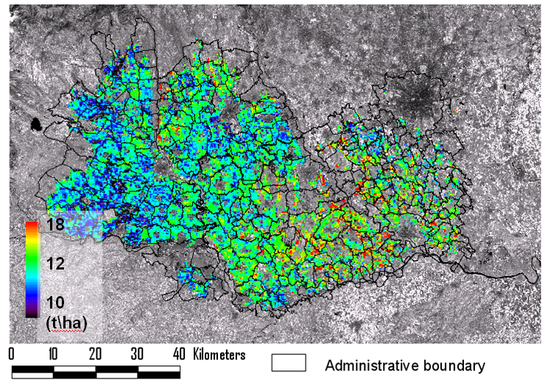
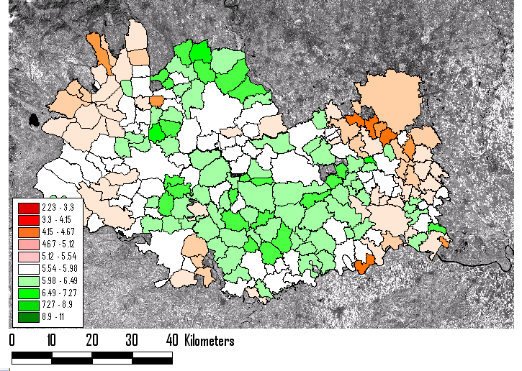
Rice regional estimates
Biomassa
Yield
2002
2003
2004
Boschetti et al. 2011
Administrative unit

Slide 12

DM operational product
Main application domains:
By comparison of current DMP or GDMP estimate with long-term average and/or previous periods, it is possible to detect the anomalies in vegetation growth which are useful for early warning purposes.
By accumulating DMP or GDMP information over time (e.g. from the start of the growing season onwards), it is possible to identify zones of high or low productivity. These can be useful for the monitoring of pasture areas.
The DMP is also used in agro-meteorological models to estimate and forecast the crop yield.
Main users:
European institution for global crop monitoring and yield forecast
NGO for early warning.

Slide 13
Assimilation in crop model
“A Crop Simulation Model (CSM) is a simulation model that describes processes of crop growth and development as a function of weather conditions, soil conditions, and crop management”

Slide 14

Crop model in a nut shell 1/4
Crop models have been increasingly used since the 70s to analyse the interactions between plants and factors driving their growth (weather, soil, and management practices)
From the mid-80s, crop modellers focused to develop management-oriented models suitable for field decision-making (e.g. EPIC - Williams et al., 1984; CropSyst - Stöckle et al., 2003).
Since late ’90s key use is crops monitoring conditions and yields forecasting at regional, national and international scales (Genovese et al., 2001; Bezuidenhout and Singels, 2007).

Slide 15
Crop model in a nut shell 2/4
Example of model output:
lai → leaf area index (m2 m-2,)
glai → green leaf area index (m2 m-2).
ground_biomass → aboveground biomass (kg ha-1)
lbiomass → leaves biomass (kg ha-1)
stem_biomass → stems biomass (kg ha-1)
org_biomass → storage organs biomass (kg ha-1)

Slide 16
Crop model in a nut shell 3/4
The portion of unexplained variability in yield estimate
(i) absence of algorithms to reproduce the effect of biophysical processes actually affecting yields (e.g., plant-pathogen interaction),
(ii) uncertainty in the input data ingested into the crop models due to data quality and reduced spatial dimension (usually interpolated values from point stations), and
(iii) the aggregation of results from the elementary simulation units to the administrative level for which the forecast is produced (e.g. region country)
New sub-model for impact of biotic and a-biotic injuries on crop yields (e.g., WARM - Water Accounting Rice Mode, Confalonieri et al., 2009).
Working on small areas (reduce uncertainty in input data and no need aggregation)
Need of spatially distributed inputs at appropriate resolution
assimilation of high quality and timely EO information to continuously approximate the simulated system to the real one.

Slide 17
Crop model in a nut shell 4/4
AGB and panicle biomass
Potential vs limited production according to irrigation management
The potential production* level
limited by blast disease
actual production level (i.e., limited by all biotic and abiotic stresses)
*potential production level (i.e., limited by temperature and radiation)

Slide 18
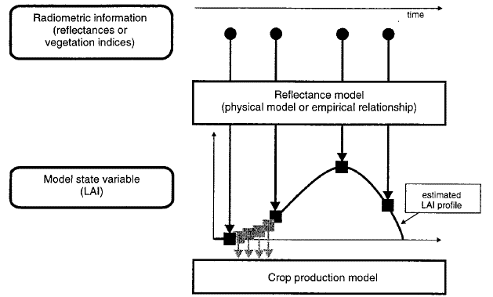
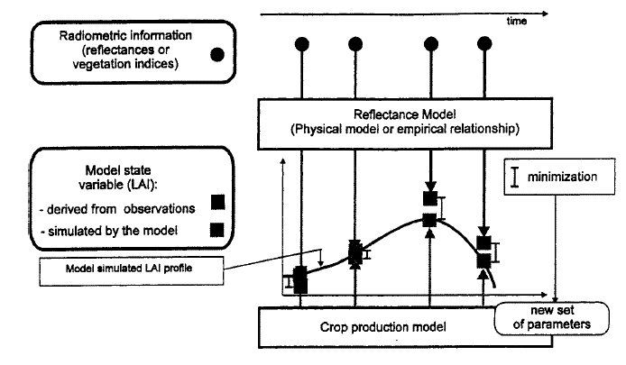
EO data assimilation strategy: forcing vs recalibration
forcing strategy*
recalibration strategy*
* temporal behavior of one state variable (e.g. LAI) derived from satellite observations and used as input variable within the model
**comparing modelled LAI and `EO LAI observations’ some parameters of the crop model (or some initial conditions) are re-tuned
Moulin et al. 1998

Slide 19
Examples of assimilation of EO data in crop model
Direct use of EO data in crop model for yield estimation
  Recalibration exploiting EO derived GAI
    regional level wheat yields estimates (Belgium)
    farm level rice yield estimates and field variability (Italy)
Assimilation & post processing in Yield forecast systems
  Forcing of sowing dates and LAI assimilation for local scale rice estimates and forecast (rice district in Europe)

Slide 20
Recalibration Examples 1:
Estimating regional winter wheat yield with WOFOST through the assimilation of green area index retrieved from MODIS observations

Slide 21
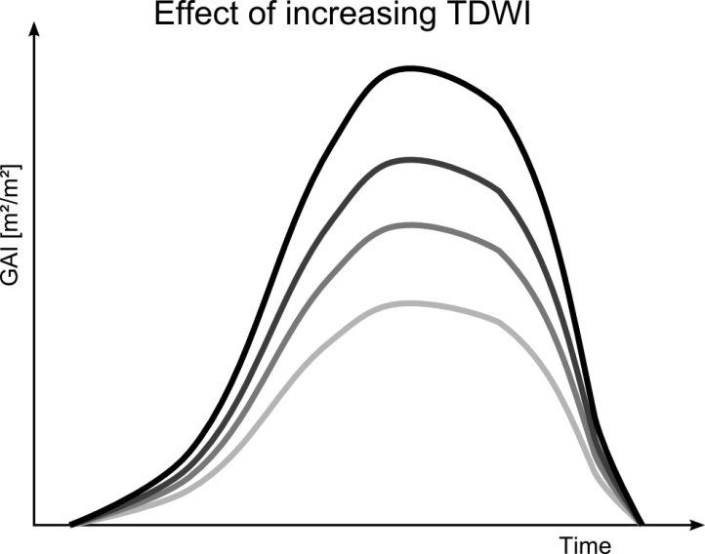
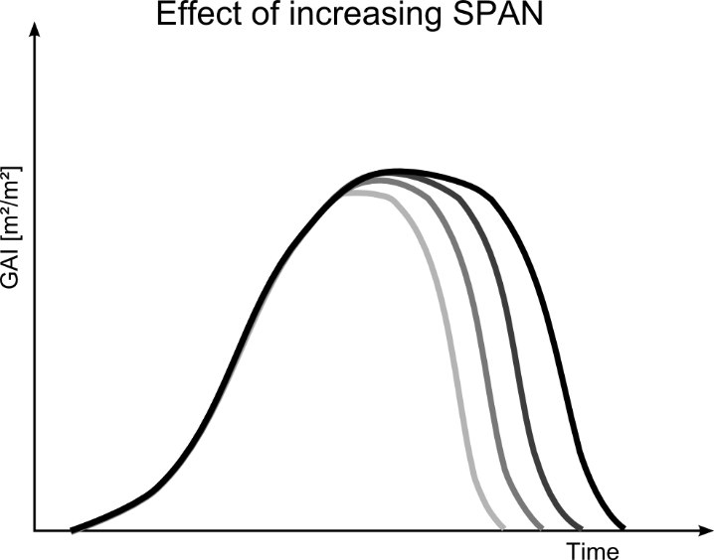
Recalibration of a crop model based on GAI time series
Crop : Wheat
Study area: Walloon region of Belgium; 6 years of official yield records (EUROSTAT)
Model: WOFOST (Diepen; 1989); simulation unit ADMIN level
EO product: crop-specific green area index (GAI) estimations from 250-m MODIS
Approach: Re-ajustement of key par. describing GAI in WOFOST based on RS-GAI
Par1: Initial biomass after winter (TDWI)
Par2: Length of leaf lifespan (SPAN)
  Higher initial biomass result in higher GAI peak
  Determines senescence of leaves
Duveiller 2011
de Wit et al2012

Slide 22
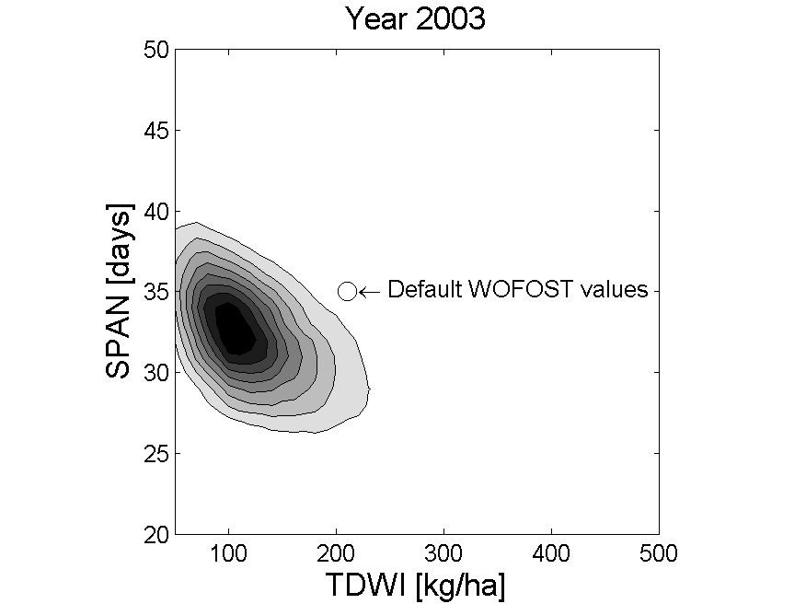
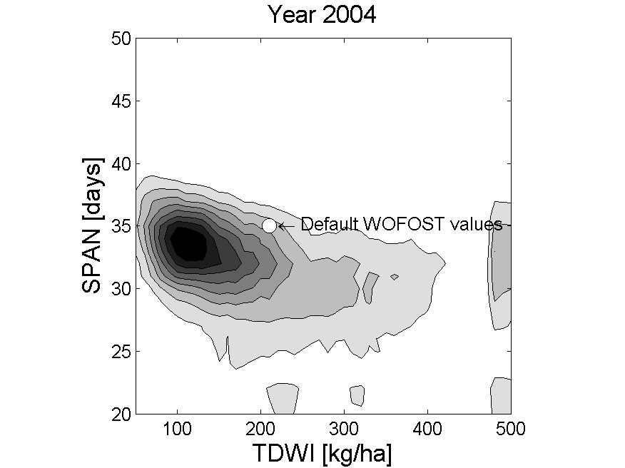
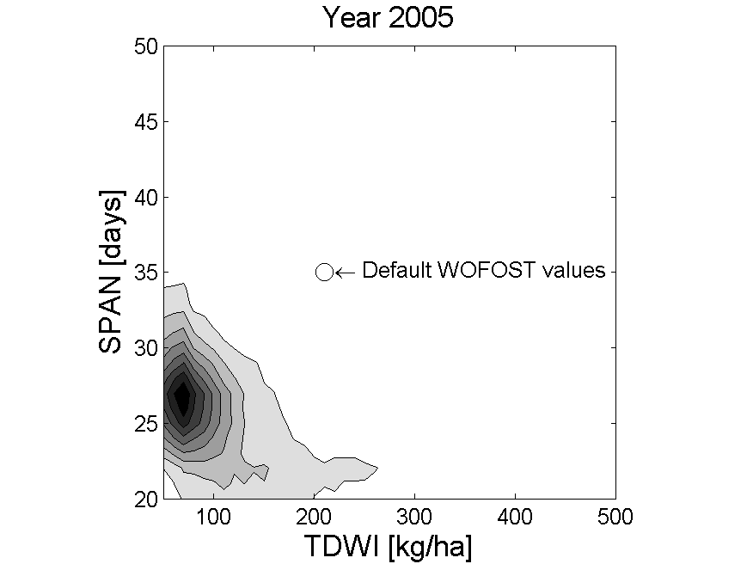
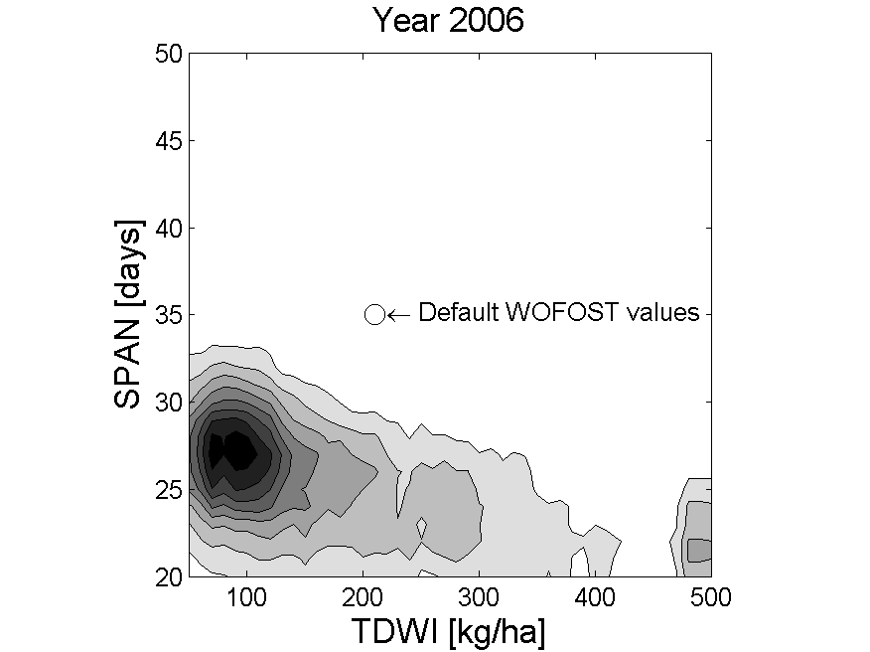
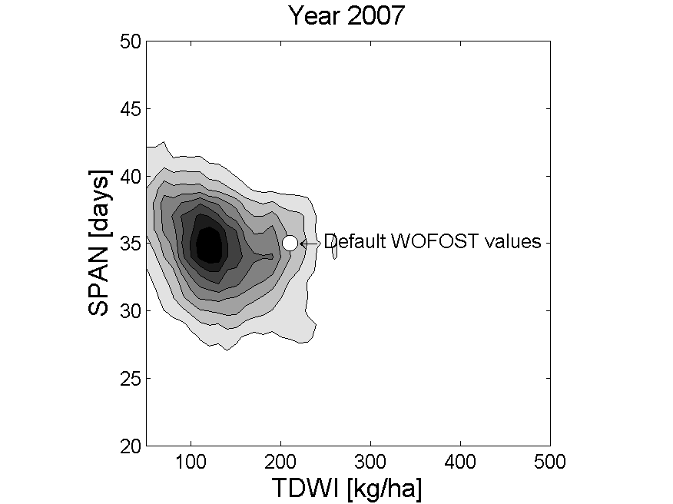
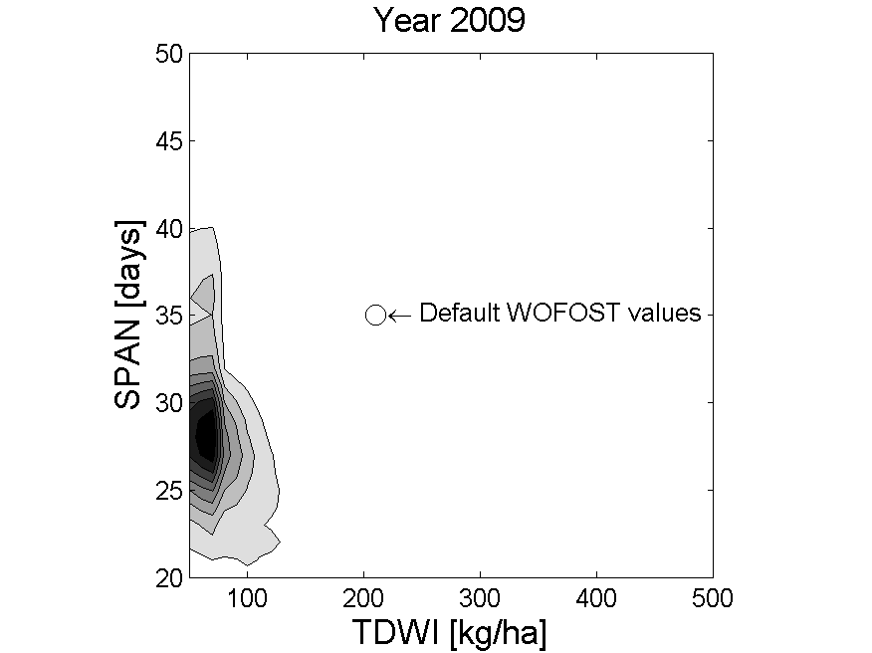
Recalibration of a crop model based on GAI time series
EO inclusion allows to define seasonal parameters that are different from the default model values

Slide 23
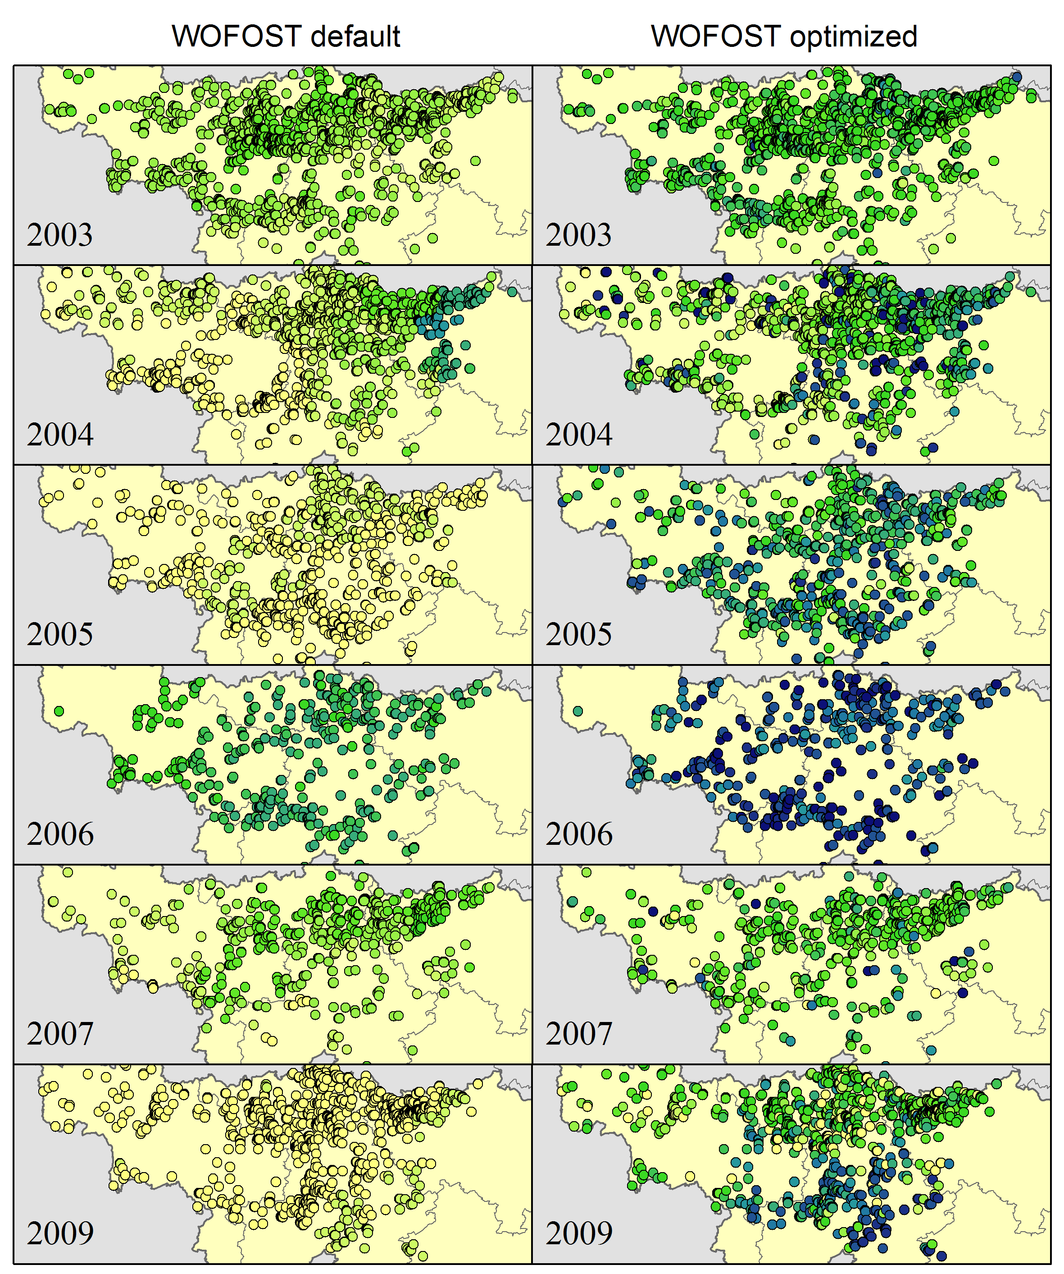


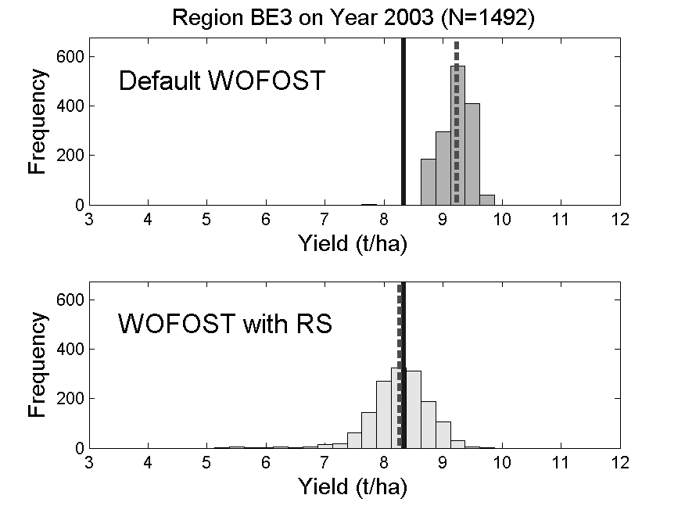
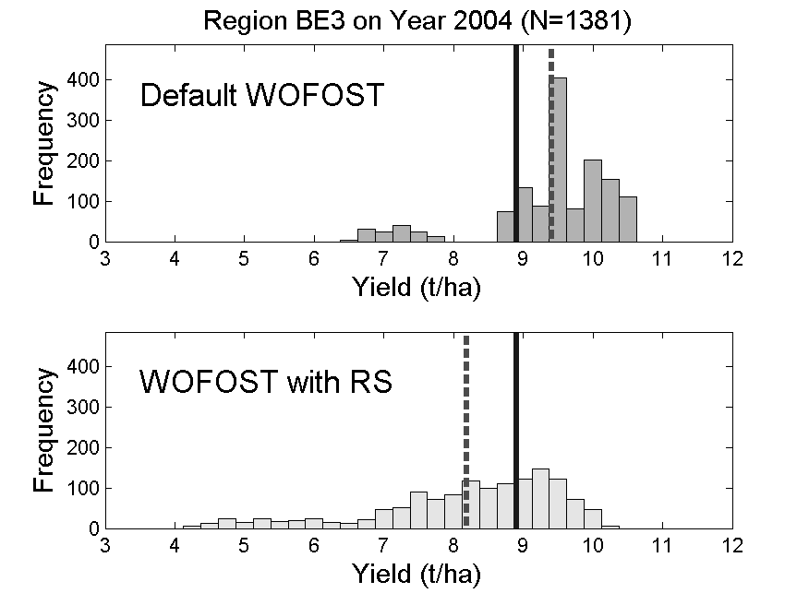
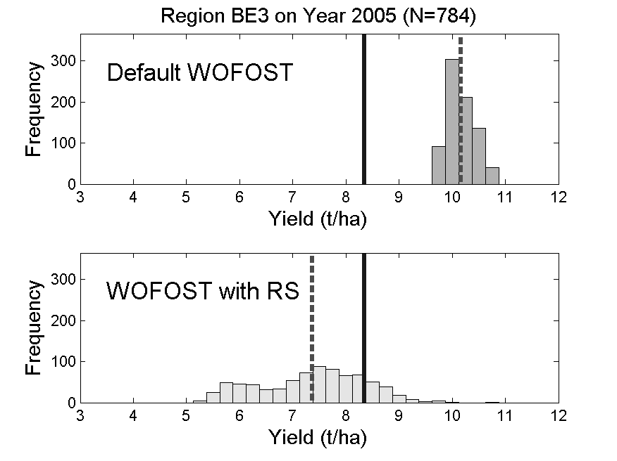
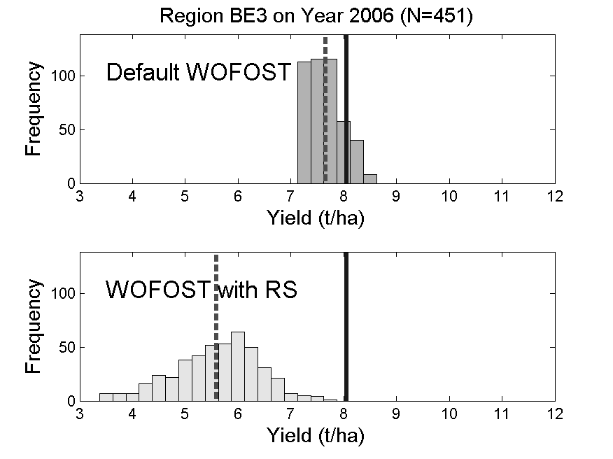
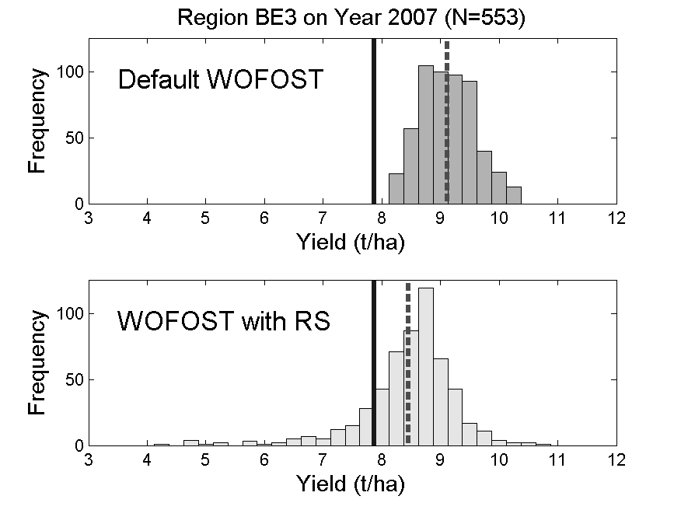
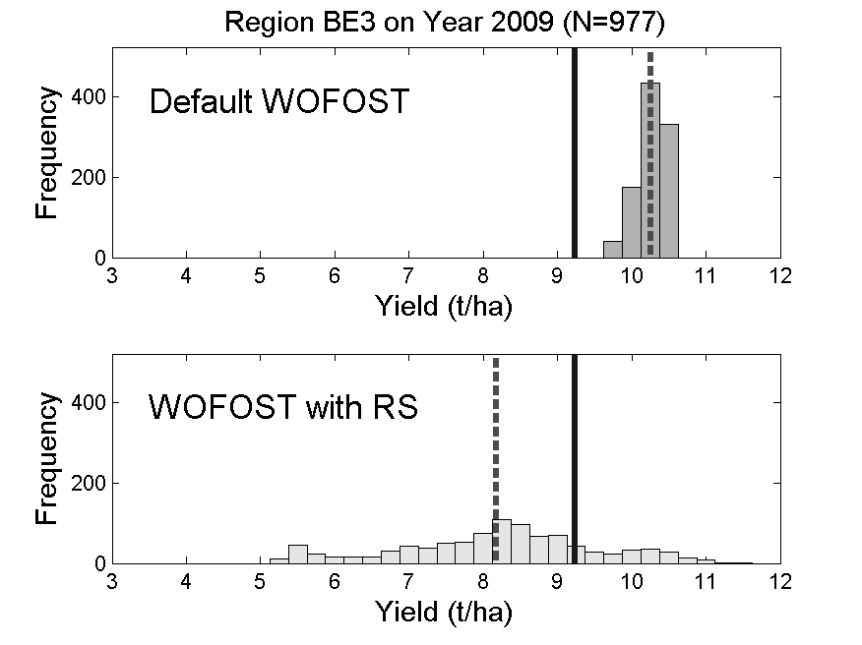
Yield estimates: standard vs recalibration with RS
A validation using yields reported by EUROSTAT over the period 2000–2009 revealed that assimilating MODIS-GAI provides an improved relationship between simulation results and reported yields at the regional level.
Improved:3 yr
Equal:2 yr
Worse:1 yr

Slide 24
Recalibration Examples 2:
Rice yield simulation at sub-field scale using remotely sensed LAI data

Slide 25
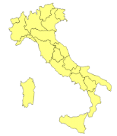
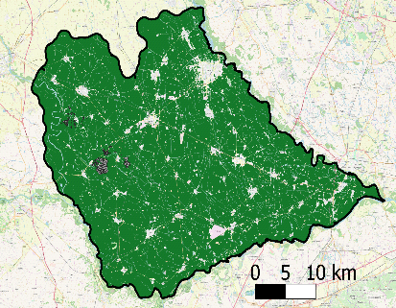
Field level yield estimates: crop model & EO LAI
Crop: Rice
Study area: Lomellina – Lombardy (IT); 40 fields (3 farms) x 3 years [variety, sowing date and yield]
Model: WARM (Confalonieri et al. 2006)
EO data: LAI (i.e., Landsat-8, Landsat-7 and Sentinel–2A); Simulation unit @ 30 m regular cell
Assimilation strategy: recalibration of 3 model parameters related to LAI development
Max radiation use efficiency (RUE, g MJ⁻¹),
Specific leaf area @ emergence (SLAini, m2 kg⁻¹)
Specific leaf area @ mid-tillering (SLAtill, m2 kg⁻¹)
Specific model calibration (default parameters) for varietal group
Gilardelli et al. 2019

Slide 26
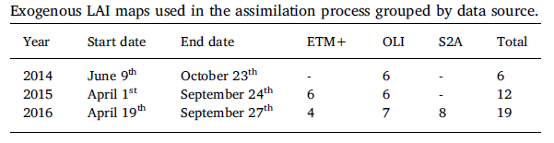
Field level yield estimates: crop model & EO LAI
INPUT
Model capability to reproduce yield distribution within each field improved in almost all the cases:
Assimilation: MAE = 0.71 t ha-1 and RRMSE = 14.7%
Default par.: MAE = 0.80 t ha-1 and RRMSE= 15.7%
The recalibration allowed to improve yield estimates as demonstrated by Relative Bias Error (RBE)
OUTPUT
Relative Bias Error (RBE) result from comparison between observed and simulated yields for each simulation unit

Slide 27
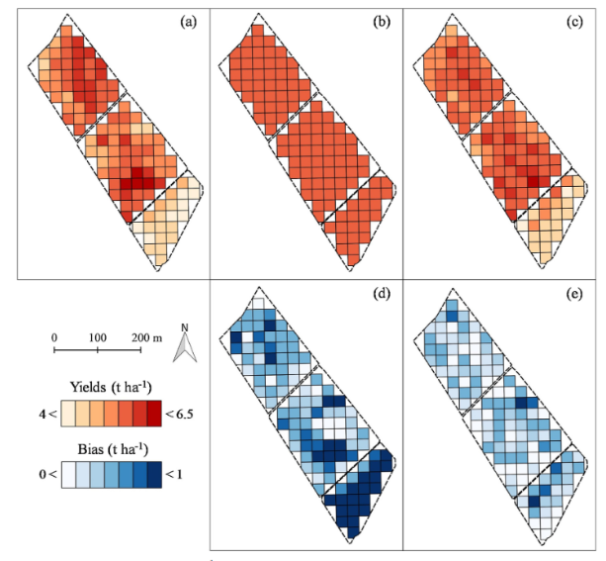

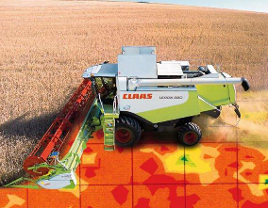
Towards PA: 30 m within field yield variability
Gilardelli et al. 2019
Observed yields
Simulated default
Simulated assim. LAI
simulated yield is constant within and across fields (all fields were sown in the same DOY with the same rice variety), without the possibility to reproduce the observed yield variability
+
The improved results derive from the capability to describe the within-field spatial variability offered by the assimilation of remotely sensed LAI data.
Bias default
Bias assim. LAI

Slide 28
Regional rice monitoring system in Europe 5/5
Conclusion
The assimilation of exogenous remotely sensed LAI into model increased the accuracy of the system: MAE and RRMSE were 0.66 t ha-1 and 13.8% whereas they were 0.82 t ha-1 and 15.7% without assimilation.
Moreover, the system allowed to properly reproduce the within-field yield variability, thus laying the basis for possible applications in precision agriculture advisory services.

Slide 29
Contribution in yield forecast systems
Overview of available systems and practices
http://www.amis-outlook.org/resources-list/detail/en/c/386062/

Slide 30
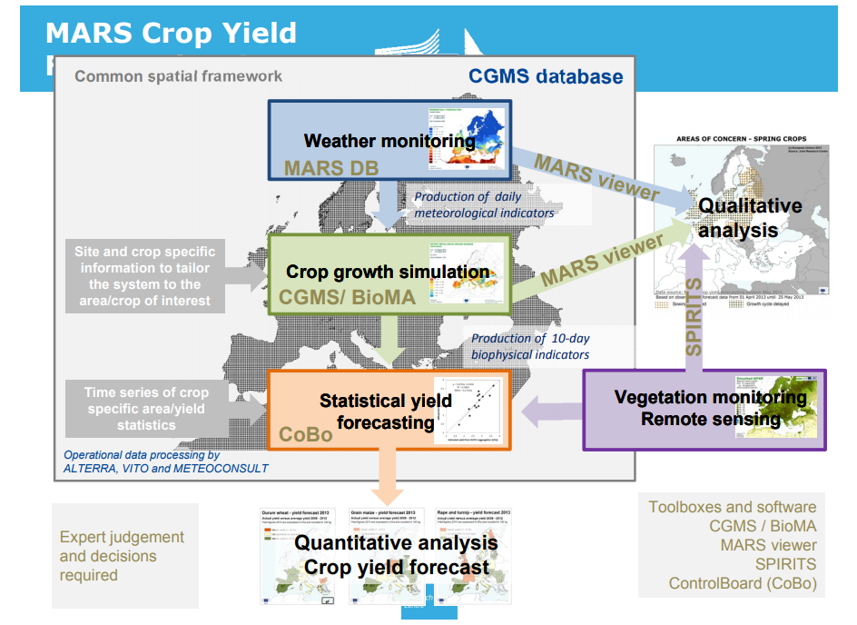
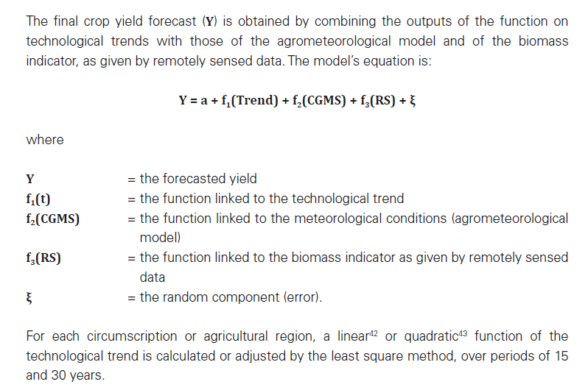
Yield forecast systems: EC-MARS example
  Crop monitoring systems (e.g. CGMS-MARS, Genovese et al., 2001) use in statistical procedures to produce a yield prevision:
meteorological and
crop status indicators from
  modelling and/or
  EO data
Model outputs are assumed, separately, as independent variables to build multiple regression models with historical official statistic

Slide 31
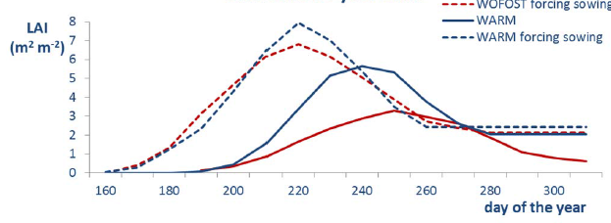


Yield forecast systems: importance of “sowing dates”
Synchronize model simulation with actual crop phenology of the analyzed season (instead than relying on “fixed” crop calendars) is fundamental to effectively estimate the effect of “extreme” events (e.g., heat waves, droughts, meteo condition favorable to pathogen) on crop production
Impact of blast infection @ flowering
Forcing sowing date
Crop calendar
Forcing sowing

Slide 32
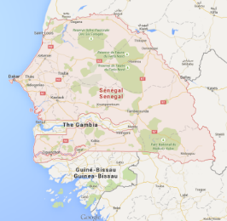
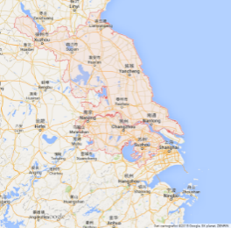
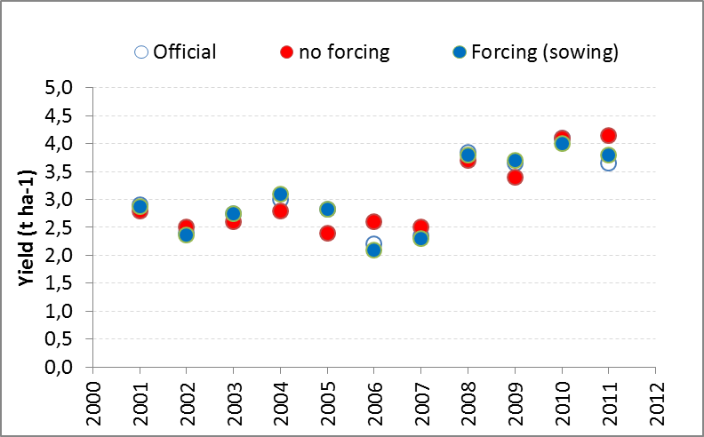
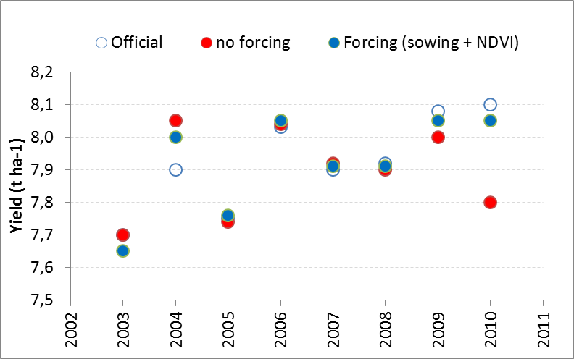

Yield forecast: forcing “sowing dates” estimated by EO
Yield estimates
Senegal
(national estimates)
China
(Jiangsu province forecast)
sowing date estimates for the period 2001-2011 (Manfron et al., 2012)
sowing date estimates and value of Max NDVI for the period 2003-2010
R² = 0.88 (R² trend: 0.68);
R² = 0.75
R² = 0.98 (R² trend: 0.68);
Indicators:
Storage organs, DVS, LAI, Heat induced sterility
R2 = 0.89 (only sowing) 0.95 (sowing & NDVI)

Slide 33
Forcing and recalibration Examples:
Rice yield forecasting at district level: EO data assimilation and post processing

Slide 34


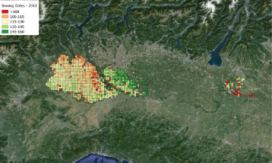
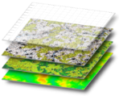




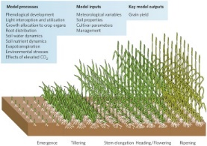
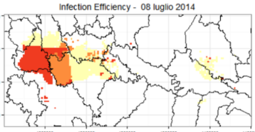
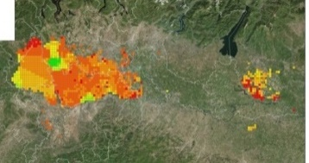
Regional rice monitoring system in Europe 1/5
ERMES products
Geo-processing
2 by 2 km Simulation «Grid»
  EO processing chain: automatic procedure to derive geo productsas spatialized inputs for the model
  Crop mapping (S1 and OLI)
  Meteo maps (ECMWF - ERA-Interim)
  LAI (GEOV1 dataset)
  Sowing dates → Phenology (MODIS derived)
Modelling solution: customization of WARM rice model, for ERMES regional applications, to simulate rice growth processes on a 2x2 km grid over study areas (Italy, Spain and Greece).
Post processing: 13 years of yield data
Outputs generation and deploy: provide via dedicated GEOPORTAL risk alert and yield estimation
WARM MODEL
Risk
Yield

Slide 35
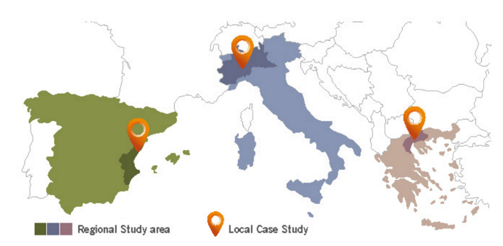
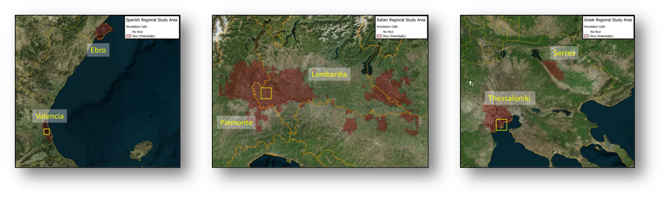
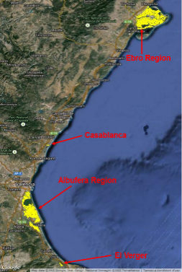
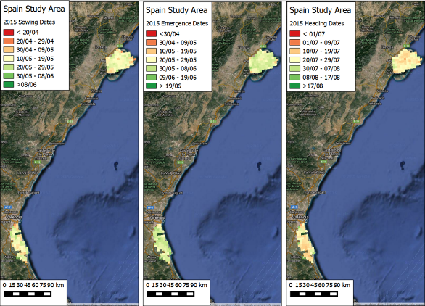


Regional rice monitoring system in Europe 2/5
Study area: three European rice districts
Seasonal crop mask
Phenology
LAI

Slide 36







Regional rice monitoring system in Europe 2/5
Pagani et al 2018
Indicators used in regression analysis
Official statisitcs
MULTIPLE LINEAR REGRESSION (2003-2014)
REGRESSION MODEL VALIDATION:
leave-one-out procedure
OFFICIAL YIELDS
(2003-2014)
MODEL OUTPUTS
(at forecasting ten-days-period)
P=potential conditions;
B-l=blastlimited;
C-l=cold shock-limited;
U=updated;
R=recalibrated
Application to
FORECASTING YEARS (2015/2016)
Selection of the
BEST REGRESSION MODEL
(RMSE, RRMSE, R²)
FORECASTED YIELDS (2015)
MODEL OUTPUTS (2015)

Slide 37
Regional rice monitoring system in Europe 2/5
Official (grey circles) vs forecasted yields for Japonica cultivars in Valencia using
off. stats
off. stats
model
(no EO)
model (EO)
model (post)

Slide 38



Regional rice monitoring system in Europe 3/5
Forecasting Results
Early forecast (30 July)
Final estimation (10 September)
Vercelli
7.3 t ha⁻¹
6.8 t ha⁻¹
Simulated indicators:
(indipendent variables in the regression)
LAI
Development stage code
forced GLAI
forced yield
Simulated indicators:
(indipendent variables in the regression)
Aboveground biomass
Development stage code
forced GLAI
forced yield
R² = 0.59
RRMSE = 4.19 %
R² = 0.92
RRMSE = 3.41 %
Notes:
At 20th of august the reliability of the model is higher!
the model has captured a large part of the season
comparable

Slide 39








Regional rice monitoring system in Europe 3/5
End of season:
a)
b)
R² = 0.66
R2 = 0.74
c)
d)
R2 = 0.76
Red crosses shows forecasted yields in 2015
R2 = 0.70
Comparison between official (orange circles) and forecasted (green crosses) yields for a) Indica rice in Thessaloniki, b) Japonica rice in Valencia, c) Indica Lungo B in Lomellina and d) Japonica Tondo in Vercelli.

Slide 40
Summary of concept and presented examples

Slide 41
Yield forecast and remote sensing
Empirical approaches
Time series of EO biomass proxy (Vis or BV) are indicators of final crop yields
Seasonal integral of VIs are able to explain spatio/temporal yield variability
Approaches need target identification (needs of crop maps to select pixels) and have to take into accouint landscape fragmentation (approrpiate data spatial resolution)
Crop seasonality is due to cultivated variety (physiological cycle), management (sowing dates) and climatic condition (spatio temporal variability of meteo drivers) and impact on the model performances
Phenological estimates from RS able to identify pixel by pixel (field or homogeneous area) spatio temporal crop dynamics improve model performances
Pros: simple and feasible → operational systems are based on this solution
Cons: limited applicability to different areas or years different for the ones analyzed

Slide 42
Yield forecast and remote sensing
Semi-Empirical approaches
Monteith LUE approach provides a formal framework to directly exploit EO derived crop bio-physical information (LAI and fAPAR)* in a GPP (NPP) model.
Such approach is exploited to provide seasonal yield proxy also operationally (Copernicus DM product) that are exploited in food security bulletins (qualitative use)
Calibration with field data is required to provide quantitative estimation
Scientific research is still on-going to derive from EO data information on i) specific biome/crop parameters, ii) stess factors (e.g. ET) or iii) directly real RUE estimations (e.g. chlorophyll-related vegetation indices, solar-induced chlorophyll fluorescence- SIF, and the photochemical reflectance index (PRI) ).
* EO derived product should be able to account for long term effect of potential stressor (water shortage, temperature impacts, etc.) that affect crop growth

Slide 43
Yield forecast and remote sensing
Crop models
Crop simulation model are able to reproduce plant behaviour and predict yield
Accurate results require
1) proper crop parameterisation,
2) high quality input (meteo and soil),
3) seasonal information of agro practices (sowing date) and
3) modules able to assess pest and disease impact
RS can contribute by «observing» seasonal crop condition and agropractices. Different EO derived information can be used in assimilation framework
Sowing dates and Phenological stages occurrence estimation → synchronise simulation
LAI estimation → provide a better approximate the simulated system to the real one.

Slide 44
Yield forecast and remote sensing
Yield forecast systems
Operational systems (e.g. MCYFS - MARS Crop Yield Forecasting System) are based on a complex framework that exploit – meteo information, crop model outputs and crop growth indicators from remote sensing
Data are statistically processed using historical records of yield statistics
Analyst perform estimation producing reports and bulletins
Research results demonstrate an improvement from the direct ingestion of EO data in crop modelling solution

Slide 45
References
Becker-Reshef et al. (2010) “A generalized regression-based model for forecasting winter wheat yields in Kansas and Ukraine using MODIS data”. Remote Sens. Environ. 114, 1312–1323.
131–148. [CrossRef]Bezuidenhout, C.N., Singels,. (2007) Operational forecasting of South African sugarcane production: Part 1 -System description, Agricultural Systems, 92, 23-38.
Bolton and Friedl (2013) “Forecasting crop yield using remotely sensed vegetation indices and crop
phenology metrics” Agri. and Forest Meteorology, 173, 74-84 https://doi.org/10.1016/j.agrformet.2013.01.007
Boschetti et al (2011) “Estimation of rice production at regional scale with a Light Use Efficiency model and MODIS time serie“ European Journal of Remote Sensing 43:63-81. DOI: 10.5721/ItJRS20114335.
Confalonieri, R., Rosenmund, A.S., Baruth, B., 2009a. An improved model to simulate rice yield. Agron. Sustain. Dev. 29, 463–474. http://dx.doi.org/10.1051/agro/2009005
de Wit et al 2012 Estimating regional winter wheat yield with WOFOST through the assimilation of green area index retrieved from MODIS observations. Agricultural and Forest Meteorology 164 (2012) 39– 52. https://doi.org/10.1016/j.agrformet.2012.04.011
Diepen, C.A., van Wolf, J., van Keulen, H., 1989. WOFOST: a simulation model of crop production. Soil Use Manage. 5, 16–24.

Slide 46
References
Franch et al (2015) “Improving the timeliness of winter wheat production forecast in the United States of America, Ukraine and China using MODIS data and NCAR growing degree day information”. Remote Sens. Environ. 161, 131-148
Genovese, G., Vignolles, C., Nègre, T., Passera, G., A methodology for a combined use of normalized difference vegetation index and CORINE land cover data for crop yield monitoring and forecasting A case study on Spain, Agronomie, 21, 91-111. 2001.
Gilardelli et al. 2019 Downscaling rice yield simulation at sub-field scale using remotely sensed LAI data. European Journal of Agronomy 103, 108-116. https://doi.org/10.1016/j.eja.2018.12.003
Monteith, J. Solar radiation and productivity in tropical ecosystems. Journal of Applied Ecology 1972, 19, 747-766
Moulin et al. 1998 “Combining agricultural crop models and satellite observations: From field to regional scales” International Journal of Remote Sensing, 19, 6 https://doi.org/10.1080/014311698215586

Slide 47
References
Ren et al 2008 “Regional yield estimation for winter wheat with MODIS-NDVI data in Shandong, China” International Journal of Applied Earth Observation and Geoinformation 10, 4, pp 403-13 https://doi.org/10.1016/j.jag.2007.11.003
Stöckle, C.O., Donatelli, M., Nelson, R., CropSyst, a cropping systems simulation model. Eur. J. Agron. 18, 289-307. 2003.
Williams, J.R., Jones, C.A., Dyke, P.T., A modeling approach to determining the relationship between erosion and soil productivity, Trans. ASAE, 27, 129-144. 1984

