Slide 1
Food Security Thematic Exploitation Platform
– Using and sharing algorithms, products and services
– Applications to micro-insurance and crop nitrogen uptake
M. Muerth, T. van Roey, R. van Hoolst

Slide 2
Prerequisites for today
As announced on Monday, by now you already should have
Registered to ESA Earth Observation Users‘ Single-Sign-On (EO SSO) → https://eo-sso-idp.eo.esa.int/idp/umsso20/registration
Visited Food Security TEP once, so you are a registered user → https://foodsecurity-tep.net/app
Asked us for coins by writing an email to support@foodsecurity-tep.net
Brought your laptop for today’s practical tasks

Slide 3
Background
Introduction to crop analysis in the cloud

Slide 4
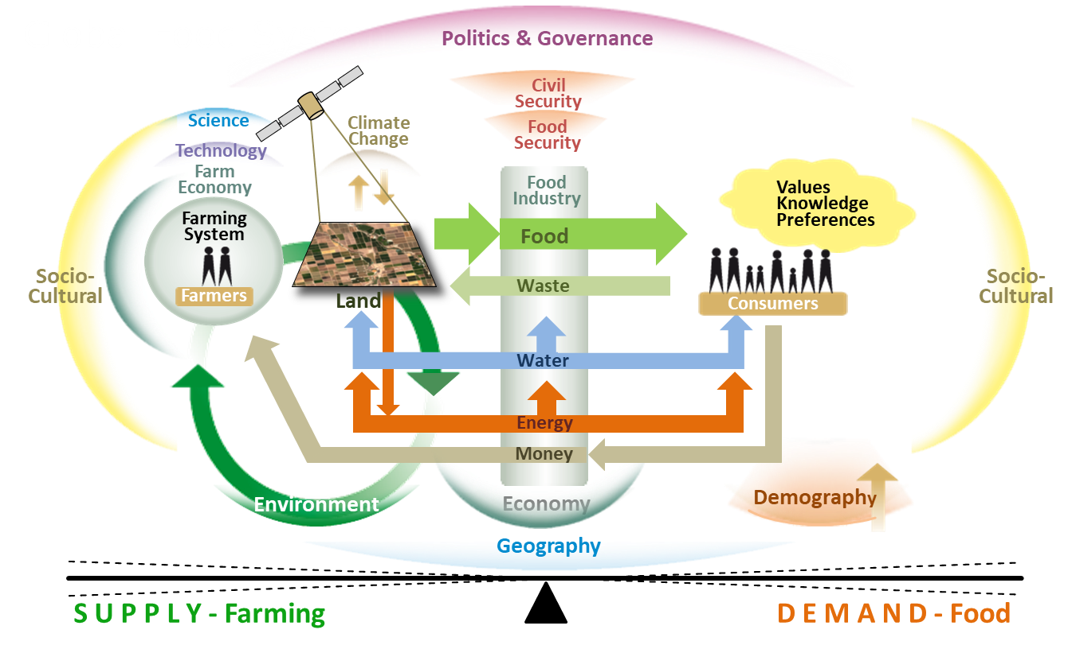
The Global Food System
Adapted from graphic by ShiftN

Slide 5
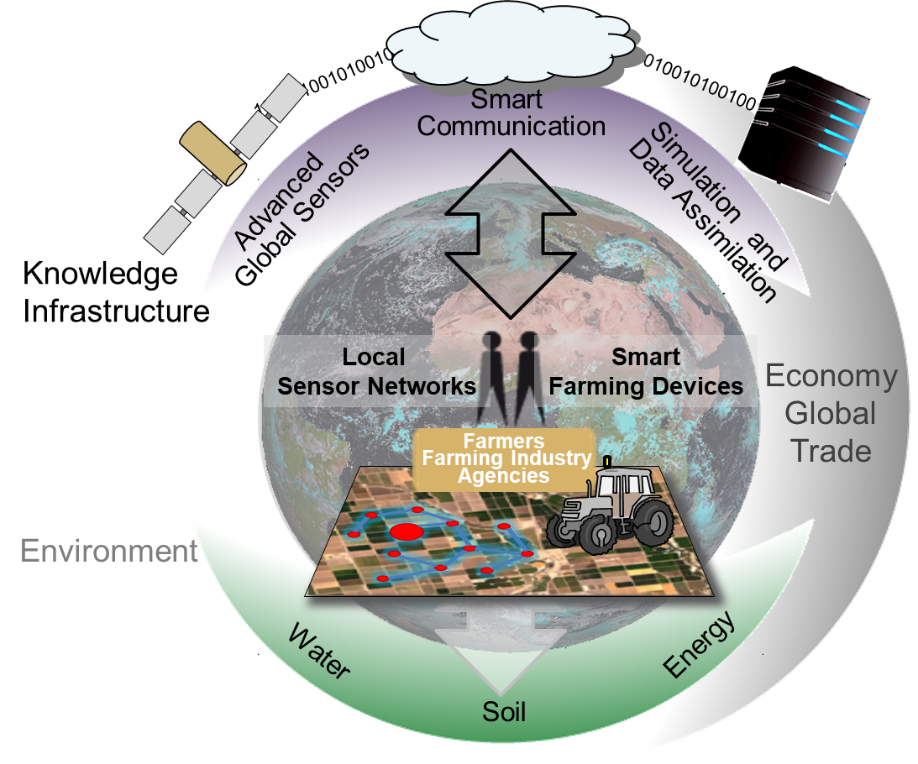
The Future Global Smart Farm
Each actor in the Global Food System will be embedded in an
open knowledge & information framework which supports them in managing farms sustainably and in contributing to global food security.
At the same time, they are also part of the Global Smart Farm.

Slide 6
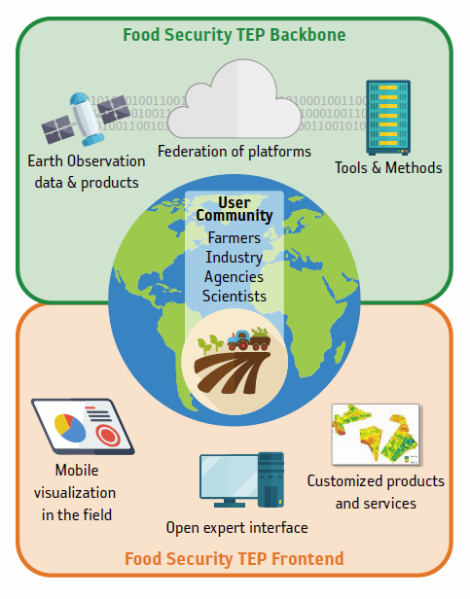



The Food Security Thematic Exploitation Platform
“Supporting Sustainable Food
Production from Space”
The innovative platform aims at simplifying the extraction of informa-tion from Earth Observation data for the advancement of data-intensive services in the food security sector mainly in Europe and Africa.
Notes:
Open Interface for non-IT experts and scientists
Customized services to support Food Security but also for commercial use

Slide 7
Why we analyse EO data in the cloud
Introduction to crop analysis in the cloud

Slide 8
Typical applications in agriculture
National scale (systematic) monitoring of crops requiring a large amount of processing capability, e.g. for early warning systems
Quick and reliable on-demand analysis of e.g. fields distributed over wide areas
Inclusion of data available elsewhere (via APIs, WMS, WCS, WPS)
  Analysis Ready Datasets
  (Large) Collections of pre-processed EO products
  Complementary data provided by others
International cooperation e.g. in science & development support
Agile, virtual work environments
Distribution of data to remote clients

Slide 9
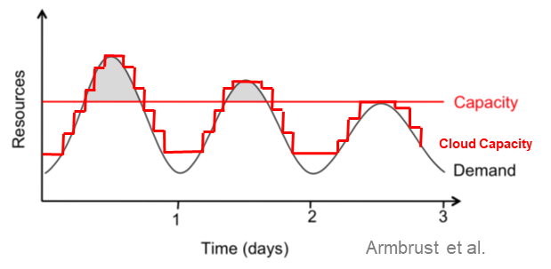
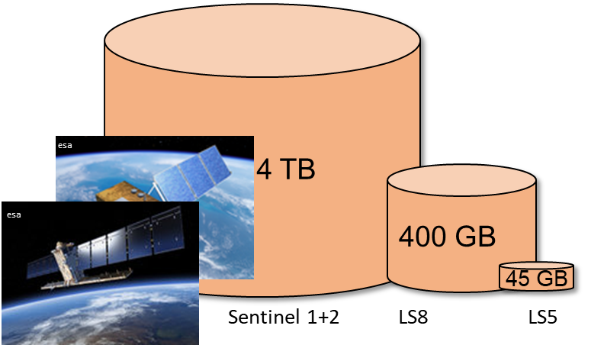
Features of cloud platforms
Scalability of computing resources and storage for massive computing
Distributed building blocks for data, resources, tools, and services
Federation of platforms for accessibility to data and distribution of workloads
Clouds allow ensuring the ownership of data & software
Sharing of data, algorithms and information without duplication

Slide 10
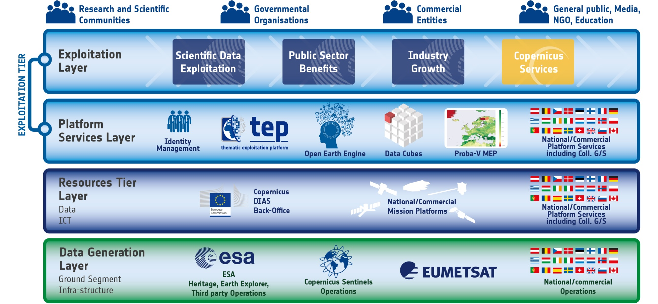

Building blocks of data, resources, tools, and services
No need to download data or install tools locally!
Notes:
Ecosystem of platforms, services, software and infrastructure (data, computing)

Slide 11




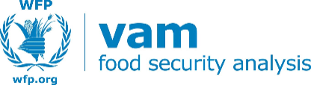
Federation of platforms example
???

Slide 12
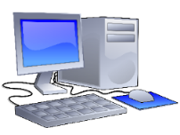






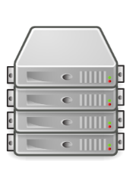
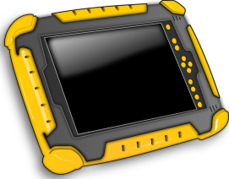
Sharing and ownership
Customized
products & services
User input
Service
provider
Satellite data
(mainly Copernicus)
User data
{api}
Open expert interface
User data
knowledge & algorithms
Toolbox
Ancillary data
(terrain, soil,…)
tools
Sharable user generated results
Processing power
Mobile visualization of
biophysical parameters in the field
Notes:
Algorithms and data are still controled by its owners, while they can be delivered, shared and published

Slide 13
Cloud processing Concepts
Introduction to crop analysis in the cloud

Slide 14

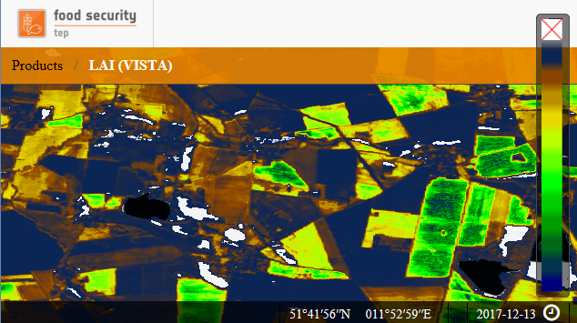
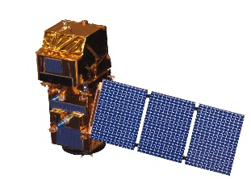
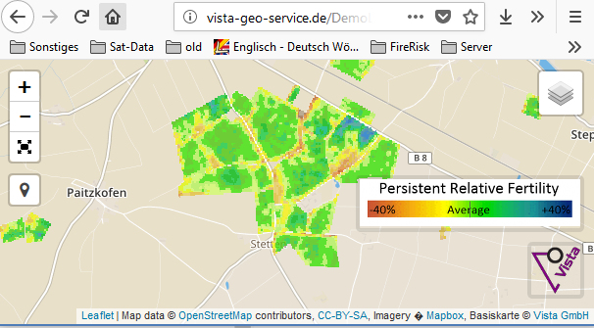
Thematic Exploitation Platform Workflow
Basic workflow on a platform
Use results for…
Further processing
Direct access to data
(Pre-) Processing on platform
Access via GUI or API
Provision to own front-end
Notes:
Only SSO account needed to access platform
Platforms allow constructing complex workflows using orchestration

Slide 15

A Backbone provides typical cloud services
The Food Security TEP Backbone consists or uses existing infrastructure / software so that development is focused on Food Security functionalities:
Infrastructure and data access provided by CREODIAS (one of the Copernicus Data & Infrastructure Services)
Software from the F-TEP
Platform & Information services of the Proba-V Mission Exploitation Platform (MEP)
Selected products from Copernicus Land Monitoring Services & Coastal TEP
Food Security TEP Backbone
Food Security TEP
InaaS
Food Sec TEP
PaaS, DaaS & SaaS
PaaS
SaaS
InaaS
Proba-V MEP
F
CLMS
C-TEP
-
TEP
DaaS
& IaaS
CREODIAS

Slide 16
Typical frontend services – GUI and API
The Food Security TEP Frontend offers
Public platform services, which allow access to the full functionality as well as public services and standardized products on the platform via GUI & API
A web-based “Analyst” frontend for the discovery and visualization of products
“Customized” services that provide additional, user-adapted information and restricted data management; Customized services are typically not public, but may be distributed to other users via GUI & API
Food Security TEP Frontend
Customised services
–
InaaS
restricted data and services, commercial
Food Sec TEP Analyst
–
InaaS
free, easy, but limited
Food Sec TEP
–
Paas
& SaaS
free, for advanced users
Food Sec TEP Backbone
Food Security TEP
InaaS
Food Security TEP
PaaS & SaaS
PaaS
SaaS
InaaS
Proba-V MEP
F
CLMS &
C-TEP
-
TEP
DaaS & IaaS
CREODIAS

Slide 17



Highly flexible workflows

Slide 18
Standard products & Services
Introduction to crop analysis in the cloud

Slide 19
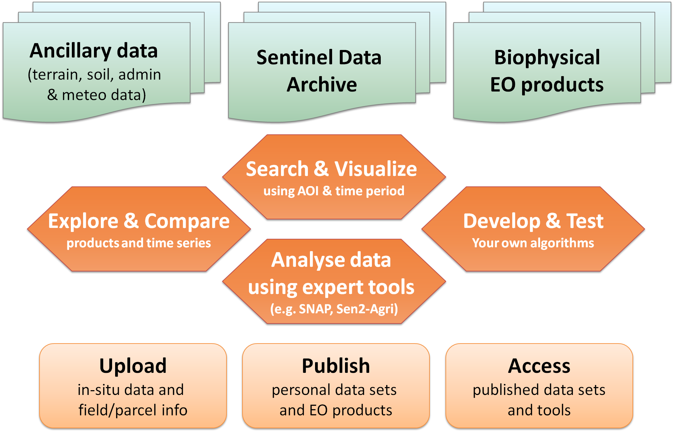
Essential functionality

Slide 20
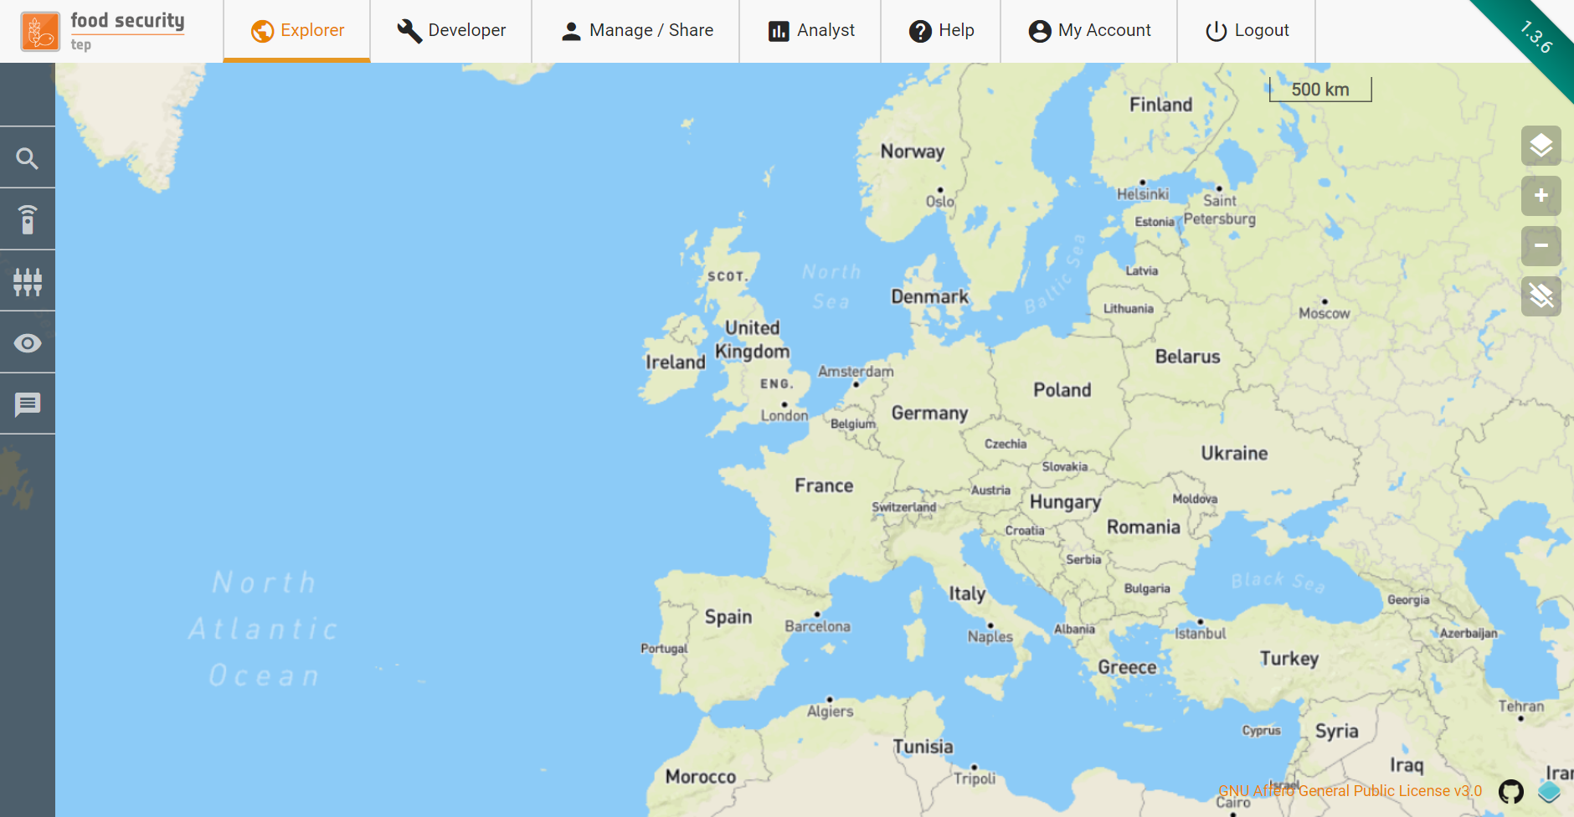
The Main User Interface
The Food Security TEP Open Expert interface allows
Exploring EO data, products & user data as well as applications & processing services
Developing your own services as Docker applications
Managing & Sharing your data, services & jobs
Visualization of products in the Analyst
Account management

Slide 21
Food Security Data and Service Portfolio
Public processing services | Spatial res.
SNAP S-2 Band Ratio Processor | yes
SNAP S-2 Normalized Band Difference Processor | yes
SNAP S-2 Red Edge Position Index | yes
SNAP S-2 Modified Chlorophyll Absorption Ratio | yes
SNAP S-2 Brightness Index | yes
SNAP S-2 Generic Graph Processor | (beta)
Generic R Script Processor | (upcoming)
Sen2Cor | (beta)
(+ your contributions that you can share with others!)
Parallel Processing Services | Public?
VISTA (Green) Leaf Area | (beta)
VISTA Reflectance at Bottom of Atmosphere | (beta)
VITO Fraction of APAR | yes
VITO Fraction of Vegetation Cover | yes
VITO Normalized Difference Vegetation Index | yes
VITO Leaf Area Index | yes
Higher level services (VITO, VISTA, Hatfield) | (upcoming)
(+ your services if you like to publish your algorithm on the Food Security TEP and become an EO service provider on the platform!)
Notes:
Part of the data will be hosted on the platform, other data will be accessed on the fly

Slide 22
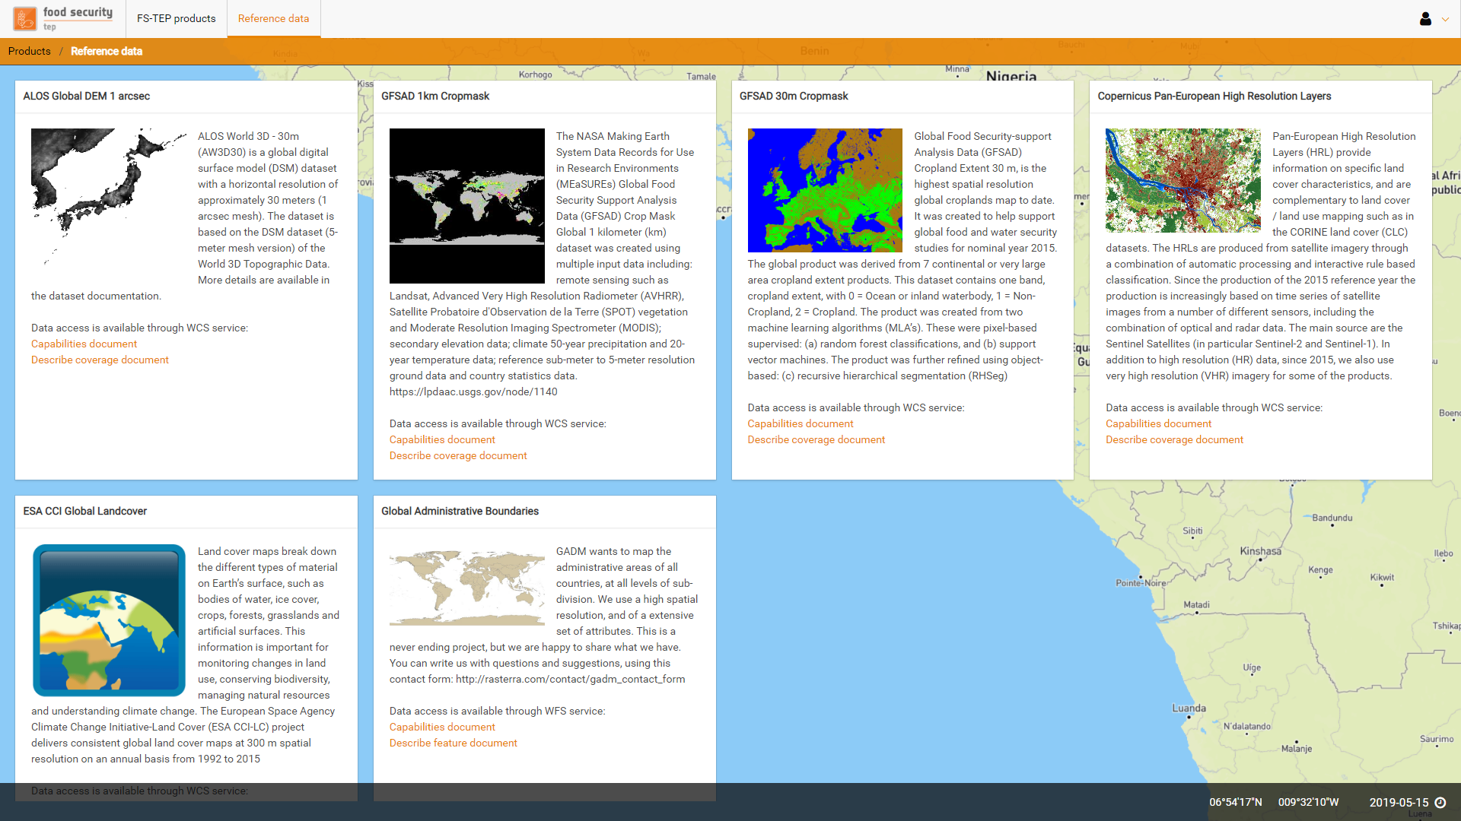
Complementary data for analysis
Upcoming:
HWSD and ESDB Soil maps
Population data
Precipitation data documentation

Slide 23








Tools on Food Security TEP
Run your scripts in parallel mode!
Notes:
Running R scripts in parallel under construction

Slide 24
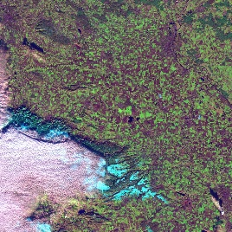

Pre-Processing of EO products (example)
Digital Elevation Model
Public Data Space
Product: BoA reflectance
Definition of Input S2 Data
Product: Leaf Area
Definition of output Collections
PreProcessor
Product: Chlorophyll content
Notes:
https://github.com/docker

Slide 25
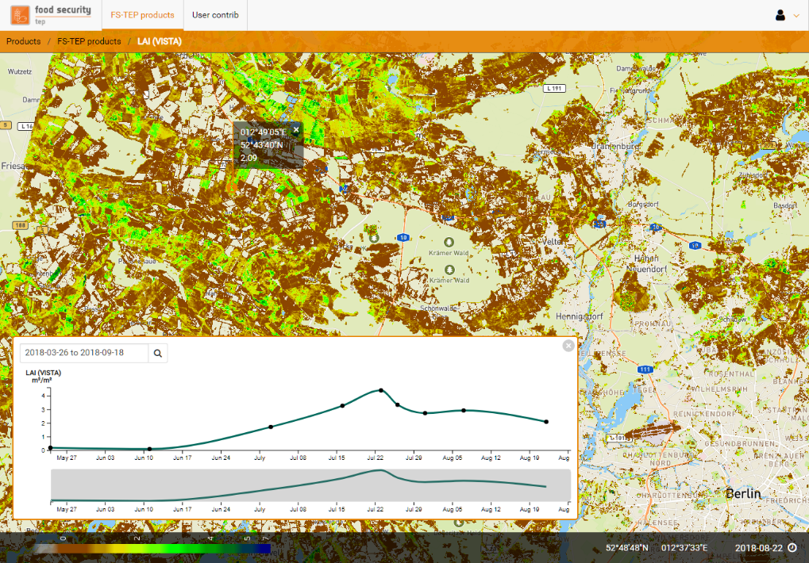
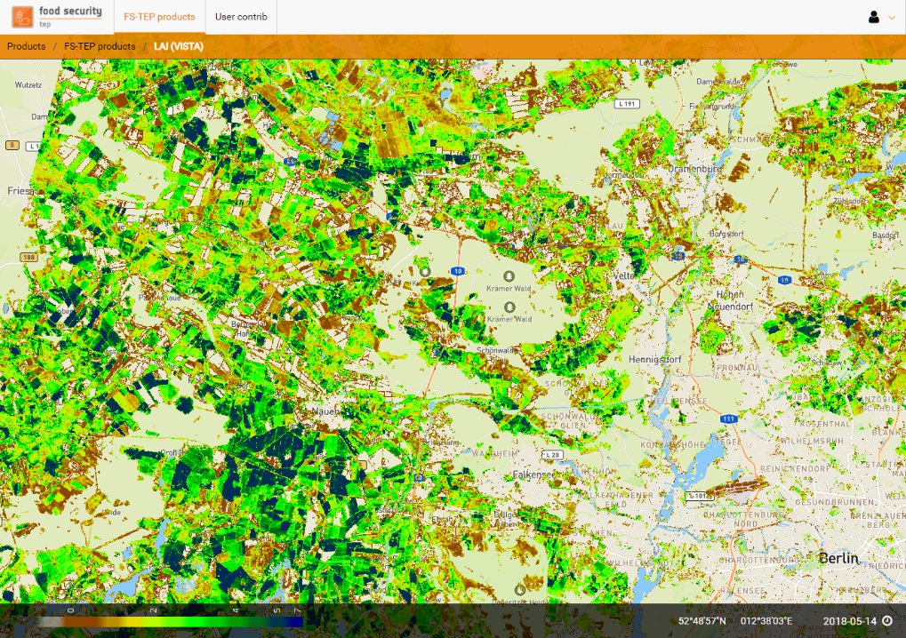
Food Security TEP Analyst View:
Browser based visualization
Green leaf area of agricultural areas near Berlin, Germany showing the decrease of plant health during the summer drought 2018

Slide 26
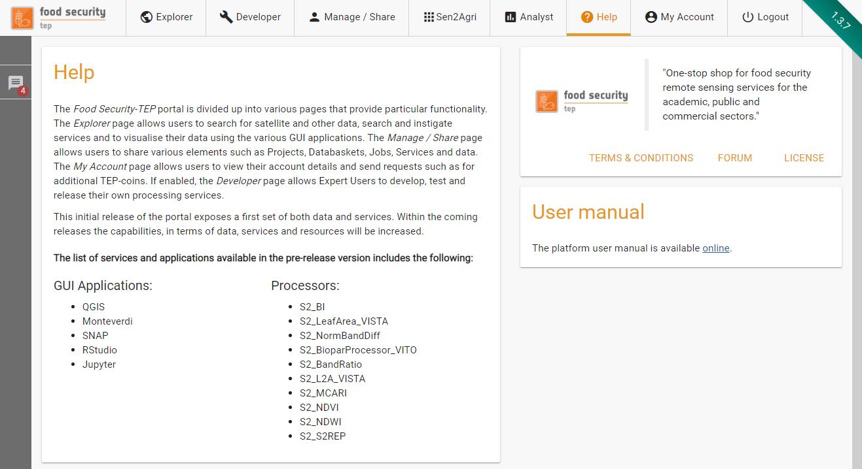
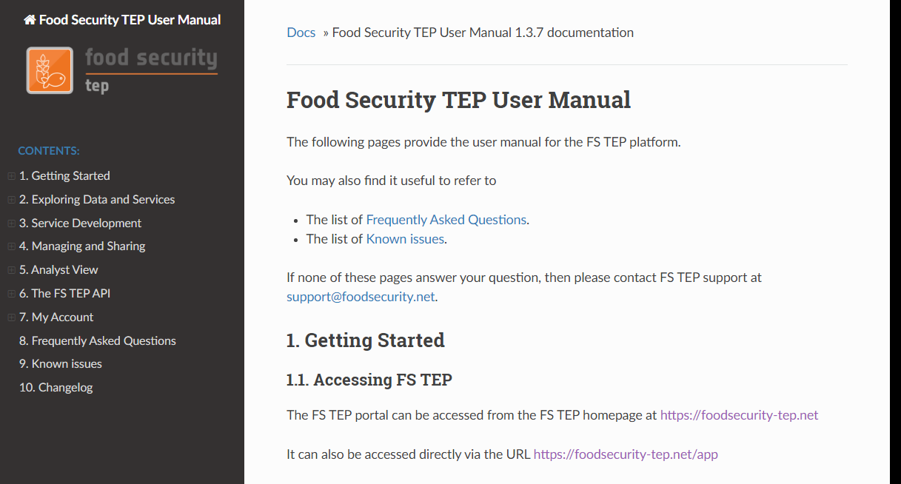
Current documentation and support
Online User Manual: Regularly updated with each release by the main developers
User Forums: Access to the user community as well as dedicated help sections for service providers and open-source developers
Help desk: First level of support for EO SSO registered platform users
Technical support from the Food Security Platform team, including addition of new features and data upon user request (subject to available resources).

Slide 27
Demonstration session
Quick demonstration:
Exploring EO data, products & user data as well as applications & processing services
Managing & Sharing your data, services & jobs
Visualization of products in the Analyst
Account management

Slide 28
Higher Level Services
Introduction to crop analysis in the cloud

Slide 29





Food Security TEP Service Pilots
Food Security TEP Customized is demonstrated in three service pilots.
Pilot 1 ‘Agriculture’ (VISTA – VITO)
Central Europe &
Southern Africa
Pilot 2 ‘Agriculture’ (VITO – VISTA)
Kenya
Pilot 3 ‘Aquaculture’ (Hatfield)
Tanzania

Slide 30
Example Service Pilot 1: Sustainable Intensification
„Customized Service“ using pre-processed products: On-demand generation of oil rapeseed N-uptake maps at field scale from S-2 leaf area
VISTA processing chain to derive atmospheric corrected Sentinel-2 data and LAI and chlorophyll products over Germany in 10m.
Fertilization is a central task for each farmer. It determines yield formation, implies costs and can have negative environmental impact (groundwater pollution) when applied inadequately.
For demonstration of sustainable intensification, winter oil rapeseed is a good candidate, since the biomass development over the winter season is input to nitrogen application advice.
(Oil rapeseed is a very important crop in Germany, covering 1.4 Million ha.)
Notes:
Biomasseverlaufs über den Winter bestimmt werden kann.

Slide 31
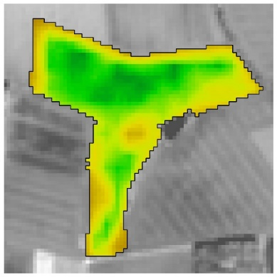
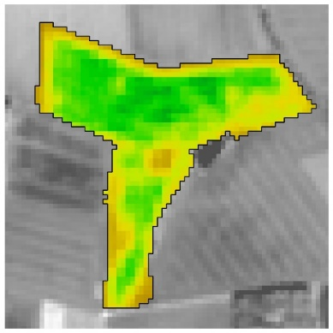
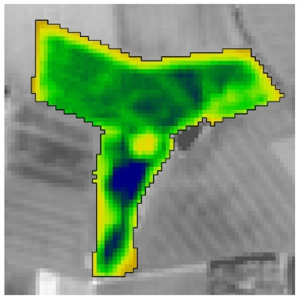
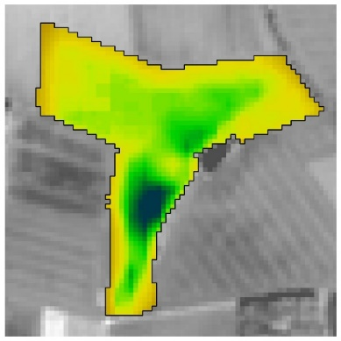
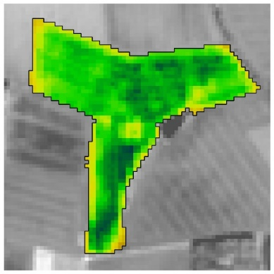
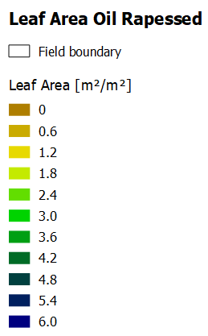

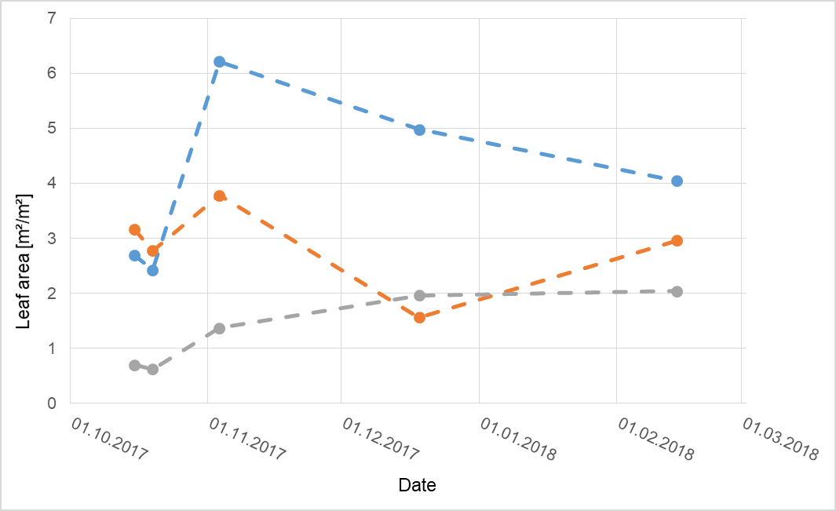
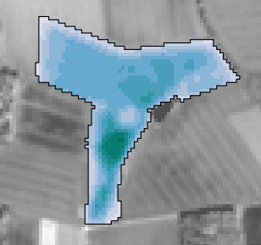
Pilot 1b: Oil Rapeseed – Using satellite data for calculating site-specific N-Uptake
15 Oct 2017
19 Oct 2017
03 Nov 2017
18 Dec 2017
14 Feb 2018
N-Uptake
[kg N/ha]

Slide 32
Background of winter rapeseed nitrogen uptake
Winter rapeseed nitrogen uptake calculation based on „Règlette Azotte colza“ used by French farmers for decades (e.g. Hebinger, Rapool Symposium 2008)
In-situ method based on green biomass:
→ N-Uptake (kg/ha) = Green Biomass (kg/m2) * 65
Putting this in scientific terms reads:
→ N-Uptake = leaf area * specific leaf weight * 6.5%
About 50% of nitrogen in leaves lost during winter is available in spring again:
→ N-Uptake = ((LAImax+LAImin)/2) * specific leaf weight * 6.5%
Time series analysis between October and March (Northern Europe): ((LAImax+LAImin)/2)*(MIN(0.04+EXP((LAImax+LAImin)/2)*0.0015;0.1)*10000*6.5%
(PS: Actual fertilizer amount depends on yield target and soil nitrogen storage)

Slide 33
Canola N-Uptake
Service Processor
Public Data Space
Products: e.g. Vista_LAI
Definition of Input Product Collection
Private Data Space
Year (of Fertilization)
Product:
N-Uptake
in [kg/ha]
Canola N-Uptake
Processor
Private Data Space
Shapefile with Field Boundaries (.zip)
TITLE
Author | ESRIN | XX/XX/2017 | Slide 33
Notes:
https://github.com/docker

Slide 34
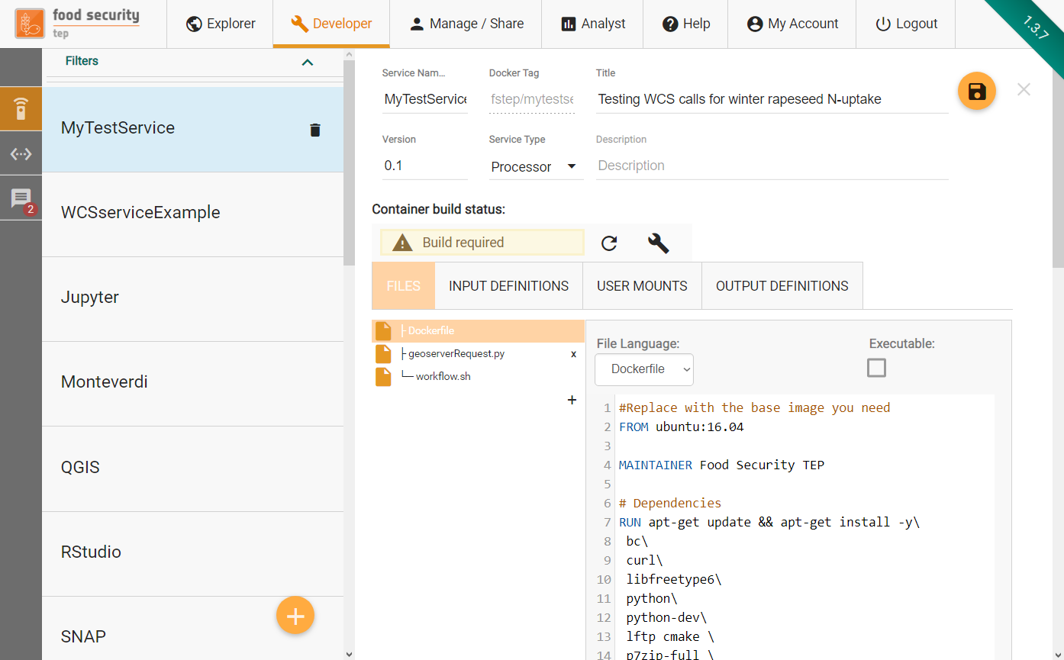

Developing new processing services

Slide 35
Practical session I
Access the shared AOI shape file
Explore the biophysical parameter collections
Setup your own Docker container for nitrogen uptake analysis
Define collection data
Script your algorithm
Run field scale analysis

Slide 36
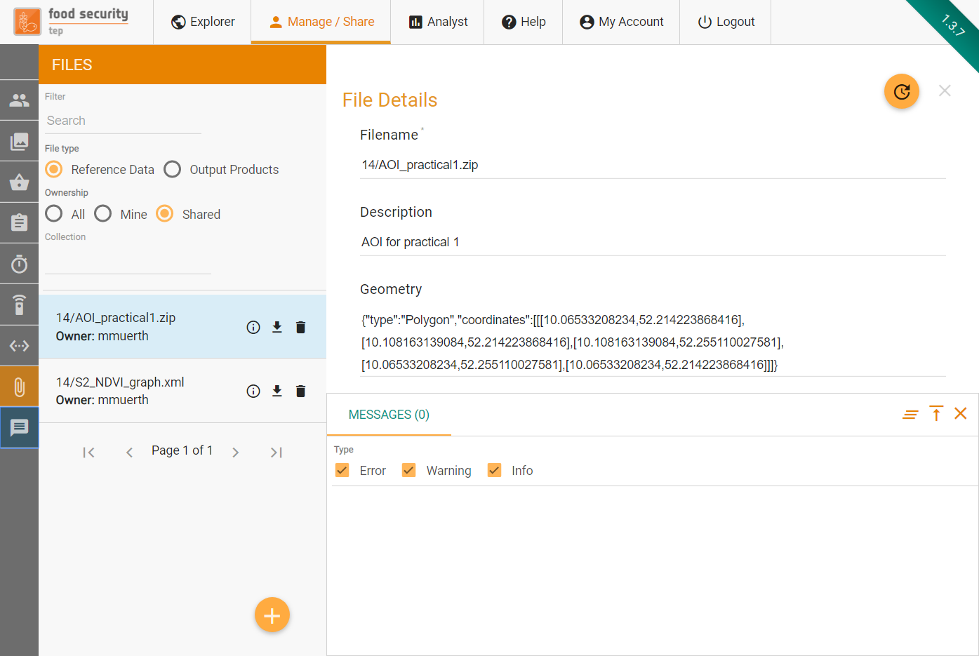
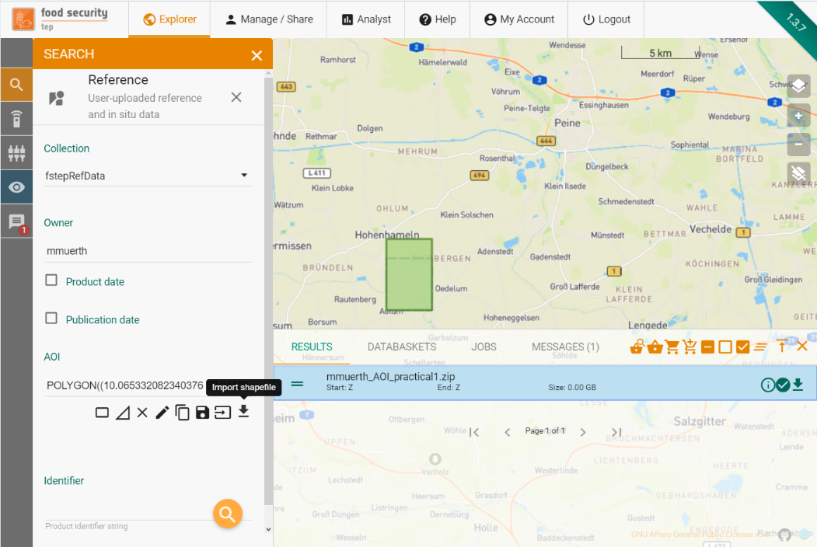
Access the shared AOI shape file

Slide 37
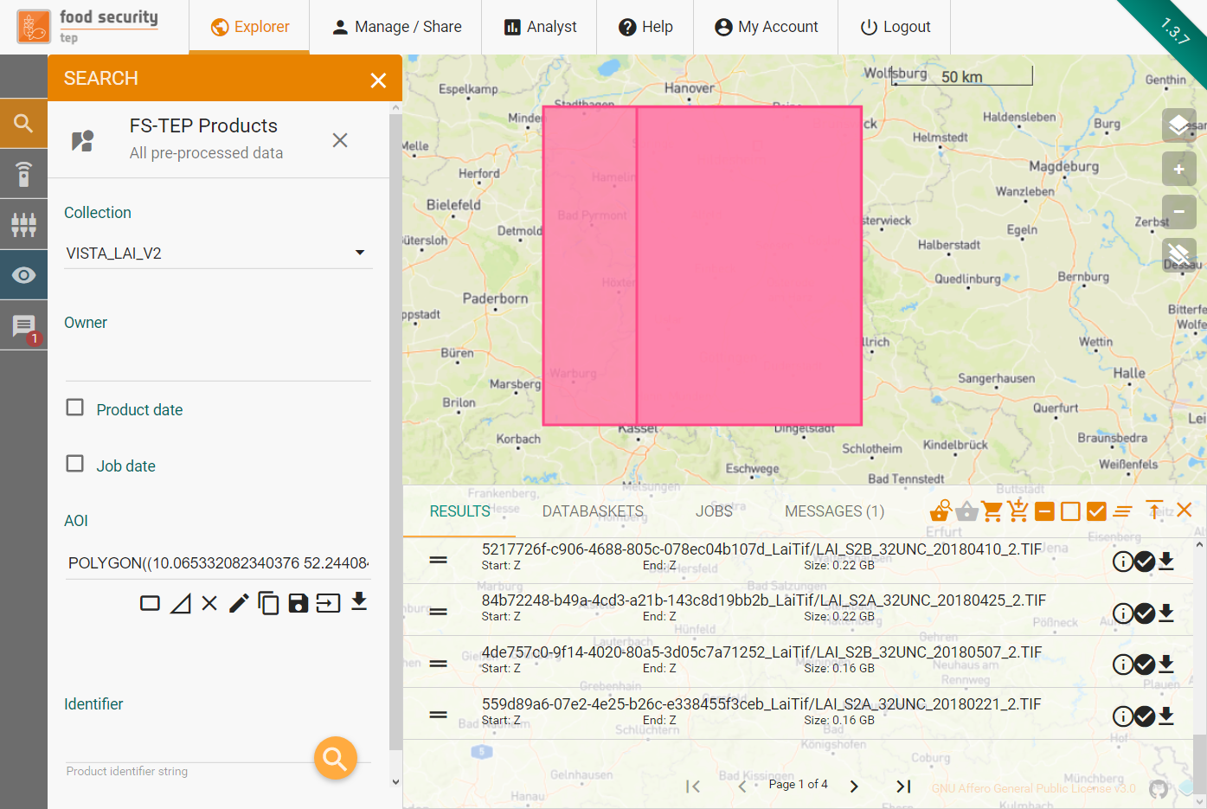
Explore the biophysical parameter collections
Training tasks:
Download AOI shape to local computer
Select FS-TEP Products/VISTA_LAI_V2 to discover the input data
Upload .shp to define search AOI
Search for VISTA_LAI_V2 products
Put them in a new databasket for reference
Note: A Sentinel-2 L1C databasket could be used to process EO products for a new AOI and time period. Yet, for the training event, the relevant EO products are already available in the LAI collection.

Slide 38
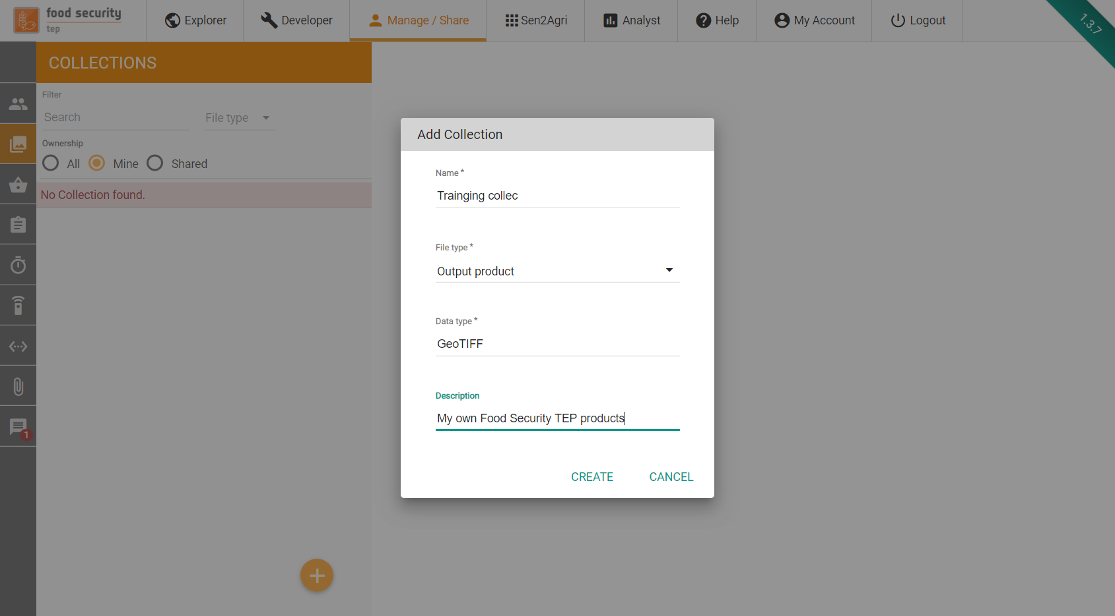
Creating your own product collection
PS: If you create your own collection, you can store your own products there later on and search and access them for your own higher level service.
Note: For retrieving data via WCS calls, you need a FS-TEP Geoserver layer that can be created by the Food Security TEP support team. Please let us know:
support@foodsecurity-tep.net

Slide 39
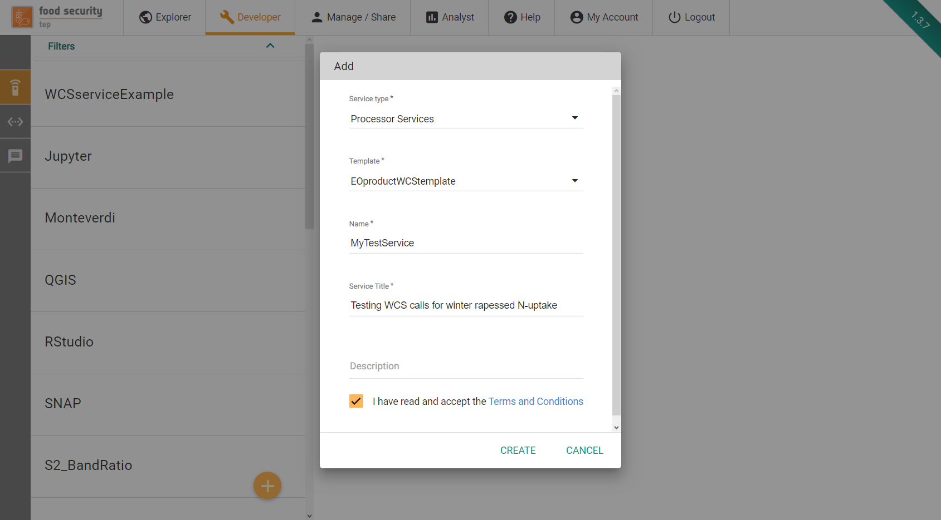
Setting up your own Docker container
Practical:
Create a (non-parallel) Processor service based on the EOproductWCStemplate
Define the input geoserver ID for WCS retrieval of inputs (e.g. LAI), ideally via Default Input Definitions
Same for your output collection (if you created any)
Optional: Provide a product time RegExp for the output product(s)

Slide 40
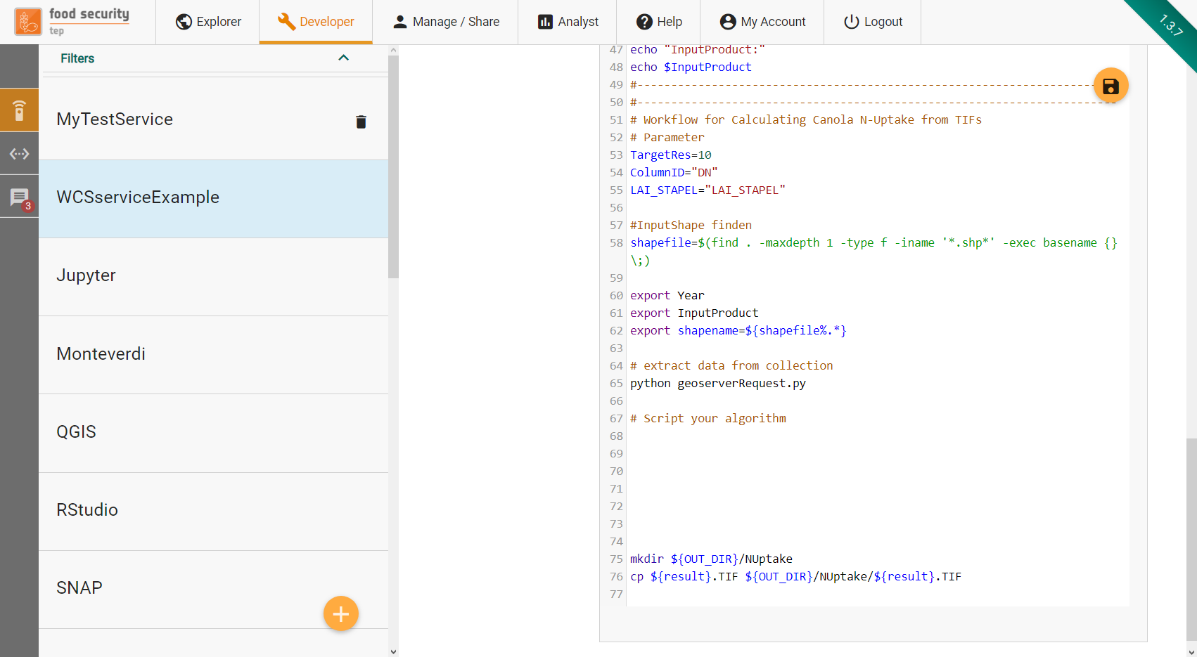
Advanced:
Script your algorithm based on EO products
Advanced users:
Script the nitrogen uptake processing or any other analysis based on one or more biophysical parameters
Note: To derive other biophysical parameters, you can use one of the available SNAP services, modify the SNAP Band Ratio or Normalized band Difference services or create your own by using the respective service template

Slide 41
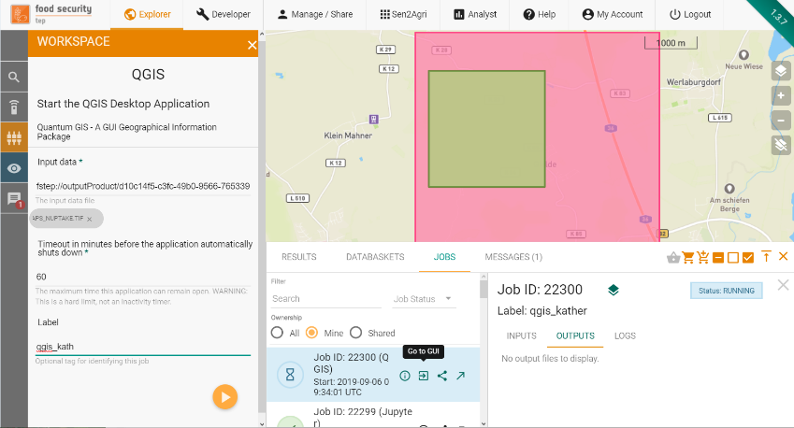
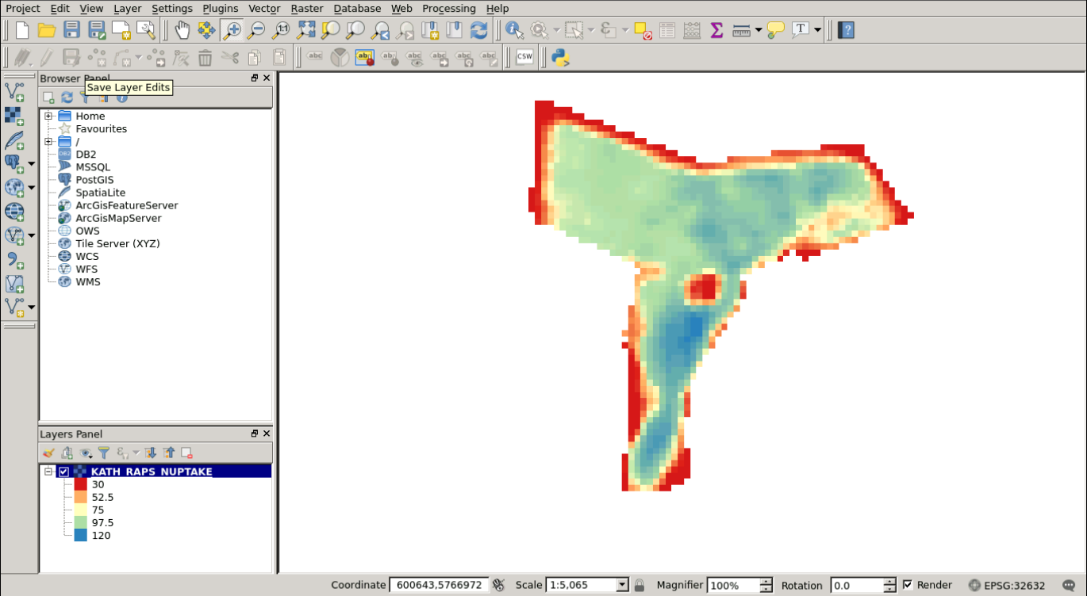
Optional:
Visualization/Analysis using TEP Applications
Food Security TEP and many other exploitation platforms provide GUI applications (e.g. QGIS, SNAP, Orfeo/Monteverdi, R Studio,…) as well as Jupyter Notebooks to run interactive analysis of service results and product collections

Slide 42
Short break…..
Food Security TEP Jupyter Notebooks for crop monitoring –
A micro-insurance application
(Tom Van Roey – Roel Van Hoolst (VITO)

Slide 43
FS-TEP Jupyter Notebooks for crop monitoring - micro-insurance application
Part 1:
TEP-FS pilot for Area Yield Index insurance in Kenya.
User: World Food Program & Pula Advisors
Application: Food Security TEP Jupyter Notebook
Part 2:
Introduction to Jupyter Notebook
Set-up
Practical example: NDVI timeseries extraction

Slide 44
FS-TEP Jupyter Notebooks for crop monitoring
- micro-insurance application -
Part 1: Food Security TEP pilot for Area Yield
Index Insurance in Kenya.

Slide 45
The Food Security Thematic Exploitation Platform
“Supporting Sustainable Food
Production from Space”
The innovative platform aims at simplifying the extraction of informa-tion from Earth Observation data for the advancement of data-intensive services in the food security sector mainly in Europe and Africa.
Notes:
Open Interface for non-IT experts and scientists
Customized services to support Food Security but also for commercial use

Slide 46
TEP-FS Pilot 2
Background:
R4 Rural Resilience Initiative (R4):
  strategic partnership between Oxfam America (OA) & UN’s World Food Program (WFP)
Micro-insurance:
  Kenya’s Arid & Semi-Arid Lands
  In 2016: feasibility study for two types of index insurance
    Area Yield Indices
    Weather Index Based
  Area Yield approach
    Easier for partners & participants to understand, accept and actively engage
  Currently an operational service in the region
    Developed & operated by WFP with local partner Pula Advisors
Notes:
The R4 Rural Resilience Initiative (R4) is a strategic partnership between Oxfam America (OA) and the United Nations World Food Programme (WFP). The initiative combines improved resource management (risk reduction), insurance (risk transfer), livelihoods diversification and microcredit (prudent risk taking), and savings (risk reserves).
In Kenya’s Arid and Semi-Arid Lands (ASALs), a 2015 feasibility study has set the basis to conduct a dry run for the 2016 short rain season (October – December) in five sub-counties of Kitui – Kitui Rural, Kitui East, Kitui South, Mwingi Central and Mwingi North. Two types of index insurances were tested: Area Yield Index, where regional yield indices are derived from Crop Cutting Experiments (CCE) and a Weather Index based approach. Based on the dry run, it was selected to proceed with the Area Yield approach as it is easier for partners and participants to understand, accept and actively engage in the process. Technical and operational challenges and key lessons learnt during the dry run phase provided a critical input into the strategic planning and design of the scale up phase. In 2017, 963 participants (90 percent women) accessed area yield index insurance coverage for four drought tolerant crops – cow peas, green grams, millet and sorghum, under the risk transfer component of the initiative. The program is now an operational service in the region.
Pula Advisors (pula-advisors.com), a specialist risk analysis and assessment advisory firm based in Nairobi, is responsible for the development of the regional yield indices in the Kitui county. To support the planning of the Crop Cutting Experiments (CCE), it is important to have information on where what grows and the crop stage of development. Furthermore, high resolution yield indicators could potentially support the upscaling of the crop cutting experiments. In this pilot, the TEP-Food Security platform was used to facilitate Sentinel 2 data exploitation for crop monitoring at the parcel level in the Kitui county in Kenya.

Slide 47
Area Yield Index Insurance
Region or farmers group
Per unit:
Number of representative fields
Crop Cutting Experiments (CCE)
CCE to determine yield
Use aggregated CCE’s yield as index for region
If yield < threshold
  All insured farmers in region get pay-out
Field 1
Field 2
Field 3
Advantage:
Easy to understand
Disadvantage:
labor and travel intensive
>> 92% of unit cost
Notes:
Area Yield Index Insurance
In Area Yield Index Insurance the payout is based on the average yield within an insurance unit.
This average yield is calculated from a number of Crop Cutting Experiment (CCE) within the region.
If this average yield index is below a certain threshold, all insured farmers in the insurance unit get a pay-out.
The advantage is that it is easy to understand, it covers all natural catastrophes that could impact the yield.
The disadvantage is that is labor and travel intensive which determines about 92% of the unit costs.
The lower the costs, the cheaper the insurance product can be distributed.

Slide 48
Area Yield Index Insurance
EO opportunities
Crop growth status at field level
Optimize Crop Cutting Experiments (CCE)
Optimize definition of insurance units
  Search for larger homogeneous units with a similar agro-ecological behavior
First step for Pula Advisors:
Explore Sentinel 2 combined with CCE in-situ data
TEP-FS application:
Jupyter Notebook
Sentinel 2 time series exploration
Integrate existing in-situ data records from CCE
Notes:
The idea is to make the area yield collection more efficient:
By optimizing the Crop Cutting Experiments (CCE)
Optimize timing of field visit
Upscale information of field visits
By optimizing the definition of insurance units
EO could help to define larger insurance units by detecting regions with a similar agro-ecological behavior.
This reduces the amount of field visits.
The user (Pula Advisors) first needs to explore the Sentinel 2 data over the micro-insurance region.
They want to analyze how well the Sentinel 2 data matches with the in-situ data.
They didn’t want to spend a lot of effort in preprocessing of the satellite data, but rather focus on the analysis.
As a solution, a TEP-FS application was developed in the form of a Jupyter Notebook.
This tool integrates Sentinel 2 time series with existing in-situ data records from Crop Cutting Experiments (CCE).

Slide 49
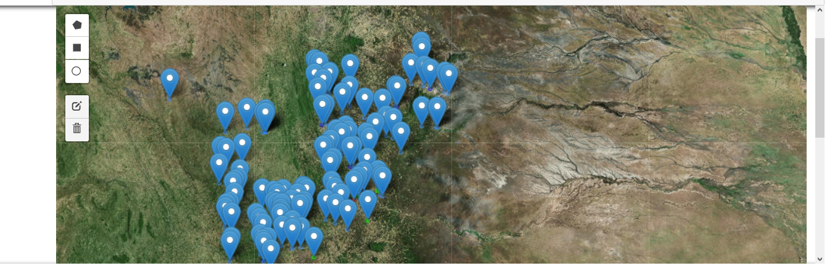
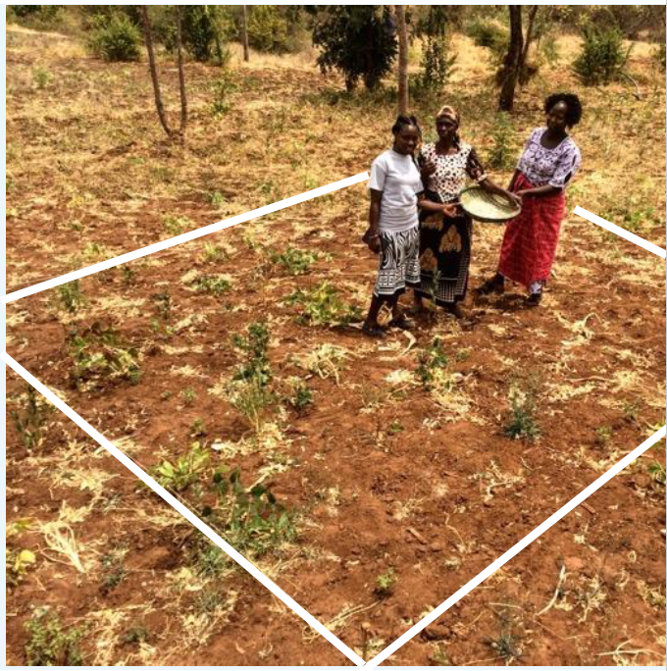
CCE in-situ data
120 fields surveyed
2 boxes/field
Available information:
  Geolocation
  Crop description
  Crop Health
  Yield
Copyright:
https://www.spacefordevelopment.org/wp-content/uploads/2018/06/Using-Satellite-Data-for-Area-Yield-Insurance.pdf

Slide 50
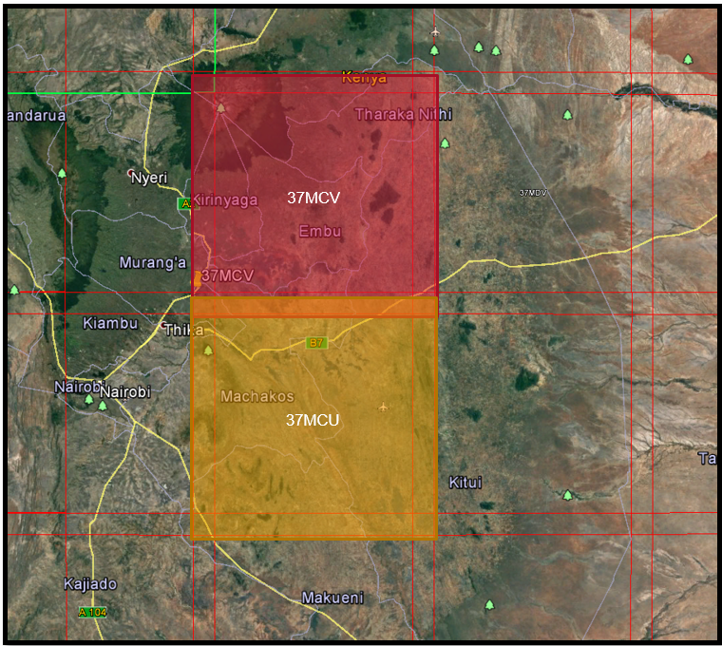
TEP-FS application
In the background (Food Security TEP processing):
Sentinel 2 data processing
Level 1C → Level 2A with iCOR for atmospheric correction
Level 2A → Biophysical parameters (BIOPAR)
For pilot: two tiles around Kitui Province
Inclusion of meteo data (ECMWF):
  Average daily temperature,
  Minimum daily temperature,
  Maximum daily temperature
  Rainfall
Notes:
The Sentinel 2 data is processed from level 1C till level 2A derived biophysical parameters via the TEP Food Security platform. A processing chain is embedded that uses iCOR for atmospheric corrections, SEN2COR for cloud/shadow masking and the BIOPAR (as in the SNAP toolbox) for the retrieval of biophysical parameters. A Python Notebook was developed to facilitate the Sentinel 2 data exploration. Time series of biophysical parameters are extracted at the field level, gap-filled and smoothed to estimate the crop’s growing stage. Via the Notebook, an extensive in-situ dataset on Crop Cutting Experiments (CCE) was connected with Sentinel 2 derived parameters and meteo data. Both WFP and Pula Advisors were actively involved in the development of this Python Notebook.

Slide 51
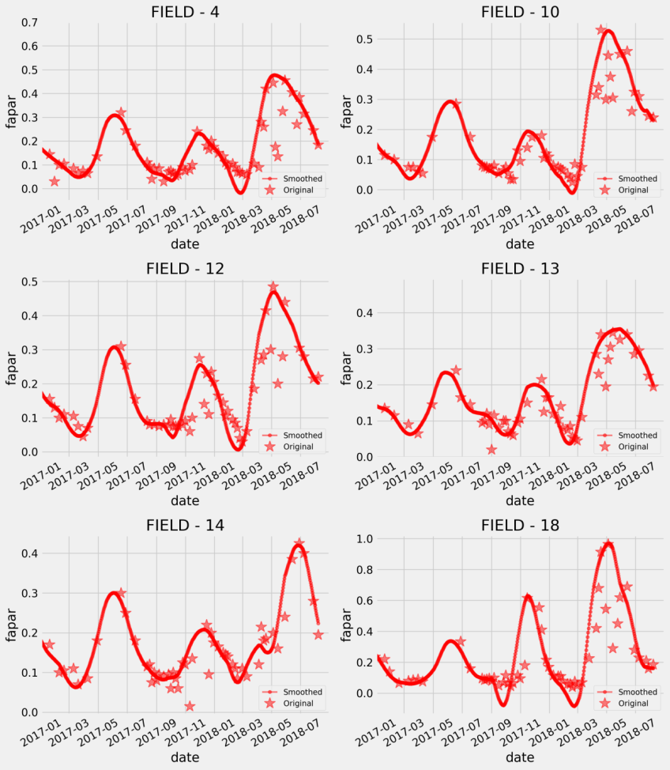
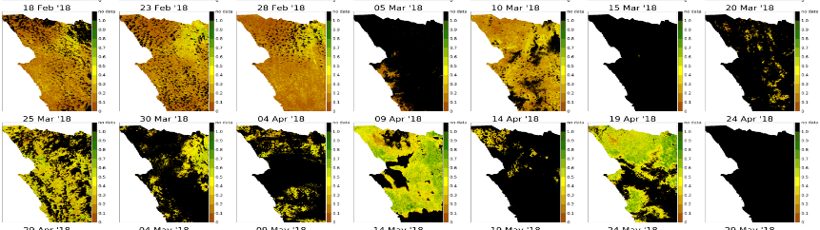
TEP-FS application
In the background (FS-TEP processing):
From raw observations
to construction of crop growth curves
Challenge:
  Many clouded images
  Undetected clouds cause temporal outliers
Solution:
  Outlier removal & smoothing
Notes:
The Sentinel 2 data is processed from level 1C till level 2A derived biophysical parameters via the TEP Food Security platform. A processing chain is embedded that uses iCOR for atmospheric corrections, SEN2COR for cloud/shadow masking and the BIOPAR (as in the SNAP toolbox) for the retrieval of biophysical parameters. A Python Notebook was developed to facilitate the Sentinel 2 data exploration. Time series of biophysical parameters are extracted at the field level, gap-filled and smoothed to estimate the crop’s growing stage. Via the Notebook, an extensive in-situ dataset on Crop Cutting Experiments (CCE) was connected with Sentinel 2 derived parameters and meteo data. Both WFP and Pula Advisors were actively involved in the development of this Python Notebook.

Slide 52
TEP-FS application
Co-design Notebook application – required functionalities :
Displaying in-situ sites and adding new sites
Retrieving crop growth parameters for the selected sites
Comparing temporal profiles of different sites (incl. link with meteorological data)
Plotting crop growth curves
Deriving crop parameters
Analysis of crop productivity parameters
Notes:
The Sentinel 2 data is processed from level 1C till level 2A derived biophysical parameters via the TEP Food Security platform. A processing chain is embedded that uses iCOR for atmospheric corrections, SEN2COR for cloud/shadow masking and the BIOPAR (as in the SNAP toolbox) for the retrieval of biophysical parameters. A Python Notebook was developed to facilitate the Sentinel 2 data exploration. Time series of biophysical parameters are extracted at the field level, gap-filled and smoothed to estimate the crop’s growing stage. Via the Notebook, an extensive in-situ dataset on Crop Cutting Experiments (CCE) was connected with Sentinel 2 derived parameters and meteo data. Both WFP and Pula Advisors were actively involved in the development of this Python Notebook.

Slide 53
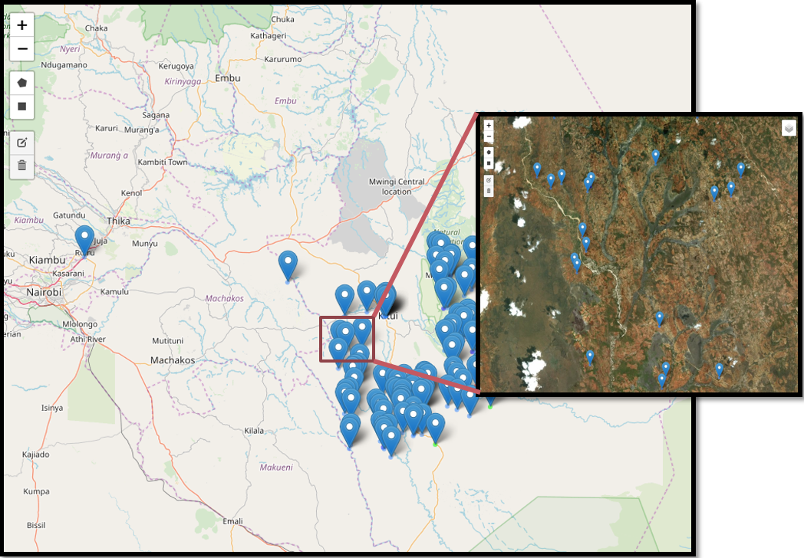
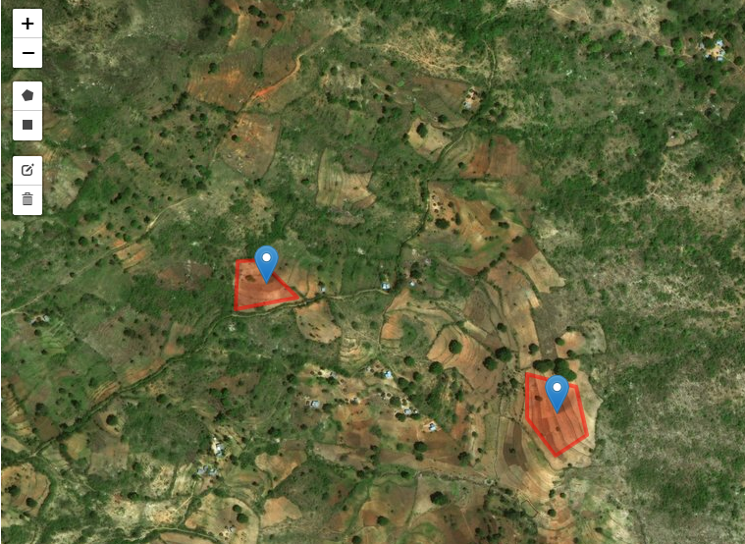
Field selection
Crop Cutting Experiments geolocations
Add own fields

Slide 54
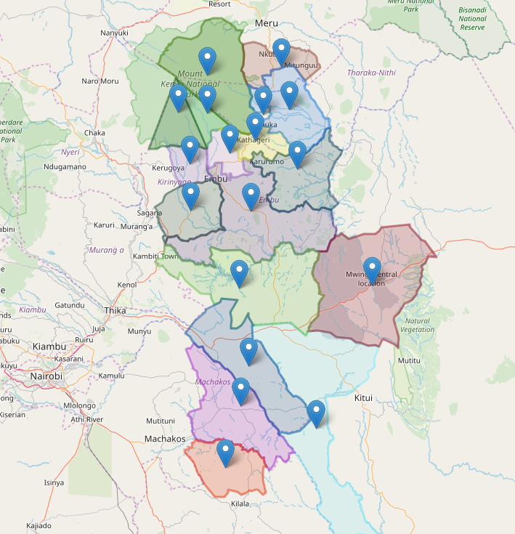
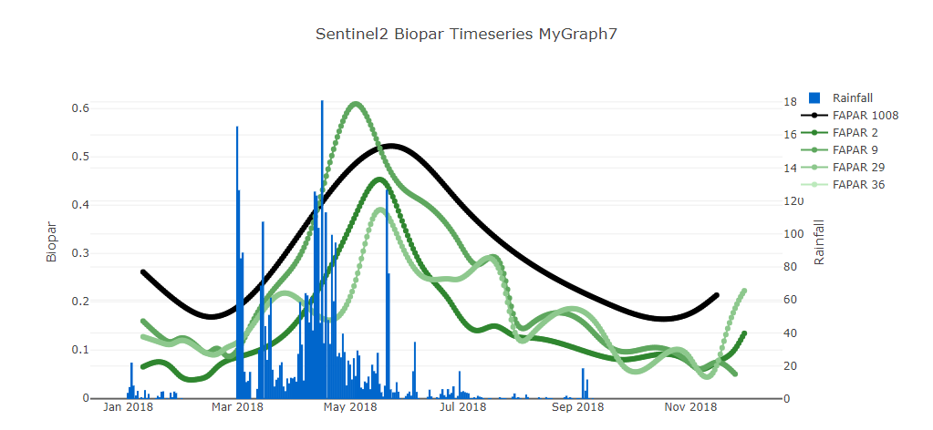
Regional analysis
How does the field compare with the regional average?

Slide 55
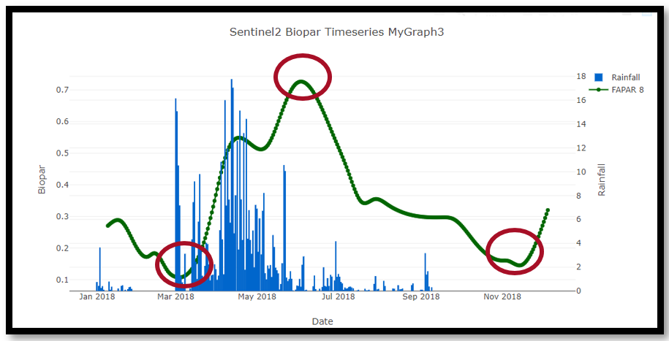
Crop growth parameters
Crop Phenology
Crop productivity parameters
  Maximum vegetation index
  Integral under curve

Slide 56
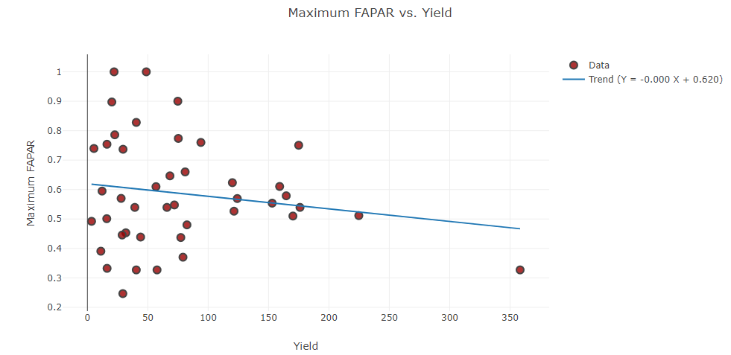
Analysis of Crop Growth Parameters
The basis of the insurance scheme are the actual measured yields.
Via Notebook check the relation between the Sentinel 2 derived crop parameters and measured CCE yields.
First, simple analysis
Max fAPAR vs yield
Weak relation – possible causes:
Geolocation CCE accuracy
Mixed cropping systems
Relevance of crop growth parameter
Further analysis is being done by Pula

Slide 57
FS-TEP Jupyter Notebooks for crop monitoring - micro-insurance application
Part 2: TEP-FS Notebook for Sentinel Timeseries Analysis

Slide 58
Sentinel Timeseries Analysis – Use case
Calculate average NDVI of a farm parcel and see how it changes over time:
  “Classic” approach:
  Perform query to get list of S2 scenes in the chosen area or time range
  Download XXX products from OpenHub with an average size of 0,75GB per product
  Unzip products and extract required bands (RED and NIR in this case)
  In case AOI is inside two or more tiles, a stitching needs to be performed.
  Optionally, re-project from one CRS into target CRS.
  Create two composites, one for NDVI image and one for cloud mask
  Clip the AOI and compute statistics within it.
  Perform smoothing, as “raw” profile is irregular by nature (e.g. due to undetected clouds)
  Output the result as JSON, images, chart, etc.
  ➔ I don’t dare estimate how long all this would take !!
Notes:
This vegetation growth curve can be then compared to a typical “crop signature” (the expected NDVI over time for a certain crop), which often reveals what kind of crop it is if ground-truth data is unavailable. In case it is known, deviations from the expected behavior can identify abnormalities, and act as a warning for the farmer.

Slide 59
Sentinel Timeseries Analysis – Use case
Solution:
Make use of (private/public) cloud infrastructure and services build on top of it
Use RESTful API interface to access the Sentinel satellite archive and compute using your own code:
  Sentinel Hub API: https://www.sentinel-hub.com/develop/documentation/api
Use pre-processed, corrected biophysical parameters provided on a cloud platform, e.g.
  Terrascope platform: https://terrascope.be/en
  Food Security TEP: https://foodsecurity-tep.net/app

Slide 60
Sentinel Timeseries Analysis – Example
Step 1: perform timeseries query (using the Terrascope)
Python sample code:
  startDate = "2018-03-01"
  endDate = "2018-10-31“
  examplePoint1 = {
  "geometry" : {
  "coordinates" : [37.29146, -0.860292],
  "type": "Point"
  }
  };
  data1 = timeseries(“some_timeseries”, startDate, endDate, examplePoint1, “NDVI”, doSmoothing = True);

Slide 61
Sentinel Timeseries Analysis – Example
Step 2: plot data
  import plotly.graph_objs as go
  trace1 = go.Scatter(
  x = dates,
  y = data1[‘some_timeseries'],
  mode = 'lines+markers',
  name = 'Timeseries NDVI',
  connectgaps=True,
  line=dict(shape='spline', color='#FF0000')
  );
  layout = dict(
  title = 'Timeseries Example',
  xaxis = dict(title = 'Date'),
  yaxis = dict(title = ‘NDVI'),
  showlegend=True
  );
  data = [trace1]
  fig = dict(data=data, layout=layout);
  iplot(fig);

Slide 62
Sentinel Timeseries Analysis – Exercise Food Sec TEP
Use provided notebook application:
  Access Food Security TEP and search for the reference file “ESA_EOTraining.ipynb”
  Start Jupyter from the Services Tab with this file as input
  Go to /workDir/inDir/input and launch the notebook
  Modify the first block by selecting “Code” in the drop-down menu to activate all lines showing ‘sys’ commands
Update notebook application:
  Draw parcel on map
  Render both smoothed and raw timeseries profile of the parcel on a graph
  Advanced users: derive start of growing season from timeseries profile

Slide 63
Sentinel Timeseries Analysis – Exercise Terrascope
Use provided notebook application:
  Access Jupyter Notebooks from Terrascope platform: https://notebooks.vgt.vito.be/hub/login
    Username / password: esa_ltc19 / pwd4esaltc19
  Copy “Private/notebook-samples/ESA_EOTraining/ESA_EOTraining.ipynb” and rename it to own notebook application (e.g. “<my_name>.ipynb”)
  Click: Help – Launch Classic Notebook
  Go to own notebook application and start it
Update notebook application:
  Draw parcel on map
  Render both smoothed and raw timeseries profile of the parcel on a graph
  Advanced users: derive start of growing season from timeseries profile

Slide 64
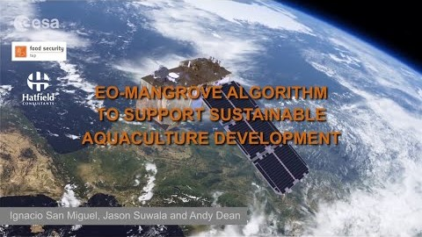

Example application for aquaculture

