Slide 1
Water stress detection, evapotranspiration indicator and irrigation management
Albert Olioso INRA (UMR EMMAH) Avignon, France albert.olioso@inra.fr

Slide 2
EVAPOTRANSPIRATION
ET

Slide 3
Evapotranspiration
- introduction, definition, processes
- the energy balance
- some evapotranspiration concepts
- reference evapotranspiration
Remote sensing of evapotranspiration
- energy balance approaches
- residual methods
- evaporative fraction
- water balance approaches
- crop water requirements
le bilan hydrique

Slide 4
Evapotranspiration: ET
combination of processes where
water changes phase from liquid to vapour
vapour is released to the atmosphere
Evaporation : the process involves water surfaces and soil considering only physical interactions
Transpiration: the process involves living organisms considering physical AND physiological mechanisms.

Slide 5
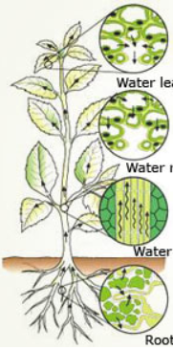
Transpiration involves:
stomatal regulation and development of leaf surface
processes to withdraw water from the soil
  water transfer through the plant xylem toward the leaves
  root development
  root absorption that can be passive or active
(images from wonderwhizkids)

Slide 6
Some of the functions of evapotranspiration:
- maintains the thermal equilibrium of plants
- nutrient transport from the soil
- plant turgor
- availability of water for physiological and biochemical processes
(less than 5 % of the water is concerned,
more than 95 % is released to the atmosphere)

Slide 7
Transpiration is closely related to photosynthesis and plant productivity
- CO2 is extracted from the atmosphere through the stomata
- « stability » of the ratio (dry mater production) / (quantity of used water)
[water use efficiency]

Slide 8
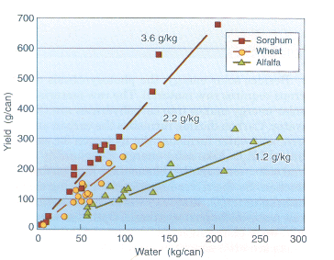
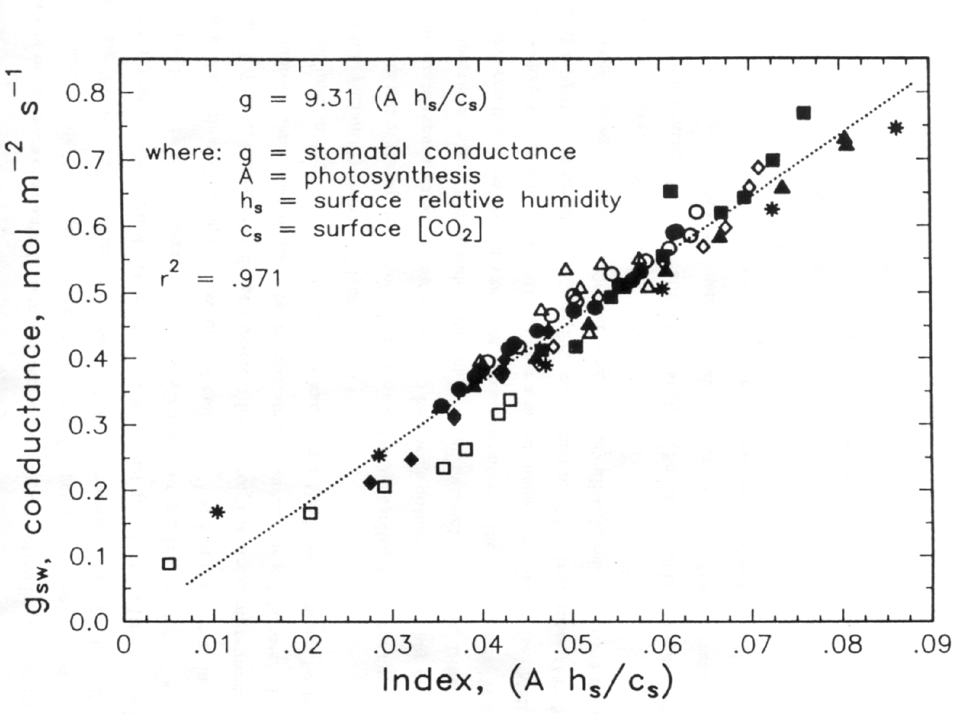
(Dening 1993) (redrawn from de Wit 1958)

Slide 9
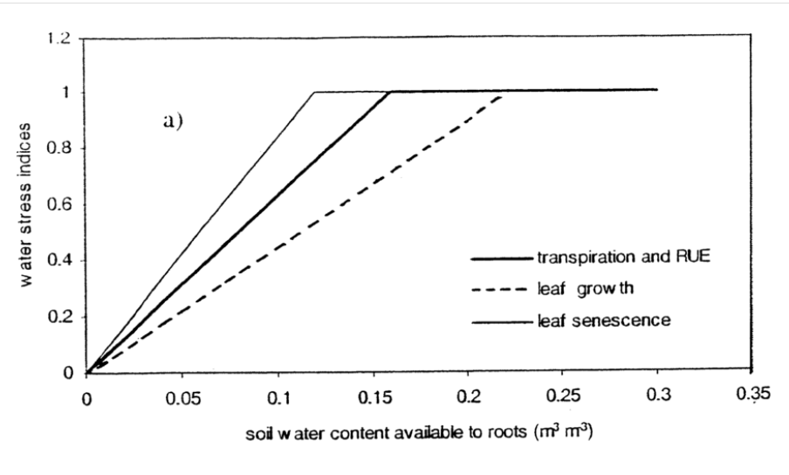
Water stress (pragmatic definition) :
when a plant process is limited by the reduction of water availability

Slide 10
What controls evaporation?
Evaporation consumes a lot of energy : λ = 2256 kJ/kg
This energy is provided by :
– solar radiation (and atmospheric radiation)
– heat (sensible) transferred by convection and conduction
– kinetic energy, internal energy of the water

Slide 11
What controls evaporation ? transpiration ?
Evaporation
- the energy balance
- incident radiations
- the temperature
- the vapour content
- the wind
- the availability of water
- ...
Transpiration
- the type of vegetation
- its vegetative state
- stomatal processes
- the density and size of the vegetation
- the soil structure
- the CO2 concentration in the air
- ...

Slide 12
What controls evaporation ? transpiration ?
Evaporation
- the energy balance
- incident radiations
- the temperature
- the vapour content
- the wind
- the availability of water
- ...
Transpiration
- the type vegetation
- its vegetative state
- stomatal processes
- the density and size of the vegetation
- the soil structure
- the CO2 concentration in the air
- ...
availability of energy

Slide 13
What controls evaporation ? transpiration ?
Evaporation
- the energy balance
- incident radiations
- the temperature
- the vapour content
- the wind
- the availability of water
- ...
Transpiration
- the type vegetation
- its vegetative state
- stomatal processes
- the density and size of the vegetation
- the soil structure
- the CO2 concentration in the air
- ...
availability of energy
availability of water

Slide 14
What controls evaporation ? transpiration ?
Evaporation
- the energy balance
- incident radiations
- the temperature
- the vapour content
- the wind
- the availability of water
- ...
Transpiration
- the type vegetation
- its vegetative state
- stomatal processes
- the density and size of the vegetation
- the soil structure
- the CO2 concentration in the air
- ...
availability of energy
type of climate
availability of water

Slide 15
What controls evaporation ? transpiration ?
Evaporation
- the energy balance
- incident radiations
- the temperature
- the vapour content
- the wind
- the availability of water
- ...
Transpiration
- the type vegetation
- its vegetative state
- stomatal processes
- the density and size of the vegetation
- the soil structure
- the CO2 concentration in the air
- ...
thermodynamic status of the atmosphere, turbulence
type of climate

Slide 16
What controls evaporation ? transpiration ?
Evaporation
- the energy balance
- incident radiations
- the temperature
- the vapour content
- the wind
- the availability of water
- ...
Transpiration
- the type of vegetation
- its vegetative state
- stomatal processes
- the density and size of the vegetation
- the soil structure
- the CO2 concentration in the air
- ...
vegetation processes

Slide 17
What controls evaporation ? transpiration ?
Evaporation
- the energy balance
- incident radiations
- the temperature
- the vapour content
- the wind
- the availability of water
- ...
Transpiration
- the type of vegetation
- its vegetative state
- stomatal processes
- the density and size of the vegetation
- the soil structure
- the CO2 concentration in the air
- ...

Slide 18
The Energy Balance
Rn = λ ET + H + G + P_{S}
latent heat flux ET: evapotranspiration
λ : latent heat

Slide 19
The Energy Balance
Rn = λ ET + H + G + P_{S}
energy storage in plants
latent heat flux
evapotranspiration
net radiation
ground heat flux
sensible heat flux

Slide 20
The Energy Balance
Rn = λ ET + H + G + P_{S}
air temperature Ta + VPD (vapor
latent heat flux vapour pressure ea - pressure deficit)
evapotranspiration wind speed ua +
surface roughness zo + vegetation height
leaf area index LAI +
stomatal conductance gs +
availability of soil water +
light (PAR) +
Ta +/-
ea + VPD
[CO₂]_{a} -
age +/-

Slide 21
The Energy Balance
Rn = λ ET + H + G + P_{S}
latent heat flux
evapotranspiration
net radiation solar radiation Rg + (+)
atmospheric radiation Ra + (+)
albedo a - (-)
surface temperature Ts - (-)

Slide 22
The Energy Balance
Rn = λ ET + H + G + P_{S}
latent heat flux
evapotranspiration
air temperature Ta - (+)
sensible heat flux surface temperature Ts + (-) wind speed ua + (+)
surface roughness zo - (+)

Slide 23
The Energy Balance
Rn = λ ET + H + G + P_{S}
energy storage in plants: usually neglected
latent heat flux
evapotranspiration
net radiation
ground heat flux: - soil temperature gradient
- thermal conductivity
sensible heat flux

Slide 24
Some ET concepts :
Potential Evapotranspiration (PET)
the highest rate of ET that can occurs for a given climate -> theoretical calculation
(or for a given type of plant in a given climate)
[dozens of different formulas are available]
Reference Evapotranspiration (ETo)
the rate of ET for a reference surface with a full canopy cover and a full water availability
two main references : alfalfa (American Society of Civil Engineers), grass (FAO)
used for computing irrigation requirements

Slide 25
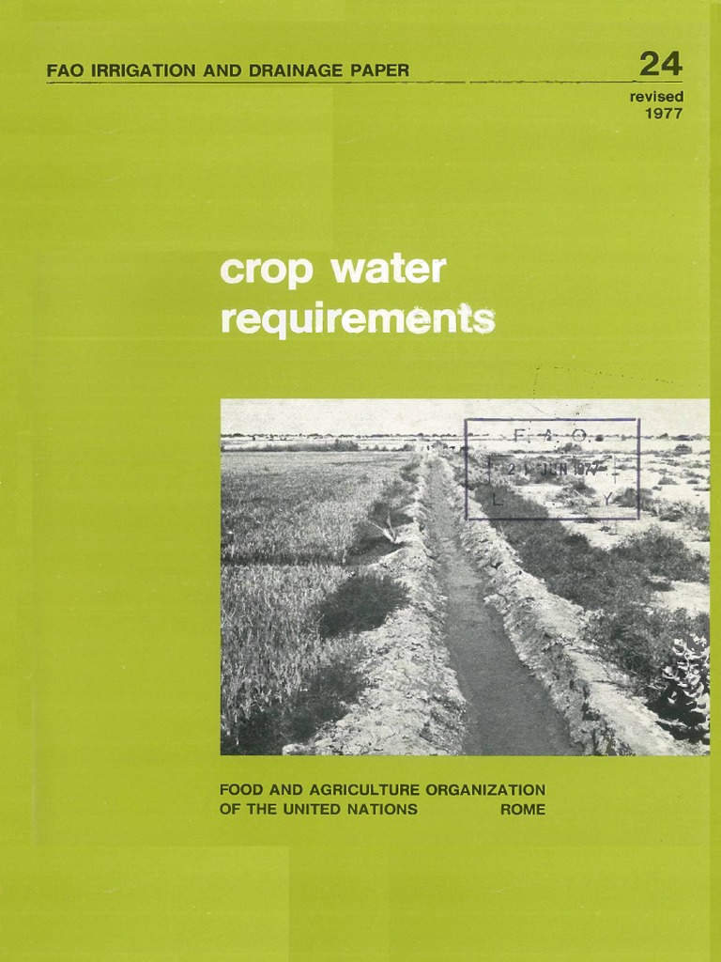
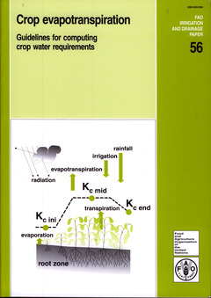
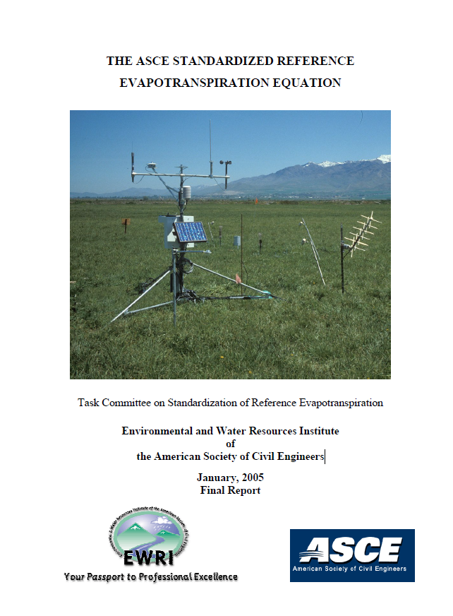
Reference Evapotranspiration

Slide 26
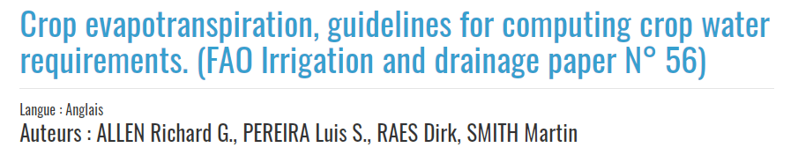
1998
http://www.fao.org/3/X0490E/X0490E00.htm

Slide 27
- ETo calculated with the Penman-Monteith equation
assuming parameters for a short grass canopy
water requirements computed as ET = Kc X ETo
Kc = crop coefficient
provides a catalog of
  crop coefficient values
  methods for computing inputs (meteo data)
  method for computing water balance and
  adapt Kc to non ideal conditions

Slide 28
ETc = Kc X ETo

Slide 29
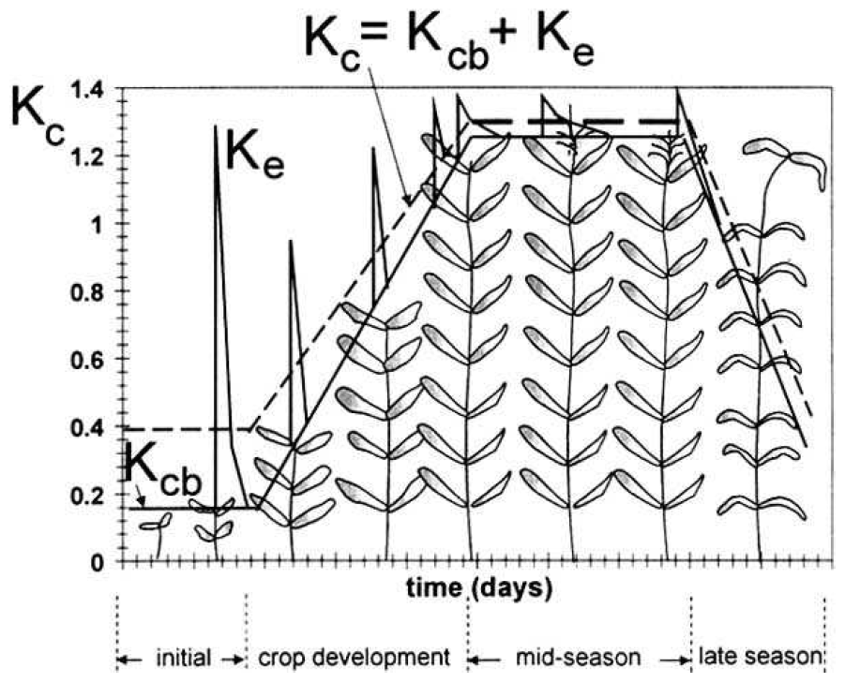
Coefficient cultural
ET = Kc X ETo

Slide 30
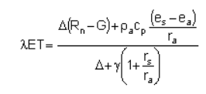
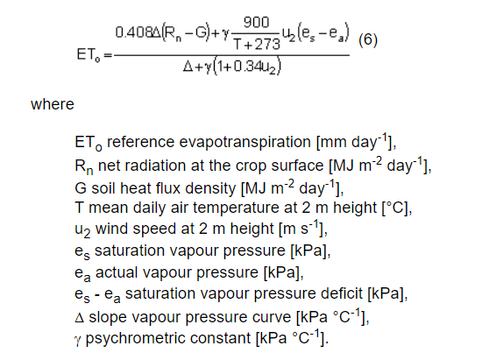
Equation de Penman-Monteith

Slide 31
REMOTE SENSING OF
EVAPOTRANSPIRATION

Slide 32
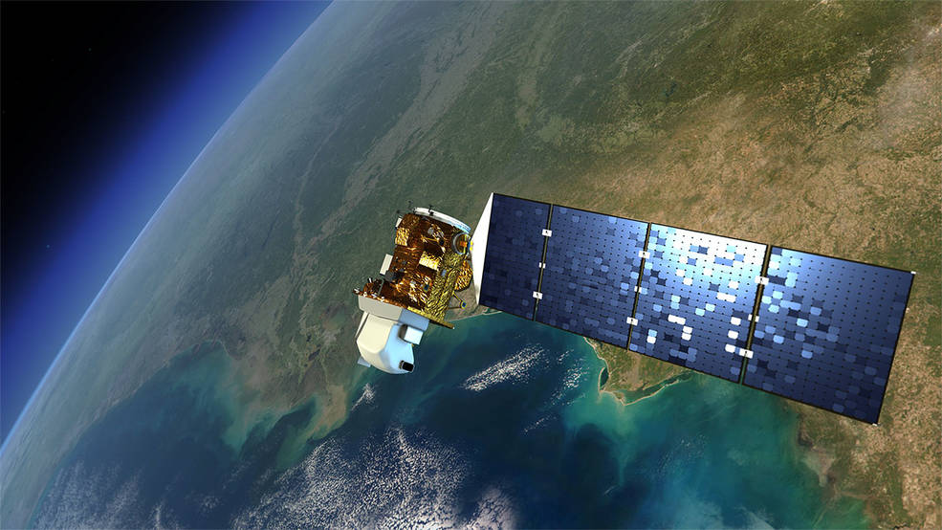
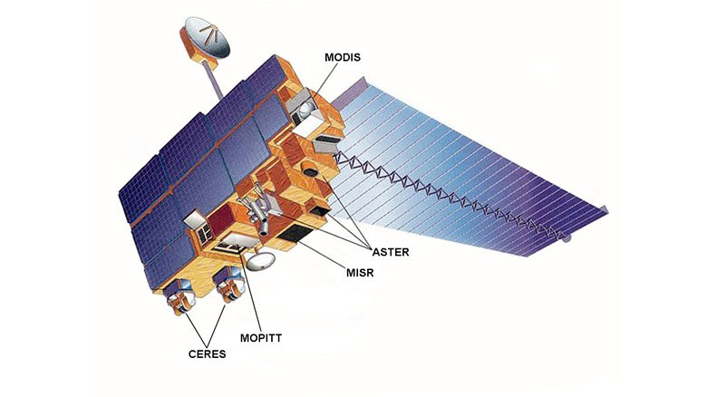
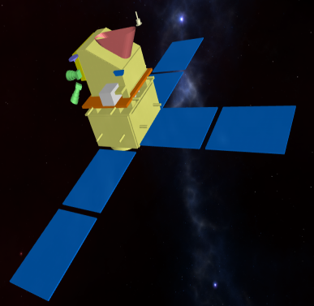
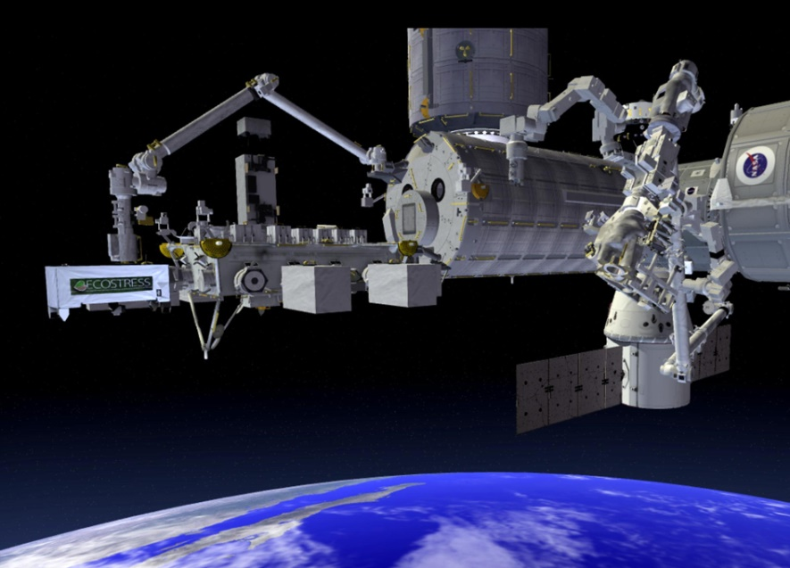
LANDSAT TERRA
modis
aster
ECOSTRESS
THIRSTY

Slide 33
Remote sensing of ET
Three main types of methods
  aerodyanic residual equation
  evaporative fraction method
  water balance method
  crop water requirements
energy balance equation,
surface temperature and albedo
  Landsat
  MODIS
  Sentinel 3
water balance equation and fraction cover (vegetation indices)
  Earth Observation satellites : Landsat, SPOT, Sentinel 2...

Slide 34
REMOTE SENSING OF EVAPOTRANSPIRATION
Energy balance approaches

Slide 35
The Energy Balance
Rn = λ ET + H + G + P_{S}
energy storage in plants: usually neglected
latent heat flux
evapotranspiration
net radiation
ground heat flux: - soil temperature gradient
- thermal conductivity
sensible heat flux

Slide 36
The Energy Balance -> residual method
λ ET = Rn - H - G
Rn
NDVI
Ts
NDVI
plant type
albedo
Ts
spectral reflectances
thermal infrared radiances
models / methods such as
- ALEXI / disALEXI
- Sebal / Metric
(Bastiansen, 1998, Allen et al., 2007
- Rel. Simplifiée
requires meteorological data : Rg, Ra, ua, Ta...
    meteorological network
    atmospheric reanalysis
    remote sensing

Slide 37
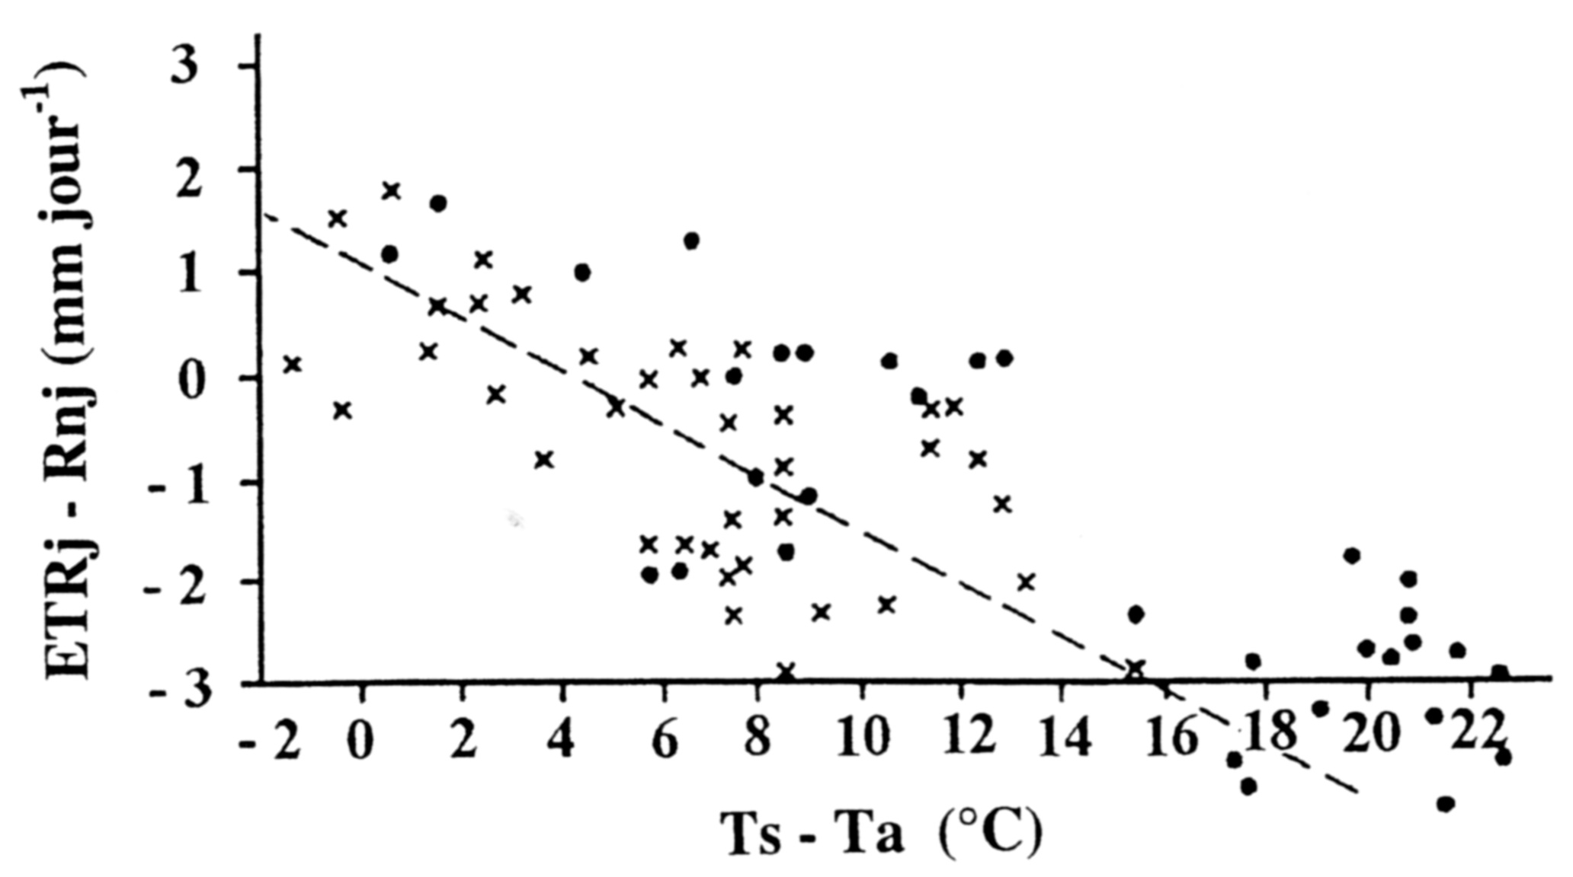
Simplified relationship (Seguin and Itier 1983)
residual method integrated at the daily scale : ETR_{d} – Rn_{d} = A + B (T_{s} – T_{a})
• ETR_{d} :
cumulated daily evapotranspiration
• Rn_{d} :
cumulated daily net radiation
• T_{s} and T_{a} :
surface and air temperatures
at ~2:00 pm

Slide 38
Simplified relationship (Seguin and Itier 1983)
coefficients A and B can be
obtained by linear regression on experimental or simulated data
tabulated for standard type of vegetation (in particular differing in roughness) or related to NDVI
The simplified relationship can be easilly integrated in time over long periods
as in the following example :
integration of Ts derived from NOAA-AVHRR data from March to October
for 3 years with different drought level in France (1988 wet, 1989 and 1990 dry)
-> analyse of drought extent for national agricultural management (Ministry)

Slide 39
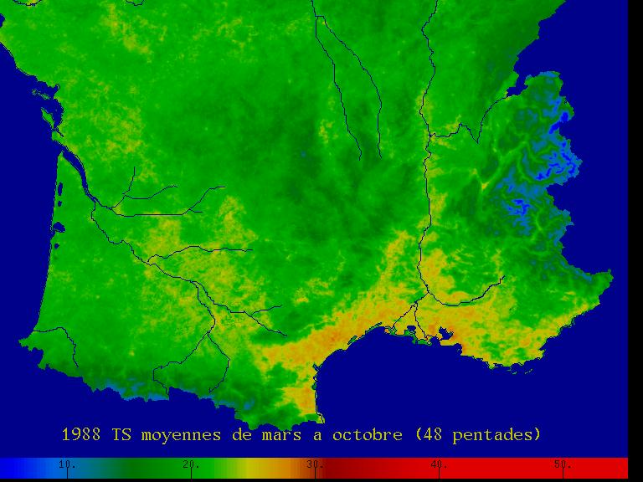
1988: Averaged surface temperature from March to October
10 20 30 40 50 °C

Slide 40
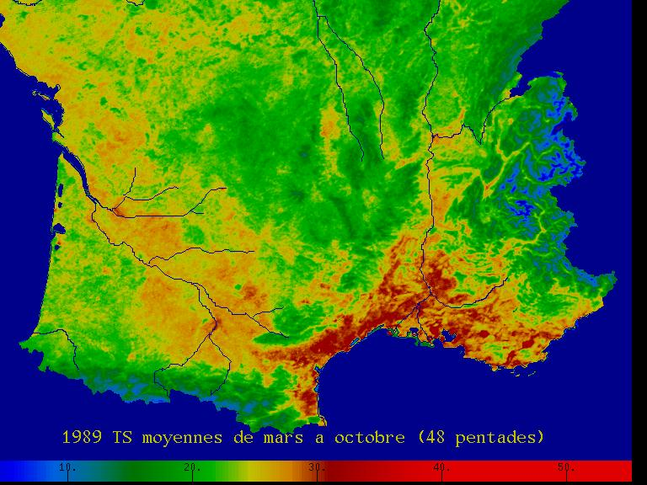
1989: Averaged surface temperature from March to October
10 20 30 40 50 °C

Slide 41
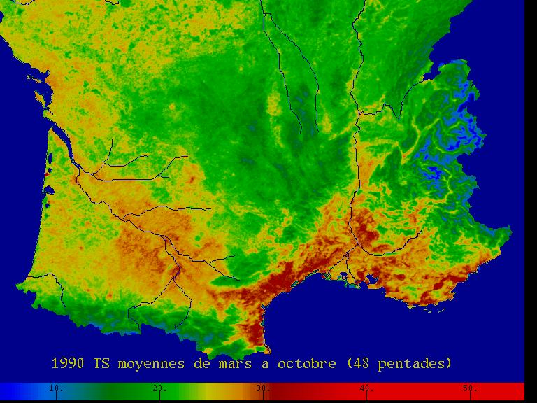
1990: Averaged surface temperature from March to October
10 20 30 40 50 °C

Slide 42
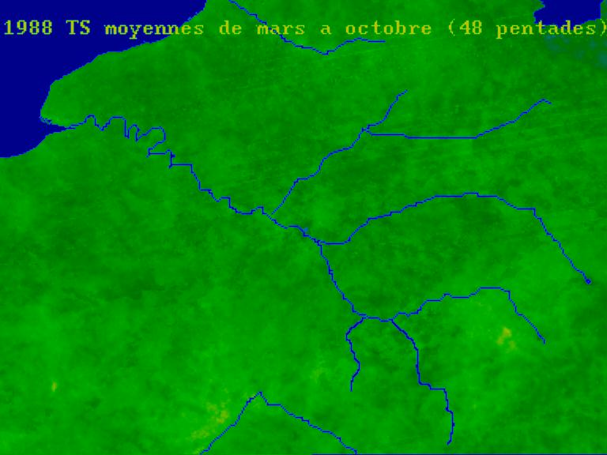
1988: Averaged surface temperature from March to October

Slide 43
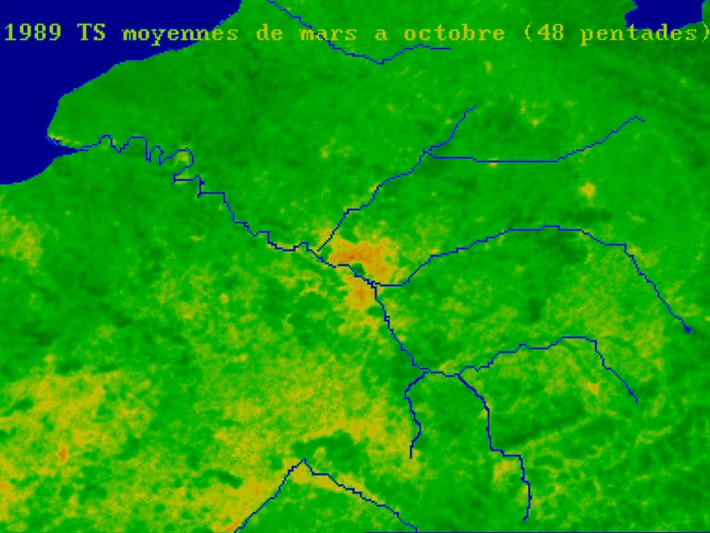
1989: Averaged surface temperature from March to October

Slide 44
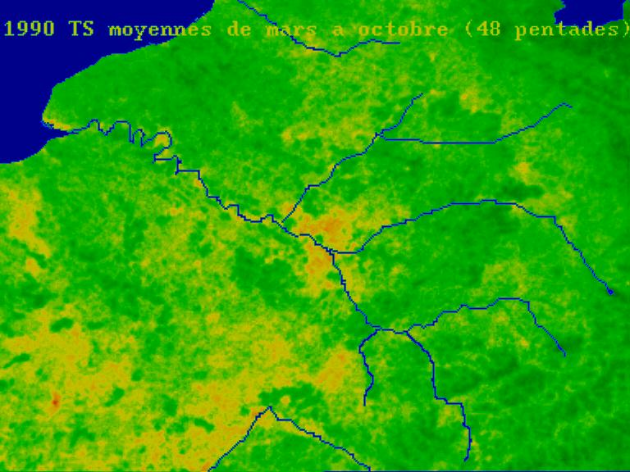
1990: Averaged surface temperature from March to October

Slide 45
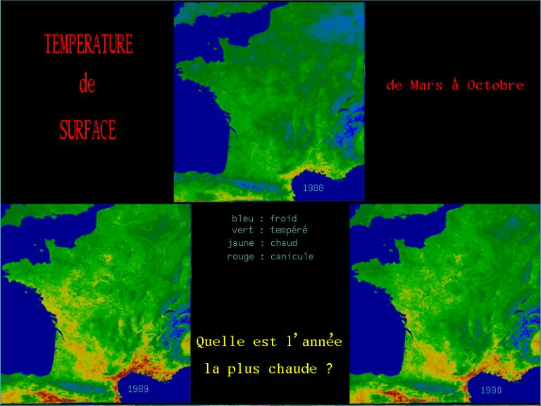
Surface temperature
NOAA/AVHRR
March-October
1989
1990
1988

Slide 46
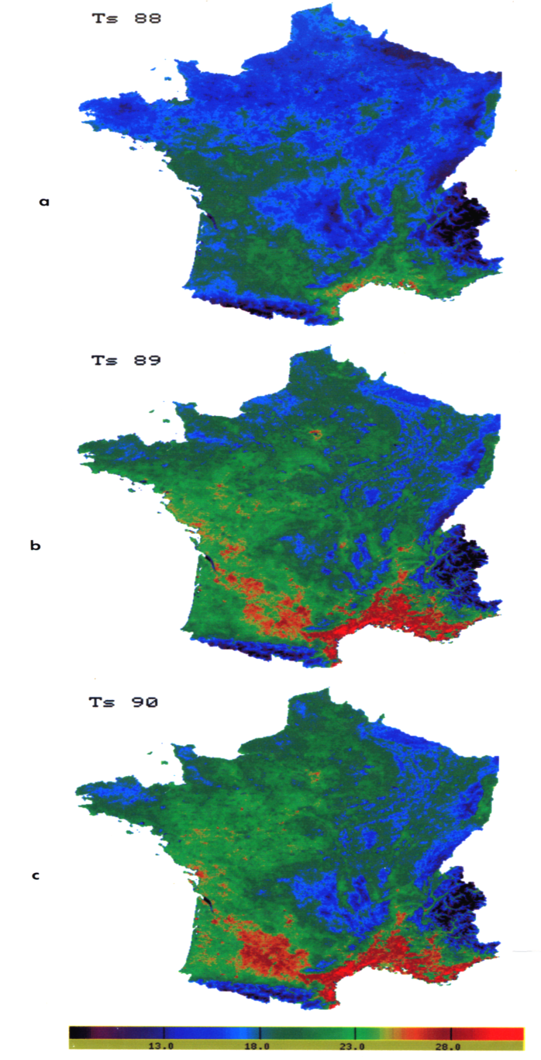

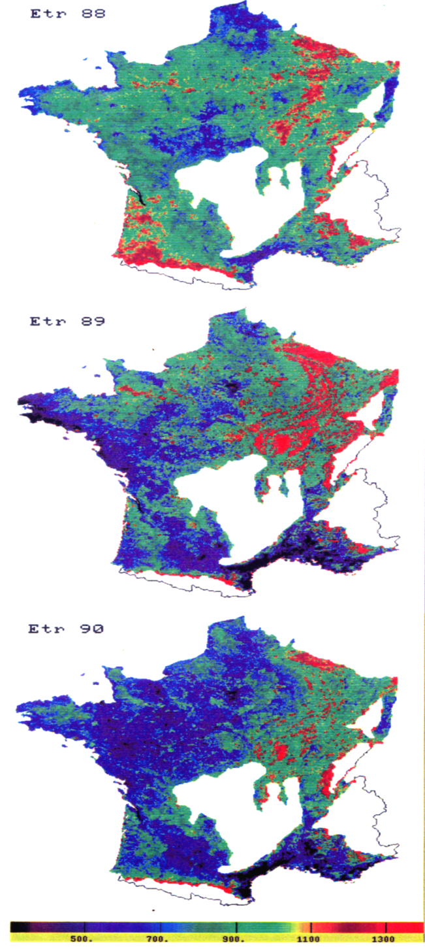
annual average of Ts
annual ET
13 18 23 28 °C
500 700 900 1100 1300 mm

Slide 47
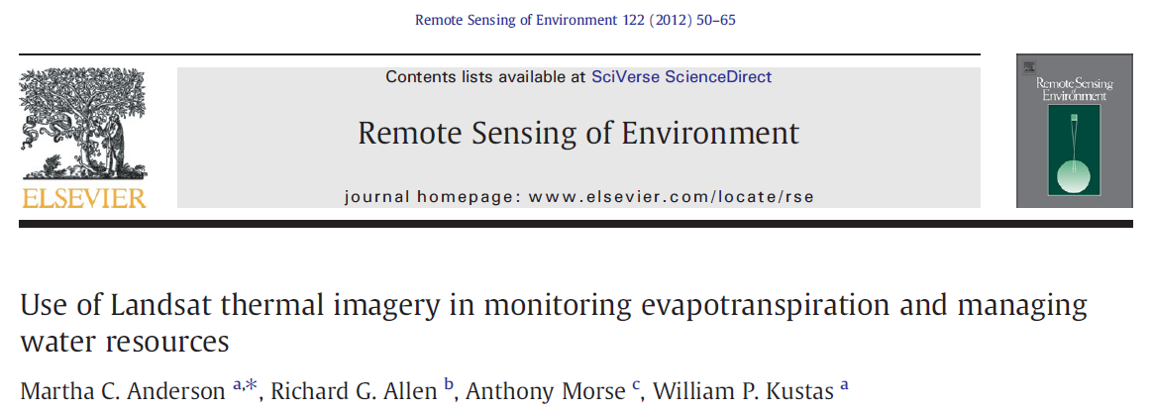
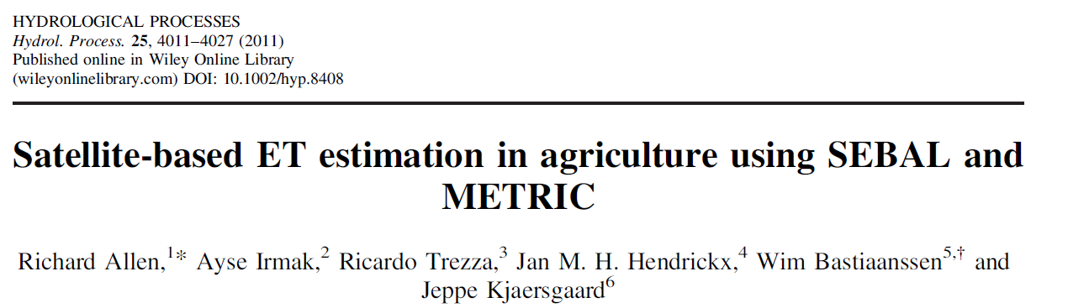

Slide 48
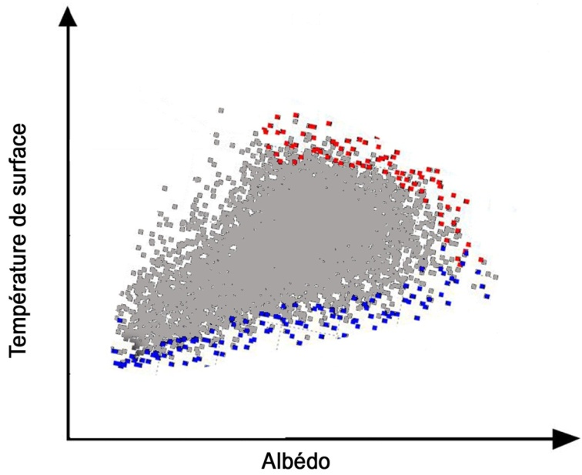
The Energy Balance -> evaporative fraction methods
λ ET = Λ (Rn – G) with Λ the evaporative fraction = λ ET / (Rn – G)
Λ is determined by analysing the scatterogram Ts vs. albedo or Ts vs. NDVI
TH
Hmax
Ts
Surface temperature
Contextual estimation
TLE
λ ET max
Albedo

Slide 49
The Energy Balance -> evaporative fraction methods
λ ET = Λ (Rn – G)
different models:
S-SEBI (Roerink et al., 2000) : scatterogram Ts vs. albedo
Triangle (Tang et al. 2010) : scatterogram Ts vs. Fraction cover or NDVI
WDI (Moran et al. 1995): scatterogram (Ts – Ta) vs. PVI or SAVI
requires meteorological data : Rg, Ra, but not Ta and ua
but
– no aerodynamic equation => not accounting of variation in roughness (vegetation height)
– require that meteorological conditions are homogeneous in space
– require that the variability of Ts cover the variability of water status from full to zero

Slide 50
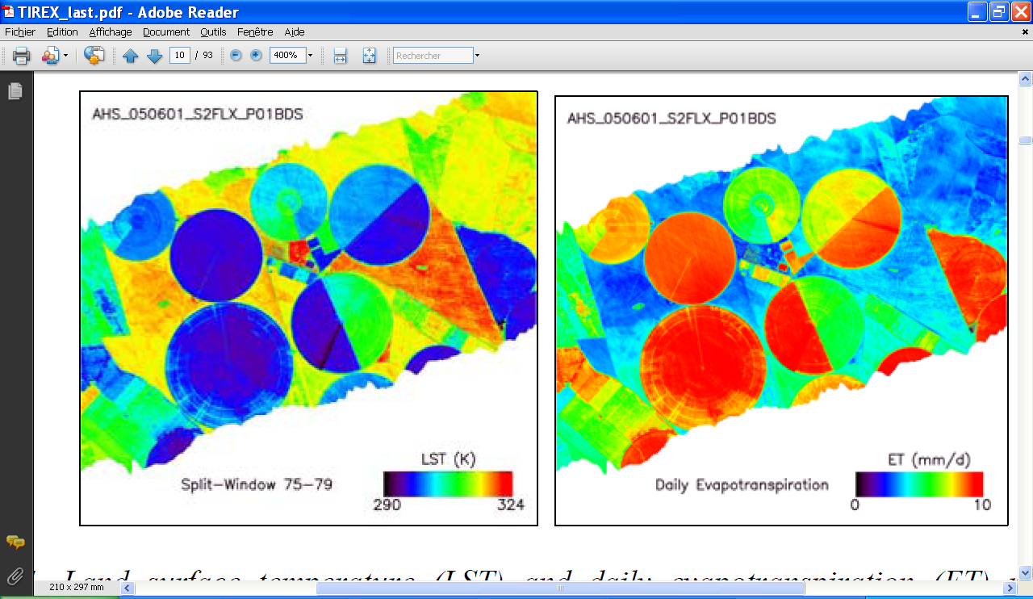
The Energy Balance -> evaporative fraction methods
Land surface temperature (LST) from Airborne Hyperspectral Scanner (AHS) data
daily evapotranspiration (ET) with the S-SEBI model
Barrax agricultural area (Spain). SEN2FLEX-2005 campaign (Sobrino et al., 2008)

Slide 51
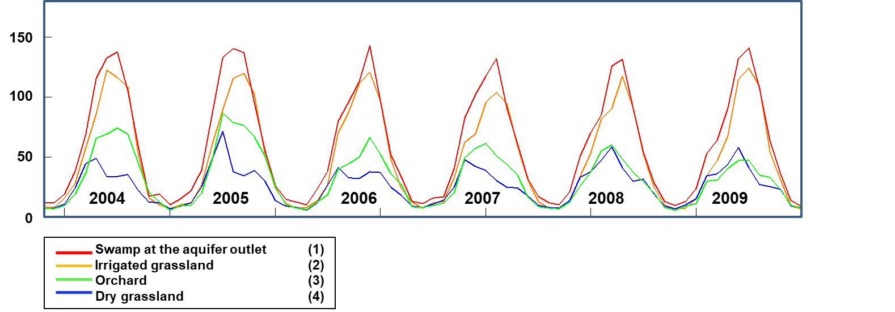
monitoring of ET over the Crau-Camargue area
using EVASPA and MODIS data (1km resolution)
monthly ET (mm)
(Olioso et al. 2017)

Slide 52
Application of S-SEBI to the
Iberian Peninsula
using NOAA AVHRR data
(Sobrino et al. 2007)

Slide 53
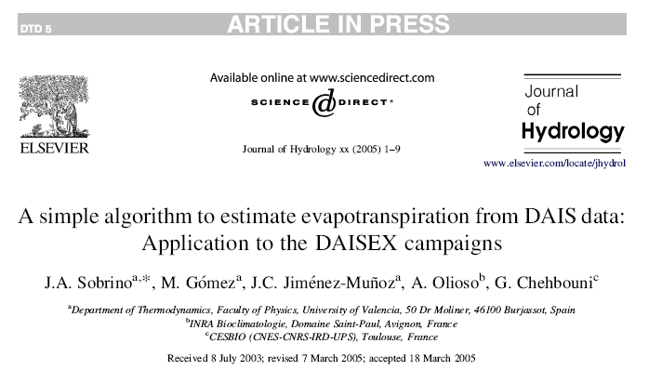
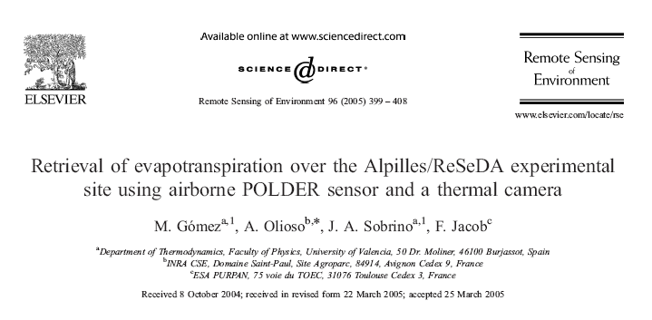
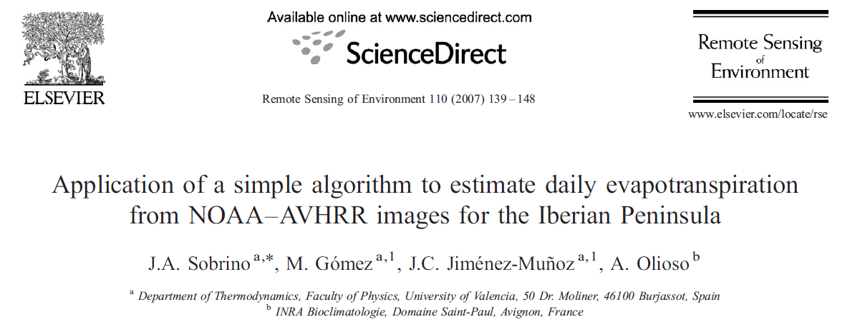

Slide 54
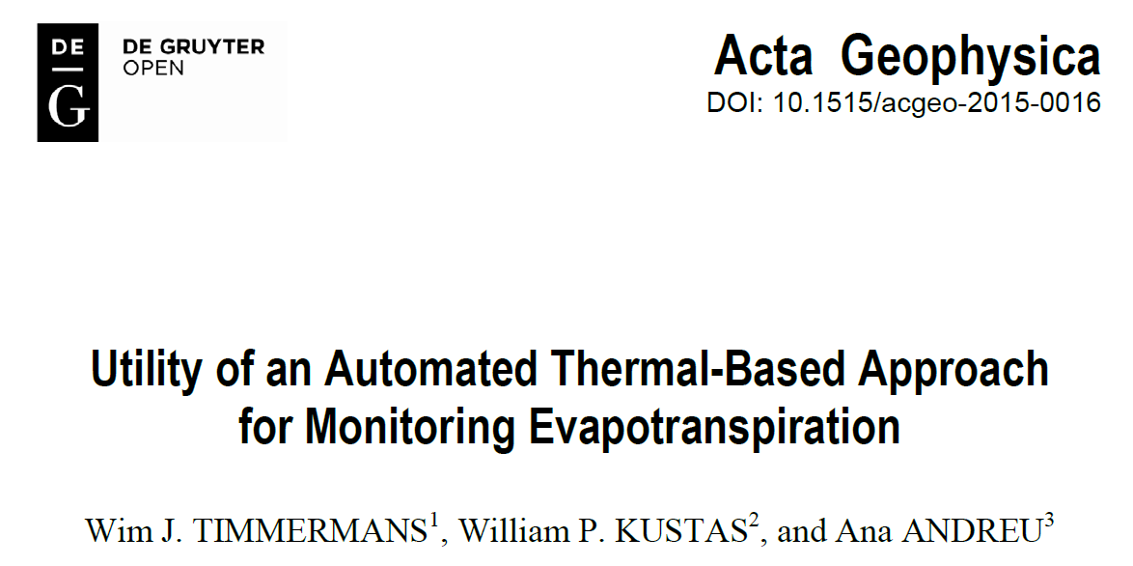
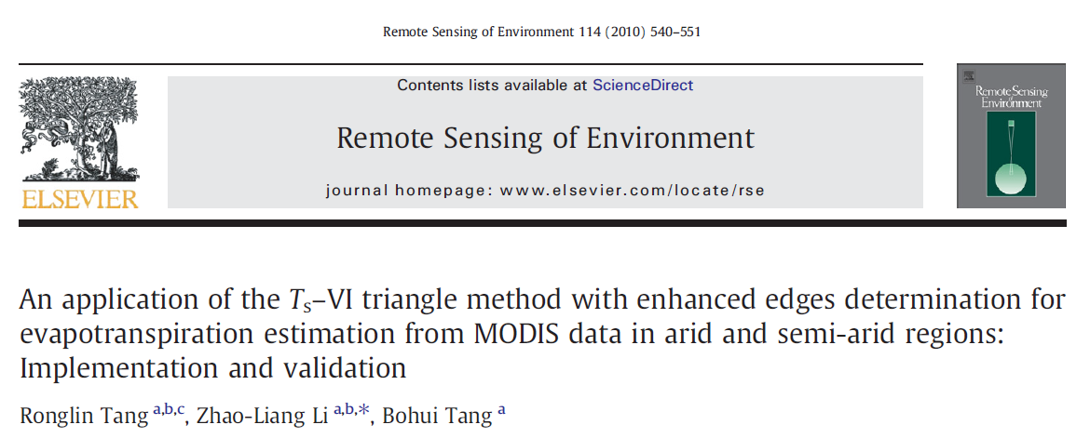
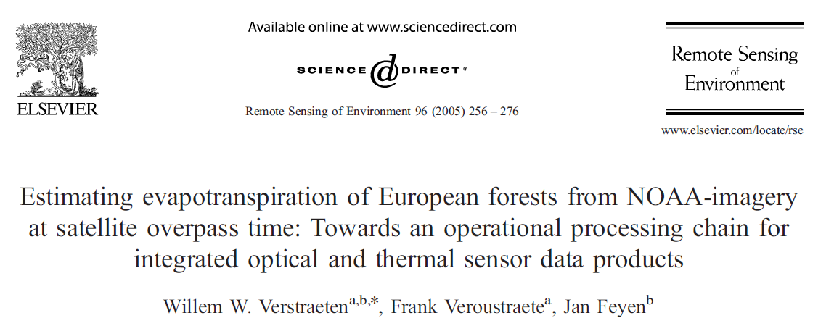
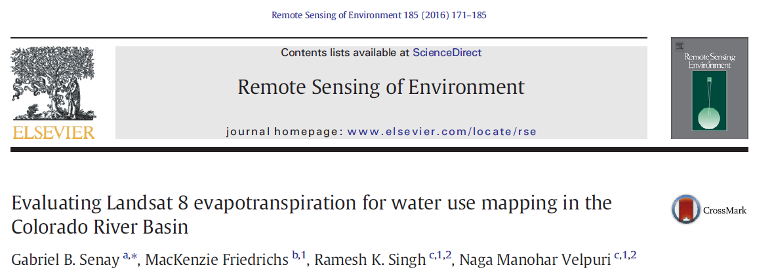

Slide 55
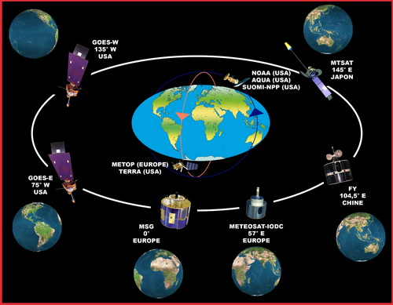
The main systems including TIR sensors available today…
Earth observation
Landsat 8 : TIRS sensor → 2 LWIR, 100m, 16 days revisit
Landsat 7 : ETM+ → 1 LWIR
Sentinel 3 : 5 MWIR+TIR, 1000m, 5-10 days
Experimental
ASTER : 5 LWIR bands, 90m, 16 days
Sentinel 3 : 5 MWIR+TIR, 1000m, 5-10 days
Large swath systems
MODIS : 9 TIR, 1000m, 4/day (TERRA & AQUA)
SUOMI-NPP : 3 LWIR, 750m, daily
Meteorological satellites
Geostationary : > 2km, 15mn
MetOp AVHRR/3, TIR, 1000m, daily
… but none of them combining high spatial resolution with high revisit capacities !

Slide 56
REMOTE SENSING OF EVAPOTRANSPIRATION
Water balance approaches
&
Crop water requirement estimation

Slide 57
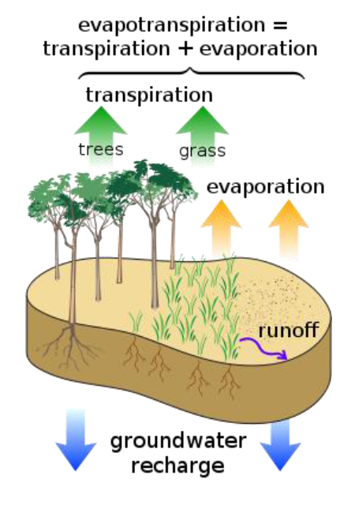
Water balance
ET = P - ΔS - Q – D
- ET = Evapotranspiration
- P = Precipitation
- ΔS = Change in Storage
- Q = Stream flow
- D = Groundwater recharge

Slide 58
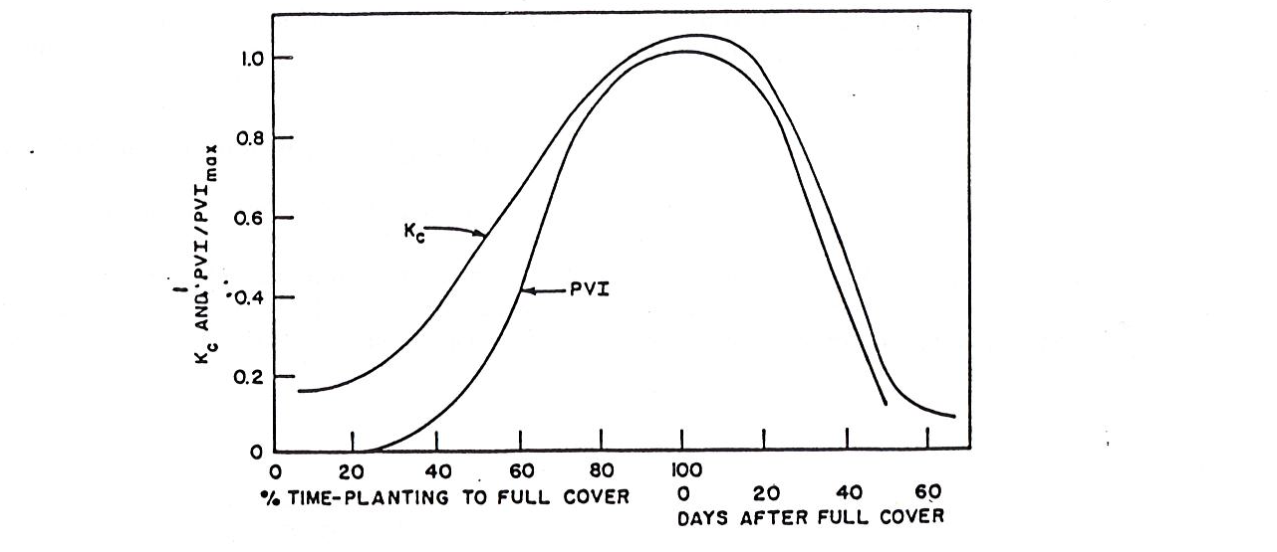
Crop coefficient – vegetation
Jackson 1980

Slide 59
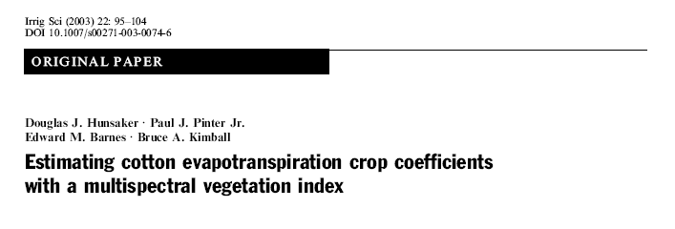
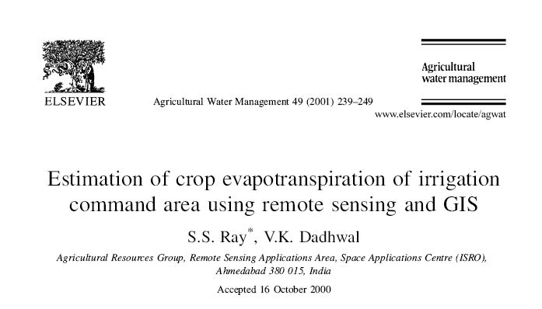
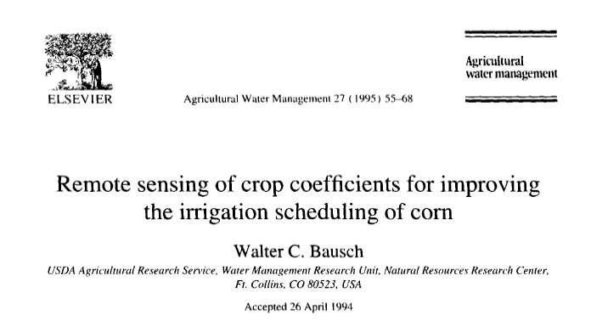

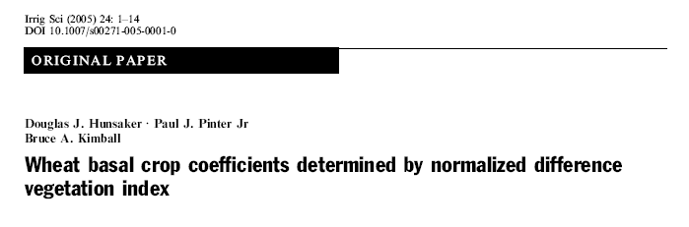
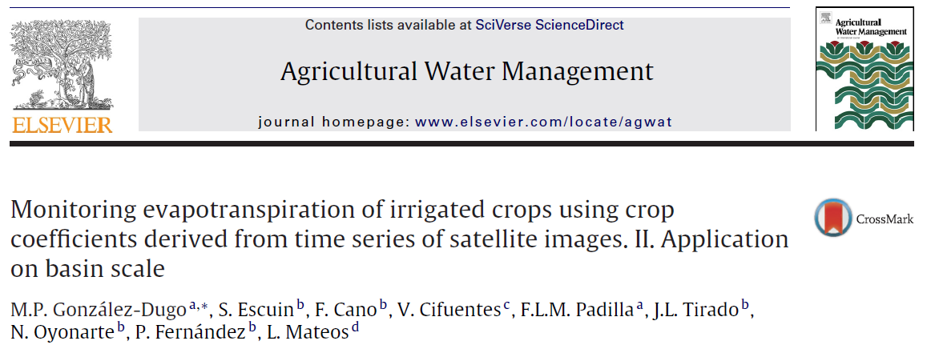
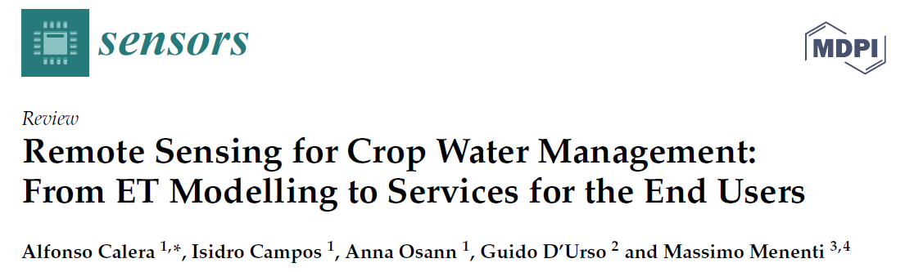
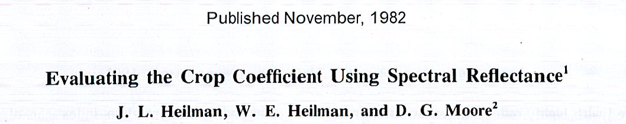
Agron. J.

Slide 60
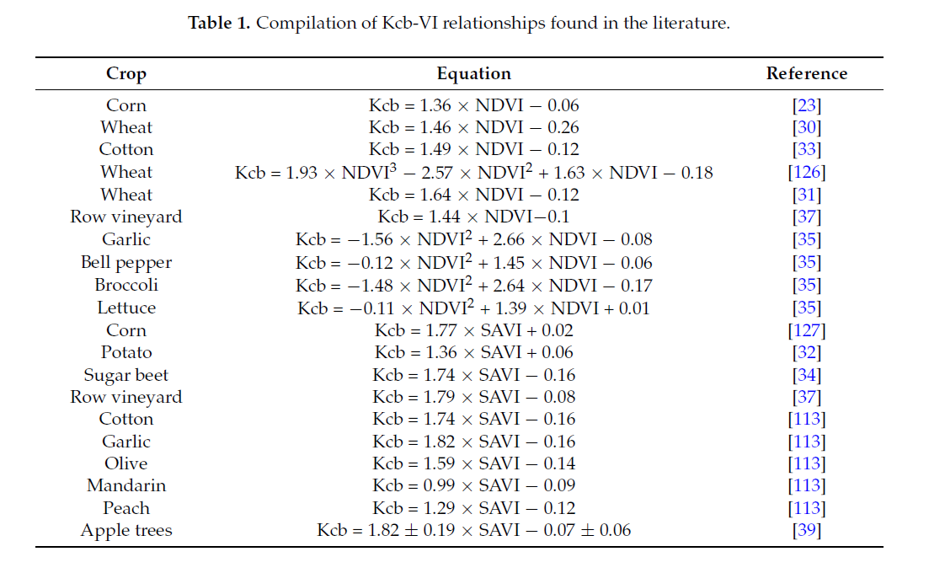
Calera et al. 2017

Slide 61
ETc = Kc X ETo
=> crop water requirements

Slide 62
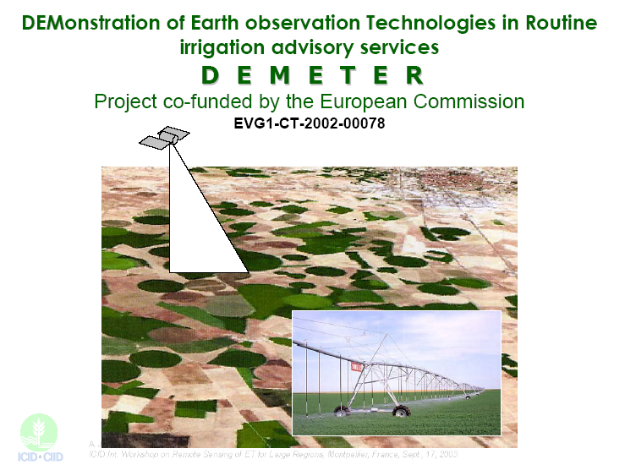
Extract from a
presentation by
Jochum et al. (2003)
ICID workshop
Montpellier

Slide 63
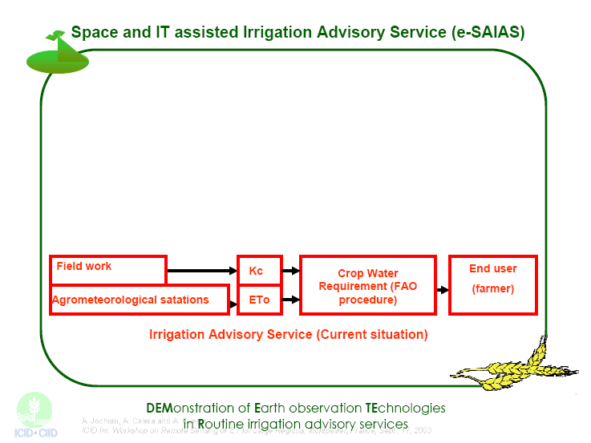

Slide 64


Slide 65


Slide 66


Slide 67


Slide 68


Slide 69


Slide 70


Slide 71


Slide 72


Slide 73


Slide 74


Slide 75


Slide 76


Slide 77


Slide 78


Slide 79


Slide 80


Slide 81


Slide 82


Slide 83


Slide 84


Slide 85


Slide 86


Slide 87


Slide 88


Slide 89

2018 version (FATIMA project)
FATIMA project deliverable
2018

Slide 90

2018 version (FATIMA project)

Slide 91
2004 version (DEMETER project)

Slide 92
Sentinel 2

Slide 93

Predicted week ETc

Slide 94
Water balance
ET = P - ΔS - Q – D
- ET = Evapotranspiration
- P = Precipitation
- ΔS = Change in Storage
- Q = Stream flow
- D = Groundwater recharge

Slide 95
impact of non optimal water level
ETc = Kc X ETo
Kc = Kcmin + (Kcmax . Ks – Kcmin) * fCOVER
evaporation transpiration
rain frequency
SimpKcET model
Ollivier et al. 2019
Olioso et al. 2018

Slide 96
impact of non optimal water level
ETc = Kc X ETo
Kc = Kcmin + (Kcmax . Ks – Kcmin) * fCOVER
transpiration
SimpKcET model
Ollivier et al. 2019
Olioso et al. 2018
copernicus product
(Proba-V and VEGETATION sensors: 333 m and 1km)

Slide 97


Puechabon: oak forest near Montpellier

Slide 98


Slide 99


Slide 100
Avignon: wheat crops

Slide 101

Font-Blanche: pine forest near Marseille

Slide 102
Water balance model
- vegetation indices or fraction cover estimates from reflectances
high frequency of images (Landsat, Sentinel 2), free images
- require information on the soil properties, difficult to distribute in space
(maximum available water content)
adapted to crop water requirements and irrigation management

Slide 103

Monitoring drought through drought indices
USDM, SPI-03, PMDI : meteo-derived indices
f_{PET} , ET : calculated using ALEXI and GOES data
Green indicates wetter conditions and red indicates drier conditions (after Anderson et al., 2011)
see also : http://digitalcommons.unl.edu/droughtfacpub

Slide 104

Monitoring drought through drought indices
Monthly drought conditions for April-September during 2002 recorded in the US Drought Monitor (USDM) and mapped with the thermal-based GOES ESI at 10-km resolution.
Also shown are maps of fPET generated with MODIS and Landsat TIR imagery, scaling down to moisture conditions in individual fields in central Iowa (after Anderson et al., RSE 2012).

Slide 105
Remote sensing of Evapotranspiration
Thermal infrared and energy balance approaches
‘direct’ information on ET
no need for information on the soil properties
no need for information on plant processes
no mission with an adequate frequency for high resolution monitoring
    time interpolation between images
Project of new thermal missions at ESA (LSTM) and CNES/ISRO (TRISHNA)
Water balance approaches
- adapted to crop water requirements and irrigation management
- requires information on the soil properties

Slide 106
References

Slide 107
de Wit 1958, Transpiration and crop yields. 1958.
http://www-formal.stanford.edu/jmc/nature/node22.html
Dening 1993, https://slideplayer.com/slide/6882005/
Moran, M.S., Clarke, T.R., Inoue, Y. and Vidal, A., 1994a. Estimating crop water deficit using the relation
between surface-air temperature and spectral vegetation index. Remote Sens. Environ., 49: 246-263.

Slide 108
References (most significant ones are highlighted in bold)
Agam, N., Kustas, W.P., Anderson, M.C., Li, F. and Colaizzi, P., 2007, Utility of thermal sharpening over Texas high plains irrigated agricultural fields., J. Geophys. Res., 112, D19110, doi:10.1029/2007 JD008407Allen R.G., Tasumi M. and Trezza R., 2007, Satellite-based energy balance for mapping evapotranspiration with internalized calibration (METRIC)-Model. ASCE J. Irrigation Drainage Eng. 133, 380-394.
Allen R.G., Tasumi M. and Trezza R., 2007, Satellite-based energy balance for mapping evapotranspiration with internalized calibration (METRIC)-Model. ASCE J. Irrigation Drainage Eng. 133, 380-394.
Anderson M.C., Allen R.G., Morse A., William P. Kustas W.P., 2012. Use of Landsat thermal imagery in monitoring evapotranspiration and managing water resources. Remote Sensing of Environment 122, 50–65
Anderson M. C., Hain C., Wardlow B., Mecikalski J. R., 2011. Evaluation of drought indices based on thermal remote sensing of evapotranspiration over the continental United States. J. Climate, 24(8), 2025-2044.
Anderson M.C., Kustas W.P., Norman J.M., Hain C.R., Mecilaski J.R., Schultz L., Gonzales-Dugo M.P., Cammalleri C., d'Urso G., Pimstein A., Gao F. (2011). Mapping daily evapotranspiration at filed to continental scale using geostationary and polar orbiting satellite imagery. Hydrol. Earth Syst. Sci., 15, 223–239.
Bastiaanssen W.G.M., Menenti M., Feddes R.A. and Holtslag A.A.M., 1998, A Remote Sensing Surface Energy Balance Algorithm for Land (SEBAL) -2. Validation. Journal of Hydrology, 213, 198-212
Courault D., Seguin B., Olioso A. (2005). Review on estimation of evapotranspiration from remote sensing data: from empirical to numerical modeling approaches. Irrigation and Drainage Sytems, 19, 223-249.
Crébassol P., Lagouarde J.-P., Hook S., Boissin B., Gamet P., Varinois A., Bret-Dibat T., Lum K., Foote M., Johnson W., Goullioud R. (2014). THIRSTY THermal InfraRed SpaTial sYstem. International Geoscience and Remote Sensing Symposium (IGARSS), 13th-18th July, Québec City, Canada.
Gallego-Elvira et al., 2013. EVASPA (EVapotranspiration Assessment from SPAce) Tool: An overview. Procedia Environ. Sciences, Vol. 19, 303-310.
Ghilain N., Arboleda A., Gellens-Meulenberghs F., 2011. Evapotranspiration modelling at large scale using near-real time MSG SEVIRI derived data. Hydrol. Earth Syst. Sci., 15, 771–786.

Slide 109
References
Kalma J.D., McVicar T.R. and McCabe M.F., 2008, Estimating Land Surface Evaporation: A Review of Methods Using Remotely Sensed Surface Temperature Data, Surveys in Geophysics, 29(4-5): 421-469
Jacob F., Schmugge T., Olioso A., French A., Courault D., Ogawa K., Petitcolin F., Chehbouni A., Pinheiro A. and Privette J., 2008, Modeling and Inversion in Thermal Infrared Remote Sensing over Vegetated Land Surfaces (Chapter 10). Advances in Land Remote Sensing: System, Modeling, Inversion, and Application (ed S. Liang), 354 (Springer, on line): 245-292.
Kustas W., Anderson M., 2009. Advances in thermal infrared remote sensing for land surface modeling. Agr. For. Meteor., 149, 2071-2081.
Lagouarde J.-P., Bach M., Sobrino J.A., Boulet G., Briottet X., Cherchali S., Coudert B., Dadou I., Dedieu G., Gamet P., Hagolle O., Jacob F., Nerry F., Olioso A., Ottlé C., Roujean J.L., Fargant G. (2013). The MISTIGRI Thermal Infrared project: scientific objectives and mission specifications. Int.. Journal of Remote Sensing. 2013, 34 (9-10), p. 3437-3466. http://dx.doi.org/10.1080/01431161.2012.716921
Lagouarde, J. P. (1991). Use of NOAA AVHRR data combined with an agrometeorological model for evaporation mapping. International Journal of Remote Sensing 12, 1853-1864.
Norman JM, Anderson MC, Kustas WP, French AN, Mecikalski JR, Torn RD (2003) Remote sensing of surface energy fluxes at 10¹ m resolutions. Water Resour Res 39(8):1221. doi:10.1029/2002WR001775
Roerink G.J., Su B. and Menenti M., 2000, S-SEBI A simple remote sensing algorithm to estimate the surface energy balance. Phys. Chem. Earth (B), 25, 147–157
Sobrino, J. A., J. Jiménez-Muñoz, C., Sòria, G., Gómez, M., Barella-Ortiz, A., Romaguera, M., Zaragoza, M., Julien, Y., Cuenca, J., Atitar, M., Hidalgo, V., Franch, B., Mattar, C., Ruescas, A., Morales, L., Gillespie, A., Balick, L., Su, Z., Nerry, F., Peres, L. and Libonati, R., 2008, Thermal Remote Sensing in the Framework of the SEN2FLEX Project: Field Measurements, Airborne Data and Applications. International Journal of Remote Sensing, 29 (17-18), 4961-4991, 2008.

