Slide 1
Pre-processing and multi-temporal analysis of SAR time series
Magdalena Fitrzyk

Slide 2
Part 1
Multitemporal Analysis of SAR Backscatter Intensity

Slide 3
Objectives
Familiarizing with SNAP toolbox
Familiarizing with Sentinel-1 GRD prodcucts
Calculation of backscatter intensity from Sentinel-1 detcted products
Analysis of temporal backscatter signatures for various land cover types
Change detection over AOI (Beijing Daxing International Airport)

Slide 4
Introduction
Input data: time series of Sentinel-1 GRDH images over China
S1A_IW_GRDH_1SDV_20151003T222044_20151003T222111_007994_00B2F6_9374 S1A_IW_GRDH_1SDV_20160611T222046_20160611T222112_011669_011DDC_7FB0 S1B_IW_GRDH_1SDV_20171115T222014_20171115T222041_008298_00EAE8_2415 S1B_IW_GRDH_1SDV_20181110T222021_20181110T222048_013548_019131_A556 S1B_IW_GRDH_1SDV_20190930T222028_20190930T222054_018273_022698_C498
Output:
temporal backscatter signatures for various land cover types
change detection

Slide 5
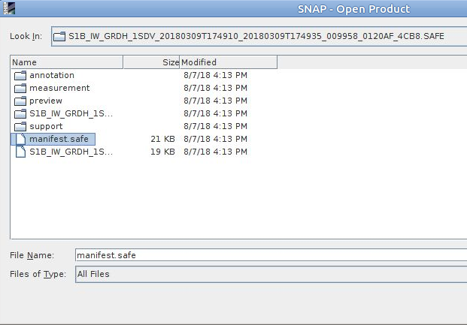
Data preparation
1. Opening the S1 data
For unzipped products

Slide 6
Data processing
Creating a subset of S1 GRDH images
Spatial subset depending on the AOI
Updating orbits
Radiometric calibration
Conversion of image intensity to sigma0 providing the radar backscatter
Terrain correction
Compensate for geometric distortions caused by topographical variations of a scene and the tilt of satellite sensor
Creating a multitemporal stack
Collocation spatially overlapping products (based on geolocation)
Speckle filtering
Filtering the inherent salt and pepper like texturing called speckles
Linear to dB conversion
Compensate for very high dynamic range in visualisation
Stack statistics and analysis of temporal backscatter signatures

Slide 7
Data processing
Creating a subset of S1 GRDH images
Spatial subset depending on the AOI
Updating orbits
Radiometric calibration
Conversion of image intensity to sigma0 providing the radar backscatter
Terrain correction
Compensate for geometric distortions caused by topographical variations of a scene and the tilt of satellite sensor
Creating a multitemporal stack
Collocation spatially overlapping products (based on geolocation)
Speckle filtering
Filtering the inherent salt and pepper like texturing called speckles
Linear to dB conversion
Compensate for very high dynamic range in visualisation
Stack statistics and analysis of temporal backscatter signatures

Slide 8
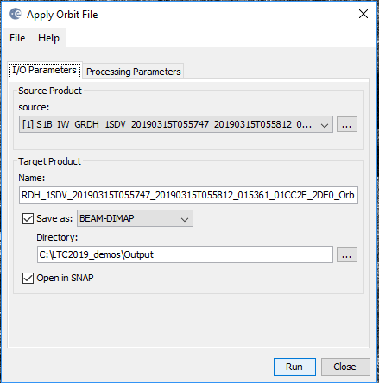
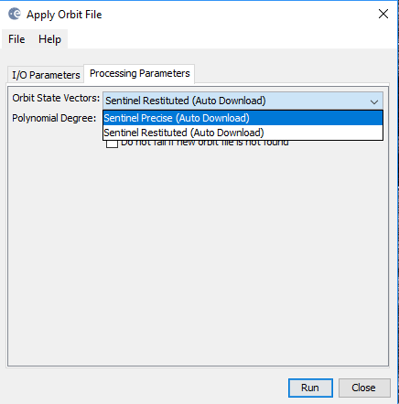
Updating orbits
Radar / Apply orbit file
The orbit file provides accurate satellite position and velocity information. Based on this information, the orbit state vectors in the abstract metadata of the product are updated.
POEORB - few weeks after acq.
RESORB – within few hours

Slide 9
Data processing
Creating a subset of S1 GRDH images
Spatial subset depending on the AOI
Updating orbits
Radiometric calibration
Conversion of image intensity to sigma0 providing the radar backscatter
Terrain correction
Compensate for geometric distortions caused by topographical variations of a scene and the tilt of satellite sensor
Creating a multitemporal stack
Collocation spatially overlapping products (based on geolocation)
Speckle filtering
Filtering the inherent salt and pepper like texturing called speckles
Linear to dB conversion
Compensate for very high dynamic range in visualisation
Stack statistics and analysis of temporal backscatter signatures

Slide 10
Radiometric Calibration
From image pixel values or digital numbers (DNs) we can derive:
Beta Naught – radar brightness coefficient, reflectivity per unit area in slant range which is dimensionless
Sigma Naught – power returned to the antenna from the ground (distributed scatterer) in dB. A number comparing the strangth of the signal to that expected from and area of one square meter. It is defined with respect to the nominal horisontal plane and is varying with incidence angle, wavelength, polarisation and scattering surface itself

Slide 11
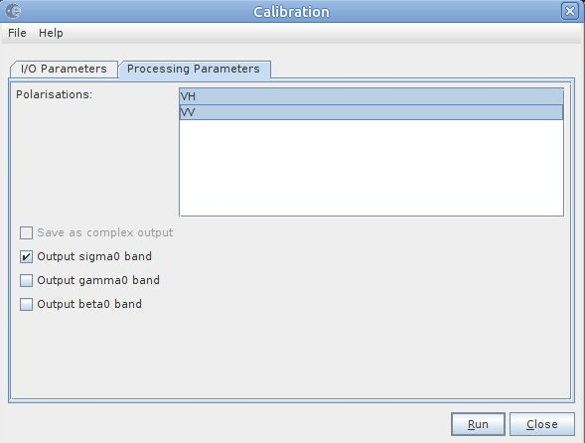
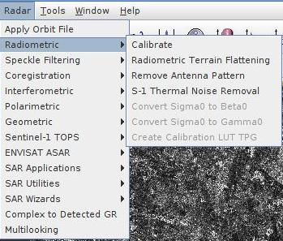
Radiometric Calibration
Radar/Radiometric/Calibrate
Pixel values can be directly related to the radar backscatter

Slide 12
Data processing
Creating a subset of S1 GRDH images
Spatial subset depending on the AOI
Updating orbits
Radiometric calibration
Conversion of image intensity to sigma0 providing the radar backscatter
Terrain correction
Compensate for geometric distortions caused by topographical variations of a scene and the tilt of satellite sensor
Creating a multitemporal stack
Collocation spatially overlapping products (based on geolocation)
Speckle filtering
Filtering the inherent salt and pepper like texturing called speckles
Linear to dB conversion
Compensate for very high dynamic range in visualisation
Stack statistics and analysis of temporal backscatter signatures

Slide 13
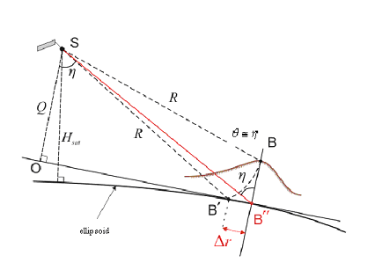
Terrain correction & Geocoding
Point B with elevation h above the ellipsoid is imaged at position Β’ in SAR image, though its real position is B". The offset $∆r$ between Β' and B" exhibits the effect of topographic distortions
Terrain Correction allows geometric overlays of data from different sensors and/or geometries.

Slide 14
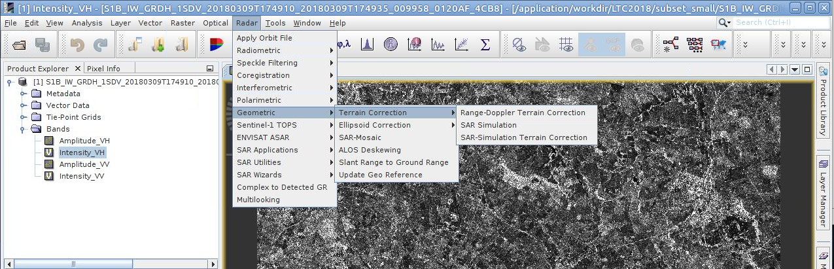
Terrain correction & Geocoding
Radar / Geometric / Terrain Correction / Range Doppler Terrain Correction

Slide 15
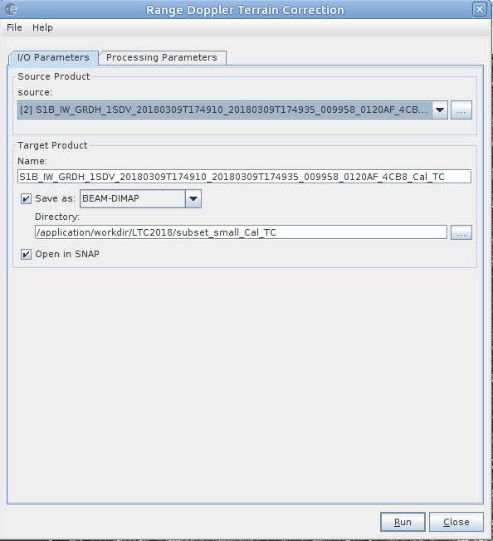
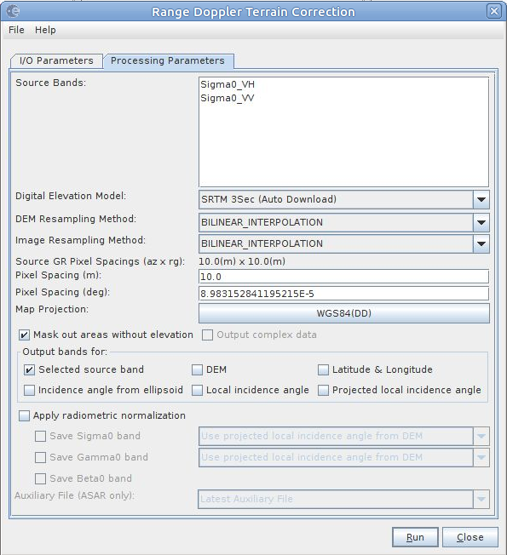
Terrain correction & Geocoding
DEM selection
Pixel spacing
Map projection
Masking areas without elevation

Slide 16
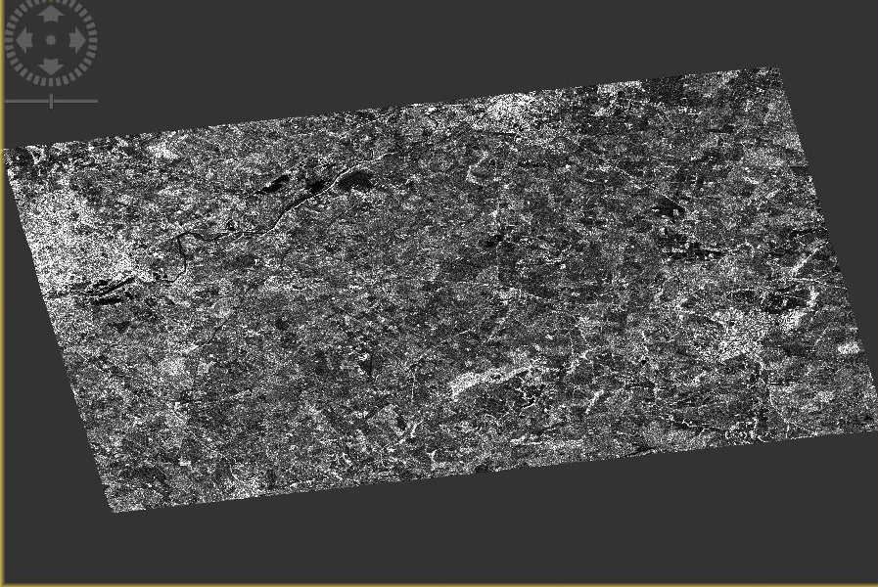
Data check

Slide 17
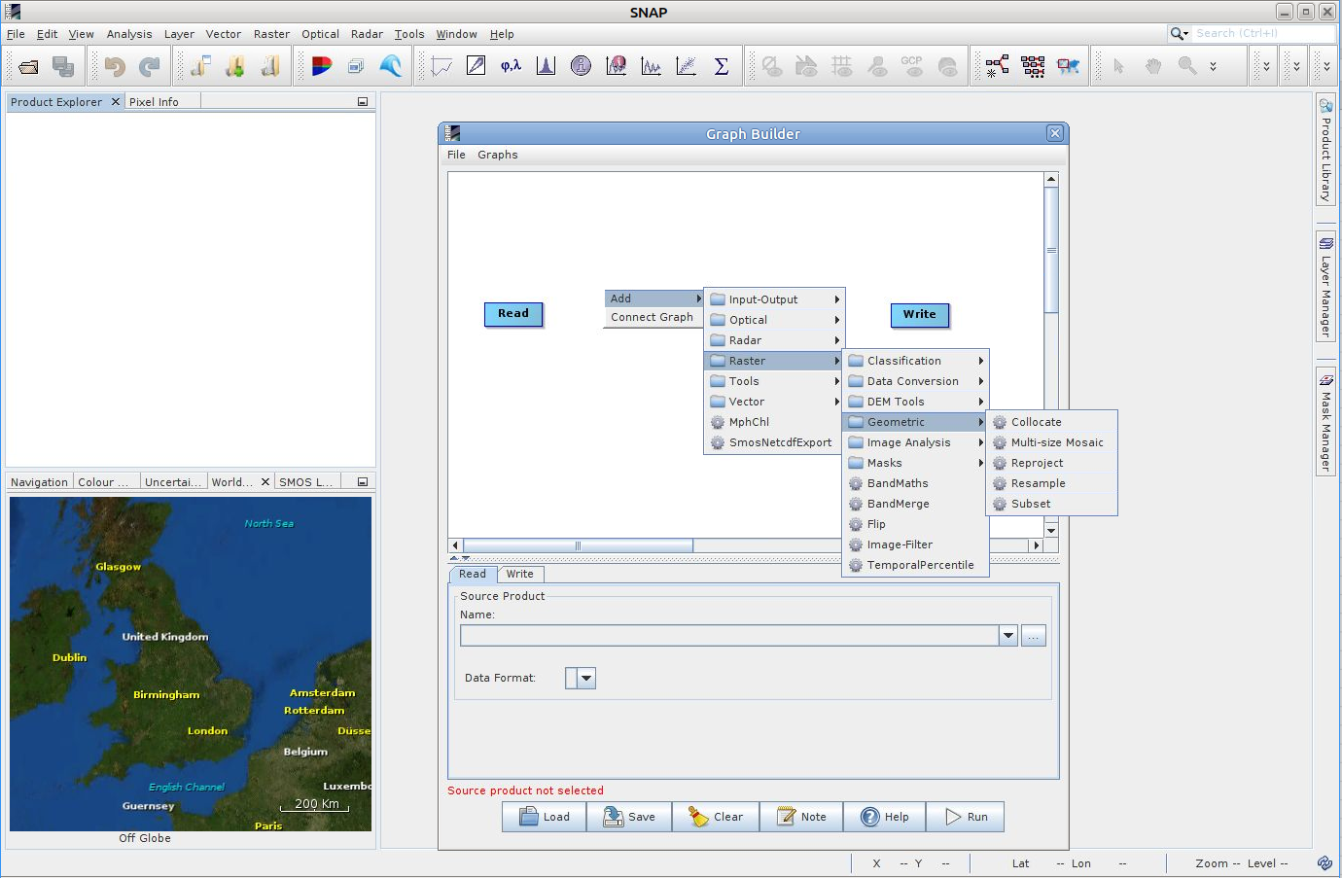
Automatic Processing with Graph
Graph Builder
Inserting blocks with particular processing operators
(right mouse button)
Save the graph and/or Run

Slide 18
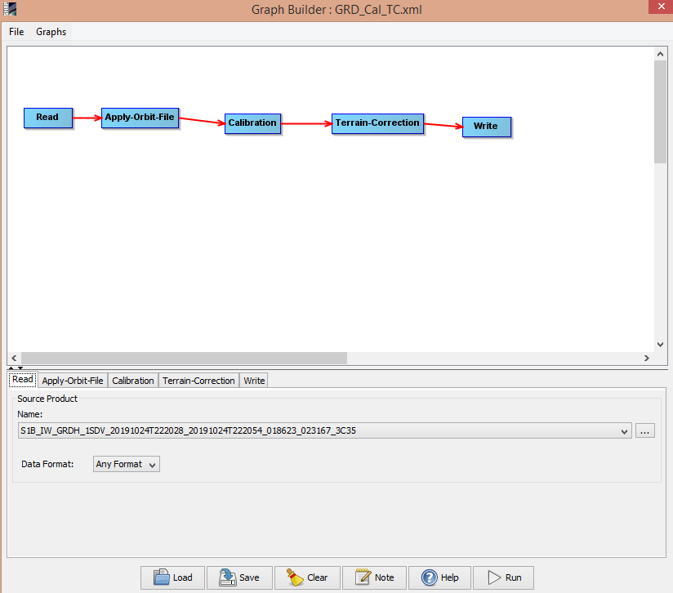
Automatic Processing with Graph – Calibration, Terrain Correction
Apply Orbits: Sentinel Precise
Calibration: Output Sigma0
Terrain Correction: pixel spacing 10m
The same settings like in manual processing
save as GRD_Cal_TC.xml

Slide 19
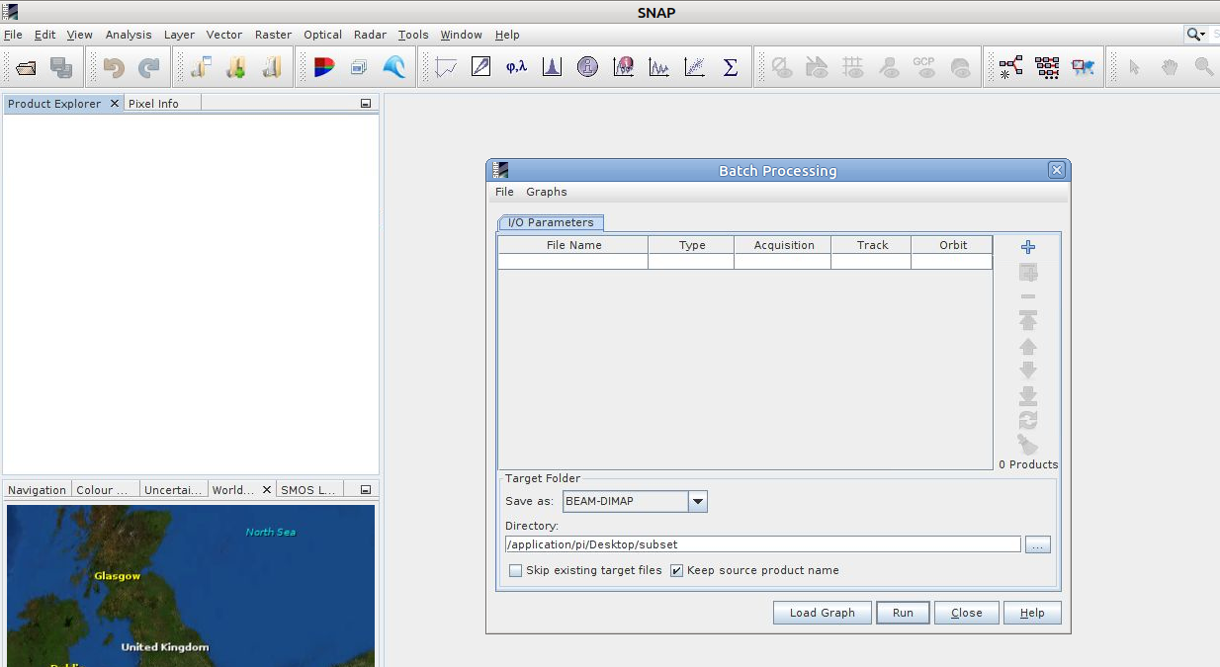
Batch processing
Batch processing tool
Adding data products
Loading the graph

Slide 20
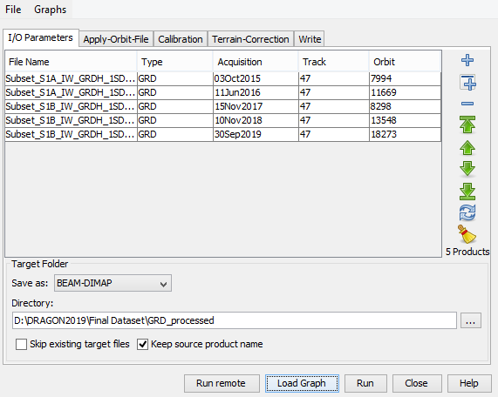
Batch processing
Open previously saved graph GRD_Cal_TC.xml

Slide 21
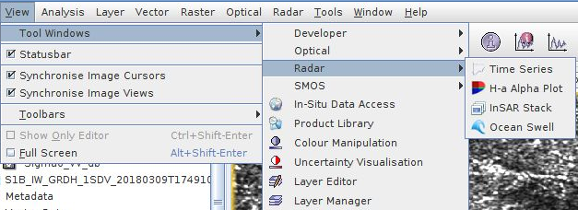
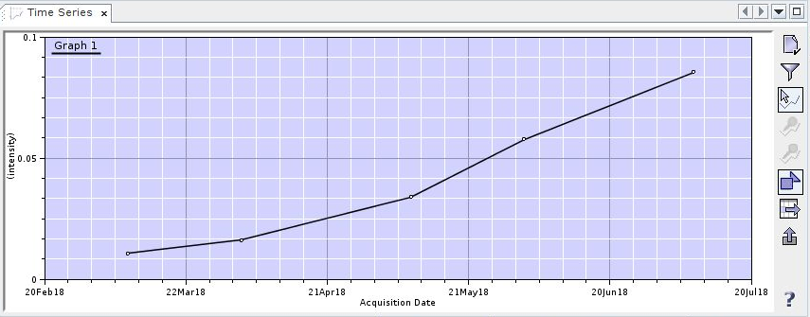
Time series analysis
Add your data products

Slide 22
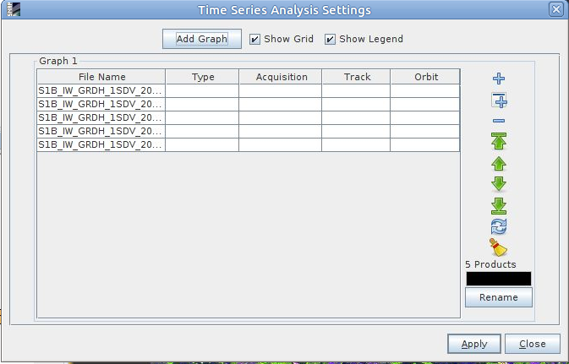
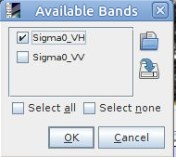
Time series analysis
Choose your processed data products
Bands filter
Show plot at cursor position

Slide 23
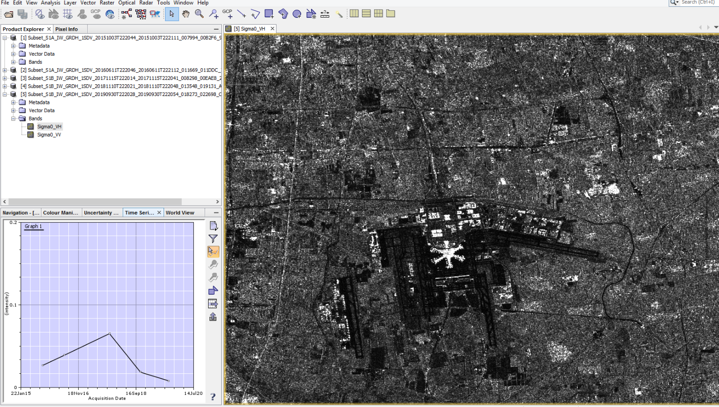
Time series analysis
One of the plottet bands has to be opened

Slide 24
Data processing
Creating a subset of S1 GRDH images
Spatial subset depending on the AOI
Updating orbits
Radiometric calibration
Conversion of image intensity to sigma0 providing the radar backscatter
Terrain correction
Compensate for geometric distortions caused by topographical variations of a scene and the tilt of satellite sensor
Creating a multitemporal stack
Collocation spatially overlapping products (based on geolocation)
Speckle filtering
Filtering the inherent salt and pepper like texturing called speckles
Linear to dB conversion
Compensate for very high dynamic range in visualisation
Stack statistics and analysis of temporal backscatter signatures

Slide 25
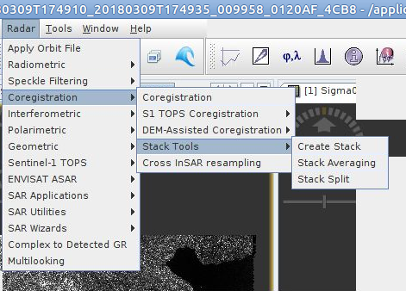
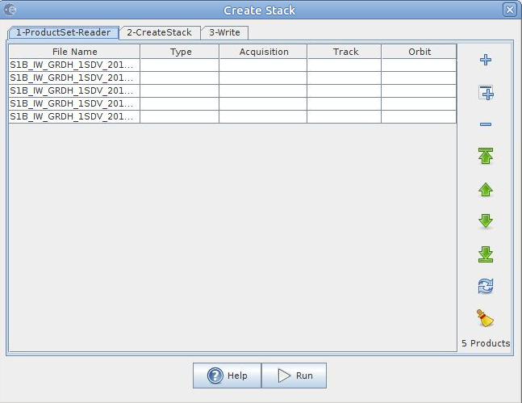
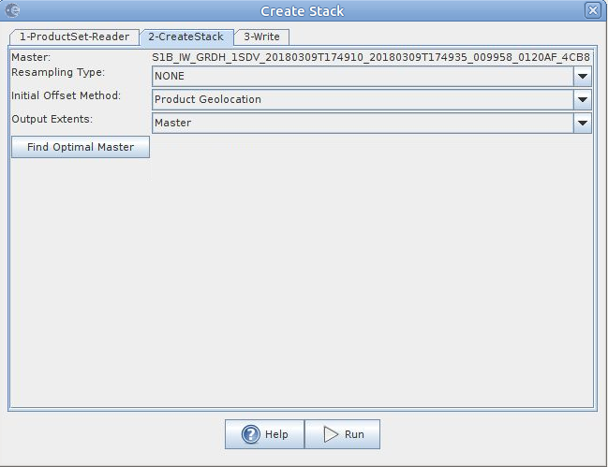
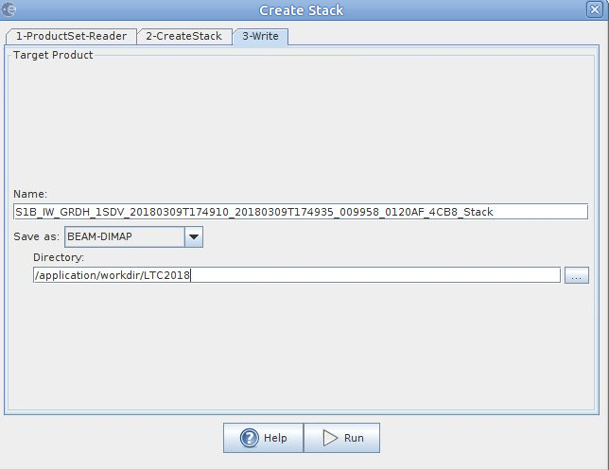
Creating multitemporal stack
Collocating spatially overlapping images
Product geolocation (if terrain corrected)
Orbits (if not terrain corrected)

Slide 26
Data processing
Creating a subset of S1 GRDH images
Spatial subset depending on the AOI
Updating orbits
Radiometric calibration
Conversion of image intensity to sigma0 providing the radar backscatter
Terrain correction
Compensate for geometric distortions caused by topographical variations of a scene and the tilt of satellite sensor
Creating a multitemporal stack
Collocation spatially overlapping products (based on geolocation)
Speckle filtering
Filtering the inherent salt and pepper like texturing called speckles
Linear to dB conversion
Compensate for very high dynamic range in visualisation
Stack statistics and analysis of temporal backscatter signatures

Slide 27
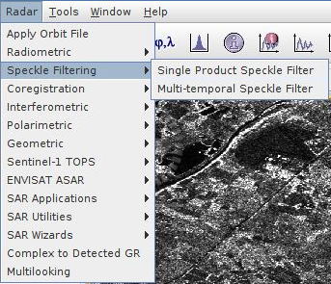
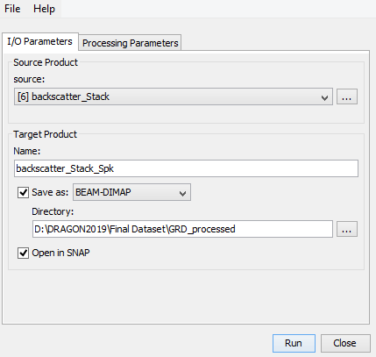
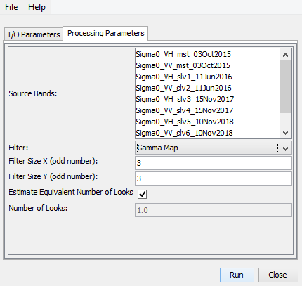
Multitemporal speckle filtering
Spatial filtering with weighted average of selected filter across the images of the time series

Slide 28
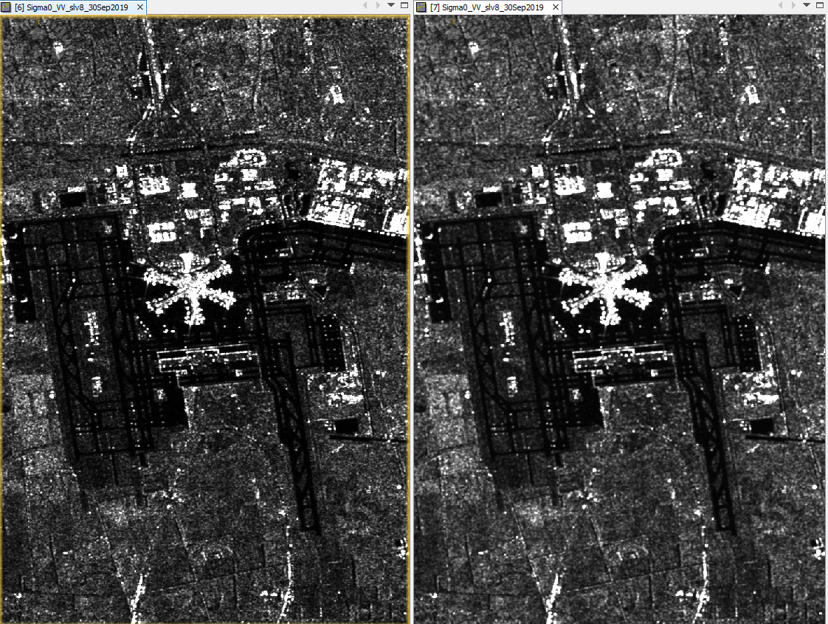
Multitemporal speckle filtering
Not filtered
Filtered

Slide 29
Data processing
Creating a subset of S1 GRDH images
Spatial subset depending on the AOI
Updating orbits
Radiometric calibration
Conversion of image intensity to sigma0 providing the radar backscatter
Terrain correction
Compensate for geometric distortions caused by topographical variations of a scene and the tilt of satellite sensor
Creating a multitemporal stack
Collocation spatially overlapping products (based on geolocation)
Speckle filtering
Filtering the inherent salt and pepper like texturing called speckles
Linear to dB conversion
Compensate for very high dynamic range in visualisation
Stack statistics and analysis of temporal backscatter signatures

Slide 30
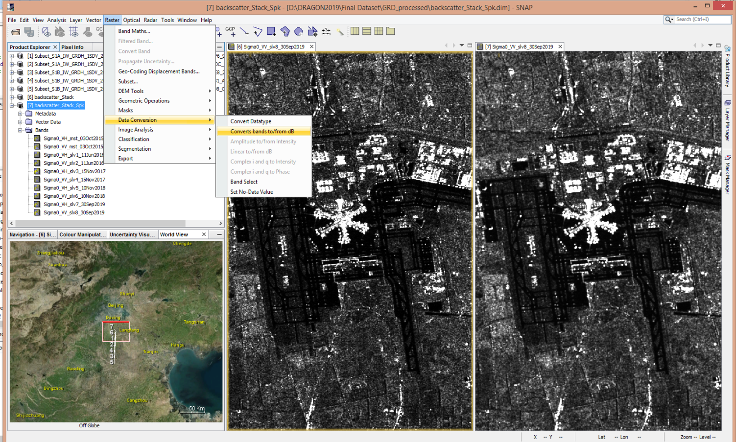
Conversion from linear to dB

Slide 31
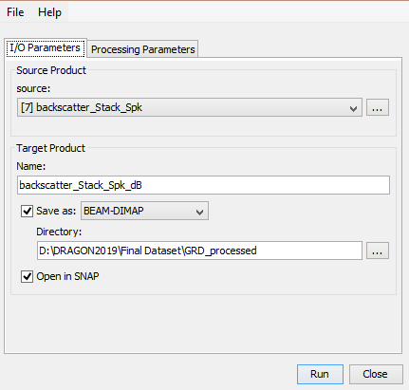
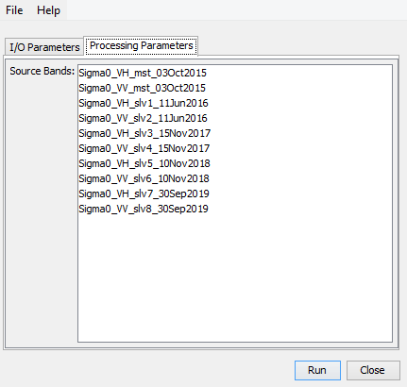
Conversion from linear to dB

Slide 32
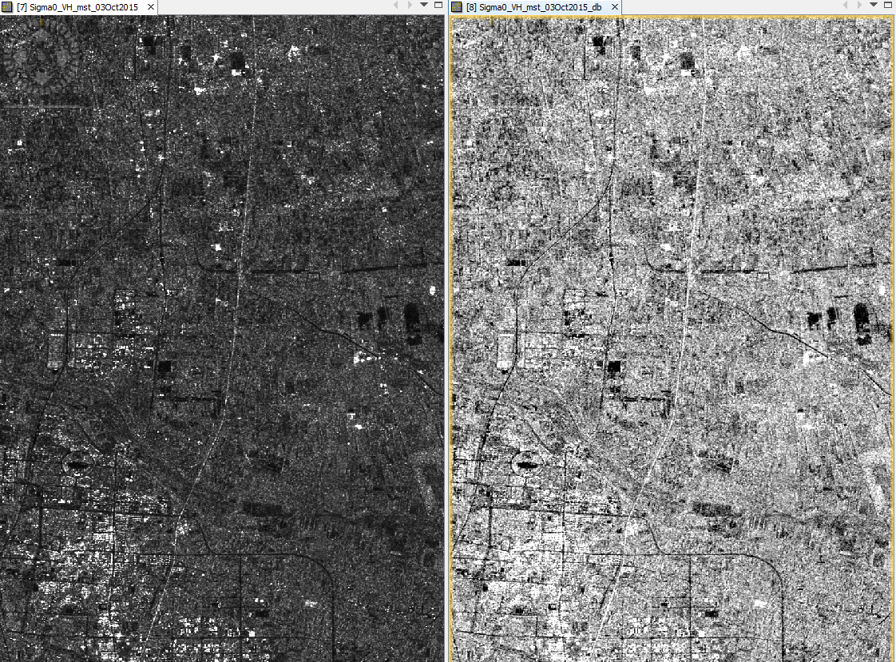
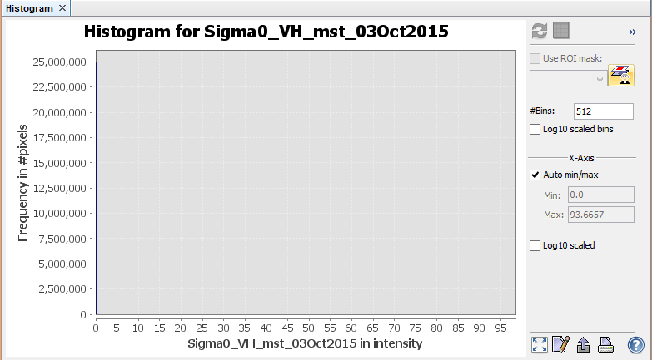
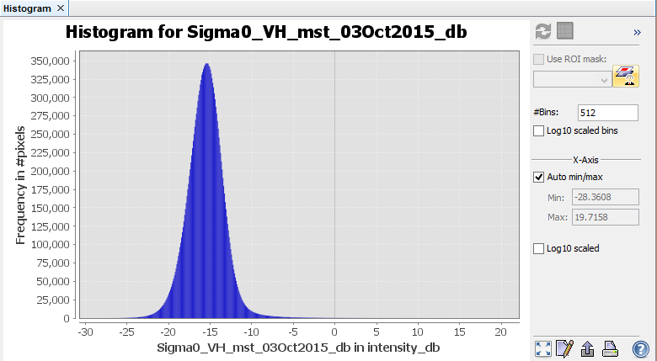
Linear vs dB comparison

Slide 33
Data processing
Creating a subset of S1 GRDH images
Spatial subset depending on the AOI
Updating orbits
Radiometric calibration
Conversion of image intensity to sigma0 providing the radar backscatter
Terrain correction
Compensate for geometric distortions caused by topographical variations of a scene and the tilt of satellite sensor
Creating a multitemporal stack
Collocation spatially overlapping products (based on geolocation)
Speckle filtering
Filtering the inherent salt and pepper like texturing called speckles
Linear to dB conversion
Compensate for very high dynamic range in visualisation
Stack statistics and analysis of temporal backscatter signatures

Slide 34
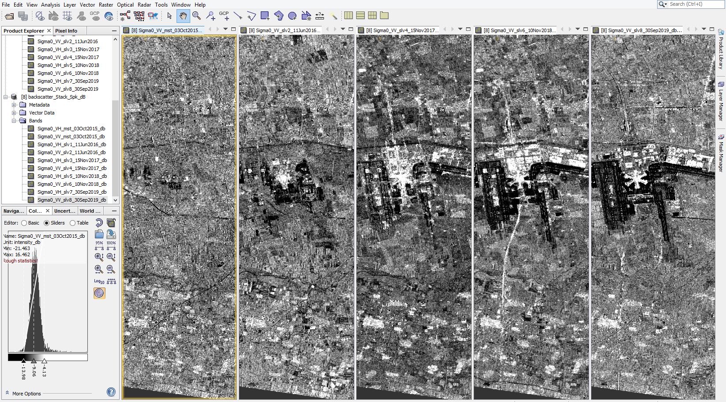
Visual inspection of the time series

Slide 35
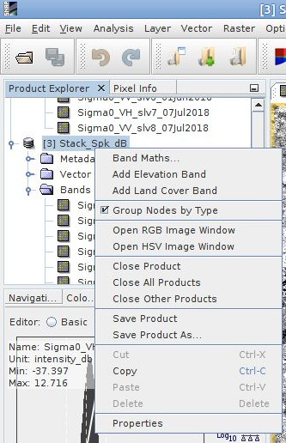
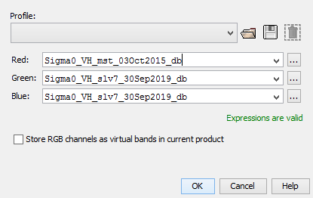
RGB Composite
Right click on the product
Band selection

Slide 36
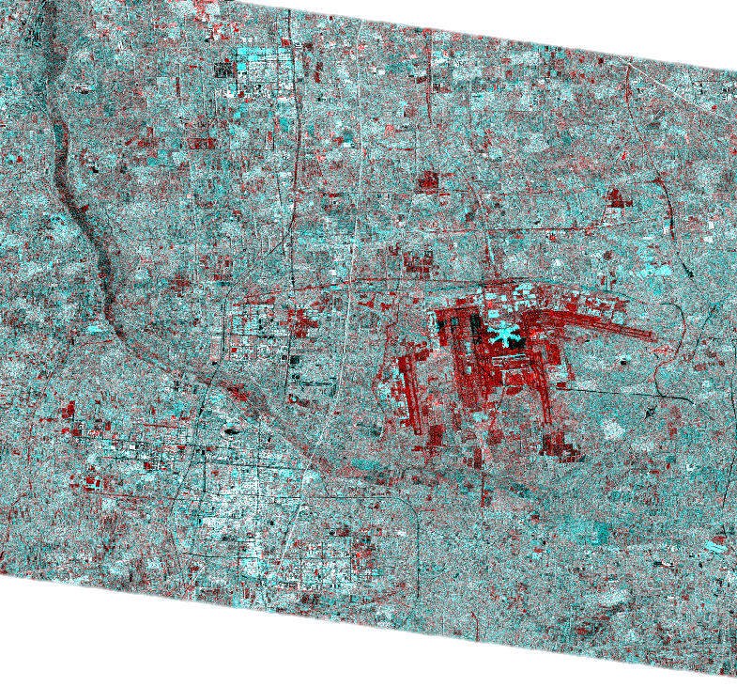
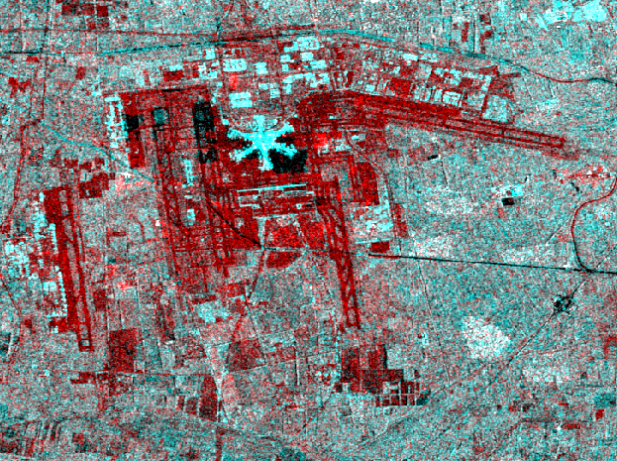
RGB Composite
Red – high backscatter in 2015, low backscatter in 2019
Cyan – low backscatter in 2015, high in 2019

Slide 37
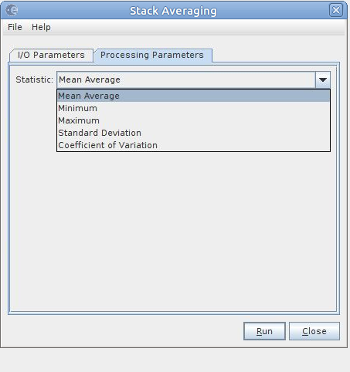
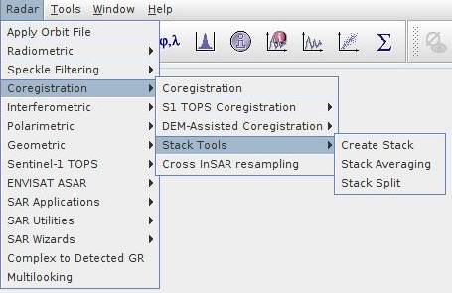
Stack averaging

Slide 38
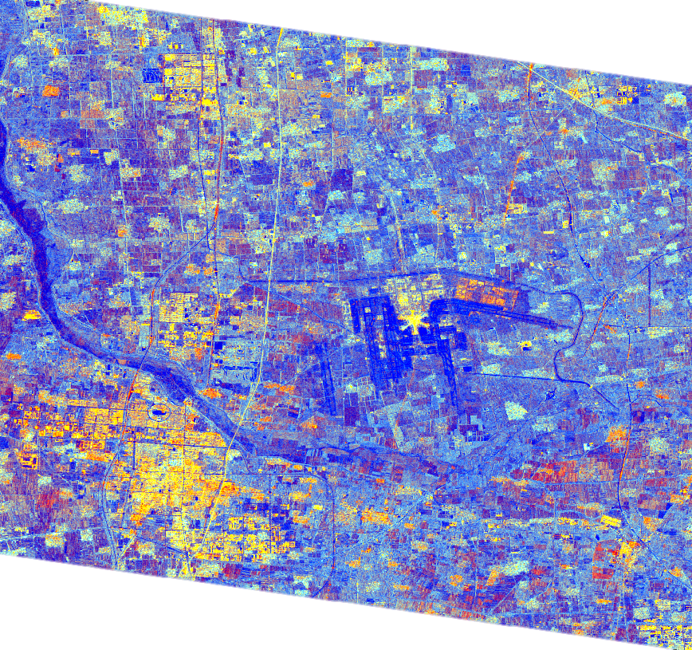
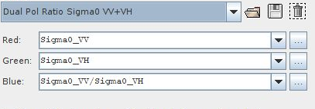
Stack averaging – RGB Composite
RGB combination for land cover classification

Slide 39
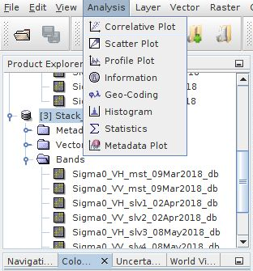
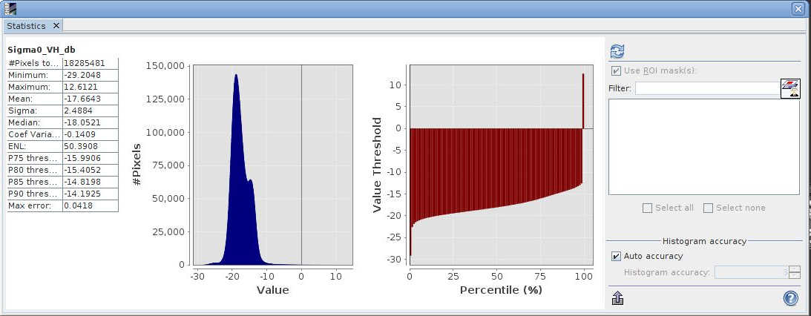
Image statistics
Choose your band

Slide 40
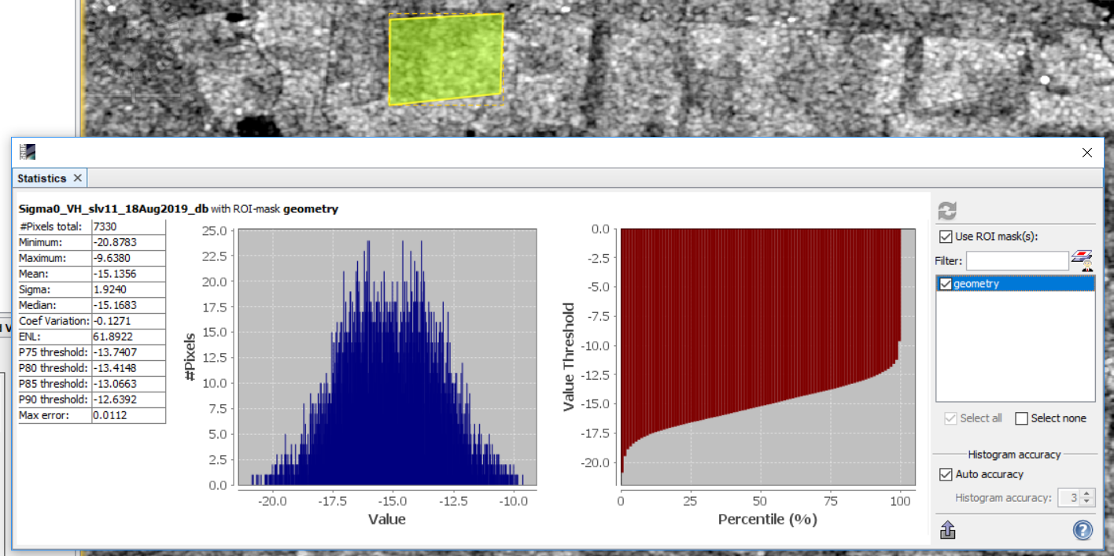
Image statistics - polygon
Draw the polygon

