Slide 1
Introduction to ESA toolboxes
Magdalena Fitrzyk

Slide 2
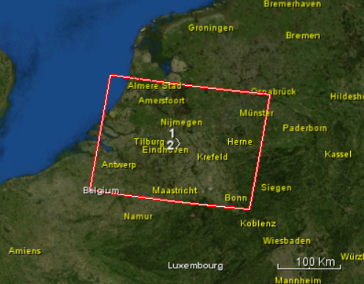
Introduction
Input data: set of Sentinel-1 SLCs
S1A_IW_SLC__1SDV_20190819T055015_20190819T055043_028634_033D5F_B955
S1A_IW_SLC__1SDV_20190831T055016_20190831T055043_028809_03437F_6942
Output: coherence – intensity false colour composites for land cover mapping

Slide 3
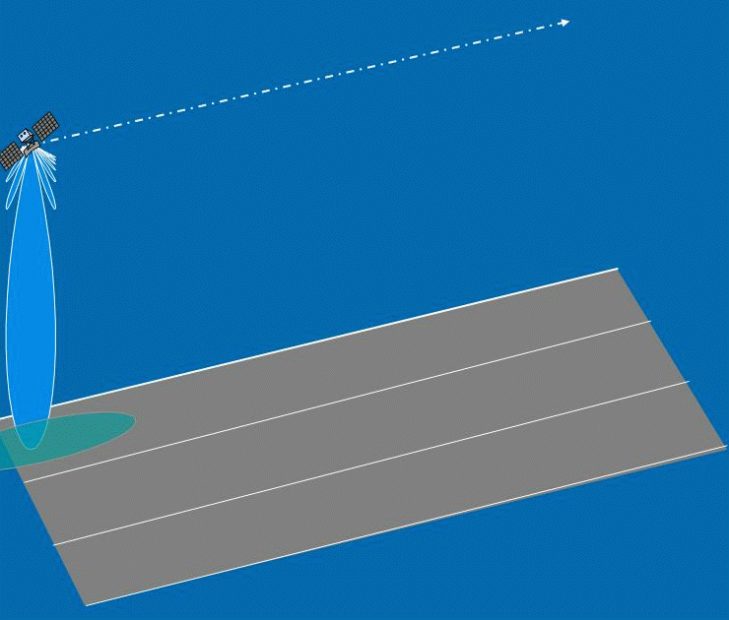
Sentinel-1 data acquisition
Terrain Observation
by Progressive Scans
(TOPS)

Slide 4
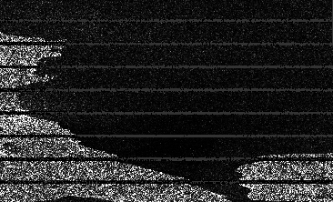
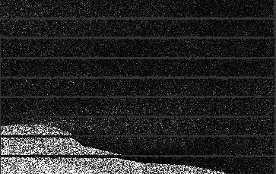
Sentinel-1 TOPS Data Handling and Processing
Bursted IW SLC
TOPSAR Split to choose a subswath and bursts for the AOI

Slide 5
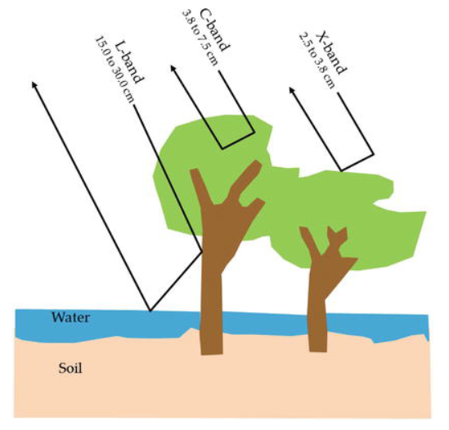
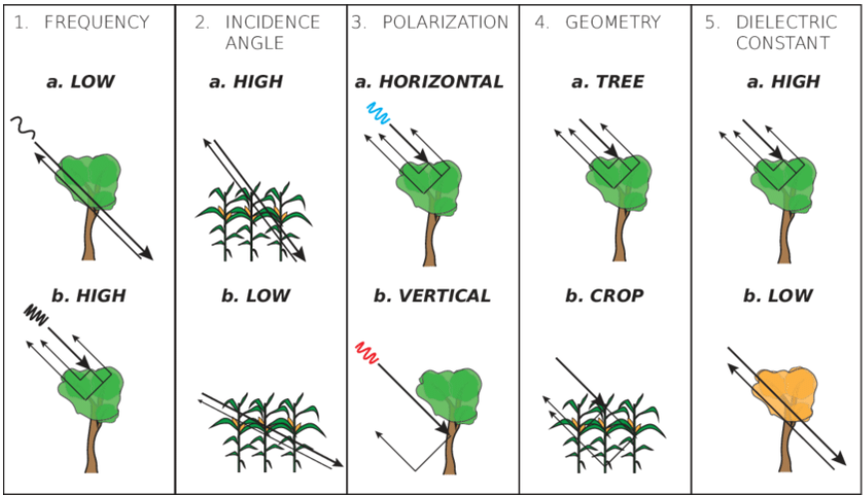
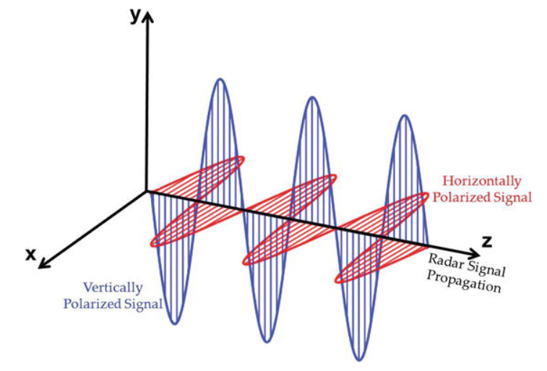
Scattering mechanisms

Slide 6
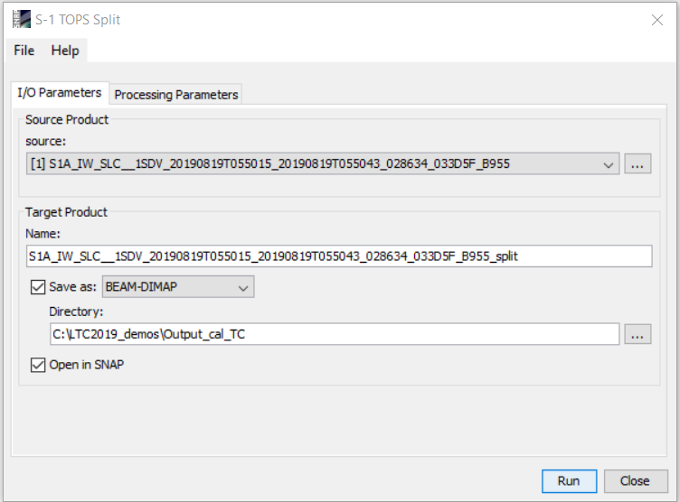
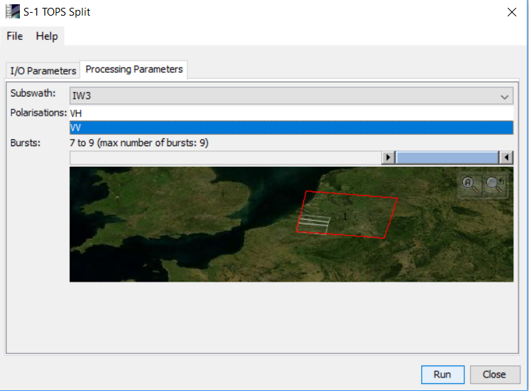
Sentinel-1 TOPSAR Split
MENU: Radar/Sentinel-1 TOPS/S-1 TOPS Split
Selection of subswath
Selection of polarization
Selection of bursts
IW3
VV
7-9
TOPS Split applied to both S-1 SLCs

Slide 7
STEP 1
Interferometric Coherence

Slide 8
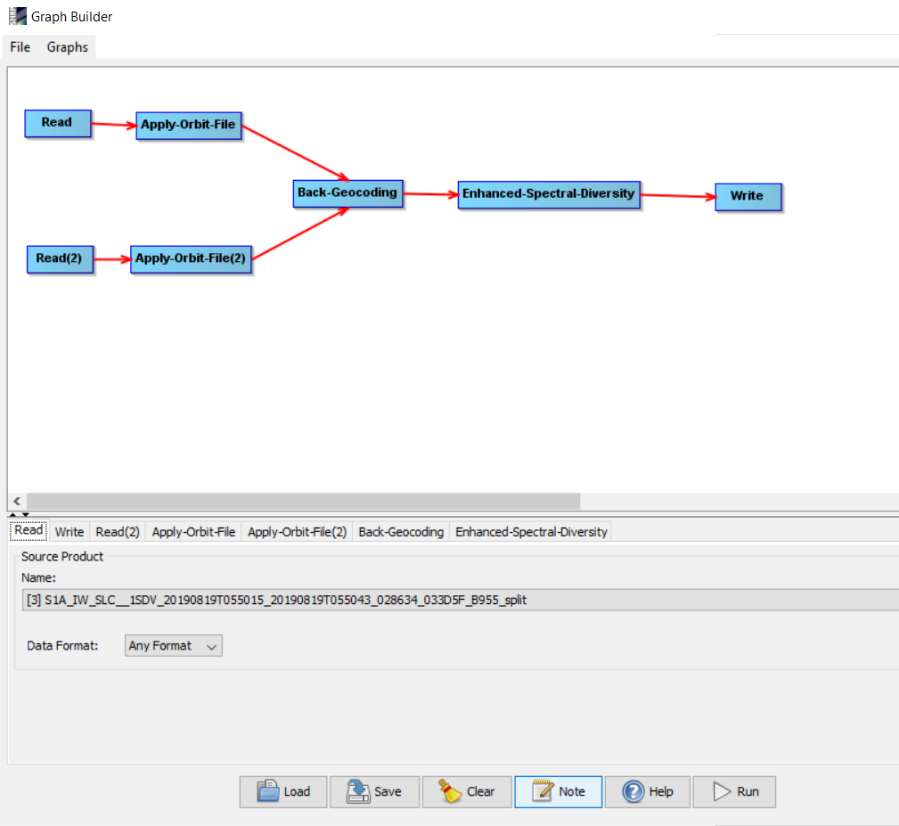
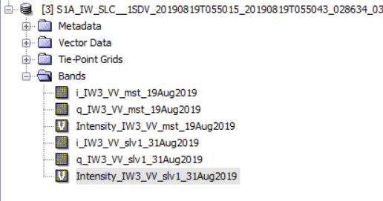
Coregistration
S1A_IW_SLC__1SDV_20190819T055015…
S1A_IW_SLC__1SDV_20190831T055016…
Coregistered bands in one product
Co-registration of two S-1 SLC split products (master and slave) of the same sub-swath using the orbits of the two products and a Digital Elevation Model (DEM).
ESD estimates the range and azmiuth offset (exploiting the data at the overlapped area of the adjacent bursts) and performs range and azimuth corrections for every burst in the slave image

Slide 9
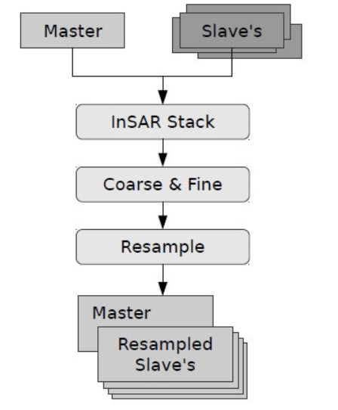
Coregistration
The Cross Correlation operator creates an alignment between master and slave images (matching automatically distributed correlation optimization windows between master and slave)
First on coarse level, with large windows and lower oversampling factors, later on fine level, with smaller windows and higher oversampling factors.
With the master-slave offsets computed, a coregistration polynomial (CPM) is estimated by the Warp operator, which resamples pixels in the slave image into pixels in the master image.

Slide 10
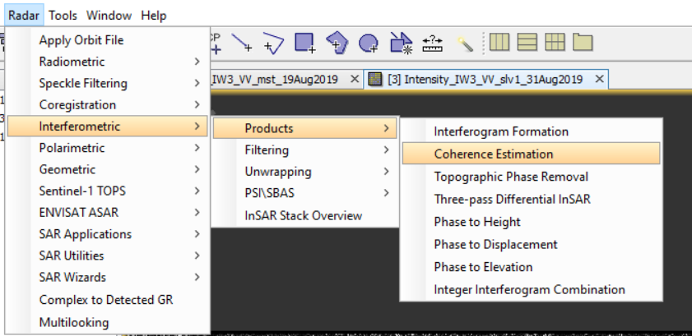
Interferometric Coherence
COHERENCE
Measure of correlation between phase in two SAR complex images
Ranging from 0 (no correlation) to 1
Coherence may be affected by:
Local slope
Properties of the surface
Time lag between acquisitions
The perpendicular baseline
Poor coregistration

Slide 11
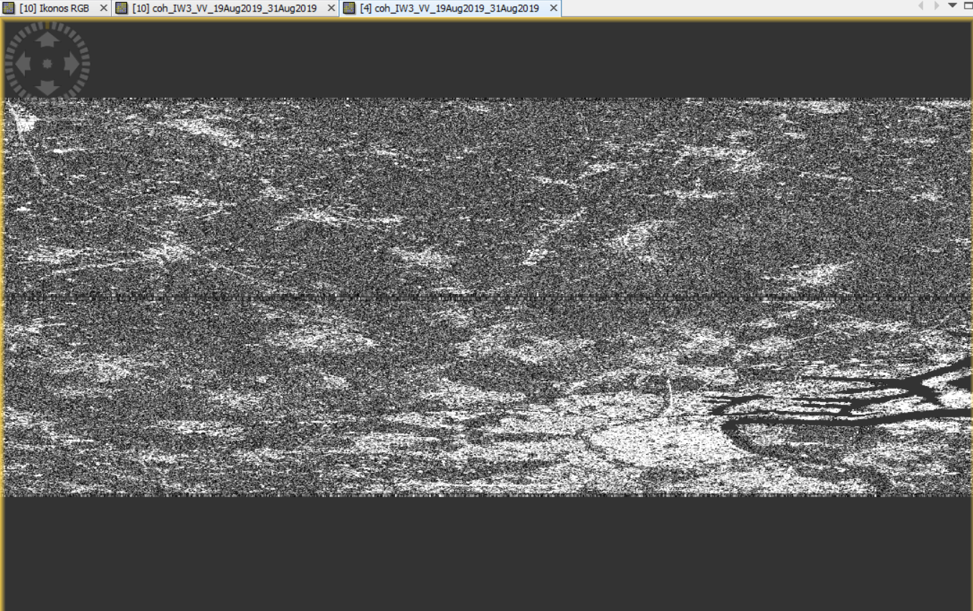
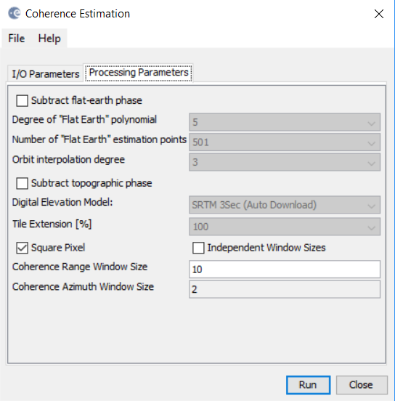
Interferometric Coherence
Demarcation black-filled line between bursts

Slide 12
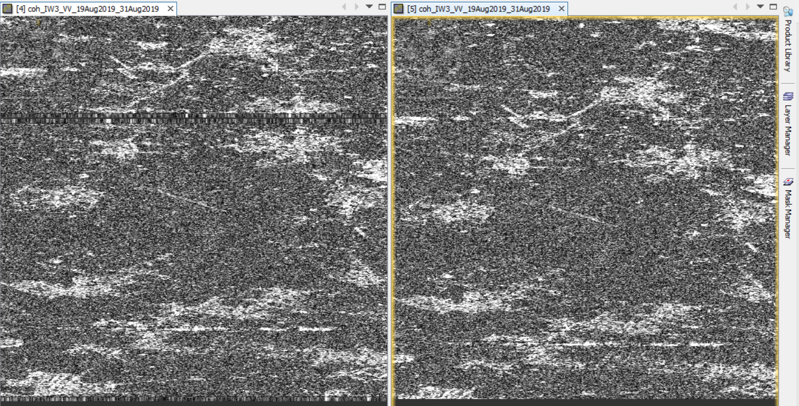
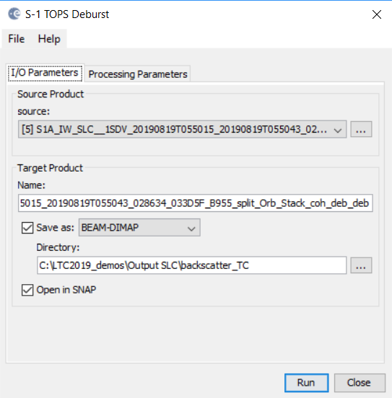
S-1 TOPS Debursting
MENU: Radar/Sentinel-1 TOPS/S-1 TOPS Deburst
Input: Coherence

Slide 13
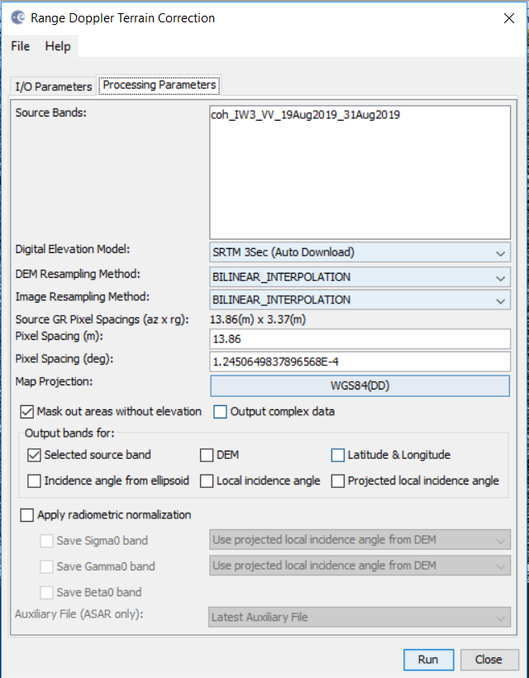
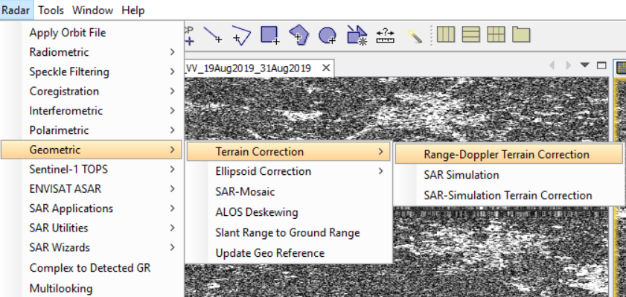
Terrain Correction
Select:
DEM
Resampling
Pixel spacing
Projection
Compensate for geometric distortions caused by topographical variations of a scene and the tilt of satellite sensor
+ Geocoding

Slide 14
STEP 2
Backscatter Intensity

Slide 15
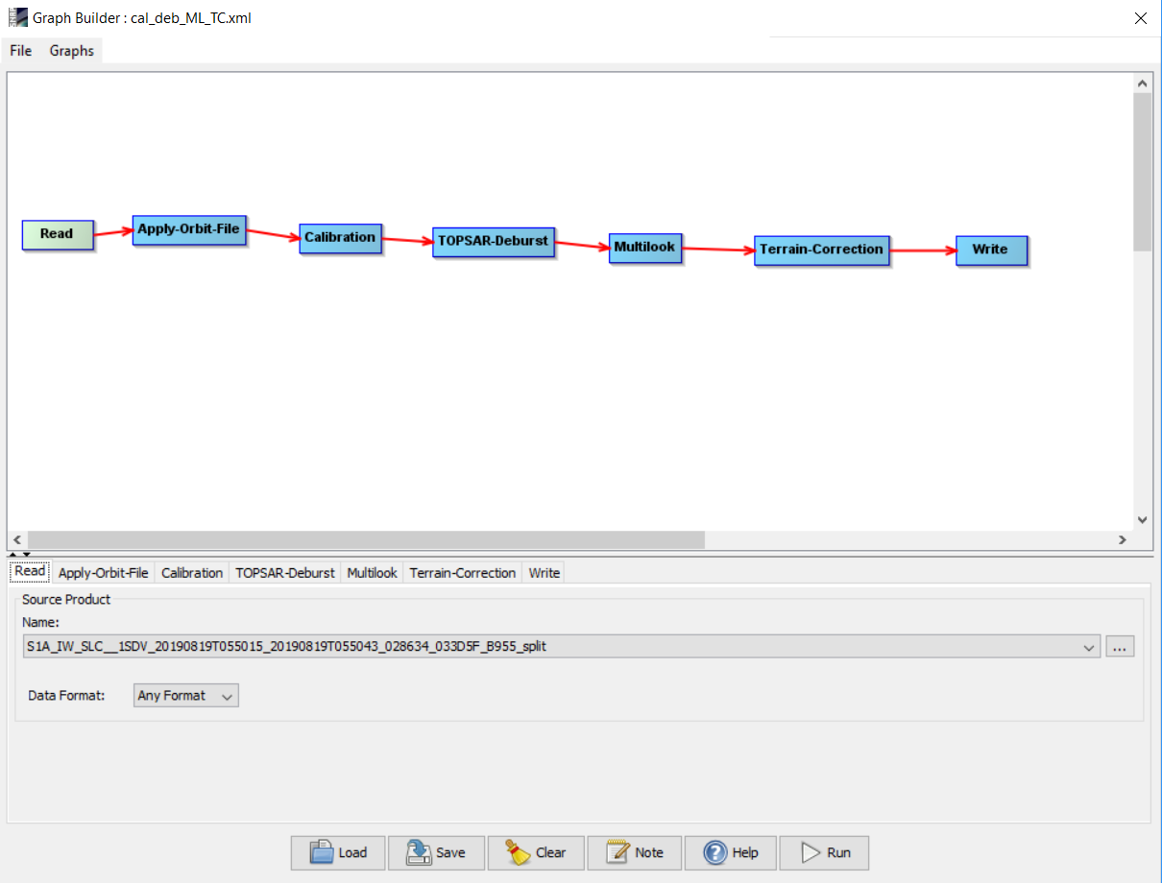
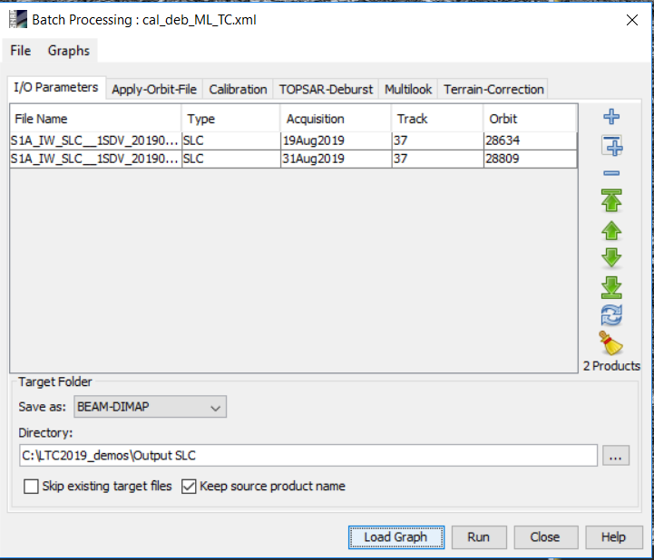
Backscatter Intensity product
MENU: Graph Builder + Batch processing tool
Input: Two splitted SLCs

Slide 16
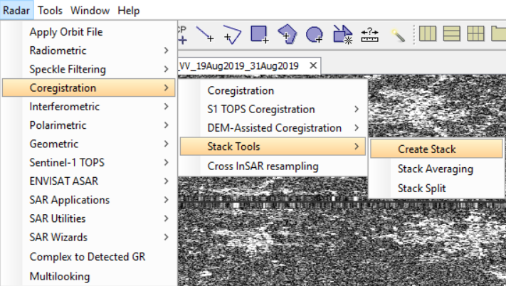
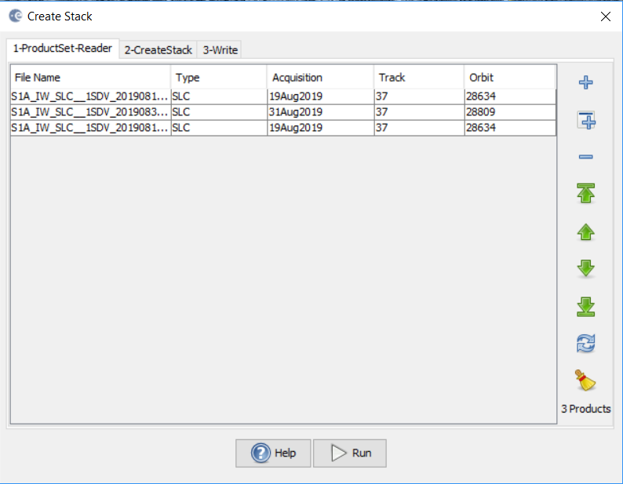
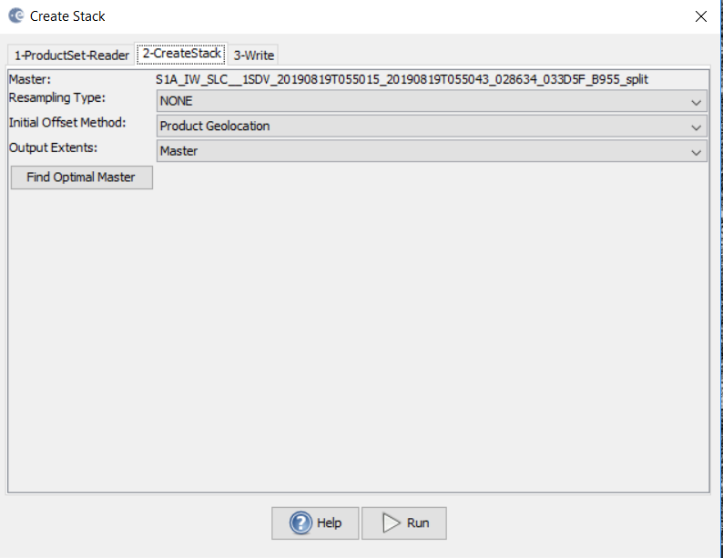
Creating a stack
Input: Coherence from STEP 1
Intensity backscatter for 2 SLCs from STEP 2

Slide 17
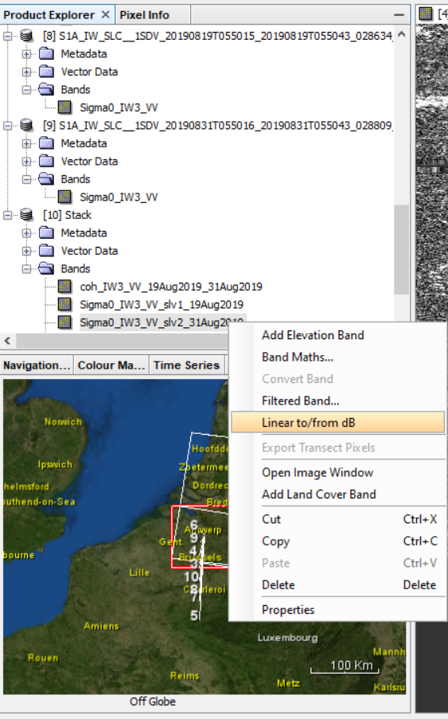
Conversion of sigma0 to db
Right click on the sigma0 band
Conversion linear to/from db
Right click on the sigma0_db virtual band
Select „convert band”
Save the product: File/Save product

Slide 18
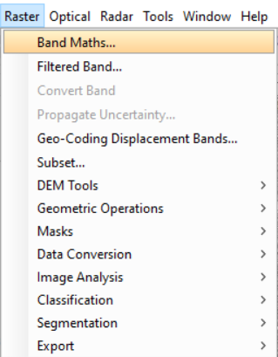
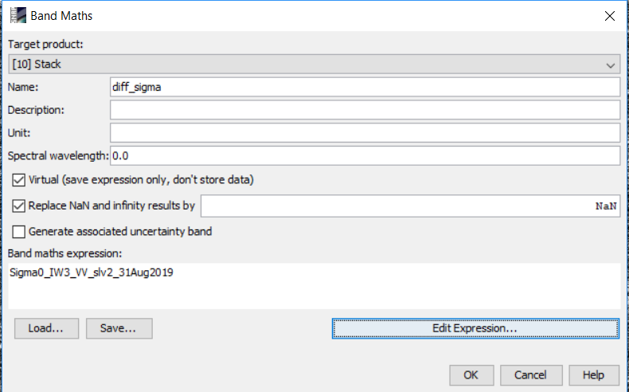
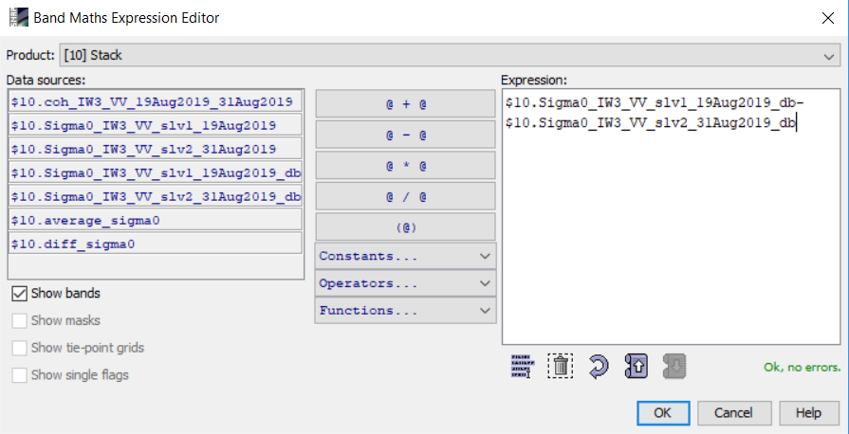
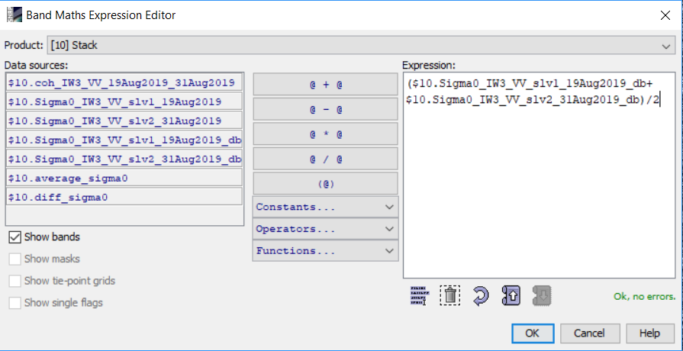
Band math: average sigma 0 and difference
Sigma0 difference
Sigma0 average

Slide 19
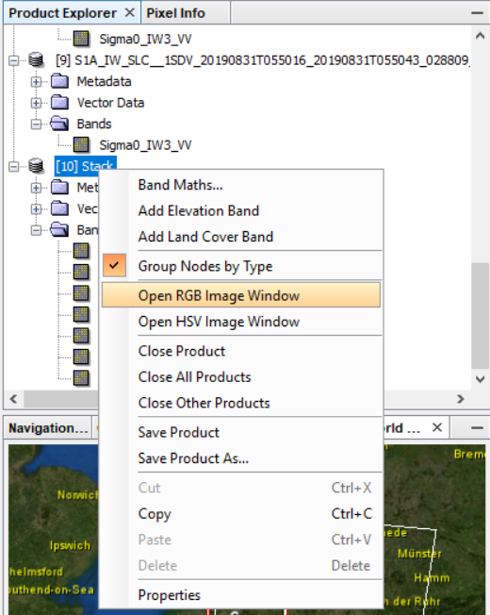
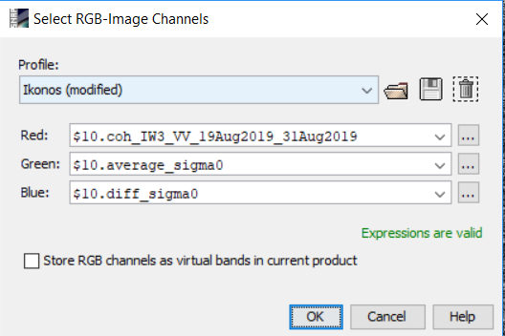
Creating RGB false composite
Select RGB bands:
R: coherence
G: average sigma0
B: difference sigma0
Right click on the stack product
Open RGB Image Window

Slide 20
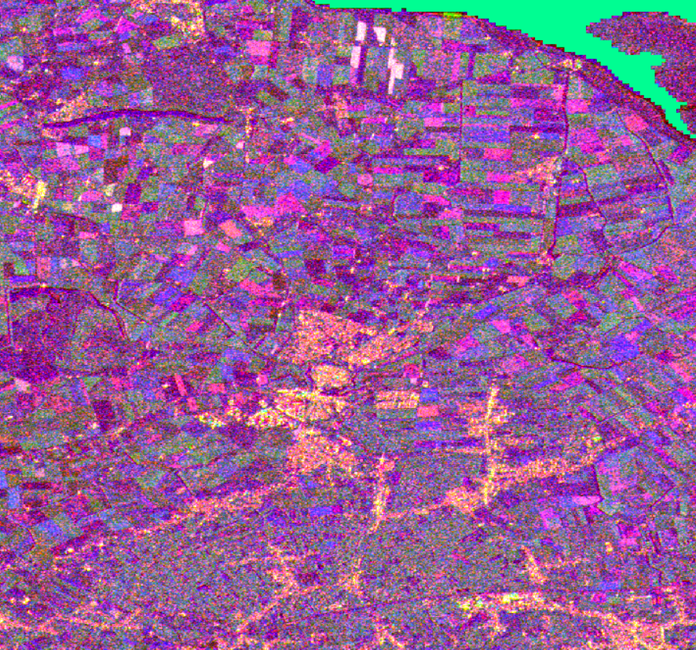
Resulting RGB false composite
Multi-temporal 12-day product (August 2019)
Yellow: Urban centers
Magenta: objects not changing
Green: Vegetated lands and forests
Blue: objects changing in 12 days (e.g. ploughing)

Slide 21
Resulting RGB false composite
Multi-temporal product (2015-2017)
Yellow: Urban centers
Magenta: objects not changing
Green: Vegetated lands and forests
Blue: objects that changed

Slide 22
2015
2017

Slide 23
2015
2017

Slide 24
Answers to your questions
What is the difference between Range Doppler TC and SAR Simulated TC?
SAR Simulation TC : generates simulated SAR image using DEM and orbit vectors from orginal file, coregisters the simulated SAR image and original one, terrain correct – for each pixel of DEM finding corresponding position in the simulated image and corresponding pxel position in the original SAR image
The Range Doppler Terrain Correction Operator implements the Range Doppler orthorectification. It uses: orbit state vector information in the metadata,the radar timing annotations, the slant to ground range conversion parameters together with the reference DEM data to derive the precise geolocation information.

Slide 25
What do we do if my AOI is in two products?
AOI
Consecutive slices
IW1
IW2
AOI
Slice Assembly
Merge
Product1
Product2
SAR Mosaic
*It shall be TC and Calibrated before

