Slide 1
Practical on pre-processing of optical time series including S2
Fabrizio Ramoino
ESA/ESRIN

Slide 2
Practical on pre-processing of optical time series including S2
Overview of Sentinel-2
Spectral bands
Level 2A products
Pre-processing chain starting from S2 L2A data
Resampling
Subset
Band Maths
Radiometric Indices
S2 Biophysical processor
Graph Builder
Batch Processing
Time series analysis

Slide 3
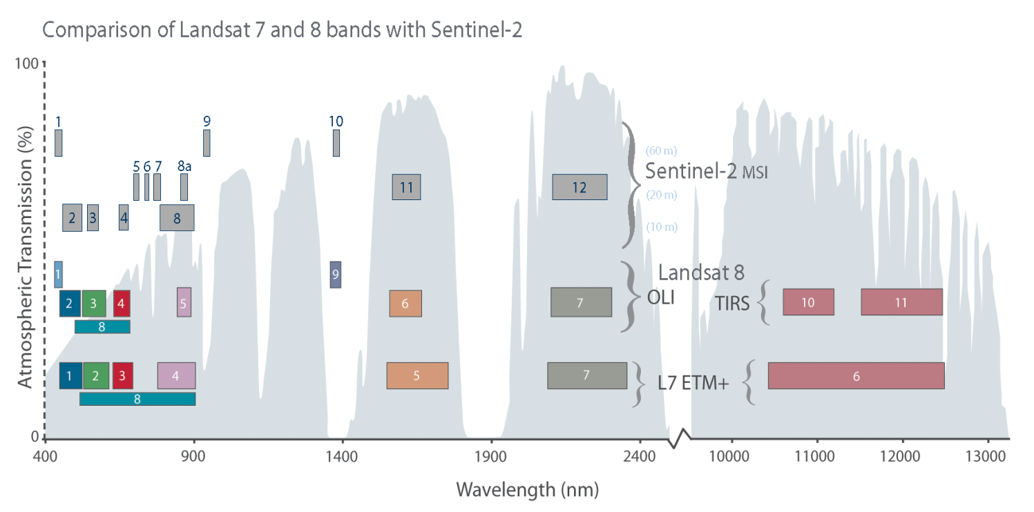
Sentinel-2 spectral bands

Slide 4
Sentinel-2 L2A data overview
Sen2Cor is the Atmospheric Correction processor used in the ESA Payload Data Ground Segment to generate S2 L2A data and it is distributed via STEP to be used as SNAP plug-in or via command line.
Bottom-of-atmosphere (BOA) reflectances in cartographic geometry (UTM/WGS84)
Products additionally include:
Scene Classification Map
Water Vapor Map
Aerosols Optical Thickness Map
Algorithm includes:
Cloud and cloud shadow detection
Cirrus detection and correction
Slope effect correction
BRDF effect correction
Beyond Sen2Cor, Sentinel-2 data can be atmospherically corrected using others processors:
MAJA (developed by CESBIO/CNES)
i-COR (developed by VITO)
CorA (developed by Brockmann Consult)
LaSRC (developed by NASA GSFC/USA)
……

Slide 5
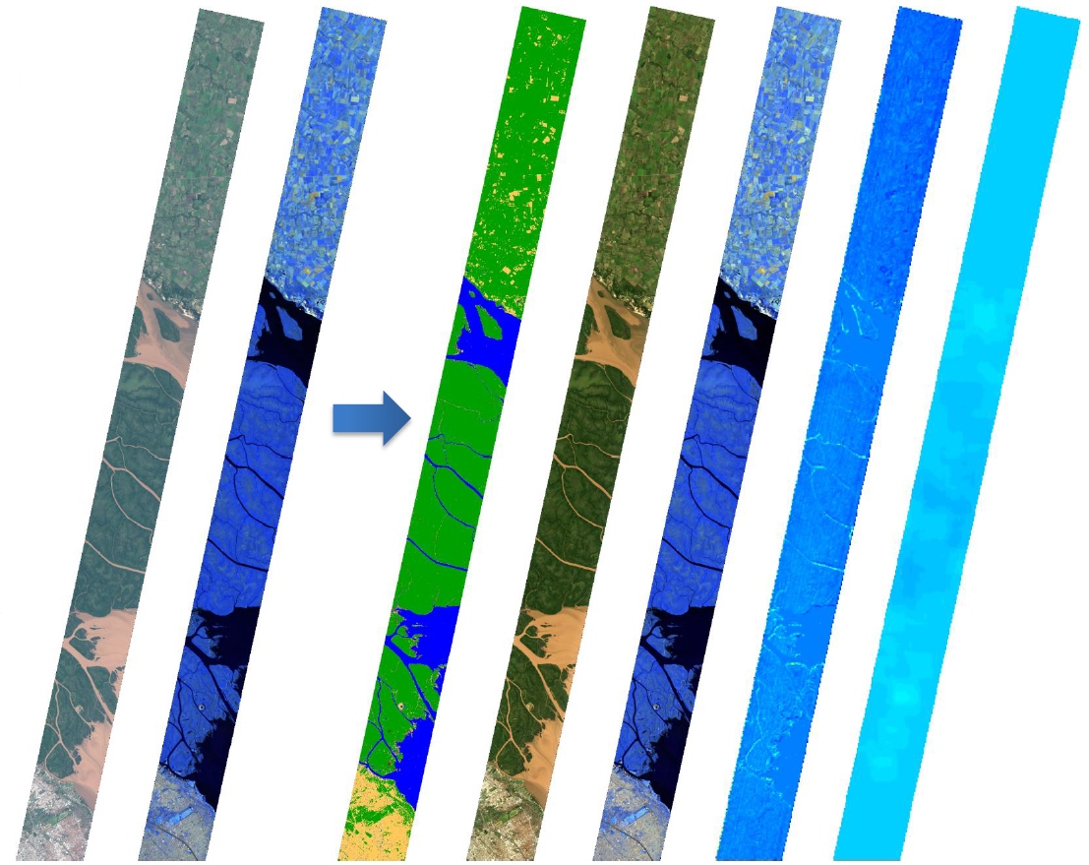
Sentinel-2 L2A data overview
From left to right:
Level-1C [TOA]
[RGB] B4-B3-B2
[RGB] B12-B11-B8a
Level-2A [BOA]
Scene Classification
[RGB] B4-B3-B2
[RGB] B12-B11-B8a
Water Vapour
Aerosols Optical Thickness

Slide 6
Sentinel-2 pre-processing
Essential pre-processing steps:
Resampling
The S2 products are multi-size
B2, B3, B4 and B8 @ 10m
B5, B6, B7, B8A, B11 and B12 @ 20m
B1, B9 and B10 @ 60m
Needed if the user wants to combine bands with different spatial resolution
Subset (spatially/spectrally)
The S2 data are distributed in tiles 100x100 km² ortho-images in UTM/WGS84 projection.
Needed if the AOI covers a portion of the S2 scene or if only a subset of bands are useful in the next step (this will reduce the computation time)
Re-projection
If the AOI covers more than one S2 tile in different UTM zones the user needs to re-project in a common CRS before to mosaic them.
If the user wants to merge different data sources projected in different CRS.
To export the view in KMZ and visualise your output in Google Earth.

Slide 7
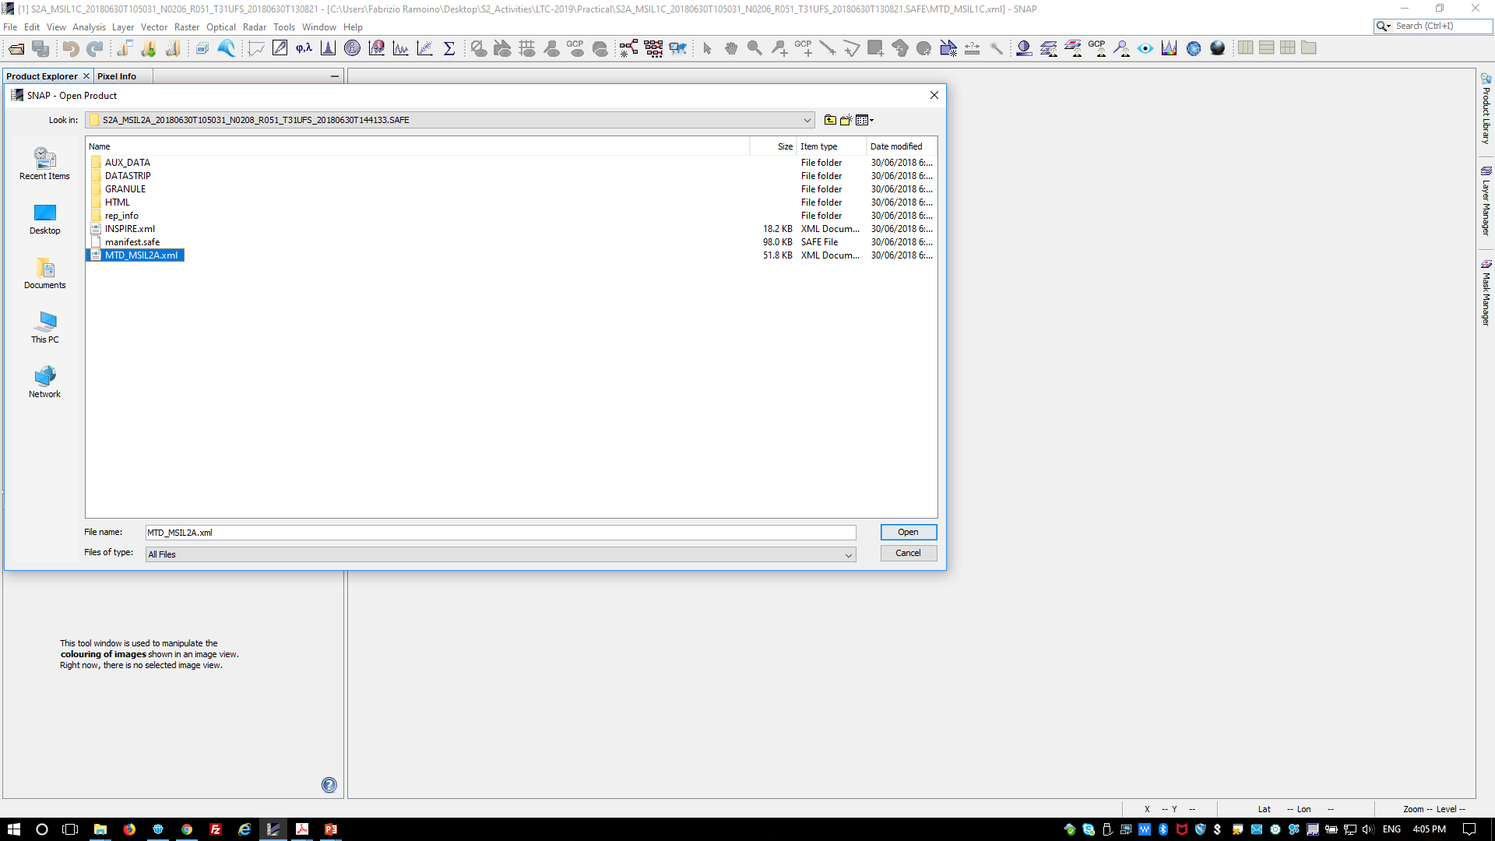
Open a Sentinel-2 data
Click on ‘File’ → ‘Open Product…’ → select the ‘MTD_MSIL2A.xml’ file

Slide 8
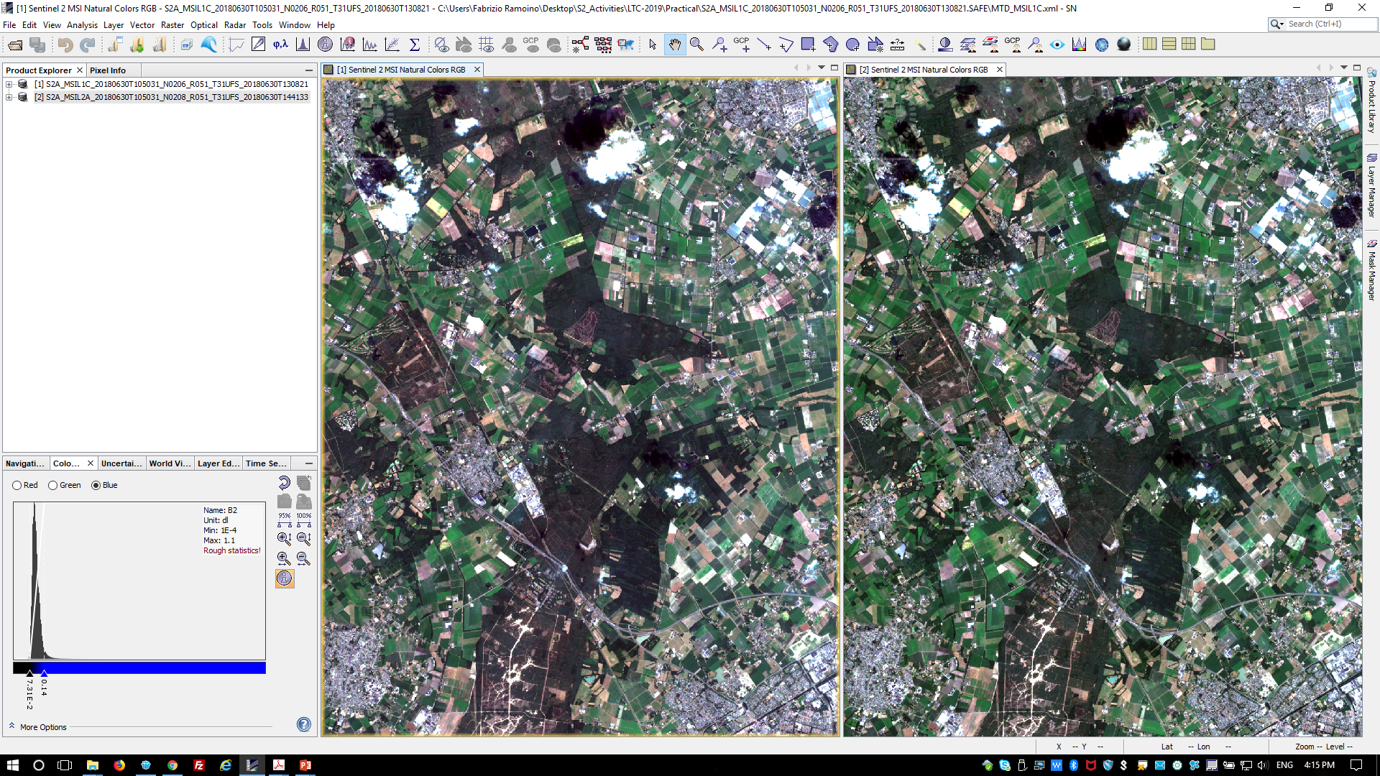
Visualize Sentinel-2 data
S2 L1C (Refl TOA)
S2 L2A (Refl BOA)

Slide 9
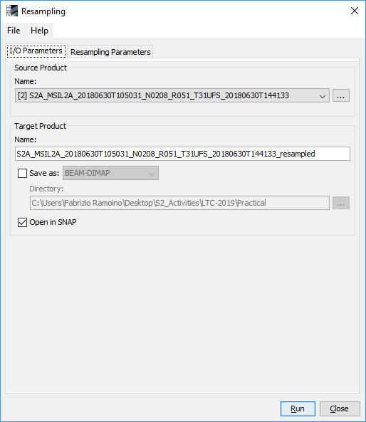
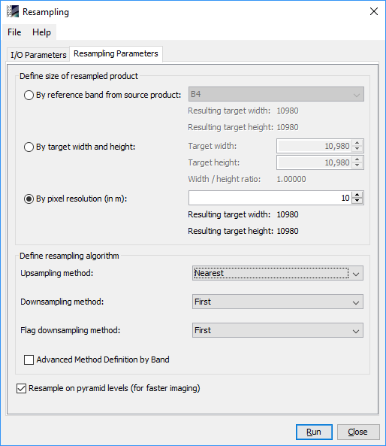
Resampling
Select the product in the Product Explorer window.
Click on ‘Raster’ → ‘Geometric Operations’ → ‘Resampling’
In the pop-up window set up the parameters as shown in the Figures:
Unselect ‘Save as:’
‘10m’ as pixel resolution
‘Nearest’ as Upsampling method
Click on ‘Run’

Slide 10
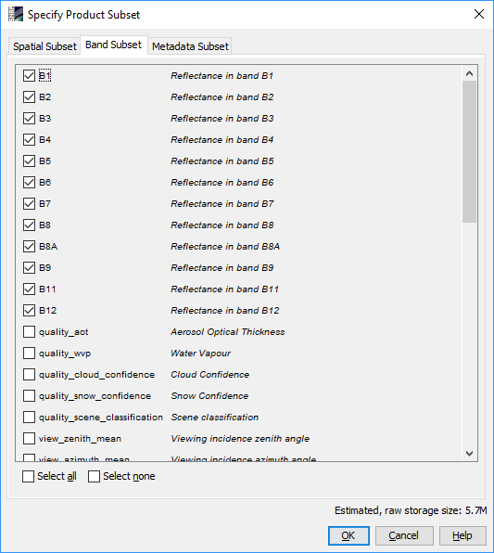
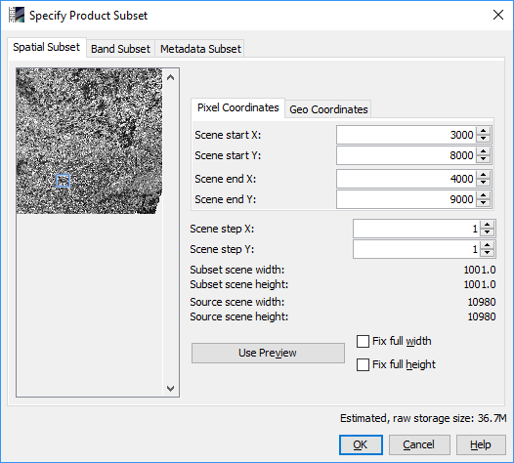
Subset (spatially/spectrally)
Select the new product in the Product Explorer window.
Click on ‘Raster’ → ‘Subset…’
In the pop-up window set up the parameters as shown in the Figures:
Define the X and Y pixels range or the X and Y geo-coordinates to crop the input product
Define which bands you want to export
Click on ‘Run’

Slide 11
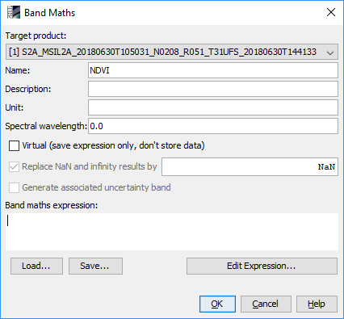
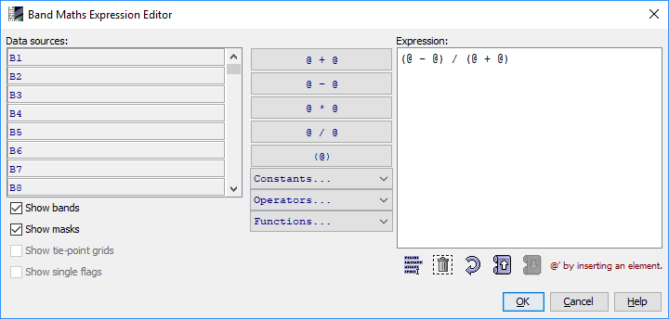
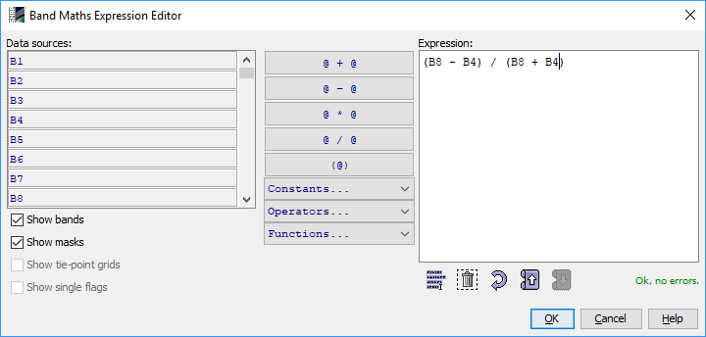
Band Maths (e.g. NDVI)
Select the product in the Product Explorer window.
Click on ‘Raster’ → ‘Band Maths…’
In the pop-up window set up the parameters as shown in the Figures:
Change the Name: ‘NDVI’
Unselect ‘Virtual’ box
Click on ‘Edit Expression…’
Create your expression using ‘@’ and after replace them with the bands
(@ - @) / (@ + @)
(B8 – B4) / (B8 + B4)
Click on ‘Run’

Slide 12
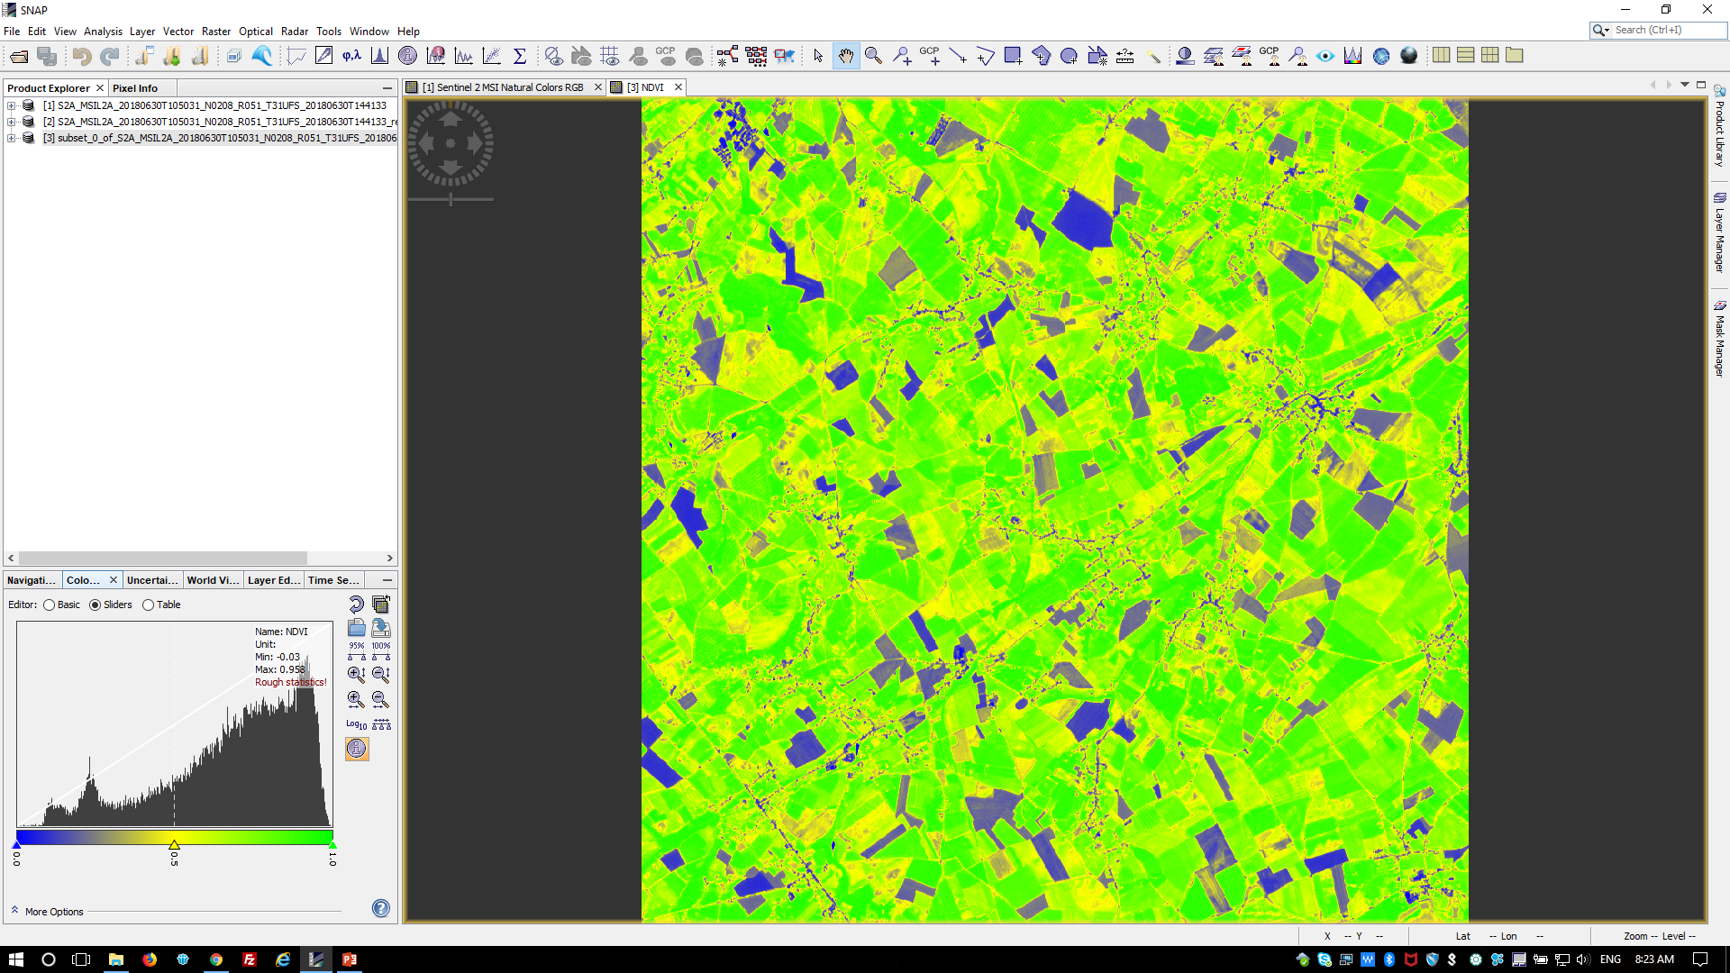
Output Visualization
When the processing is finished the output will be automatically opened in the ‘Product Explorer’ of SNAP Select the product in the Product Explorer window.
Using the Colour Manipulation (bottom left) you can modify the colour palette.

Slide 13
Radiometric Indices
Radiometric indices are quantitative measures of features that are obtained by combining several spectral bands
Vegetation indices
Soil indices
Water indices
DVI, RVI, PVI
BI
NDWI
NDVI, WDVI, TNDVI, GNDVI
BI2
NDWI2
SAVI, TSAVI, MSAVI, MSAVI2
RI
MNDWI
GEMI
GEMI
NDPI
ARVI
NDTI
NDI45
MTCI, MCARI, PSSRa
S2REP, REIP, IRECI

Slide 14
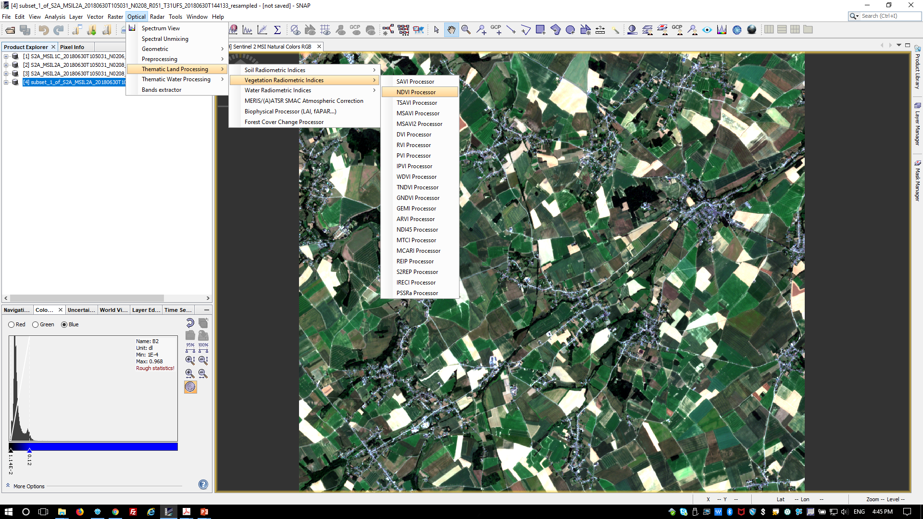
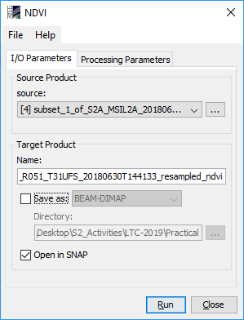
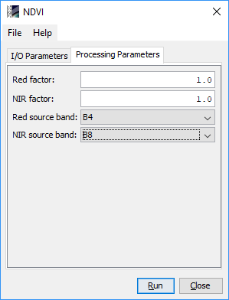
Radiometric Indices (e.g. NDVI)
$$\frac{\left(NIR−Red\right)}{(NIR+Red)}$$
$$\frac{\left(B8−B4\right)}{(B8+B4)}$$

Slide 15
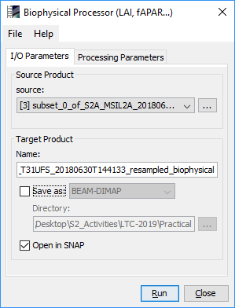
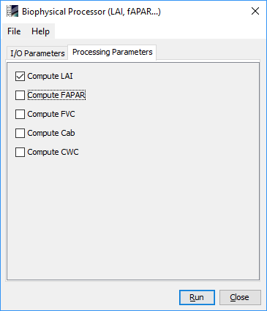
Biophysical processor (L2B)
Select the new product in the Product Explorer window.
Click on ‘Optical’ → ‘Thematic Land Processing’ → ‘Biophysical processor (LAI, fAPAR, …)’
In the pop-up window set up the parameters as shown in the Figures:
Unselect ‘Save as:’
Select only ‘LAI’
Click on ‘Run’
LAI: Leaf Area Index
fAPAR: Fraction of Absorbed Photosynthetically Active Radiation
FVC: Fraction of vegetation cover
Cab: Chlorophyll content in the leaf
CWC: Canopy Water Content

Slide 16
GraphBuilder
The Graph Builder allows the user to assemble graphs from a list of available operators and connect operator nodes to their sources.
Right click on the top panel to add an Operator.

Slide 17
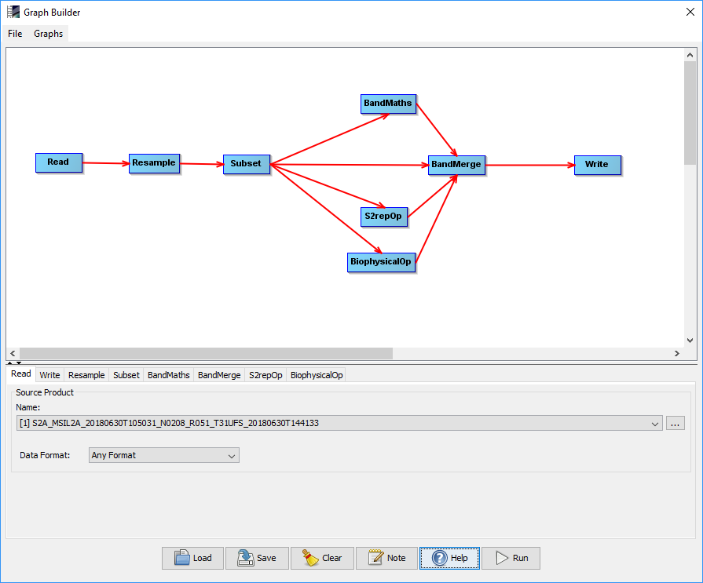
GraphBuilder
We can create our processing chain adding to the default blocks ‘Read’ and ‘Write’:
‘Rempling’
‘Raster’ → ‘Geometric’ → ‘Resample’
‘Subset’
‘Raster’ → ‘Geometric’ → ‘Subset’
‘Band Maths’
‘Raster’ → ‘BandMaths’
‘S2rep’ (S2 Red-Edge Position Index)
‘Optical’ → ‘Them. Land Proc.’ → ‘Veg. Rad. Ind.’ → ‘S2repOp’
‘Biophysical Processor’
‘Optical’ → ‘Thematic Land Processing’ → ‘BiophysicalOp’
‘Band Merge’
‘Raster’ → ‘BandMerge’

Slide 18
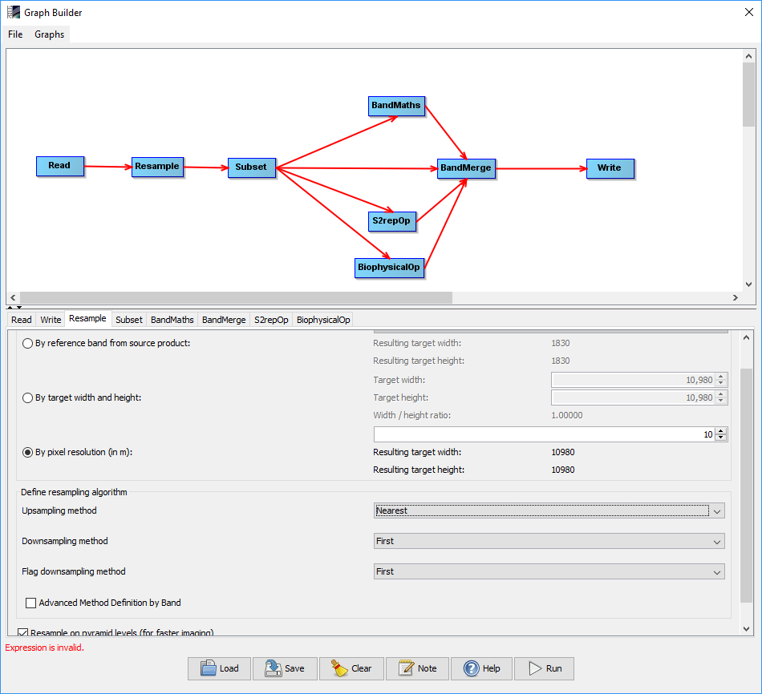
GraphBuilder (Resample module)

Slide 19
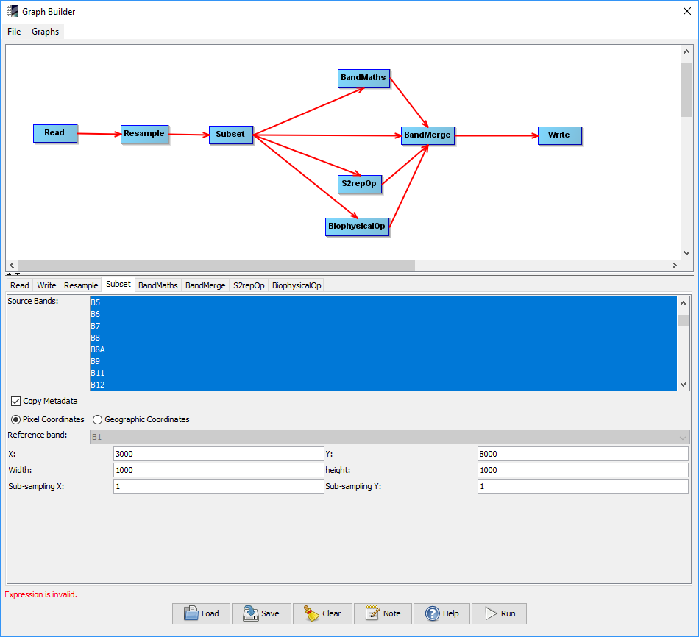
GraphBuilder (Subset module)

Slide 20
GraphBuilder (BandMaths module)

Slide 21
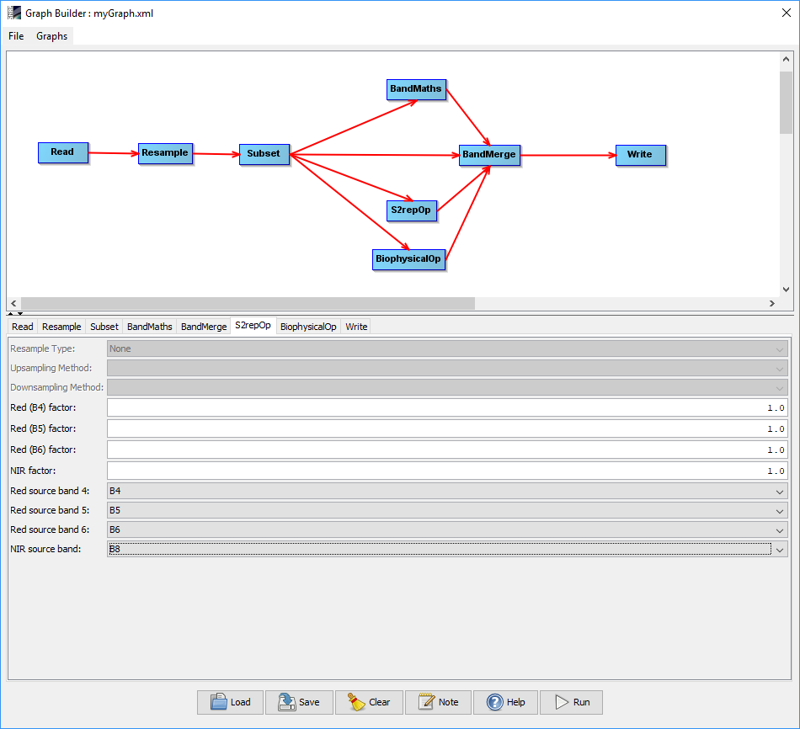
GraphBuilder (S2repOp module)
The Sentinel-2 Red-Edge Position Index algorithm is based on linear interpolation, as presented by Guyot and Baret (1988).
Red edge, as the inflection point of the strong red absorption to near infrared reflectance, includes the information of both crop (chlorophyll content) N and growth status.
$$705+35 ×\frac{\frac{\left(Red+NIR\right)}{2}−{Red}_{2}}{({Red}_{3}−{Red}_{2})}$$
$$705+35 ×\frac{\frac{\left(B4+B7\right)}{2}−B5}{(B6−B5)}$$

Slide 22
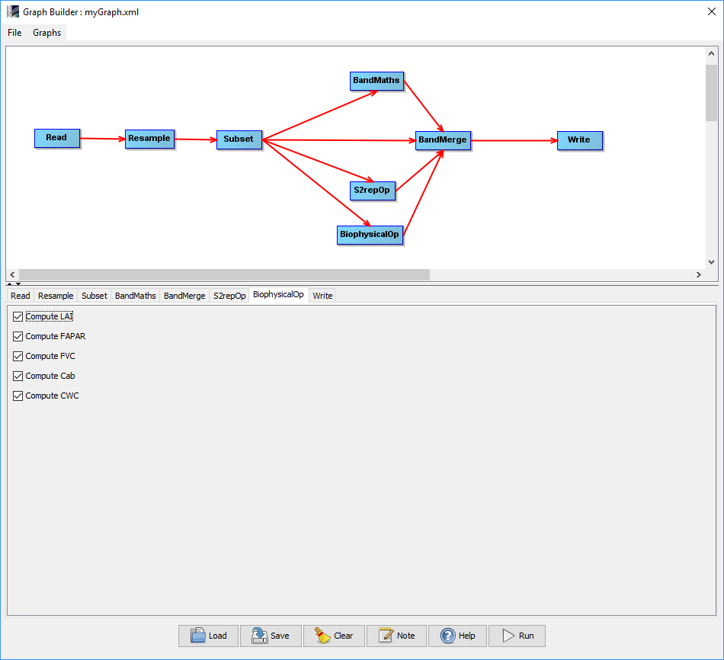
GraphBuilder (BiophysicalOp module)
The Biophysical Processor computes Level-2B Biophysical products from Sentinel-2 reflectances.
From Bottom Of Atmosphere normalized reflectance data, it derives a set of biophysical variables, namely:
LAI: Leaf Area Index
fAPAR: Fraction of Absorbed Photosynthetically Active Radiation
FVC: Fraction of vegetation cover
Cab: Chlorophyll content in the leaf
CWC: Canopy Water Content

Slide 23
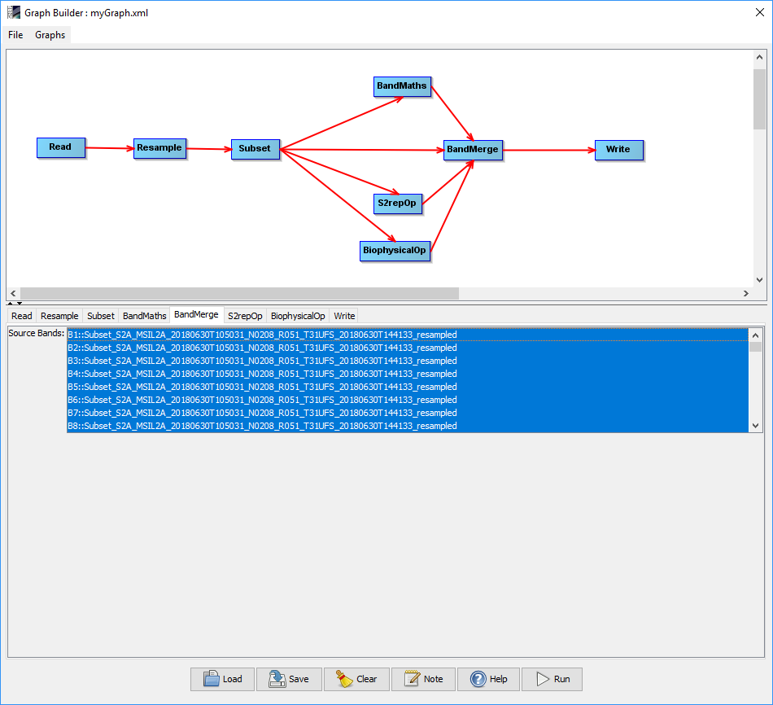
GraphBuilder (Band Merge module)

Slide 24
GraphBuilder (Save the graph)

Slide 25
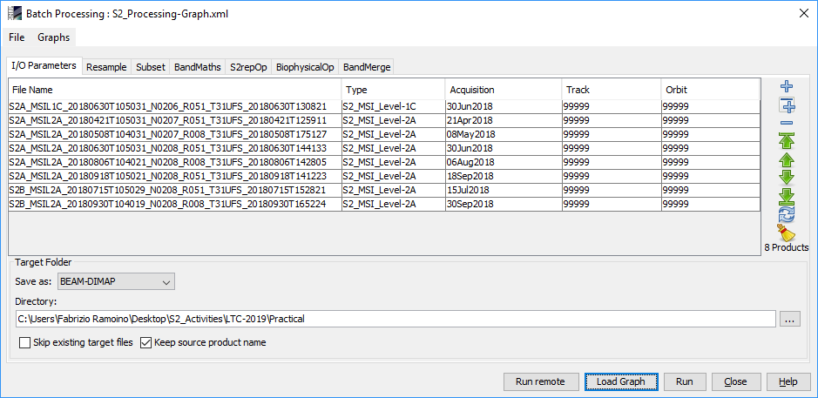
Batch Processing
The Batch Processing tool allows you to execute a single reader/writer graph for a set of products. Select the Batch Processing tool from the Graphs menu and then press the "Load" button to browse for a previously saved graph. Next, add products in the I/O tab by pressing the "Add" button. Set the target folder where the output will be written to and then press "Run“.

Slide 26
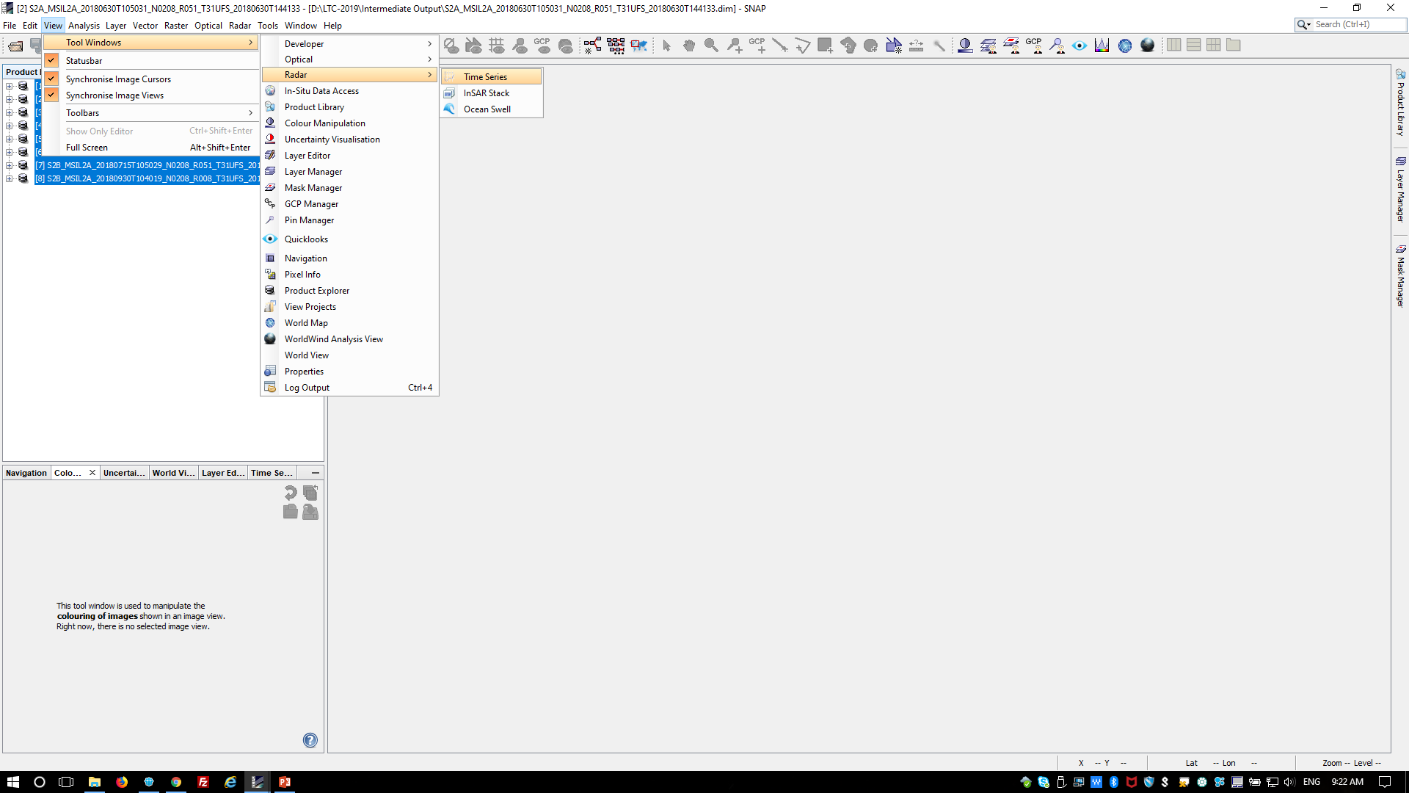
Time Series
Due to the short time you can find the batch processing output in the ‘Intermediate Output’ folder in DIMAP format.
Open them in SNAP and then open the Time Series Window. ‘View’ → ‘Tool Windows’ → ‘Radar’ → ‘Time Series’

Slide 27
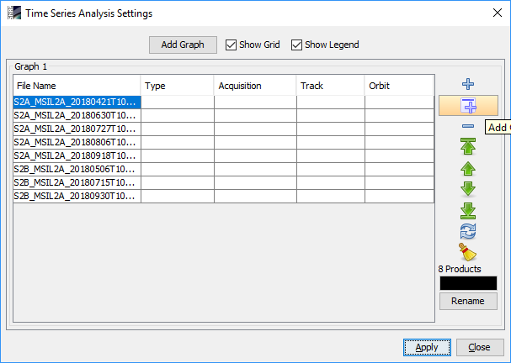
Time Series
To populate the time series you can add all the products opened in SNAP or browsing from your disk.

Slide 28
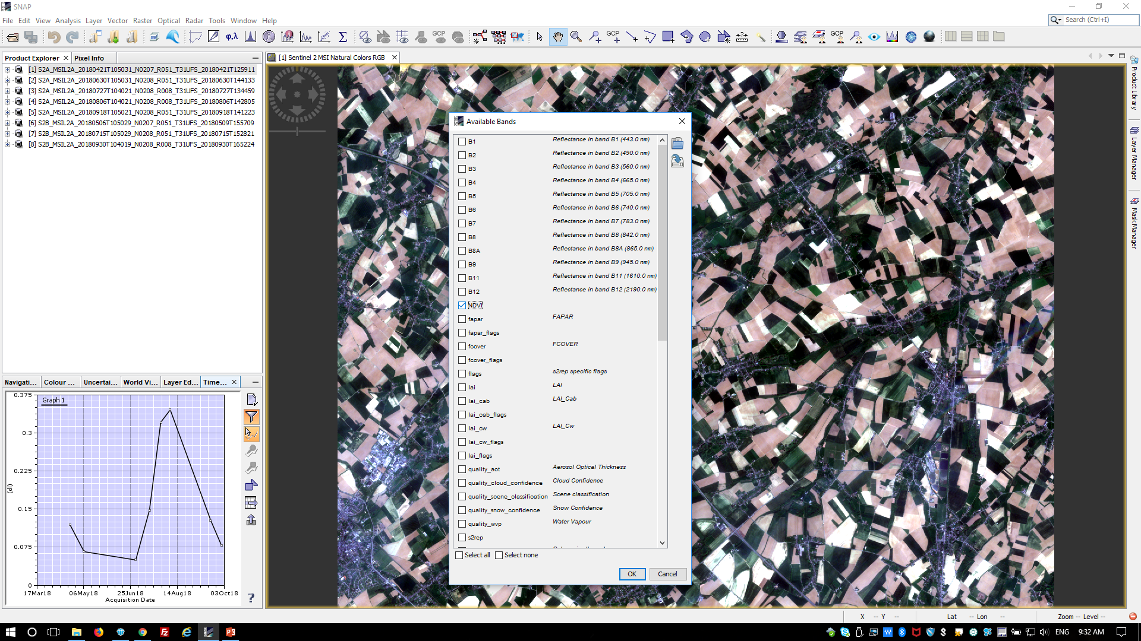
Time Series

