Slide 1
Mapping cropland and crop type from S2 time series (Sen2-Agri)
Sophie Bontemps

Slide 2
Training outline
Launch crop mask and crop type products through Sen2-Agri
Prepare in situ data
Understand the crop classification principles on SNAP
Explore the Sen2-Agri crop mask and crop type products

Slide 3
Training outline
Launch crop mask and crop type products through Sen2-Agri
Prepare in situ data
Understand the crop classification principles on SNAP
Explore the Sen2-Agri crop mask and crop type products

Slide 4
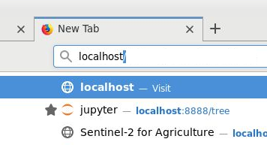
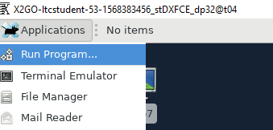
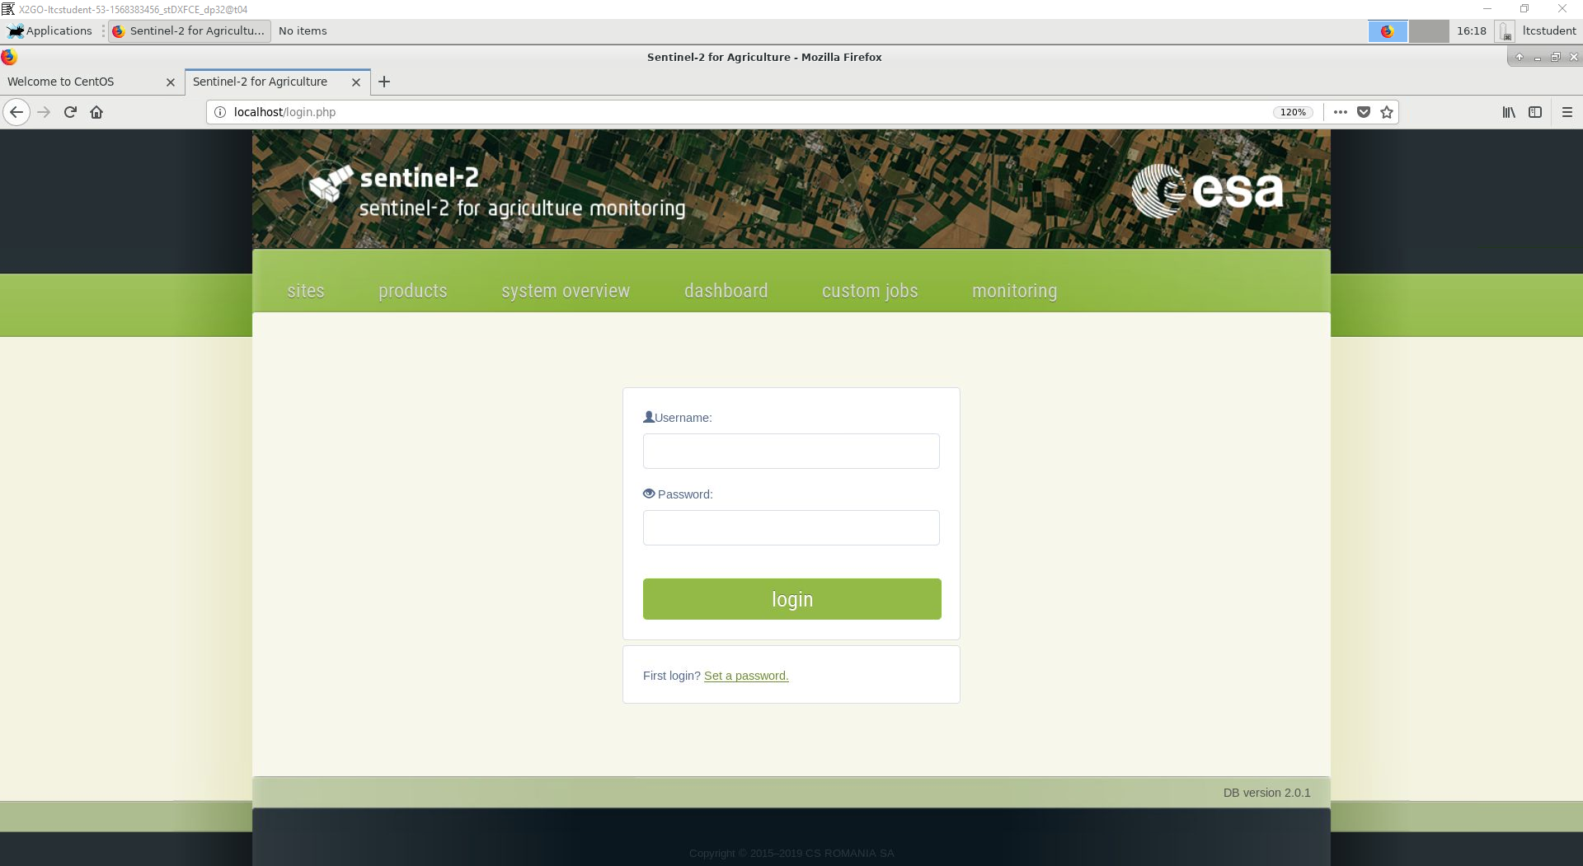
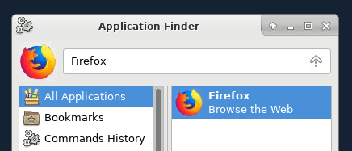
Access to your Sen2-Agri system (web interface)
Open Firefox
Write « localhost »
3
1
2

Slide 5
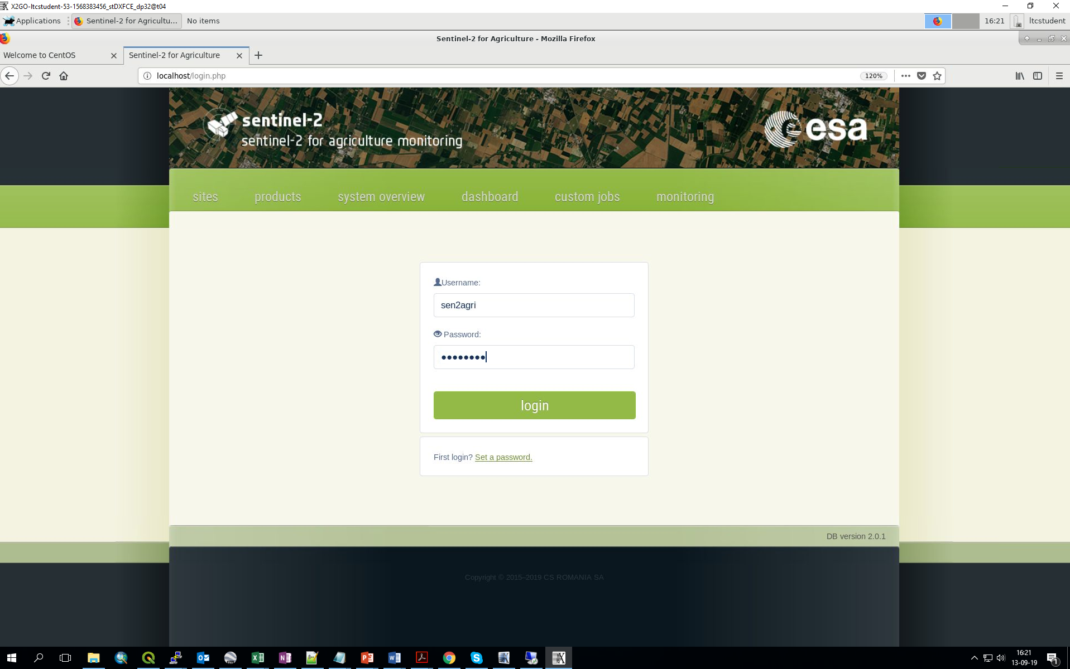
Access to your Sen2-Agri system (web interface)
Login
Username = sen2agri
Password = sen2agri
4

Slide 6
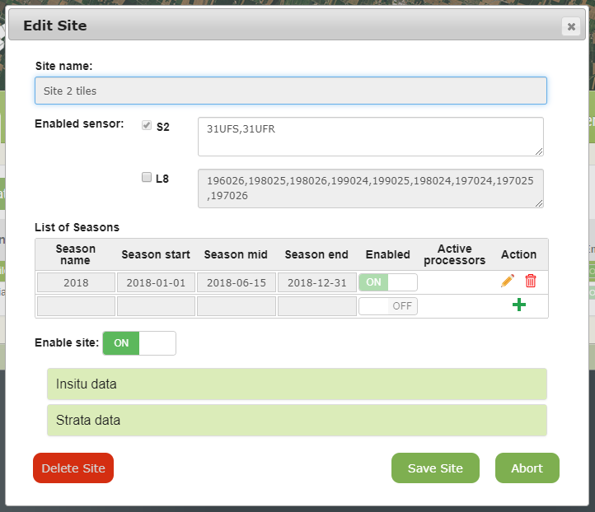
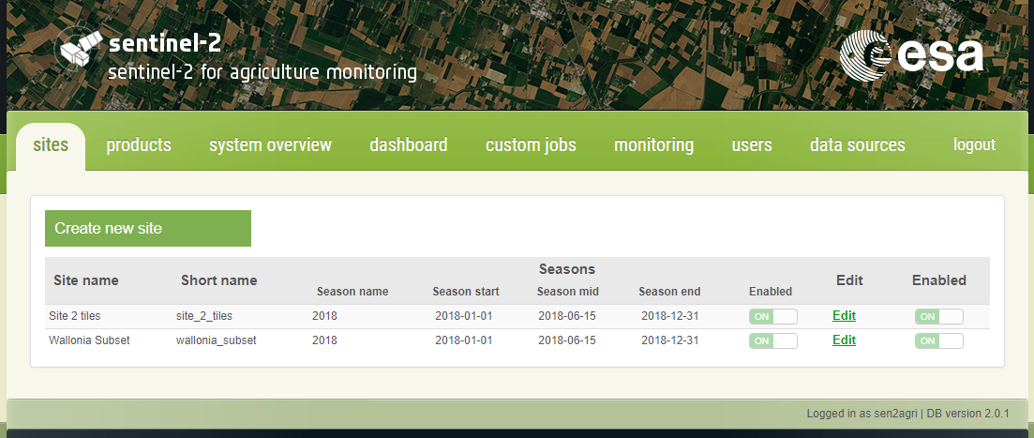
Sen2-Agri system overview
« sites » tab

Slide 7
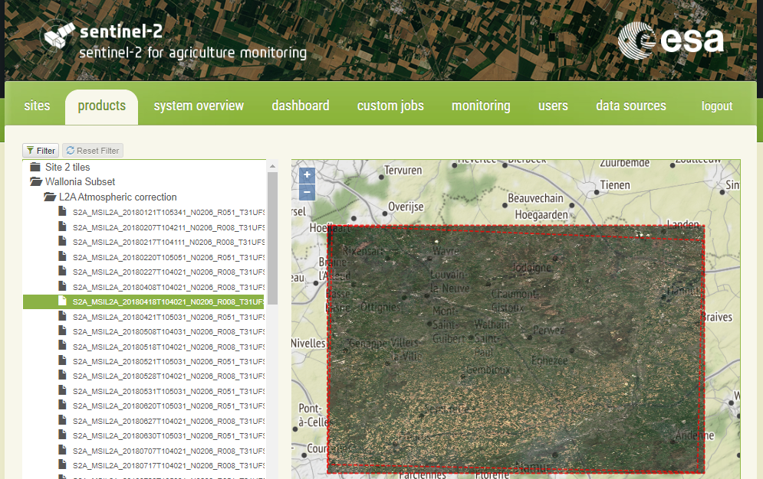
Sen2-Agri system overview
« products » tab

Slide 8
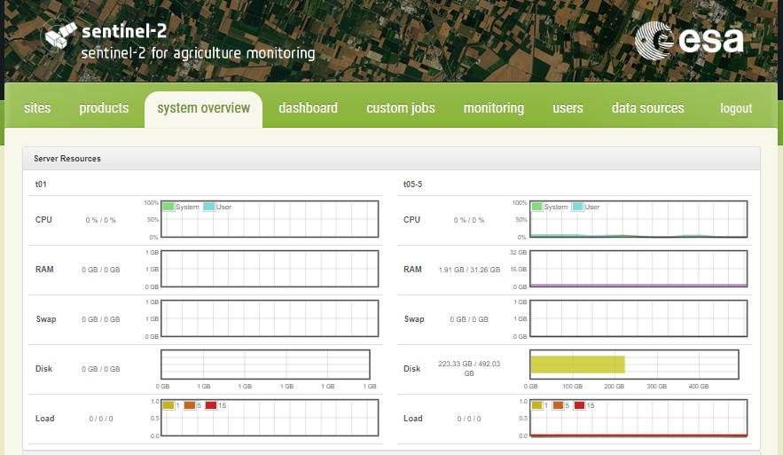
Sen2-Agri system overview
« system overview » tab

Slide 9
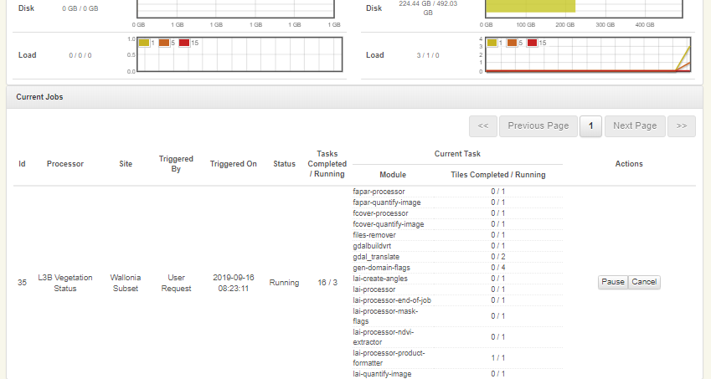
Sen2-Agri system overview
« system overview » tab

Slide 10
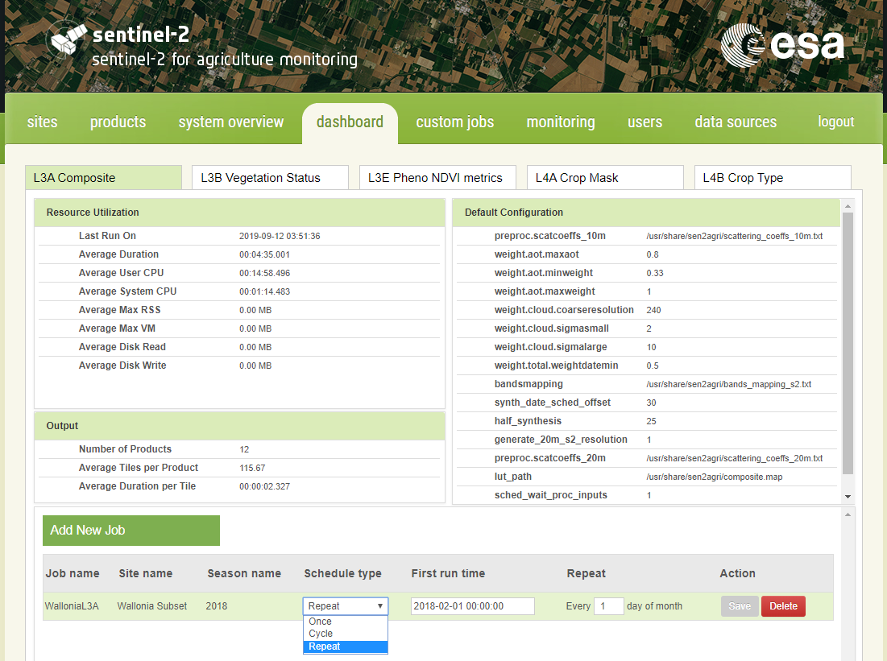
Sen2-Agri system overview
« dashboard » tab

Slide 11
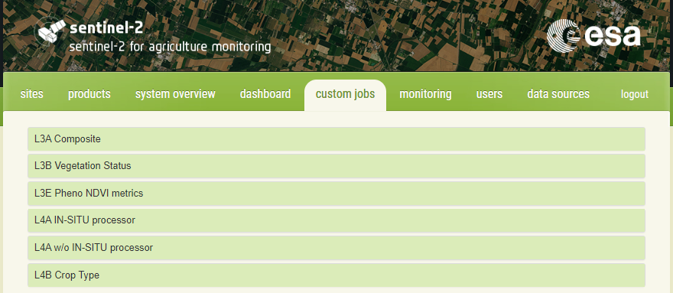
Sen2-Agri system overview
« custom jobs » tab

Slide 12
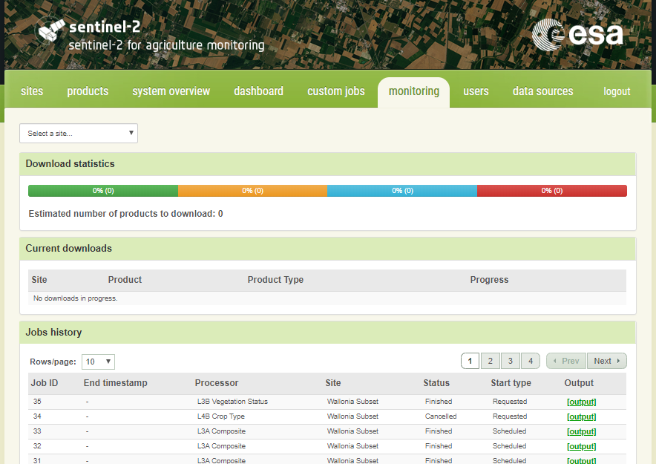
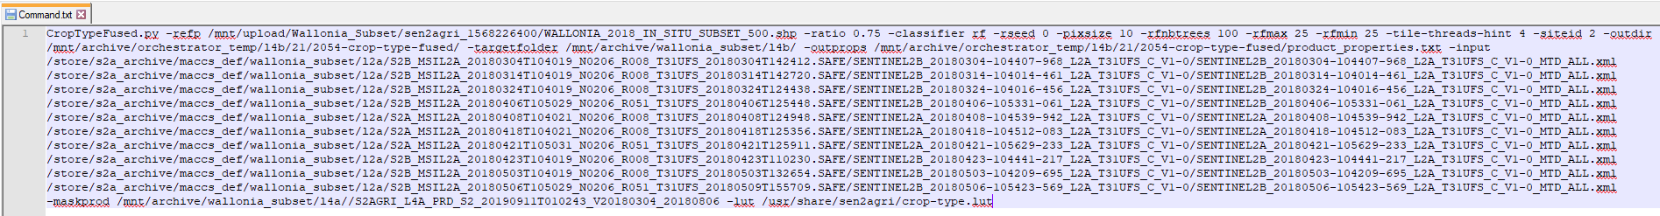
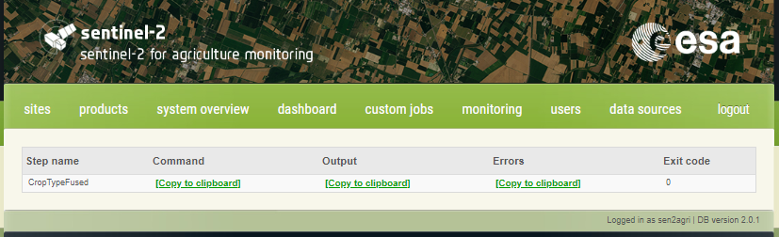
Sen2-Agri system overview
« monitoring » tab

Slide 13
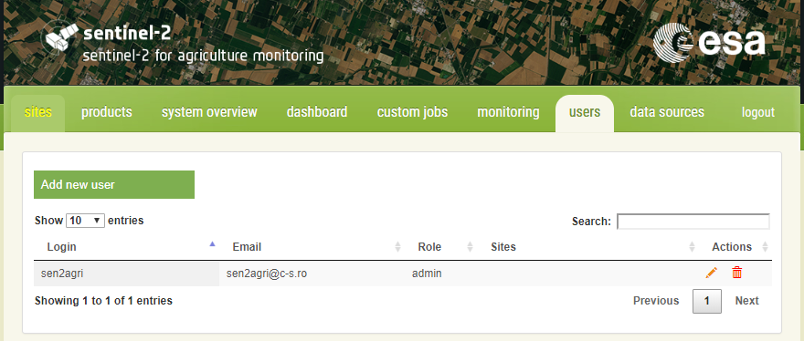
Sen2-Agri system overview
« users » tab

Slide 14
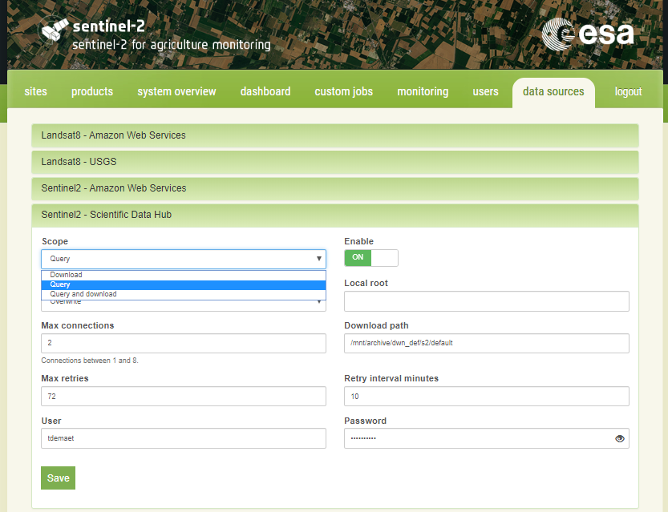
Sen2-Agri system overview
« datasource » tab

Slide 15
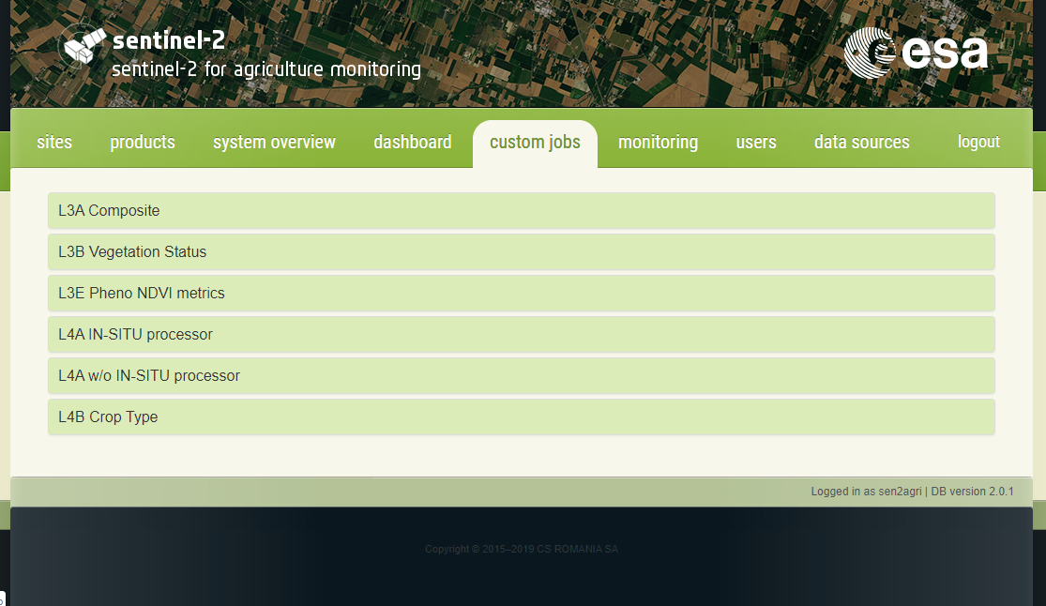
Launch crop mask and crop type products through Sen2-Agri
Go in the « custom jobs » tab
1. Crop mask with in situ data (L4A)
2. Crop mask without in situ data (L4A)
3. Crop type map with in situ (L4B)

Slide 16
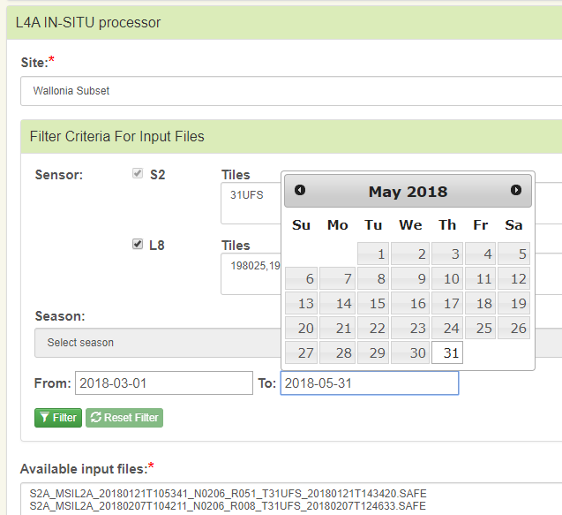
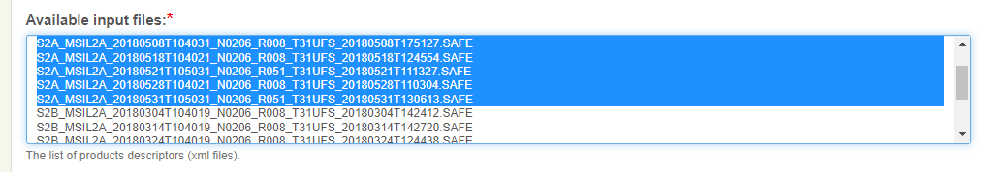
Launch a crop mask through Sen2-Agri (L4A)
Select your site = Wallonia Subset
Select your input L2A images
From 2018-03-01 To 2018-05-31
Filter
Highlight in blue from the list (all or selected ones)

Slide 17
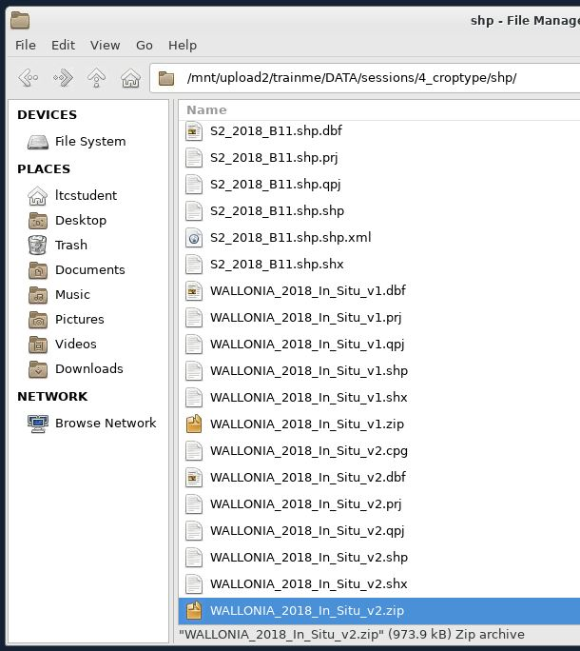
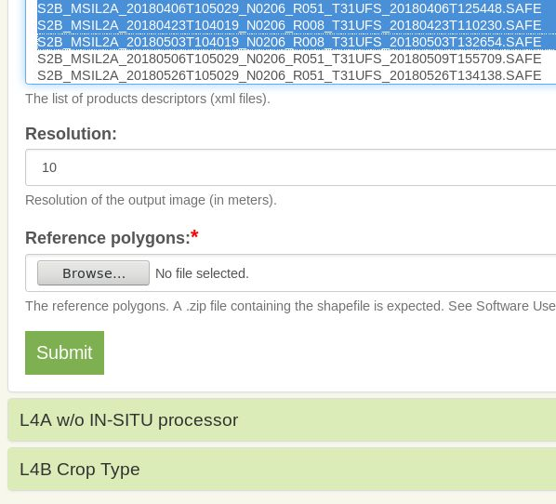
Launch a crop mask through Sen2-Agri (L4A)
Upload in situ data
Submit your job

Slide 18
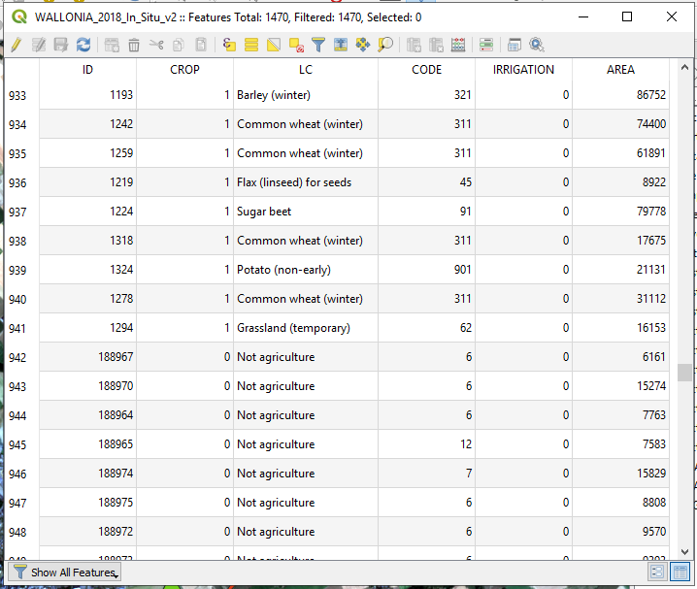
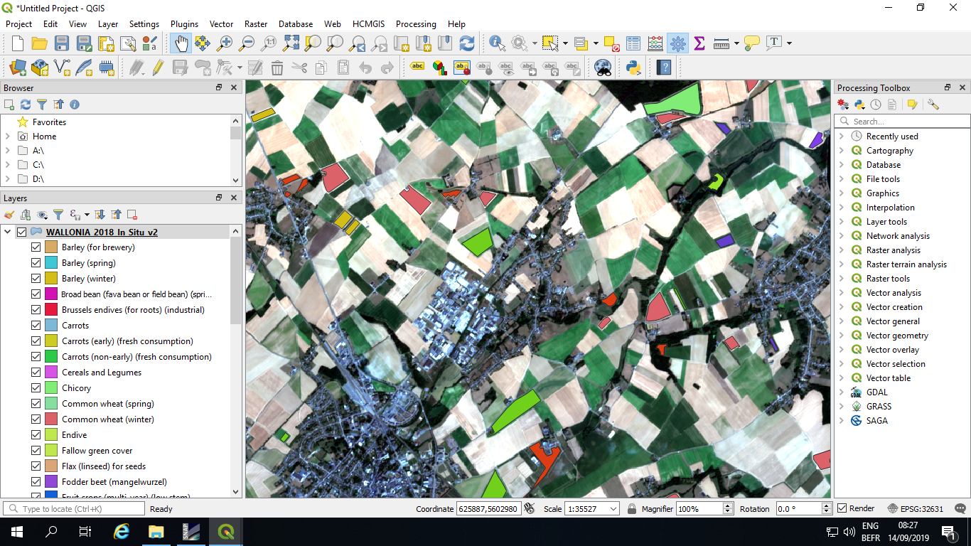
Crop mask with in situ data through Sen2-Agri (L4A)
Used for the crop mask
Used for the crop type
Overview of the in situ data

Slide 19
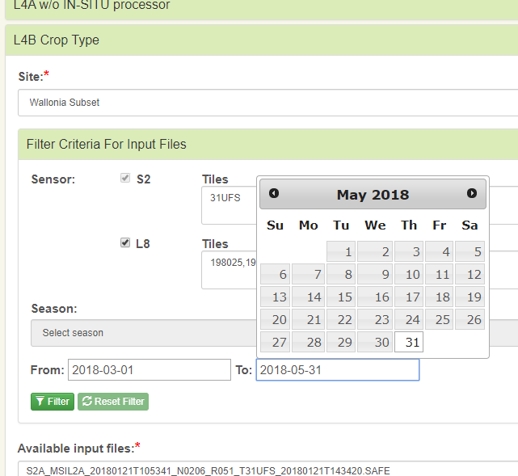
Launch a crop type map through Sen2-Agri (L4A)
Select your site = Wallonia Subset
Select your input L2A images
From 2018-03-01 To 2018-05-31
Filter
Highlight in blue from the list (all or selected ones)

Slide 20
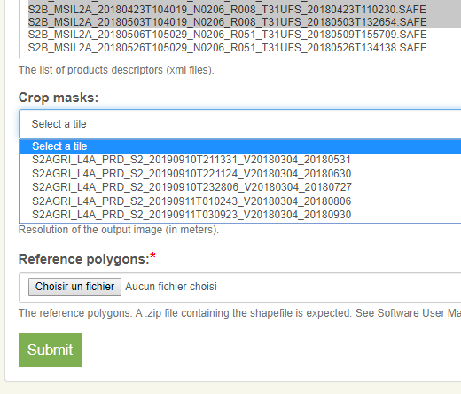
Launch a crop type map through Sen2-Agri (L4A)
Select the crop mask that you want to apply
We processed already several L4A crop masks, based on different periods
The crop mask is used to mask the non crop area of the processed crop type map but the two products are delivered (with and without the mask)
Upload in situ data
Submit your job

Slide 21
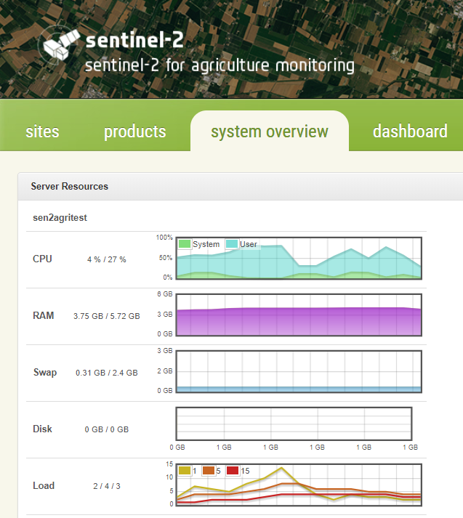
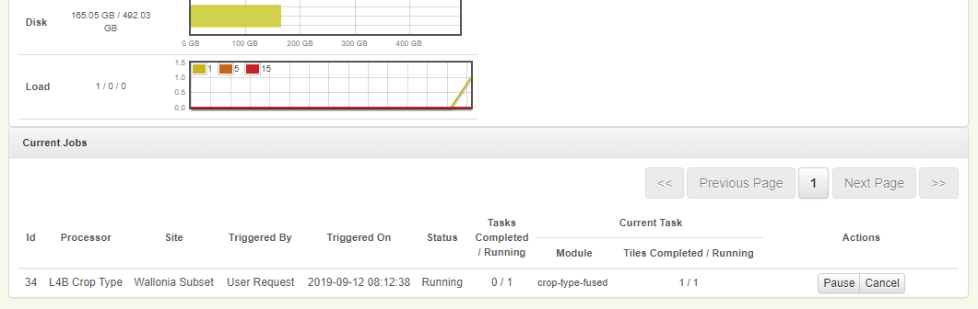
Process monitoring of your Sen2-Agri jobs
Go in the « system overview » tab
Check the IT ressources used by the system
Check the status of your running jobs

Slide 22
Training outline
Launch crop mask and crop type products through Sen2-Agri
Prepare in situ data
Understand the crop classification principles on SNAP
Explore the Sen2-Agri crop mask and crop type products

Slide 23
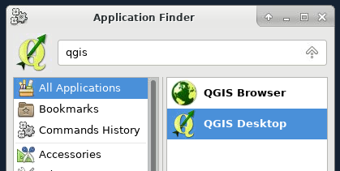
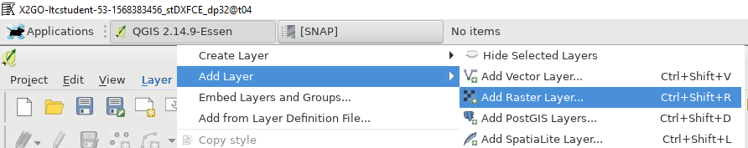
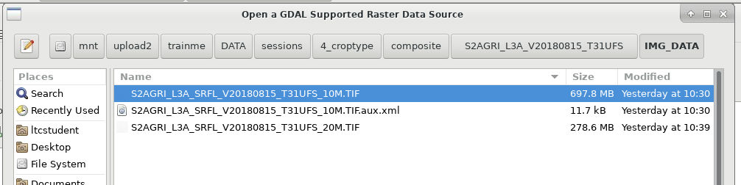
Display surface reflectance in the background
Open QGIS
Add a background surface reflectance image (composite image made of S2 data from August 2018 using Sen2-Agri)
1
2
3
/mnt/upload2/trainme/DATA/sessions/4_croptype/composite/*/IMG_DATA

Slide 24
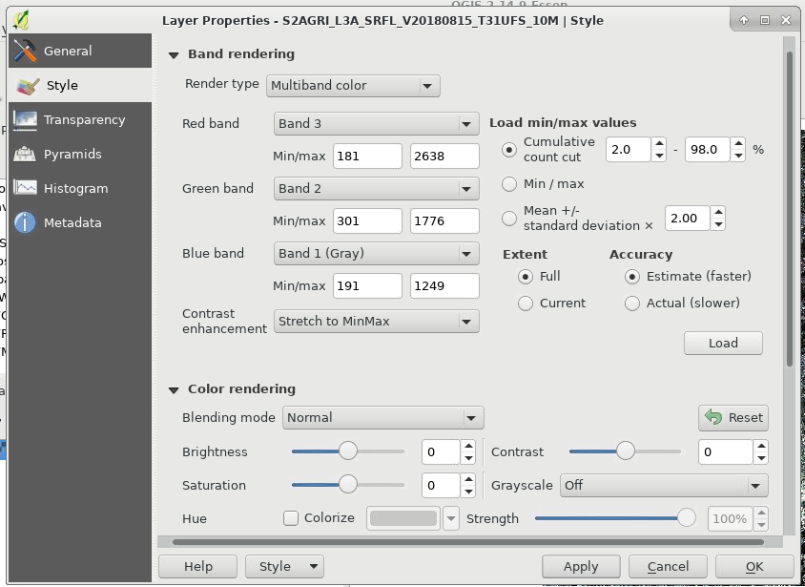
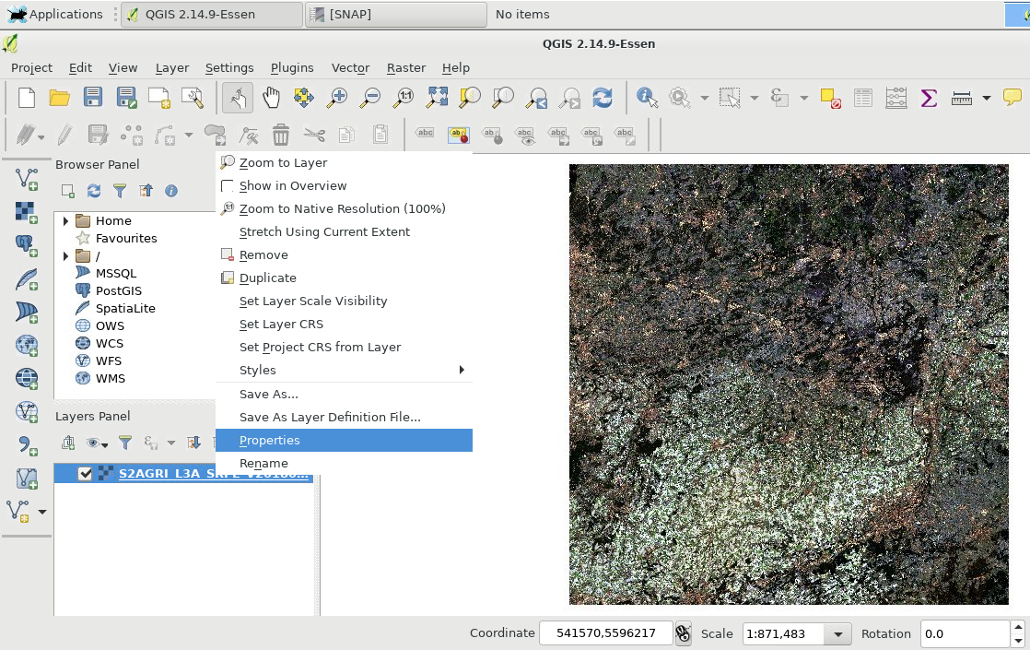

Display surface reflectance in the background
Right-click on the layer -> Properties
Set the right bands
1 = Blue
2 = Green
3 = Red
4 = NIR
Load the min-max values calculation -> for the contrast
Apply

Slide 25
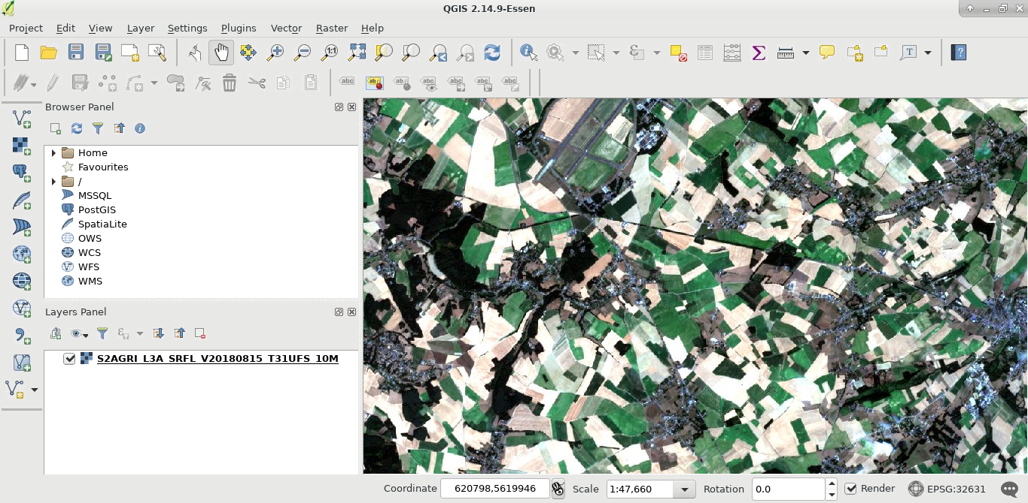
Display surface reflectance in the background
Explore the layer

Slide 26

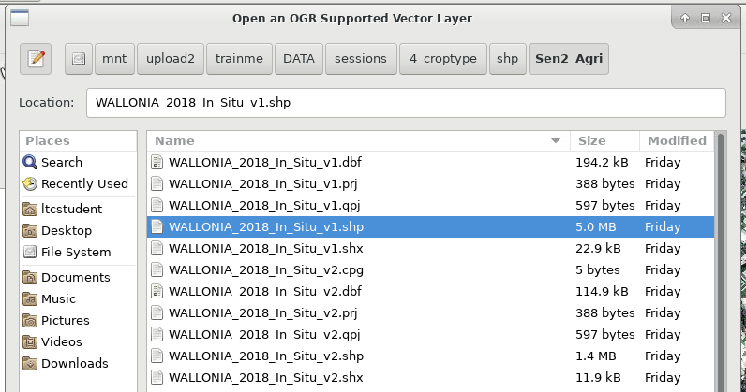
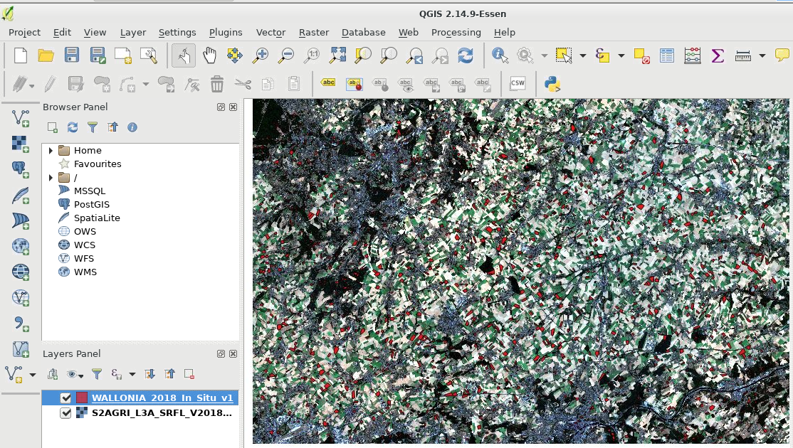
Display original in situ dataset
Add the original crop parcel (and non crop) layer

Slide 27
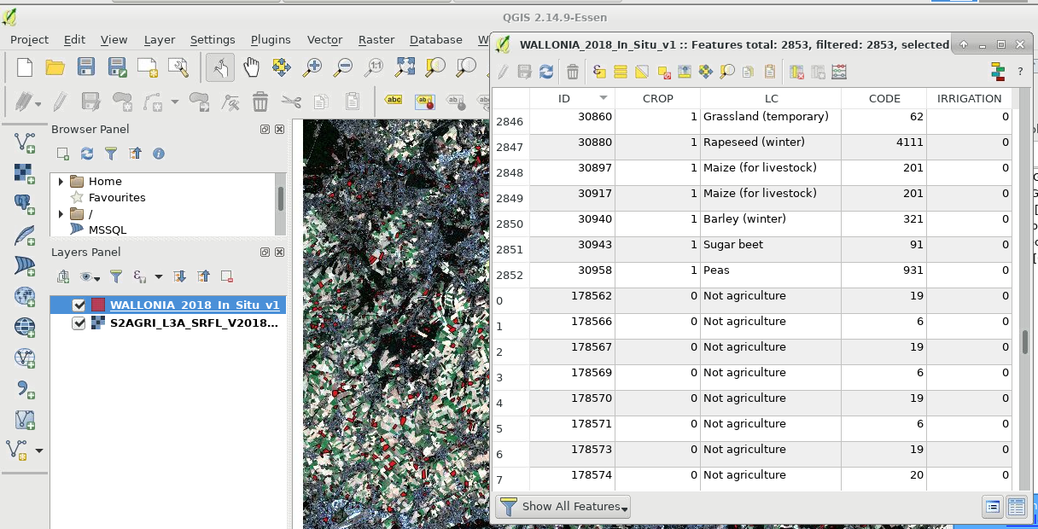
Display original in situ dataset
Used for the crop mask
Used for the crop type
Needed attributes for Sen2-Agri

Slide 28
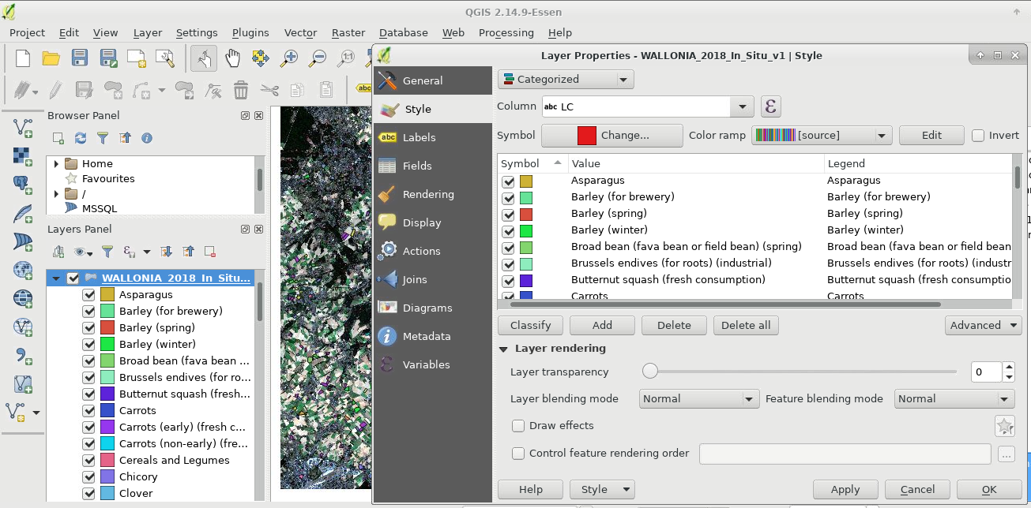
Display original in situ dataset
Display the LC class of the in situ

Slide 29
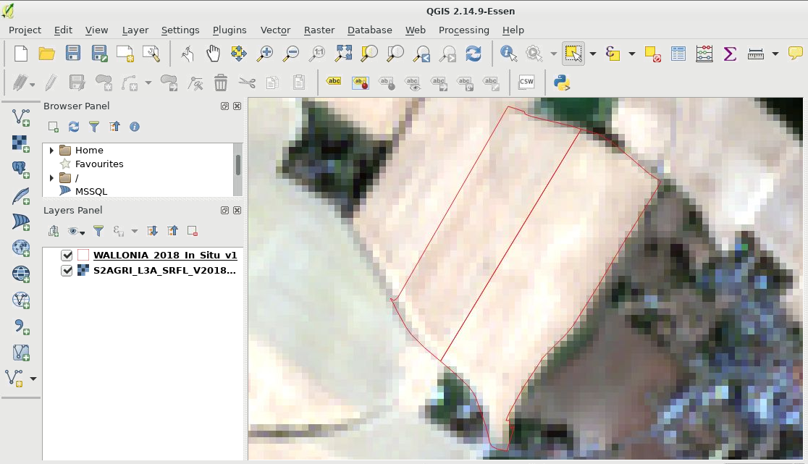
Prepare the final in situ dataset
Mixed pixels at the borders of the parcels
-> Apply a 15m inner buffer

Slide 30
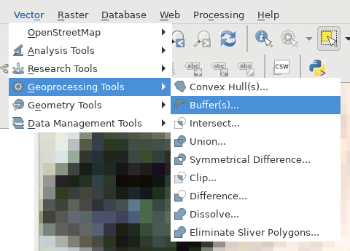
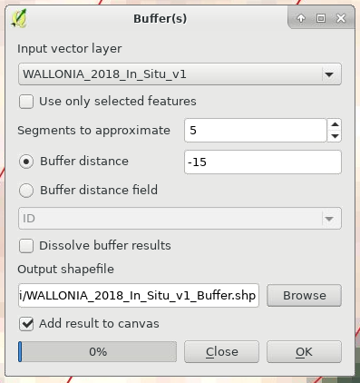
15m inner buffer of the in situ dataset
Vector -> Geoprocessing tools -> Buffer
Set parameters

Slide 31
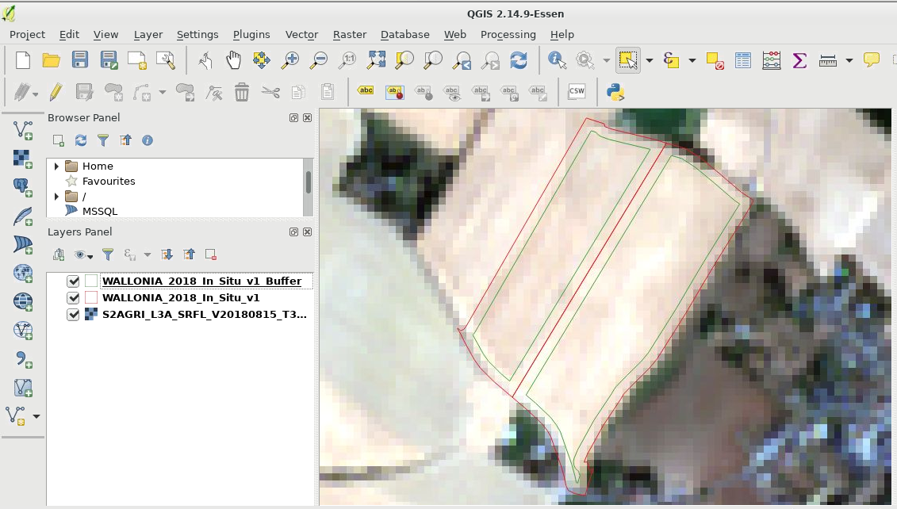
15m inner buffer of the in situ dataset
Results

Slide 32
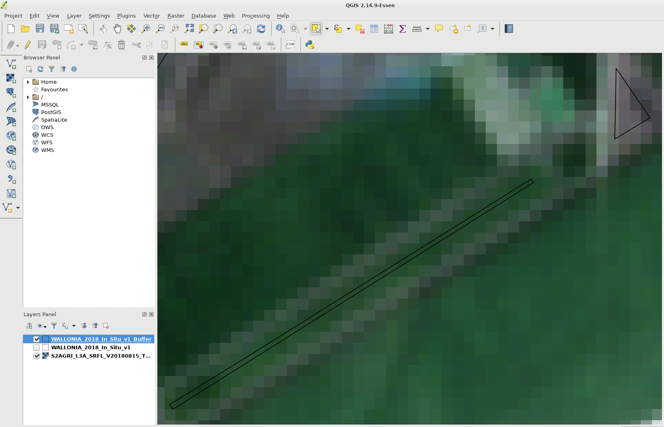
Prepare the final in situ dataset
Small parcels
subject to heterogeneity
don’t contain much information
-> Select only parcels > 5000 m² (0,5 ha)

Slide 33
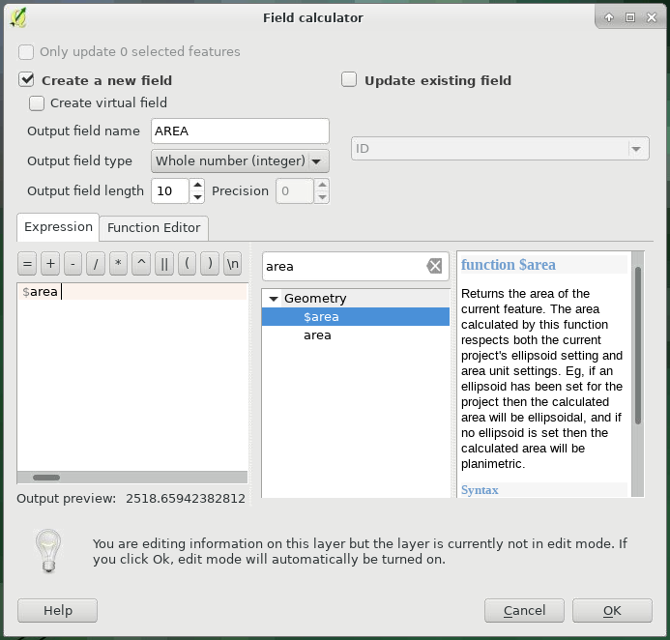
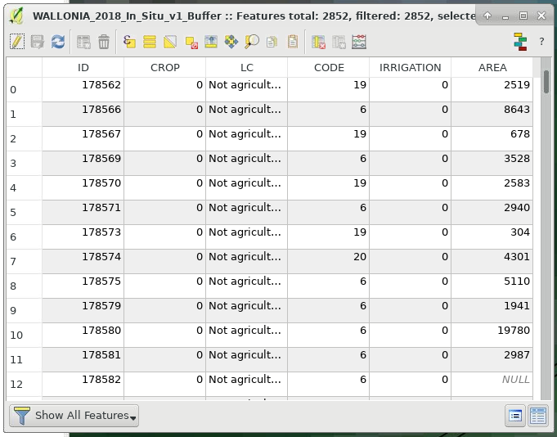
Calculate AREA
Field calculator
Create a new field AREA
Save the changes by going out of editing mode

Slide 34
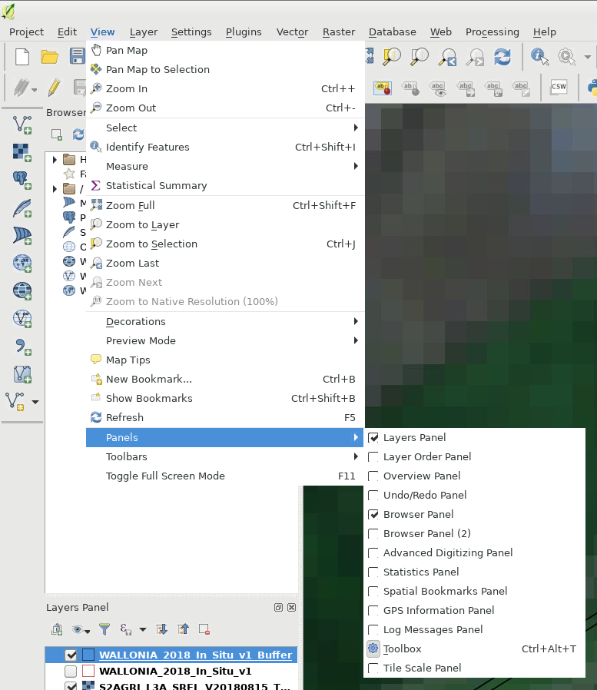
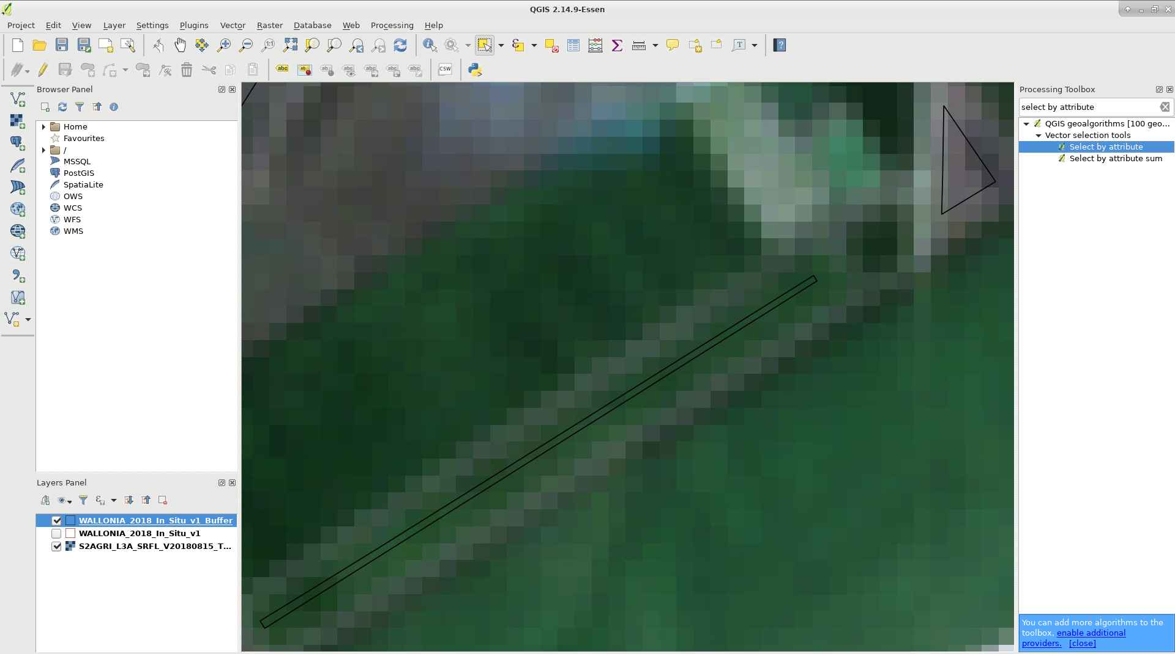
Select the big (enough) parcels and export
Display the processing toolbox
Search for « Select by attribute »

Slide 35
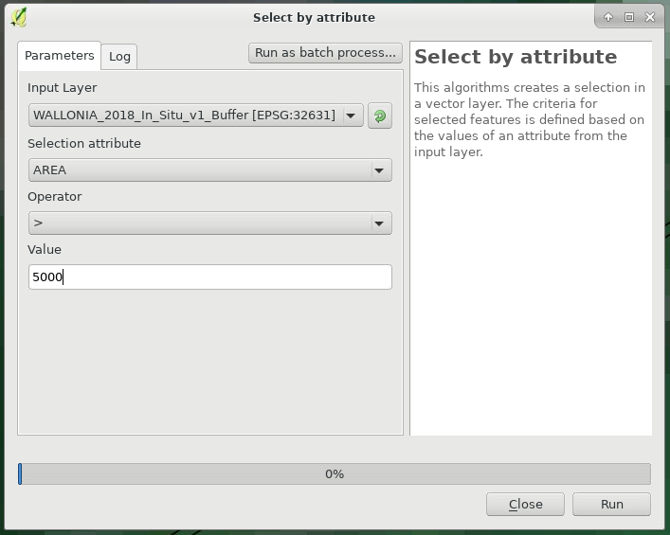
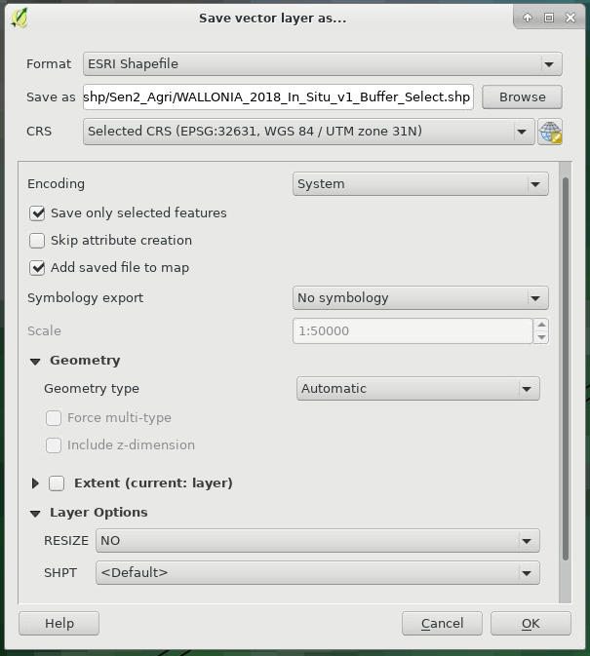
Select the big (enough) parcels and export
Select parcels with AREA > 5000 m²
Export
Right-click on the layer
Save as…
Save only selected features

Slide 36
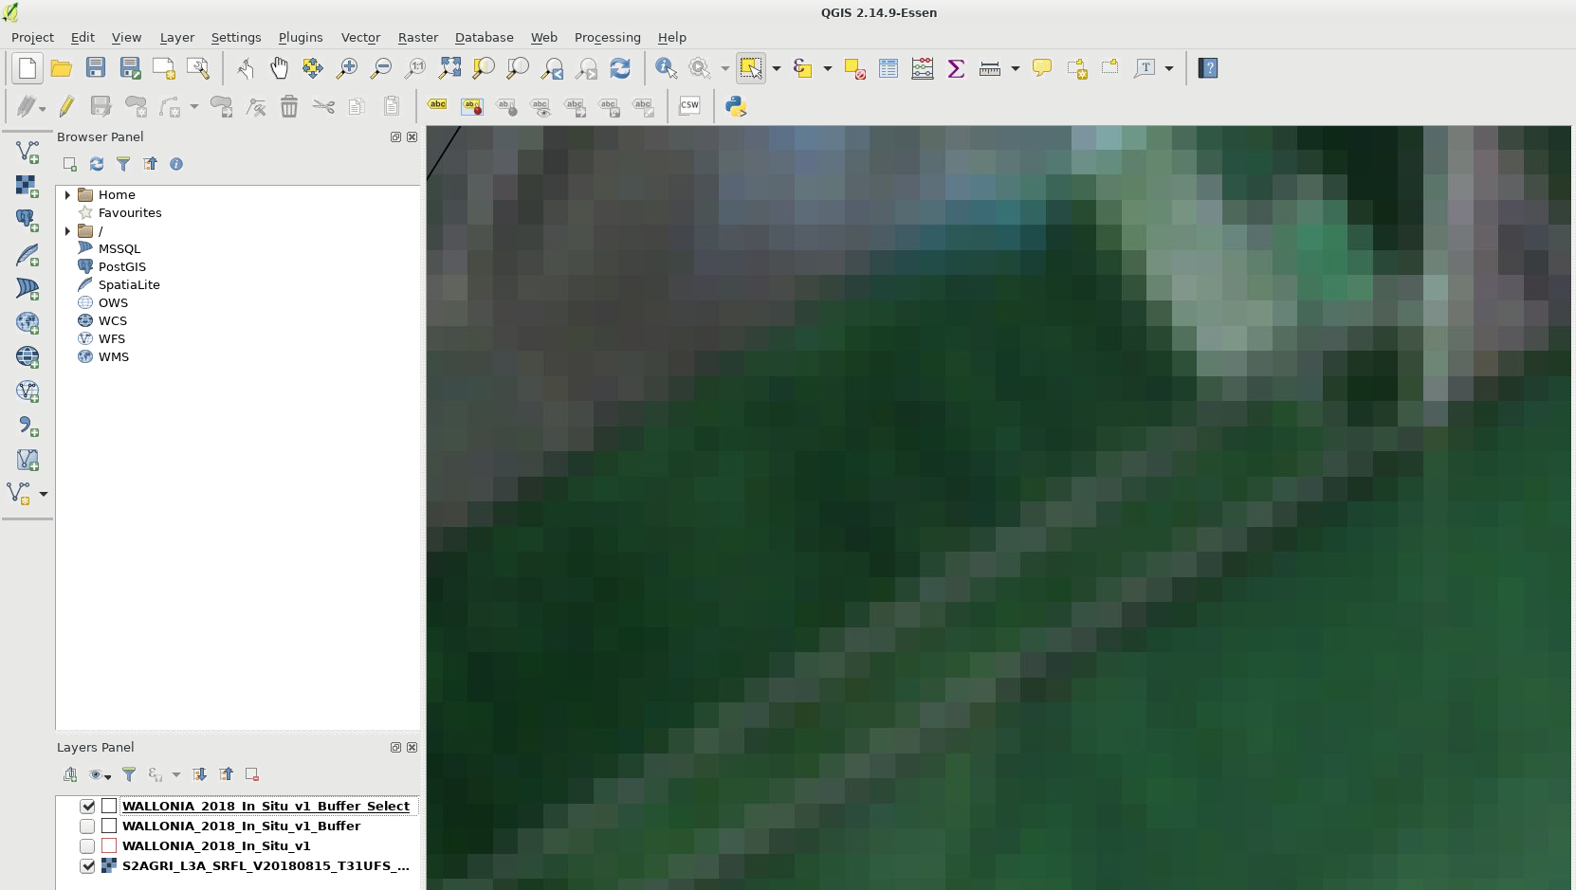
Prepare the final in situ dataset
Zip the generated shp in a folder
-> ready to be used in Sen-Agri!

Slide 37
Training outline
Launch crop mask and crop type products through Sen2-Agri
Prepare in situ data
Understand the crop classification principles on SNAP
Explore the Sen2-Agri crop mask and crop type products

Slide 38

Understand the crop classification principles on SNAP
A series of multiband layers have been processed in: /mnt/upload2/trainme/DATA/subset/multiband
S2_L2A:
  9 dates
  5 bands
Band_1= green (B3)
Band_2= red (B4)
Band_3= red-edge (B5)
Band_4= NIR (B8)
Band_5= SWIR (B11)

Slide 39

Understand the crop classification principles on SNAP
A series of multiband layers have been processed in: /mnt/upload2/trainme/DATA/subset/multiband
S2_L2A
S2_L2A_obj:
  S2_L2A aggregated by parcel (mean)
S1_coherence:
  Weekly coherence values VV and VH from Apr to Sept 2018
  + aggregated by parcel (mean)

Slide 40

Understand the crop classification principles on SNAP
Open SNAP7 from the desktop
Open a S2_L2A multiband image from July
Display a false-color IR image (4-2-1) from it
/mnt/upload2/trainme/DATA/subset/multiband/S2_L2A/S2A_20180727_sub1

Slide 41



Understand the crop classification principles on SNAP
Add in situ data to the layer: vector layers of samples in the different crop types
+ non crop samples: Urban, Forest and Water
/mnt/upload2/trainme/DATA/sessions/4_croptype/shp/SNAP/*
Add all classes
For all classes

Slide 42



Understand the crop classification principles on SNAP
Perform a RF classification (100 trees, 25 samples by class)
Add the layer

Slide 43

Understand the crop classification principles on SNAP
Perform a RF classification (100 trees, 25 samples by class)
Set the parameters
Select the LC classes and input bands

Slide 44

Understand the crop classification principles on SNAP
Perform a RF classification (100 trees, 25 samples by class)
Set the parameters
Select the LC classes and input bands
Save the generated layer
Run

Slide 45


Understand the crop classification principles on SNAP
Explore the output txt file
Display the generated layer

Slide 46
To go further
S2 L2A (per-pixel data): /mnt/upload2/trainme/DATA/subset/multiband/S2_L2A/*
-> test other configurations: bands, another date, RF parameters (trees and number of samples by class)
S2 L2A aggregated by object: /mnt/upload2/trainme/DATA/subset/multiband/S2_L2A_obj/*
-> test different configurations
S1 coherence aggregated by object: /mnt/upload2/trainme/DATA/subset/multiband/S1_coherence/S1_coh_OBJ_AprSep2018_Sub1.tif
-> test different configurations
Compare the results using the different datasets

Slide 47
Training outline
Launch crop mask and crop type products through Sen2-Agri
Prepare in situ data
Understand the crop classification principles on SNAP
Explore the Sen2-Agri crop mask and crop type products

Slide 48


Let’s explore the crop mask products
We processed already several versions of the crop masks, with different monitoring period
Always the same structure of the Sen2-Agri products

Slide 49

Let’s explore the crop mask products
Let’s explore them on QGIS
Sen2-Agri Common Structure and Naming convention

Slide 50


Let’s explore the crop mask products
Add a crop mask product: /mnt/archive/wallonia_subset/l4a/*/TILES/*/IMG_DATA/
Add the corresponding quality layer: /mnt/archive/wallonia_subset/l4a/*/TILES/*/QI_DATA/

Slide 51


Let’s explore the crop mask products
Apply the predefined symbology to the crop mask
Layer properties
Style: Load style…
Upload qml file

Slide 52

Let’s explore the crop mask products
Explore the layer

Slide 53


Let’s explore the crop mask products
Explore the quality file
Layer properties
Display the different bands

Slide 54

Let’s explore the crop mask products
List of input images
Algorithm parameters

Slide 55

Let’s explore the crop mask products
Confusion matrix
Accuracy metrics:
Precision, Recall and F-Score of the individual classes
Overall Accuracy and Kappa of the classification

Slide 56

To go further
Display the different crop masks corresponding to the different monitoring periods
Compare them visually and in terms of Overall Accuracy

Slide 57


Let’s explore the crop type products
We processed already 2 crop type maps: end of May and end of August
The same structure as the crop mask

Slide 58


Let’s explore the crop type products
On QGIS: Add a crop type product: /mnt/archive/wallonia_subset/l4b/*/TILES/*/IMG_DATA/
Apply the predefined symbology to the crop type map: /mnt/upload2/trainme/DATA/sessions/4_croptype/qml/
Layer properties
Style: Load style…
Upload qml style

Slide 59

Let’s explore the crop type products
Explore the layer

Slide 60
To go further
Display the 2 crop type maps: end of May and end of August
Compare them visually and in terms of Overall Accuracy
Check the F-Score of the main crop types

