Slide 1
Biophysical variables retrieval and time series smoothing
Martin Claverie, UCLouvain-Geomatics
Marie Weiss, INRA Avignon
Philippe Malcorps, UCLouvain-Geomatics

Slide 2

Overall Objectives of the training
Generate Biophysical Variables products from Sentinel-2 data using neural network algorithms implemented in SNAP and Sen2-Agri
Analyze the temporal dimension of the LAI time series, focussing on crop land
Apply a simple empirical algorithm to model the LAI trajectory through time
Apply an interpolator method (spline) and a smoothing method (savitzky golay)
Run a simple validation plan
The training is based on :
Jupyter notebook, providing all instructions
SNAP
Sen2-Agri
Python 3 is used for coding

Slide 3
Training Content
Part 1: Generate LAI image using SNAP
Part 2: Generate LAI time series using Sen2Agri
Part 3: Derive LAI Time Series per field
3.0. Vizualize the Input data using QGIS
3.1. Import and generic functions definition
3.2. Import of the crop field shapefile
3.3. Open and display one LAI product
3.4. Zonal Statistics
Part 4: Analyse the LAI time-series
4.1. Introducing the CSDM
4.2. Analyze one LAI time-series
4.3. Introducing two other LAI interpolators
4.4. Run CSDM and interpolators on all fields
4.5. Run CSDM per crop type
Part 5: LAI Validation

Slide 4
SENTINEL2 ALGORITHM (SNAP/SEN2-AGRI)
NEURAL NETS TRAINED ON 1D SIMULATIONS
RTM= PROSAIL model
1D – Turbid medium
Inputs (20m)
Reflectances + geometry (cosine)
Acronym | Central (nm) | Width (nm) | Spatial resolution (m)
B3 | 560 | 35 | 10
B4 | 665 | 30 | 10
B5 | 705 | 15 | 20
B6 | 740 | 15 | 20
B7 | 783 | 20 | 20
B8a | 865 | 20 | 20
B11 | 1610 | 90 | 20
B12 | 2190 | 180 | 20
Biophysical Variables: GAI, fAPAR, fCover
Canopy Chlorophyll Content, Canopy Water Content

Slide 5
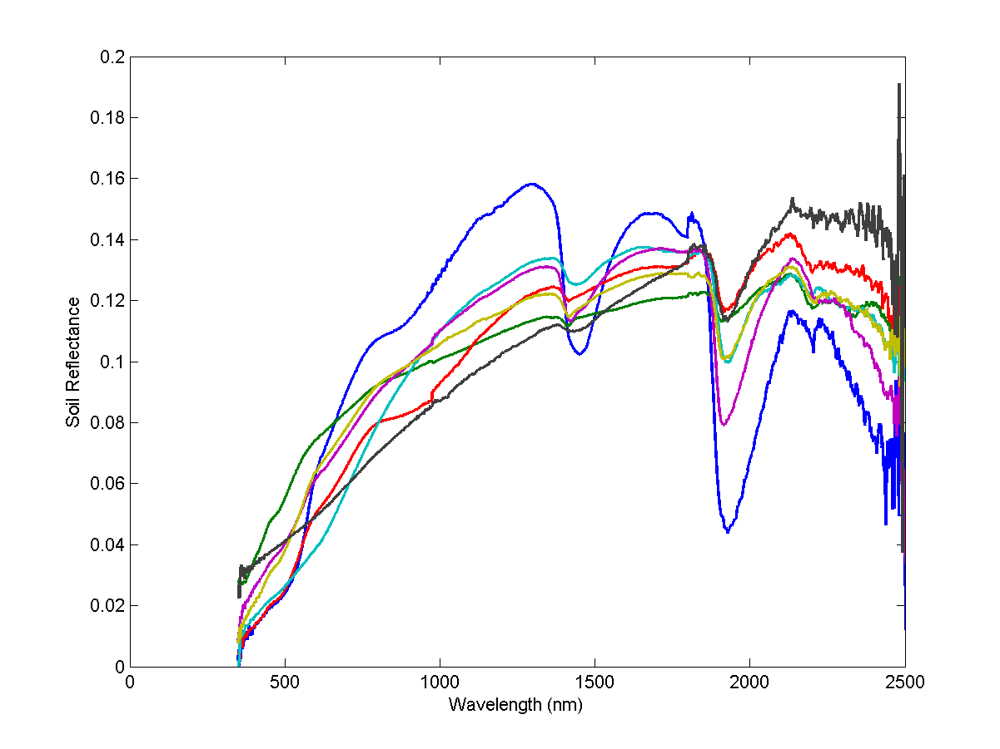
SENTINEL2 ALGORITHM (SNAP/SEN2-AGRI)
Composition of the training dataset
Soil Background: 7 reference spectra & Brightness index
GAI, Inclination, Leaf Optical properties:
distribution parameters taken from littérature
Co-distribution based on a simple assumption (saturation)

Slide 6
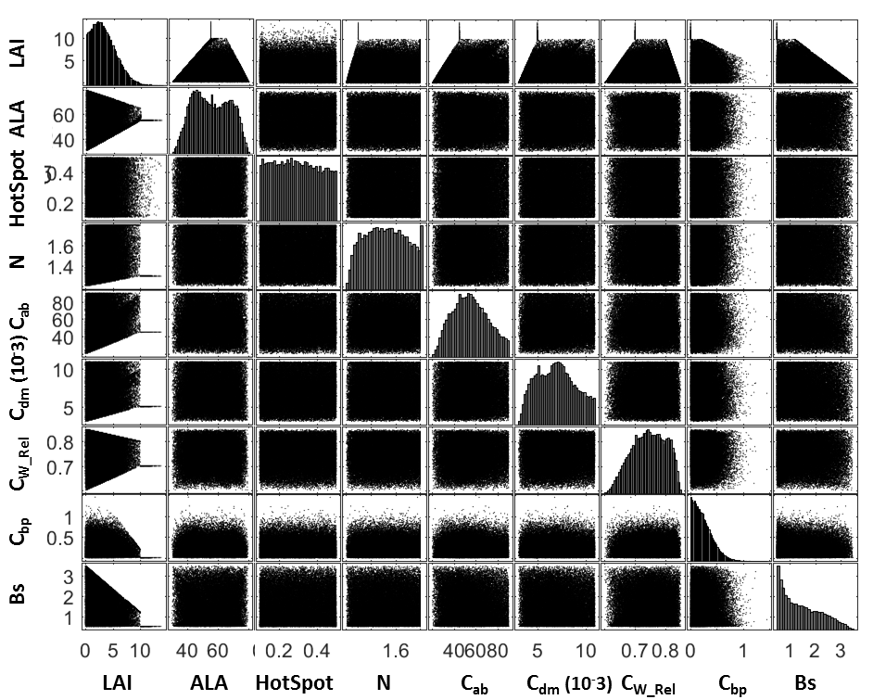

Slide 7
Flag Meaning
Definition Domain
Adequation with the training dataset
Output out of range
Is the estimated product in the range
of the training data set
Input 2
2)
Inuput
0
0
1
0
0
0
0
0
0
0
0
0
1
0
0
0
0
0
0
0
Max(
0
1
1
0
0
0
0
0
0
0
0
1
1
1
0
0
0
0
1
1
0
1
1
1
1
0
0
1
1
1
0
1
1
1
1
1
1
1
1
1
0
1
1
1
1
1
1
1
0
0
0
1
1
1
1
1
1
0
0
0
2)
0
1
1
1
1
1
1
0
0
0
1
1
1
0
0
0
0
0
0
0
Inuput
Min(
Inuput
1)
Max (
Inuput
1)
Min(
Input 1

Slide 8
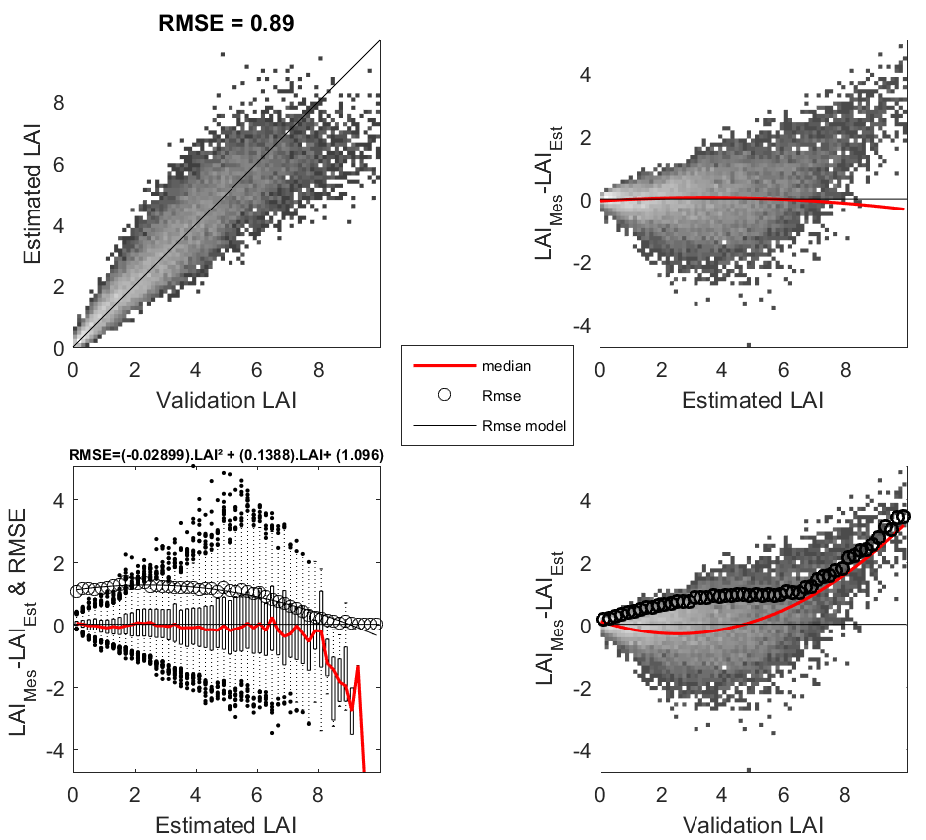
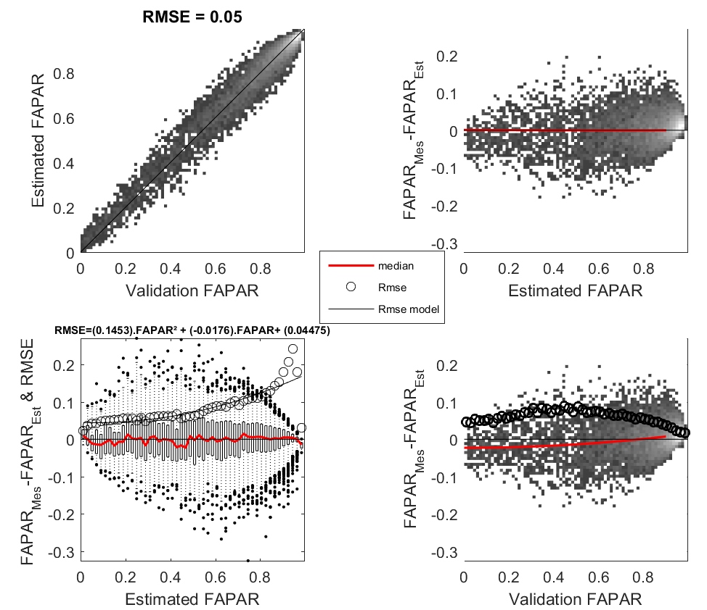
Theoretical performances
Pseudo-independent database, still simulated with SAIL

Slide 9
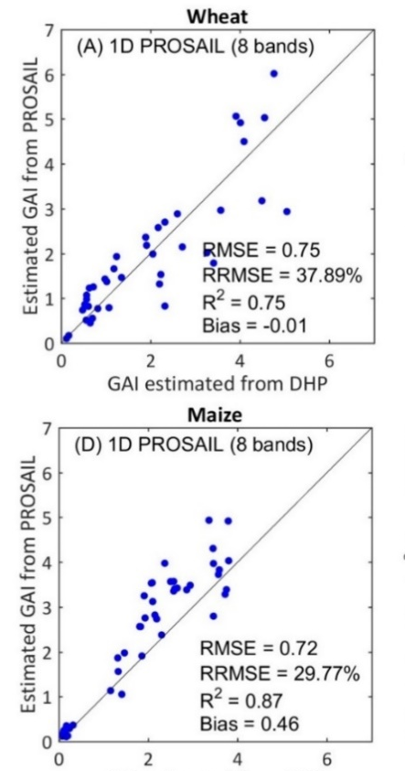
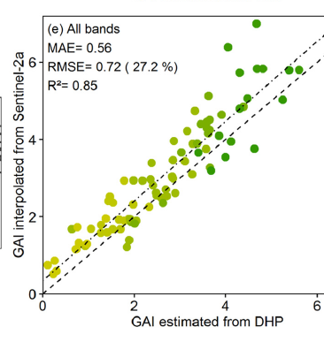
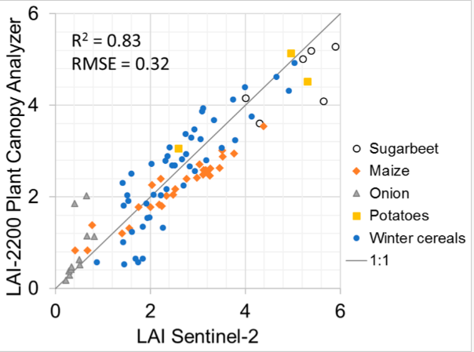
Validation against measurements (GAI)
wheat
From Delloye et al, RSE, 2018
From Vuolo et al, RS, 2016
From Jiang et al, in prep

Slide 10
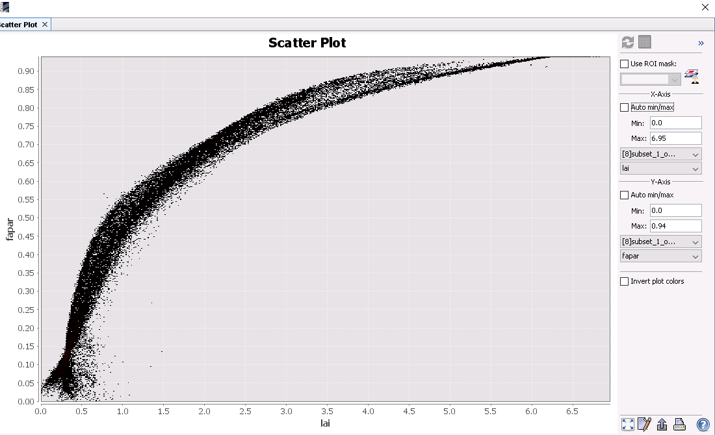
3.3. Import of the crop field shapefile

Slide 11
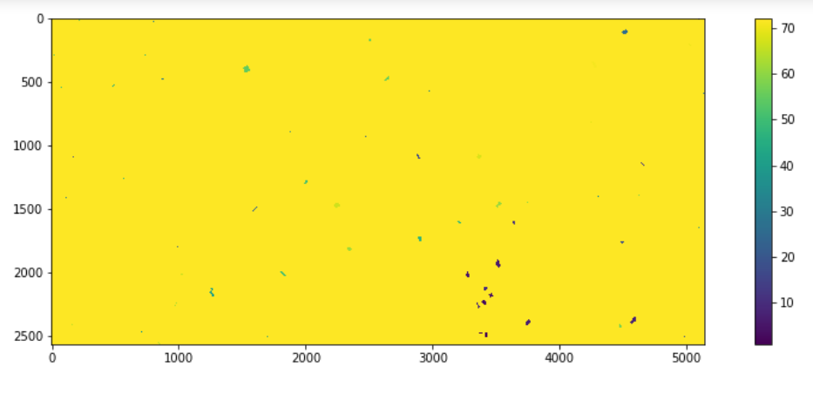
3.3. Import of the crop field shapefile

Slide 12
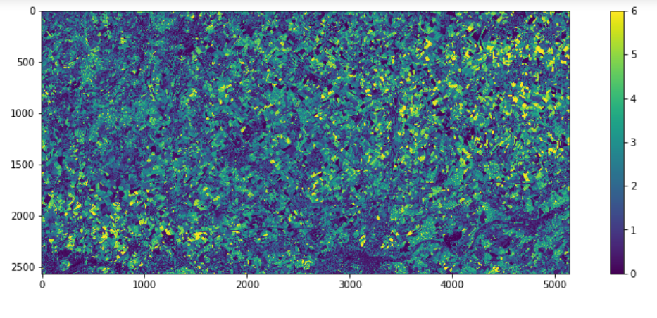
3.4. Open and display one LAI product

Slide 13
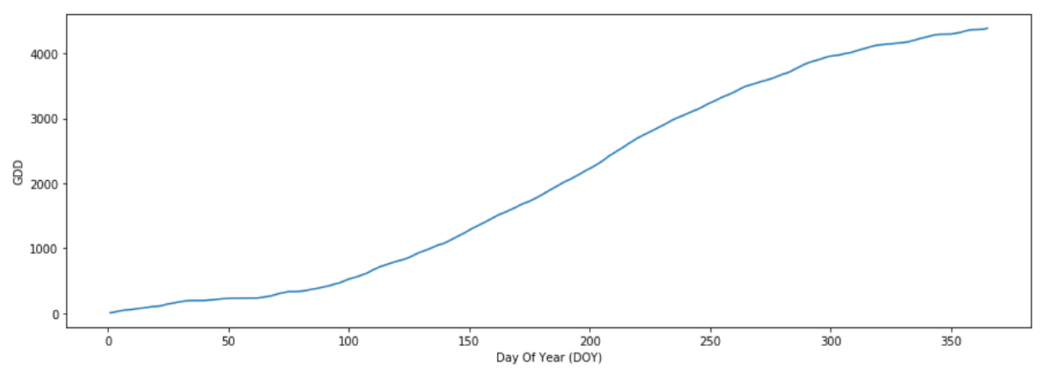
4.1. Introducing the CSDM

Slide 14
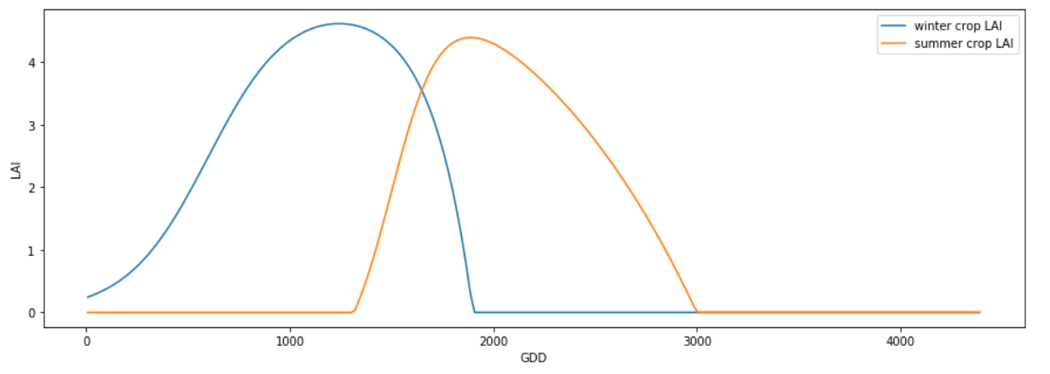
4.1. Introducing the CSDM

Slide 15
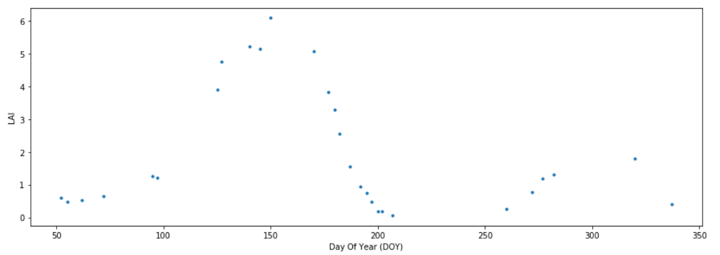
4.2 Analyze one LAI time-series

Slide 16
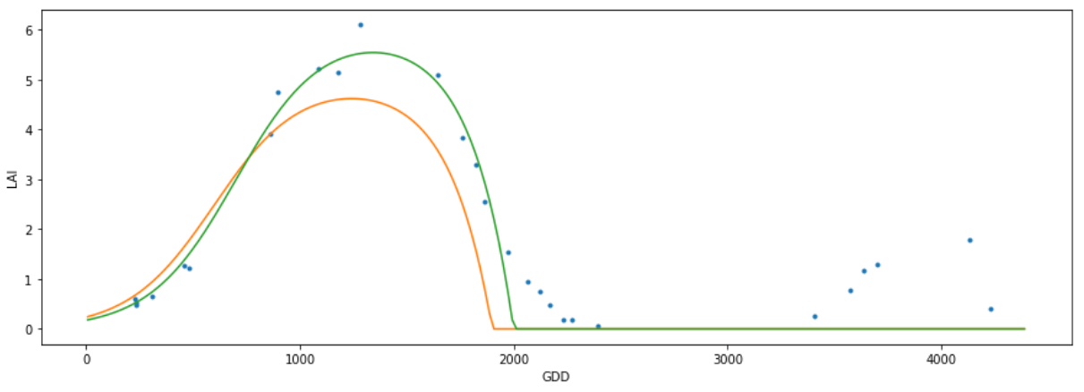
4.2 Analyze one LAI time-series

Slide 17
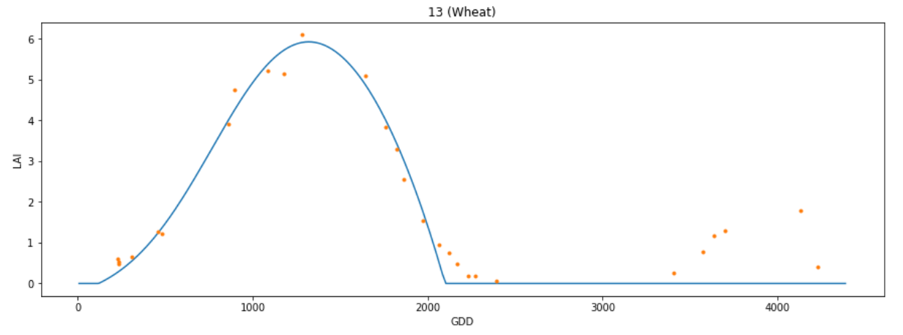
4.2 Analyze one LAI time-series

Slide 18
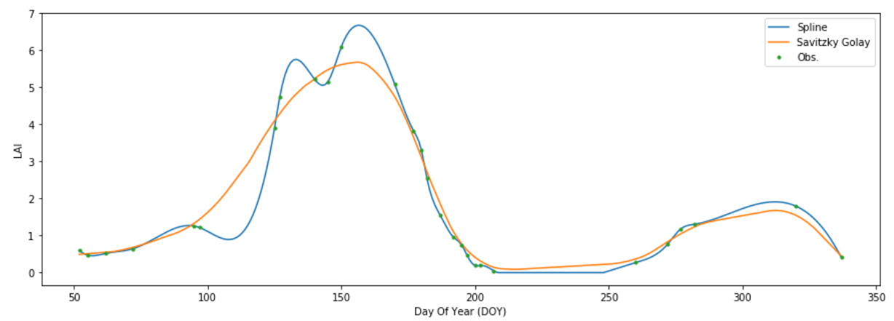
4.3. Introducing two other LAI interpolators

Slide 19
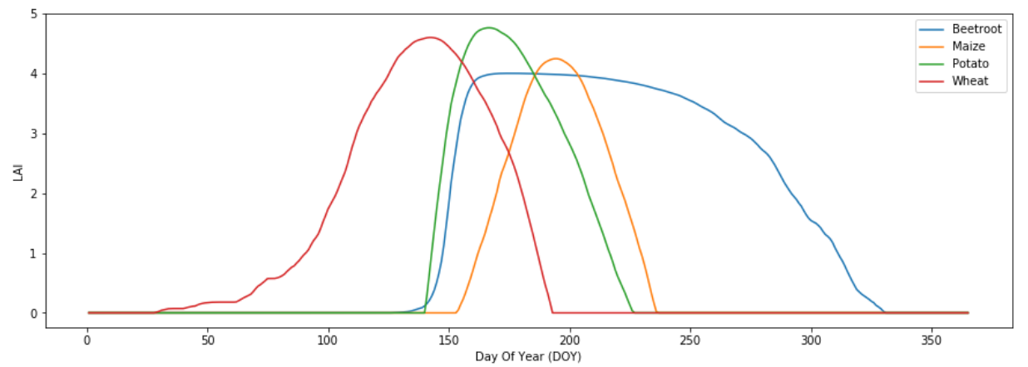
4.5. [Extra] Run CSDM per crop type

Slide 20
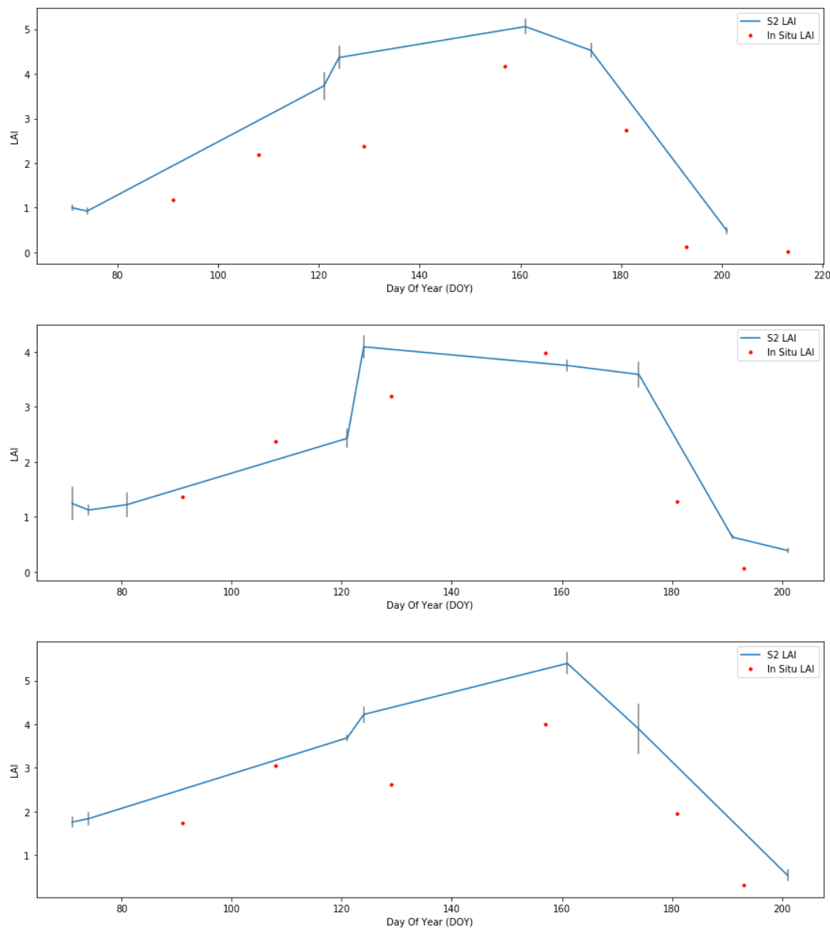
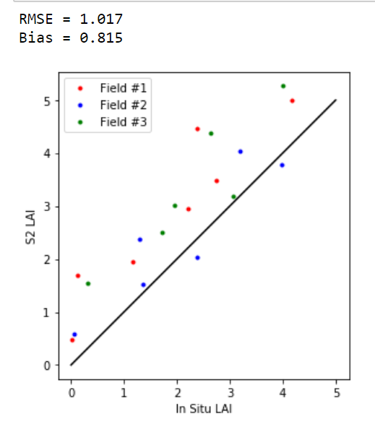
Part 5: LAI Validation

