Slide 1

Practical on cloud computing (Virtual Machine) for Sen2Agri installation and processing
C. Cara (CS ROMANIA), C. Udroiu (CS ROMANIA), T. De Maet (UCL)

Slide 2
Outline
System overview (5 min)
System installation (20 min)
User interface overview (5 min)
EO data source configuration (15 min)
Create a site and define a season (15 min)
Manual execution: L3A processor (10 min)
Inspect advanced parameters (10 min)
Output handling (5 min)

Slide 3
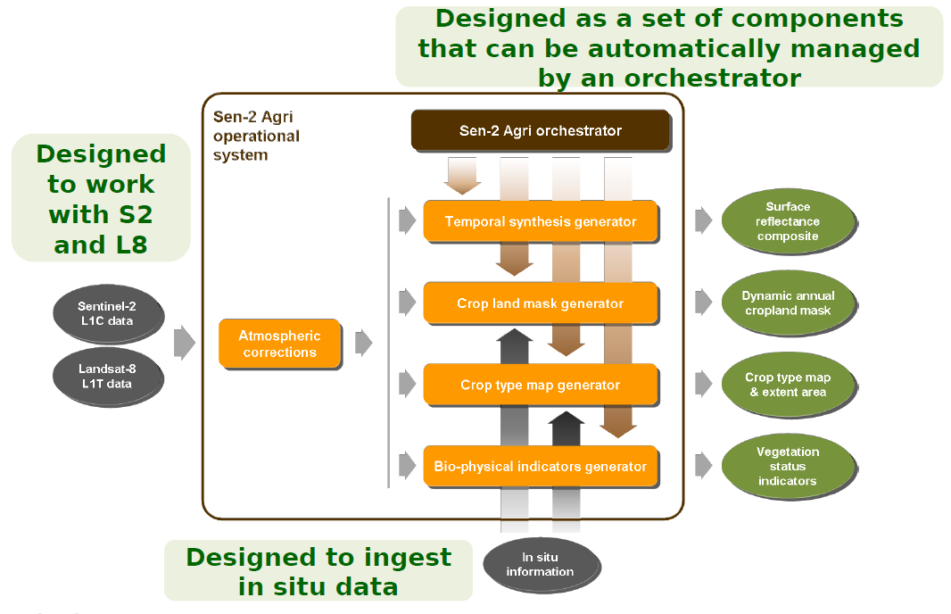
System Overview

Slide 4




System Overview
Free open source software
4 types of products
  Cloud-free surface reflectance composite
  Vegetation status
  Dynamic cropland mask
  Cultivated crop type map
2 operation modes
  Automatic
  Manual
Based on Orfeo ToolBox
Cluster-ready architecture for distributed processing
Integration with Sentinel-2 ToolBox
Source code: https://github.com/sen2agri/

Slide 5
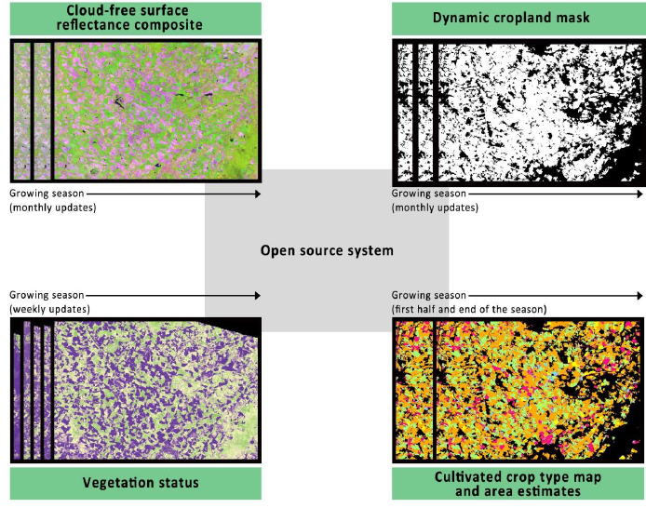
System Overview
Free open source software
4 types of products
  Cloud-free surface reflectance composite
  Vegetation status
  Dynamic cropland mask
  Cultivated crop type map
2 operation modes
  Automatic
  Manual

Slide 6
System Overview
Free open source software
4 types of products
  Cloud-free surface reflectance composite
  Vegetation status
  Dynamic cropland mask
  Cultivated crop type map
2 operation modes
  Automatic
  Manual
Automated Mode (near real-time)
  Automatic data flow
  Processing driven by new products availability
  Automated (scheduled) downloads for
  S2A L1C (only needed granules) and L8 L1T
Manual Mode (on-demand)
  Processing triggered by user requests
  Data processed in one run

Slide 7
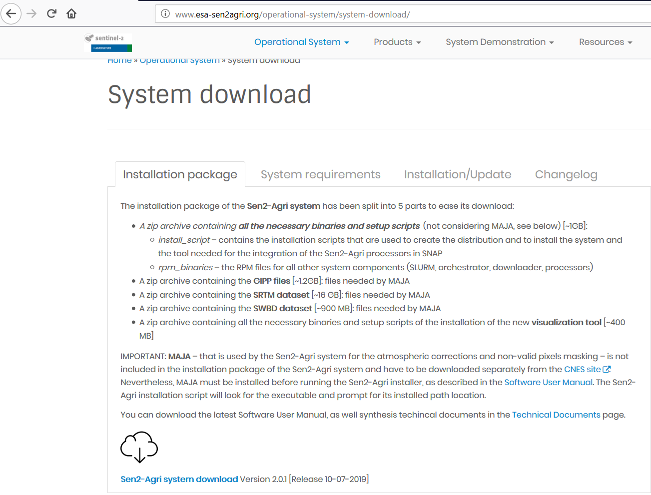
System Installation
Step 1: Download the system
Go to http://www.esa-sen2agri.org/operational-system/system-download/

Slide 8
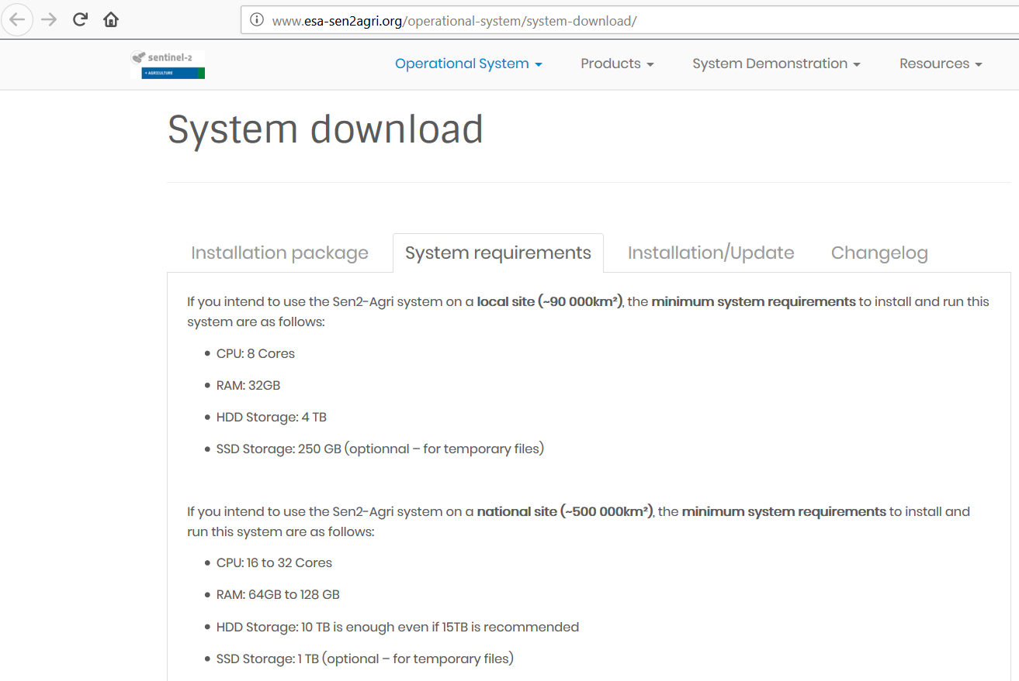
System Installation
Step 1: Download the system
Go to http://www.esa-sen2agri.org/operational-system/system-download/
Read carefully the “System requirements”
section to dimension your hardware

Slide 9
System Installation
Hardware Requirements
 | Small Site | Large Site
Area | 90,000 km² | 500,000 km²
Sentinel-2 coverage | 9 tiles | 50 tiles
Landsat-8 coverage | 4 scenes | 16 scenes
Season duration | 10 months | 10 months
Storage | 4 TB – 8 TB | 10 – 15 TB
CPU | 8 cores | 16 cores
RAM | 32 GB | 64 GB – 128 GB

Slide 10
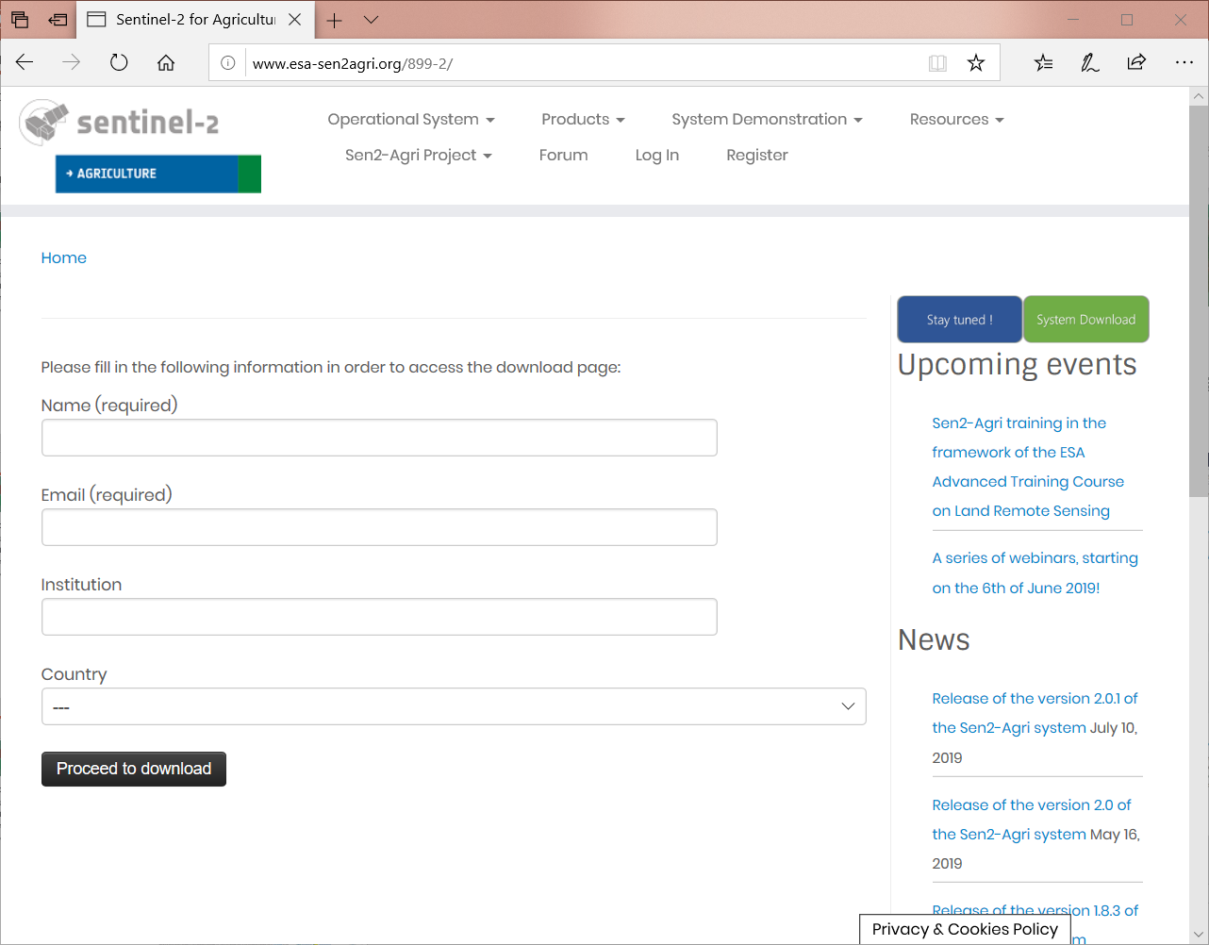
System Installation
Step 1: Download the system
Go to http://www.esa-sen2agri.org/operational-system/system-download/
Read carefully the “System requirements”
section to dimension your hardware
Fill in some information about yourself

Slide 11
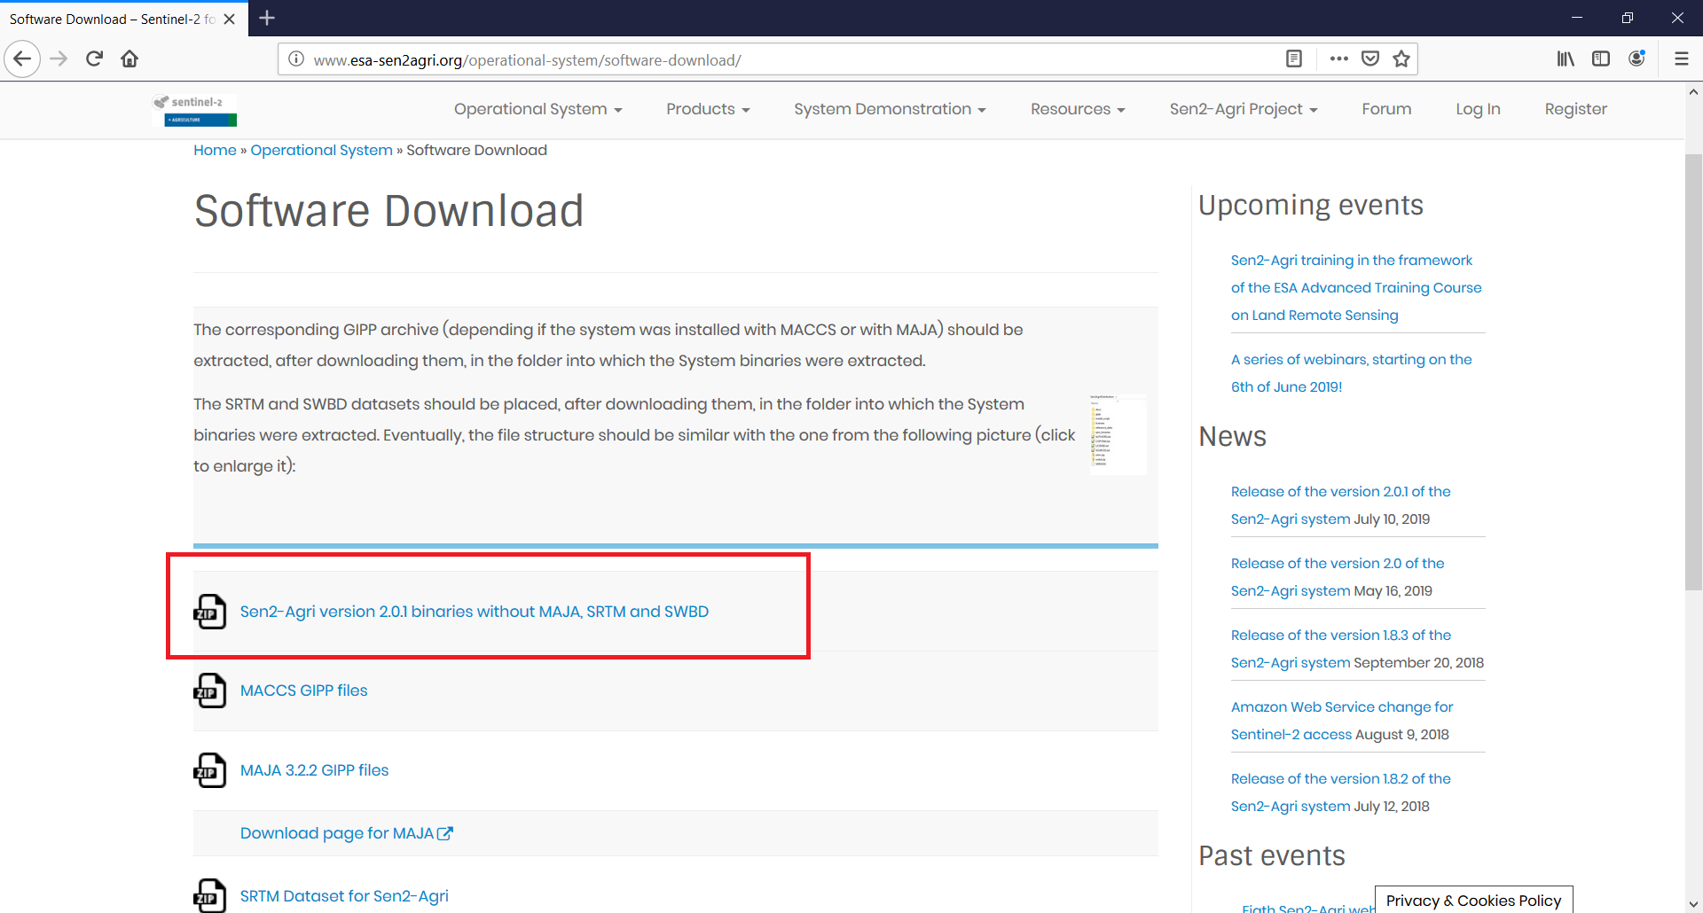
System Installation
Step 1: Download the system
Go to http://www.esa-sen2agri.org/operational-system/system-download/
Read carefully the “System requirements”
section to dimension your hardware
Fill in some information about yourself
Download the system installation package

Slide 12
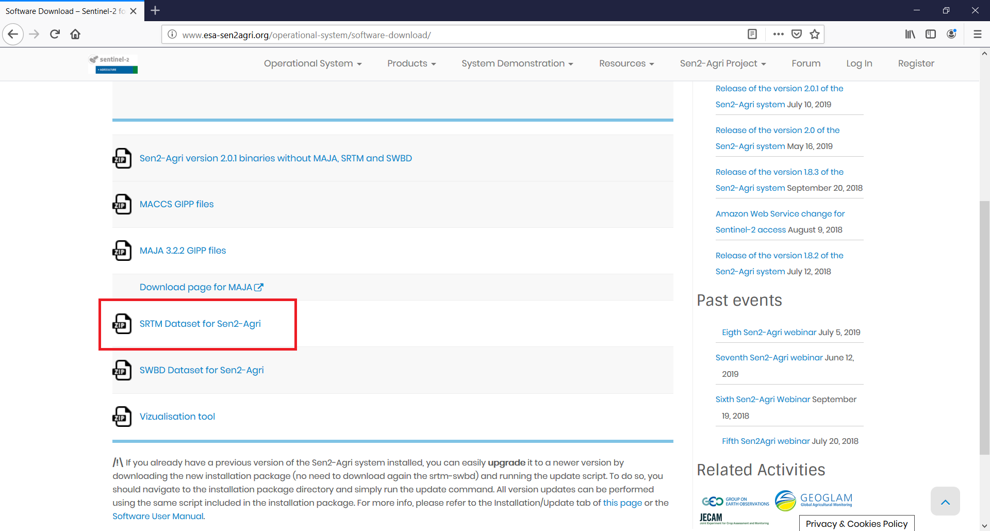
System Installation
Step 1: Download the system
Go to http://www.esa-sen2agri.org/operational-system/system-download/
Read carefully the “System requirements”
section to dimension your hardware
Fill in some information about yourself
Download the system installation package
Download the SRTM dataset

Slide 13
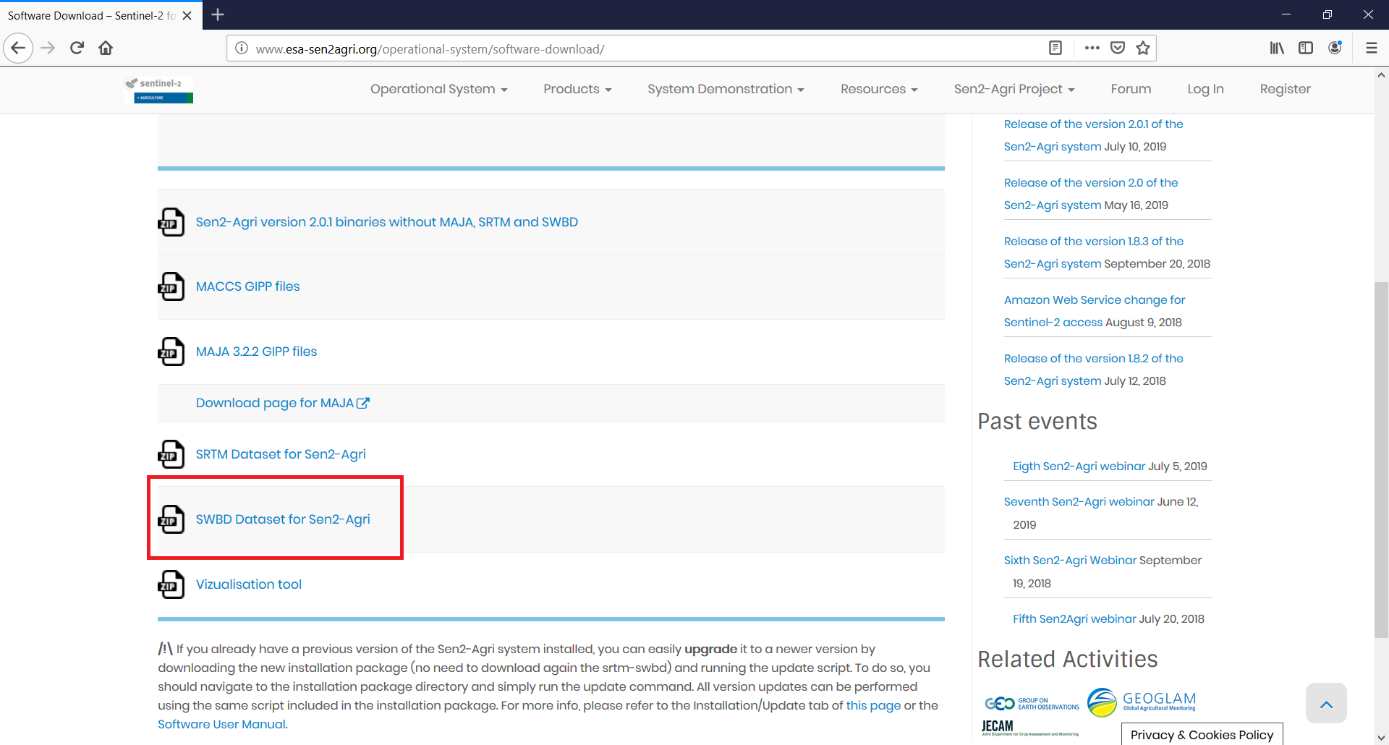
System Installation
Step 1: Download the system
Go to http://www.esa-sen2agri.org/operational-system/system-download/
Read carefully the “System requirements”
section to dimension your hardware
Fill in some information about yourself
Download the system installation package
Download the SRTM dataset
Download the SWBD dataset

Slide 14
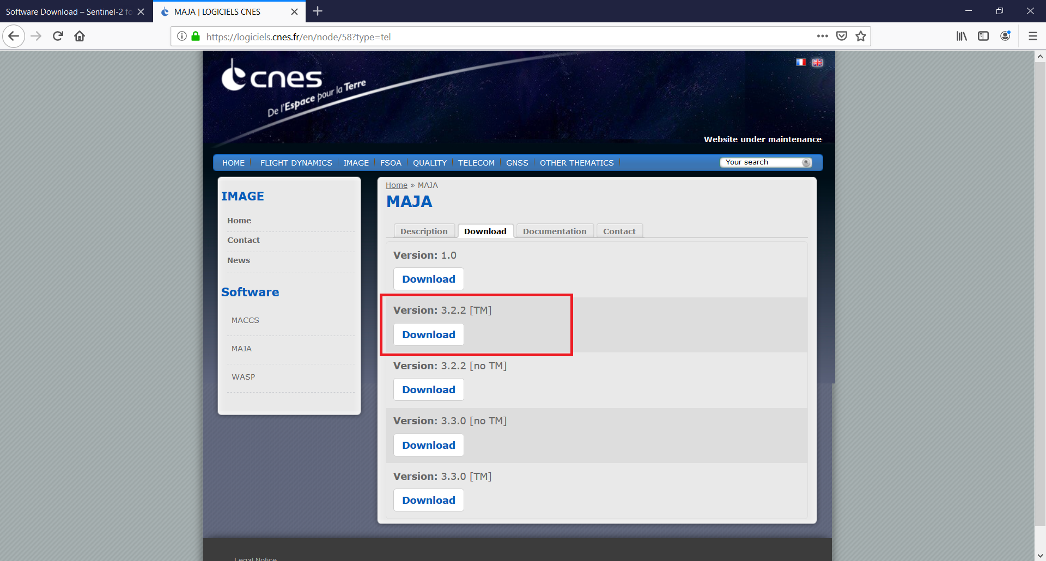
System Installation
Step 1: Download the system
Go to http://www.esa-sen2agri.org/operational-system/system-download/
Read carefully the “System requirements”
section to dimension your hardware
Fill in some information about yourself
Download the system installation package
Download the SRTM dataset
Download the SWBD dataset
Download the MAJA package from CNES
(after accepting their terms and conditions)

Slide 15
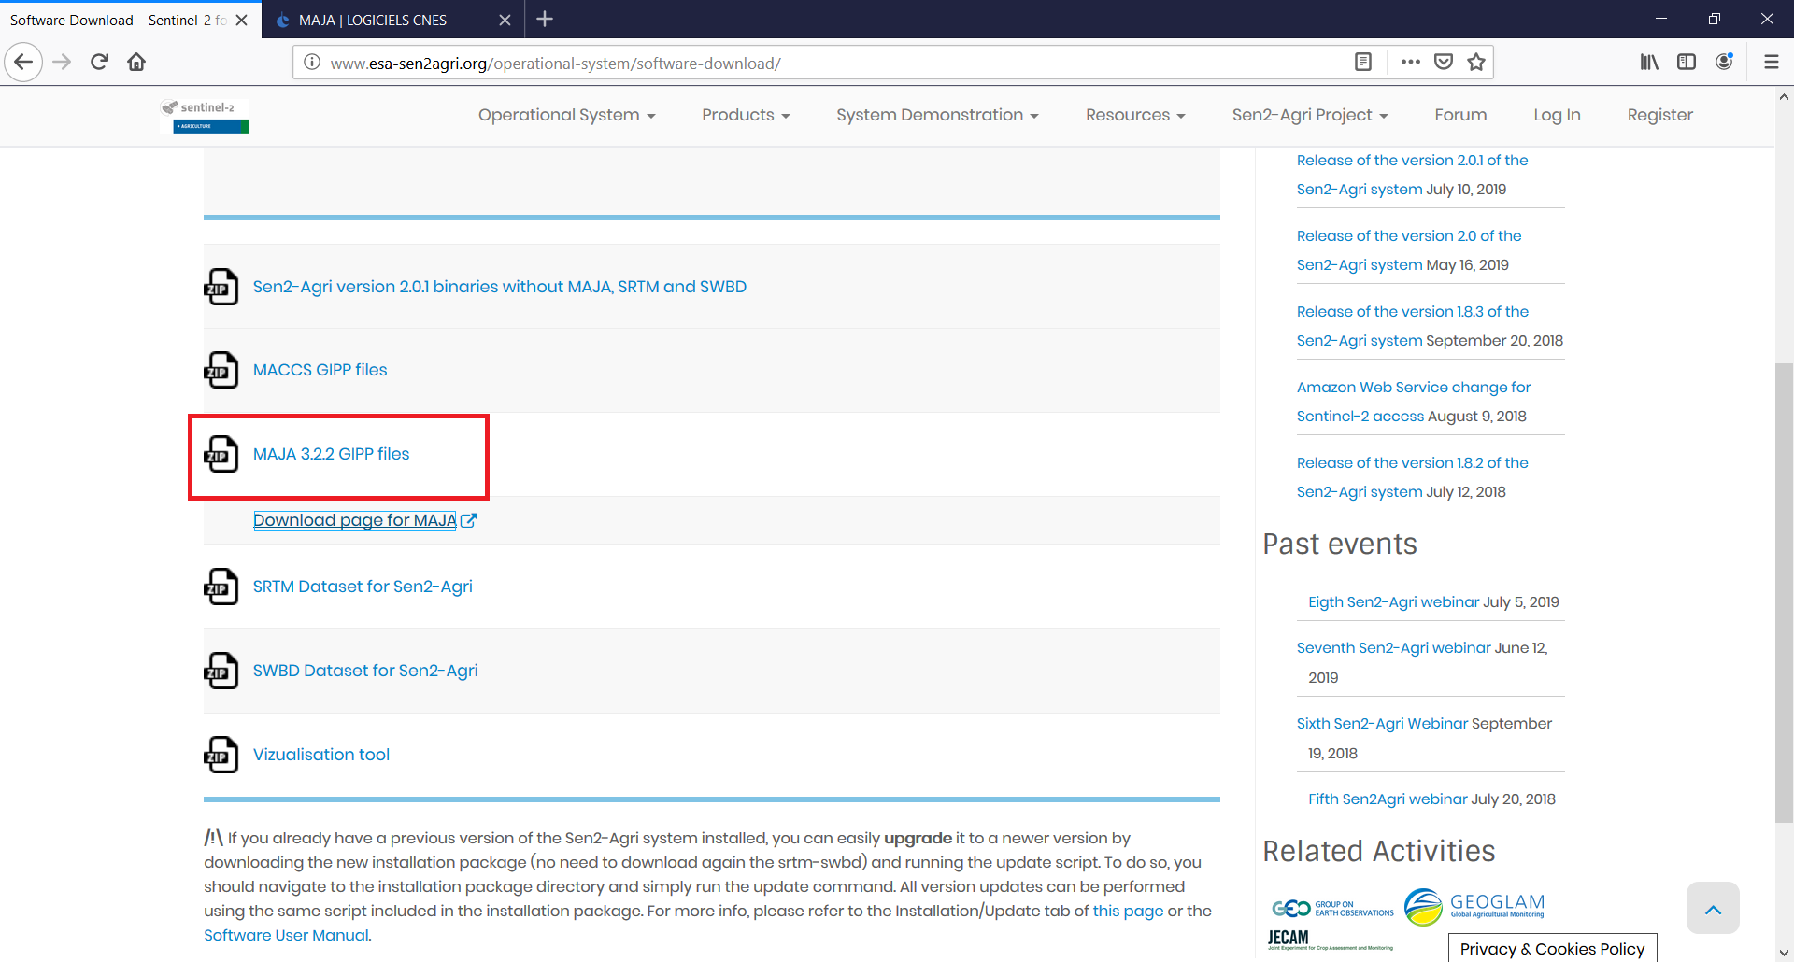
System Installation
Step 1: Download the system
Go to http://www.esa-sen2agri.org/operational-system/system-download/
Read carefully the “System requirements”
section to dimension your hardware
Fill in some information about yourself
Download the system installation package
Download the SRTM dataset
Download the SWBD dataset
Download the MAJA package from CNES
Download the MAJA GIPP files for Sen2Agri

Slide 16
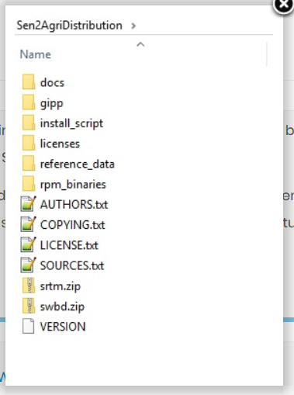
System Installation
Step 1: Download the system
Go to http://www.esa-sen2agri.org/operational-system/system-download/
Read carefully the “System requirements”
section to dimension your hardware
Fill in some information about yourself
Download the system installation package
Download the SRTM dataset
Download the SWBD dataset
Download the MAJA package from CNES
Download the MAJA GIPP files for Sen2Agri
Decompress the Sen2Agri and move the other downloaded
packages in a file structure like on the right. MAJA can be decom-
pressed in a “maja” subfolder and it will be installed altogether.

Slide 17
System Installation
Step 2: Install the system
Setup a machine with CentOS7 Linux minimal install. Use an account with super-user privileges.
CentOS7 Minimal ISO can be downloaded from http://isoredirect.centos.org/centos/7/isos/x86_64/CentOS-7-x86_64-Minimal-1810.iso
Install utility packages needed for installation:
Unzip (for decompression): sudo yum install –y unzip
Nano (simple text editor): sudo yum install –y nano
Midnight Commander (file manipulation): sudo yum install –y mc
While installation is in progress, let’s browse the Sen2Agri web site.

Slide 18
System Installation
Step 2: Install the system
Create some necessary folders:
sudo mkdir /mnt/archive && sudo mkdir /mnt/upload
Make sure the folders are writable for any account:
sudo chmod 777 /mnt/archive && sudo chmod 777 /mnt/upload
Make sure the installation script is executable:
sudo chmod +x ~/Downloads/Sen2AgriDistribution/install_script/sen2agriPlatformInstallAndConfig.sh
Run the installation script:
sudo ~/Downloads/Sen2AgriDistribution/install_script/sen2agriPlatformInstallAndConfig.sh
Done!

Slide 19
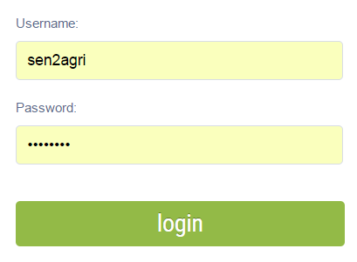
User Interface Overview
Connect to the graphical user interface
In a web browser on the installation machine, go to http://localhost/login.php or http://127.0.0.1/login.php
Username: sen2agri
Password: sen2agri

Slide 20
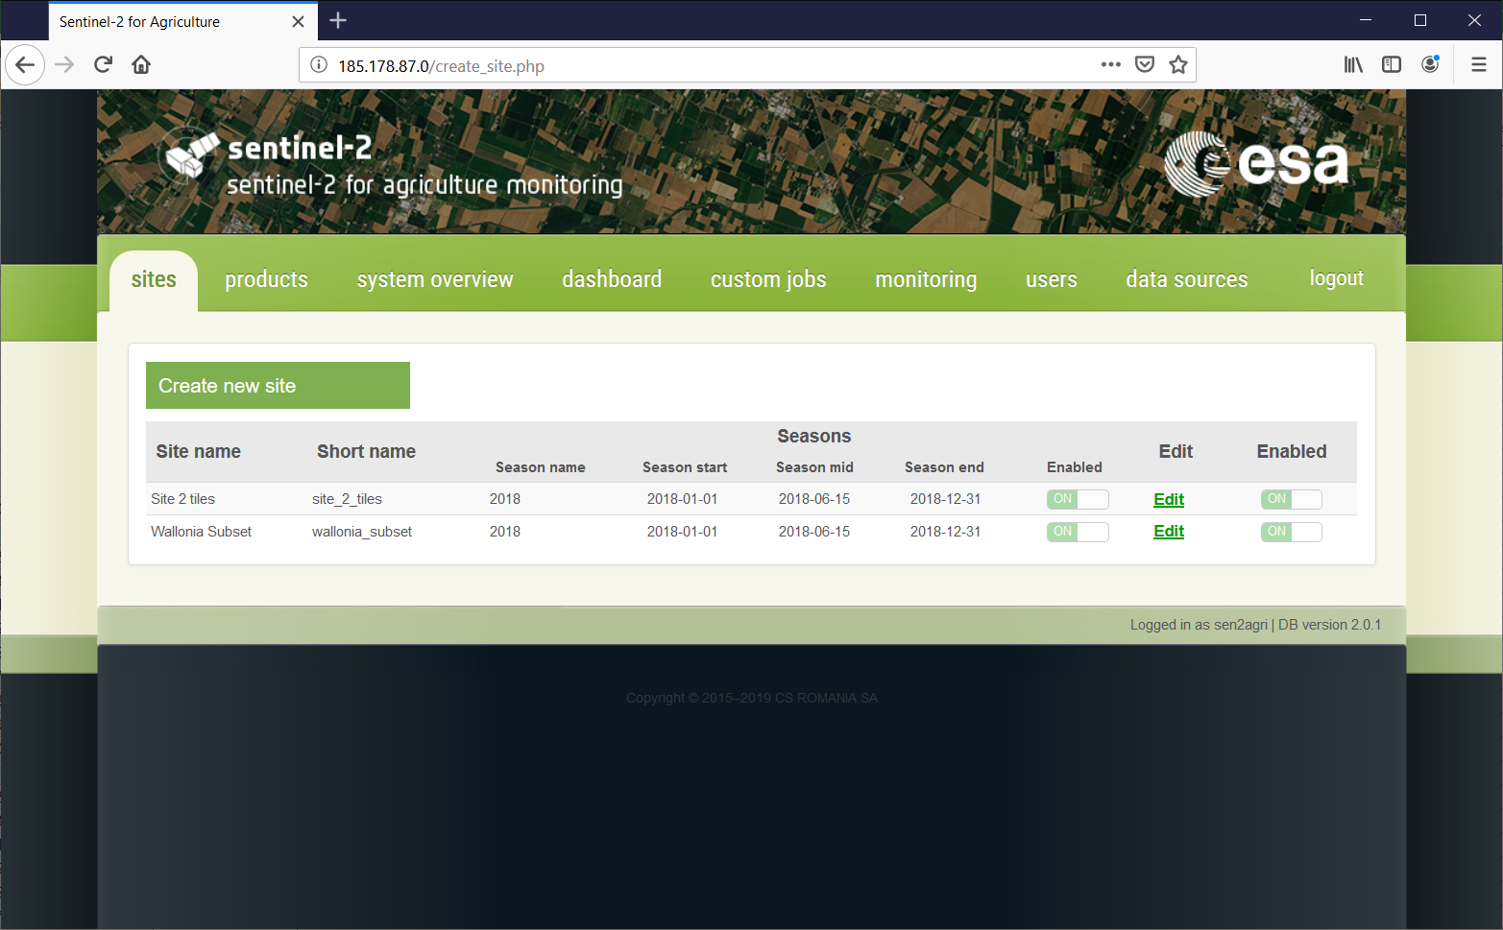
User Interface Overview
Site management
Add, edit sites
Define seasons
Define processors to execute
Upload in-situ data
Upload strata data

Slide 21
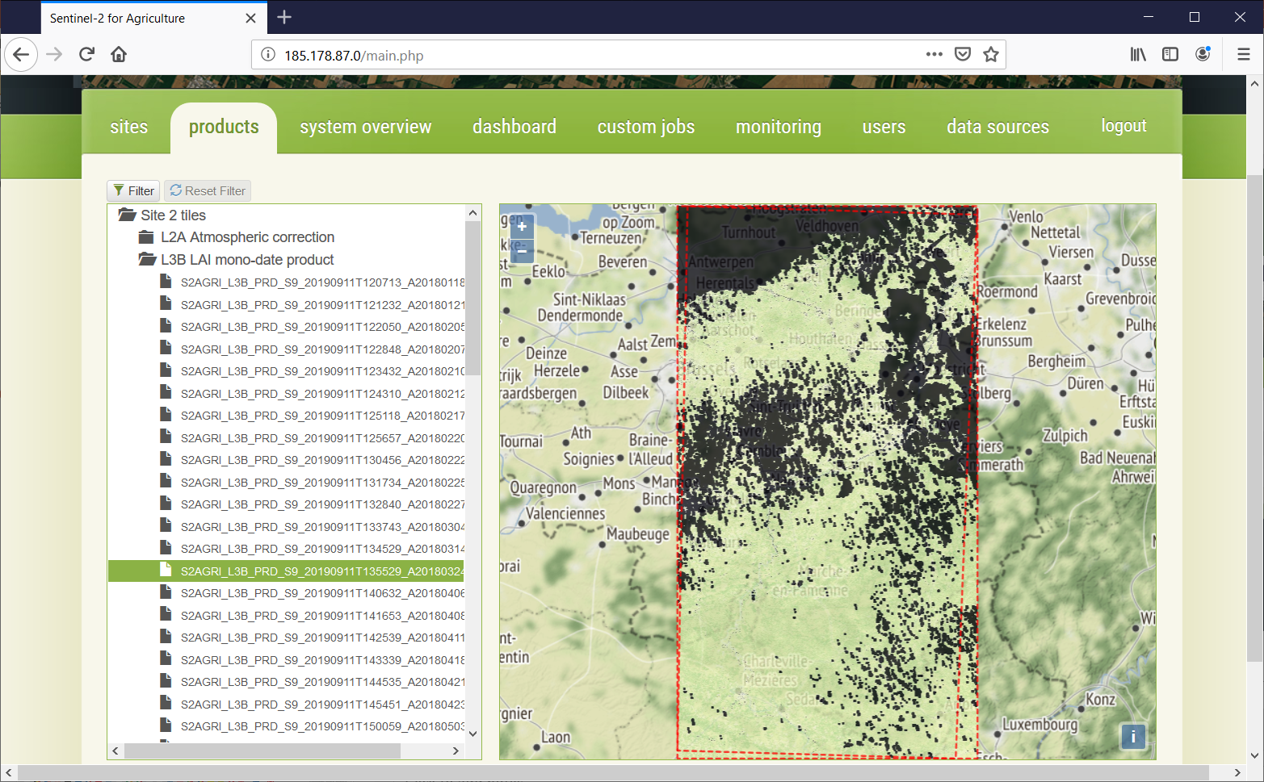
User Interface Overview
Output products
Visualize quick looks of
Output products (L2A, L3*, L4*)
Download products

Slide 22
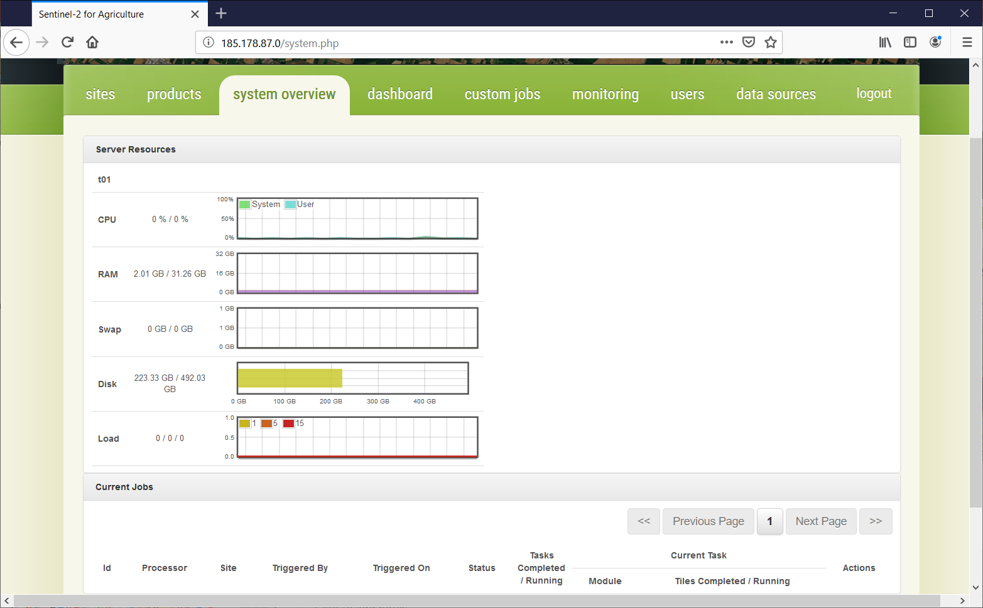
User Interface Overview
System resources and running
jobs
View CPU, RAM, Disk and Load
of execution machines
View currently executing
processing jobs and tasks

Slide 23
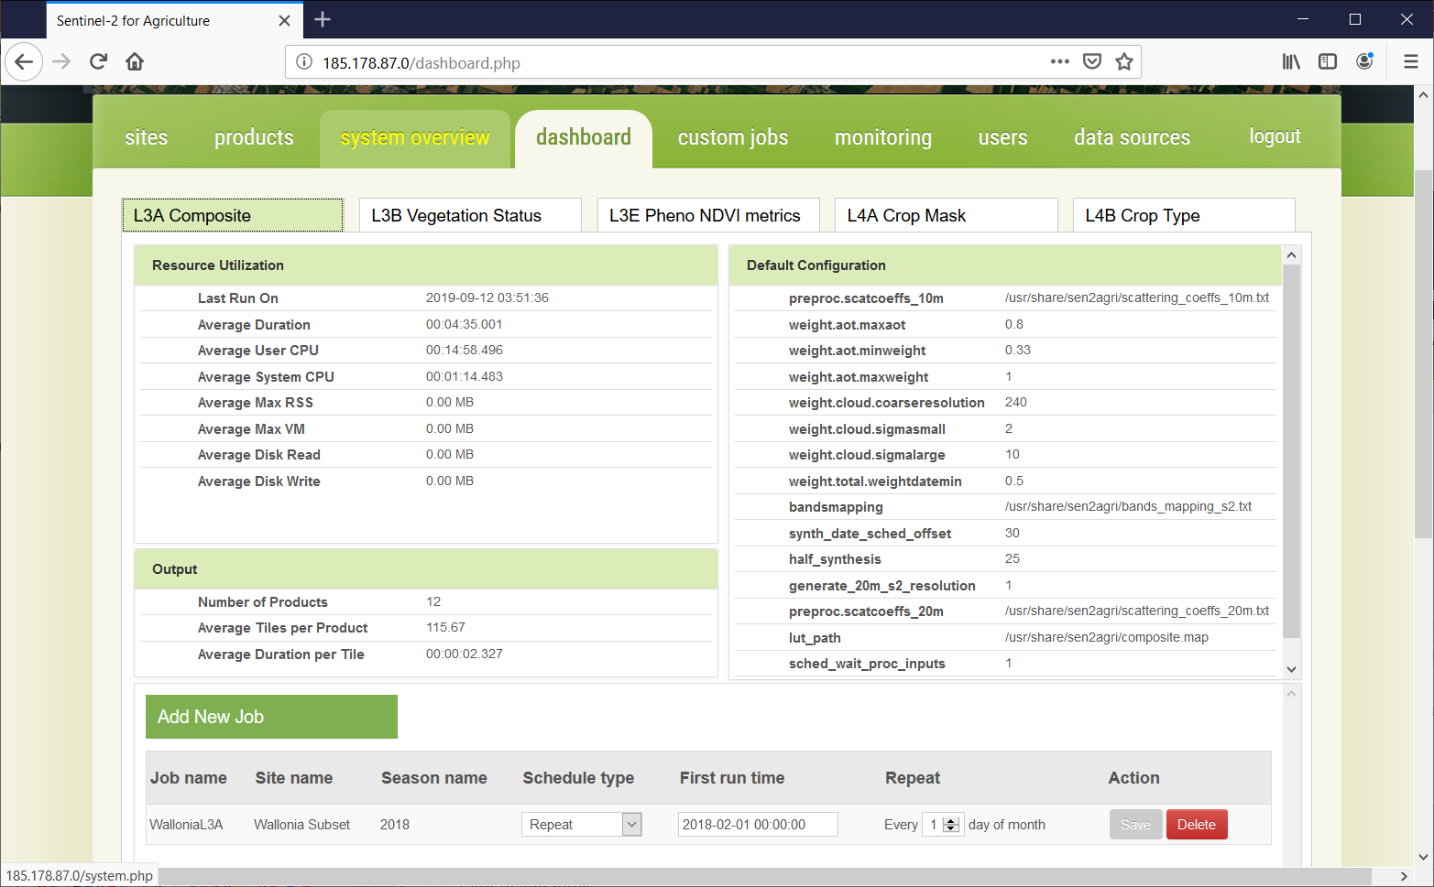
User Interface Overview
Processor dashboard
View resources used by each
processor
View default configuration of
each processor
View scheduled jobs defined
for each processor

Slide 24
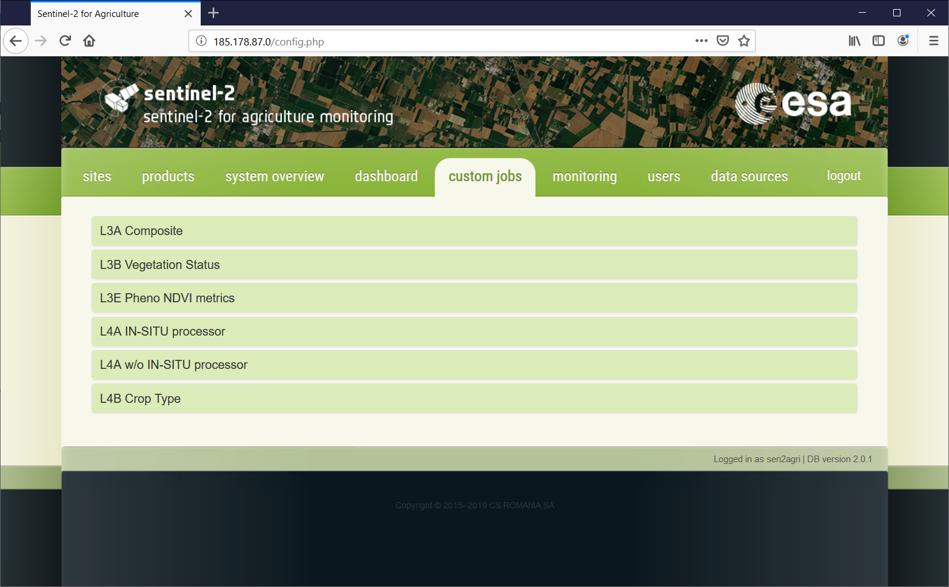
User Interface Overview
Manual jobs
Parametrization for manual
invocation of all processors
Default values for parameters
Common parameters
Advanced parameters

Slide 25
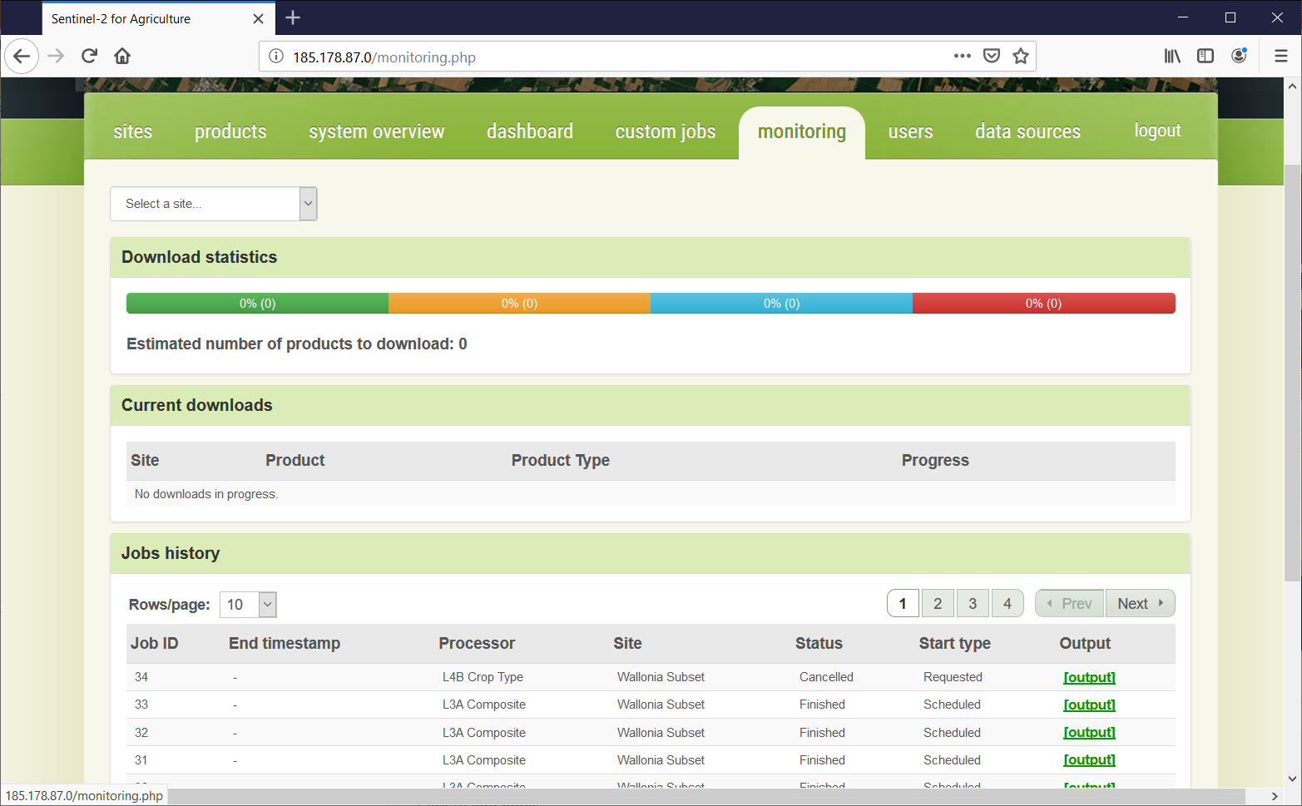
User Interface Overview
Monitoring
Monitoring of downloads
(completed, in progress, errors)
Progress of current download
History of execution jobs

Slide 26
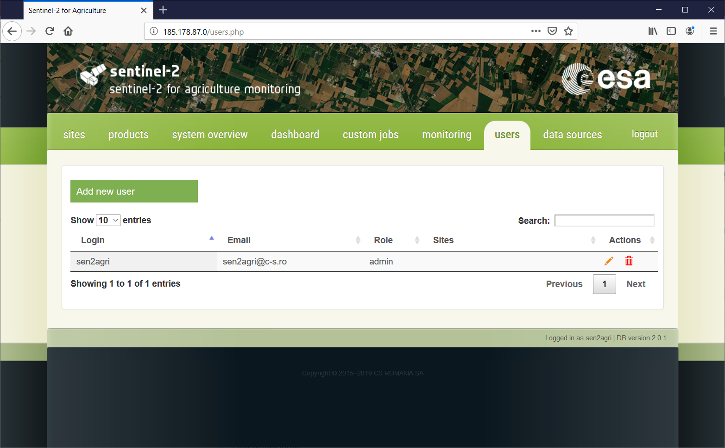
User Interface Overview
Users
Simple management of
system users
Two kinds of users:
Administrators: can see/work
on any site of any user
Users: can only see/work on
sites defined by her-/him-self

Slide 27
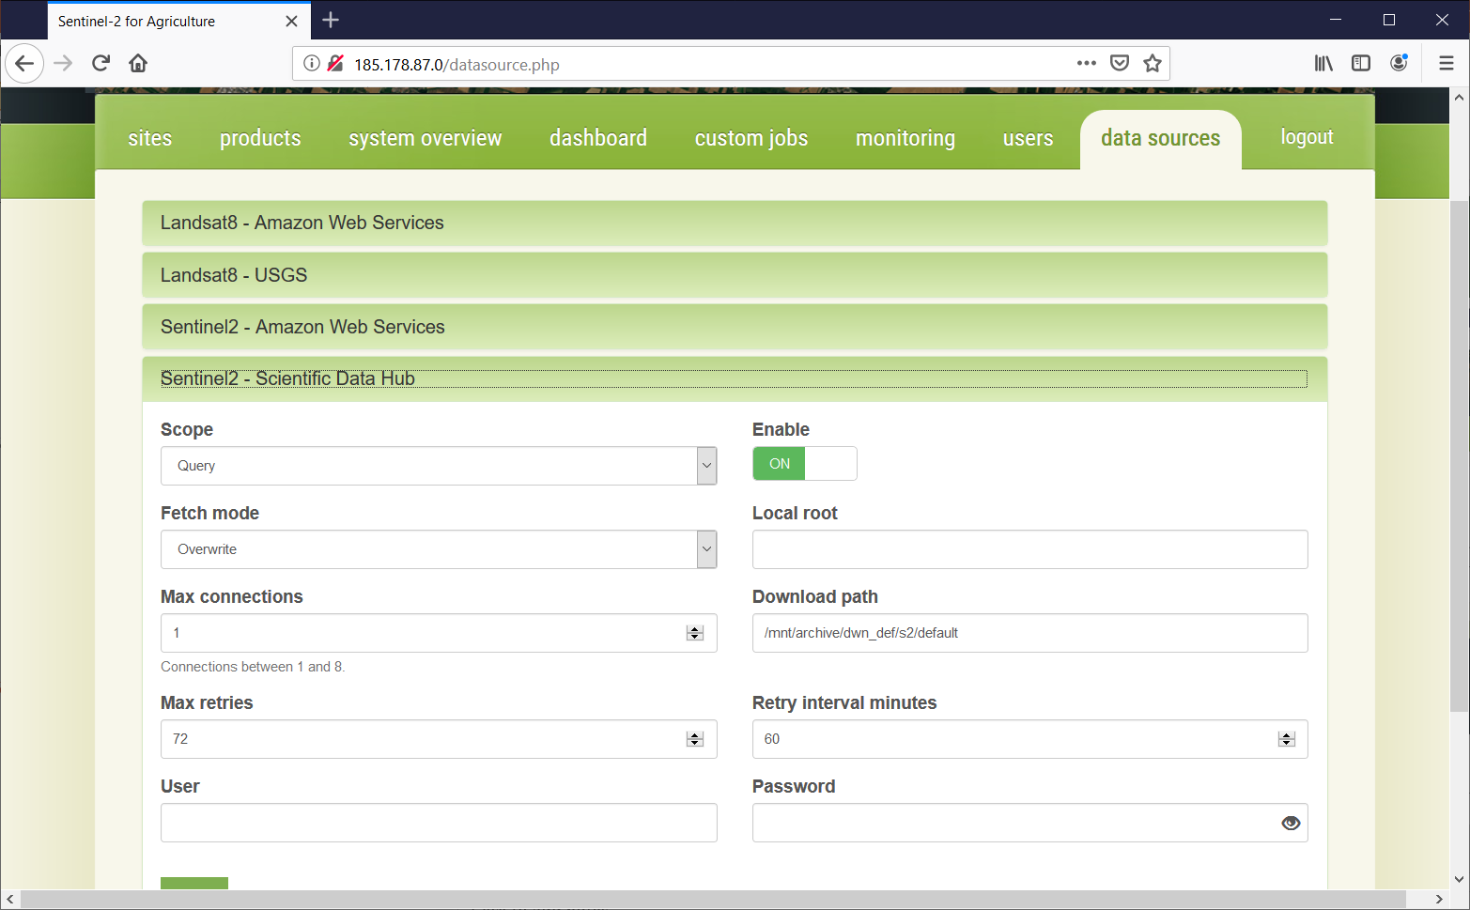
User Interface Overview
Data sources
Configuration of modules
for query and download¹ of
Sentinel-2 and Landsat-8
Products
Dynamic behavior:
if new modules (jar files) are copied
in a specific folder², they will be
shown here.
¹ download or linking to local product repos
² /usr/share/sen2agri/sen2agri-services/lib

Slide 28
EO Source Configuration – on premises
Scientific Data Hub (SciHub) used for looking up for S2 products
USGS used for looking up for L8 products
No local product repository available
=>
    S2 products will be downloaded from SciHub
    L8 products will be downloaded from USGS

Slide 29
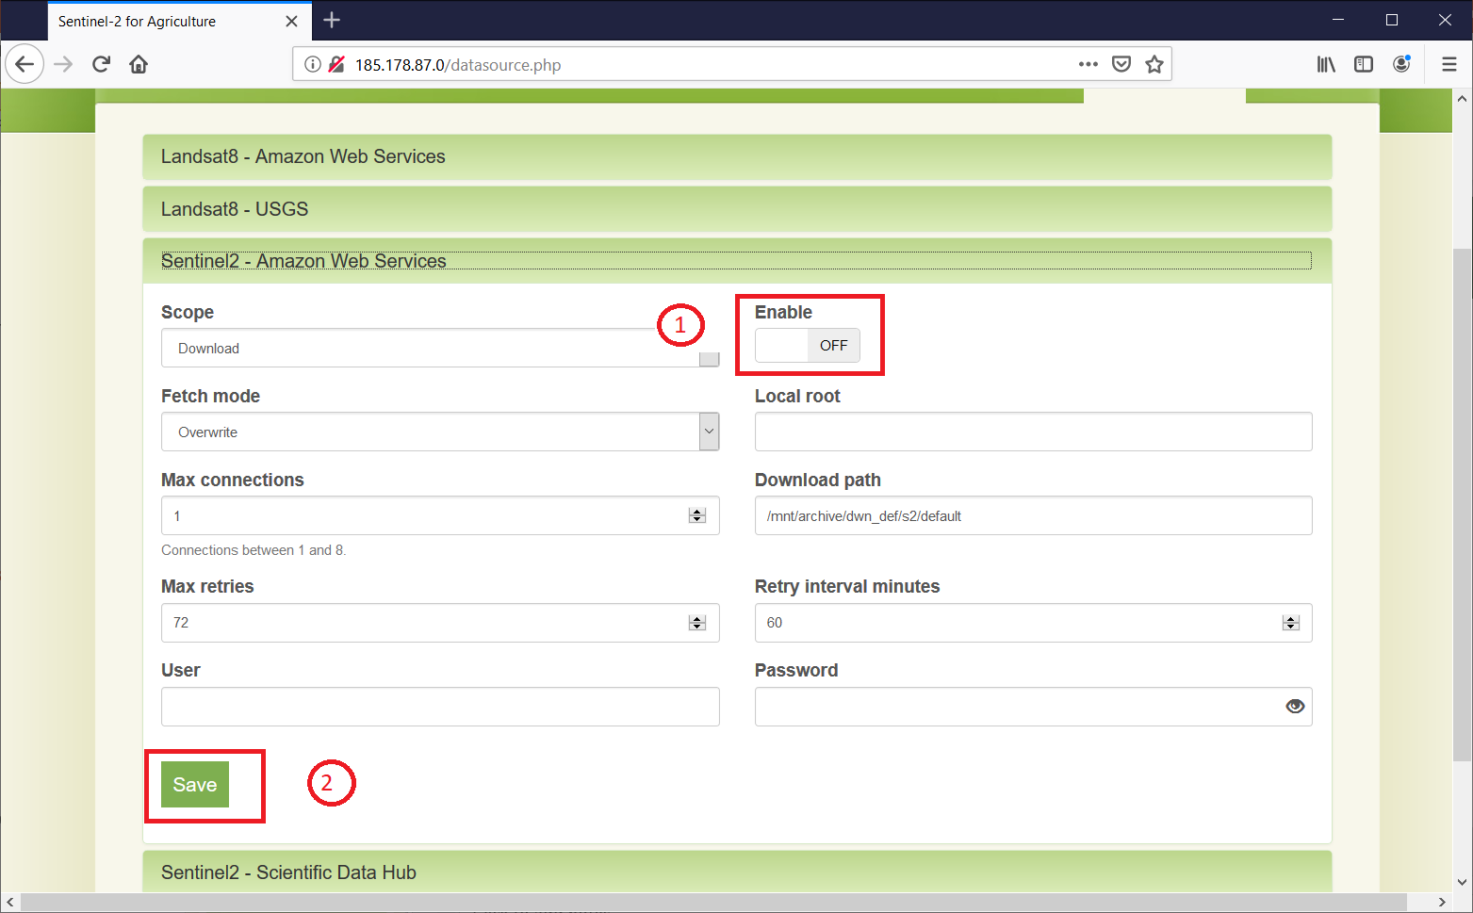
EO Source Configuration – on premises
How to configure query and download for S2 from SciHub?
1. Disable other S2 sources
2. Set the S2 – SciHub scope to
“Query and download”;
Set the fetch mode to
“Overwrite”;
Enter your SciHub account;
Save.

Slide 30
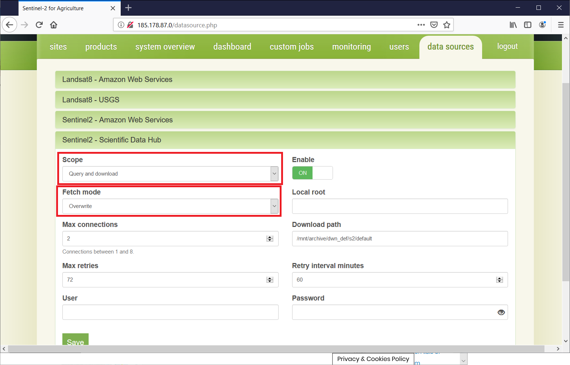
EO Source Configuration – on premises
How to configure query and download for S2 from SciHub?
1. Disable other S2 sources
2. Set the S2 – SciHub scope to
“Query and download”;
Set the fetch mode to
“Overwrite”;
Enter your SciHub account;
Save.

Slide 31
EO Source Configuration - cloud
Any cloud (except DIASes or AWS): like on-premises
For DIAS or AWS installation:
  SciHub used to lookup for S2 products
  USGS used to lookup for L8 products
  Local product repository available
  =>
    S2 products linked (via symlinks) from local buckets; if not available, they can be downloaded from SciHub
    L8 products linked (via symlinks) from local buckets; if not available, they can be downloaded from USGS

Slide 32
EO Source Configuration - cloud
What you need to know before selecting a DIAS:
Sentinel-2 on-line availability
 | CreoDIAS | MUNDI | Sobloo | ONDA | SciHub | AWS
L1C | all | July 2015 (Europe) January 2018 (Global) | Previous 2 years | September 2018 | Last 12+ months | all
L2A | orderable | April 2017 (Europe) | Previous 1 year | September 2018 | Last 18+ months | all

Slide 33
EO Source Configuration - cloud
How to configure data sources?
1. Disable other S2 sources
2. Set the S2 – SciHub scope to
“Query and download”;
Set the fetch mode to
“Overwrite”;
Enter your SciHub account;
Enter the local repository mount;
Save.
3. Configure the local path
resolver

Slide 34
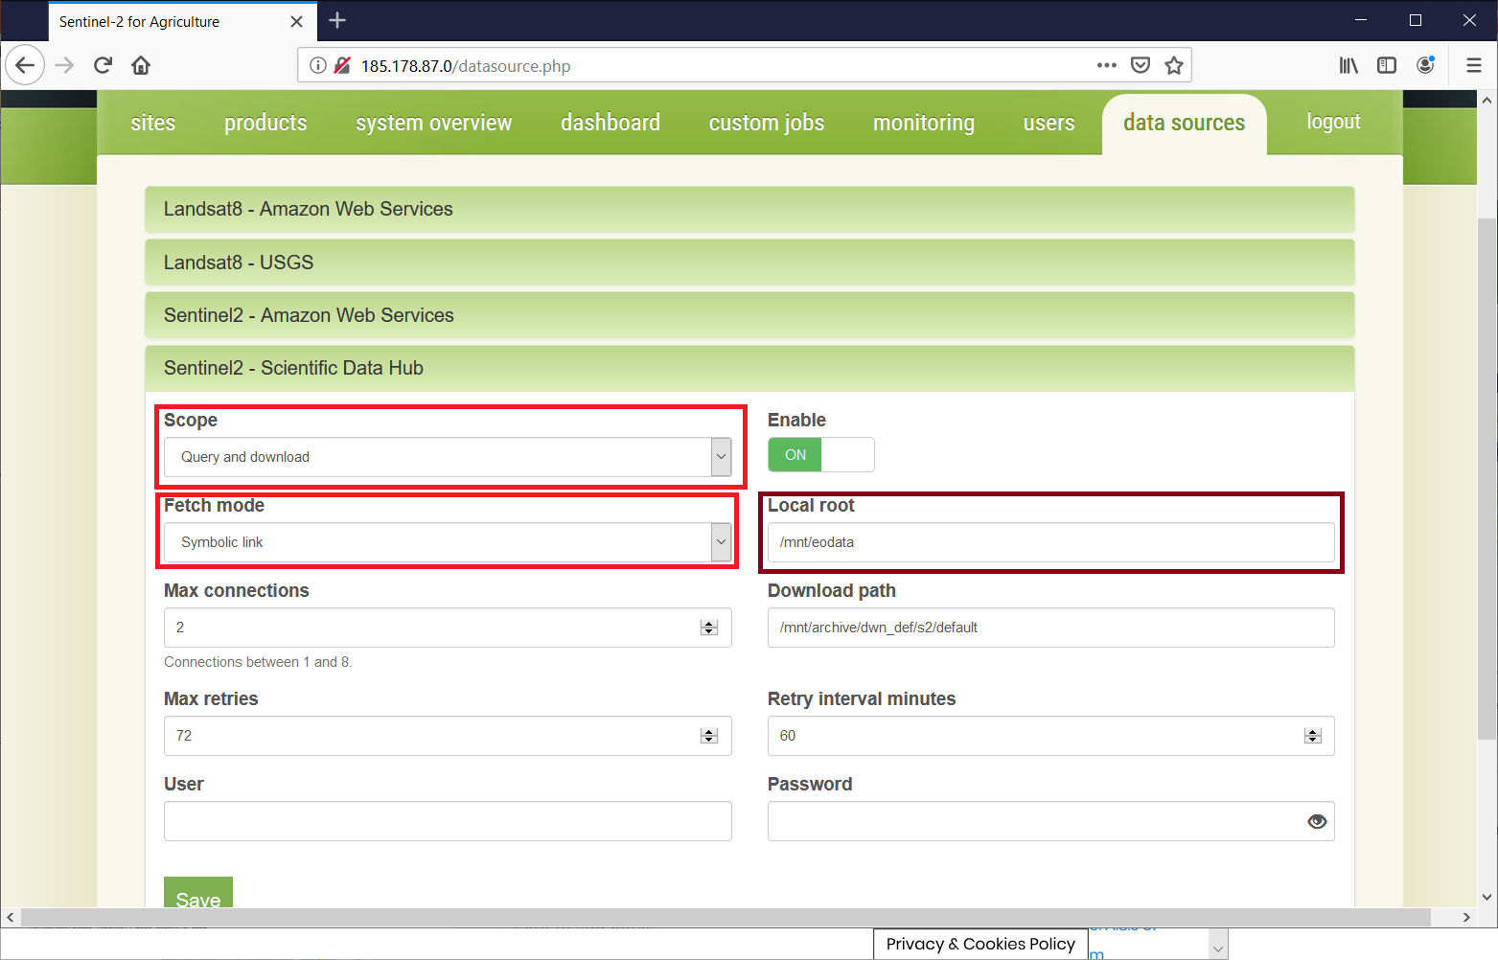
EO Source Configuration – cloud
How to configure data sources?
1. Disable other S2 sources
2. Set the S2 – SciHub scope to
“Query and download”;
Set the fetch mode to
“Symbolic link”;
Enter your SciHub account;
Enter the local repository mount;
Save.
3. Configure the local path
resolver

Slide 35
EO Source Configuration – cloud
How to configure data sources?
1. Disable other S2 sources
2. Set the S2 – SciHub scope to
“Query and download”;
Set the fetch mode to
“Symbolic link”;
Enter the local repository mount;
Enter your SciHub account;
Save.
3. Configure the local path
resolver
If not on CreoDIAS, in the file
/usr/share/sen2agri/sen2agri-services/config/services.properties
uncomment the section specific to the DIAS platform (see next slide)

Slide 36
EO Source Configuration – cloud
MUNDI DIAS path resolver example
On MUNDI, the Sentinel-2 L1C path is UU/L/SS/YYYY/MM/dd/<product_folder>, where:
UU = the UTM code, L = the latitude band,
SS = the UTM square code, YYYY = year,
MM = month (0-padded), dd = day (0-padded),
<product_folder> = the product folder, without .SAFE suffix
eg. the product S2A_MSIL1C_20181015T104021_N0206_R008_T31UFS_20181015T125304.SAFE would be located in
/eodata/31/U/FS/2018/10/15/ S2A_MSIL1C_20181015T104021_N0206_R008_T31UFS_20181015T125304
In services.properties file, the uncommented section is:
SciHubDataSource.Sentinel2.path.builder.class = org.esa.sen2agri.dias.mundi.Sentinel2PathBuilder
SciHubDataSource.Sentinel2.local.archive.path.format = UU/L/SS/YYYY/MM/dd
SciHubDataSource.Sentinel2.path.suffix = none
SciHubDataSource.Sentinel2.product.format = folder

Slide 37
Hands-on – access local products
Step 1: Let’s have access to EO Data on CreoDIAS
On the training machine, open a Terminal (Applications > Terminal Emulator) and type
sudo mount /eodata
Enter the password E0grB97450if2AD
Verify that the mount was created. Enter:
ls /eodata/Sentinel-2/MSI/L1C

Slide 38
Hands-on – configure data source
Step 2: Configure the Sen2Agri data sources
Open Firefox (Applications > Internet > Firefox) and go to address
http://localhost
Login using the user sen2agri with the password sen2agri
Go to data sources tab. Disable the following sources:
Landsat8 – Amazon Web Services
Landsat8 – USGS
Sentinel2 – Amazon Web Services
(for each one, toggle the Enable button and then click Save)

Slide 39
Hands-on – configure data source
Step 2: Configure the Sen2Agri data sources (cont.)
Modify the Sentinel2 – Scientific Data Hub as follows
  Change Scope to Query and download
  Change Fetch Mode to Symbolic link
  Set Local root to /eodata/Sentinel-2/MSI/L1C
  Enter your SciHub account details (User and Password)
  Click Save

Slide 40
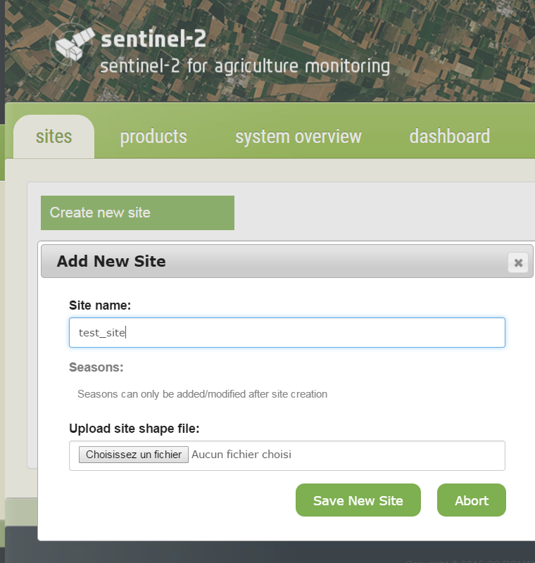
Hands-on – site and season
Site and season creation
In the Sites tab, press the Create new site button
In the Add New Site dialog box provide the following informations
  Enter a unique site name – 1st letter must be an uppercase
  Upload a shapefile with the site extent.
  The uploaded file will have to be in a “.zip” archive that contains all
  the “.shp”, “.dbf”, “.prj” and “.shx” files.
Browse for a zipped small shape file in:
/home/ltcstudent/Desktop/Sen2Agri_Training_Files/sen2agri_sample_site_shape.zip
  Press the Save New Site button
    → Your new site is created

Slide 41
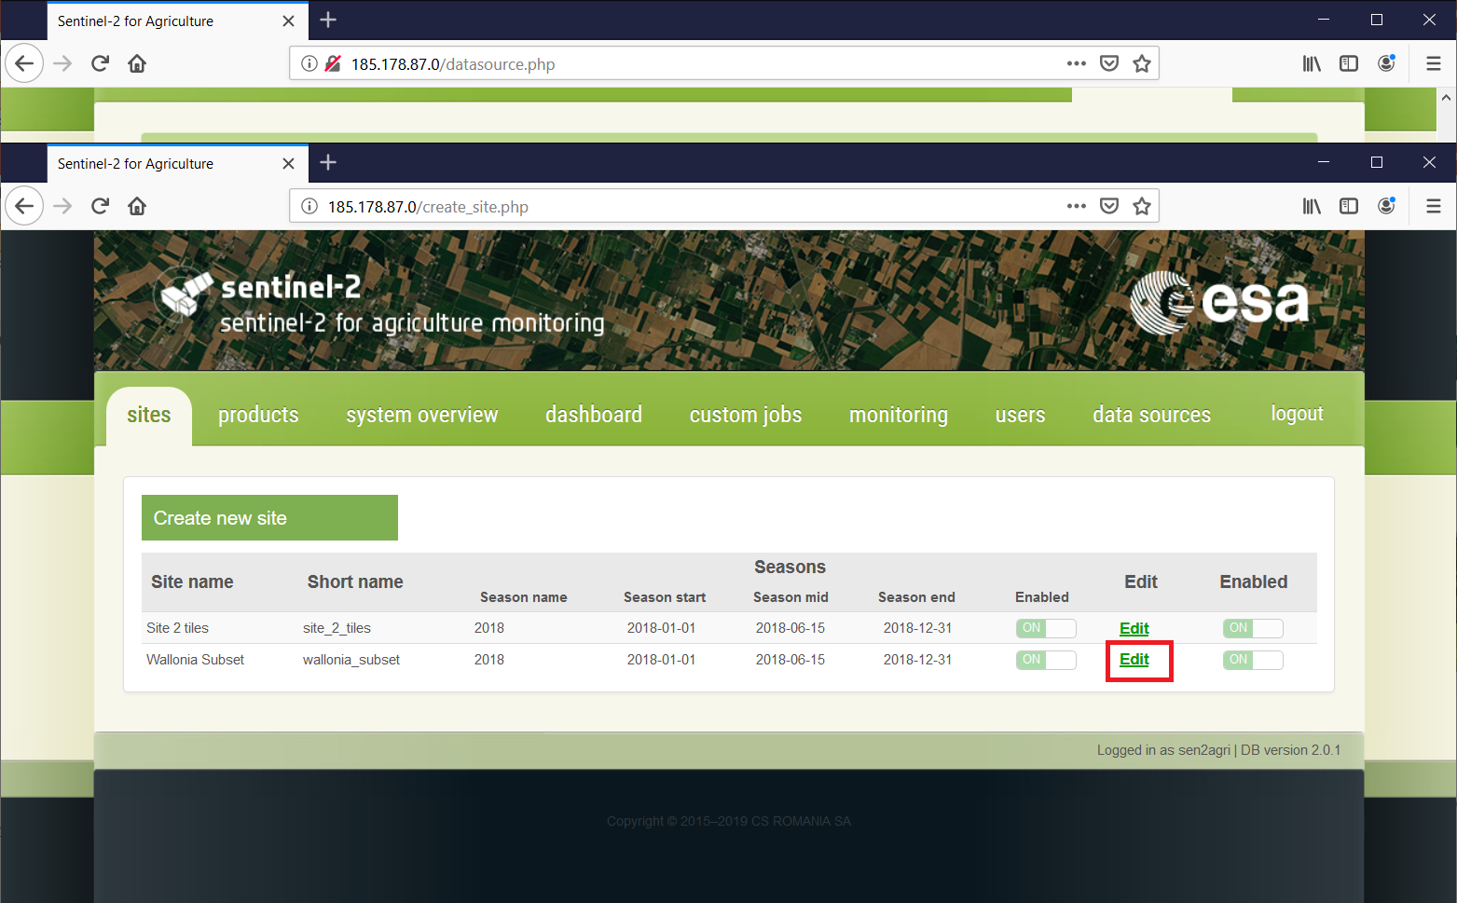
Hands-on – site and season
Site and season creation
  To configure the season, go to Sites tab and press the Edit button corresponding to the newly created site

Slide 42
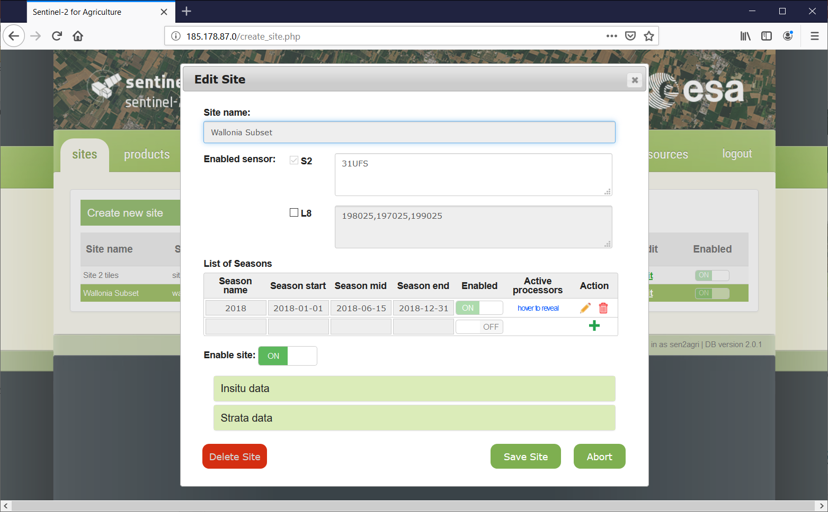
Hands-on – site and season
Site and season creation
In order to add a season, press the “+” icon in the List of Seasons section
It will allow you specifying the following parameters:
Season Name eg. Summer 2018
Season start eg. 01-04-2018
Season mid eg. 01-09-2018
Season End eg. 01-11-2018

Slide 43
Hands-on – site and season
Site and season creation
  You can then specify which processor will be run in the automated mode for the site and the specified season
    Atmospheric correction (L2A) is always run automatically since it is a mandatory input for all the other processor
    L3A = Monthly cloud free composite
    L3B = Vegetation Status (LAI and NDVI) produced for each L2A product
    L4A = Monthly Cropland Mask starting from the middle of the season
    L4B = Crop Type map produced at the middle and at the end of the season
    Once the season is defined, it can be saved using the icon. The changes can be cancelled using the icon.

Slide 44
Hands-on – site and season
Not to wait until the next Lookup job, let’s restart the services to pick the changes.
Open (if not already) a Terminal window and type:
sudo systemctl restart sen2agri-services
If prompted, enter again the password E0grB97450if2AD
After 15-20 seconds, revisit the Monitoring tab of the web site. The bar from Download statistics should be blue this time with a product count > 0.

Slide 45
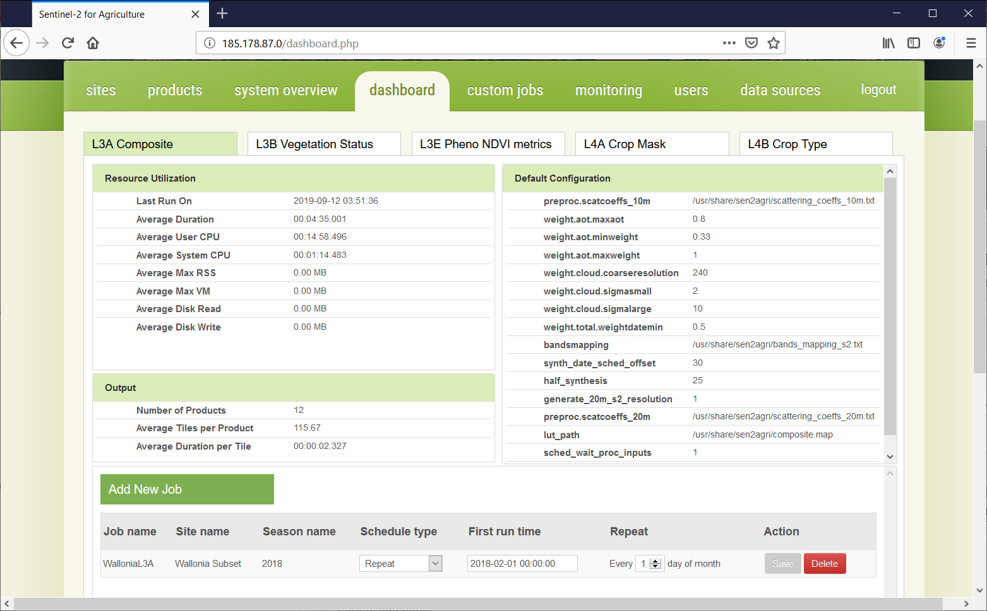
Hands-on – site and season
After the successful creation of a season, a set of scheduled jobs corresponding to the selected processors are automatically created for that season. These jobs are available in the Dashboard tab and will start to execute once the site is Enabled.
Go to the Dashboard tab and navigate through the processors sub tabs to see the automatically created jobs and the by-default parameters values used for each processors.

Slide 46
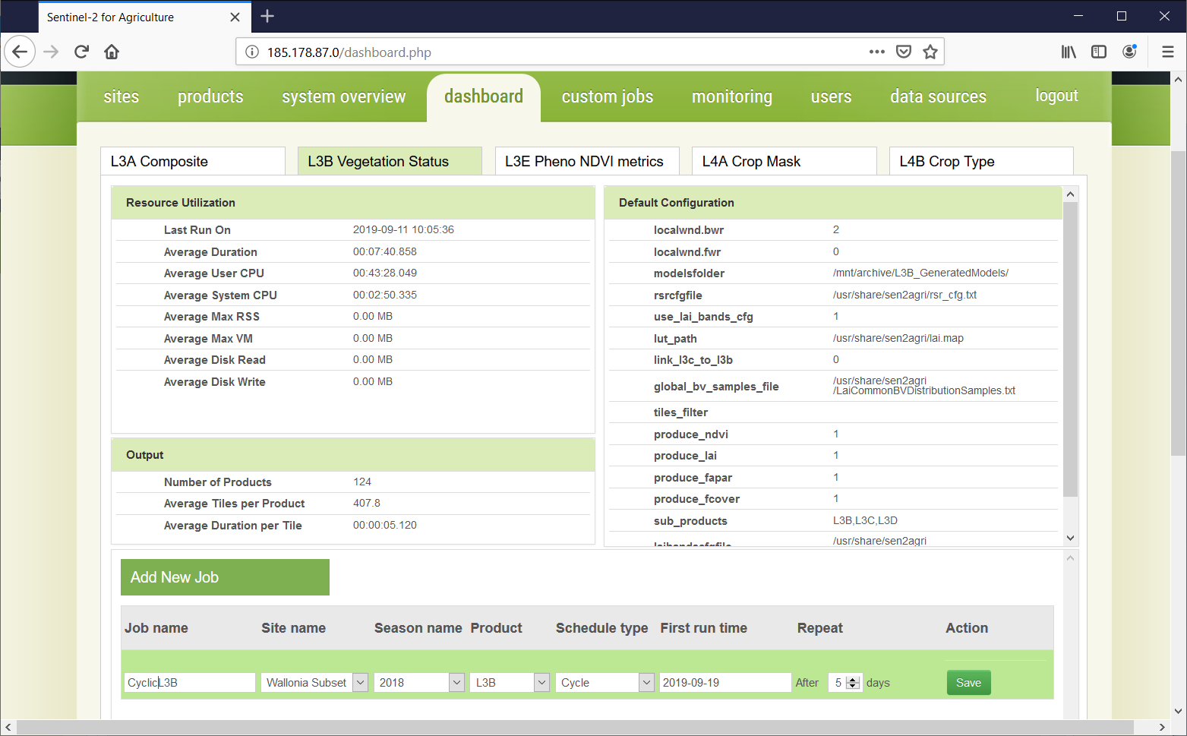
Hands-on – scheduled job
Add a scheduled jobs on a site already configured for the training
In the Dashboard tab, press the Add New Job button
Job name eg. « LAI_Training »
Select a Site: 2 sites are pre-configured
    Site 2 Tiles
    Wallonia subset
Season: pick the only season available
Product: select the L3B product (Vegetation Status)
Schedule Type : Once
First run time: TBD

Slide 47
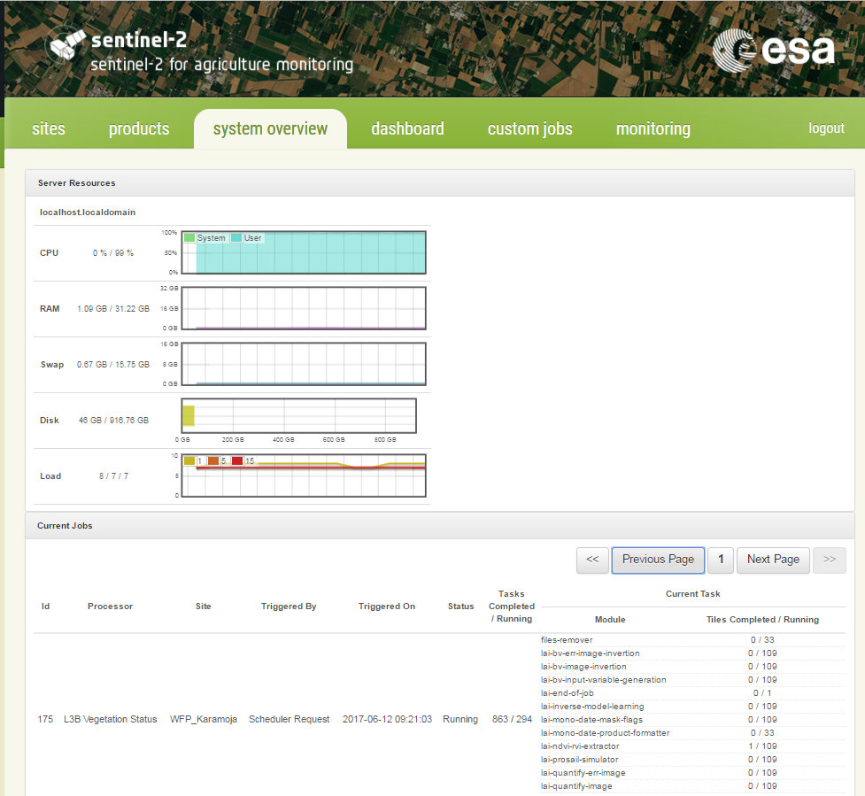
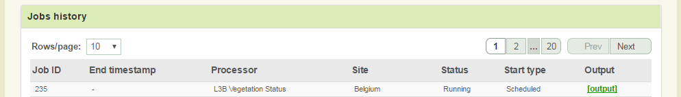
Hands-on – scheduled job
After the successful configuration of this additional scheduled job,
Go to System Overview tab to
monitor the activity of the system in terms of resources and storage
see the progress of the LAI job: Task Completed/Running
Go to Monitoring tab to
see the new LAI scheduled job added in the current job history list.
see the command line inputs, outputs and potential error of each individual command launched by the processor (click on the button)
Notes:
For each site, the extent and the season to monitor need to be defined. At least one season (winter or summer) should be defined, specifying the start and end dates of the season. These parameters are associated to by-default values, which can be modified by the user. The season dates are defined by a month, a day and a year;

Slide 48
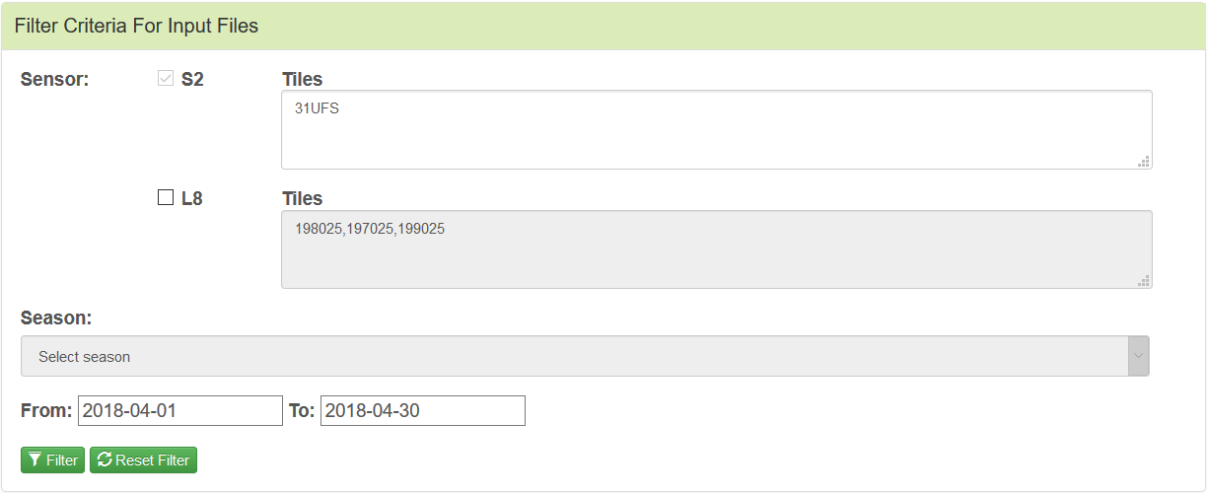
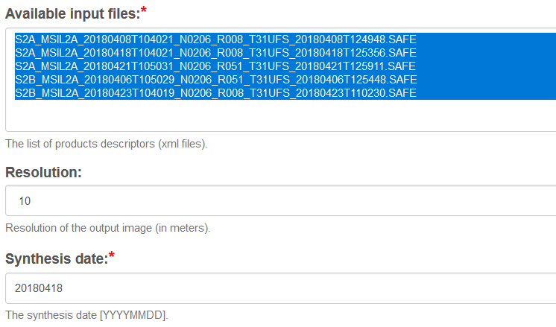
Hands-on – custom job
Add a custom job on a site already configured for the training
In custom jobs tab, expand L3A Composite
Select the input L2A products using filters:
Uncheck L8, From: 2018-04-01, To: 2018-04-30
and press “Filter”
Select them all in the product list:
S2A_MSIL2A_20180408T104021_...
S2A_MSIL2A_20180418T104021_...
S2A_MSIL2A_20180421T105031_...
S2B_MSIL2A_20180406T105929_...
S2B_MSIL2A_20180423T104018_...
Select Resolution = 20
Select Synthesis date = 20180418
Tick Show advanced parameters to see what other parameters can be set

Slide 49
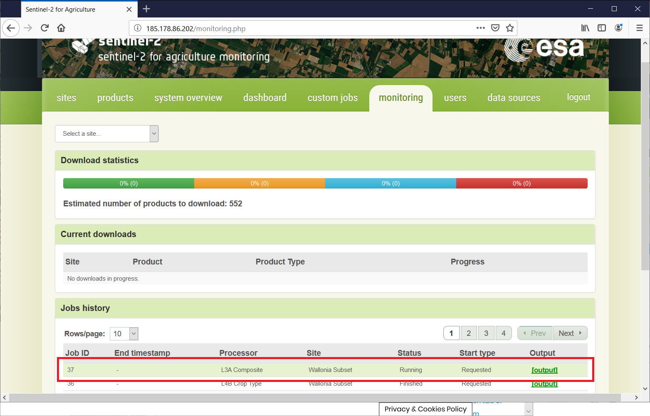
Hands-on – custom job
The new custom job can be seen in the monitoring tab with the status Running.
You can check the command issued,
the output and any error by clicking
the [output] link.

Slide 50
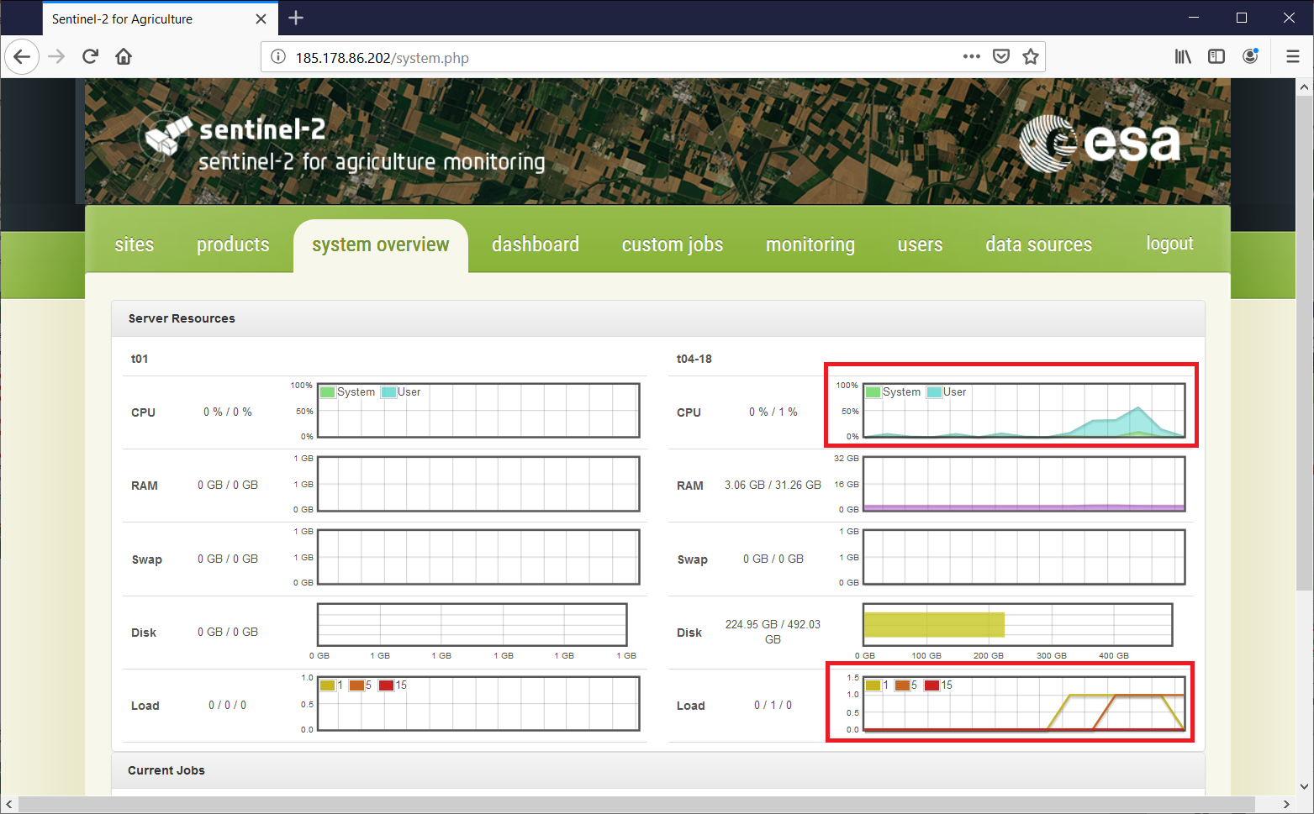
Hands-on – custom job
In system overview tab, you can see that some activity takes place in the system.
At least the CPU and Load graphs
are being updated (@ 1 min).

Slide 51
Hands-on – custom job
While waiting for the task to complete, let’s see what advanced parameters are available for other processors.
Go to the custom jobs tab
Select other processors and tick Show advanced parameters
More information about them can be found by opening the User Manual:
  Find it on your desktop, in Sen2Agri_Training_Files/ Sen2Agri_SUM_v3.0.pdf
  All parameters are found in Appendix F.9 (starting with page 137)
  They start with the prefix “processor.lxx.”

Slide 52
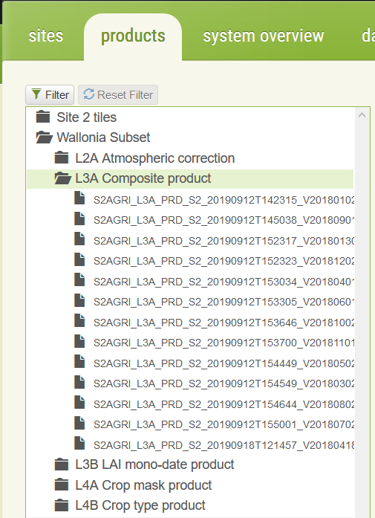
Hands-on – output handling
After ~10-15 minutes, the custom job should have finished.
In the products tab, expand:
Wallonia Subset
└ L3A Composite product
…

Slide 53
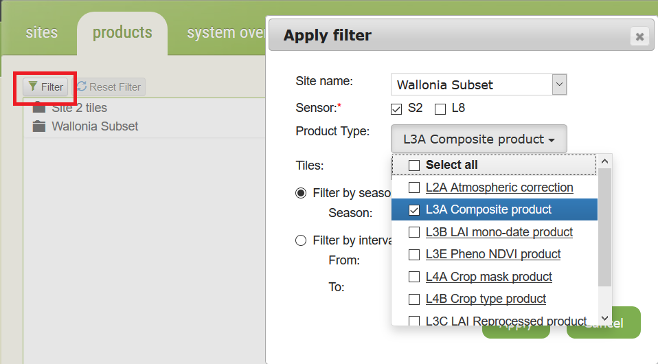
Hands-on – output handling
… or use the “Filter” to easily sort out the products (click Apply after criteria selection)
You can filter by:
Site
and
Sensor
and
Product Type
and
Season or specific dates interval

Slide 54
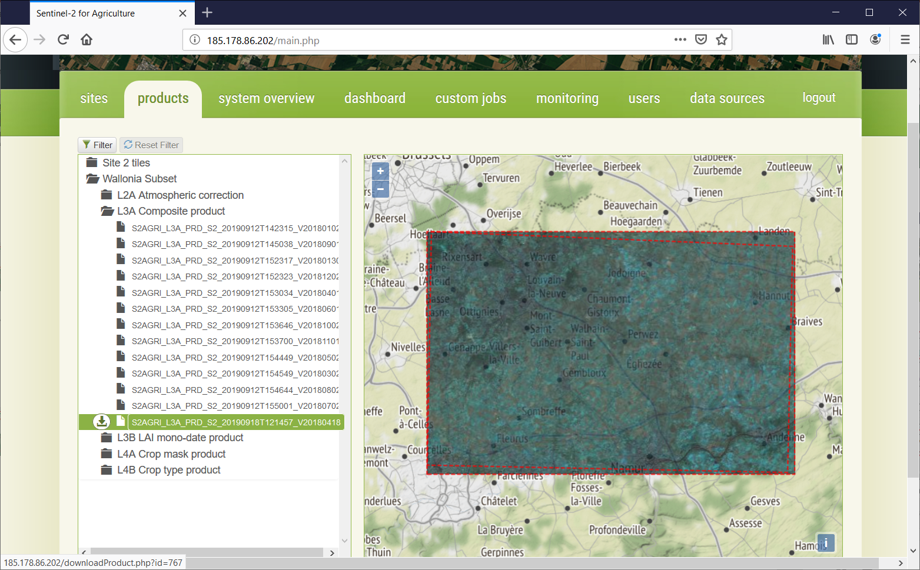
Hands-on – output handling
The just-finished product is there:
S2A_L3A_PRD_S2_20190919…
Select it to see its quick look.
Click the left arrow button to
download it as tar.gz archive
(available on hover)

Slide 55
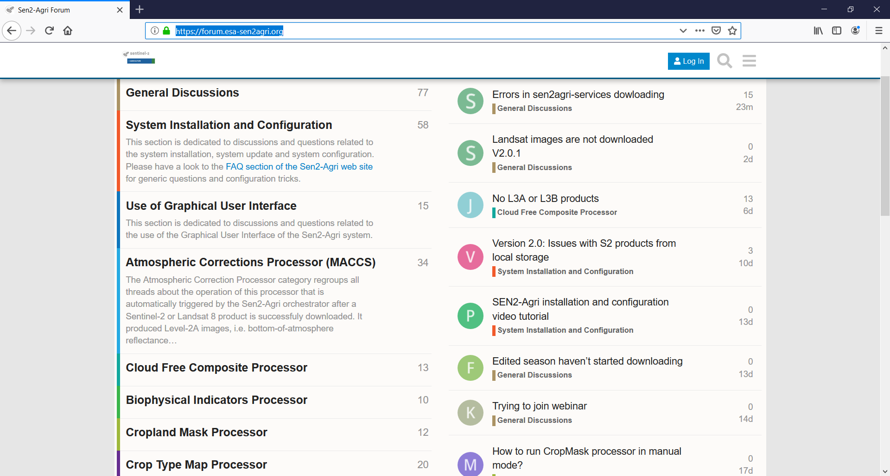
Assistance and Troubleshooting
For more information about products and processors, please visit
http://www.esa-sen2agri.org
For additional assistance or troubleshooting:
1. Register on Sen2Agri web site at
http://www.esa-sen2agri.org/wp-login.php?action=register
2. Login to the Sen2Agri forum at
https://forum.esa-sen2agri.org

