Slide 1
PolSARPro & Land Retrievals
Erxue Chen & Lei Zhao Eric Pottier
Chinese Academy of Forestry
I.E.T.R - Univ Rennes 1, FR

Slide 2
Land cover classification from PolSAR data with PolSARPro

Slide 3
Outlines
Introduction
GF-3 PolSAR dataset
Practical

Slide 4
1.1 General technique framework for remote sensing image classification
I. Introduction
classification legend for your specific project
Ground true & reference data
Final map
Manual editing
Class delineation & Training sample designation
Training AOIs
No
Yes
Features extraction & Preliminary classification
Accuracy OK?
Final classification description definition
classification
Accuracy assessment
Check AOIs
Class speckle filtering
Ground true & reference data
Clump, sieve

Slide 5
I. Introduction
1.2 Classification system and legend defining
Classification system
It is an abstract representation of the situation in the field using well defined diagnostic criteria
One define it as: “The ordering or arrangement of objects into groups or sets on the basis of their relationships”
A classification system is
scale independent: the classes should be applicable at any scale or level of detail;
source independent: independent of the means used to collect information, whether it be through satellite imagery, aerial photography, field survey or using a combination of sources.
Remote sensing classification legend
It is the application of a classification system in a specific area using a defined mapping scale and specific data set
Classification legend is
Scale and cartographic representation dependent;
Data and mapping methodology dependent.

Slide 6
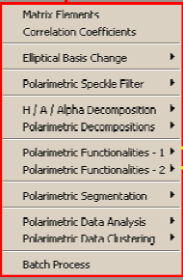
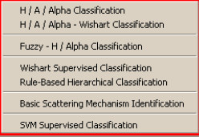
I. Introduction
1.3 Classification method introduction through PolSARPro
Pixel based ←→Object based
Unsupervised←→Supervised
-Currently only pixel based classifier
-Object based is not available

Slide 7
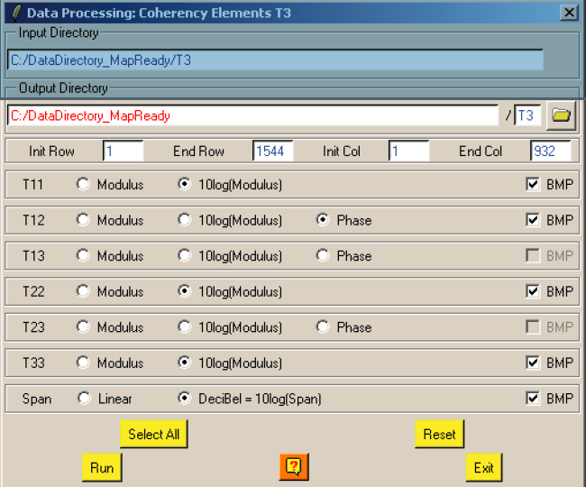
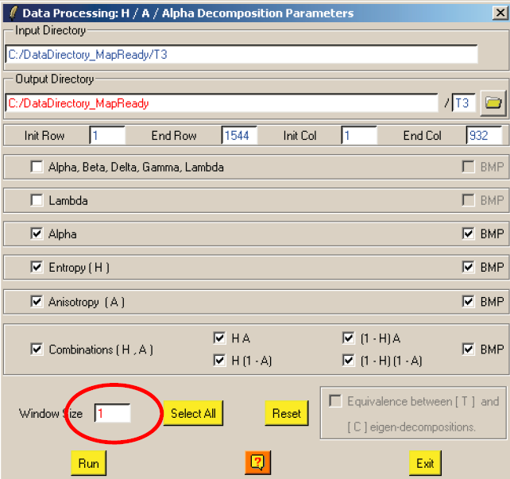
I. Introduction
1.4 Feature selection and transformation
Features available in PolSARPro:
(1) Matrix elements, eg. [T3]
(2) Polarimetric decomposition features
eg. H/A/Alpha decomposition
All the elements can be used as features

Slide 8
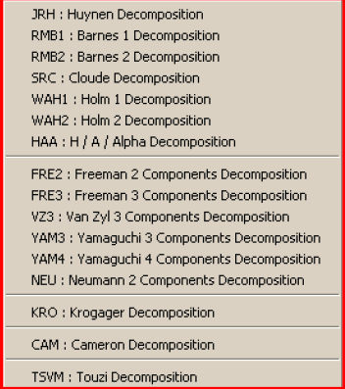
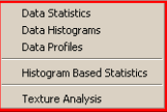
I. Introduction
1.4 Feature selection and transformation
Features available in PolSARPro:
(2) Polarimetric decomposition features and many others provided by PolSARPro:
But it does not mean the more the better for classification:
Dimension disaster problem:
With fixed training samples, accuracy increases with dim to one maximum acc., then decreases
The key reason is there are correlations between features , and more feature needs more training samples to solve the classification model.
PorSARPro solution:
SVM supervised classification, lets you to choose features.

Slide 9
I. Introduction
1.5 Classifier training and testing
“spectral classes “ and “informative classes”
Spectral classes
Classes can be spectrally separated, optical remote sensing
Classes can be separated by polarmteric mechanism or PolSAR data itself
Informative classes: useful for real applications
But,
Without training it is harder to get informative classes
Supervised classification
Un-supervised classification
RS data
RS data
Unsupervised classification
Classifier training
Training samples
Spectral classes
Informative classes
Accuracy testing samples
Classes combination
Informative classes
Map output
Map output

Slide 10
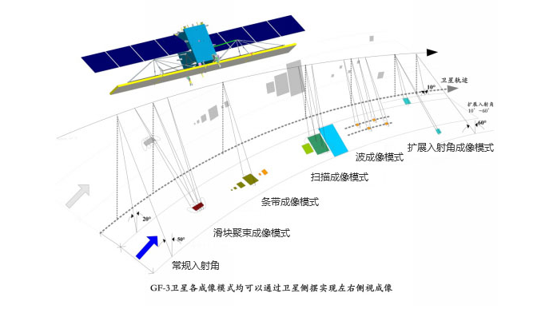
II. GF-3 PolSAR dataset
2.1 The Specifications of GF-3 Satellite
Advantages:
High spatial resolution (1 m)
Multi imaging mode (12 types)
Universal application (Ocean, Disaster reduction, Meteorology)
Parameter | Specification
Orbit altitude | 755 km
Orbit type | Sun synchronization repeating orbit
Revisit cycle | 29 days
Band | C
Incidence angle | 10°～60°

Slide 11
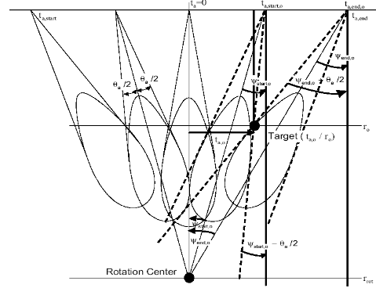
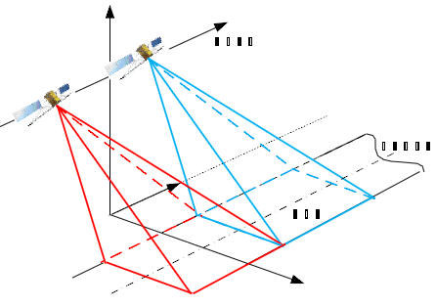
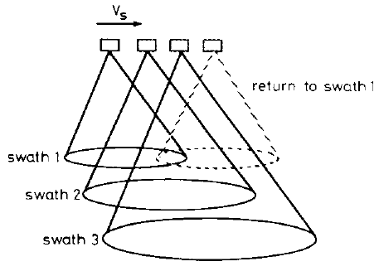
II. GF-3 PolSAR dataset
2.1 The Specifications of GF-3 Satellite
NO. | Mode | Incidence angle | Resolution (m) | Width (Km) | Polarization
1 | SL | 20-50 | 1 | 10 | Single
2 | UFS | 20-50 | 3 | 30 | Single
3 | FSI | 19-50 | 5 | 50 | Dual
4 | FSII | 19-50 | 10 | 100 | Dual
5 | SS | 17-50 | 25 | 130 | Dual
6 | QPSI | 20-41 | 8 | 30 | Full
7 | QPSII | 20-41 | 25 | 40 | Full
8 | NSC | 17-50 | 50 | 300 | Dual
9 | WSC | 17-50 | 100 | 500 | Dual
10 | GLO | 17-53 | 500 | 130 | Dual
11 | WAV | 20-41 | 10 | 5 | Full
12 | EXT | 10-60 | 25 | 80 | Dual
Spotlight
Stripmap
ScanSAR

Slide 12
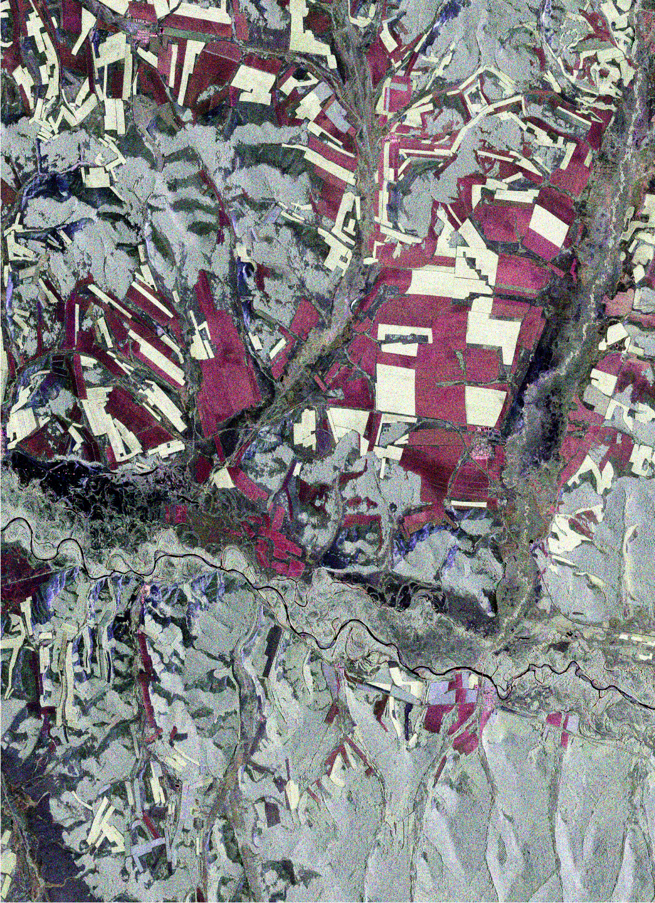
II. GF-3 PolSAR dataset
Range
Test Area
2.2 Practical Data of GF-3
GF-3 PolSAR Data
Azimuth
Observation Mode:
QPSΙ (Quad Polarization Strip Ι)
Observation Date:
Aug. 03. 2017.
Pixel Spacing(azimuth×range):
5.01 m × 4.50 m.
Center incidence angle:
48.8°
Calibrated and Multi-look ( 2 × 2) processed Result (Pauli RGB)

Slide 13
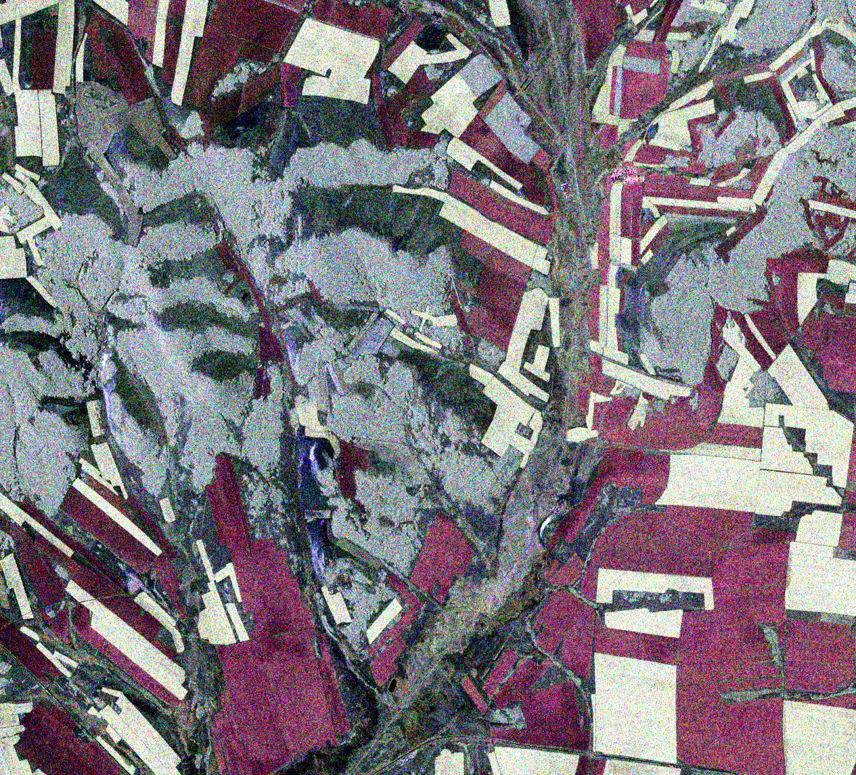
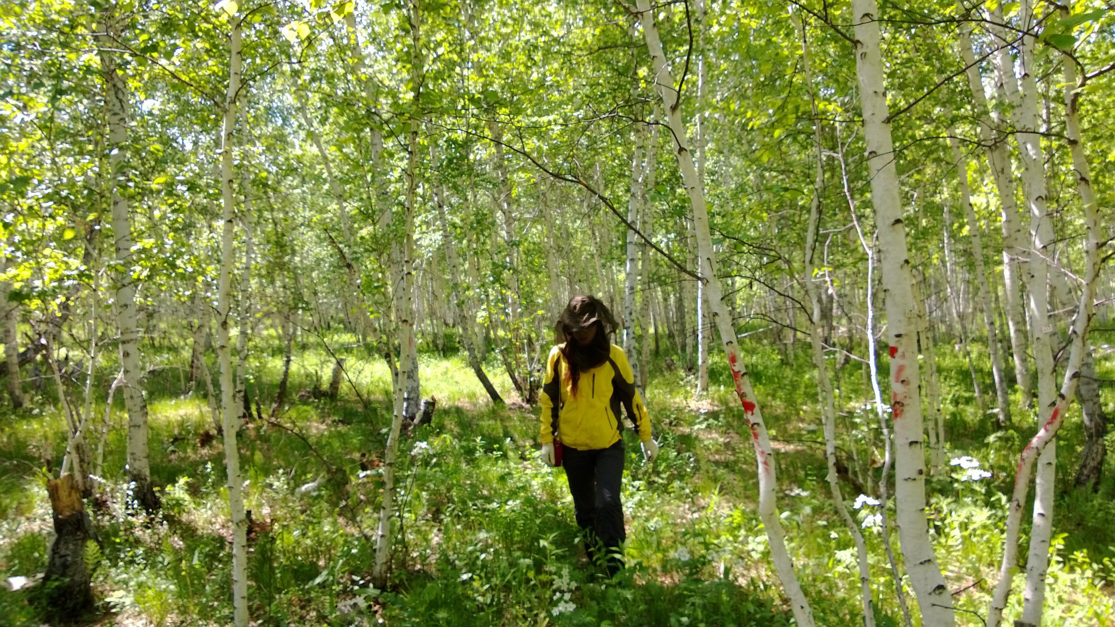
II. GF-3 PolSAR dataset
2.3 GF-3 PolSAR PauliRGB and the key landcover types
Forest
Subset Test Area

Slide 14
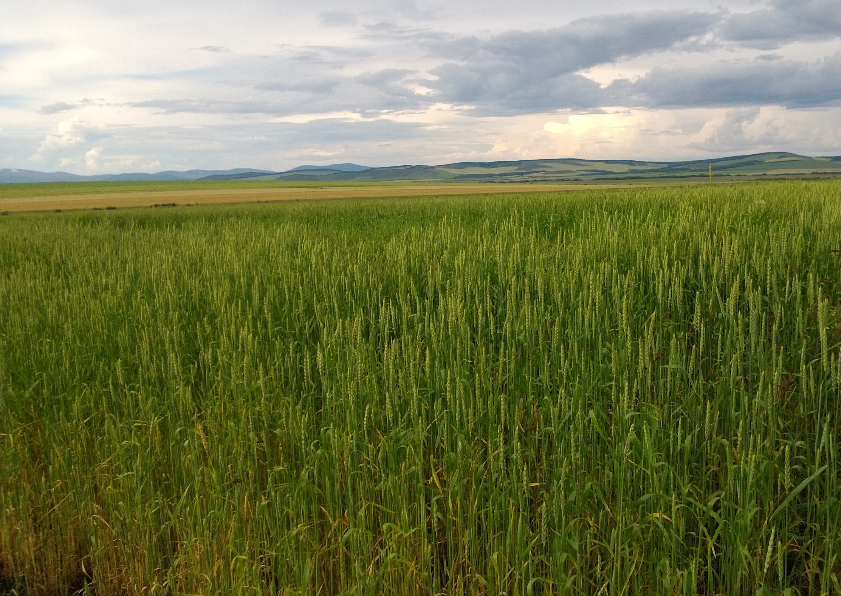
II. GF-3 PolSAR dataset
2.3 GF-3 PolSAR PauliRGB and the key landcover types
Wheat
Subset Test Area

Slide 15
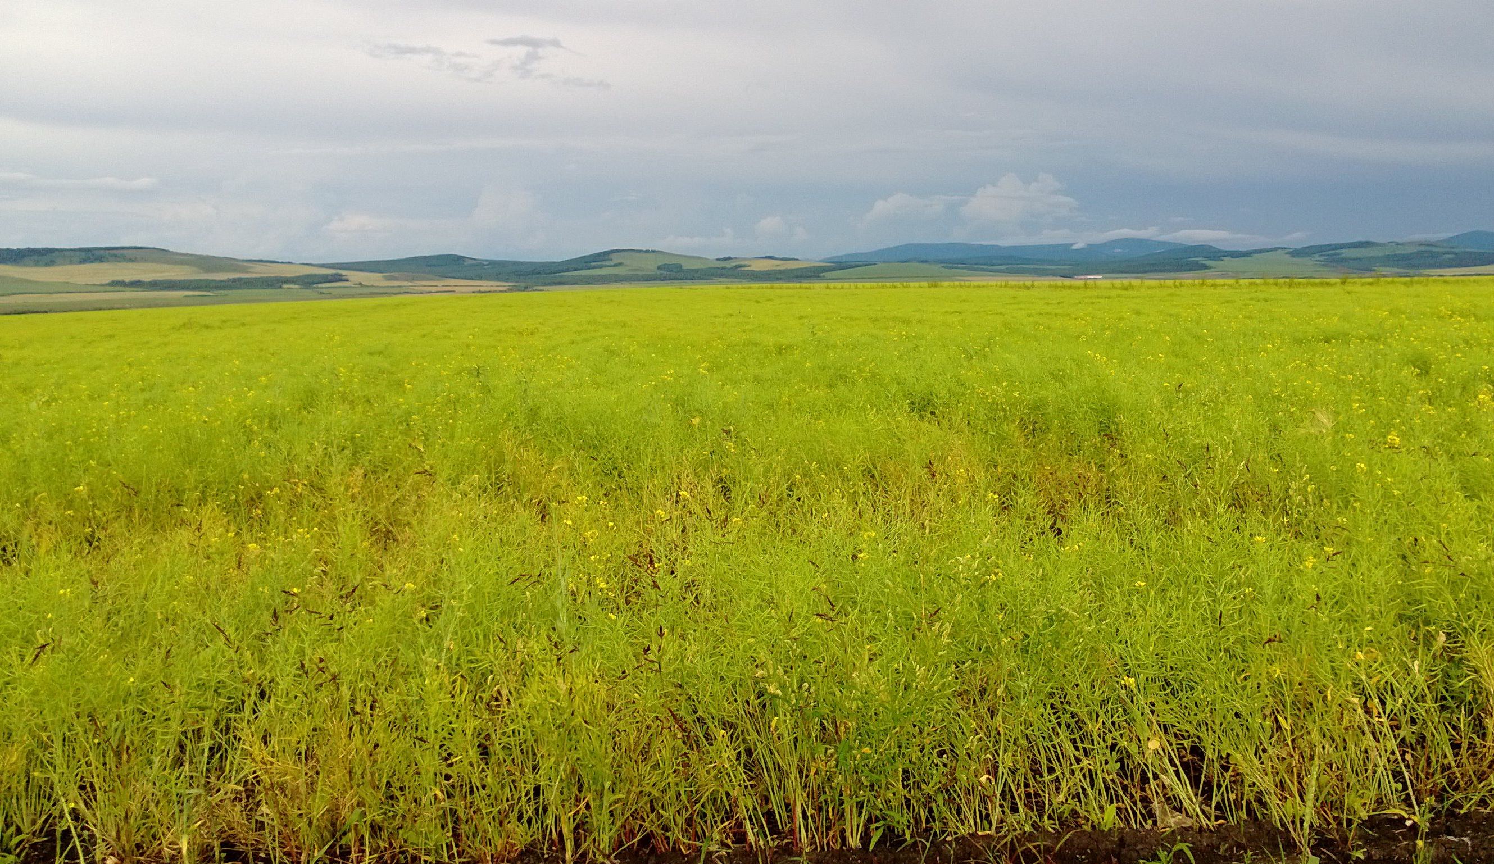
II. GF-3 PolSAR dataset
2.3 GF-3 PolSAR PauliRGB and the key landcover types
Cole
Subset Test Area

Slide 16
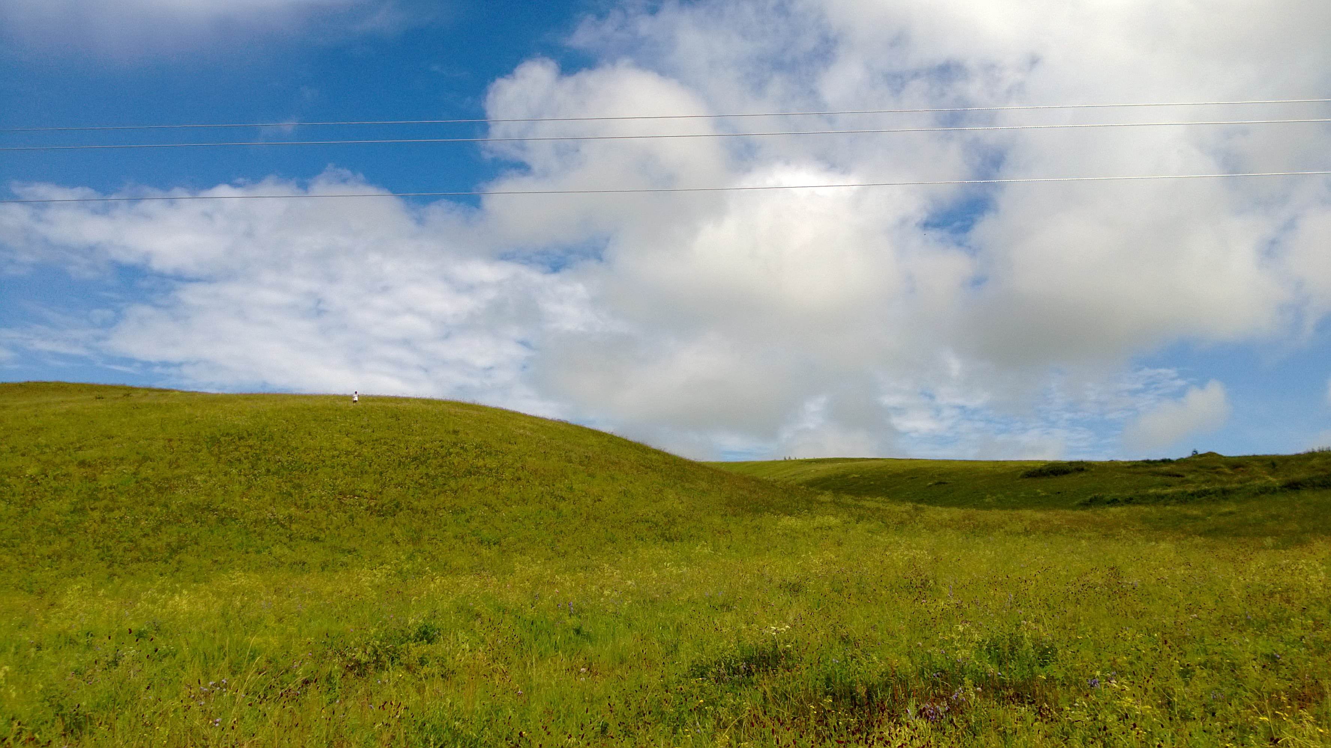
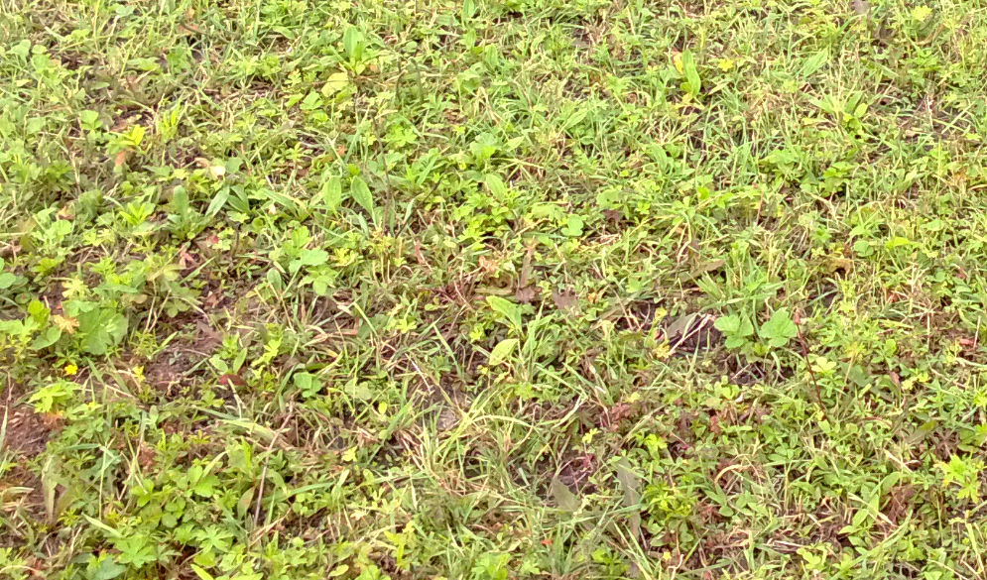
II. GF-3 PolSAR dataset
2.3 GF-3 PolSAR PauliRGB and the key landcover types
Grass
Subset Test Area

Slide 17
III. Practical
[T3] elements
Decomposition parameters
H/A/alpha classification
H/A/alpha WISHART classification
SVM supervised classification

Slide 18
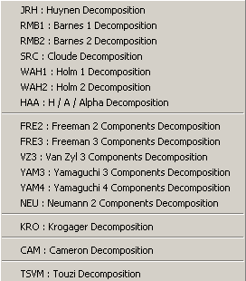
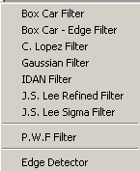
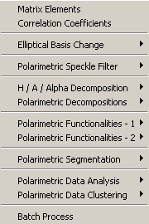
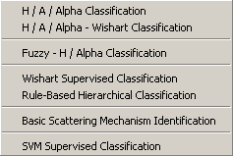
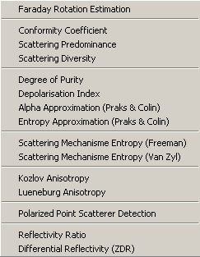
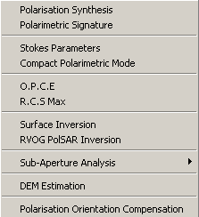
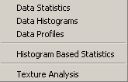
PolSARpro - Bio SOFTWARE

Slide 19
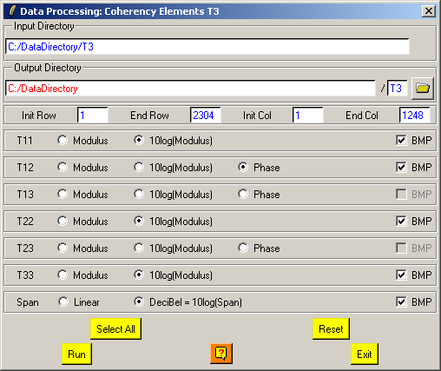
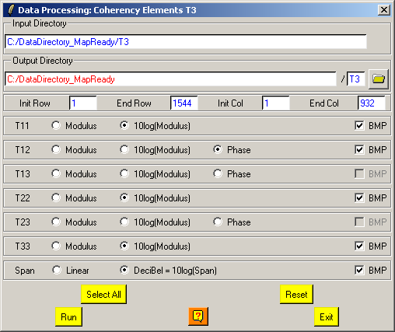
[T3] ELEMENTS
DATADIR
config.txt
T3
[T3x3] Elements
Txy_mod.bin
Txy_db.bin
Txy_pha.bin
Do it Yourself:
Select some elements, set the parameters and view the corresponding BMP files (select BMP).
Txy_mod.bmp
Txy_db.bmp
Txy_pha.bmp

Slide 20
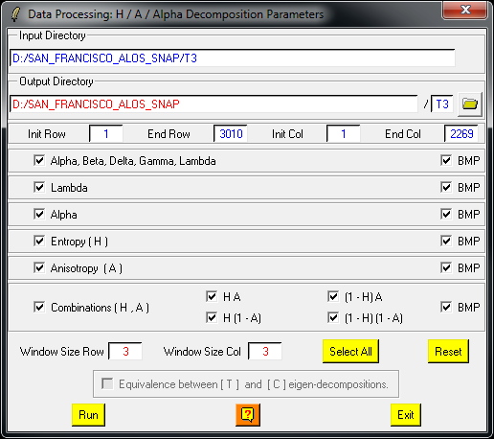
DECOMPOSITION PARAMETERS
Do it Yourself:
Select some elements, set the parameters (Nwin = 1) and view the corresponding BMP files (select BMP).
1
1

Slide 21
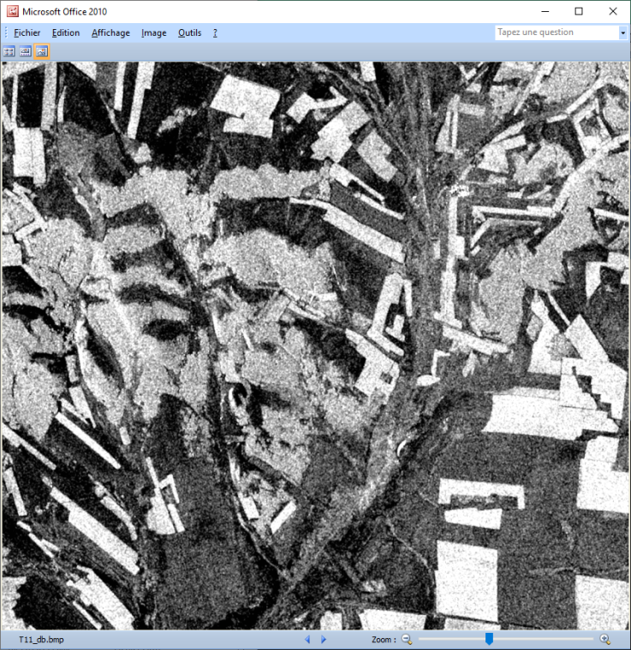
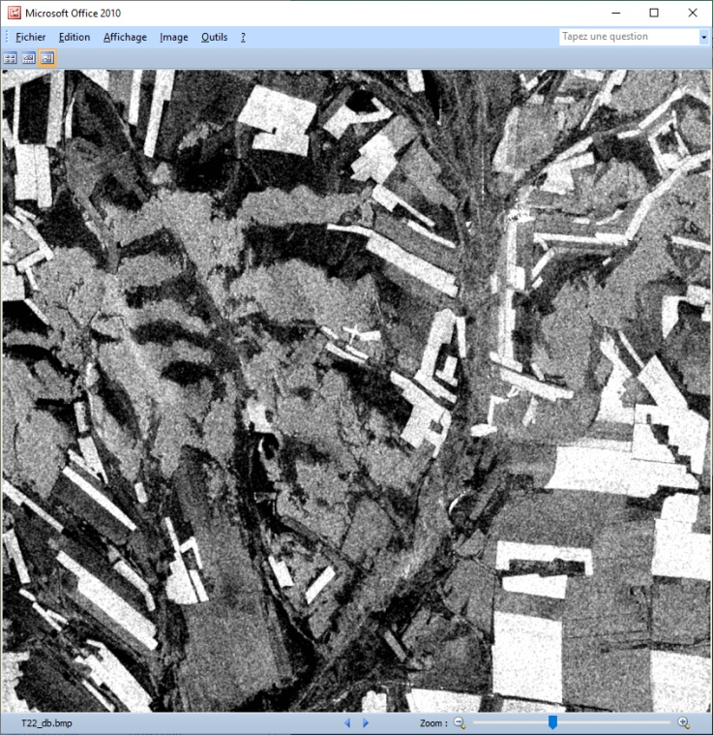
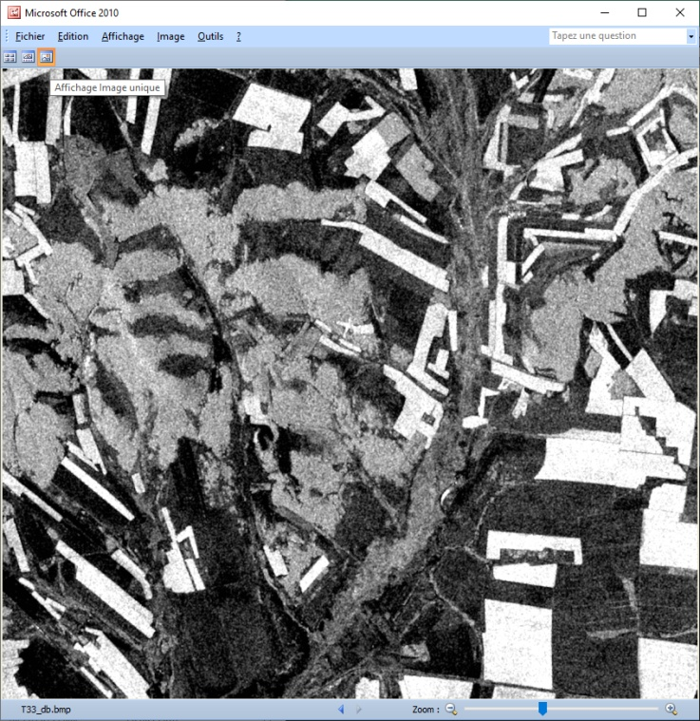
[T3] ELEMENTS
T11_dB
T22_dB
T33_dB

Slide 22
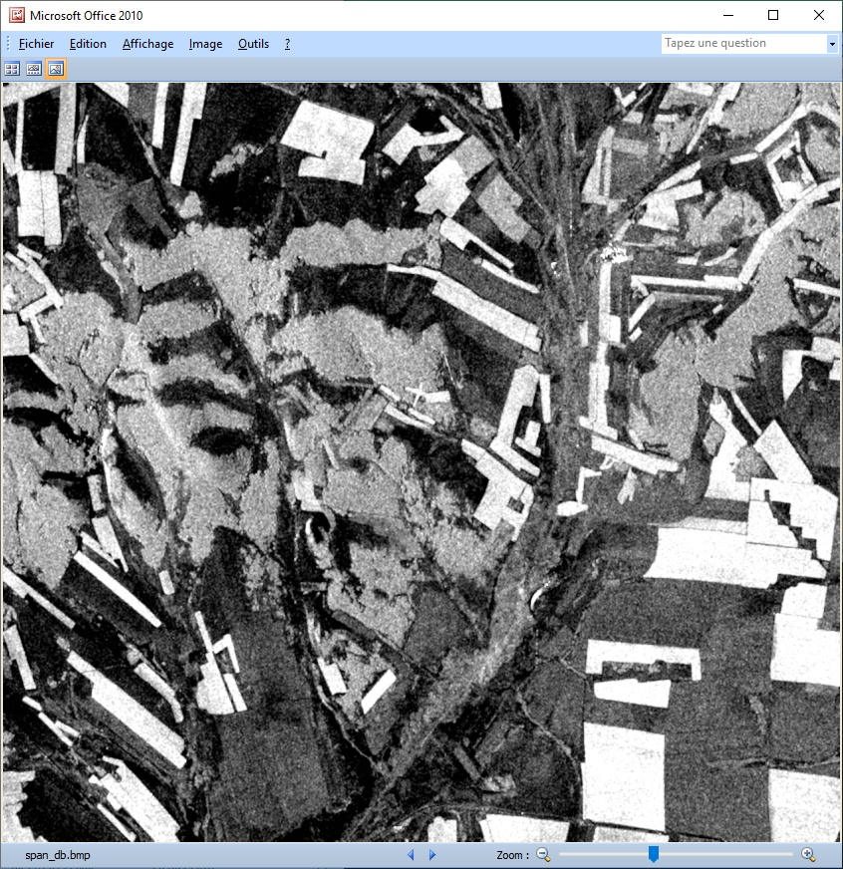
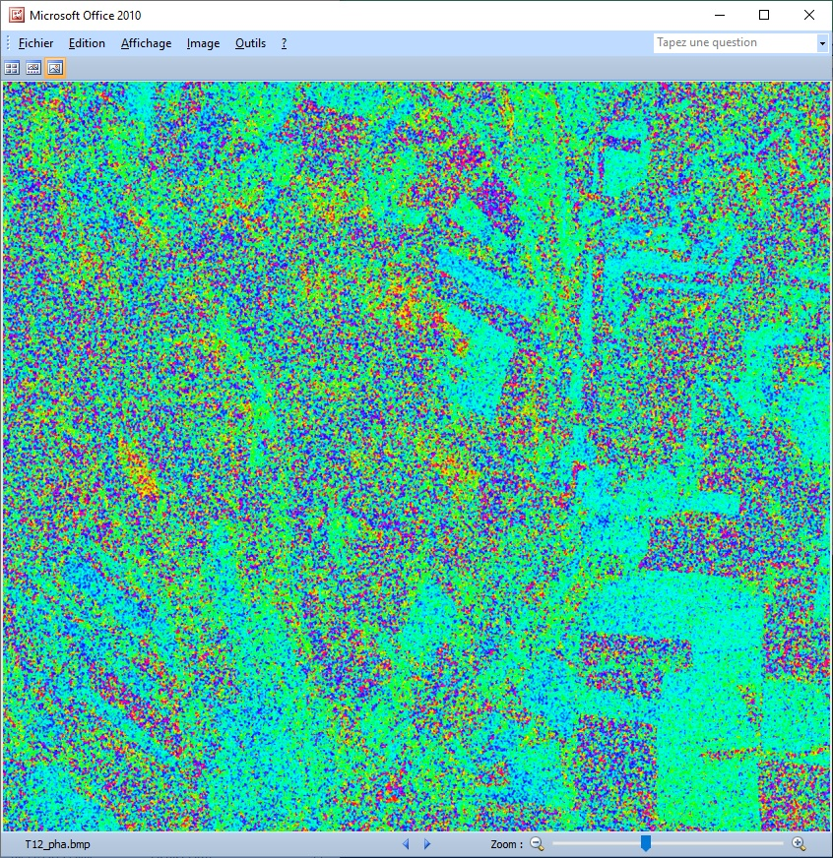
[T3] ELEMENTS
span_dB
T12_pha

Slide 23
PolSARpro - Bio SOFTWARE

Slide 24
DECOMPOSITION PARAMETERS
Do it Yourself:
Select some elements, set the parameters (Nwin = 3) and view the corresponding BMP files.

Slide 25
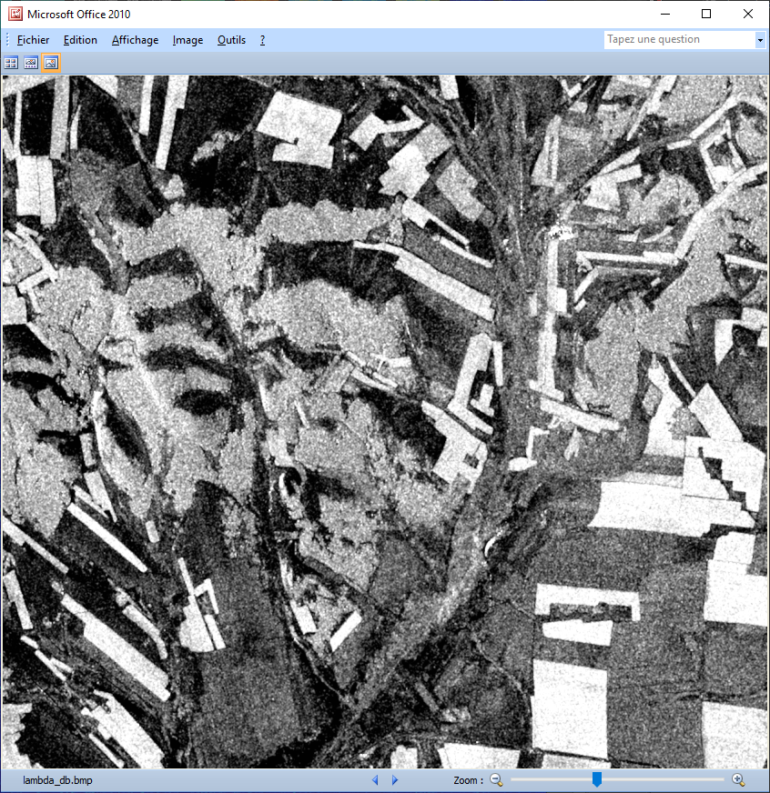
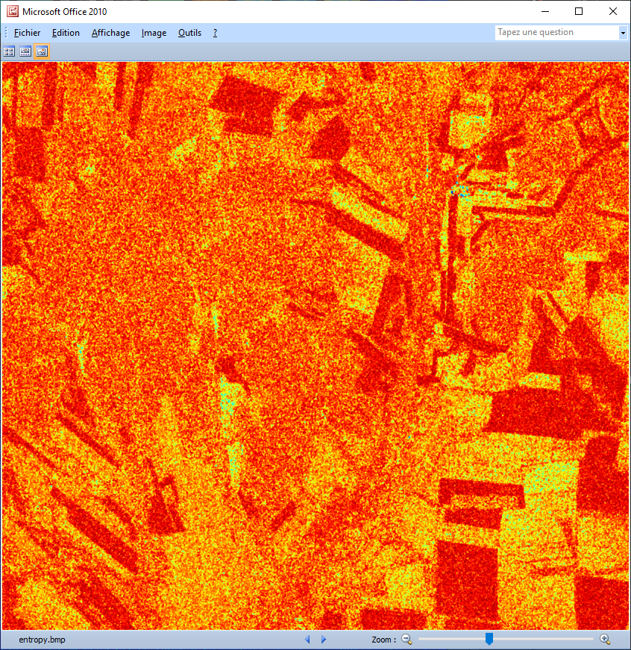
DECOMPOSITION PARAMETERS
Lambda
Entropy

Slide 26
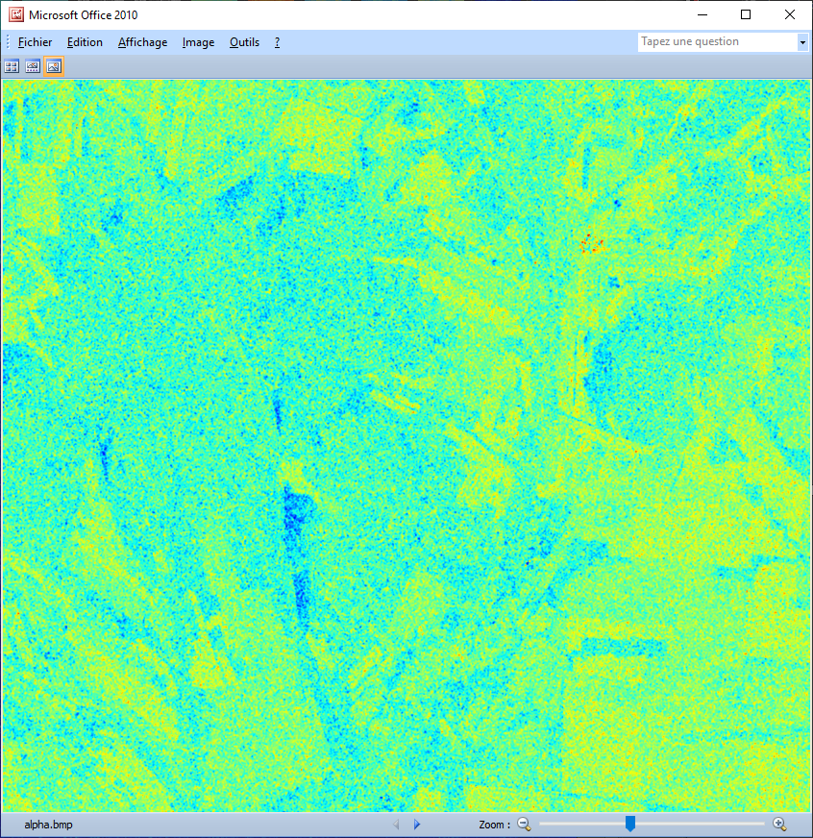
DECOMPOSITION PARAMETERS
Lambda
Alpha

Slide 27
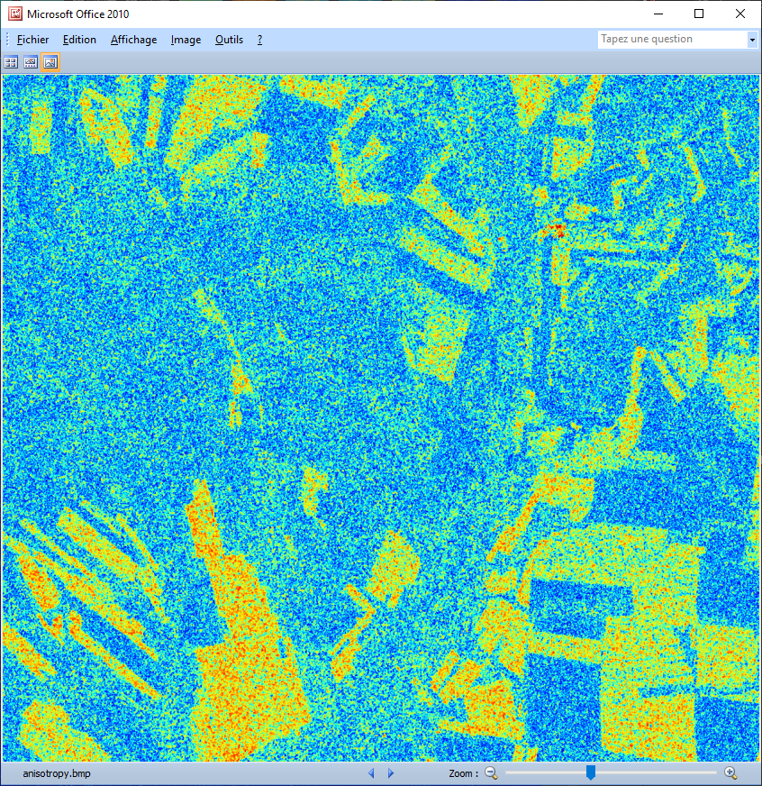
DECOMPOSITION PARAMETERS
Lambda
Anisotropy

Slide 28
DECOMPOSITION PARAMETERS
Entropy
Anisotropy

Slide 29
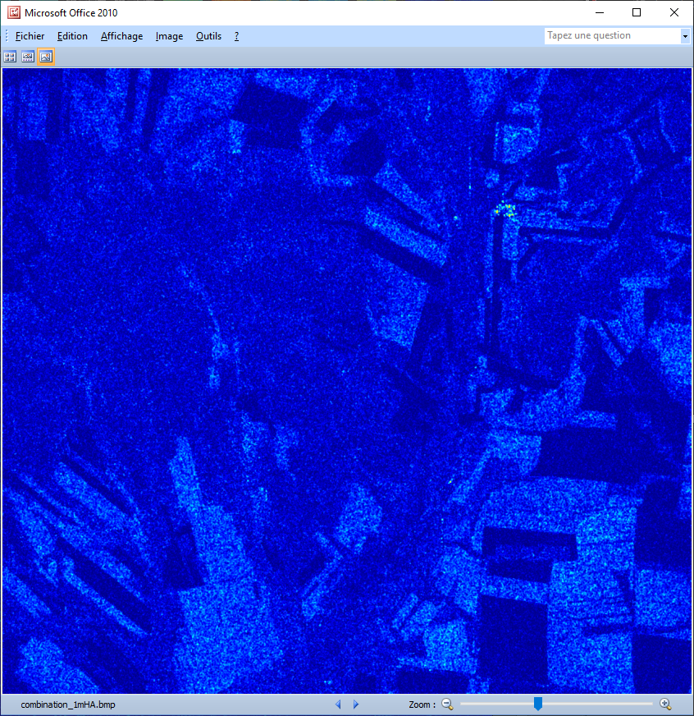
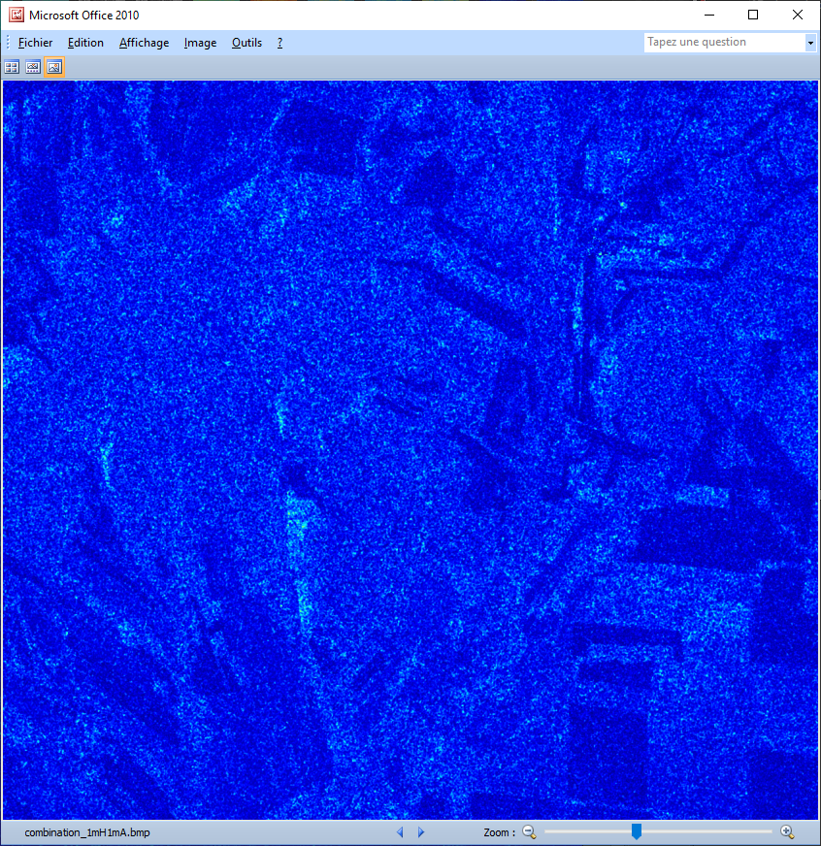
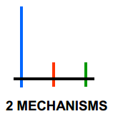
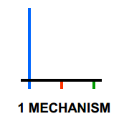
DECOMPOSITION PARAMETERS
(1–H) A
(1-H) (1-A)
low to medium entropy
low entropy and low anisotropy

Slide 30
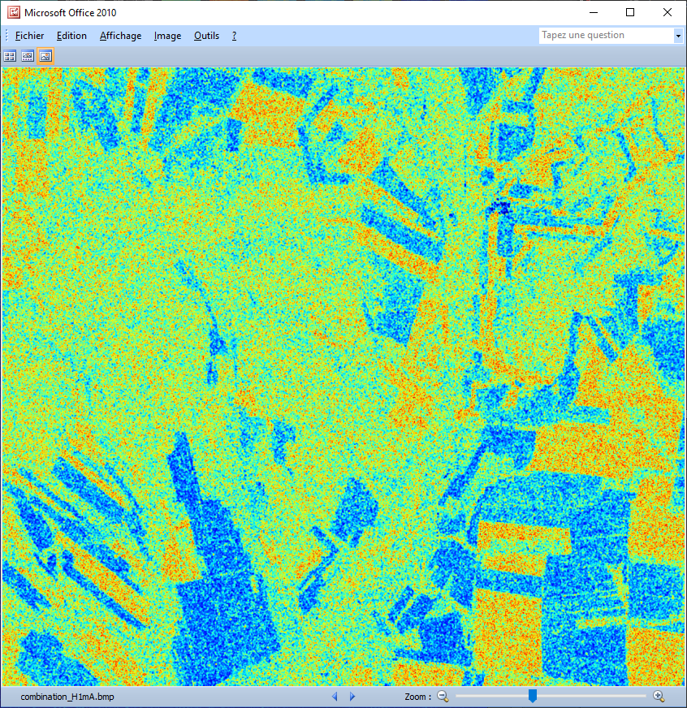
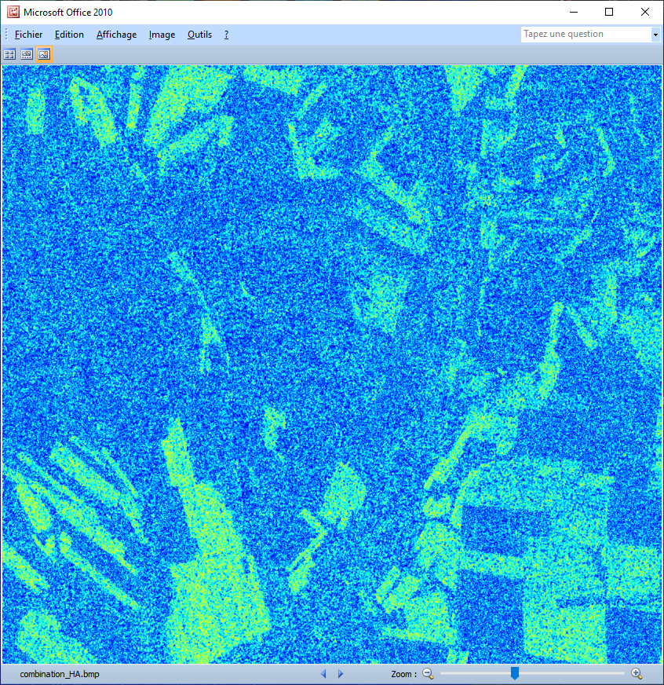
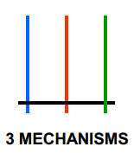
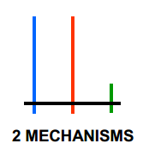
DECOMPOSITION PARAMETERS
H (1-A)
HA
high entropy and low anisotropy
high entropy and high anisotropy

Slide 31
PolSARpro - Bio SOFTWARE

Slide 32
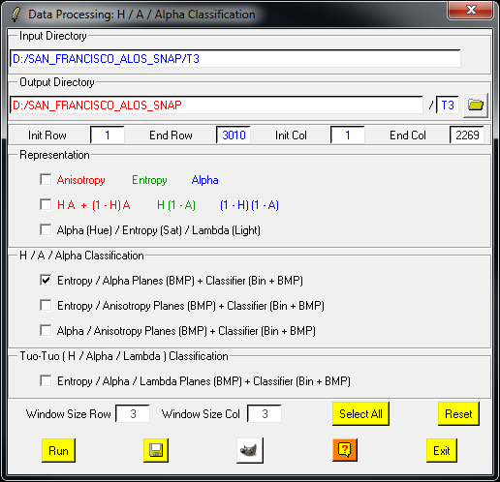
H / A / alpha CLASSIFICATION
Do it Yourself:
Select some elements, set the parameters (Nwin = 3) and view the corresponding BMP files.

Slide 33
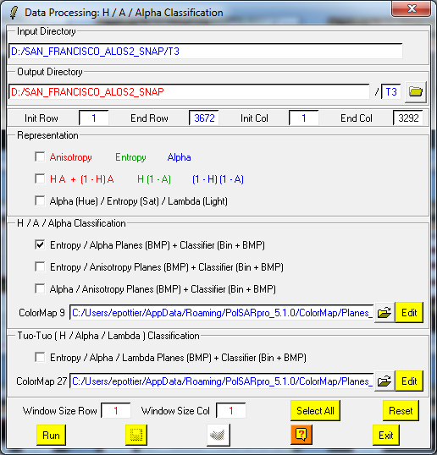
H / A / alpha CLASSIFICATION
DATADIR
config.txt
[T3x3] Elements
entropy.bin, anisotropy.bin, alpha.bin
combination_HA.bin, combination_1mHA.bin,
combination_H1mA.bin, combination_1mH1mA.bin
H_A_class.bin, H_Alpha_class.bin, A_Alpha_class.bin
entropy.bmp, anisotropy.bmp, alpha.bmp
combination_HA.bmp, combination_1mHA.bmp,
combination_H1mA.bmp, combination_1mH1mA.bmp
H_A_class.bmp, H_Alpha_class.bmp, A_Alpha_class.bmp
H_A_occurence.bmp, H_Alpha_ occurence.bmp,
A_Alpha_ occurence.bmp, H_A_segmented.bmp,
H_Alpha_ segmented.bmp, A_Alpha_ segmented.bmp
HAlphaLambda_RGB.bmp, HAAlpha_RGB.bmp
HACombinations_RGB.bmp
Do it Yourself:
Select some elements, set the parameters (Nwin = 1) and view the corresponding BMP files.

Slide 34
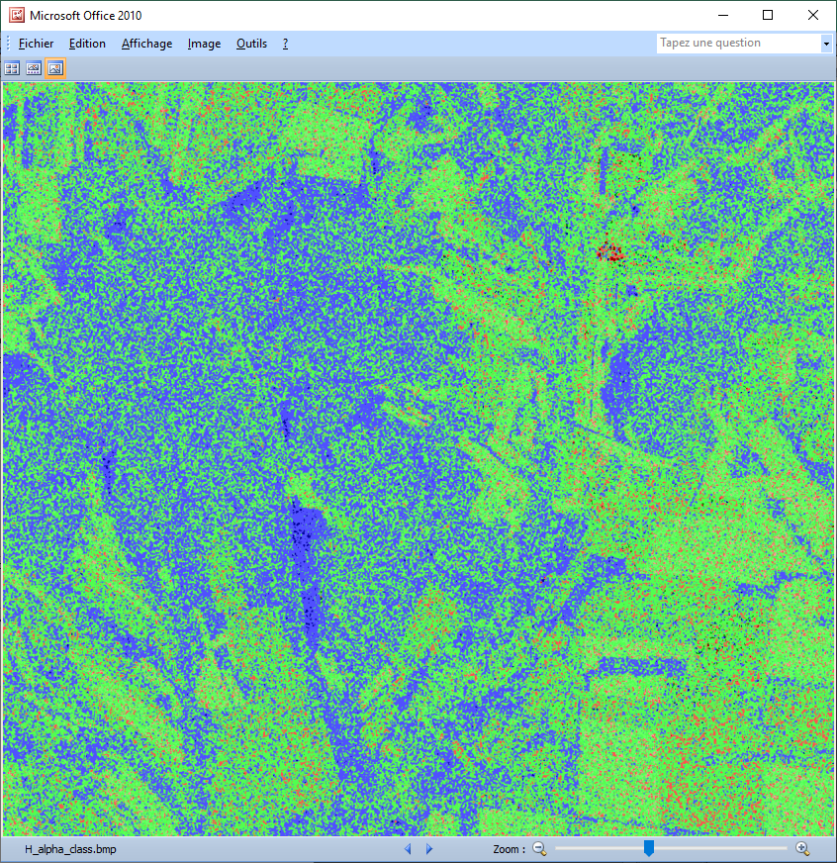
H / A / alpha CLASSIFICATION

Slide 35
H / alpha / Lambda CLASSIFICATION
Do it Yourself:
Select some elements, set the parameters (Nwin = 1) and view the corresponding BMP files.
1
1

Slide 36
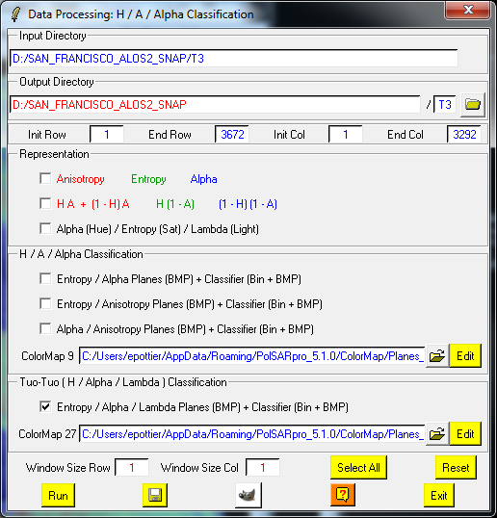
H / alpha / Lambda CLASSIFICATION
DATADIR
config.txt
[T3x3] Elements
H_alpha_lambda_class1(2,3).bin,
H_alpha_lambda_occurence_class1(2,3).bin,
H_alpha_lambda_segmented_class1(2,3).bin,
H_alpha_lambda_class.bin,
H_alpha_lambda_class1(2,3).bmp,
H_alpha_lambda_occurence_class1(2,3).bmp,
H_alpha_lambda_segmented_class1(2,3).bmp,
H_alpha_lambda_class.bmp,
Do it Yourself:
Select some elements, set the parameters (Nwin = 3) and view the corresponding BMP files.

Slide 37
H / alpha / Lambda CLASSIFICATION
Low λ
Medium λ
High λ

Slide 38
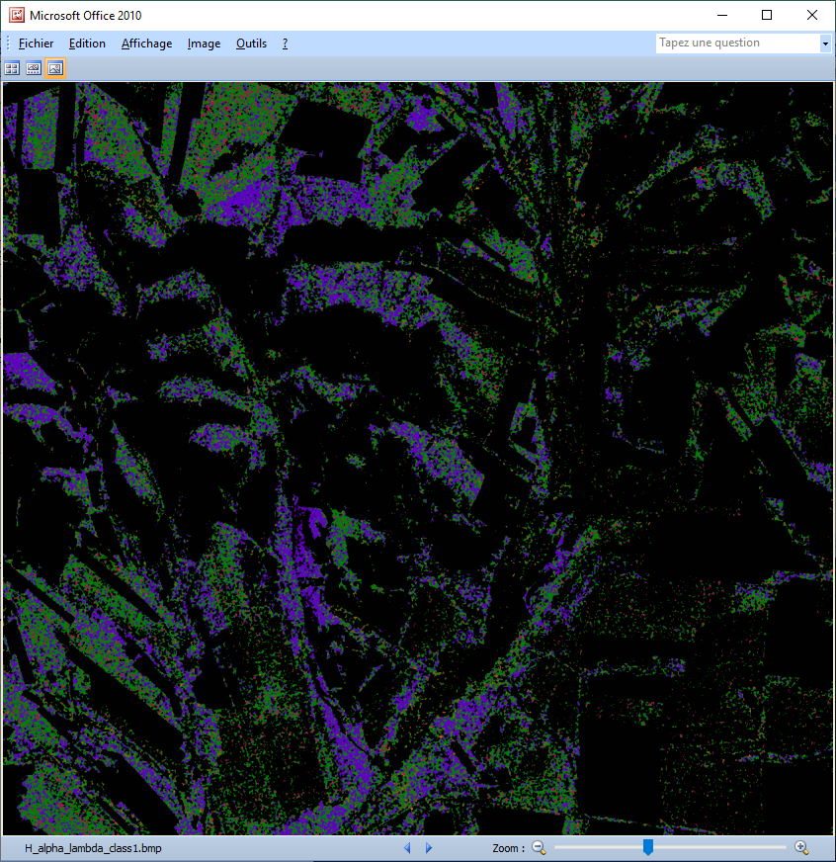
H / alpha / Lambda CLASSIFICATION
Low λ

Slide 39
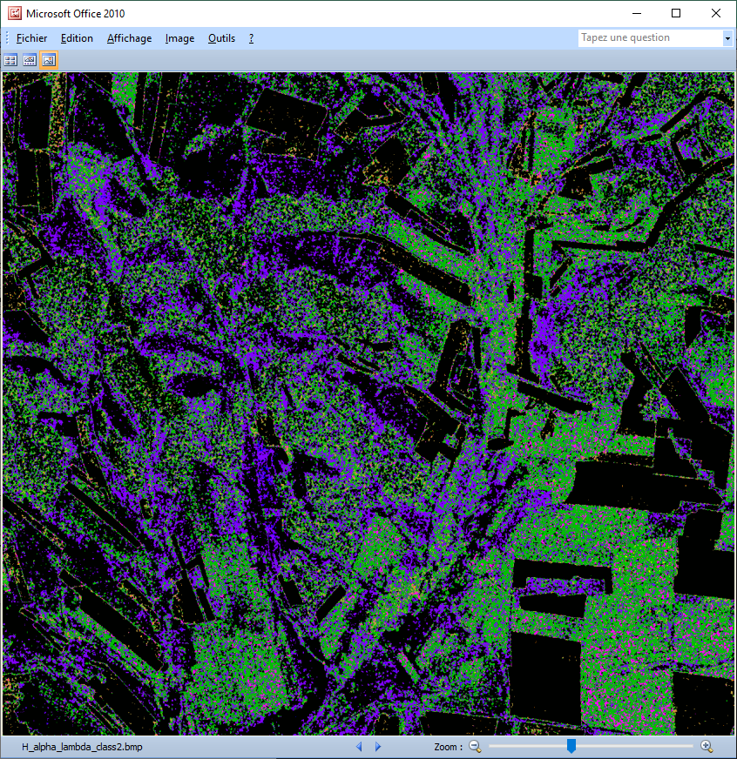
H / alpha / Lambda CLASSIFICATION
Medium λ

Slide 40
H / alpha / Lambda CLASSIFICATION
High λ

Slide 41
H / alpha / Lambda CLASSIFICATION

Slide 42
PolSARpro - Bio SOFTWARE

Slide 43
WISHART - H/A/alpha CLASSIFICATION
Do it Yourself:
Set the parameters, run and view the corresponding BMP files.
1
1

Slide 44
WISHART - H/A/alpha CLASSIFICATION
DATADIR
config.txt
[T3x3] Elements
Wishart_H_alpha_class_X.bin
Wishart_H_A_alpha_class_X.bin
Wishart_H_alpha_class_X.bmp
Wishart_H_A_alpha_class_X.bmp
X = window size
Do it Yourself:
Set the parameters, run and view the corresponding BMP files.

Slide 45
WISHART - H/A/alpha CLASSIFICATION

Slide 46
WISHART - H/A/alpha CLASSIFICATION

Slide 47
SVM supervised classification
GF-3 PolSAR Raw Data
We started this practical session from T3 matrix that has been calibrated and multi-look processed.
Import and Calibration
Multi-Look
T3 Matrix
Speckle Filter
GF-3 QPSI Quad-Pol
Range pixel spacing:
9.0 m
Azimuth pixel spacing:
10.0 m
Features Extraction
Sample Data
SVM classifier
Classification Result

Slide 48
SVM supervised classification
Step-1: Define classification system & classification legend
Classification system:
Legend:
耕地(crop land)
1.1 水田(paddy)
1.2 水浇地(irrigated)
1.2 旱地(dry)
2. 园地(garden)
3. 林地(forest)
3.1 乔木林地(arbor)
3.2 竹林地(bamboo)
…
4. 草地(grass land)
4.1 天然牧草地(natural grass land)
…
5. 商服用地(commercial)
6.
…
12. 其他土地(others)
Wheat
Cole
Forest
Grass

Slide 49
Step-2: Speckle Filter

Slide 50
Step-2: Speckle Filter
PauliRGB
Before Filter
1
PauliRGB
After Filter
2

Slide 51
Step-3: Features Extraction
Polarization features:
entropy.bin
anisotropy.bin
alpha.bin

Slide 52
Step-4: SVM classifier
1
2
Select the training sample data.
Select the classification features
Select the Kernel function
Run Classification
3
4

Slide 53
Step-4: SVM classifier
Select the training sample data.

Slide 54
Step-4: SVM classifier
Select the training sample data.
Basic operation:
Zoom button
Select button
Open the menu

Slide 55
Step-4: SVM classifier
Select the training sample data.
Basic operation:
Add a new class 1.
Select first area for class1
Click ‘Select area’ , draw a polygon
Click ‘Select area’ , stop drawing;
Click ‘Delete area’ .
Select second area for class1;
....
Add a new class 2.
Select first area for class2;Select second area for class2;....
....
Save configuration

Slide 56
Step-4: SVM classifier
Select the training sample data.
Do it yourself.
Prepare the training sample data
Forest
Grass
Wheat
Cole

Slide 57
Step-4: SVM classifier
2. Select the classification features
Select the features that need to be added to the classifier

Slide 58
Step-4: SVM classifier
3. Select the Kernel function
We choose polynomial kernel function
Degree:2
4. Run Classification
3
4

Slide 59
II. GF-3 PolSAR dataset
Classification result vs. GF-3 PolSAR Pauli-RGB image
Forest
Grass
Cole
Wheat
Cole

Slide 60
Thanks

