Slide 1
EO AFRICA Chapter 7.1 | Hyper-Temporal Mapping of Ecological Systems Part 2 Kees de Bie and Andy Nelson ITC, UTwente

Slide 2
Specific Learning Objectives
What is hyper-temporal remote sensing
Define what hyper-temporal RS is
Identify the causes of variability observed with hyper-temporal RS
Identify the main hyper-temporal data sets and their evolution in time
Indicate some pre-processing methods for hyper-temporal data
Recommend where hyper-temporal RS can be used
How to use hyper-temporal remote sensing data
Understand why and how to classify hyper-temporal RS data
Indicate methods to select the optimum amount of classes
Know how hyper-temporal data are visualized in profiles and maps

Slide 3
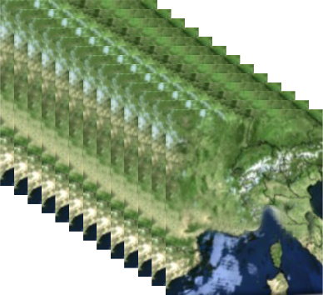
Understand why and how to classify hyper-temporal RS data
A Data-Cube:
Hyper temporal data sets contain a very large amount of data.
How can we view and use this data?

Slide 4
Understand why and how to classify hyper-temporal RS data
The MVC of one pixel for the different periods is plotted in this graph. The NDVI values of a pixel are plotted against time.
The shape of such plots indicates the behavior of vegetation. These graphics are called profiles.
A Data-Cube:

Slide 5
Understand why and how to classify hyper-temporal RS data
In this natural landscape, the landcover is homogenous across the pixel.
Question – can you think of examples where this does NOT occur?

Slide 6
Understand why and how to classify hyper-temporal RS data
Most agricultural areas are mixed pixels at moderate resolution

Slide 7
Understand why and how to classify hyper-temporal RS data
Question Can we use supervised classification to group and classify our hyper-temporal data sets ?
It is impossible to create a training set of pure land cover classes as most pixels are likely mixed pixels. Also similar land covers shows different NDVI-readings from season to season.
Therefore it is impossible to use fixed NDVI-curves for fixed land cover types.
A supervised classification is not possible

Slide 8
Understand why and how to classify hyper-temporal RS data
Unsupervised classification algorithms are clustering or partitioning techniques that identify clusters in your data, grouping together data that have the same or similar characteristics into a class.
ISODATA (Iterative Self-Organising Data Analysis Technique) calculates class means evenly distributed in the data space then iteratively clusters the remaining pixels using minimum distance techniques. Each iteration recalculates means and reclassifies pixels with respect to the new means. This process continues until the number of pixels in each class changes by less than the selected pixel change threshold or the maximum number of iterations is reached.

Slide 9
Understand why and how to classify hyper-temporal RS data

Slide 10
Understand why and how to classify hyper-temporal RS data

Slide 11
Understand why and how to classify hyper-temporal RS data
Hyper-Temporal RS images have moderate spatial resolution
This means that we often have mixed pixels
This make supervised classification challenging/impossible
Unsupervised classification groups together similar pixels, in this case, pixels that have similar temporal profiles.
What those classes represent requires further interpretation.
The classes can be used to design field sampling strategies.

Slide 12
Understand why and how to classify hyper-temporal RS data
All unsupervised methods require a decision on how many classes to map. How to make this selection?
Q - What is the purpose of classification?
Q - Can you think of some good criteria for making this decision?

Slide 13
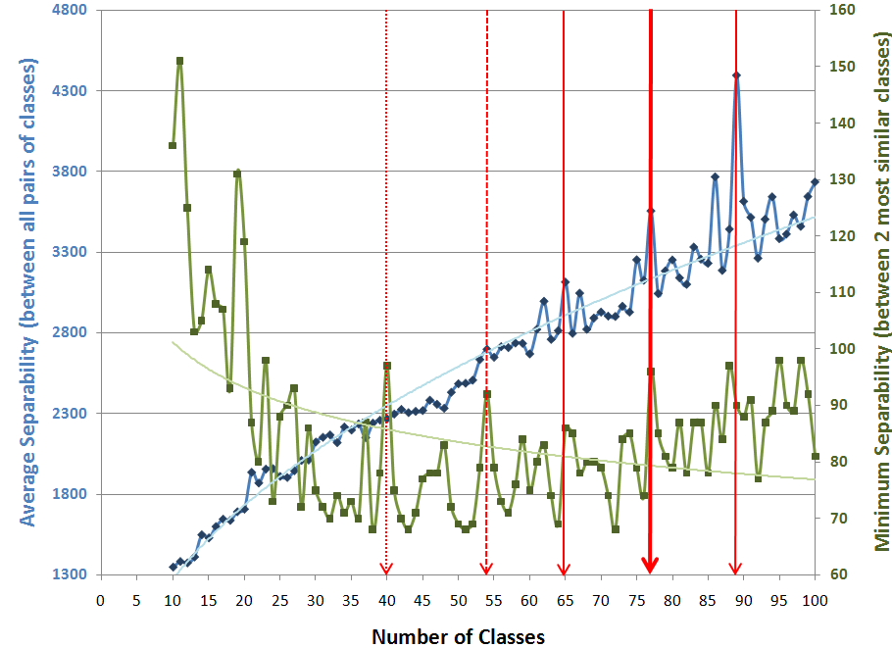
Understand why and how to classify hyper-temporal RS data
Problem:
How many classes???
My ‘old’ solution: Create ALL maps (e.g. having from 10 to 100 classes); include preparation of the signature files (contains seperability info).
Then: Plot the average and minimum seperability statistics of all the maps, and visually select the “best” product.

Slide 14
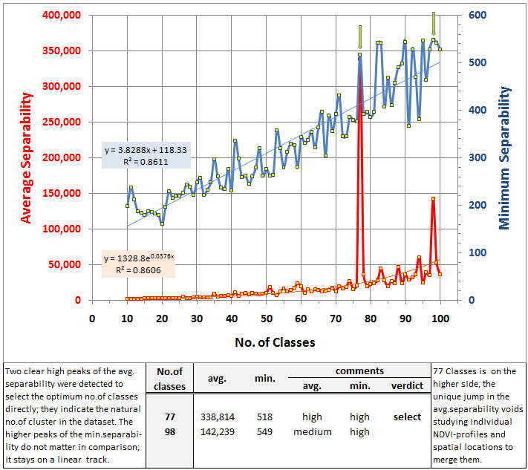
Understand why and how to classify hyper-temporal RS data
Classes must be clearly separable
This solution creates an enormous amount of work.
My ‘new’ advise to circumvented that:
Just create ‘too many’ classes
Then focus on the legend (NDVI-Profiles) to create groups. Use K-Means hierarchical clustering of those profiles to get the required ‘initialization’ and check the respective areas on the map. → ‘You’ must decide on the features that ‘matter’ while creating the groups. → See attached article (example!)

Slide 15
Understand why and how to classify hyper-temporal RS data
Signature separability is a statistical measure of distance between two signatures. This distance can be used to determine how distinct your signatures are from one another.

Slide 16
Understand why and how to classify hyper-temporal RS data
The user needs to select the number of classes in unsupervised classification.
We want the classes to be as seperable as possible so that we dont have duplication of informaiton across classes.
Seperability indices can be used to determine which number of classes give the highest amount of separability.

Slide 17
Know how HT-data are visualized in profiles and maps
To some extent this graph allows identifying good (more vegetation) and bad years (little vegetation).
These graphs are also very useful to investigate trends in vegetation response over the years.
But this is a lot of data.
Q - Can you think of other ways to visualize this?

Slide 18
Know how HT-data are visualized in profiles and maps

Slide 19
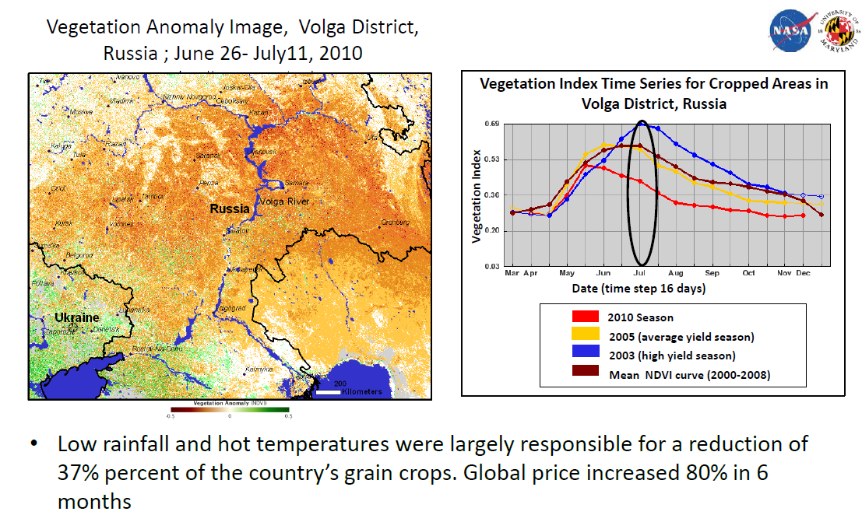
Know how HT-data are visualized in profiles and maps

Slide 20
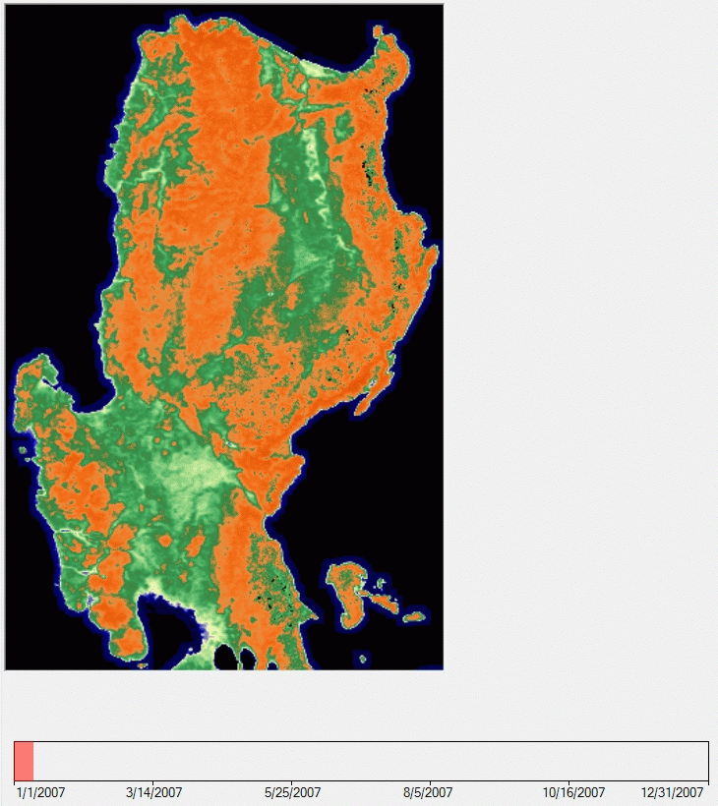
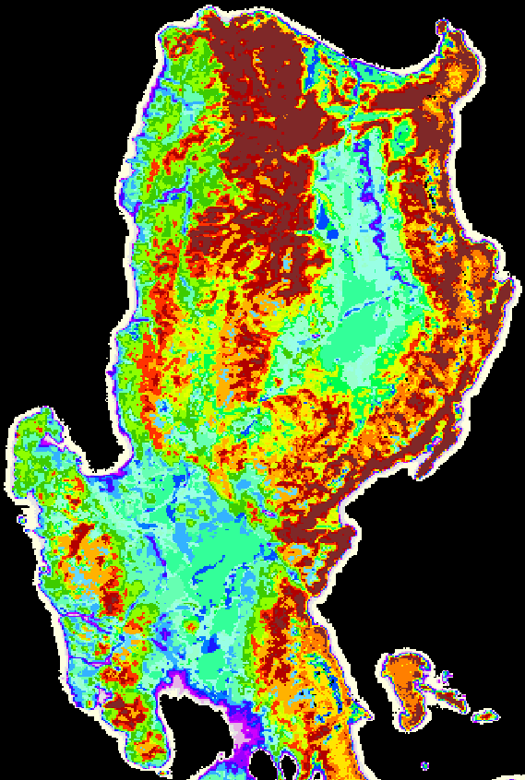
Example: Linking profiles to the map
Greenness of Luzon during a year
→ 79 classes
Classified image
10-day periods
(3 per month)
SPOT-VGT NDVI
S10 MVC-imagery: 1998-2011
(de Bie, unpub.)

Slide 21
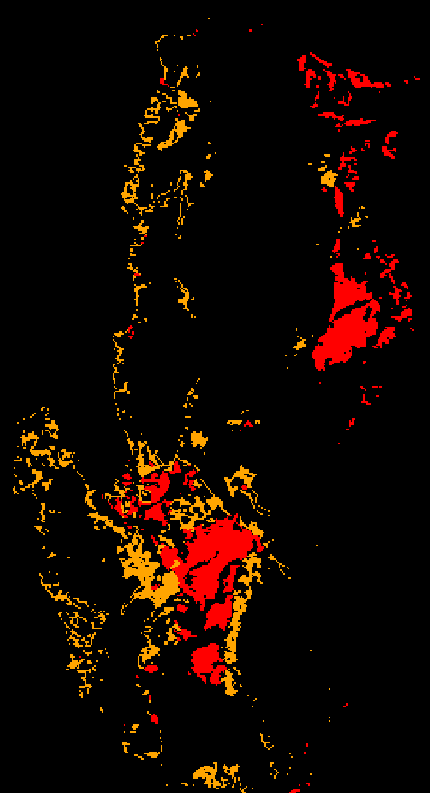
Example: Linking profiles to the map
‘Time’ moved to the legend
Classified image
Legend of
selected classes
SPOT-VGT NDVI
S10 MVC-imagery: 1998-2011
(de Bie, unpub.)

Slide 22
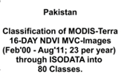
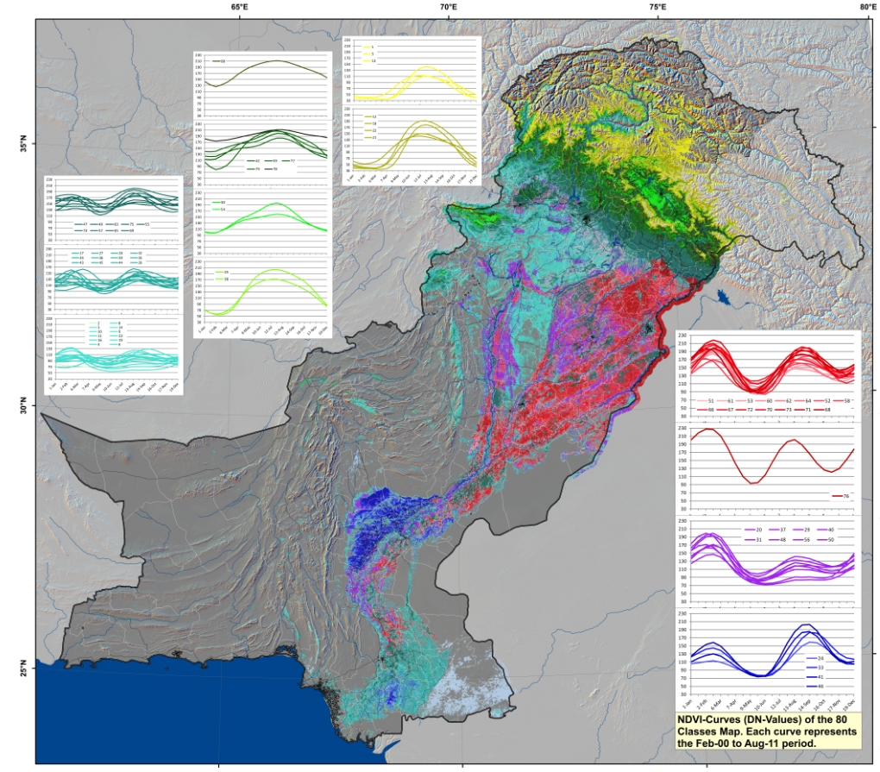
Know how HT-data are visualized in profiles and maps

Slide 23
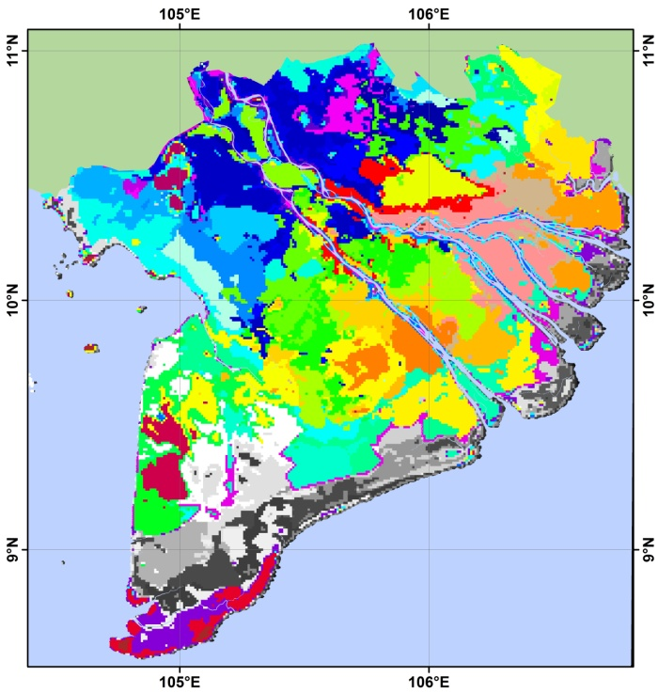
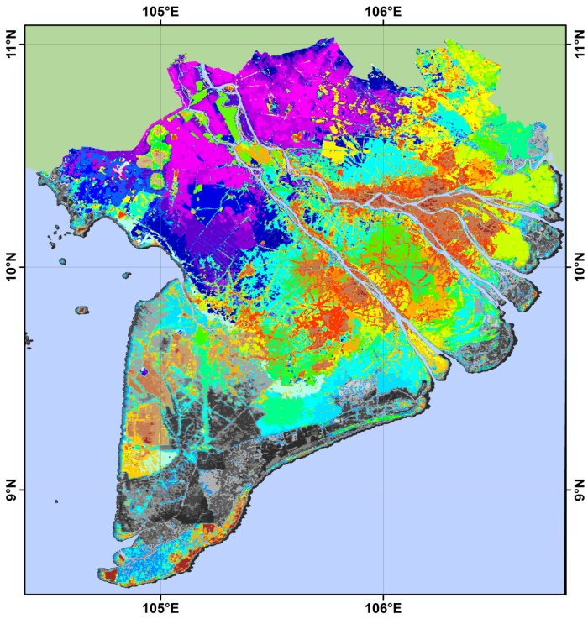
What about using different input NDVI-Images
Spot-VGT
1km-sq
Inclusions within the landscape have little influence → higher level of generalization
Modis-Terra 250m-sq
Impact of mixels increases → roads, canals, etc. become visible
MODIS is spatially better (but temporally poorer)…and it becomes grainy.
SPOT-VGT allows identifying the ‘larger’ spatial agro-ecological units.

Slide 24
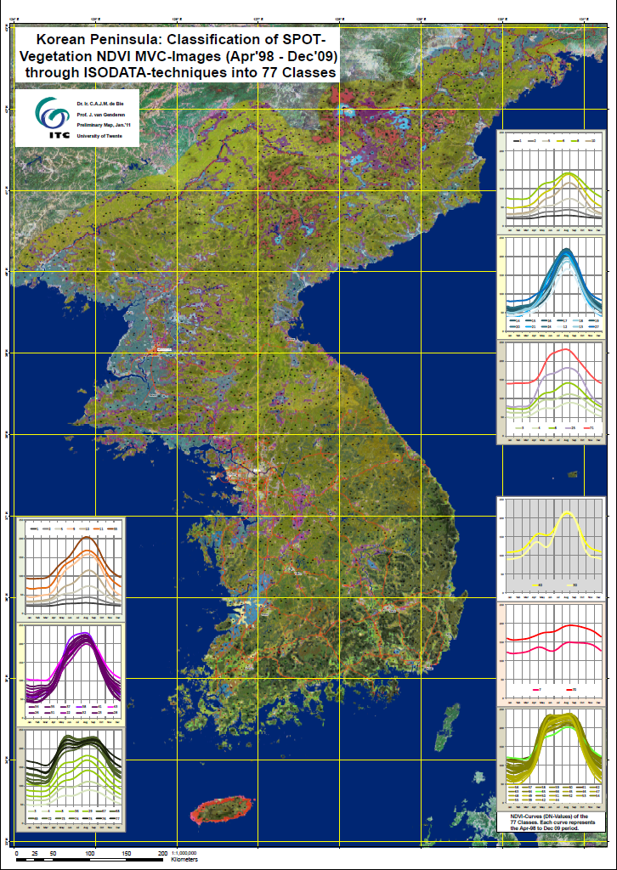
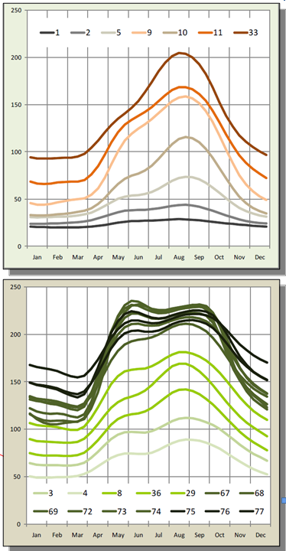
Use of colours to indicate gradients (Korea)

Slide 25
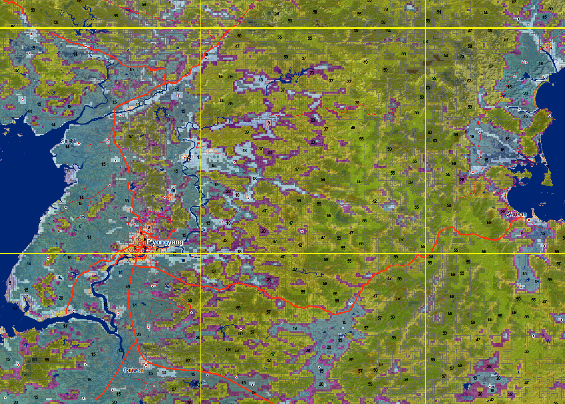
Use of colours to indicate gradients (Korea)

Slide 26
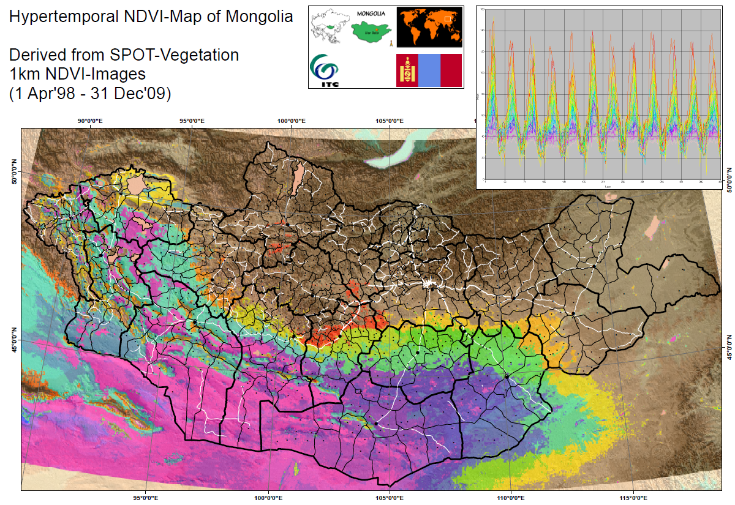
Use of colours to indicate gradients (Mongolia)

Slide 27
Know how HT-data are visualized in profiles and maps
Hypertemporal RS captures the time dimension
Visualising this requires animation or the use of temporal profiles.
Temporal profiles for a given year can be compared to short or long term averages to spot deviations or anomalies.
Further grouping of profiles may be needed, for example to show different cropping calendars within the same cropping sequence.
Temporal profiles can be used, with field data to generate map legends that contain both spatial and temporal information.

Slide 28
Hyper-Temporal Remote Sensing
The use of RS imagery with high temporal frequency to extract spatial and temporal information.
Time as a classifying variable to better understand spatial and temporal variability.
Rich datasets are available, globally and for free.
Toolkits exist to enable processing of the imagery.
Many possible applications and research questions.

Slide 29
References, Sources
de Bie, C.A.J.M., Khan, M.R., Toxopeus, A.G., Venus, V. and Skidmore, A.K. (2008) Hypertemporal image analysis for crop mapping and change detection. In: ISPRS 2008 : Proceedings of the XXI congress : Silk road for information from imagery : the International Society for Photogrammetry and Remote Sensing, 3-11 July, Beijing, China. Comm. VII, WG VII/5. Beijing : ISPRS, 2008. pp. 803-812
de Bie, C.A.J.M., Khan, M.R., Smakhtin, V.U., Venus, V., Weir, M.J.C. and Smaling, E.M.A. (2011) Analysis of multi - temporal SPOT NDVI images for small - scale land - use mapping. In: International journal of remote sensing, 32 (2011)21 pp. 6673-6693
Nguyen Thi Thu Ha, de Bie, C.A.J.M., Ali, A., Smaling, E.M.A. and Thai Hoanh Chu (2012) Mapping the irrigated rice cropping patterns of the Mekong delta, Vietnam, through hyper - temporal SPOT NDVI image analysis. In: International journal of remote sensing, 33 (2012)2 pp. 415-434.
Asilo, S., de Bie, C.A.J.M., Skidmore, A.K., Nelson, A.D., Barbieri, M. and Maunahan, A. (2014) Complementarity of two rice mapping approaches : characterizing strata mapped by hypertemporal MODIS and rice paddy identification using multitemporal SAR. In: Remote Sensing : open access, 6 (2014)12 pp. 12789-12814
Gumma, M.K., Nelson, A.D., Thenkabail, P.S. and Singh, A.N. (2011) Mapping rice areas of South Asia using MODIS multitemporal data. In: Journal of applied remote sensing, 5 (2011)1article no. 053547, 26 p
Slide material from:
Kees de Bie and Andy Nelson, UTwente (ITC) &
FAO, SIGMA Training Materials WP 6.1 (FP7 EU-Project, 2017).

Slide 30
Websites
http://modis.gsfc.nasa.gov/data/
http://www.spot-vegetation.com/
http://proba-v.vgt.vito.be/
http://www.esa.int/Our_Activities/Observing_the_Earth/Copernicus/Sentinel-3
https://earth.esa.int/web/guest/missions/esa-operational-eo-missions/envisat/instruments/meris
https://sciences-techniques.cnes.fr/en/web/CNES-en/10456-st-1998-2011-vegetation-mapping-every-ten-days.php

Slide 31
EO AFRICA Chapter 7.1 | Hyper-Temporal Mapping of Ecological Systems Part 2 Kees de Bie and Andy Nelson ITC, UTwente
Thank you

