Slide 1
EO AFRICA Chapter 7.3 | Assessing Land Suitability – Initial Exercise by Kees de Bie, ITC, UTwente

Slide 2
Basics of: "How to identify suitable species given certain requirements and environments."
The questions to address through the use of the 4 provided tables (see pages 3, 4, 7 & 8):
Which multi-purpose fuelwood species fits the given (optimum) conditions?
What are the extra benefits when the selected species is/are used in an agroforestry system?
Conditions (some place - somewhere):
Mean daily temperature is > 22.5 degrees C.
The Length of the Growing Period is > 330 days/year.
Fodder supply for cattle is required.
The soil pH varies from 5.0 to 6.0.

Slide 3
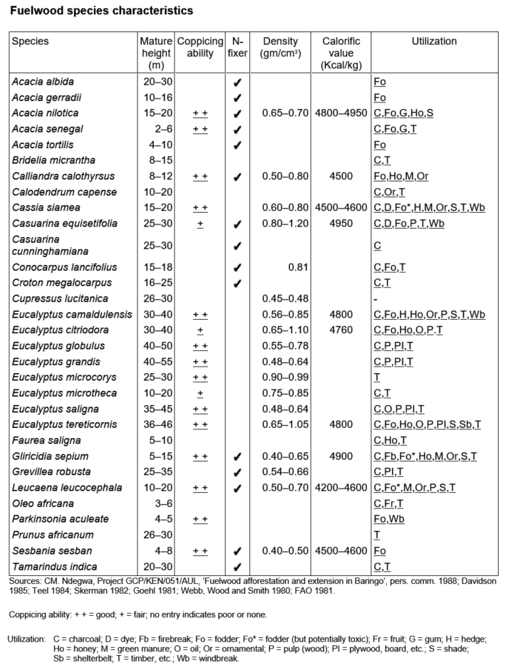
Basics of: "How to identify suitable species given certain requirements and environments."
On: Species Utilization (Products & Services provided)
Fodder supply for cattle is required
Species must be Multi-Purpose

Slide 4
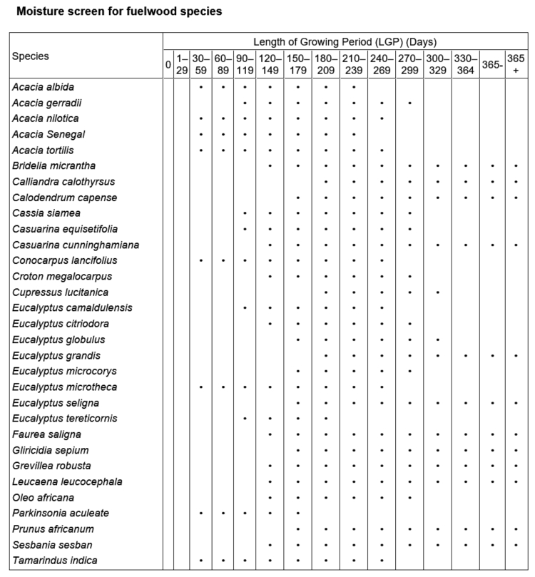
Basics of: "How to identify suitable species given certain requirements and environments."
On: Species-specific suitability to Length of Growing Periods (LGPs)
Note: A crop growing period (CGP) ≠ LGP CGP specifies the planting to harvesting period and must fall within a GP.
For some details see the next slides.
Suitability depends on given Agro-Ecological Zone (AEZ) specs.
The given Length of the Growing Period is > 330 days

Slide 5
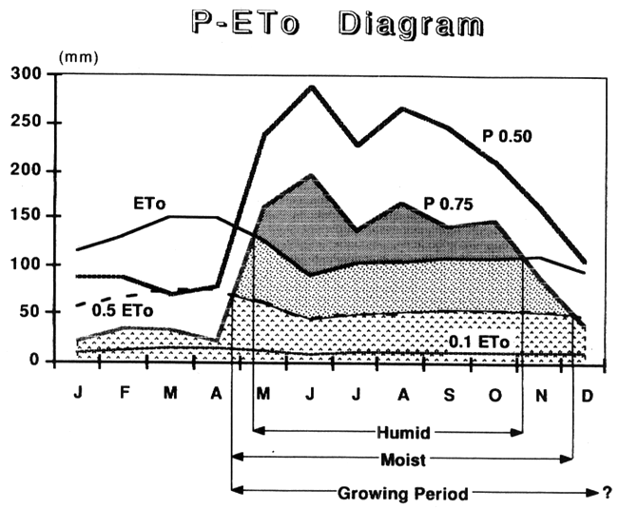
Water supply versus demand defines LGP
Determining the Length of a Growing Period (LGP) is done by comparing: P (average rainfall) versus ETo (reference Evaporation).
Residual soil-moisture from a humid period can add a limited number of days to the GP. Land preparation normally takes place once P0.75 > 0.5 Eto [moist soil]

Slide 6
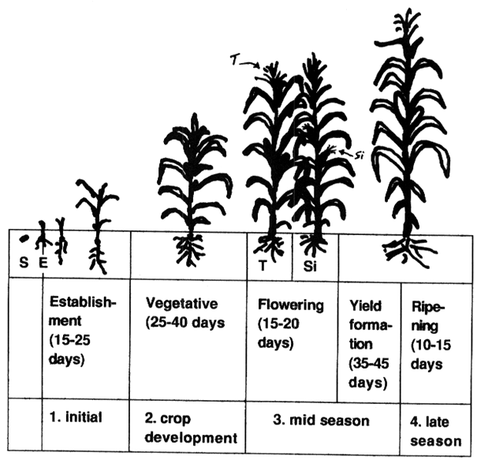
Any crop has a specific Crop Growing Period (CGP)
For instance for Maize:
(S=Seeding, E=Emergence, T=Tasseling, S=Silking) Crops (varieties) differ a lot in their length of growth stages (sum = CGP)

Slide 7
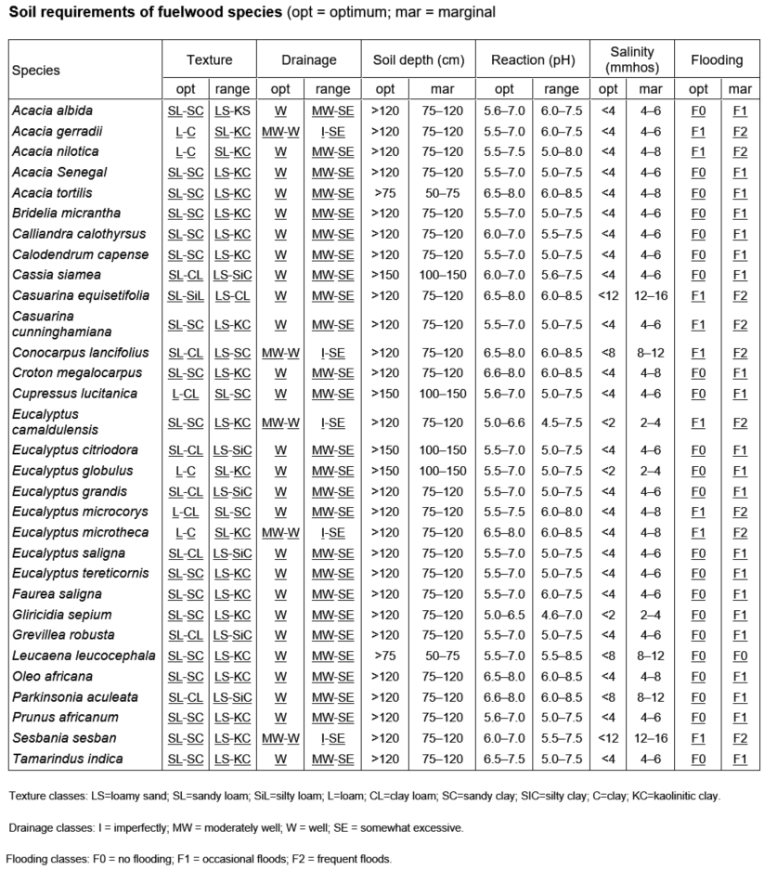
Basics of: "How to identify suitable species given certain requirements and environments."
On: Species-specific Soil Requirements
The soil pH varies from 5.0 to 6.0

Slide 8
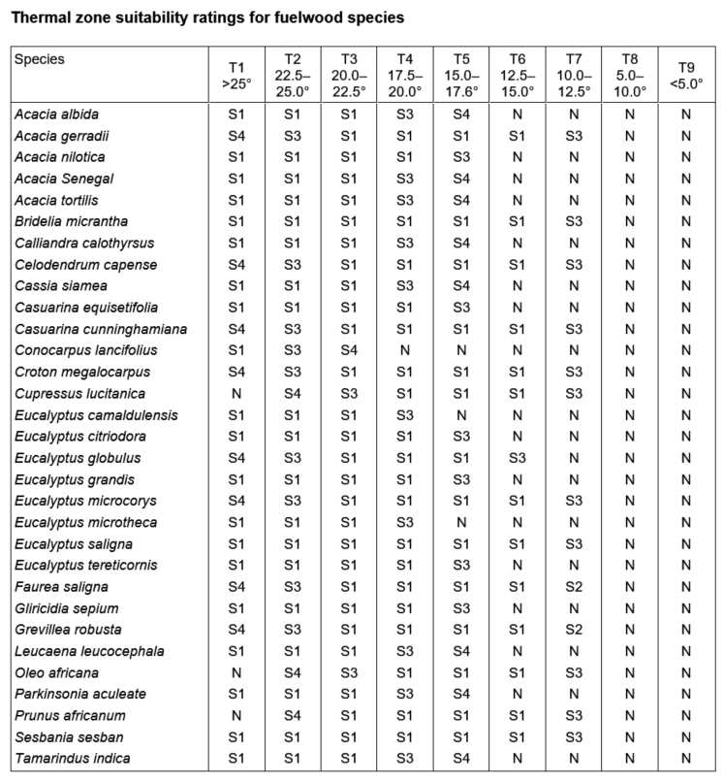
Basics of: "How to identify suitable species given certain requirements and environments."
On: Species-specific Temperature Requirements (S1=Suitable to S4=Marginally Suitable to N=Not Suitable)
Mean daily temperature is > 22.5 ºC

Slide 9
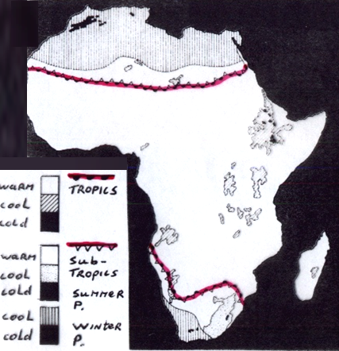
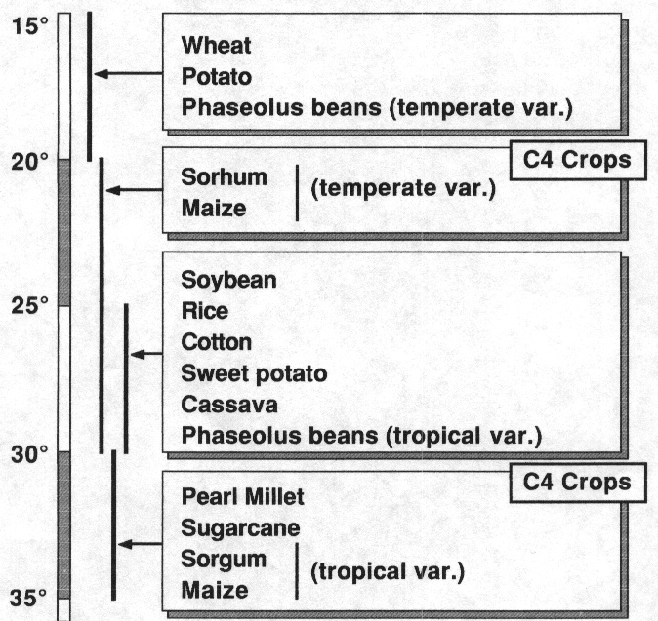
The temperature during a Growing Period
Agro-Ecological Zones (AEZs) are in the first instance defined through a Climate Inventory specified by: - Major Climates, and their
- Thermal Regimes (Tmean during GP)
… used Temperature ranges correspond with T-requirement ranges of major crops.

Slide 10
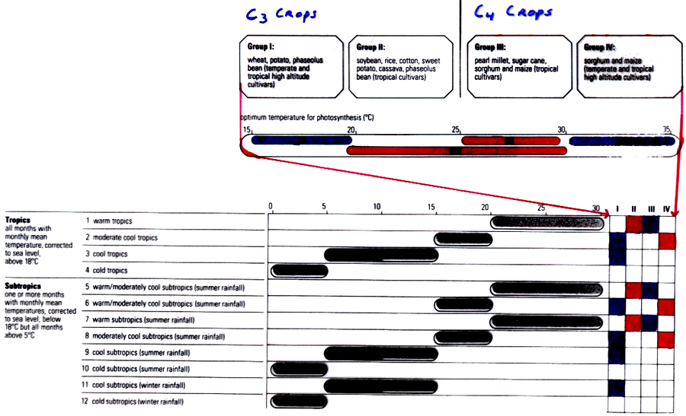
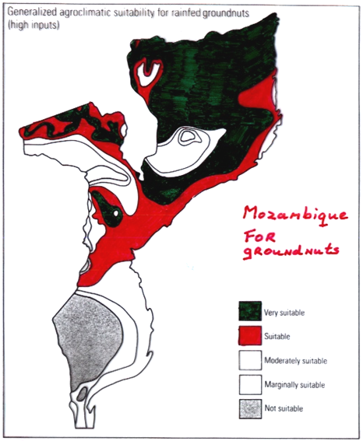
Suitability to T during the GP
And initially, Agro-Climatic suitability is assessed by matching T during the GP with crop T-requirements :
Group-1
Group-4
Group-2
Group-3
1 2 3 4
S1
S2
S3
S4
NS

Slide 11
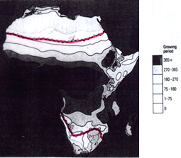
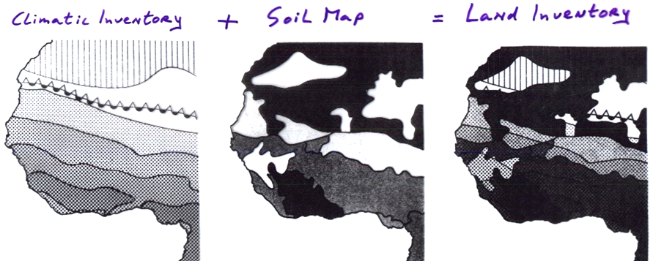
Combining maps to get a AEZ-map
A Climate Inventory with as overlay the LGP-map = The Climate Inventory
and the Climate Inventory + a Soil map = the Land Inventory map (= AEZ-map)

Slide 12
Agro-Climatic Suitability
A Climate Inventory with as overlay the LGP-map = The Climate Inventory
and the Climate Inventory + a Soil map = the Land Inventory map (= AEZ-map)

Slide 13
Back to the asics of: "How to identify suitable species given certain requirements and environments."
Now, filter all 4 tables so that the remaining species
Are multi-purpose, and
Produce fodder for cattle, and
Will grow in areas with a LGP > 330d/year, and
Will grow in areas with an average mean daily temperature > 22.5ºC., and
Will grow on soils with a pH between 5.0 and 6.0.

Slide 14
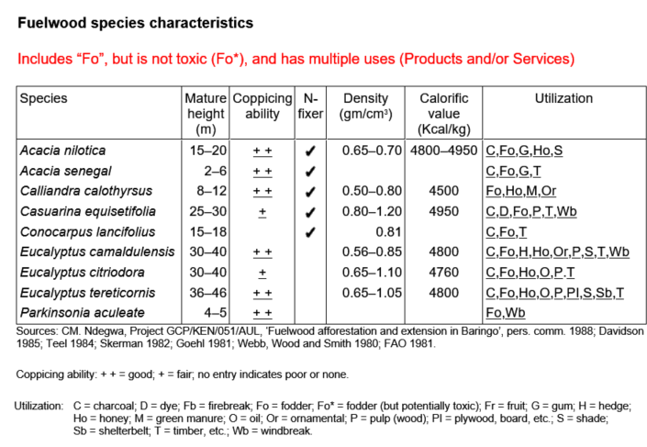
Basics of: "How to identify suitable species given certain requirements and environments."
On: Species Utilization (Products & Services provided)
Fodder supply for cattle is required
Species must be Multi-Purpose

Slide 15
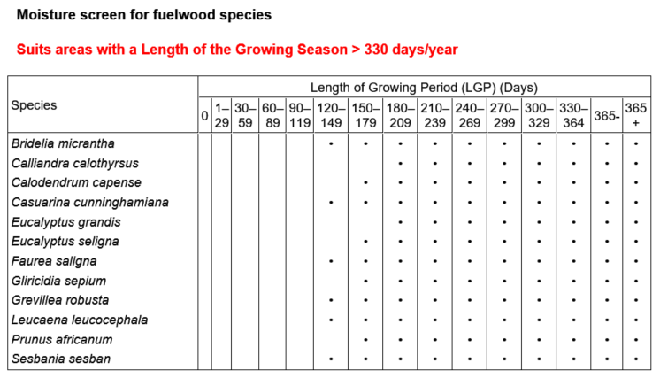
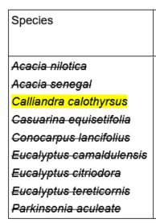
Basics of: "How to identify suitable species given certain requirements and environments."
On: Species-specific Length of Growing Season (LGS) Requirements
Suitability depends on given Agro-Ecological Zone (AEZ) specs.
The Length of the Growing Period is > 330 days

Slide 16
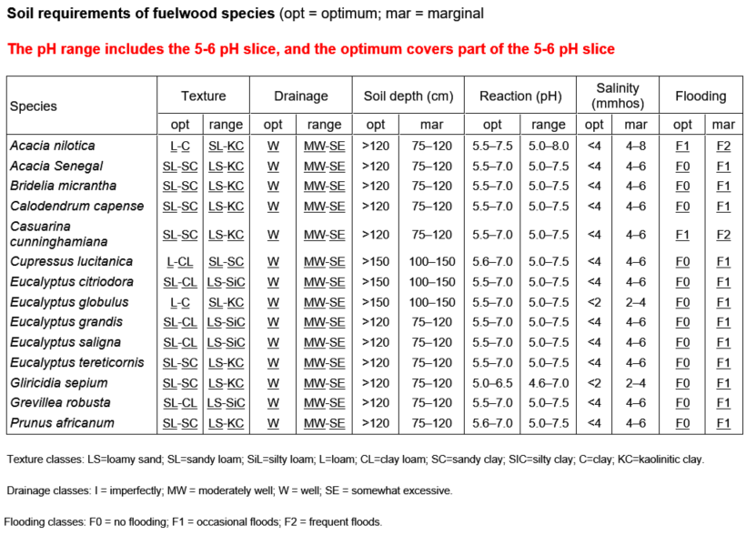
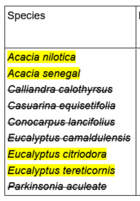
Basics of: "How to identify suitable species given certain requirements and environments."
On: Species-specific Soil Requirements
The soil pH varies from 5.0 to 6.0

Slide 17
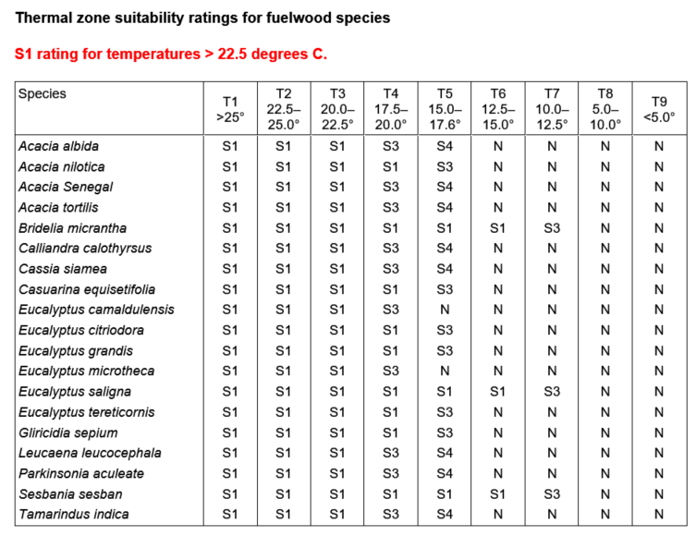
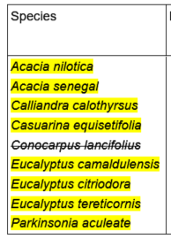
Basics of: "How to identify suitable species given certain requirements and environments."
On: Species-specific Temperature Requirements (S1=Suitable to S4=Marginally Suitable to N=Not Suitable)
Mean daily temperature is > 22.5 ºC

Slide 18
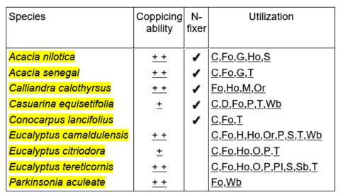
Basics of: "How to identify suitable species given certain requirements and environments."
Conclusion: No ideal species could be identified!
Utilization L.Growing Season pH Temperature
We require a larger database of species to choose from OR settle with one of the ‘less’ Suitable species.

Slide 19
Source of tables to "manually" match crops to environments and requirements: AGRO-ECOLOGICAL LAND RESOURCES ASSESSMENT FOR AGRICULTURAL DEVELOPMENT PLANNING A CASE STUDY OF KENYA by: A.H. Kassam, H.T. van Velthuizen, G.W. Fischer and M.M. Shah © FAO 1993

Slide 20
EO AFRICA Chapter 7.3 | Assessing Land Suitability – Initial Exercise by Kees de Bie, ITC, UTwente
Thank you

