Slide 2
Advanced Hyperspectral Applications Using SNAP and Sentinel-3A OLCI Data
Prepared by Daniel Odermatt¹, Ana B. Ruescas^{2,3} and Juan C. Jimenez-Muñoz³
1 Odermatt & Brockmann (Germany) 2 Brockmann Consult (Germany) 3 Image Processing Laboratory (UV, Spain)

Slide 3
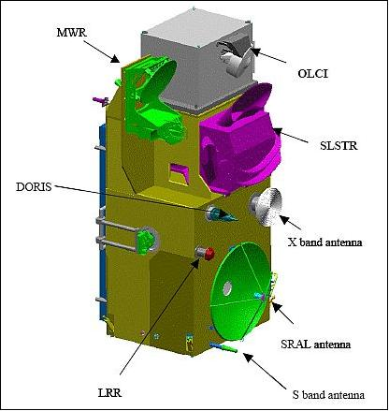
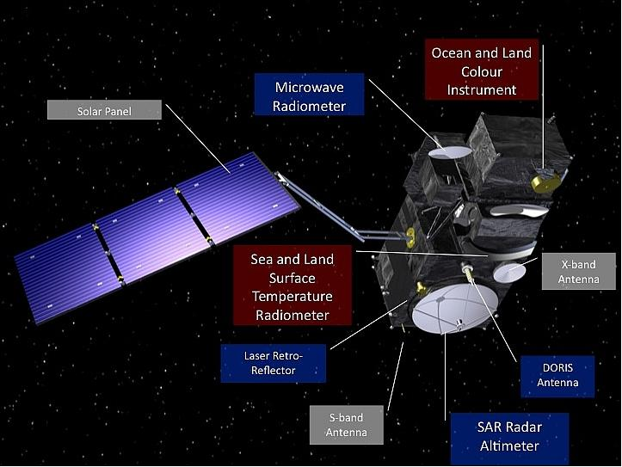
Sentinel-3 Sensors
Images credit: ESA
Notes:
An Ocean and Land Colour Instrument (OLCI), based on ENVISAT's Medium Resolution Imaging Spectrometer (MERIS). With 21 bands, compared to 15 bands on MERIS, a design optimised to minimise sun-glint and a resolution of 300 m over all surfaces, OLCI marks a new generation of measurements over the ocean and land. The swath of OLCI and nadir SLSTR fully overlap.
A Sea and Land Surface Temperature Radiometer (SLSTR) based on ENVISAT's Advanced Along Track Scanning Radiometer (AATSR), to determine global sea surface temperatures to an accuracy of better than 0.3 K. The SLSTR improves the along track scanning dual-view technique of AATSR and provides advanced atmospheric correction. SLSTR measures in nine spectral channels and two additional bands. A 1.3 micron band aimed at cirrus detection and a 2 micron band aimed at vegetation, mineral and atmospheric corrections for very turbid waters. An SLSTR with spatial resolution in the visible and shortwave infra-red channels of 500 m and 1 km in the thermal infra-red channels.

Slide 4
Ocean and Land Colour Instrument: OLCI
Notes:
The OLCI push-broom instrument swath is 1 270 km. The OLCI swath is not centred at nadir (as in the MERIS design)
but is tilted 12.6° westwards to mitigate the negative impact of sun-glint contamination. Fully overlapping with SLSTR
instrument swath and simultaneous acquisitions facilitates the use of OLCI and SLSTR in synergy.

Slide 5
Ocean and Land Colour Instrument: OLCI
Notes:
an increase in the number of spectral bands (from 15 to 21)
improved SNR and a 14-bit analogue to digital converter
improved long-term radiometric stability
mitigation of sun-glint contamination by tilting cameras in a westerly direction
complete coverage over both land and ocean at 300 m full resolution (for MERIS the reduced resolution was on-board computed)
improved instrument characterisation including stray light, camera overlap and calibration diffusers
improved coverage of the global ocean (<4 days), land (<3 days with one satellite, ignoring the effect of clouds), where MERIS is approximately 15 days
improved data delivery time of 3 hours for Level-1B and Level-2 products
100% overlap with SLSTR instrument swath and simultaneous acquisitions facilitating the use of OLCI and SLSTR in synergy.
OLCI bands are optimised to measure ocean colour over open ocean and coastal zones. A new channel at 1.02 μm has been included to improve atmospheric and aerosol correction capabilities. Two additional channels in the O₂A absorption line (764.4 and 767.5 nm, in addition to the existing channel at 761.25 nm) are included for improved cloud top pressure (height) with an additional channel at 940 nm in the H₂O absorption region, to improve water vapour retrieval. A channel at 673 nm has been added for improved chlorophyll fluorescence measurement.
The OLCI swath is not centred at nadir (as in the MERIS design) but the whole field-of-view is shifted across track by 12.6° away from the sun to minimise the impact of sun glint (sun glint contamination affects more than half of the MERIS observations at sub-tropical latitudes). In addition, the OLCI instrument is mounted on the satellite to allow a direct view of the Earth, removing the need for an additional fold mirror as used by MERIS.

Slide 6
OLCI product types
Notes:
Level-0 is the reconstructed and time-sorted Instrument Source Packet (ISP) at full space-time resolution. All communications artefacts (e.g. synchronisation frames, communications headers and duplicate data) and invalid packets are removed. OLCI data is always sensed in full resolution mode (300 m resolution).
Level-1 includes Top-Of-Atmosphere (TOA) radiometric measurements, radiometrically corrected, calibrated and spectrally characterised. It is quality controlled, ortho-geolocated (latitude and longitude coordinates, altitude) and annotated with satellite position and pointing, landmarks and preliminary pixel classification (e.g. land/water/cloud masks). Products are generated in FR (300 m) and in RR (1 km) for the whole globe with the same coverage.
Level-2 products consist of geophysical quantities derived from the processing of measurement data provided in the Level-1 product. Level-2 products specifically for marine and land application domains are generated separately by the SENTINEL-3 PDGS, with each containing the parameter relevant for the specific field of application. Level-2 atmospheric information relevant for both application domains, such as water vapour, is reported in both data streams.

Slide 7
Overview of Sentinel-3 Toolbox in SNAP
ESA has developed a common architecture for all Sentinel Toolboxes call the Sentinel Application Platform (SNAP)
The SNAP architecture is ideal for Earth Observation processing and analysis due the following technological innovations: Extensibility, Portability, Modular Rich Client Platform, Generic EO Data Abstraction, Tiled Memory Management, and a Graph Processing Framework.
http://step.esa.int/main/toolboxes/snap/

Slide 8
Sentinel Toolboxes Consortia

Slide 9
S3-TBX Heritage and Evolution

Slide 10
Exercise Overview:
Goal: To classify land surfaces and assign thermal emissivity factors to each surface type
Source: Sobrino et al. (2008, 2016)
Procedure:
Basic image visualization and manipulation tasks
OLCI L1 TOA radiance to reflectance conversion
OLCI L1/L2 product collocation
Band maths operations
Graph builder and batch processing
Sentinel-3 user guide: https://sentinels.copernicus.eu/web/sentinel/user-guides/sentinel-3-olci

Slide 11
1. Radiance to Reflectance
From the folder products exercise, open the scene: “subset_0_of_S3A_OL_1_EFR____20170729T030116_20170729T030416_20170730T064809_0180_020_246_2519_LN1_O_NT_002.dim”
Right click on the product in the Product Explorer and select Open RGB Image Window with the OLCI L1 Tristimulus profile. Stretch the histogram for a better visualization in the Colour Manipulation window
Check the image location in the World View window
Add a pin in the approximate position of Hanoi (21.00°N, 105.85°E)
In the Optical label click on Preprocessing/Radiance-to-Reflectance Processor:
Save the output product as: “subset_0_of_S3A_OL_1_EFR____20170729T030116_20170729T030416_20170730T064809_0180_020_246_2519_LN1_O_NT_002_radrefl.dim”

Slide 12
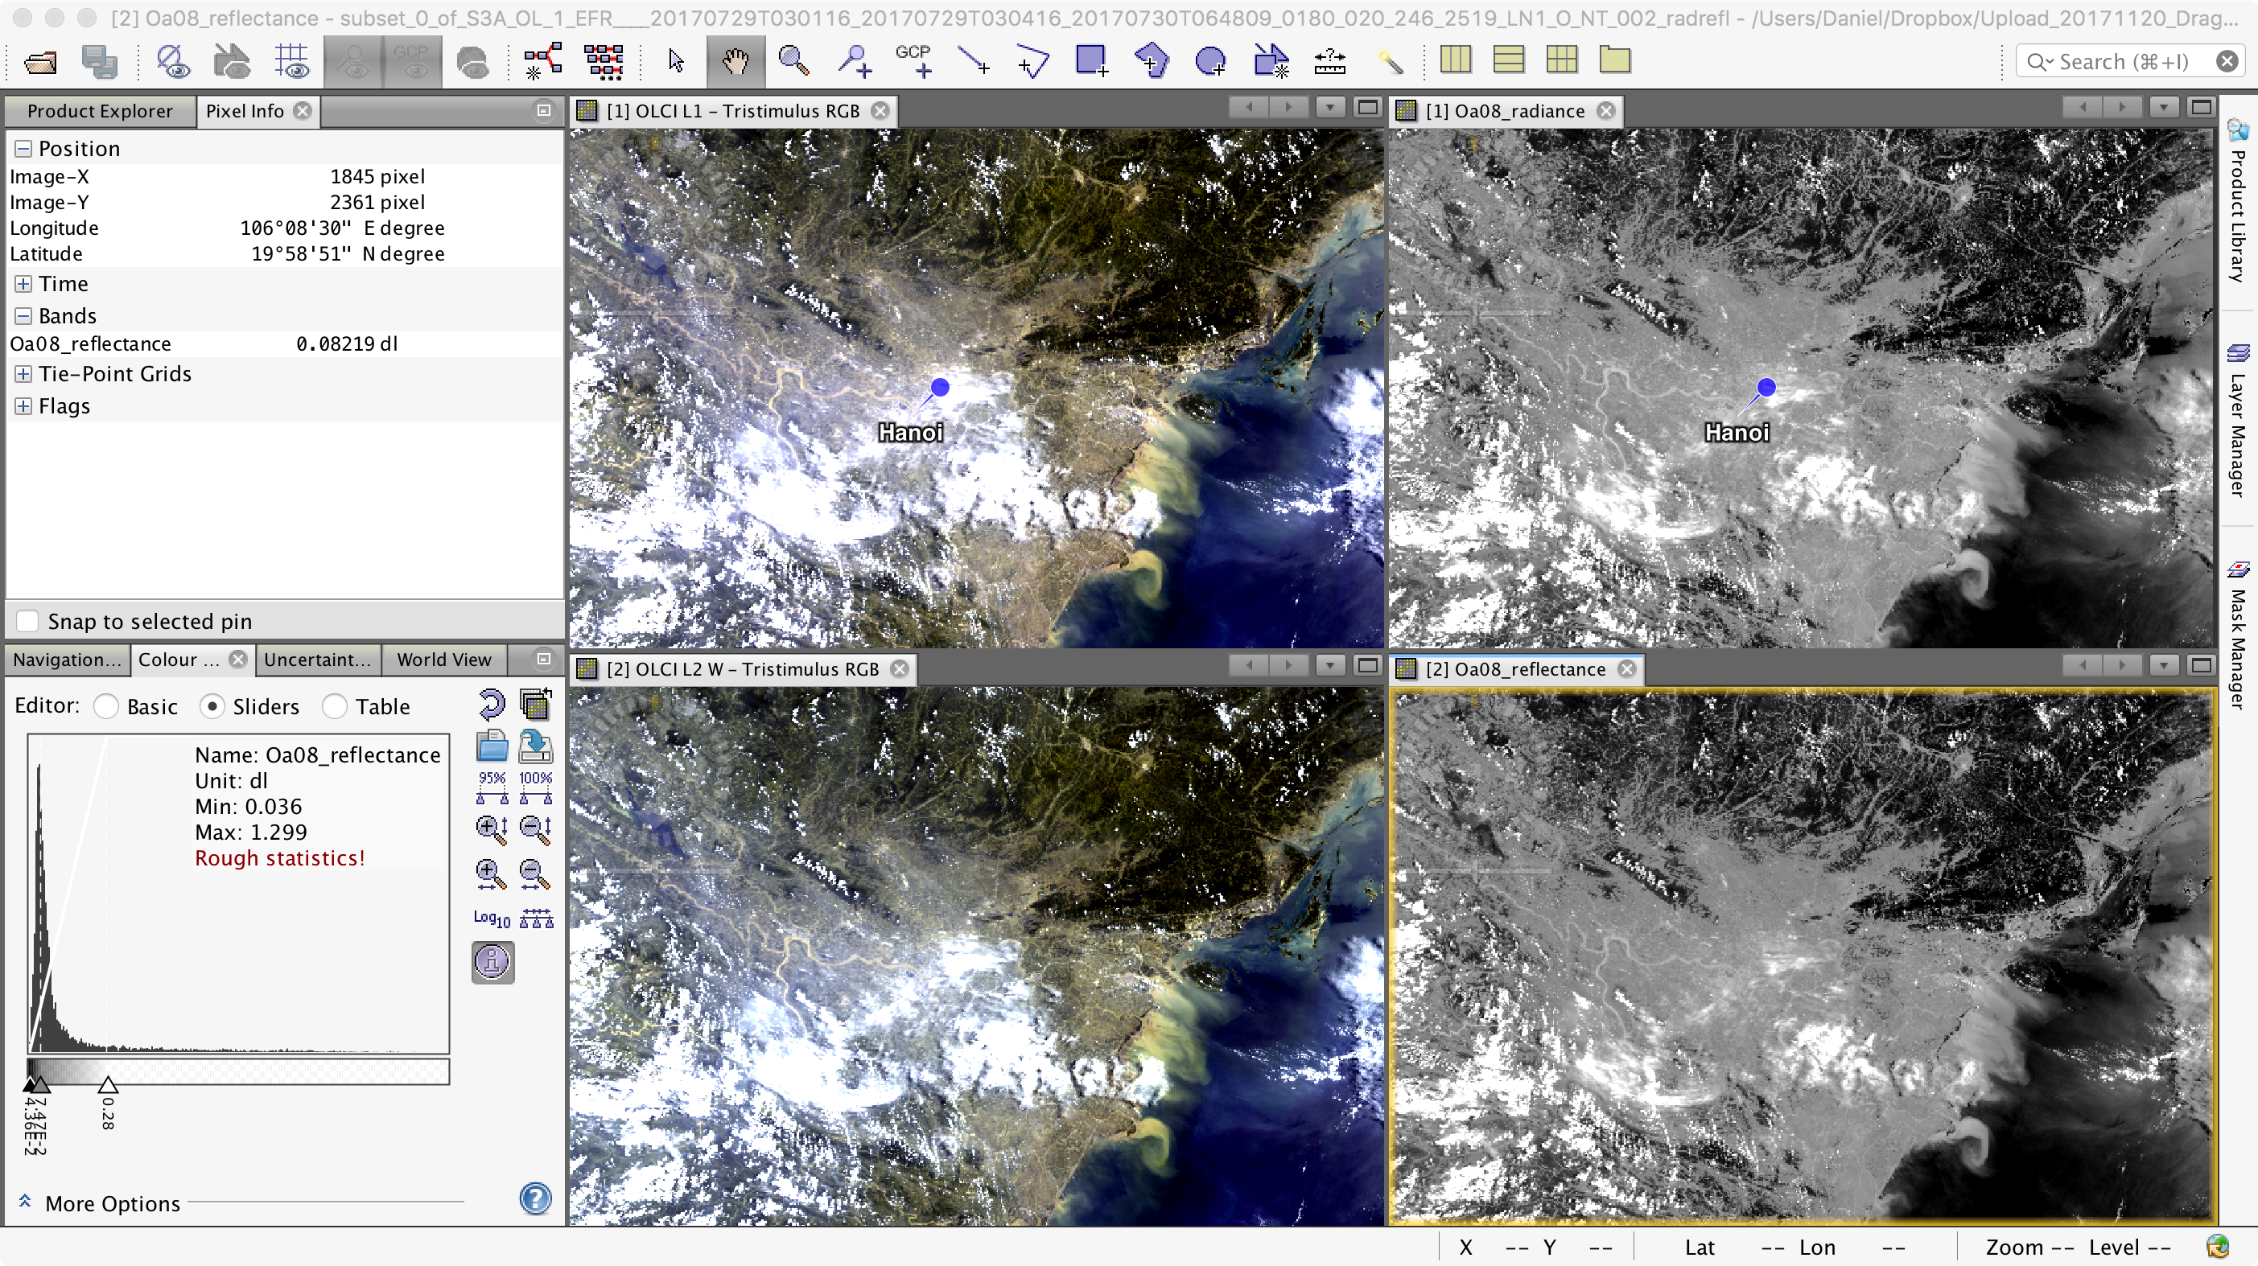
1. Radiance to Reflectance

Slide 13
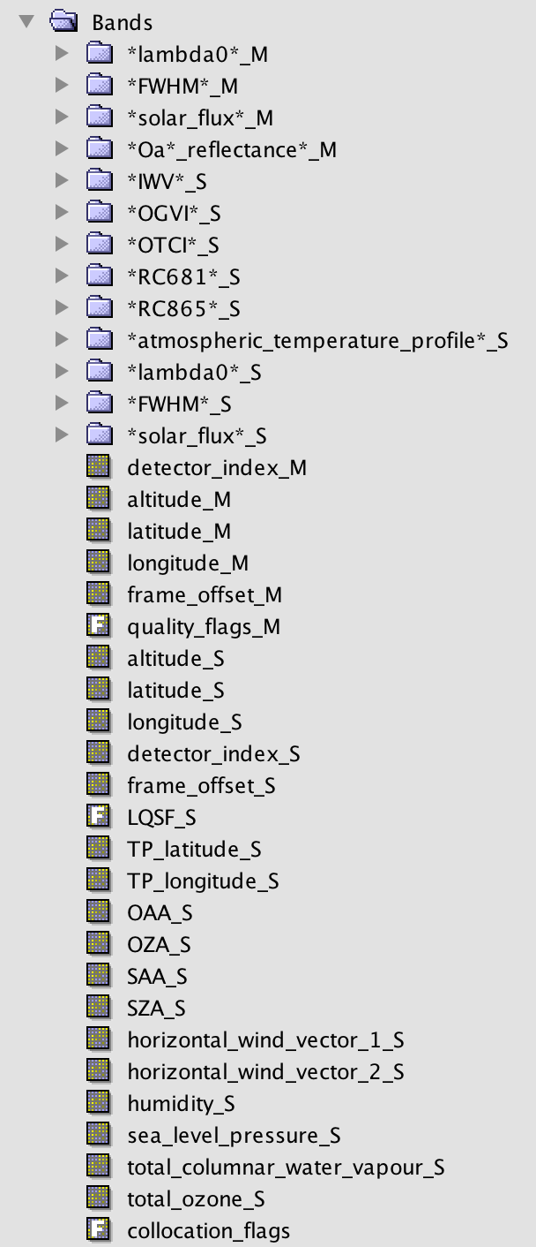
2. OLCI L1/L2 Collocation
Use the collocation tool to group the L1 (*_radrefl) and L2 OLCI bands in one product with the same spatial resolution and geo-location
Raster/Geometric Operations/Collocation
Master file: subset_0_of_S3A_OL_1_EFR____20170729T030116_20170729T030416_20170730T064809_0180_020_246_2519_LN1_O_NT_002_radrefl.dim
Slave file: subset_0_of_S3A_OL_2_LFR____20170729T030116_20170729T030416_20170730T070654_0180_020_246_2519_LN1_O_NT_002.dim
Target file: collocate_subset_0_of_S3A_OL_1_EFR____20170729T030116_20170729T030416_20170730T064809_0180_020_246_2519_LN1_O_NT_002_radrefl.dim
Open RGB view using bands 8, 6 and 3

Slide 14
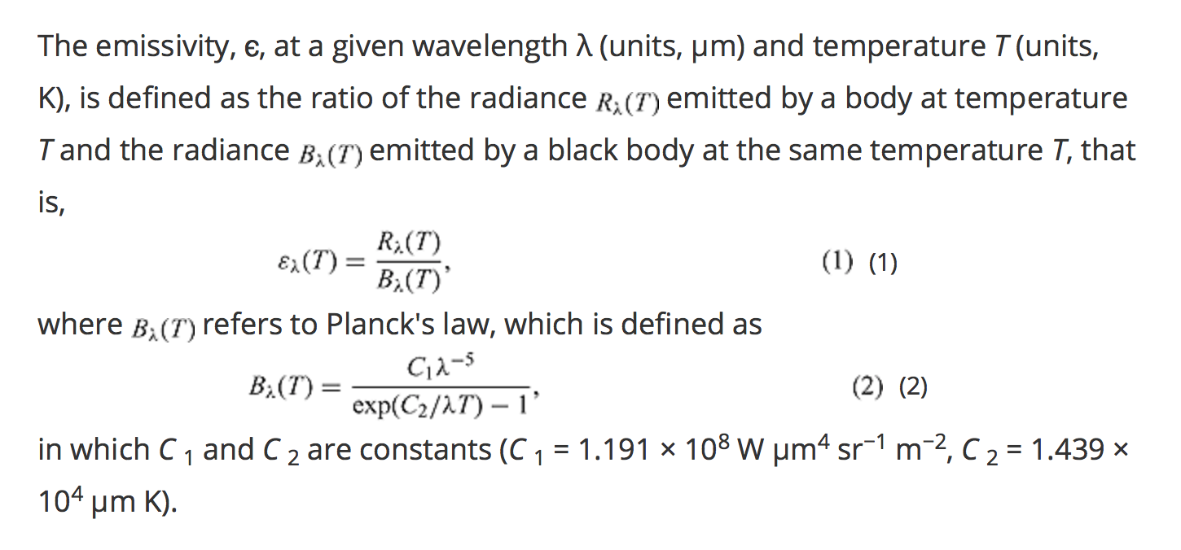
Definition of Emissivity
Land surface emissivity retrieval from satellite data; Li et al., 2013, IJRS, http://dx.doi.org/10.1080/01431161.2012.716540

Slide 15
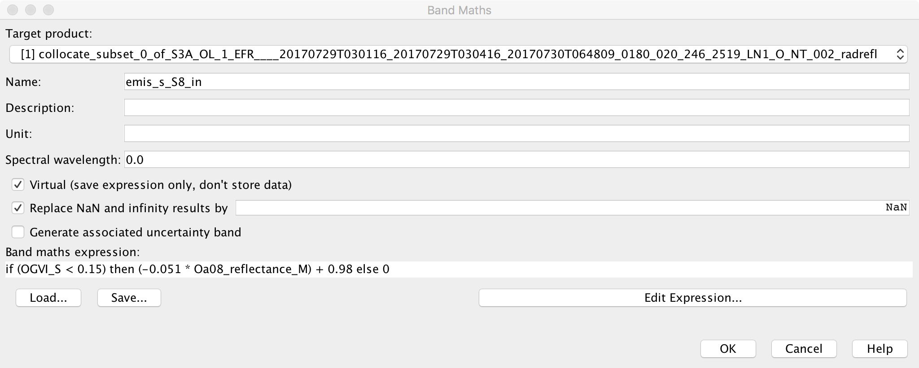
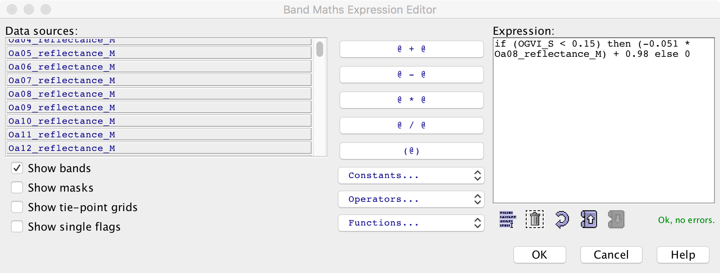
3. Emissivity Calculation using Vegetation Indices
Using the collocated product, start calculating the several variables needed for the LST algorithm with the Raster/Band Maths tool

Slide 16
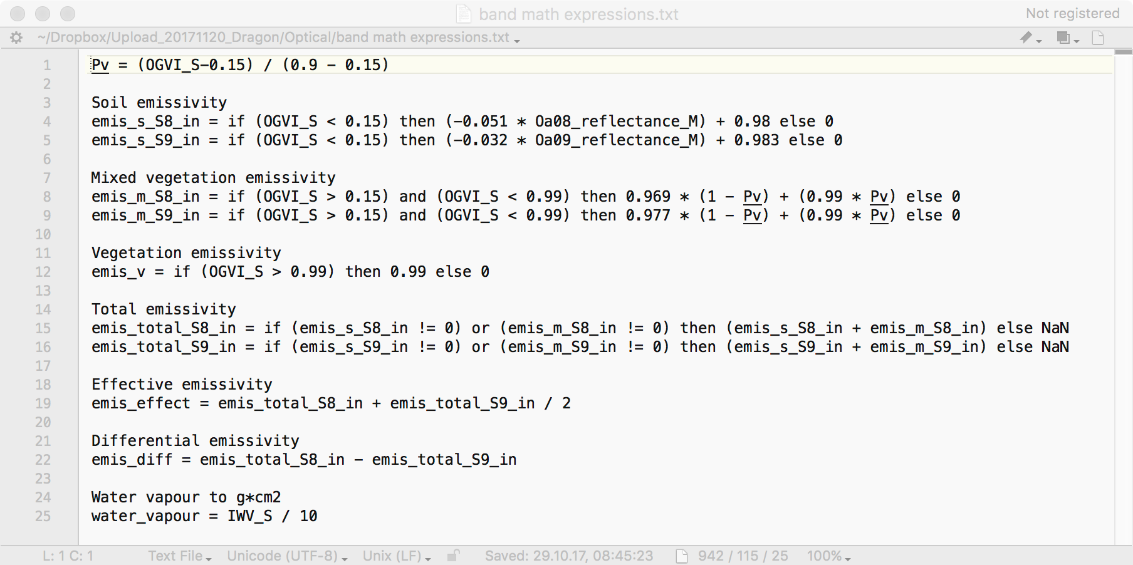

Slide 17
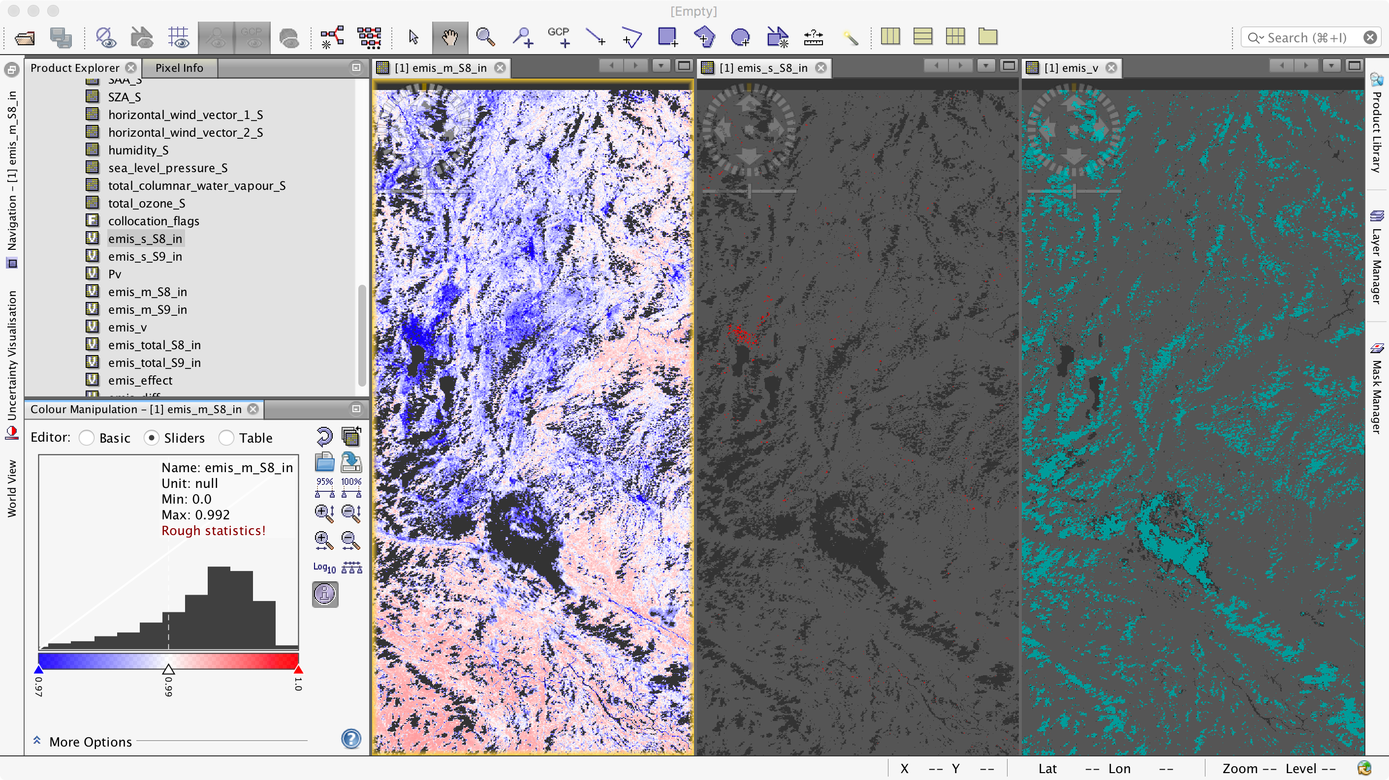
bright_flag

Slide 18
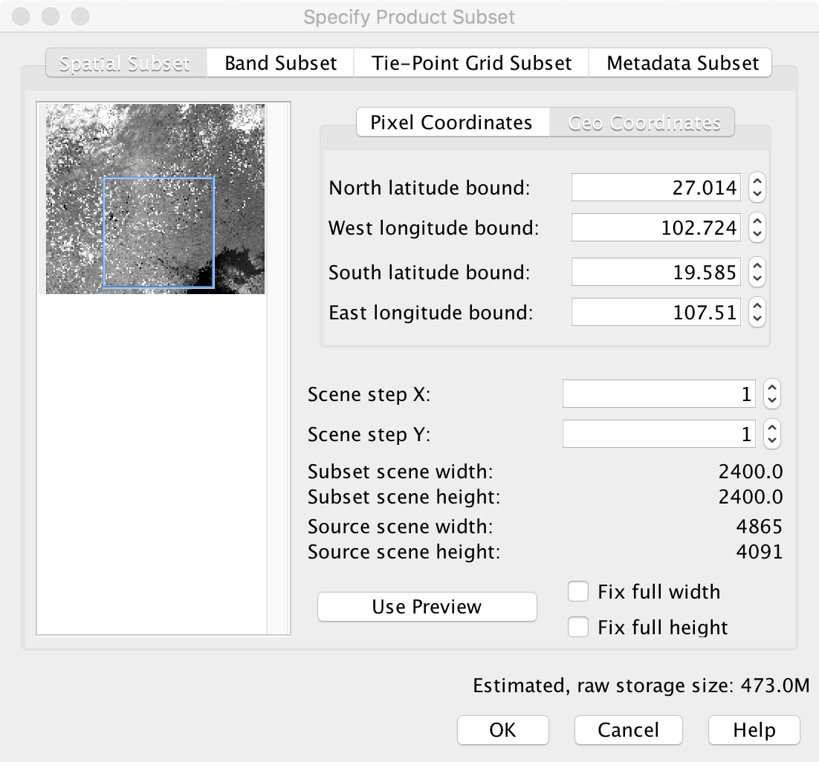
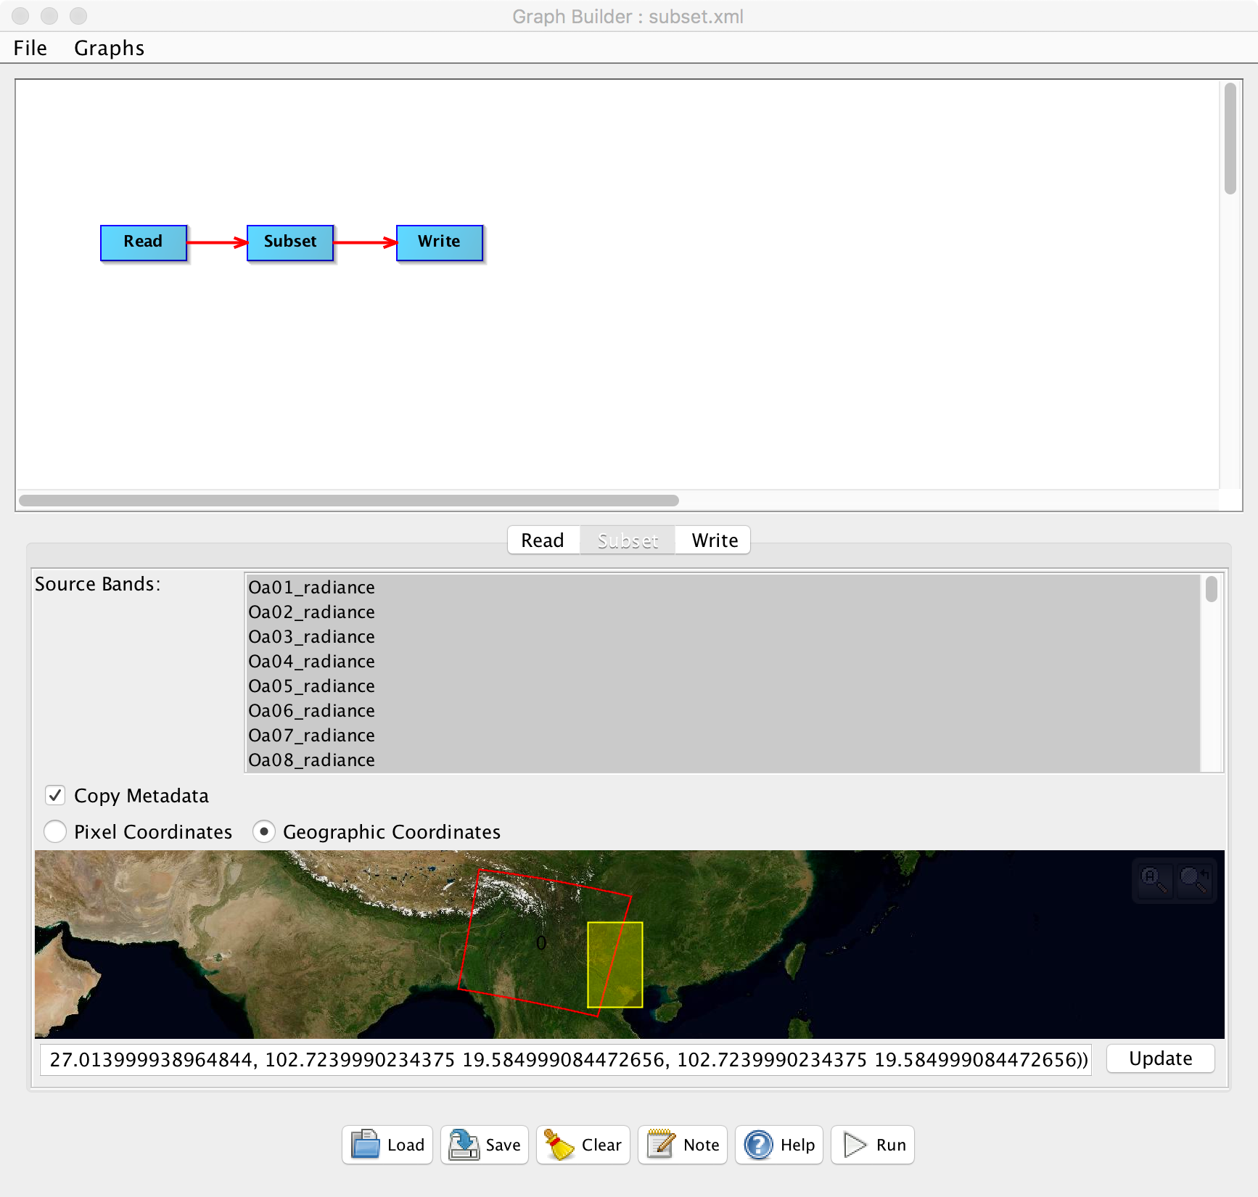
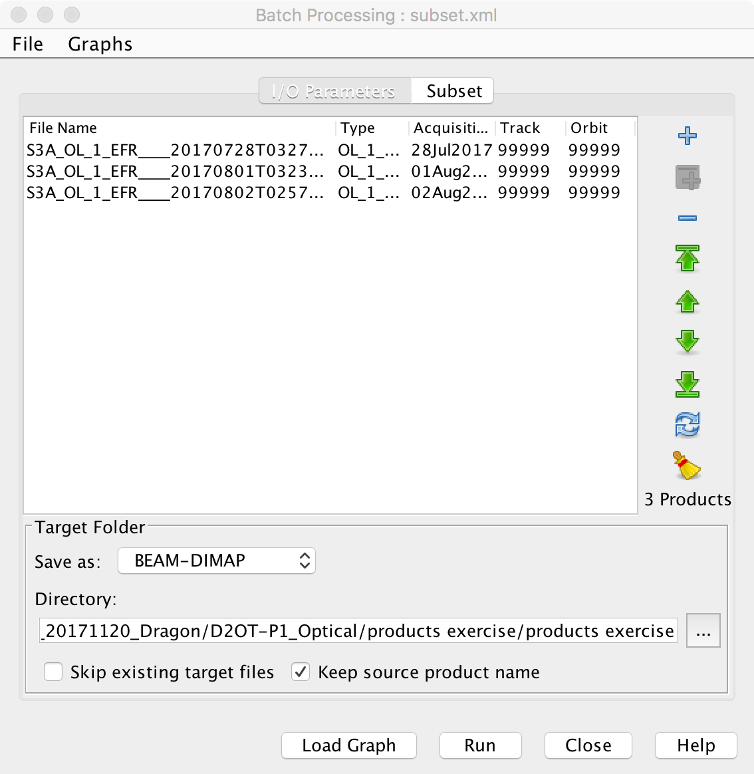
4. Batch Processing with the Graph Builder

