Slide 2
Advanced Thermal Applications Using SNAP and Sentinel-3A SLSTR Data
Prepared by Daniel Odermatt¹, Ana B. Ruescas^{2,3} and Juan C. Jimenez-Muñoz³
1 Odermatt & Brockmann (Germany) 2 Brockmann Consult (Germany) 3 Image Processing Laboratory (UV, Spain)

Slide 3
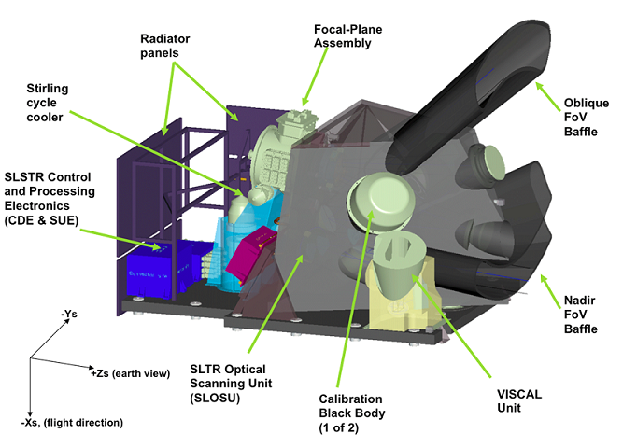
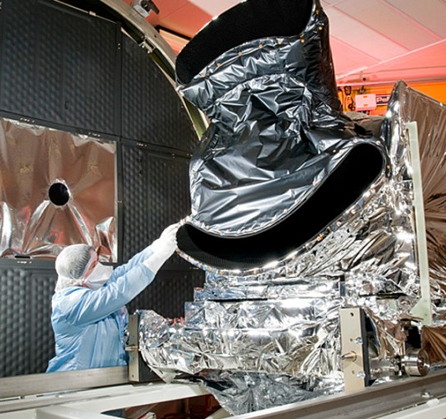
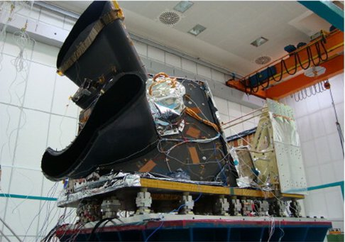
Sea and Land Surface Temperature Radiometer (SLSTR)
Notes:
Following ENVISAT AATSR, the SLSTR instrument is a conical scanning imaging radiometer employing the along track scanning dual view technique. SLSTR provides data continuity with respect to these previous missions but with a substantial improvement due to its higher swaths (740 km in dual view and 1 400 km in single view).
The principal objective of SLSTR products is to provide global and regional Sea and Land Surface Temperature (SST, LST) to a very high level of accuracy (better than 0.3 K) for both climatological and meteorological applications.

Slide 4
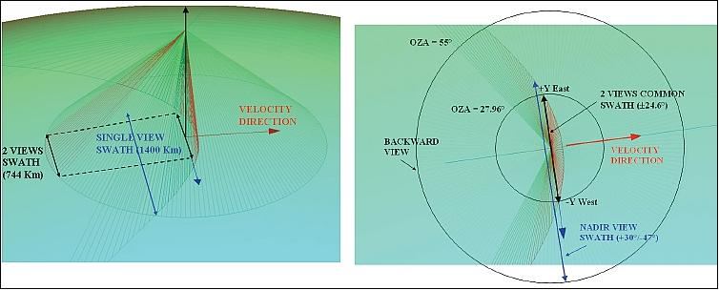
Sea and Land Surface Temperature Radiometer (SLSTR)
Backward inclined (left) and near nadir (right) views of the scanning mirror geometry
Image credit: SLSTR consortium
Notes:
The SLSTR design incorporates the basic functionality of AATSR, with the addition of some new, more advanced, features. These include wider swath coverage which completely overlaps the OLCI swath, more spectral bands, and a spatial resolution of 0.5 km for visible and SWIR bands. Both the SLSTR and OLCI instruments require a clear view to the sun for calibration purposes and accommodating both on the same platform resulted in the SLSTR oblique view pointing backwards. This configuration is different to the ENVISAT AATSR configuration.

Slide 5
Data and Physical Units in SLSTR Products
Notes:
• Increase of the dual view swath width from 500 to 740 km centred on the sub-satellite track gives a mean global coverage revisit time at the equator of 1.9 days (one spacecraft) or 0.9 days (two spacecraft).
• Enlarged single view swath width of 1 400 km provides a mean global coverage revisit time at the equator of 1 day (one spacecraft) or half a day (two spacecraft).
• An on-ground resolution of 0.5 km at nadir (instead of 1 km) for all VIS and SWIR channels. Radiance measurements from these channels are used for both land and clouds daytime observations.
• Two added channels (at wavelengths of 2.25 and 1.375 microns) in the SWIR band to allow improved cloud and aerosol detection to give more accurate SST/LST retrievals.
Two dedicated channels for fire and high temperature event monitoring at 1 km resolution (by extending the dynamic range of the 3.7 μm channel and including dedicated detectors at 10.8 μm that are capable of detecting fires at ~650 K without saturation).
• A mission design lifetime of 7.5 years which is higher that of earlier instruments.

Slide 6
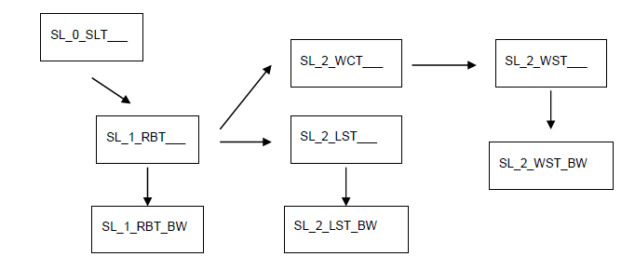
SLSTR Product Types
L0
L2
L1
Notes:
One labelled as Level-1B product and output by SLSTR Level-1 processing. The Level-1 product provides radiances and brightness temperatures for each pixel in the instrument grid, each view and each SLSTR channel, plus annotations data associated with SLSTR pixels.
• Four labelled as Level-2 products and output by SLSTR Level-2 processing:
o Level-2 WCT product (not disseminated to users) providing the sea surface temperature for single and dual view, for two or three channels
o Level-2 WST product providing L2P sea surface temperature, following the GHRSST specifications
o Level-2 LST and FRP products providing land surface temperature and fire radiative power (under specification)

Slide 7
Sentinel-3 Data Processing Chains

Slide 9
Exercise Overview:
Goal: To calculate Land Surface Temperatures using the thermal emissivity factors calculated in D2OT-P1
Source: Sobrino et al. (2008, 2016)
Procedure:
Basic image visualization and manipulation tasks
OLCI L1 TOA radiance to reflectance conversion
OLCI L1/L2 product collocation
Band maths operations
Graph builder and batch processing
Sentinel-3 user guide: https://sentinels.copernicus.eu/web/sentinel/user-guides/sentinel-3-olci

Slide 10
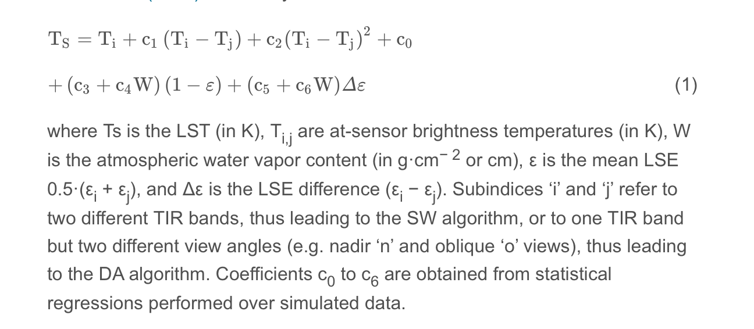
Land surface temperature using a split-window algorithm
Synergistic use of MERIS and AATSR as a proxy for estimating Land Surface Temperature from Sentinel-3 data; Sobrino et al., 2016, RSE, http://dx.doi.org/10.1016/j.rse.2016.03.035
Notes:
LST is a key parameter in the physics of land surface processes. It combines the results of all surface-atmosphere interactions and energy fluxes between the surface and the atmosphere. Warmth coming off the Earth's sites affects (and is affected by) the world's weather and climate patterns. A good indicator of this phenomenon is the land surface temperature

Slide 11
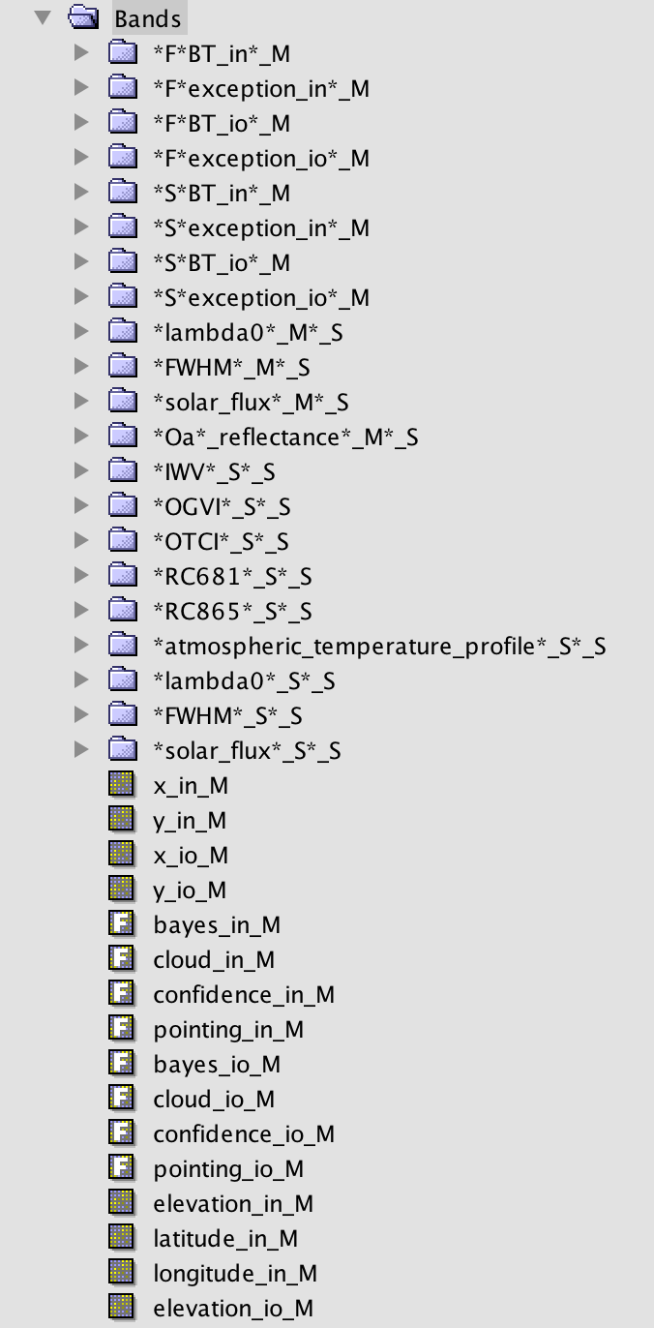
1. SLSTR-OLCI COLLOCATION
Use the collocation tool to group the SLSTR and OLCI bands in one product with the same spatial resolution (1 km) and geo-location:
Raster/Geometric Operations/Collocation
Master file: subset_0_of_S3A_SL_1_RBT____20170729T030116_20170729T030416_20170730T090755_0180_020_246_2519_LN2_O_NT_002.dim
Slave file: emissivity_collocate_subset_0_of_S3A_OL_1_EFR____20170729T030116_20170729T030416_20170730T064809_0180_020_246_2519_LN1_O_NT_002_radrefl.dim

Slide 12
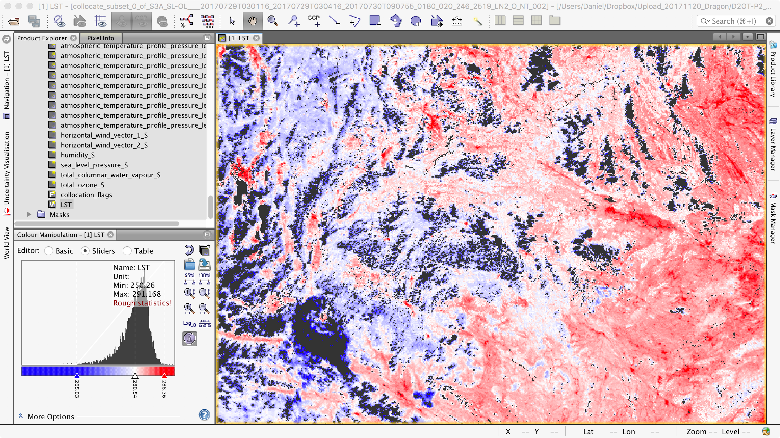
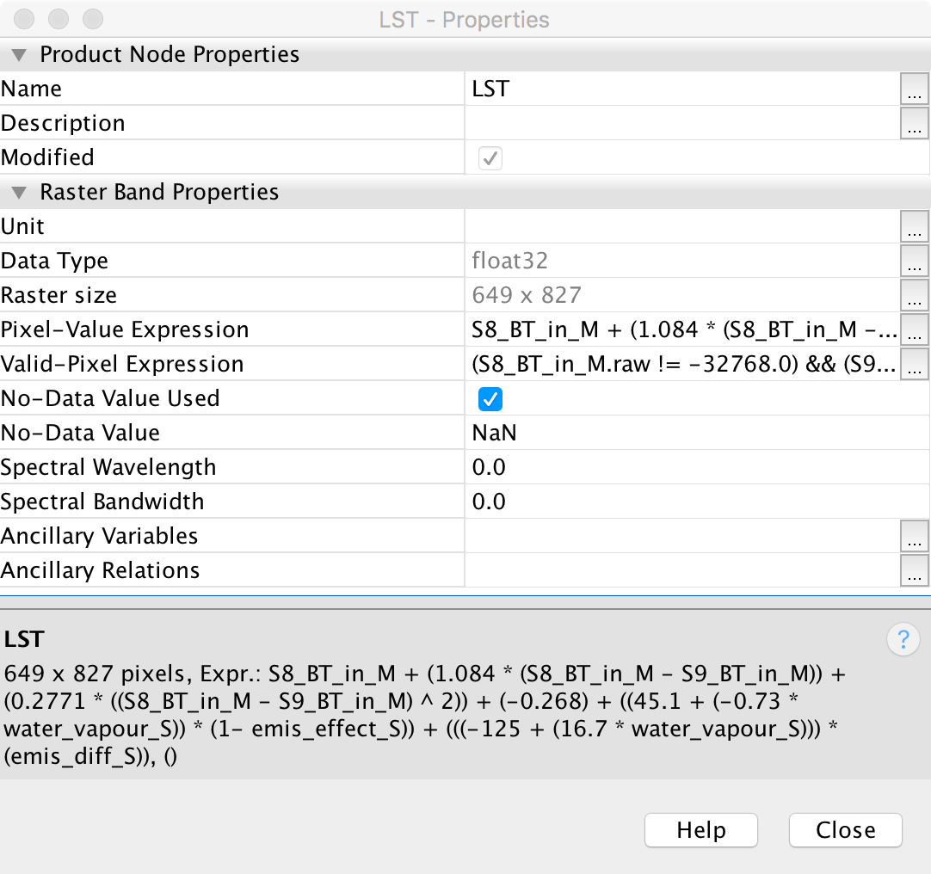
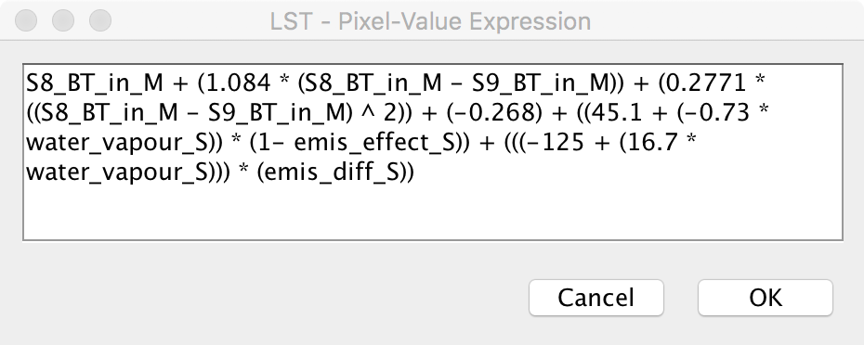
2. LST Algorithm in Band Maths

Slide 13
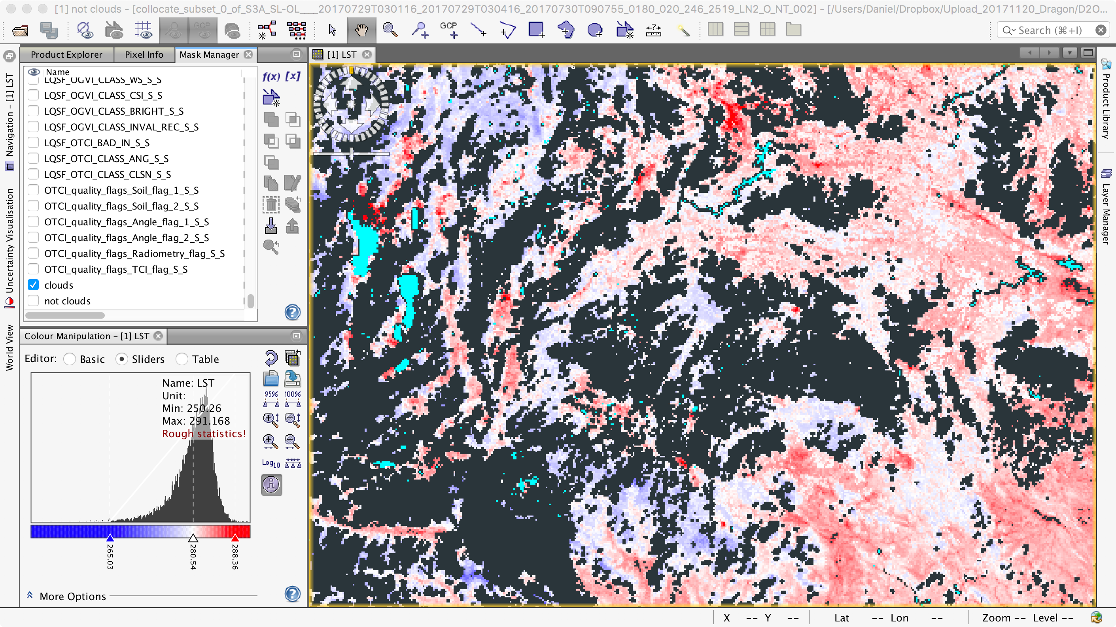
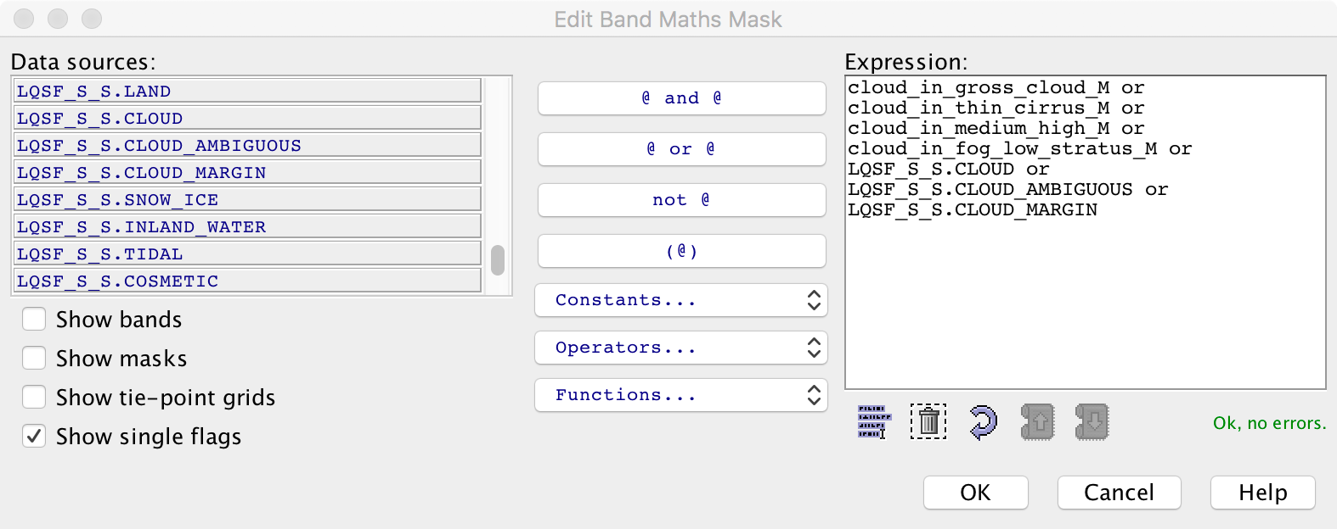
3. FLAGS AND MASKS
Use the Mask Manager to visualize, change and created new masks from flags or bands

Slide 14
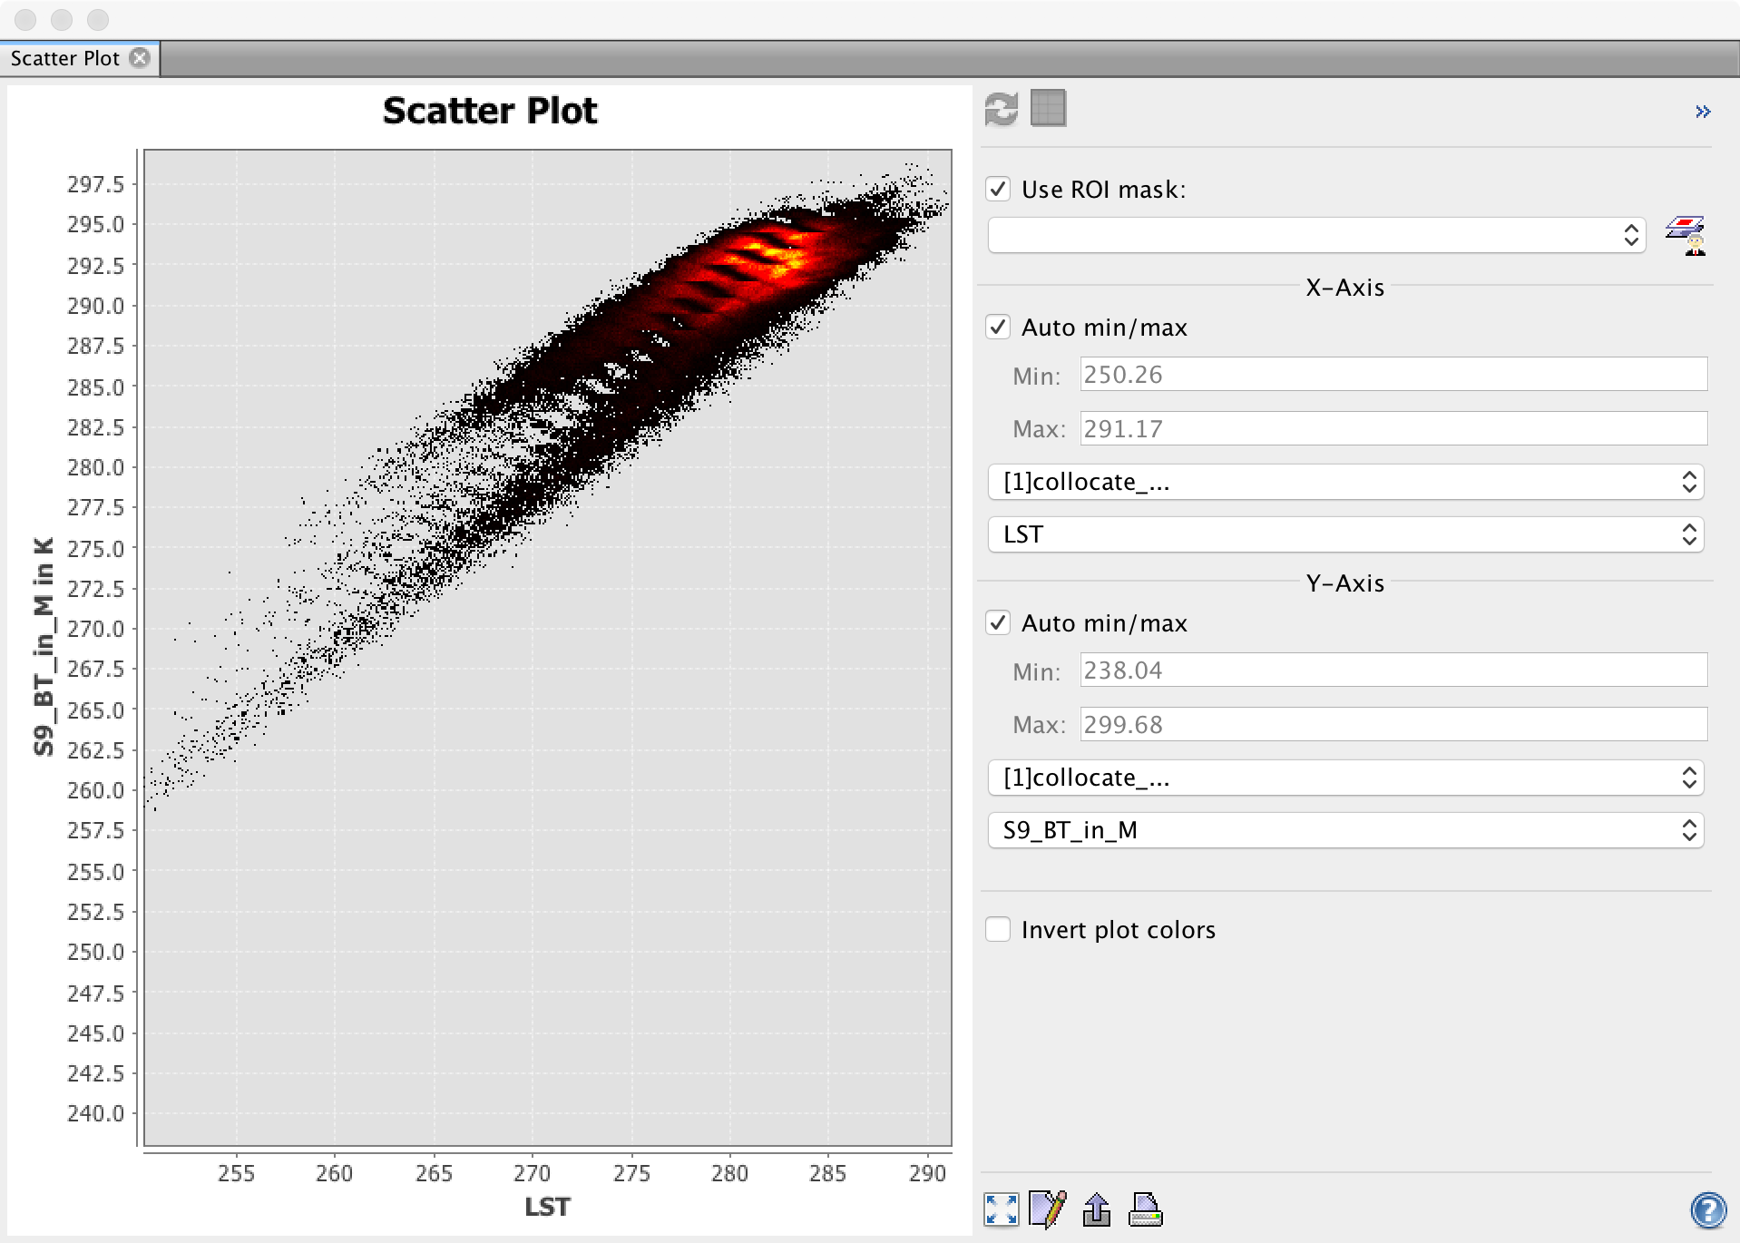
4. Scatter Plot Split Window LST vs. L2
Compare the split window calculated LST with other thermal bands (Analysis/Scatter Plot)
[Product error?] Try to collocate the split window calculated LST with the SLSTR L2 product for comparison (S3A_SL_2_LST____20170729T030116_20170729T030416_20170729T050111_0180_020_246_2519_SVL_O_NR_002.SEN3)

Slide 15
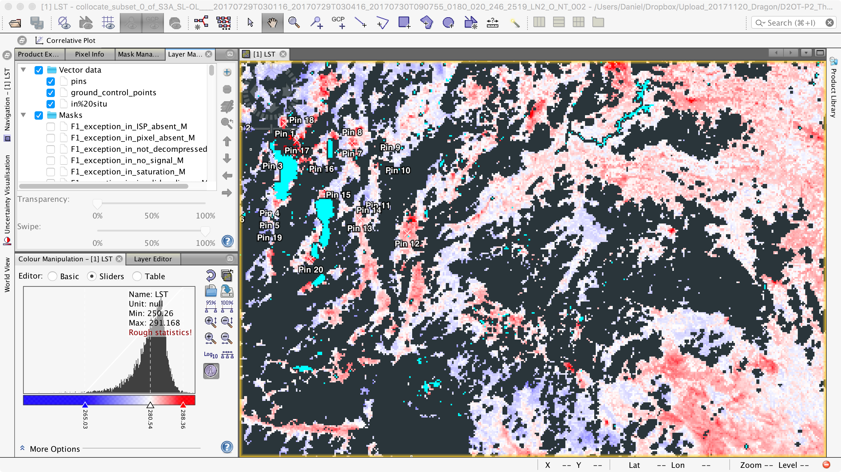
5. Import a Shapefile with in situ data
Use the dialogue File/Import/Vector data/ESRI shapefile to open the shapefile text/in situ.shp with in situ data
Check the Vector Data list in the Layer Manager
Select Analysis/Correlative Plot

Slide 16
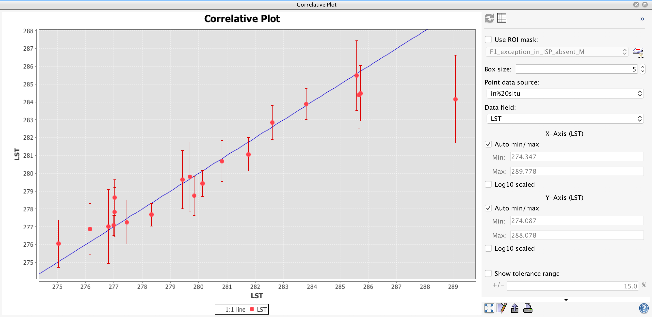
6. Make a Correlation Plot

Slide 17
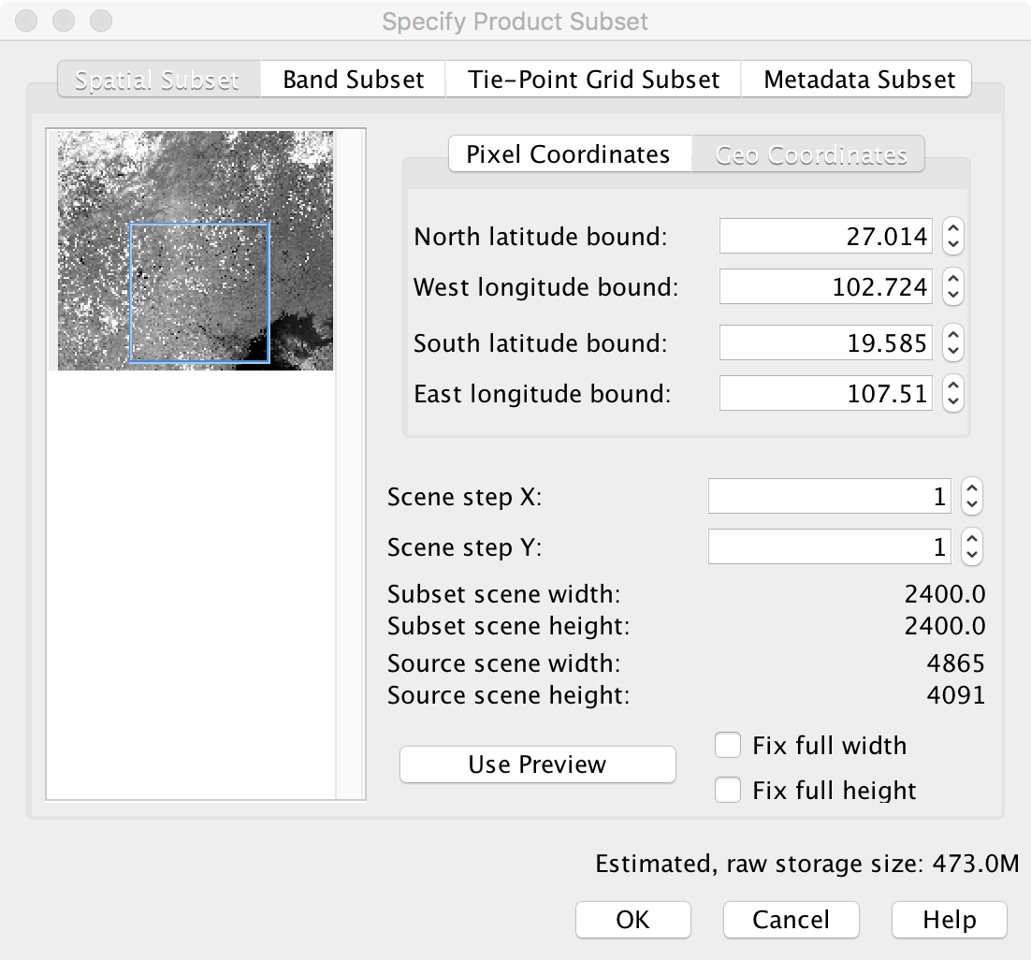
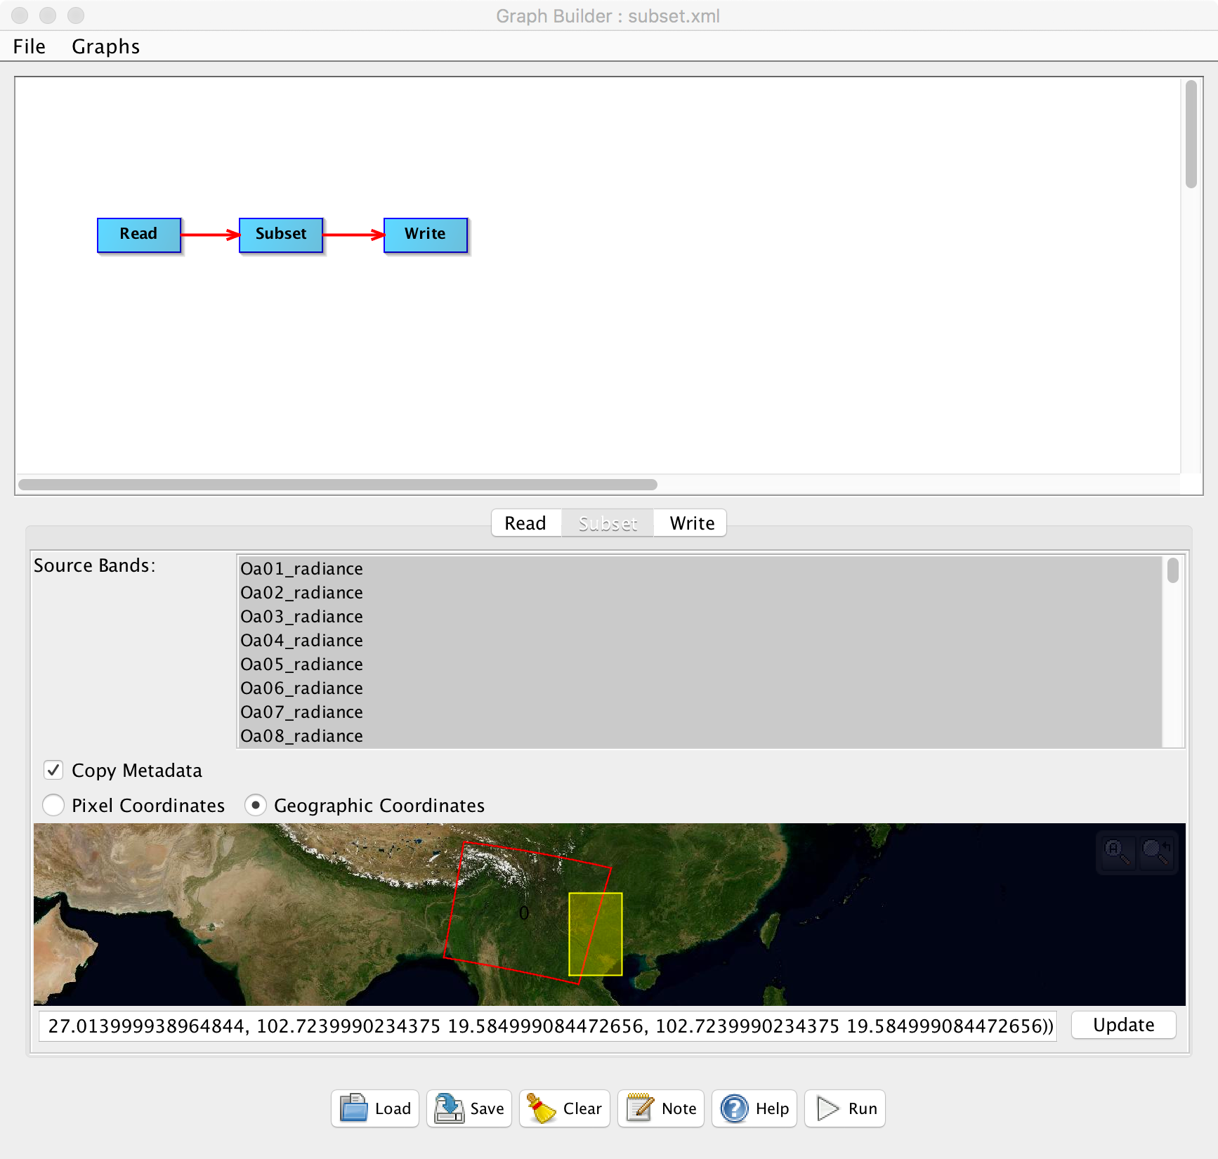
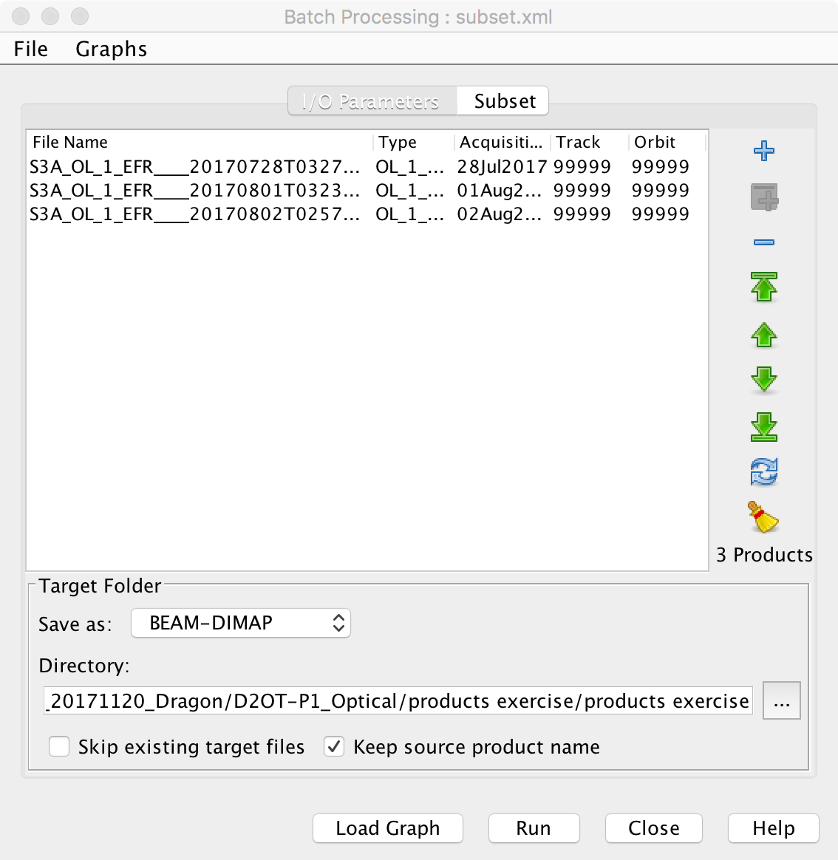
7. [cont.] Batch Processing

