Slide 1
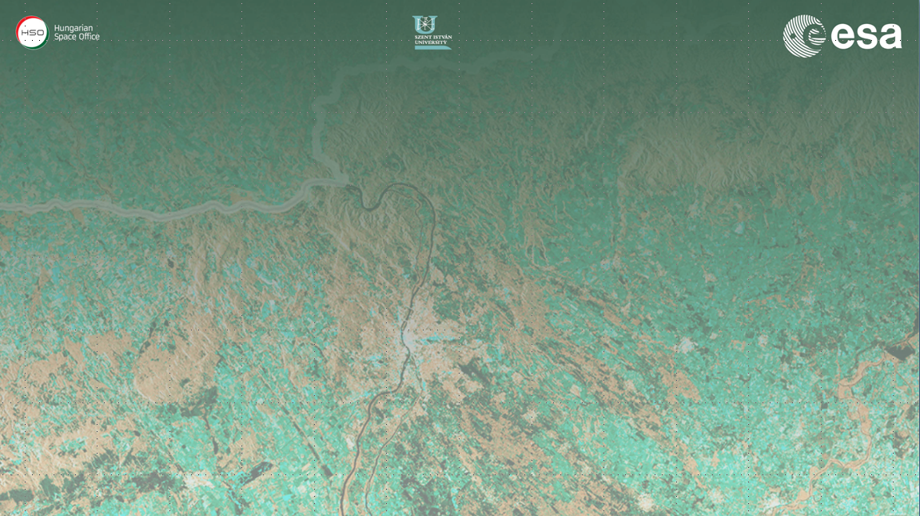
Forest SAR & Coherence
(Practical Session 1)
Erxue Chen Lei Zhao
Chinese Academy of forestry

Slide 2
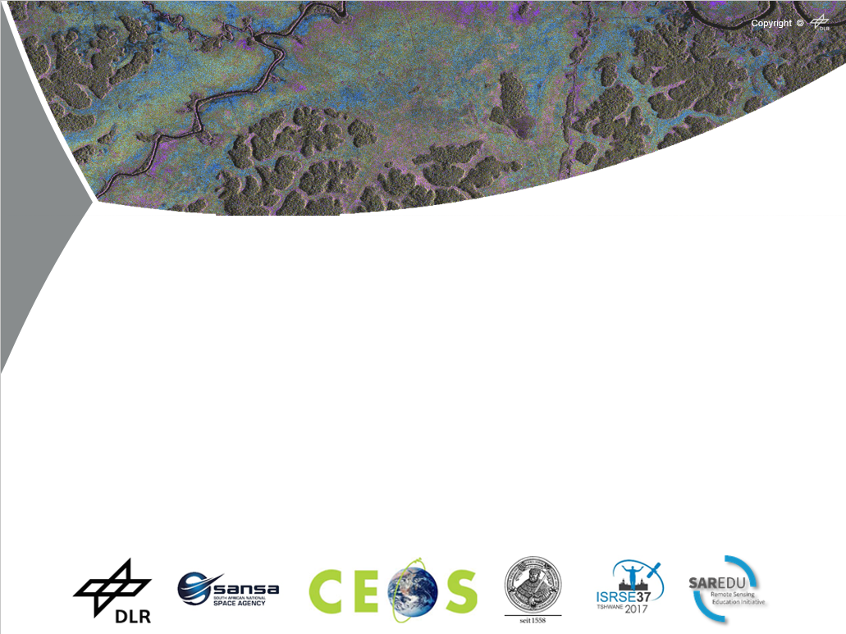
Forest cover (change) mapping using ALOS PALSAR mosaics
Mikhail Urbazaev
Christian Thiel
Christiane Schmullius
Robert Eckardt
Friedrich-Schiller-University Jena Department for Earth Observation
Jena, Germany

Slide 3
Working plan
Import ALOS PALSAR mosaics in SNAP
Processing of PALSAR mosaics (layer stacking, RGB, speckle filter)
Forest mapping for t1 and t2 based on backscatter threshold
Forest cover change mapping

Slide 4
Step by step
Import PALSAR mosaic
RGB calculation
Layer stacking
Export to Google Earth
Threshold applying
Speckle filtering

Slide 5
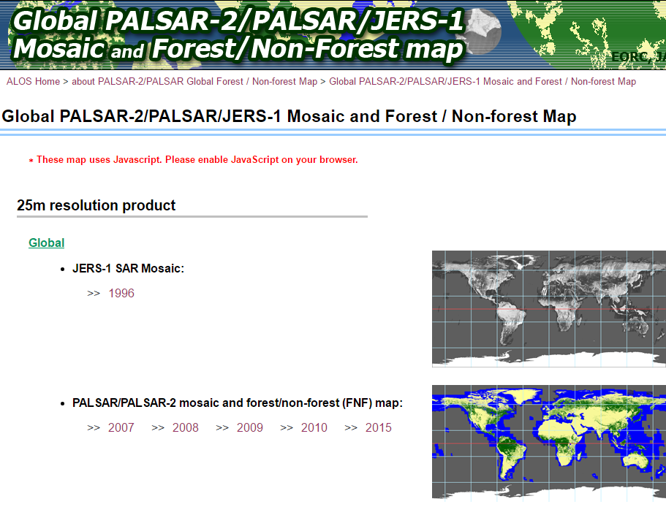
How to get the data
ALOS PALSAR and ALOS-2 PALSAR-2 L-band SAR backscatter mosaics
Free and open access (25m) Registration: http://www.eorc.jaxa.jp/ALOS/en/palsar_fnf/data/index.htm

Slide 6
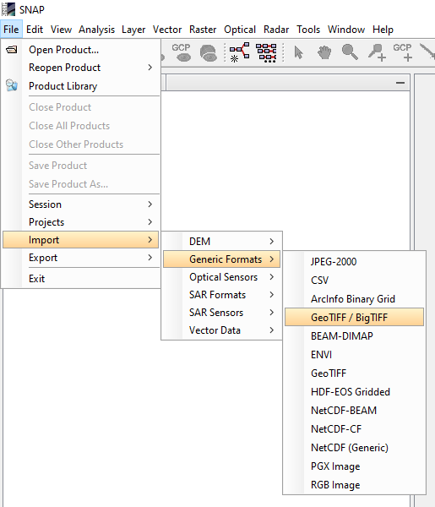
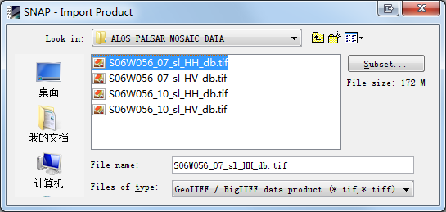
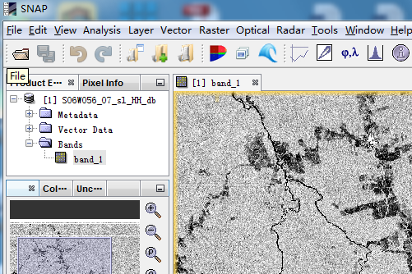
Data import
Double Click !

Slide 7
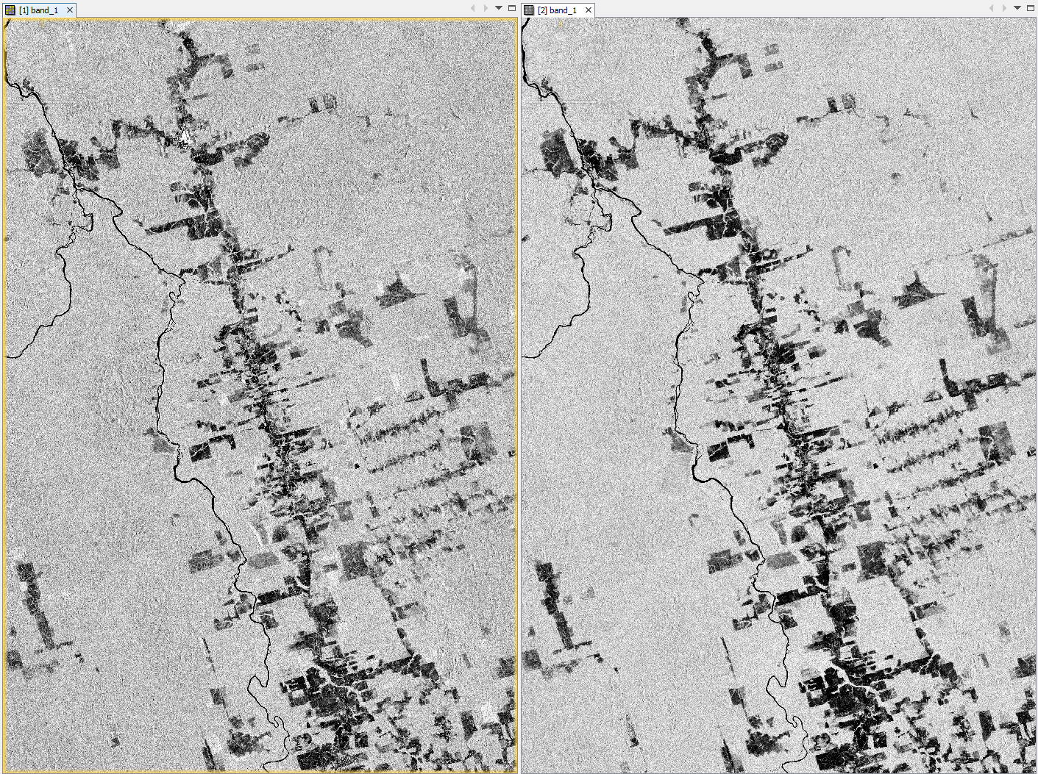
Data import
HH 2007
HV 2007

Slide 8
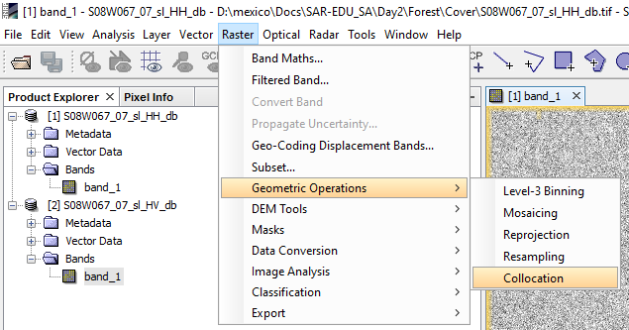
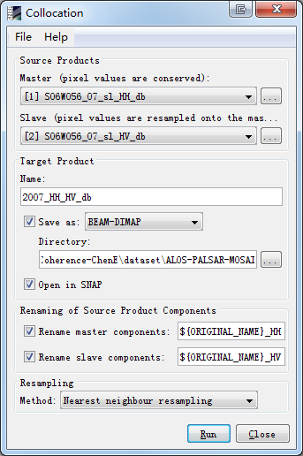
Layer stacking
1
2
Fill in the output file name.
Select the output path.
Modify the suffix of the band name.
Run.
3
4

Slide 9
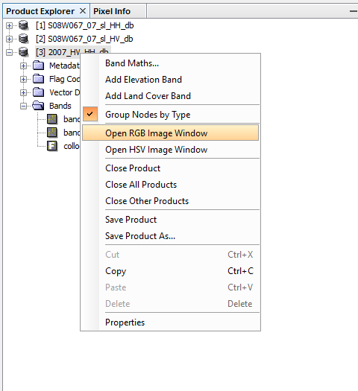
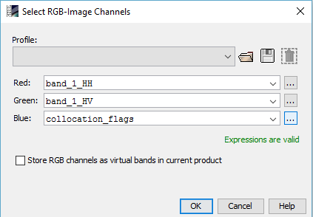
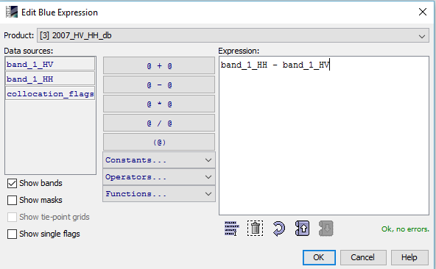
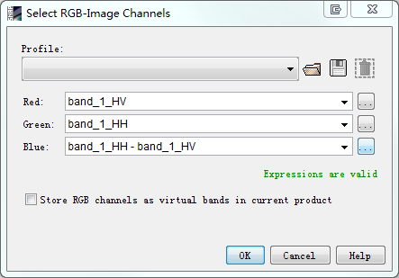
RGB composite
Right Click !
1
2
3
4
5
6

Slide 10
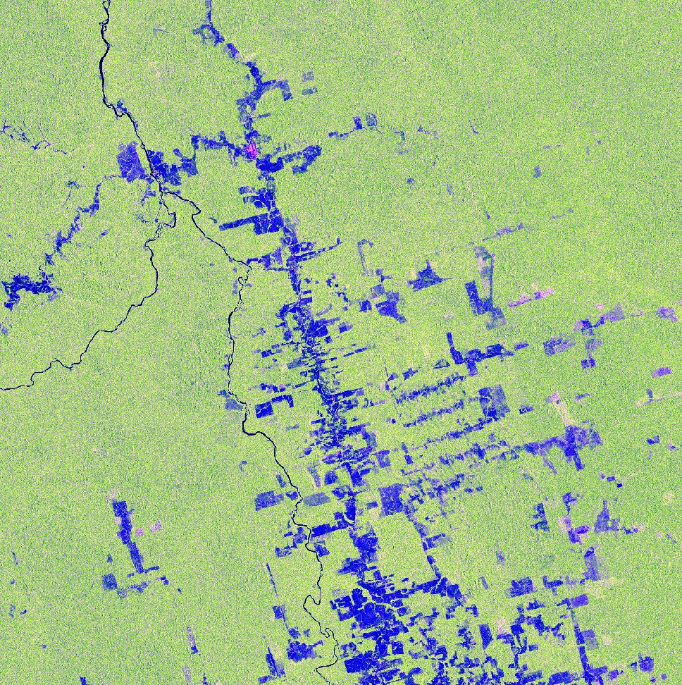
R: HH G: HV
B: HH-HV
Histogram Stretch 95%

Slide 11
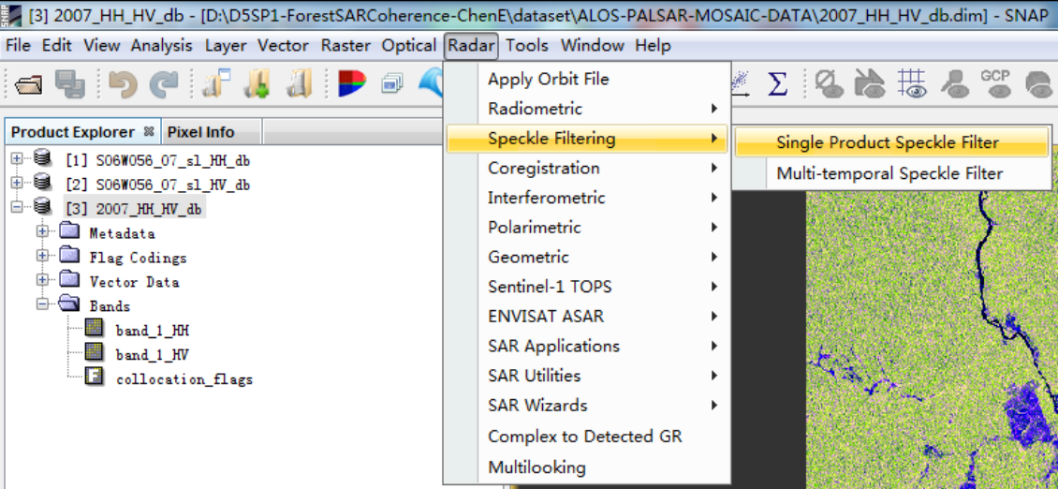
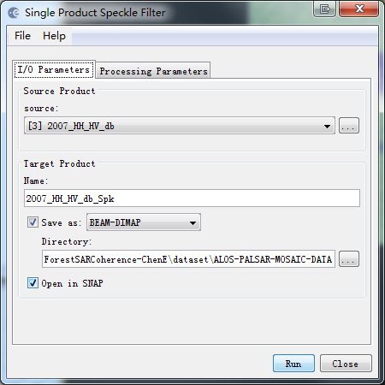
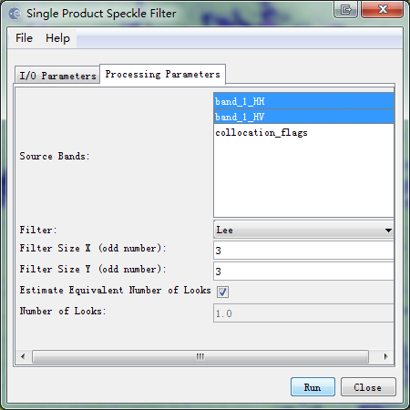
Speckle filtering
1
3
2
4
5
6
7

Slide 12
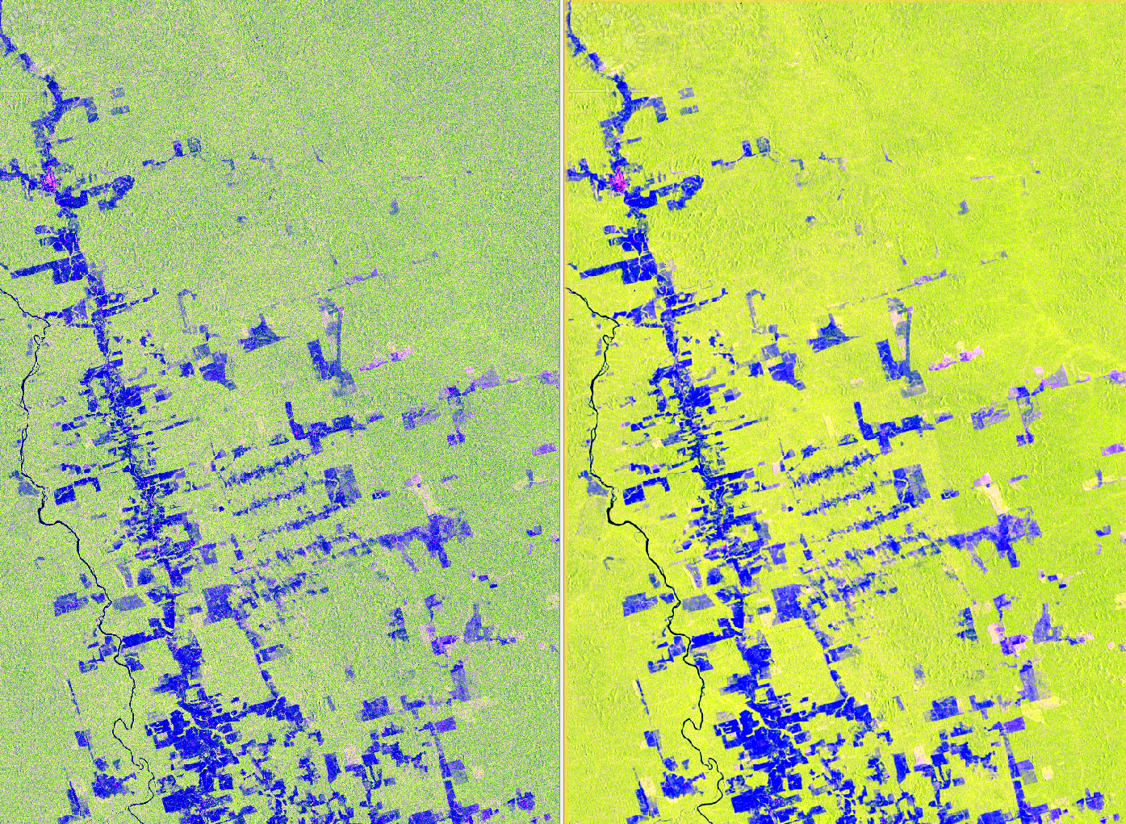
Speckle filtering
Original
Lee-filtered

Slide 13
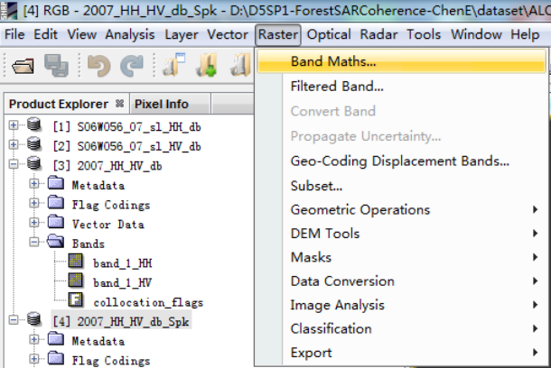
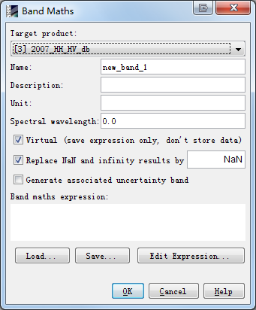
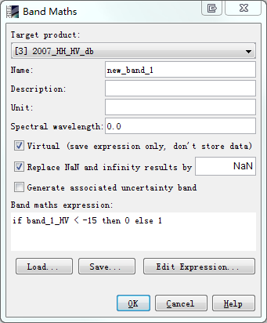
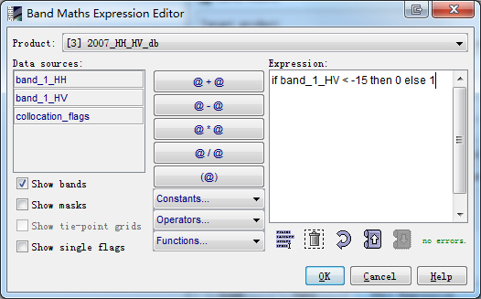
Forest mapping
1
2
3
4
5
6
7

Slide 14
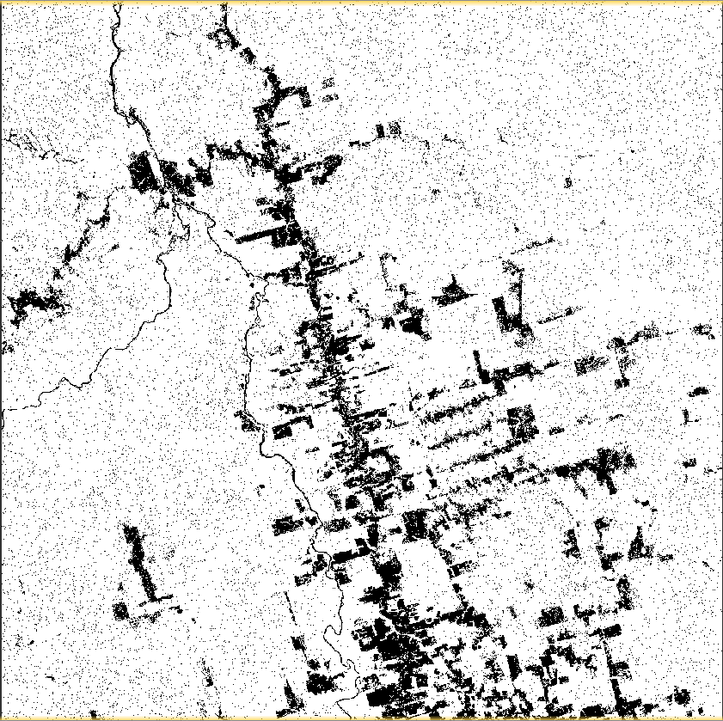
Forest mapping
Forest mapping result based on Original data
Do it yourself:
Repeat the steps for the Lee-filtered data.

Slide 15
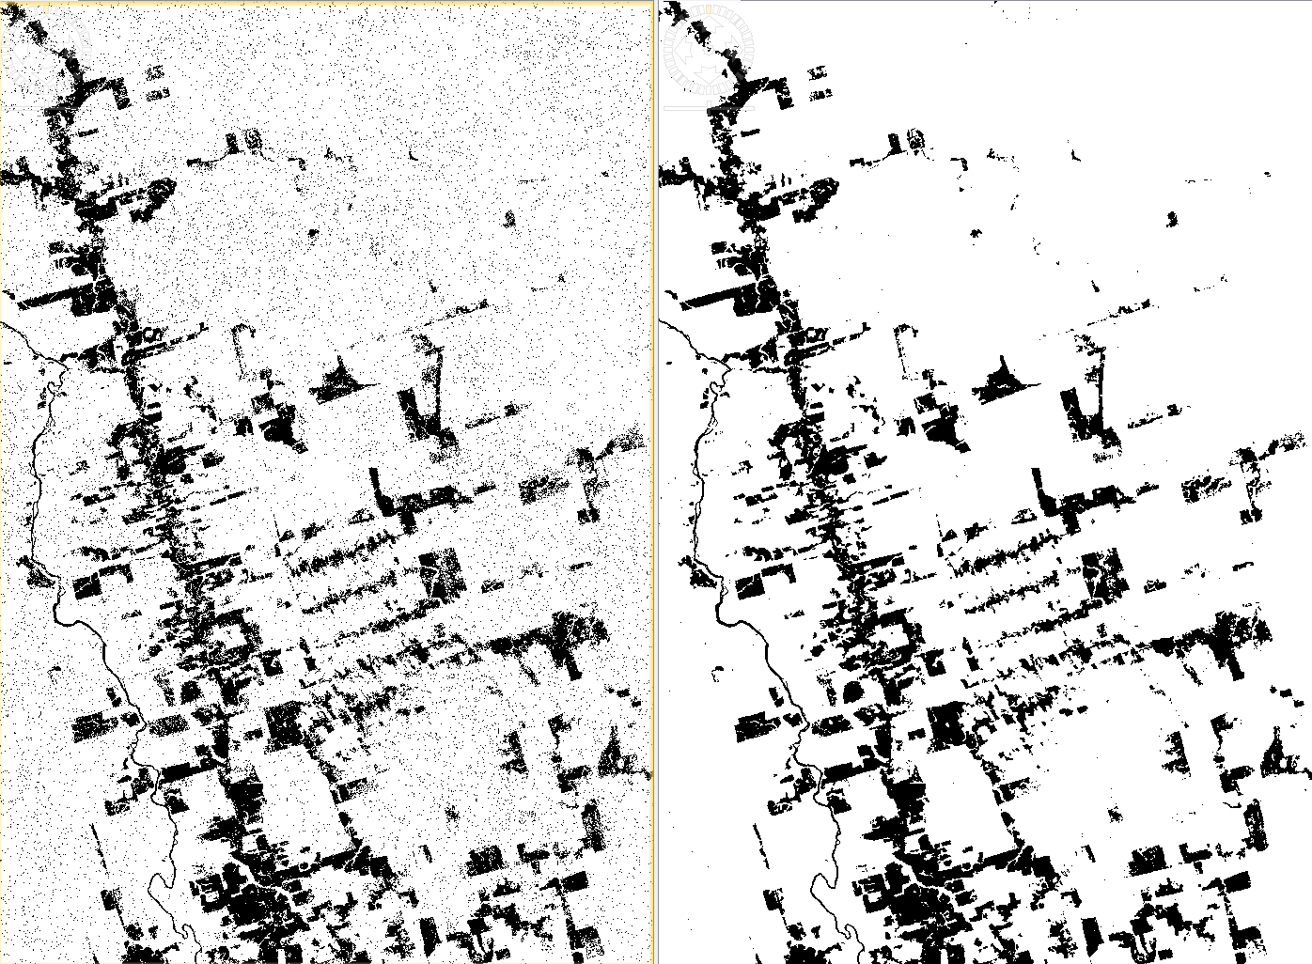
Forest mapping
Original
Lee-filtered

Slide 16
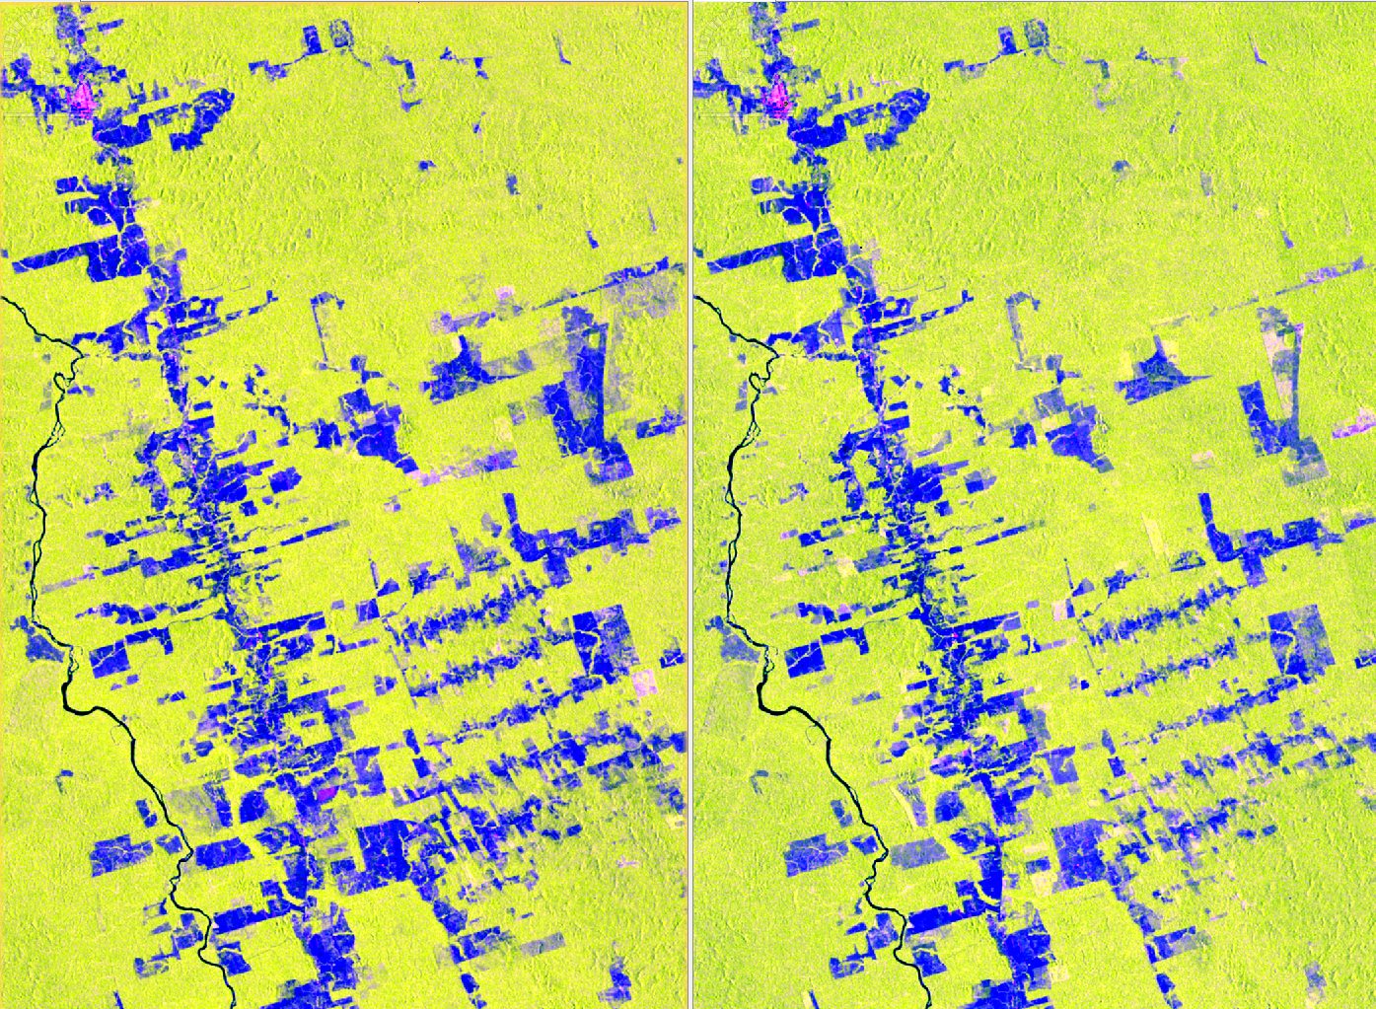
Forest mapping
Do it yourself: Repeat the steps for the ALOS PALSAR backscatter from 2010
2010
2007
R: HH G: HV
B: HH-HV
Histogram Stretch 95%

Slide 17
Forest mapping
Do it yourself: Repeat the steps for the ALOS PALSAR backscatter from 2010
2010
2007

Slide 18
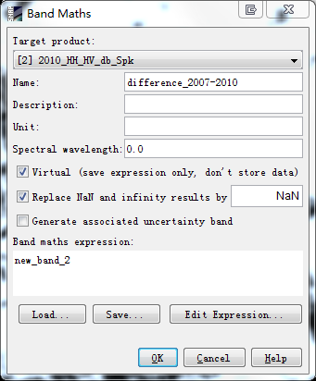
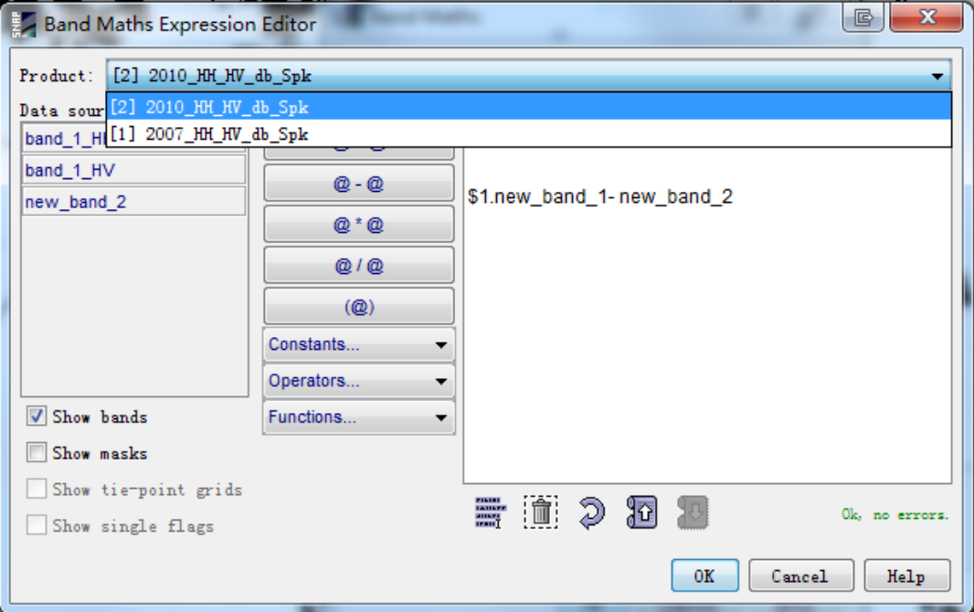
Forest mapping

Slide 19
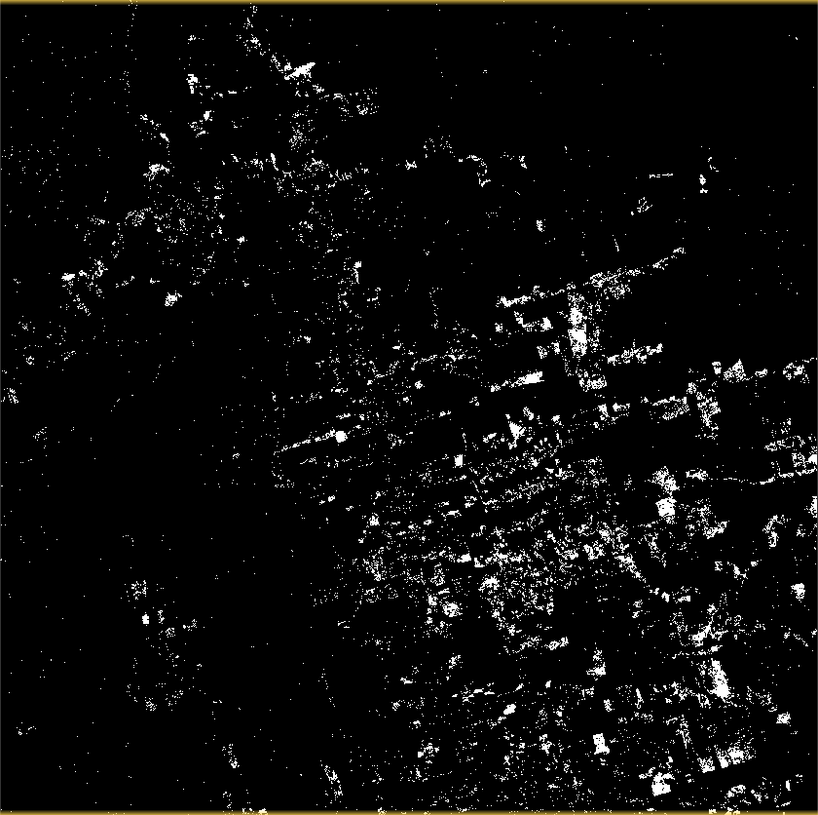
Forest mapping
Forest cover change mapping result:

Slide 20
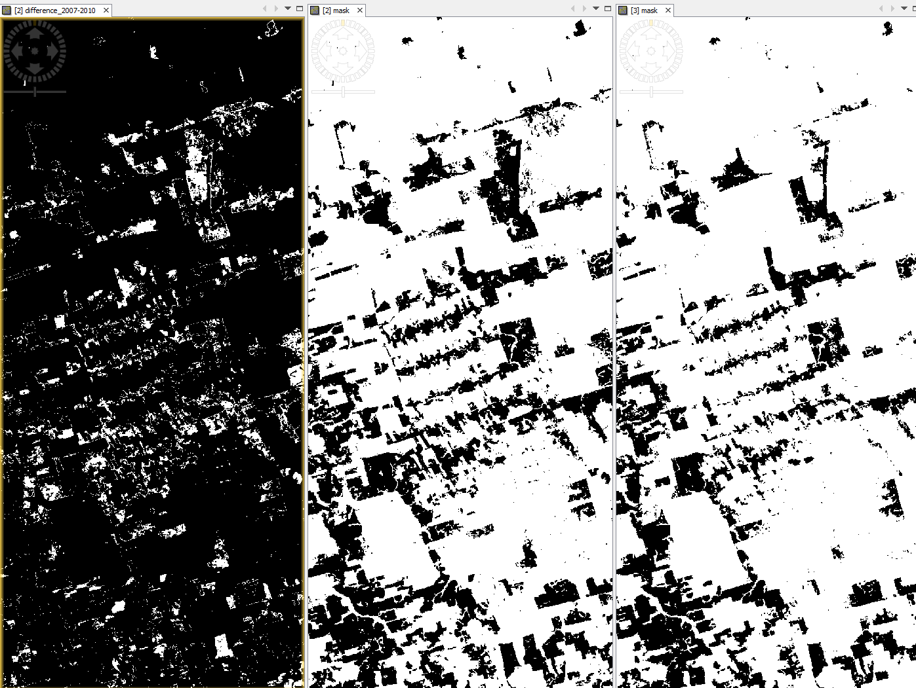
Forest mapping
Difference
2010
2007

Slide 21
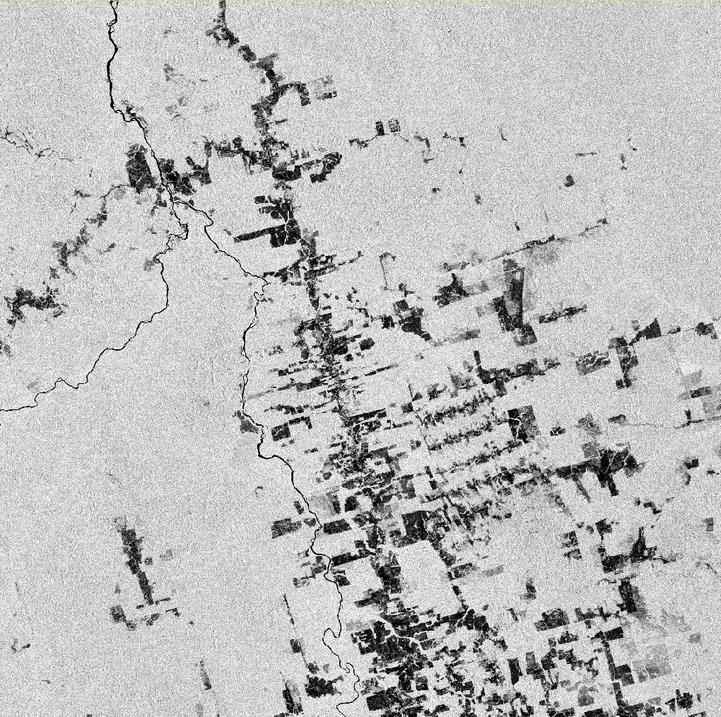
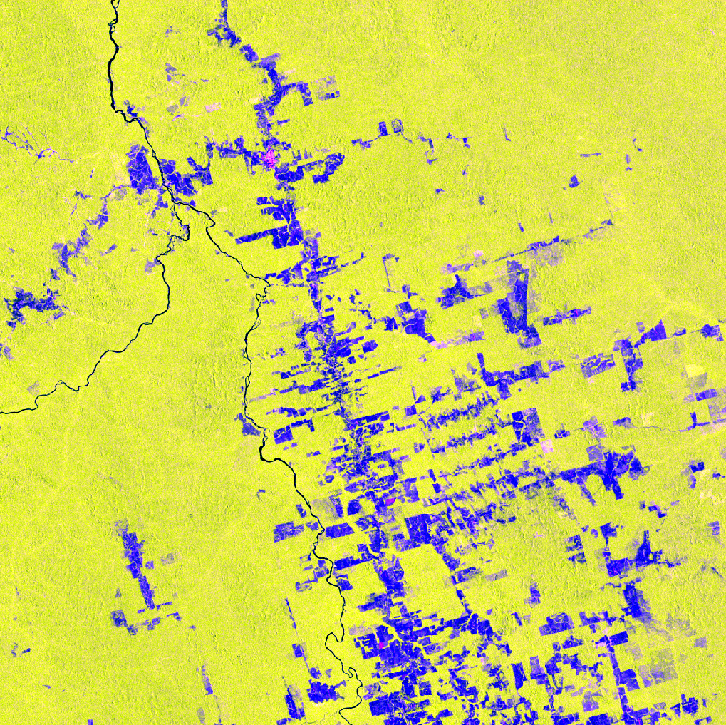
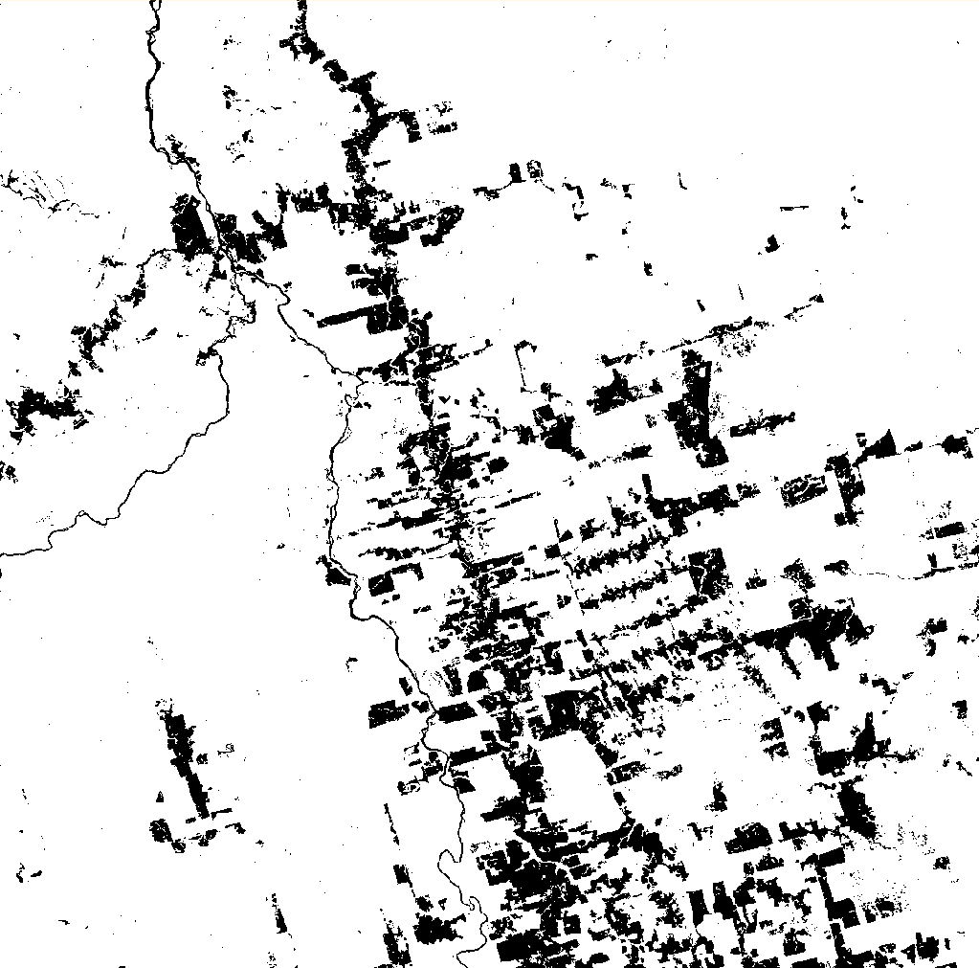
Lessons learned
Import PALSAR mosaic
Layer stacking
PALSAR mosaic
RGB
Speckle-filtered
Speckle filter
Forest cover mapping
Forest cover change mapping
Forest cover change
Forest cover

Slide 22
SAR-EDU – SAR Remote Sensing Educational Initiative
https://saredu.dlr.de/

