Slide 1
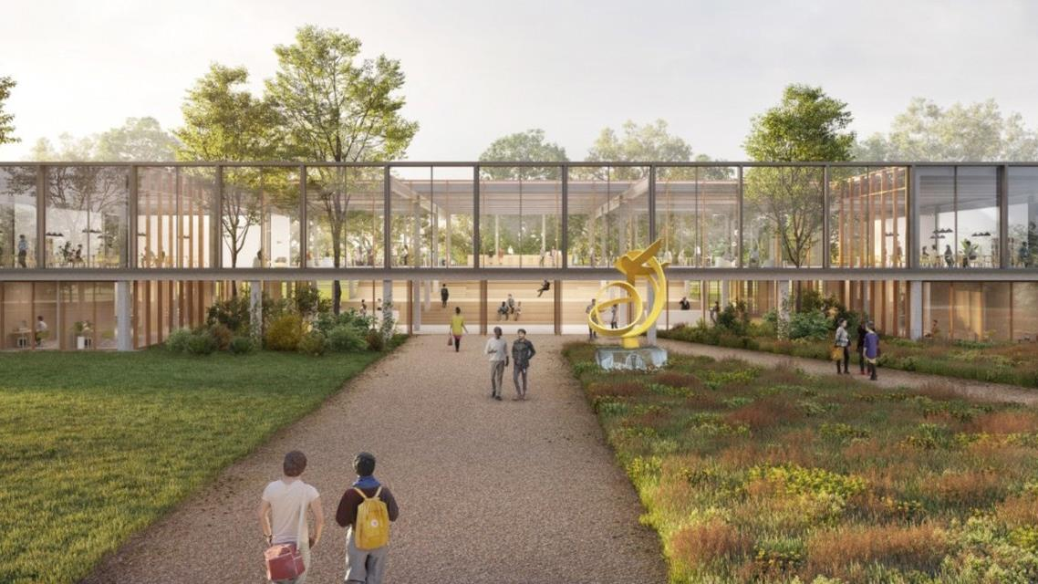
HEADING NORTH-WEST
How to organize this to a smooth landing?

Slide 2
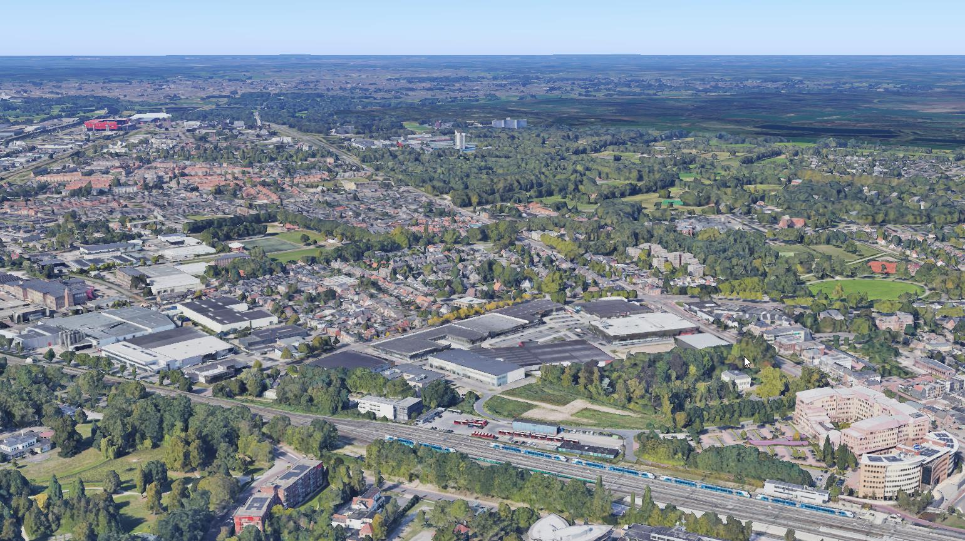
SMALL MOVE, BIG IMPACT
To share:
Why move to the campus?
How we started
Stages in the process
Landing and aftercare
Questions

Slide 3
Why move to the campus?
ITC joined UT in 2010
Concentrate activities on campus UT _vimeo (net-fs.com)

Slide 4
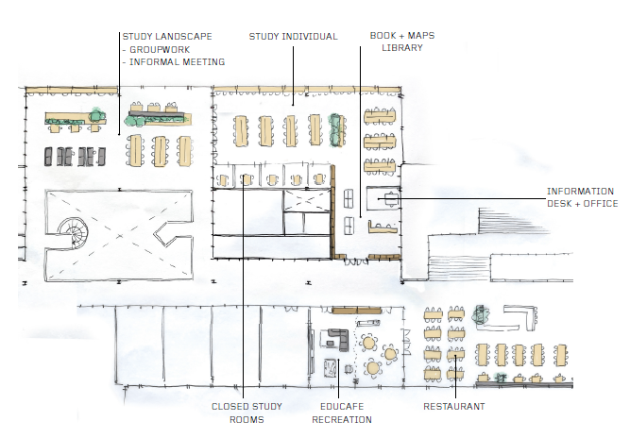
How we started
Plan of requirements
Base points formalized by FB
Project leader ITC and CFM
Owner of this project
Communication and organizing involvement
Notes:
The building offers students classrooms to interact with their lecturers and three open study landscapes for individual and groupwork. The study and learning center, the library in the old building, offers students individual study spaces, access to our collection of domain related literature and the services from information specialists.
The restaurant will also be available as meeting and study space outside of lunch hours.

Slide 5
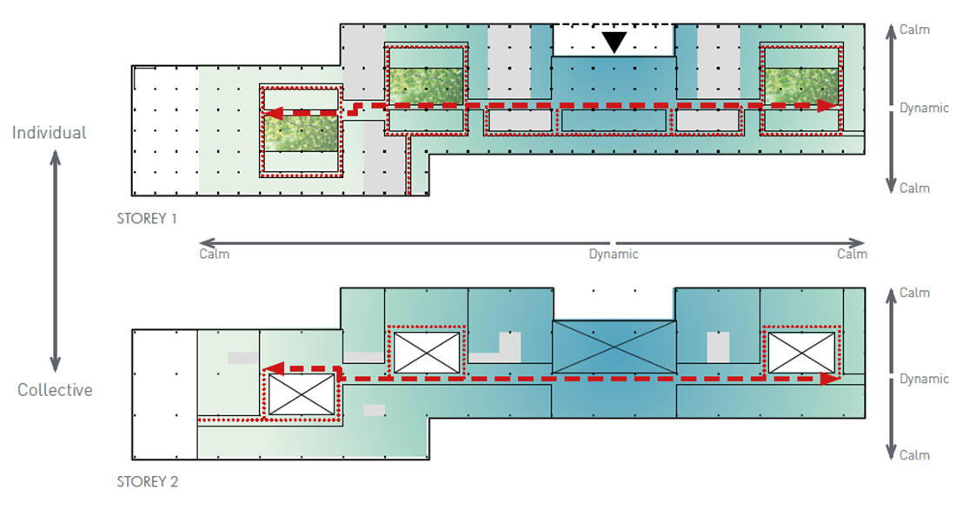
How we started
Setbacks Other housing issues on campus Increasing building costs Preferred option did not fit
Notes:
The building offers students classrooms to interact with their lecturers and three open study landscapes for individual and groupwork. The study and learning center, the library in the old building, offers students individual study spaces, access to our collection of domain related literature and the services from information specialists.
The restaurant will also be available as meeting and study space outside of lunch hours.

Slide 6
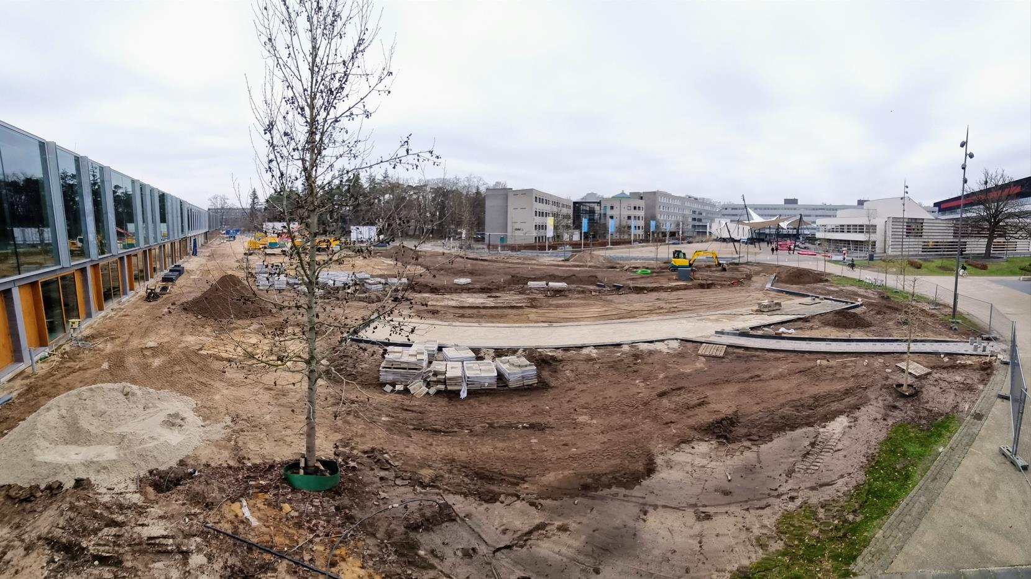
Stages in the process
From PoR, to preliminary design, final design and finally construction specifications
In 2019 definitive choice for LZ
In 2020 change in structure into housing cie: Teamleader CFM, finance, communication, education, coordination overall, lab specialist, owner/chair
Notes:
The building offers students classrooms to interact with their lecturers and three open study landscapes for individual and groupwork. The study and learning center, the library in the old building, offers students individual study spaces, access to our collection of domain related literature and the services from information specialists.
The restaurant will also be available as meeting and study space outside of lunch hours.

Slide 7
“The new ITC building will be sustainable, it will be a meeting place for all different cultures, it will be flexible and adaptable, and it will contribute to its environment. Its 37 meters of depth and 220 meters of length make it an extraordinary building.”

Slide 8
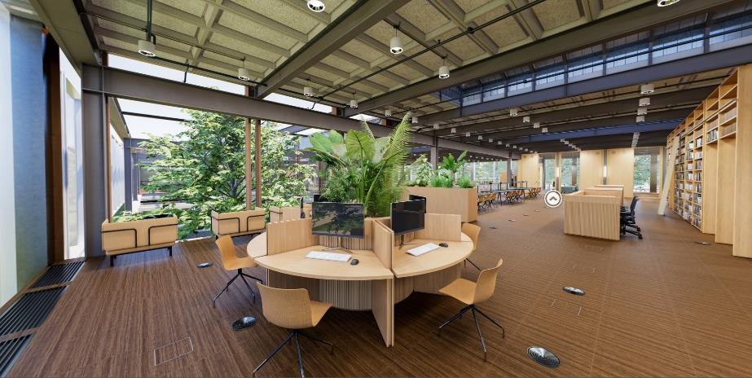
Stages in the process
Final stage: COMMUNICATION! Meet the FB, GA’s, posters, look and feel, explanations, visits, countdown, FAQ, etc…
Prepare smooth move Moving boxes but also clean up facilities
How to keep continuity?
Sustainability principles (furniture)
Notes:
The building offers students classrooms to interact with their lecturers and three open study landscapes for individual and groupwork. The study and learning center, the library in the old building, offers students individual study spaces, access to our collection of domain related literature and the services from information specialists.
The restaurant will also be available as meeting and study space outside of lunch hours.

Slide 9
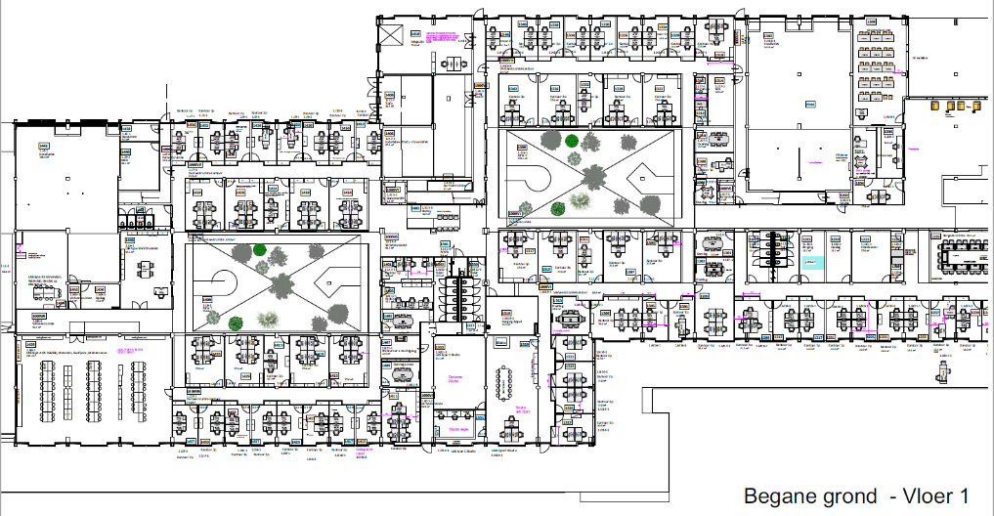
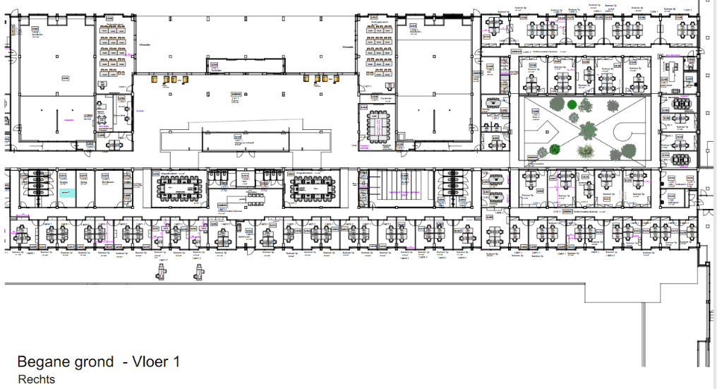
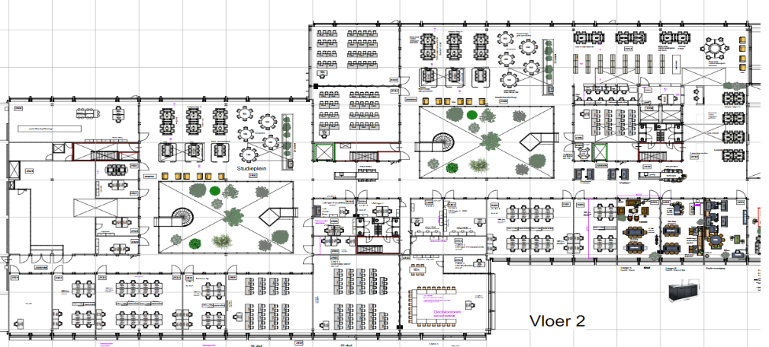
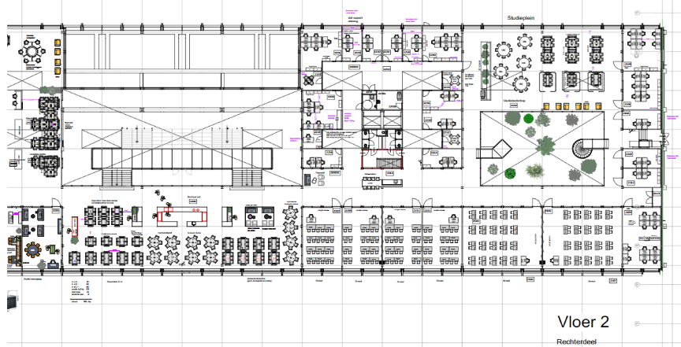
Landing and aftercare
Housing cie still in place
List with remaining points, but also issues such as dust, noise, cleaning, light, temperature, etc…
Evaluation through survey
Getting used to other way of working
Getting used to campus in and out
Main entrance
MIVA
WC
WC
WC
WC
WC
&
MIVA
BABY
Kop
Technical
Education
Study
Social
Labs
Print
Lockers
Garden
Office
Meeting
Study landscape 2
Study and learning center
Study landscape 1
MIVA
Study landscape 3
WC
Social Heart
WC
Gallery/ Designlab
WC
Lounge
Kop
Notes:
The building offers students classrooms to interact with their lecturers and three open study landscapes for individual and groupwork. The study and learning center, the library in the old building, offers students individual study spaces, access to our collection of domain related literature and the services from information specialists.
The restaurant will also be available as meeting and study space outside of lunch hours.

Slide 10
Questions?
langezijds
langezijds
langezijds
LANGEZIJDS
langezijds
Pronounced as: “Lah-nge-zites”?

