Slide 1
Minimum Viable Programme Plan
Steering Committee 20th of July 2023

Slide 2
EXTERNAL WHY
Target groups in target areas develop new/other market demand
The world is (more) ready for online / blended learning > changes the way of learning and cooperation
Why:
“Opportunity for Geoversity as global leader for geospatial education & community development”
Geospatial market size is expected to be 86 billion USD in 2023, is truly international, and is growing (significantly) the next years
Huge demand in geospatial market for foundational, technical, professional and entrepreneurial competences
Systems of scholarships is changing, revenue less easy to achieve

Slide 3
MISSION & VISION
MISSION
“Unite global geospatial expertise and experts”
VISION
“The premier platform for geospatial expertise, fostering connections and empowering a global community through lifelong learning and development”
IMPACT
In line with ITC’s mission, vision, and strategy Geoversity provides and enabling environment for knowledge and experience exchange among people and organizations to increase their collective societal impact. In particular, its aim is to contribute to achieving the UN’s sustainable development goals by mainstreaming the use and uptake of geoinformation science and earth observation in various application domains both locally and globally.

Slide 4
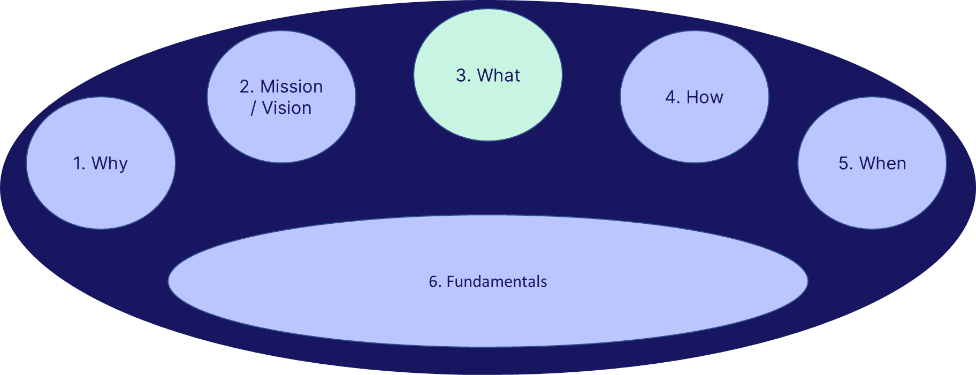
STRATEGY & OBJECTIVES (2028)
STRATEGY:
“Geoversity is the global geospatial online education & community platform – with a mix of free and paid content in multiple languages, to match market needs with innovative and high-tech geospatial content. Geoversity is market driven, is heavily marketed and targeted with a sustainable business model. Geoversity increases ITC’s visibility and position as an education leader, strengthens partnerships with alumni and industry and contributes to the professionalisation of ITC’s e-education competencies” *
OBJECTIVES:
1. Structural increase in (new) revenues streams
2. Structural strengthening of ITC's impact ​
3. Create leverage for a more market-oriented ITC​
4. Facilitating outreach and connections to ITC’s alumni and increasing its global network ​
5. Be the gatekeeper/first mover & setting the stage for the global geospatial community
*Reference: “Academy proposal to Ingenuity Phase II

Slide 5
PROGRAMME BUILDING BLOCKS
Mission, Vision & Strategy
Fundament for both: Geoversity & ITC as a whole faculty
Leadership as key element for success: both collective & personal
Growth in organizational maturity
Outside-in thinking mandatory
First phase: use everything ITC has to offer
Participate in ITC developments (Fundatis report; year plan 2024, etc.)
Portfolio
Partnerships
IT Platform
Marketing
Processes
Communication
Community
Quality assurance
Legal
Working under architecture
Business Development
Governance
Leadership / People / Culture
Organisational maturity

Slide 6
STRATEGDialogue, Questions & Remarks BJECTIVES (2028)
Where do you see opportunities for (further) collaboration?
What specific elements define the Ethiopian market?
…………………
*Reference: “Academy proposal to Ingenuity Phase II

