Slide 1
Aviation regulation and air space
G. Parodi
Notes:
1

Slide 2
Common terms
Drone pilot: responsible of the safety of the flight
Drone operator: responsible of the drone maintaince and the mission.
Hobby flights: pilot is also the operator
Other people involved:
  Observer: monitors the sky
  Camera operator: operates only expensive cameras while pilot flies.
  Payload: any connected to the drone but it is not part of it

Slide 3
certificates
For drones of 250 gr or more. EASA (European Union Aviation Safety Agency) 3 categories based on RISK (people involved + drone weight)

Slide 4
glossary
Abbreviation | Term
- | Drone
UA | Unmanned Aircraft
UAS | Unmanned Aircraft System (= aircraft + ground station, etc.)
RPA | Remotely Piloted Aircraft
RPAS | Remotely Piloted Aircraft System (= aircraft + ground station, etc.)
UAV | Unmanned Aerial Vehicle (this term is not used anymore in regulations)
Usual word is drone

Slide 5
Three agency (International-EU-NL)
ICAO: The International Civil Aviation Organization (ICAO) is the main regulatory body in general aviation, setting standards and recommended practices for the industry in the form of 19 annexes. ICAO's international standards are followed by national and supranational bodies such as EASA.
EASA: Based on ICAO, EASA publishes rules that are valid within all EU Member States. All national rules of EU member states comply with these supranational rules.
National Aviation Authority (NAA) and other national agencies: Every country has a National Aviation Authority (NAA), also called Civil Aviation Authority (CAA), which implements regulations based on the standards set by ICAO, or EASA in the case of countries within the EU.
Air Traffic Control the Netherlands (LVNL, Luchtverkeersleiding Nederland) controls civil airspace in the Netherlands. LVNL monitors the location of aircraft in their assigned airspace by radar and communicates with the pilots via radio to prevent collisions.

Slide 6
EASA regulations
There is no difference between hobby and professional flying. Everybody must meet requirements before using a drone.
There are two ways to make drone operations safer.
  1. the use of equipment built to European safety standards (CE mark).
  2. a risk assessment that considers the risk of the operation and competence of the remote pilot.

Slide 7
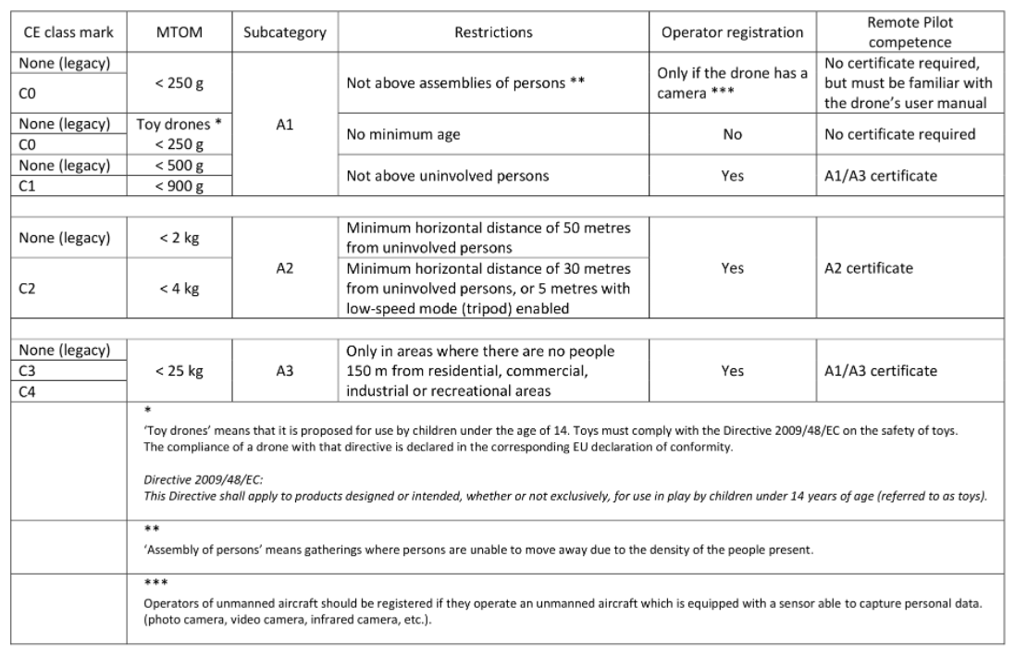
Drone classes
The new drones have a CE mark. Old drones not.
After 1/Jan/24 all OLD drones < 249 g are can fly in category A1. All others in A3.
Rules during the transitional period

Slide 8
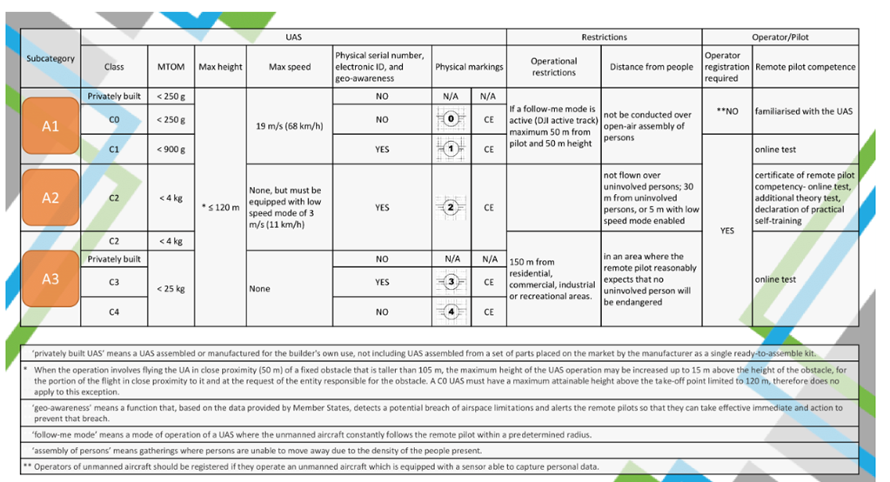
Easa open category
In this Category, drones of up to 25 kg may be used for low-risk operations. Operators can fly without prior permission under certain conditions. The drone must not exceed a height of 120 m and the pilot must keep the aircraft in visual line of sight (VLOS), away from people. This Category is further divided into 3 sub-categories:

Slide 9
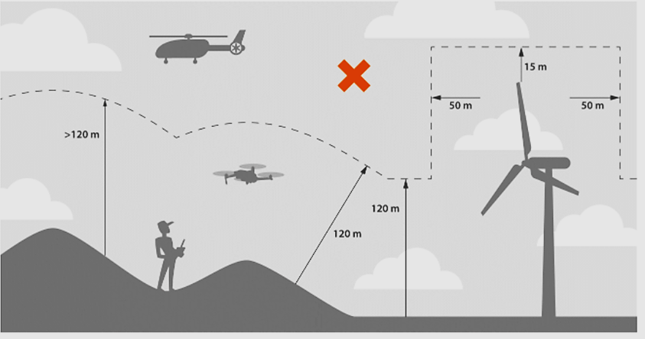
High distance and proximity
An important consideration is how high you are allowed to fly, how far and how close you may fly to other people.
All drone operations must remain within 120 m of the ground. Most UAs measure height above the take-off point. Sometimes it may be important to take note of changes in elevation, such as hills or mountains, so that you can calculate the UA’s height above the ground.
This height limitation can be extended by 15 m if flying within 50 m horizontally of an obstacle that is taller than 105 m, as long as you have permission from the person responsible of the obstacle.

Slide 10
Subcategory: drone weight & close people
A1: A: drone weight< 250 g, may overfly uninvolved persons but never assemblies of people;
B: With a UA Class C1, you may only fly where you reasonably expect that no uninvolved person will be overflown and never overfly assemblies of people. In the event of unexpected overflight of uninvolved persons, you must reduce as much as possible the time during which the unmanned aircraft overflies those persons.
A2: Must not be flown over uninvolved persons and at a safe horizontal distance of at least 30 meters from them; you may reduce the horizontal safety distance down to a minimum of 5 meters from uninvolved persons when operating an unmanned aircraft with an active low speed mode (a function that limits the speed to 3 m/s).
A3: Must be conducted at least 150 metres from residential, commercial, industrial or recreational areas, and in an area where you reasonably expect that no uninvolved person will be endangered within the range where the drone is flown.

Slide 11
Distances to roads and railways and others
Road /rail type | Min. horizontal distance
 | Category A1 & A2 | Category A3
Highway (130 km/h) | 50 m | 150 m
Motorway (100 km/h)
Fast road *80 km/h)
Railway crossing with to without barrier | 25 m | 150 m
High voltage network Drinking supply stations Surface water collection points | 150 m | 150 m

Slide 12
Survey before fly: care!! pilot responsibility
Conducting a survey of the operational area beforehand is a good way to gauge how close you would be able to fly safely. You should pay attention to:
  People and public areas
  Animals
  Property and buildings
  Vehicles
  Other airspace users

Slide 13
Validity of competency
Categories A1, A2 and A3:
renewal of certificates every 5 years
  Complete the theoretical exam
  Certificate of completion of online training
  Certificate of remote pilot competency

Slide 14
Competency for subcategory A1
It is the easiest way to operate under the EASA rules. Without a certificate for drones < 250 g. If you pass an exam, you can operate drones under 900 g. You can operate relatively unrestricted if you do it safely under the following conditions:
UAS under 250 g:
  UAS must be marked as class C0, or be privately built with a maximum speed of 19 m/s
  You may fly over uninvolved persons but never over assemblies of people
  In follow-me mode is active, the UA is never farther than 50 m from the pilot and not higher than 50 m
  The pilot must be familiar with the UAS manufacturer’s instructions in the UAS manual
UAS under 900 g:
  UAS must be marked as class C1
  Not flown over assemblies of people and reasonably expect that no uninvolved person will be overflown
  The pilot must be familiar with the UAS manufacturer’s instructions in the UAS manual
  The pilot must hold a certificate of completion of online training (online exam)
Certificate of completion of online training:
  Complete online training
  Pass an online exam

Slide 15
Competency for subcategory A2
To operate slightly heavier drones, you need to meet a few more requirements. In addition to the online exam required for A1, you will have to pass an additional theory exam aimed at further assessing your knowledge and declaring that you have sufficient skills to pilot your drone safely (declaration of self-training).
Conditions
  UAS must be marked as class C2
  Not flown closer than 30 m from uninvolved persons
  Flown up to 5 m from uninvolved persons if there is an active low speed mode (3 m/s) and after an evaluation of the area regarding:
    Weather conditions
    Performance of the UA
    Segregation of the overflown area
  The pilot must be familiar with the UAS manufacturer’s instructions in the UAS manual
  The pilot must hold a certificate of remote pilot competency
Certificate of remote pilot competency:
  Complete online training
  Pass an online exam for A1/A3
  Declare that you have completed the self-practical training
  Pass an additional exam

Slide 16
Competency for subcategory A3
This subcategory is left fairly flexible in that you are allowed to operate several different drones, including self-built, if they are less than 25 kg. The limitation here is that you can only fly outside of congested areas where no people are expected to get in the way.
Conditions:
Be conducted in an area where you reasonably expect that no uninvolved person will be endangered
Be conducted at a safe horizontal distance of at least 150 meters from residential, commercial, industrial or recreational areas
The pilot must be familiar with the UAS manufacturer’s instructions in the UAS manual
Be performed with UA that:
  Is privately built less than 25 kg
  Is marked as class C2, C3, or C4
The pilot must hold a certificate of completion of online training (online exam)

Slide 17
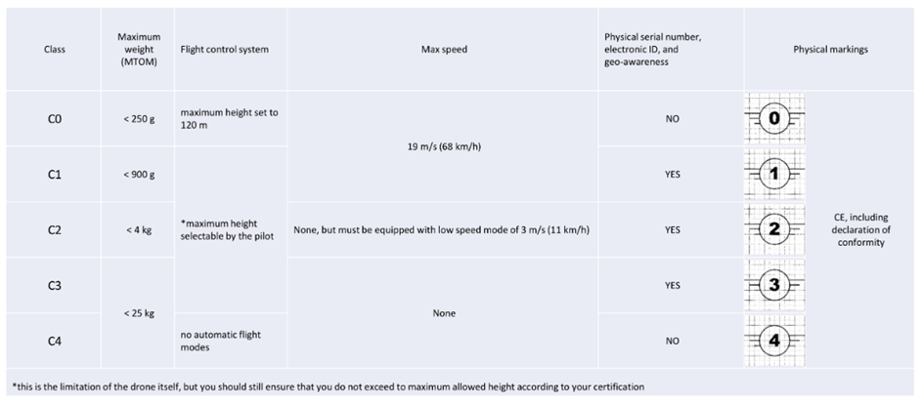
UAS Classes
All UAs used within the open category, except privately built UAS, must be classified as one of 5 Classes. Each Class, C0-C4, has different requirements and limitations, and must include a user manual and an information notice published by EASA providing applicable limitations and obligations under EU law.
All drone classes also need to be certified to be safe to use on the European market (CE mark) and must include a declaration of conformity.

Slide 18
Operators and pilots
Under EASA when flying a UA you are considered as an Operator.
In most cases, when flying in the open category, you will take the role of both the operator and pilot and have their responsibilities.
Registration as an Operator
In most cases you are required to register yourself as an Operator when flying a UA. The procedure may differ per country, but according to EASA this must include the following:
Full name and the date of birth
Address
Email address and telephone number
Insurance policy number
The confirmation by legal persons of the following statement: ‘All personnel directly involved in the operations are competent to perform their tasks, and the UAS will be operated only by remote pilots with the appropriate level of competency’

Slide 19
Responsibilities of the operator
Develop procedures for their operations.
Ensure the correct use of radio equipment.
Designate a pilot for each flight.
Ensure that their pilots hold the required certificates and that they are valid.
Update no-fly zones in the UAS.
Ensure that the UAS has the correct CE markings and certificates.
Ensure in the case of an UAS operation in subcategory A2 or A3, that all involved persons present in the area of the operation have been informed of the risks and have explicitly agreed to participate.

Slide 20
Responsibilities of the remote pilot
The whole operation is controlled by the Remote Pilot (RP). The RP may operate the ground station and fly the UA or give instructions to another crew member who operates the ground station. The RP also gives instructions to the payload operator and the observer(s).
Before flight:
Have the appropriate competency certificate
Check for any additional information on no-fly zones relative to the operation
Check the surroundings for obstacles and for uninvolved persons
Ensure that the UAS is in a condition to safely complete the intended flight, and if applicable, check if the direct remote identification is active and up-to-date
If fitted with an additional payload, ensure that the MTOM is not exceeded
During flight:
No fly if I’M SAFE rules are broken (About health. see later)
Fly Visual Line Of Sight (VLOS), and land immediately if the UA poses a risk to aircraft, people, animals, environment or property.
Set a communication with the observer in case of Extended LOS flights
Comply with any airspace or no-fly zone restrictions
Always be in control of the UA
Operate the UAS in accordance with manufacturer’s instructions
Comply with the operator’s procedures when available
When operating at night, ensure that a green flashing light on the UA is activated
During the entire flight, the drone must be controlled with the same controller

Slide 21
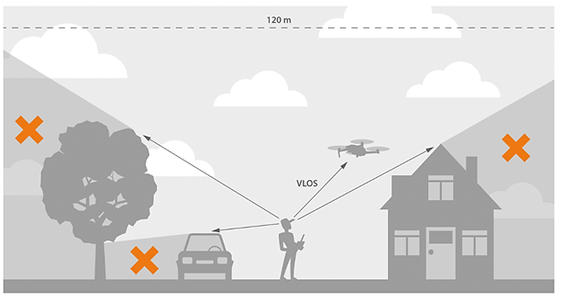
Visual line of sight
The maximum distance of the UA from the remote pilot should depend on the size of the UA and on the environmental characteristics of the area (such as the visibility, presence of tall obstacles, etc.).
Limit: if unobstructed, till a distance when the drone remains clearly visible.

Slide 22
Discontinuation of flight
It is up to the pilot to maintain good situational awareness, and scan the surrounding airspace for manned aircraft. Because UAs are generally small, pilots of manned aircraft may not be able to see them. This means that the pilot of the UA is primarily responsible for avoiding collisions.
If the pilot sees a parachute or other aircraft in the area, they must immediately give way and keep the UA at a safe distance. In most cases it is safest to land the UA immediately.

Slide 23
Emergency response effort
An emergency response is the action of responding to a dangerous or unexpected event, such as emergency services responding to an accident.
When there is an emergency response effort taking place in the operational area of a UAS, the UAS operation should be immediately discontinued unless it was explicitly authorised by the responsible emergency response services. Otherwise, a safe distance must be maintained between the UA and the emergency response site so that the UA does not interfere with, or endanger, the activities of the emergency response services. The UAS operator should take particular care to not hinder possible aerial support and to protect the privacy rights of persons involved in the emergency event.

Slide 24
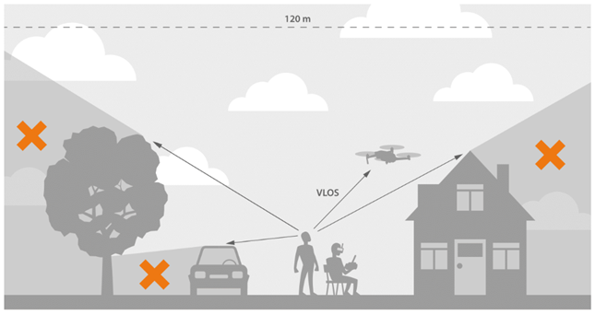
First Person View (FPV)
The remote pilot may be assisted by a UA observer helping them to keep the UA away from obstacles.
The UA observer must be situated alongside the remote pilot toprovide warnings to the remote pilot by supporting them in maintaining the required separation between the UA and any obstacle, including other air traffic.
UA observers may also be used when the remote pilot conducts UAS operations in first-person view (FPV), which is a method used to control the UA with the aid of a visual system connected to the camera of the UA. In any case, including during FPV operations, the remote pilot is still responsible for the safety of the flight.
As the UA observer is situated alongside the remote pilot and they must not use aided vision (e.g. binoculars), their purpose is not to extend the range of the UA beyond the VLOS distance from the remote pilot. Exceptions are emergency situations, for instance, if the pilot must perform an emergency landing far from the pilot’s position, and binoculars can assist the pilot in safely performing such a landing.

Slide 25
Air traffic rules
Similar to traffic!!
UAs must give priority (right of way) to all other air traffic!
If two UAs are on crossing routes then the UA which has the other UA on its right side must give priority to the other UA
If two UAs approach each other head-on then both pilots must turn to the right (as seen from the direction of flight)
Other UAs must give priority to a UA which is going to land

Slide 26
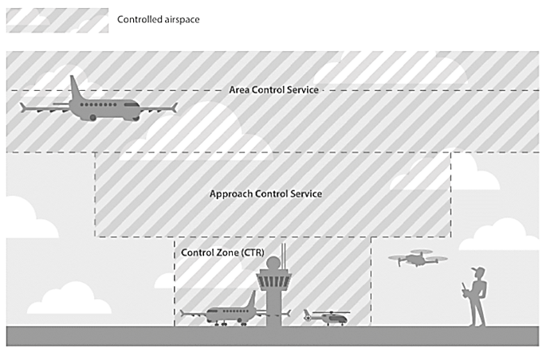
Airspace classification
Airspace is divided into various zones, some controlled by Air Traffic Control (ATC) and others uncontrolled depending on the class of airspace. Check local regulations to see in which airspaces you are allowed to fly, as this may vary between countries. Usually there is a no-fly zone chart for UA operations, highlighting all areas where flying is not allowed, or areas where there are more limitations (height, distance, etc.)

Slide 27
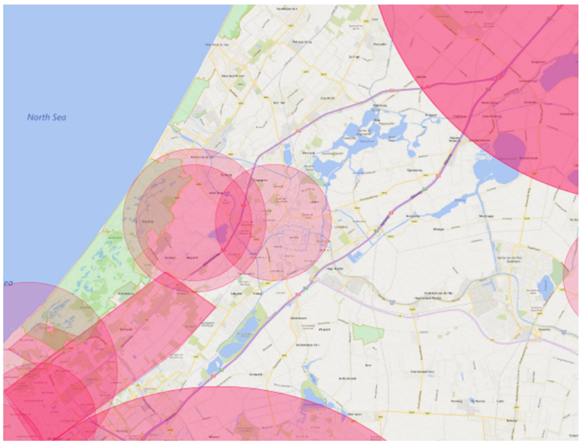
Usual no fly zones
Aerodromes : airports, airfields, heliports, flying clubs.
Control Zones (Controlled Traffic Region or CTR): controlled airspace surrounding large airports
Military training areas: usually used for helicopter training, and thus often train at low level.
Low flying areas and routes: areas where military planes and other aircraft are permitted to fly much lower than usual.
Prohibited areas
Restricted areas
Dangerous areas
Nature reserves (Nature 2000: check)

Slide 28
Flying times
Aviation usually use ZULU time (UTC). Greenwich time
SR= sunrise, SS= sunset. Flying time during the Uniform Daylight Period (UDP) 15 min before SR and 15 after SS.
Flying by night is usually prohibited. (Check locally)
Verify what time is used in the aeronautical information you use.

Slide 29
Accident and incident reporting
ACCIDENT
During time engines are on or the drone is in the air.
a person is fatally or seriously injured as a result of direct contact with any part of the UA, including parts which have become detached from the UA or direct exposure to the engine exhaust stream.
It must be reported
SERIOUS ACCIDENT
During time engines are on or the drone is in the air.
An event involving circumstances indicating that there was a high probability of an accident and is associated with the operation of an aircraft.
It must be reported
INCIDENT
A. Any safety-related event which exposes an aircraft or persons to danger or which, if it had not been corrected or compensated for, could have exposed them to danger;
B. An event resulting in damage or a structural defect of the UA which reduces its strength, performance or flight properties and which normally requires extensive repair or replacement of the affected part, except in the case of engine/motor failure or damage which is limited to the engine/motor, its cover or components; or damage limited to the propellers, wing tips, antennas, tyres, brakes, fairings or dents or small holes in the UA fuselage;
C. An event resulting in the loss or inaccessibility of the UA.

Slide 30
Examples of reportable events
Injury to persons (operator's crew or third parties) due to contact with the UA
Collision or near-collision with another aircraft (manned or unmanned)
Emergency landings and precautionary landings
Loss of the UA (fly-away), even if it is later recovered
Temporary or permanent loss of control of the UA
Landing outside the safety zone, at close proximity to uninvolved persons, buildings, obstacles, roads, boats, vehicles, etc.
Bird strike or attack by birds
Problems with the batteries, fuel or oil
Wrongly loaded or overloaded
Pilot incapacitated due to illness or feeling unwell during the flight
MSAFE incidents
Problems during the flight which affect flight safety
Damage to the UA or damage to the property of third parties due to contact with the UA
Incorrect procedures
Problems due to the condition of the take-off and landing place
Technical problems
Technical malfunctions affecting the flight properties of the UA
Fire or smoke (UA or ground station)
Temporary or permanent loss of the Command and Control (C2) link
Deliberate violation by the Remote Pilot of the rules and regulations, in the interest of safety

Slide 31
Investigations
Accidents and incidents can be investigated as:
A safety investigation by the Safety Board to determine the underlying causes so that the aviation community can learn from them. Any information you give to this investigation cannot be used for a criminal investigation.
A criminal investigation by the Aviation Police or other government body, to determine if you have committed a crime and should be prosecuted in court. This investigation is completely separated from a Safety Board investigation

Slide 32
AIRPROX and “Just culture”
In case of an AIRPROX (air proximity incident) your UA and another aircraft (UA or conventional aircraft) came so close to each other that there was a risk of an accident. This must be reported using a special AIRPROX form, usually found on the local AIS website.
Just culture means a culture in which front-line operators or others are not punished for actions, omissions or decisions taken by them that are commensurate with their experience and training, but where gross negligence, wilful violations and destructive acts are not tolerated.

Slide 33
Airmanship (1)
A good, successful and professional pilot practices “good airmanship”. A good pilot with good airmanship uses good judgment consistently before, during and after the operation. Safety in the air and on the ground is leading. For that, a good pilot has three important qualities. They have well-developed skills through training, gaining experience though practice, and following changes in the industry to carry out flight objectives professionally.

Slide 34
Airmanship: Proper planning and preparation
The pilot can make good flight preparations beforehand by checking flight information publications, aviation weather reports and determining aircraft performance. Most importantly, the pilot must know their personal limitations.
In short, airmanship is the consistent use of good judgment and well-developed skills to carry out flight operations. This consistency is forged on a cornerstone of uncompromising flight discipline and is developed through systematic skill acquisition and ability. A high state of situational awareness completes the airmanship picture and is obtained through knowledge of one’s self, aircraft, environment, team and risk.

Slide 35
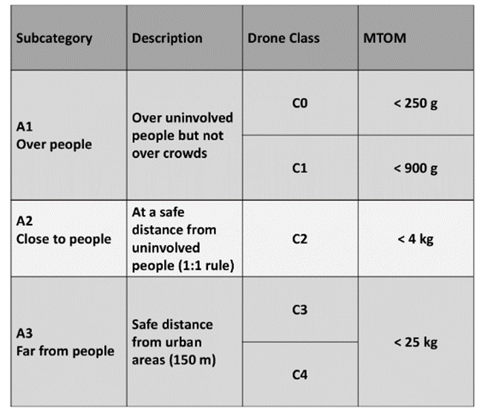
Dangers to people
If there is a reason of safety, it is about people.
Pilots must keep this as priority over any other aspect of the mission

Slide 36
Dangers to other aircraft
A drone can fly high and is able to reach over 10,000 feet (3 km) in ideal conditions. That is why drones are a very real threat to general air traffic. The height limit for drones in the EASA rules is there for good reason. Without specific reasons and official permission, it is illegal to fly above the permitted height limit.
A drone is indeed not very big. If a single drone hits the body of a stationary airplane, the plane will probably be only slightly damaged. But don't forget the speed in the air. Small things at high speed can also cause serious damage, especially to vulnerable parts like a windscreen or a propeller. If a drone hits an engine, it can certainly cause massive damage with severe consequences. Drones can easily cause the failure of that engine and millions of euros of damage.
Small drones are very difficult for an airplane pilot to see and cannot be seen by on-board radar. So, fly safely. Do not fly above the allowed limit and keep a safe distance from all other airspace users.

Slide 37
Privacy and data protection (VIP)
In general, pictures, filming or audio of people where they are recognizable cannot be taken without permission.
When they cannot be recognized, it is tolerated (limited)
Publishing of media is not permitted under any circumstance without permission.
Permissions can be withdrawn as easy as they were given.
People can request data to be erased from database and administration and from anywhere it was passed to.

Slide 38
insurance
When operating within the EU it is required to be insured in accordance with Regulation EC 785/2004. This covers third party liability, hijacking and acts of war. You are obligated to follow the rules according to the relevant member state, and check for any local regulations that way differ between member states.

Slide 39
Security
Resources to deal with risks, emergencies or contingencies.
for those on the ground and those in the air.
Rules must follow according to the sub-category of the drone

Slide 40
Dangerous goods in payloads
Avoid
explosives (mass explosion hazard, blast projection hazard, minor blast hazard, major fire hazard, blasting agents, extremely insensitive explosives);
gases (flammable gas, non-flammable gas, poisonous gas, oxygen, inhalation hazard);
flammable liquids (flammable liquids; combustible, fuel oil, gasoline);
flammable solids (flammable solids, spontaneously combustible solids, dangerous when wet);
e. oxidising agents and organic peroxides;
toxic and infectious substances (poison, biohazard);
radioactive substances;
corrosive substances;
Unchecked or contaminated blood, otherwise is OK.
Dangerous goods is allowed in certified category only as well as dropping material!!!

Slide 41
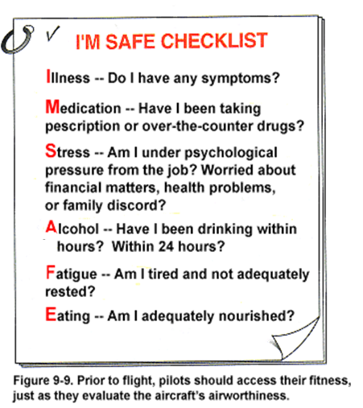
I’m safe

Slide 42
Lecture End

