Slide 1
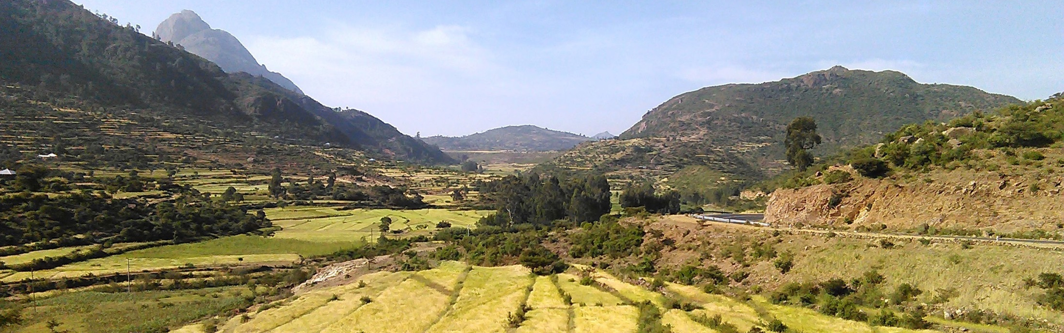
Ethiopian Education Network to Support Agricultural Transformation (EENSAT)
Monitoring and Evaluating Small-scale Irrigation Schemes in Northern Ethiopia
By: Amina Abdelkadir Mohammedshum
Supervisors: Dr. ir.Christiaan van der Tol, Dr.ir. Chris Mannaerts, Dr. Ben Maathuis , Dr. Daniel Teka
Research meeting, October 12, 2023, University of Twente

Slide 2
Overview of PhD progress
Field activities
Site selection for a small-scale irrigation scheme in the Zamra catchment was conducted.
Data collection was conducted through a socio-economic survey, focus group discussions (FGD), and key informants interview (KII).
Soil moisture sensors and a Hobo weather station were installed.
Physical soil analysis was conducted at two sites, Gerebehiwane (traditional diversion) and Gojibere (modern diversion), where soil moisture sensors were installed.
Ground truth data were collected for classification, and information on water use (depth of water applied) was gathered to calculate crop water productivity.

Slide 3
Overview of PhD progress
Paper presented and published
Mohammedshum, A.A., Mannaerts, C.M., Maathuis, B.H.P., & Teka, D. Characterize small-scale irrigation schemes in Northern Ethiopia based on socioeconomic, technical, and institutional aspects. International Conference on Environment and Society, Florida, United States, November 22-23, 2021. (Link)
Mohammedshum, A.A., Maathuis, B.H.P., Mannaerts, C.M., & Teka, D. (2022). Evaluating the performance of EO-based approaches for mapping small-scale irrigation areas in Northern Ethiopia. NAC 2022 conference on Earth and Environmental Sciences at Van der Valk Hotel Utrecht, the Netherlands, from September 5-6, 2022. (Link)
Mohammedshum, A.A.; Mannaerts, C.M.; Maathuis, B.H.P.; Teka, D. Integrating Socioeconomic Biophysical and Institutional Factors for Evaluating Small-Scale Irrigation Schemes in Northern Ethiopia. Sustainability 2023, 15, 1704. https://doi.org/10.3390/su15021704.

Slide 4
Overview of PhD progress…
Paper submitted
Mapping Small-Scale Irrigation Areas Using Expert Decision Rules and the Random Forest Classifier in Northern Ethiopia submitted to the Journal, under review.
Paper on preparation
Evaluation of irrigation scheme performances using the Triple sensor approach in the Zamra catchment.
Optional to include in the thesis
Evaluating the Performance of Earth Observation (EO)-based Approaches for Mapping Small-Scale Irrigation Areas in Northern Ethiopia.

Slide 5
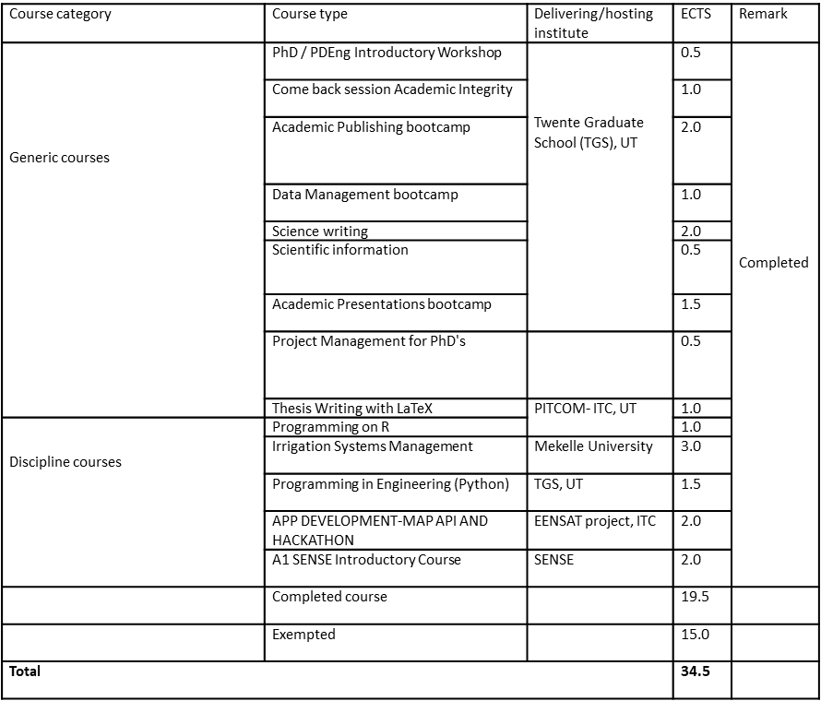
Courses
Summary of completed courses

Slide 6
Plan for the next months
Following the second article in the publication processes, the estimated finish time would be November 2023, if it is accepted.
Redo the data analysis for the third paper comments and submit the 3rd paper to the journal before or in January 2024.
The final thesis will be submitted to the supervisors after the publication of the third paper, the estimated time would be before April 2024.
I hope the public defence will occur either before or in September 2024.
Note: Once I have recovered, and assuming papers 2 and 3 are accepted on time, I can proceed well.

Slide 7
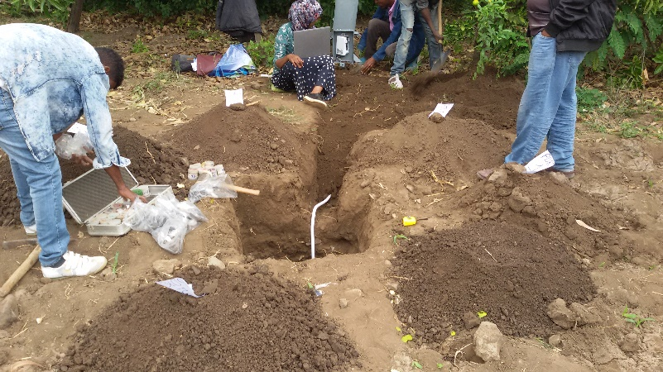
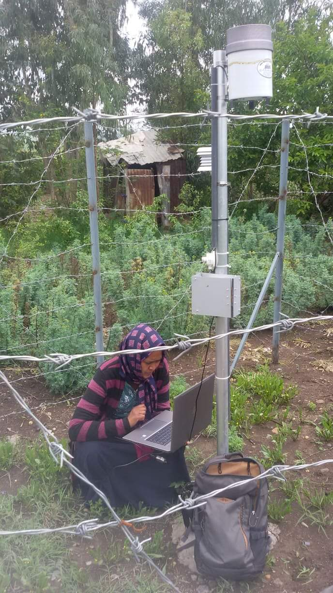
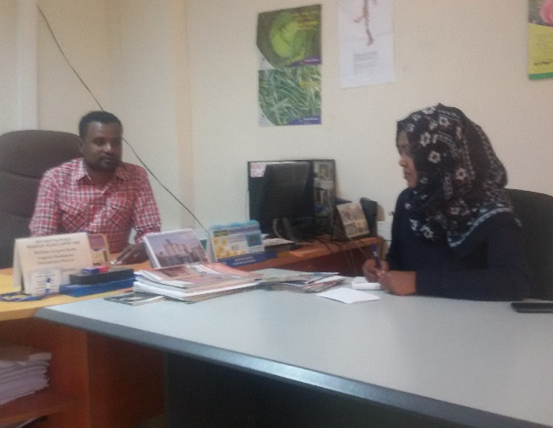
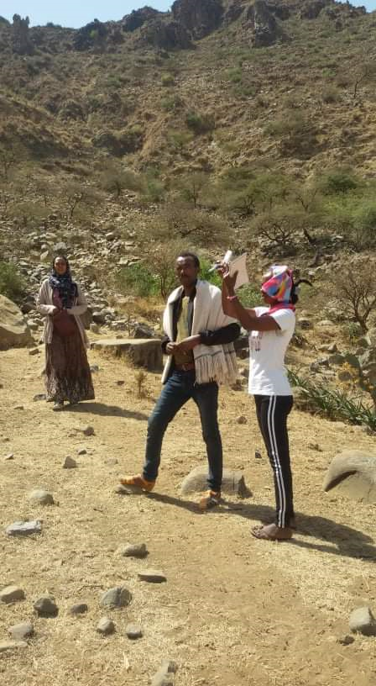
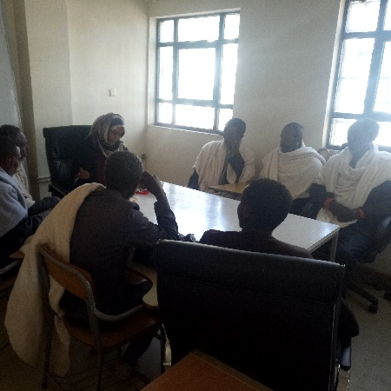
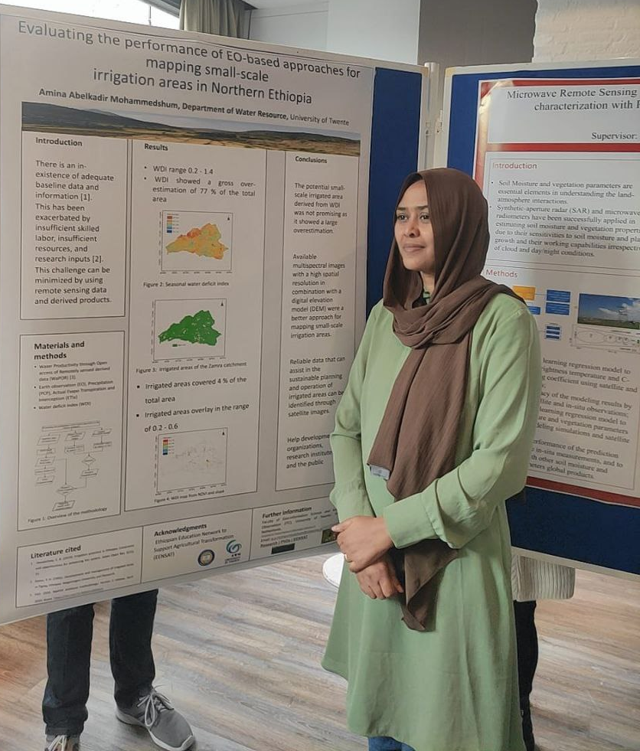
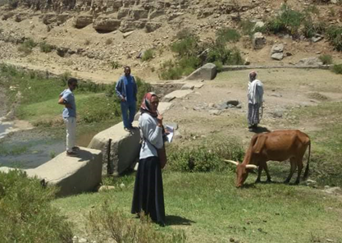
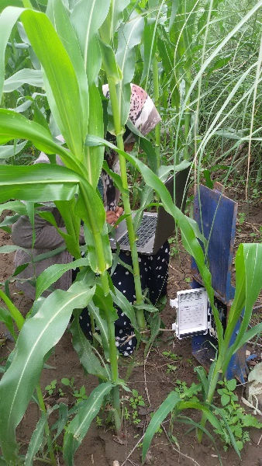
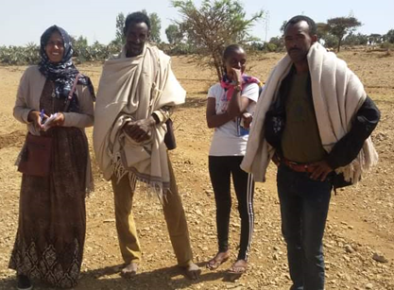
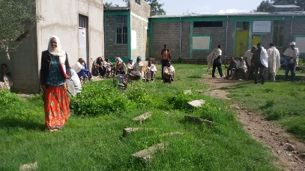
I want to express my gratitude to the EENSAT project members during that difficult time.
Thank you!

