Slide 1
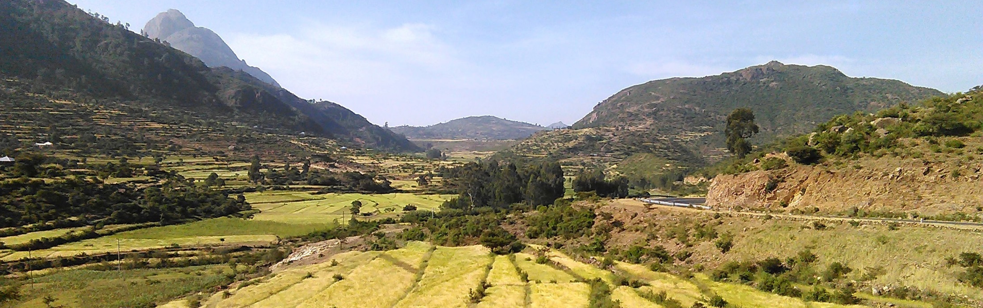
Ethiopian Education Network to Support Agricultural Transformation (EENSAT)
PhD progress report: Crop phenology monitoring and yield estimation in fragmented agricultural landscape: A multi-sensor data fusion approach
Biniam Sisheber
Supervisor: Prof. Andy Nelson
Co-supervisor: Michael Marshall (PhD)
Co-supervisor: Daniel Ayalew (PhD)
<EENSAT meeting>, <12/10/2023>, <Langezijds>

Slide 2
Contents
Current status
Remaining tasks to be completed
Timeline

Slide 3
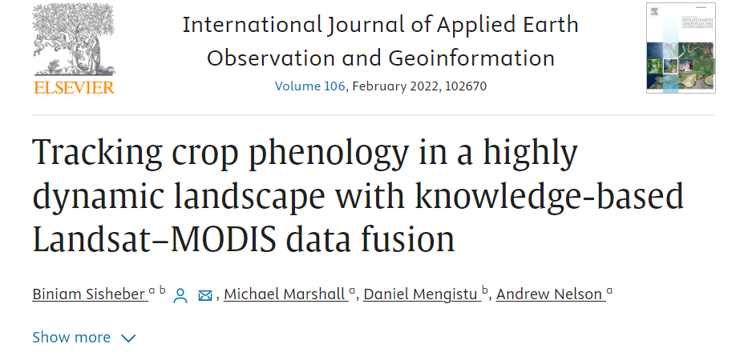
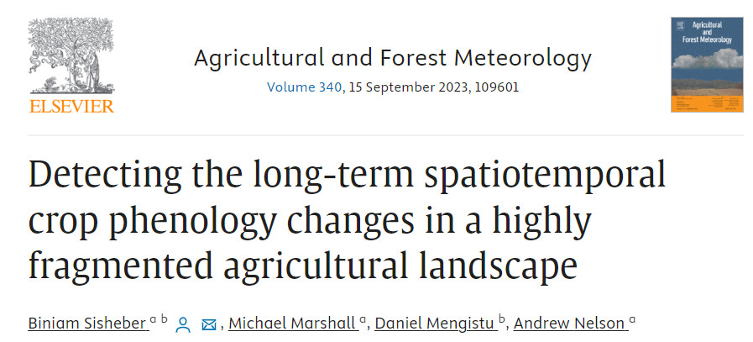
Current status
Publications:
Article I
Article II

Slide 4
Current status
Manuscript III: Reviewed
Manuscript IV: To be submitted
TGS:
28 ECTS collected and the remaining ECTS in progress
Remaining tasks:
Revision of manuscripts
Thesis write-up

Slide 5
Timeline and return to Ethiopia
Activities | October |  |  |  | November |  |  |  | December |  |  |  | January to…
 |  |  | 3 | 4 | 1 | 2 | 3 | 4 | 1 | 2 | 3 | 4
Fourth manuscript submission
Review response and revision
PhD thesis write-up
Thesis submission
Preparation for defence
Return to Ethiopia: 24, January, 2024

Slide 6
Thank You!

