Slide 1
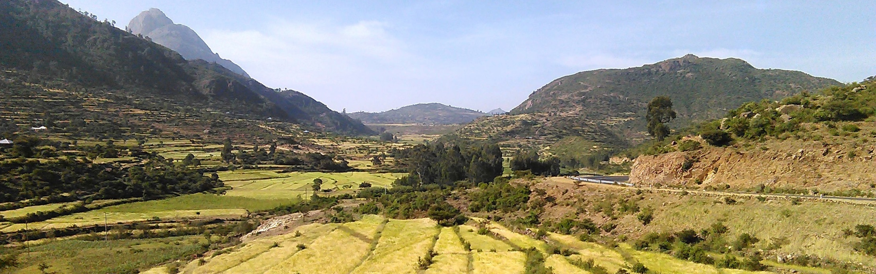
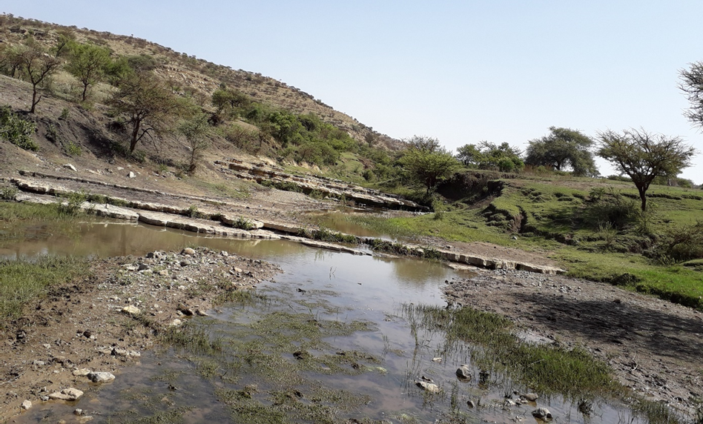
Remote sensing solution for spatio-temporal variability of surface-groundwater interactions and groundwater fluxes in northern Ethiopia
Research progress
Mewcha Amha Gebremedhin
October 2023

Slide 2
Motivation
Water shortage
recurrent droughts
Short rainy season
High rainfall variability
Wells are getting dry
Plan for more intensive agricultural practices
UTB
Food demand
Relationship b/n HDF and water fluxes are not well known
Water resource availability and distribution is not known
Poor coverage of hydro-meteorological gauging stations
Geologically varied and topographically complex
Result failure of plan and unsustainable utilization of groundwater resources
?
Requires in depth investigations of the spatio-temporal surface-groundwater interactions and groundwater fluxes

Slide 3
Objective
The main aim of this study was to integrate in-situ and satellite derived products to address the hydrological driving forces and then explore the spatio-temporal SW-GW interaction and groundwater fluxes in the semi-arid UTB of Northern Ethiopia. Specifically:
To improve daily satellite-derived rainfall products by integrating with in-situ rainfall
To derive daily potential evapotranspiration from satellite-based reference evapotranspiration
To estimate spatio-temporal rainfall interception loss at the catchment scale from earth observation
To develop IHM to explore spatio-temporal surface-groundwater interaction and groundwater fluxes

Slide 4
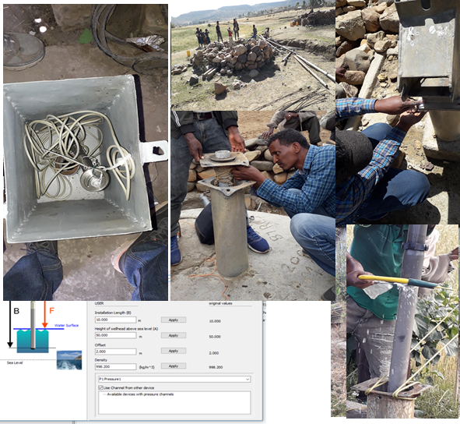
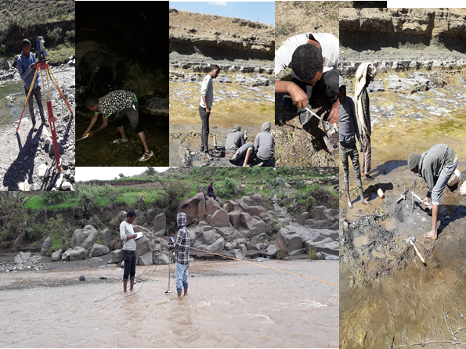
Fieldwork
Hydro-meteorological gauging stations installations
Automatic weather stations
Groundwater loggers
Streamflow loggers
Data downloading
2019
2020
Covid
War

Slide 5
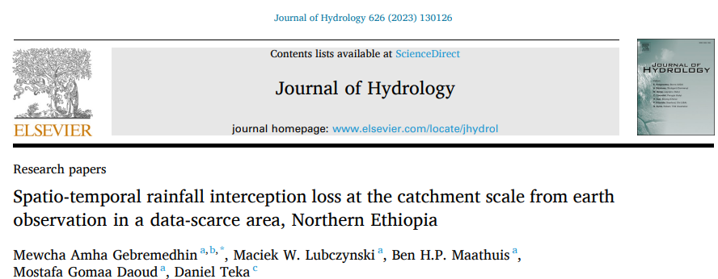
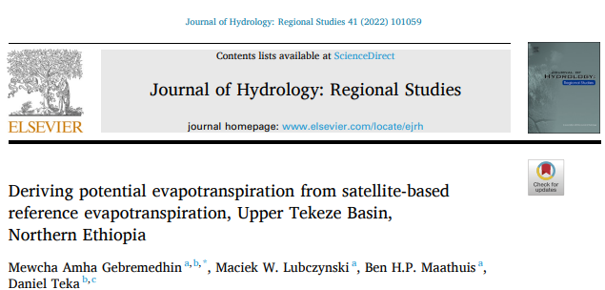
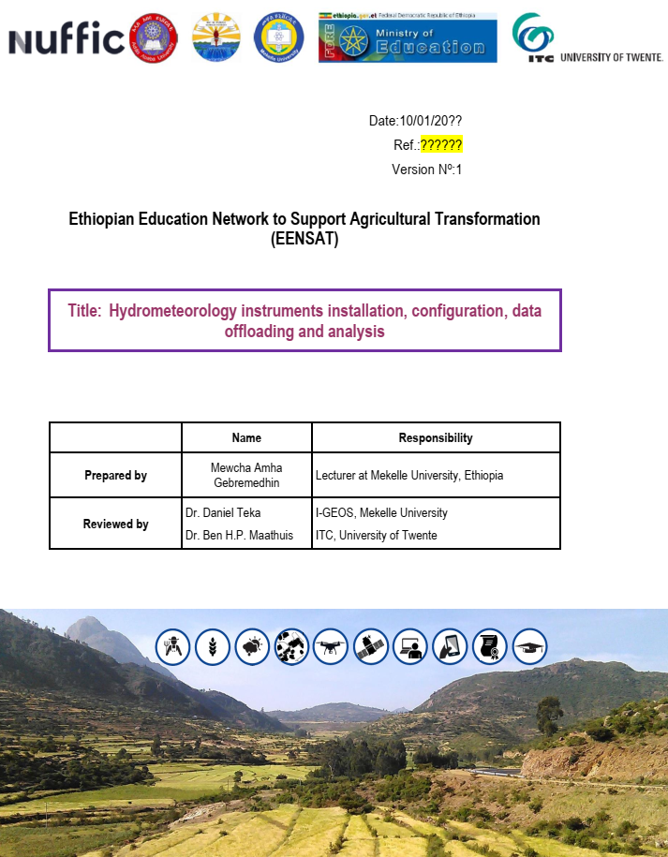
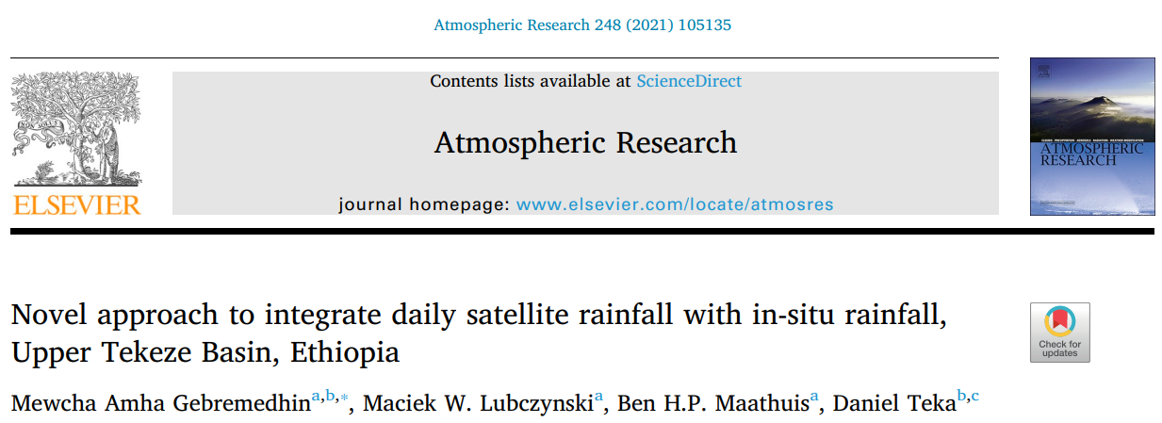
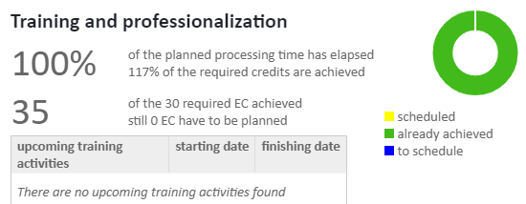
Manuscript, T&SP, manual
Plan
2023
Complete manuscript 4 (Dec 2023)
Organizing PhD thesis (Jan 2024)
2022
Objective-4
2021
Objective-3
Objective-2
Objective-1

Slide 6
Thank you!

