Slide 1
PhD Progress Report
Title: Empirical Assessments of Local Ecosystem Service Flows in Rural Mosaic Landscapes
Tegegne Molla
Promotor: Prof. Andy Nelson
Co-promotors: Prof. Louise Willemen
Dr. Derege Tsegaye
12 October 2023

Slide 2
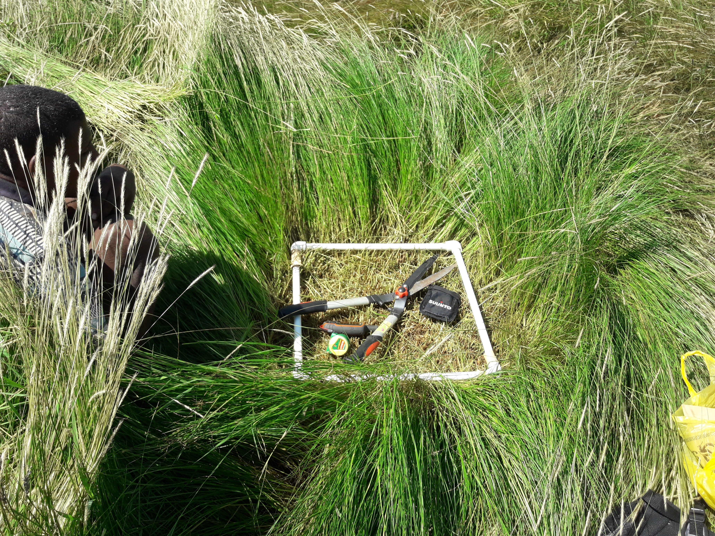
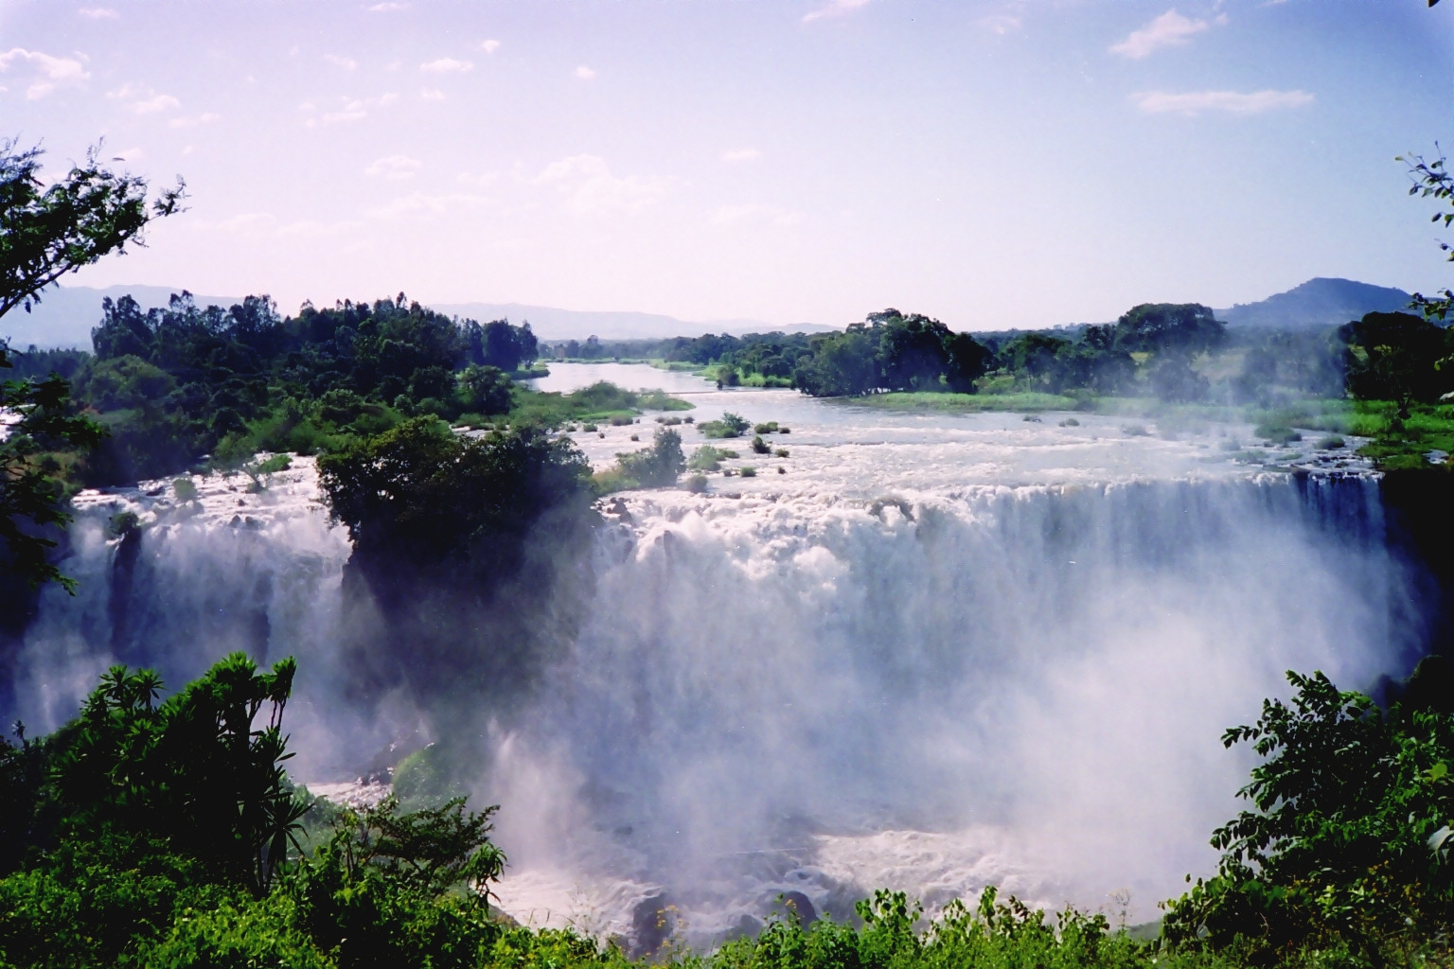
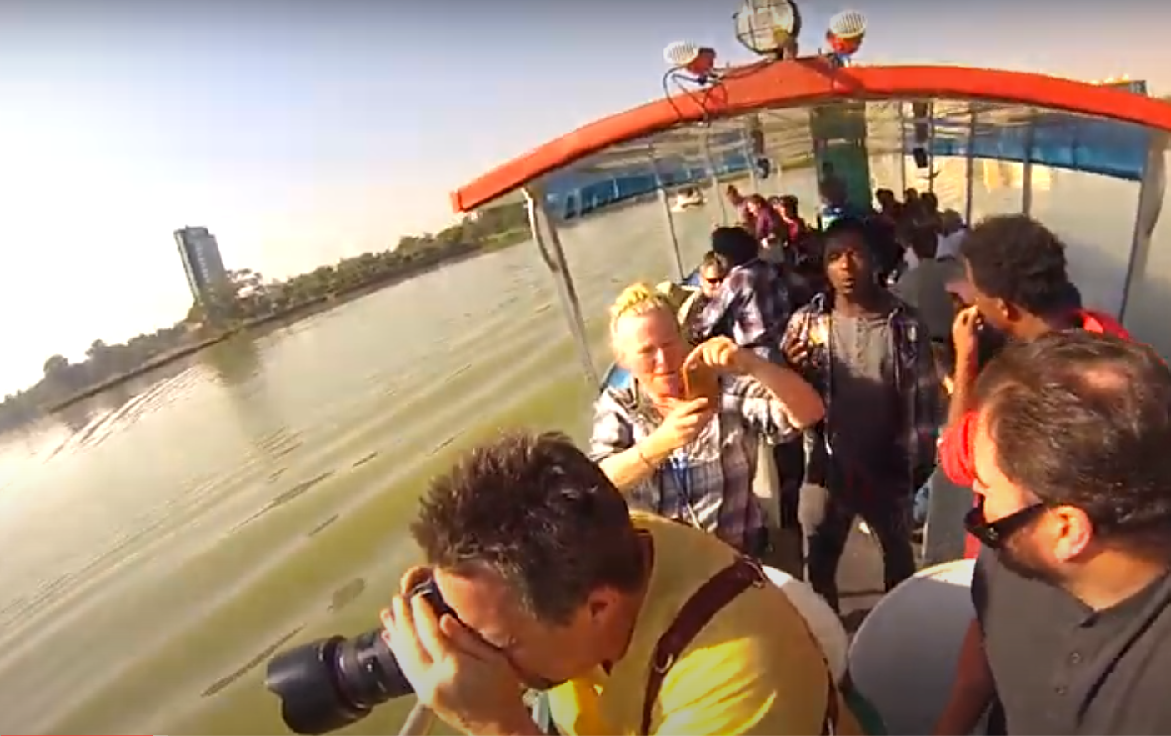
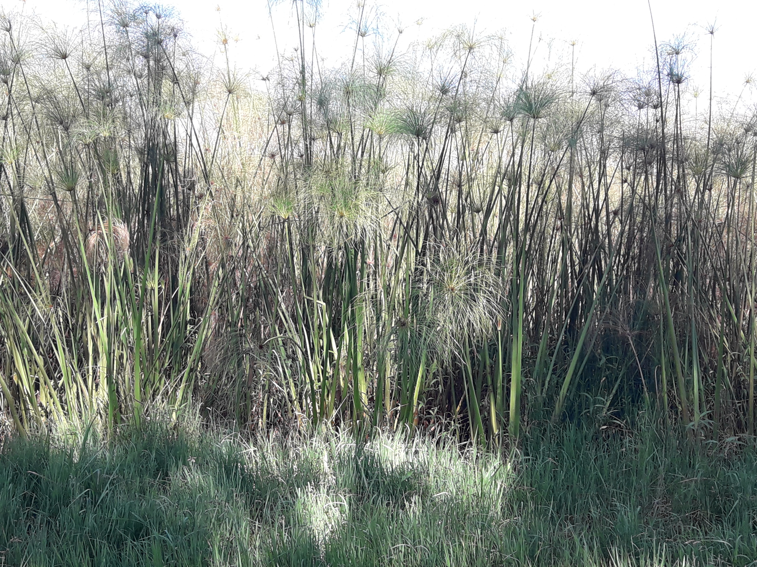
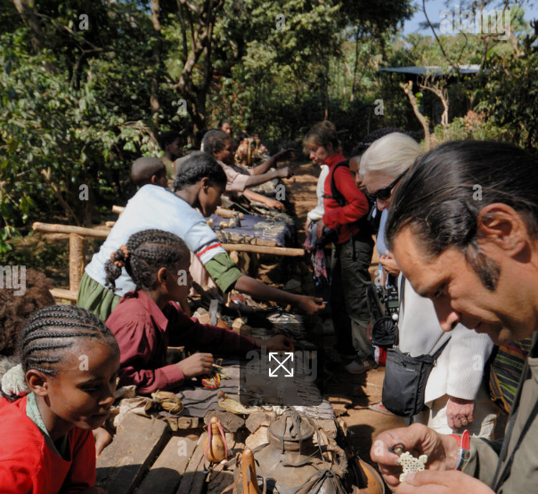
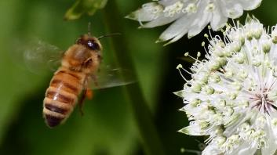
Introduction
Ecosystem services: Nature’s benefits to people
Goods
Food
Water
Materials (grass biomass)
Genetic resources
Medicinal resources
Ornamental resources
Regulating (Processes)
Air quality regulation
Climate regulation (local)
Moderation of extreme events
Regulation of water flows
Waste treatment
Soil erosion retention
Maintenance of soil fertility
Crop pollination
Biological control
Cultural (Experiences)
Aesthetic enjoyment
Nature tourism & recreation
Inspiration for art & design
Spiritual experience
Cognitive development
TEEB, 2010

Slide 3
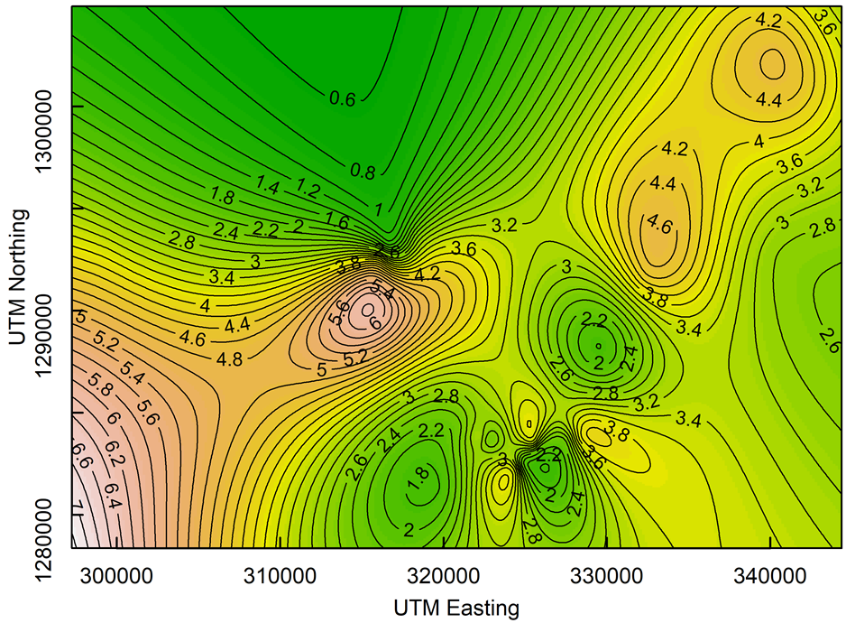
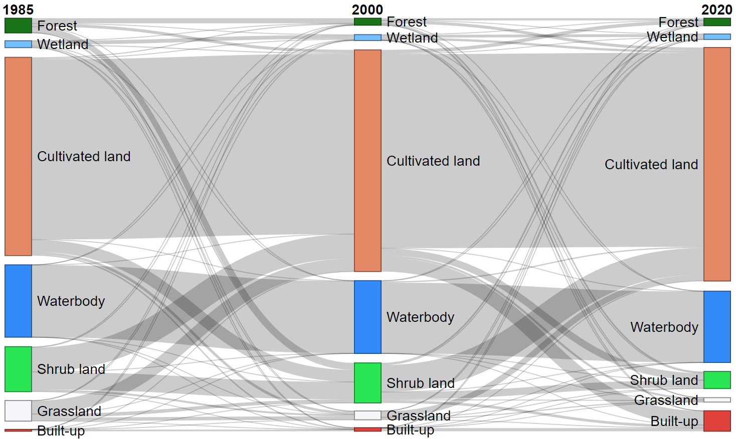
Main objective
Ecosystem services decay in space and time
Human well-being

Slide 4
Research Activities
Sacred as sources of wild pollinators for the surrounding smallholder agricultural farms in Lake Tana Basin, Ethiopia – Published (Ecological Indicators)
Empirical assessments of local ecosystem service flows in rural mosaic landscapes – Under review (Ecosystem Services)
Historical ecosystem fragmentation and its impact on ecosystem services using remote sensing applications – Completed and ready for submission (One Ecosystem)
Meta-analysis: Ecosystem Services and Food Security - Assessing the Contribution of Ecosystem Services to Human Resilience and Food Security in Degraded Landscapes = 01/09/2023 – 30/12/2023

Slide 5
Research Activities
5. Preparation PhD dissertation - Empirical Assessments of Ecosystem Service Flows in Rural Mosaic Landscapes – 25/12/2023 – 30/01/2024
6. Defence - July, 2024

Slide 6
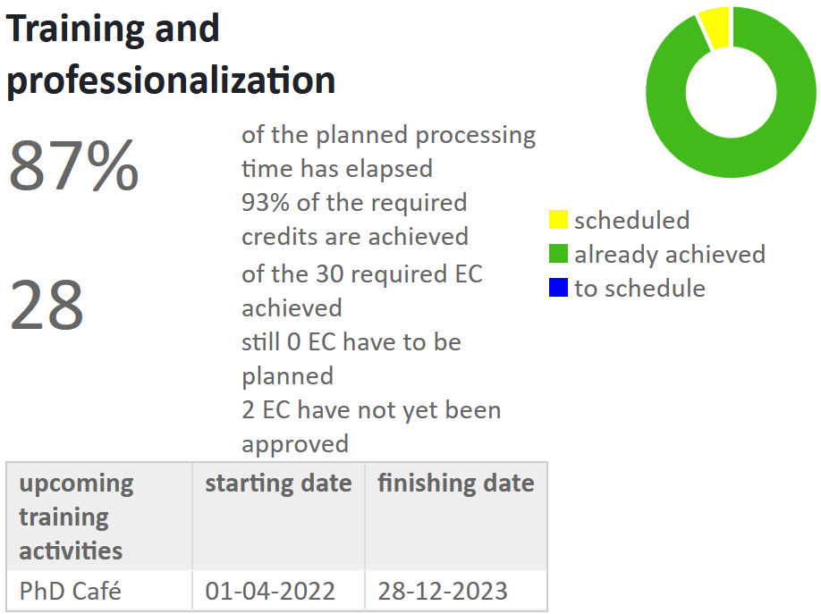
Courses

Slide 7
Challenges
Political instability
Long review time of journals

Slide 8
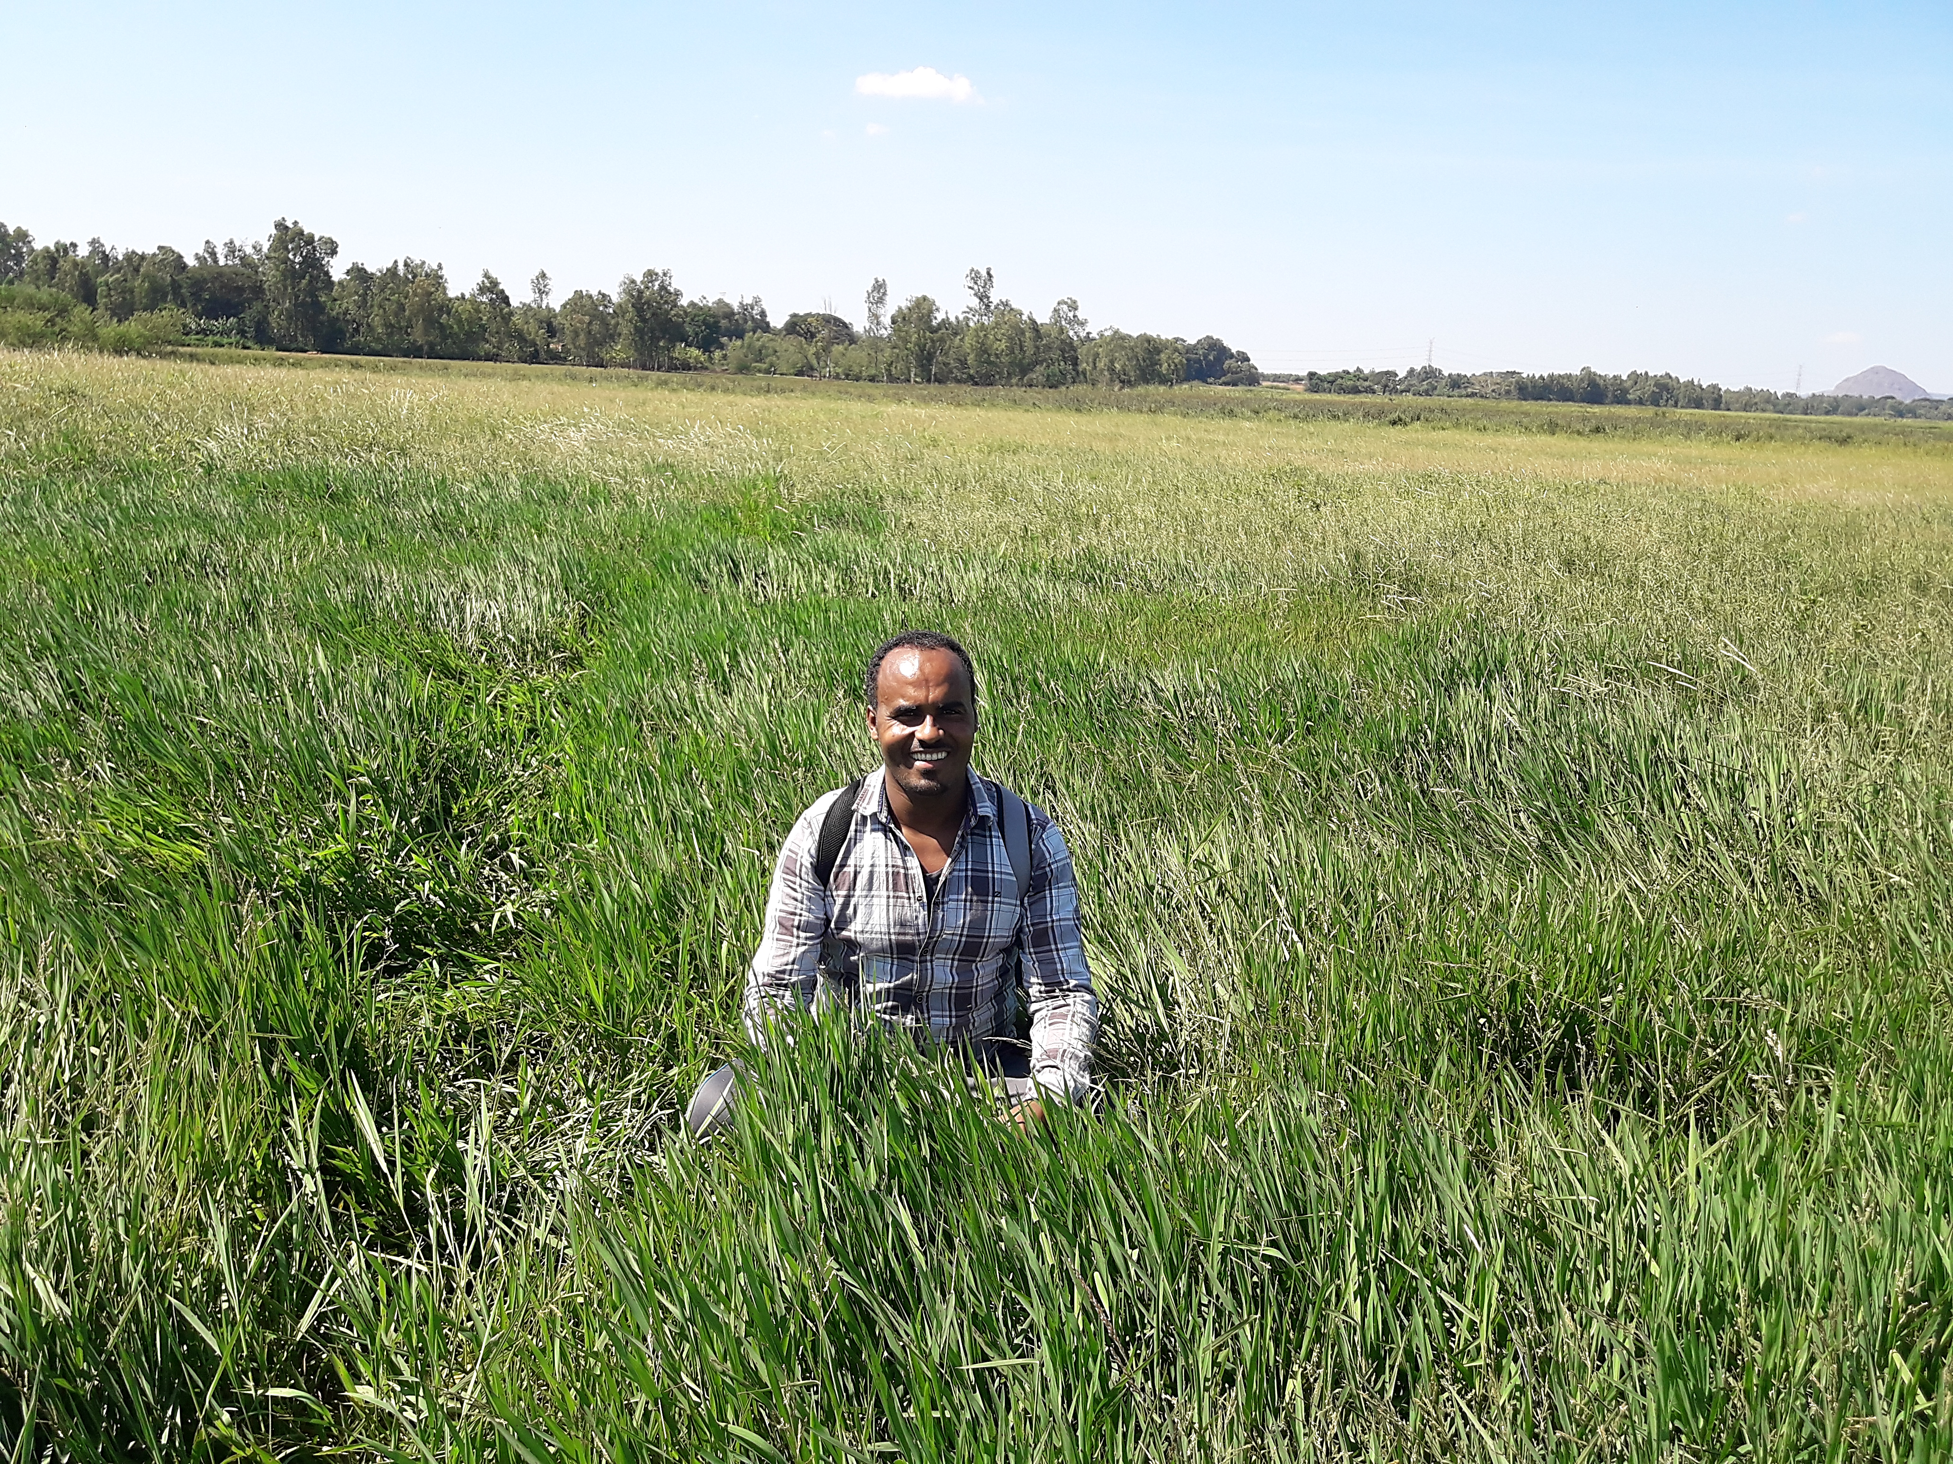
Thank you
Dank u wel
Merci
Danke
Gracias

