Slide 1
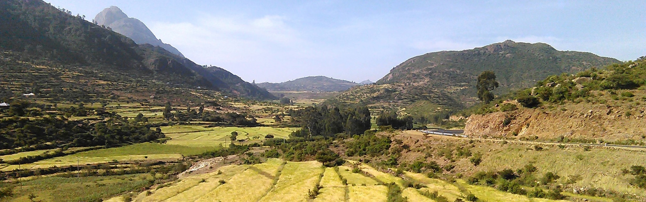
Integration of a wireless sensor network and a participatory soil monitoring system for smallholder agriculture: SDI for agriculture
Progress report
Phd candidate: Amsale Zelalem, GIP, Addis Ababa University
Supervisor (s): Dr. ir. Rolf A. de By, Dr. Javier Morales Guarin, Dr. Yaregal Assabie

Slide 2
Objective
Design and implement a (near) real-time, robust, usable, rapidly deployable and affordable soil data collection and analysis tool to assist agricultural decision makings
Deployment of IoT-WSN for soil physical properties monitoring
Citizen science for soil chemical properties monitoring
Build a spatial data infrastructure (SDI)
Develop agricultural decision support system (AgDSS)

Slide 3
Progress
Developed IoT-WSN architecture for soil monitoring in smallholder agriculture
Farm-level soil moisture and temperature data collected since end of 2019
Designed framework for integration of citizen science and commercial soil test kits
Experimental farm-level soil NPK data collected, 2020 and 2023
Designed and developed data schema/model for integration of heterogeneous inputs

Slide 4
Current status
Technical
Completed in-situ data cleaning and pre-processing
Completed data migration into PostGres based data schema
Currently working on developing the decision support system
Writing
1 journal publication (Sensors )
1 conference presentation and publication (ICEOGI 23, Algiers; IEEE); won best paper award
Manual prepared on IoT-WSN configuration
Citizen science finding written but not published, yet
Decision support system writing not completed
Thesis: skeleton defined
ECTS: completed

Slide 5
Challenges
Political instability
Severe data loss
Devices stolen, damaged
Communication, power, transport interruptions
Safety concerns to travel
Non-existence/scarcity of alternative data sources
Vague expectations/requirements
Work load

Slide 6
Plan
November 2023-May 2024
Hope to submit second and third papers for publication
Model and deploy decision support system
Draft findings of the decision support system
Start working on the thesis body
June-October 2024
Complete thesis write up and other requirements

Slide 7
Thank you

