Slide 1
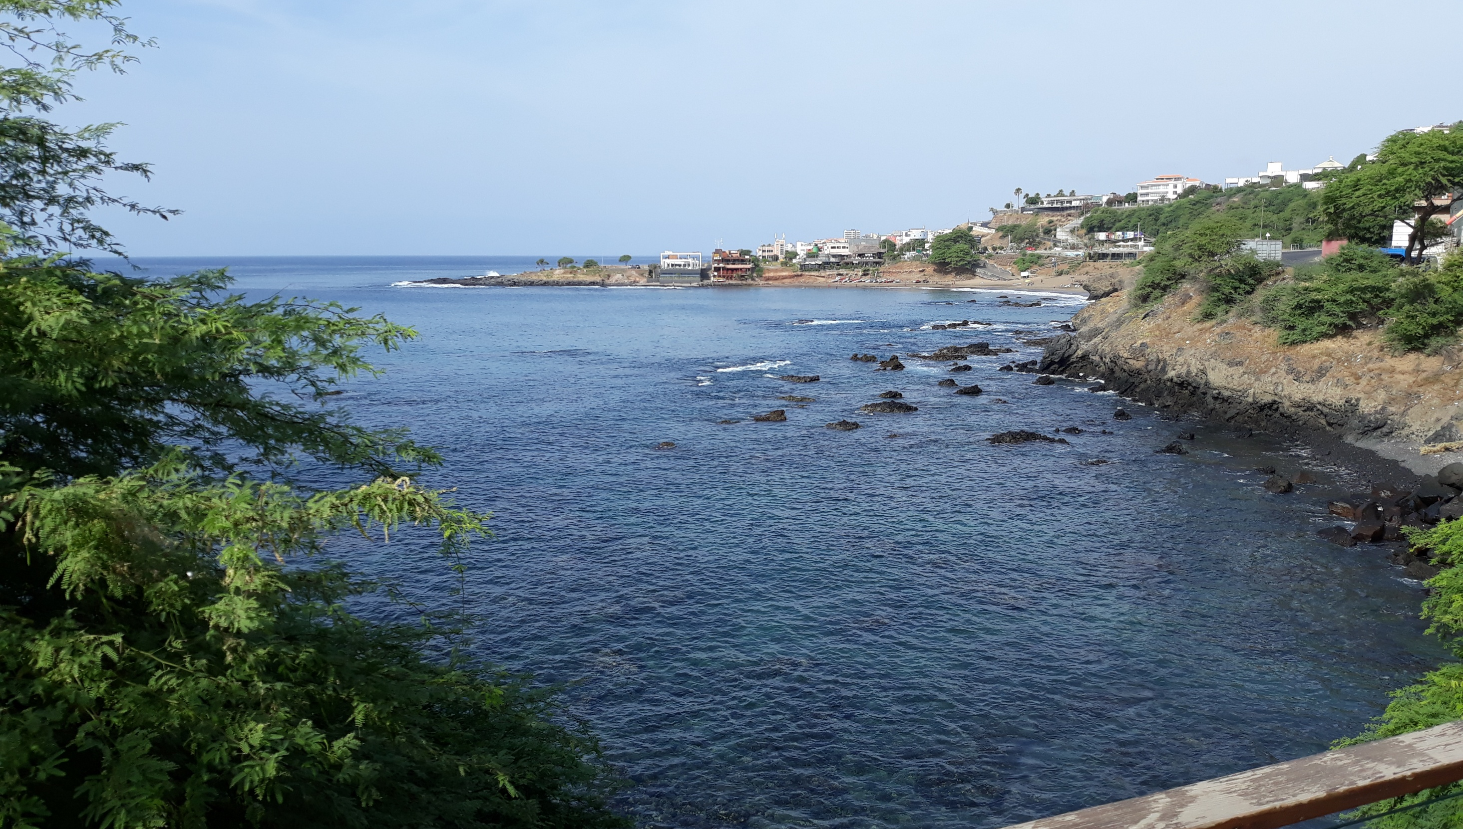






SOFF investment phase in Cabo Verde Role ITC as Capacity Development partner
Dr. Ben Maathuis Dept. of Water Resources University of Twente – Faculty ITC
25-March-2025

Slide 2



Overview presentation
Introduction Faculty ITC Proposed activities Overall project implementation arrangements Next steps and tentative timeframe

Slide 3

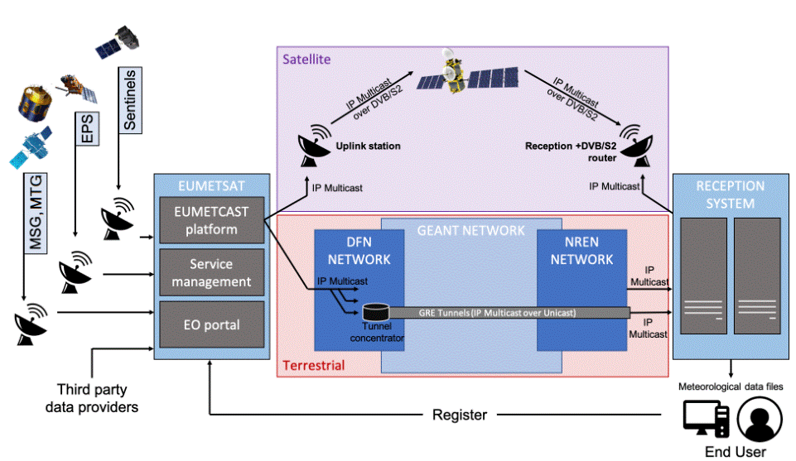
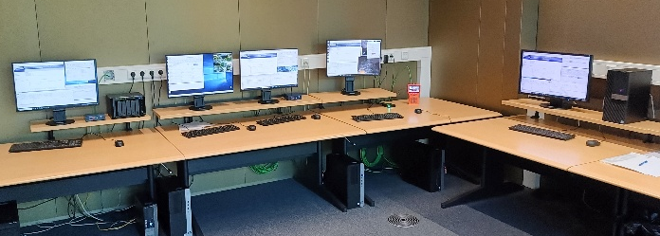
Faculty ITC – University of Twente (Netherlands) (https://www.itc.nl)
  Focus on Geo-Information Sciences – 6 Departments
  Education, Research and Institutional Development
  Within Department of Water Resources strong focus on the use of Earth Observation for WRM, weather and climate
  Operating EUMETCast satellite reception facility and development of software tools for data processing

Slide 4
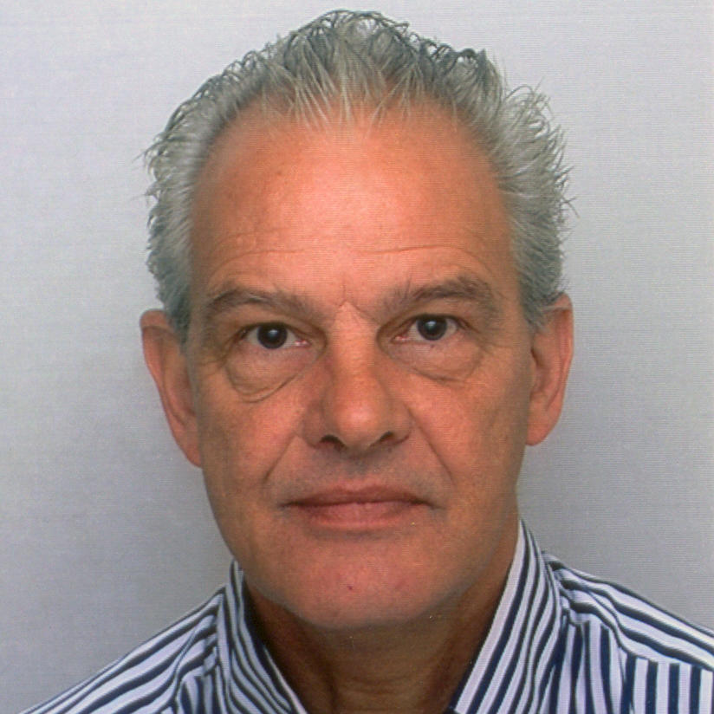
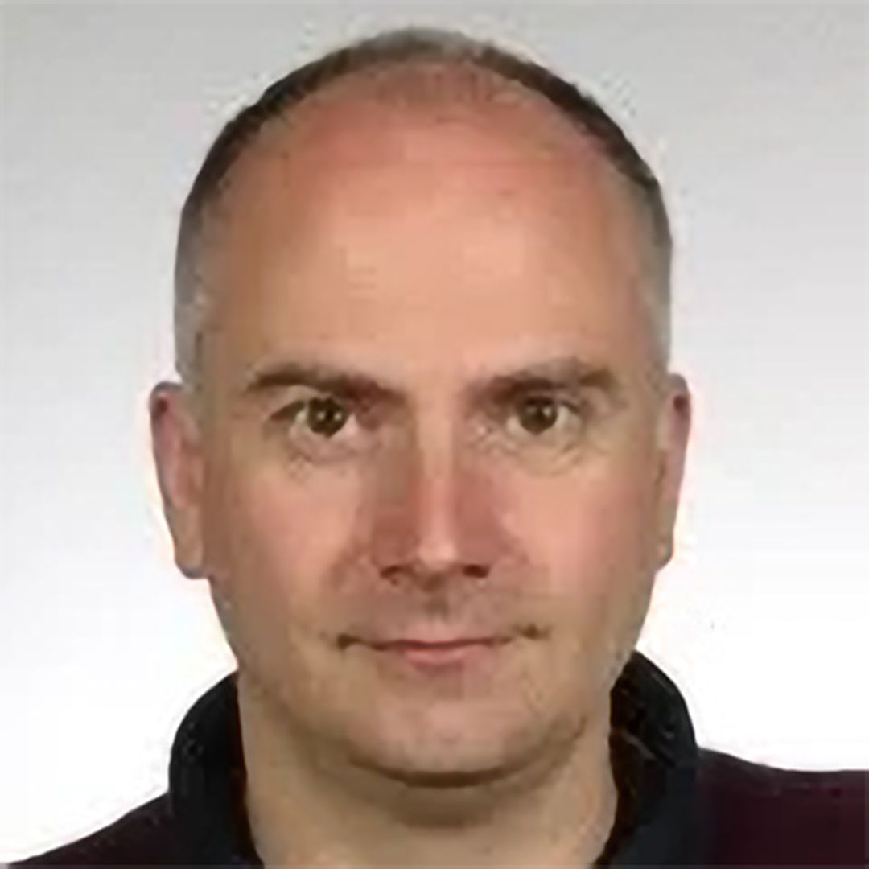
Involved as capacity developers
  Ben Maathuis
Ben is Assistant Professor at the Department of Water Resources, ITC, University of Twente. He has been working in the field of Water Resources Management as lecturer and supervisor of MSc and PhD students within the Department of Water Resources for the last 30 + years. Also has been working together with meteorological organizations in Africa in the use of satellite data disseminated through EUMETCast-Africa in the framework of African – European collaboration.
  Bas Retsios
Bas is a software developer. He has been involved within the ILWIS software development team. Currently he is working on transforming this desktop software into a python site-package. He has extensive programming experiences using multiple programming languages

Slide 5

Strengthening institutional, technical and human capacity to enable compliance with GBON
Outcome 1. GBON institutional and human capacity developed
Outcome 2. GBON infrastructure in place
Outcome 3. Sustained compliance with GBON
I T C

Slide 6
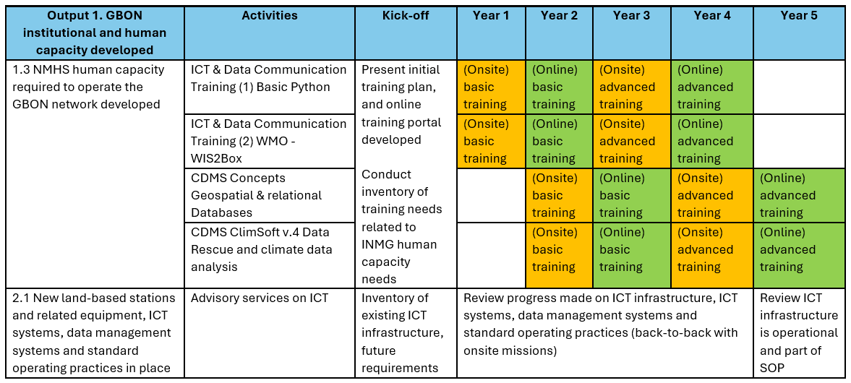
Proposed activities

Slide 7
Proposed activities - remarks
Identify staff and personalized competences development in relation to:
  Onsite trainings 1 and 2: duration 1 week each. ICT & Data Communication Trainings 1 and 2 will be provided back-to-back. 2 trainings of one week will be provided during 1 mission of two weeks, week1 - ICT & Data Communication Training 1 and during week 2 - ICT & Data Communication Trainings 2;
  Onsite trainings 3 and 4: duration 1 week each. CDMS Concepts Geospatial & relational Databases and CDMS ClimSoft v.4 Data Rescue and climate data analysis will be provided back-to-back. 2 trainings of one week will be provided during 1 mission of two weeks, week1 - CDMS Concepts Geospatial & relational Databases and during week 2 - CDMS ClimSoft v.4 Data Rescue and climate data analysis;
All onsite trainings will also be provided in an online mode (with online support) during the next year to ensure that INMG-staff that attended the onsite course can continue to practise using the online resources provided and other (new or interested) staff can study the course content, also with local support from their peer staff that have attended the previous onsite training. Online resources eventually enriched with content based on experiences onsite event;
During onsite missions also follow up on ICT advisory services (back-to-back with other onsite activities)

Slide 8

Next steps (tentative dates)
Q4 - 2028
Onsite advanced training CDMS Concepts, geospatial and relational databases, data rescue and climate data analysis
+ ICT advice
March 2025
Kick-off / inception workshop
Q4 -2025
Onsite basic training ICT @ Data Communication +
ICT advice
Q1-Q3 2026
Online basic training events for ICT @ Data Communication
Q4 - 2026
Onsite basic training CDMS Concepts, geospatial and relational databases, data rescue and climate data analysis
+ ICT advice
Q1-Q3 2028
Online advanced training events for ICT @ Data Communication
Review ICT Infrastructure
Apr – Oct 2025
Prepare ICT @ Data Communication Training / CDMS Concepts, geospatial and relational databases, data rescue and climate data analysis
Q1-Q3 2027
Online basic training CDMS Concepts, geospatial and relational databases, data rescue and climate data analysis
Q4 -2027
Onsite advanced training ICT @ Data Communication +
ICT advice
Q1 2029
Online advanced training CDMS Concepts, geospatial and relational databases, data rescue and climate data analysis

Slide 9
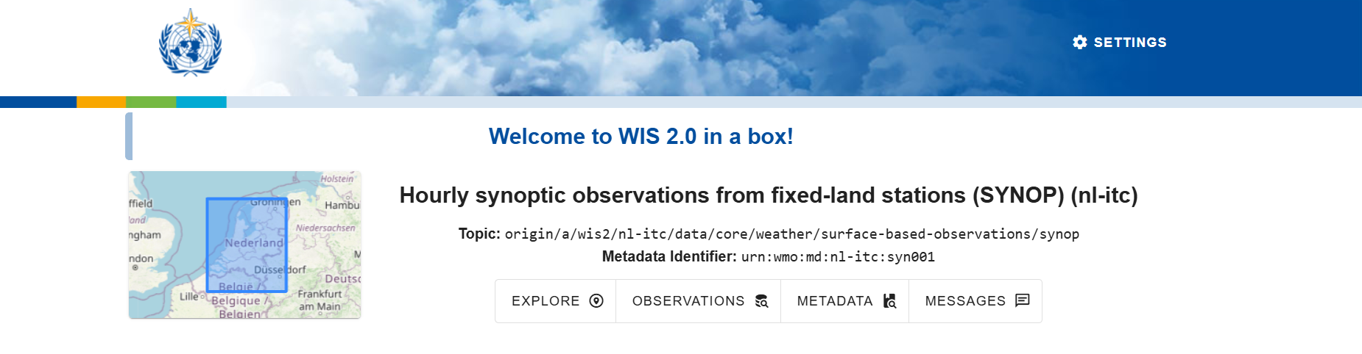
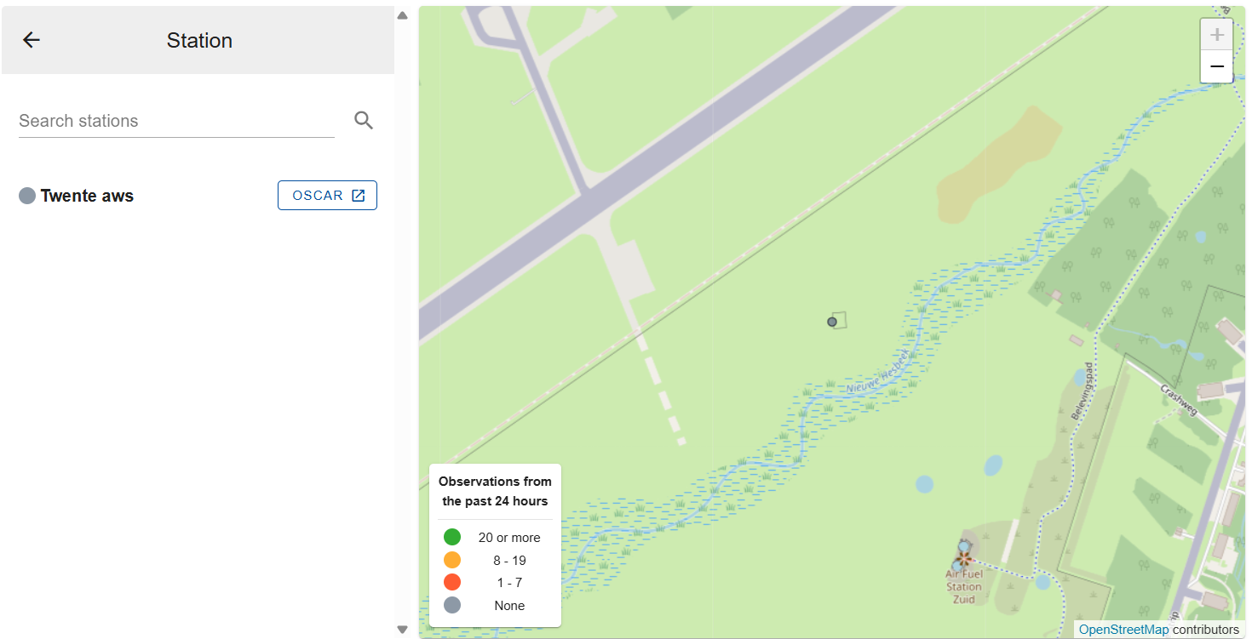
Ongoing work
  Setup of WIS2BOX node

Slide 10

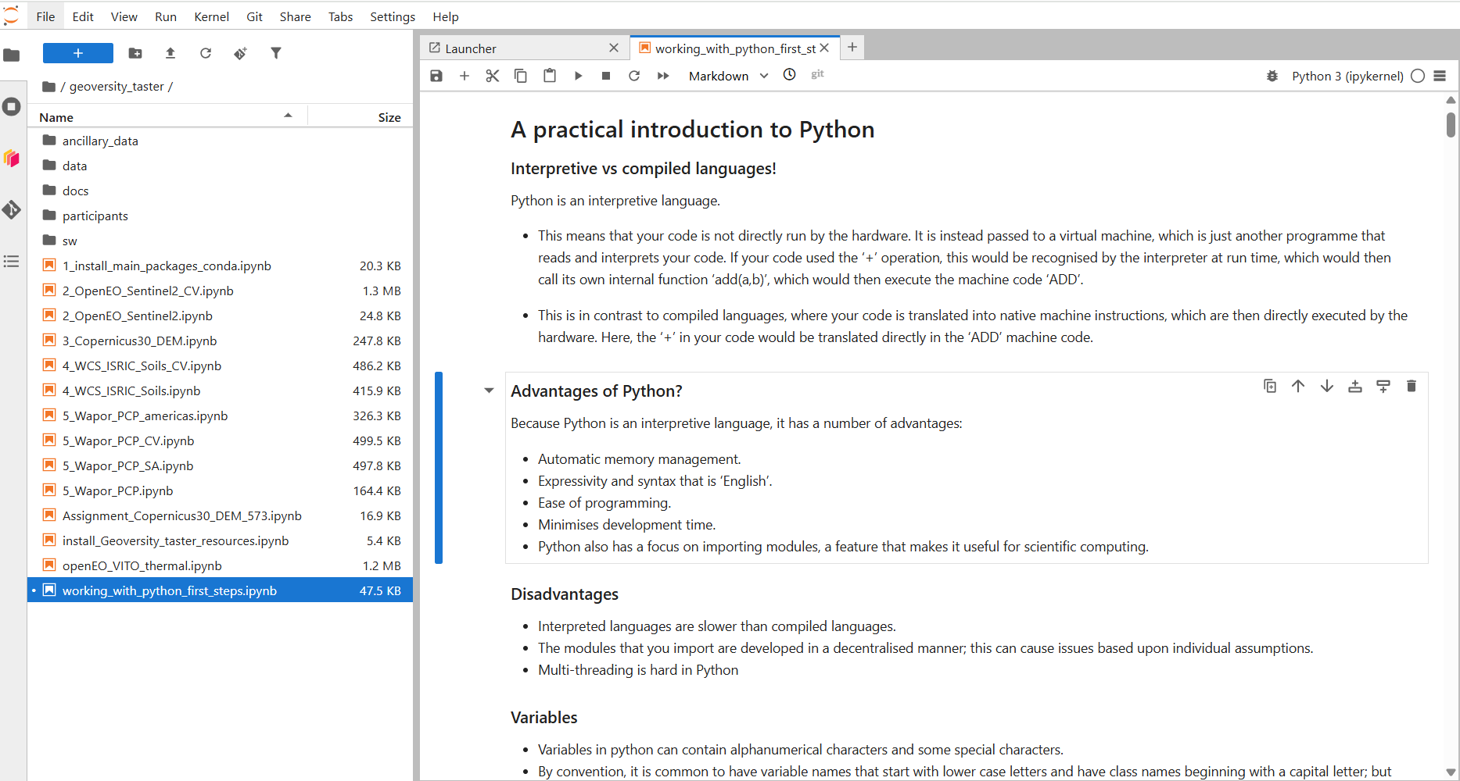
Ongoing work
Lifelong learning platform
https://www.geoversity.io/
  Prepare online training environment using ‘Geoversity’ dedicated portal
Introduction to:
Use of Jupyter Notebooks
Python
Matplotlib
Other site packages
Basics of Linux – use of Terminal
Advantage of using Jupyter Notebooks:
Explanatory text
Python code

Slide 11
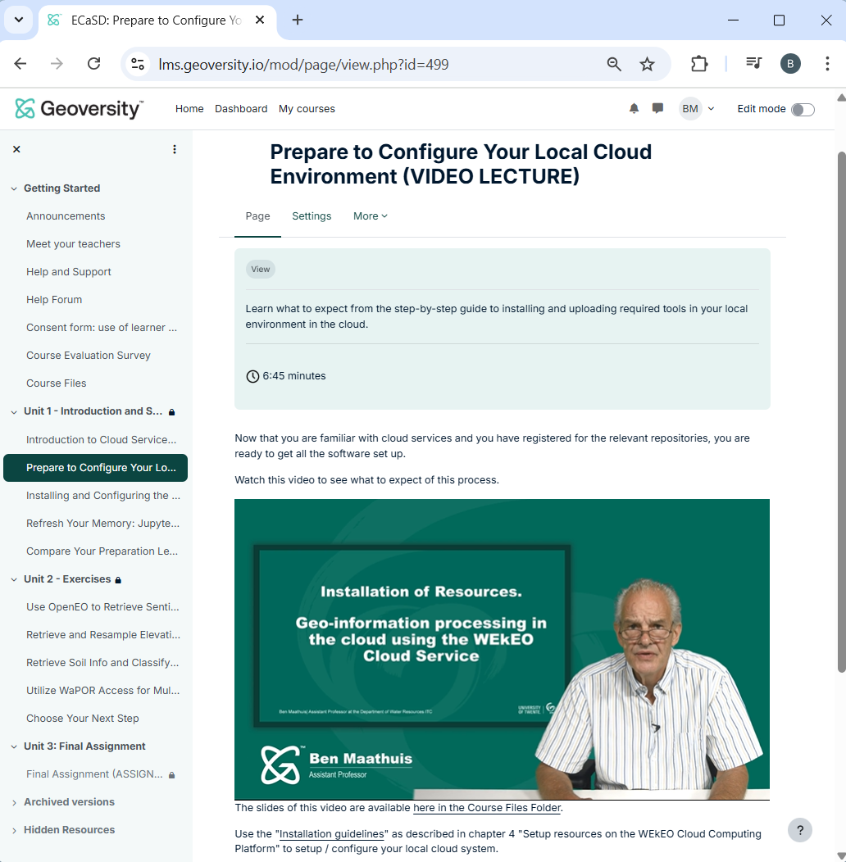
Ongoing work
Lifelong learning platform
https://www.geoversity.io/
  ‘Geoversity’ sneak preview
Teacher and participants intro, announcements, help and support, course evaluation
Setting up training resources, quizzes and tests
Provision of:
Pre-recorded lectures
Various Notebooks on different topics
Presentations
Final assignment
Supporting documents
Additional resources

Slide 12
Project Implementation Arrangements
Participating organizations
KEY: Contractual agreement
and flow of funds
Reporting
UNEP (Implementing Entity)
WMO
Training links
Executing Entities
Peer advisor
INMG
UNEP
Royal Netherlands Meteorological Institute (KNMI)
Training
Technical partner - ITC
Advice / consultation

Slide 13
Thanks for your attention / Obrigado pela sua atenção
Ben Maathuis | Dept. of Water Resources | Faculty ITC – University of Twente | b.h.p.maathuis@utwente.nl
Langezijds building Hallenweg 8 7522 NH Enschede – The Netherlands | www.itc.nl

