Slide 1
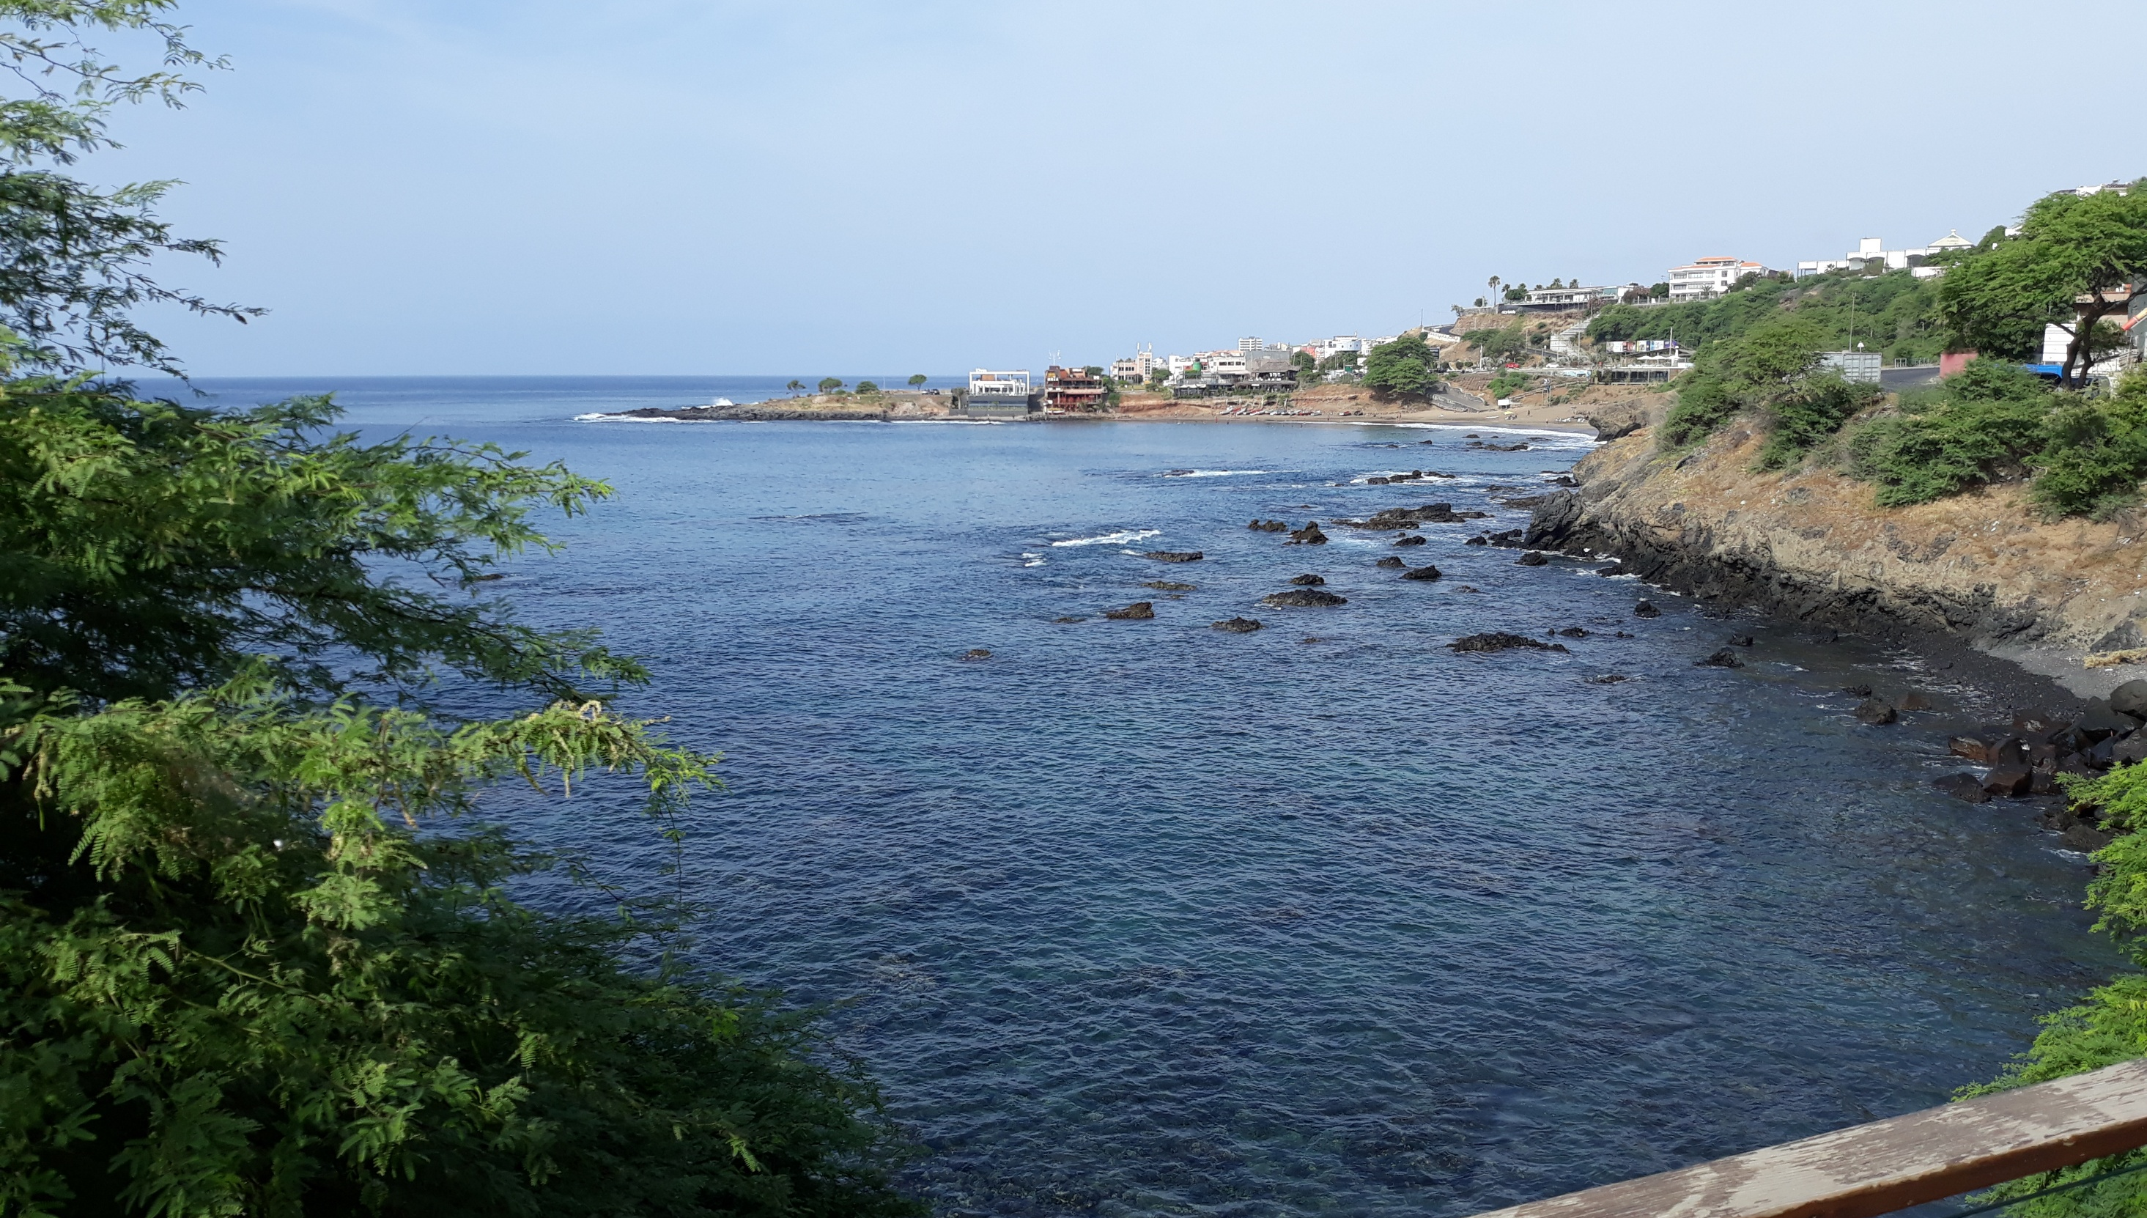



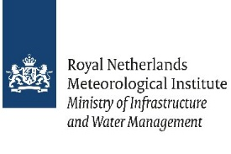


Applications of Open Satellite Data for weather and climate monitoring
Dr. Ben Maathuis Dept. of Water Resources University of Twente – Faculty ITC
26-March-2025

Slide 2



Overview presentation
Open data EUMETCast – GEONETCast [used by meteo organization] Free Cloud Services Last Mile – link to public / structured provision of pre-processed data Concluding remarks

Slide 3
Open Data
  Open (Government) Data refers to the information collected, produced or paid for by the public bodies (also referred to as Public Sector Information) and made freely available for re-use for any purpose.
  Source: https://data.europa.eu/en/dataeuropa-academy/what-open-data

Slide 4
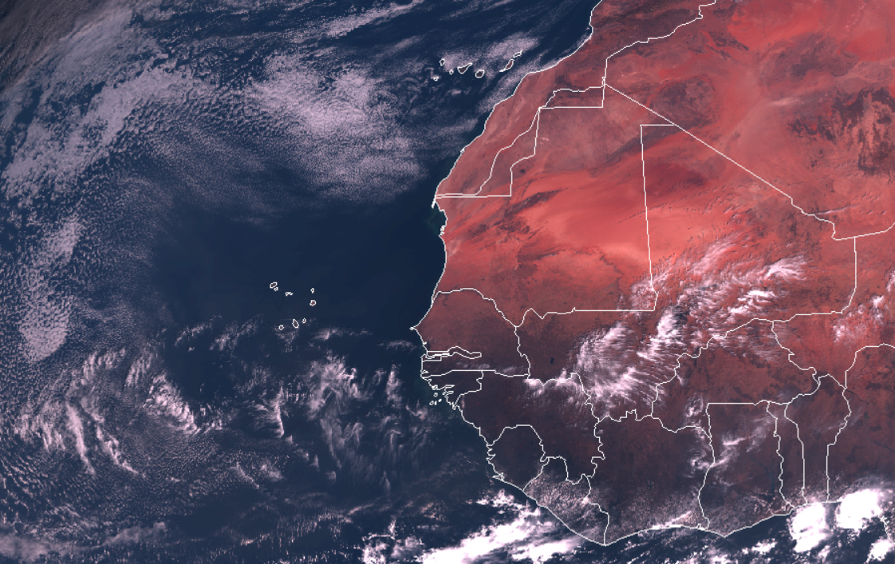
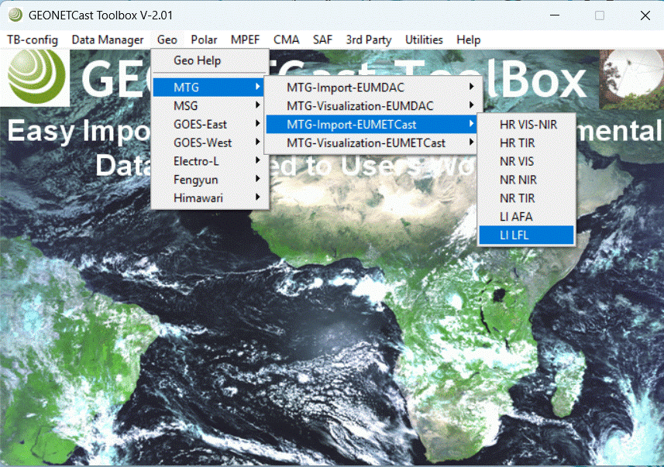
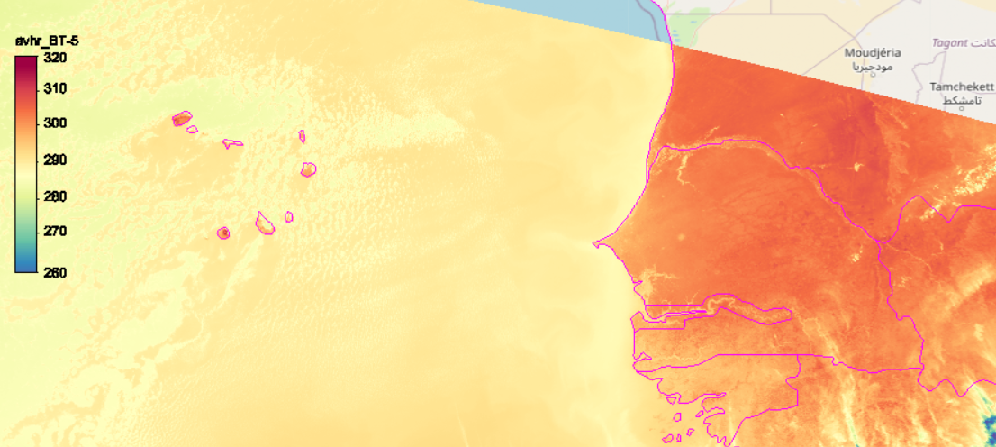
EUMETCast: near real-time access to weather info
  Collection of satellite data on land, ocean and atmosphere
MTG, MSG: new images every 10 minutes
METOP B /C:
a number of overpasses per day

Slide 5
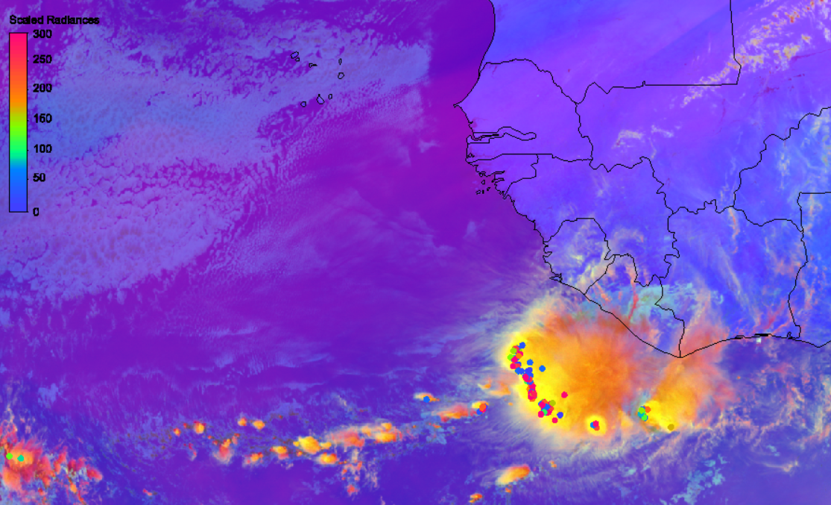
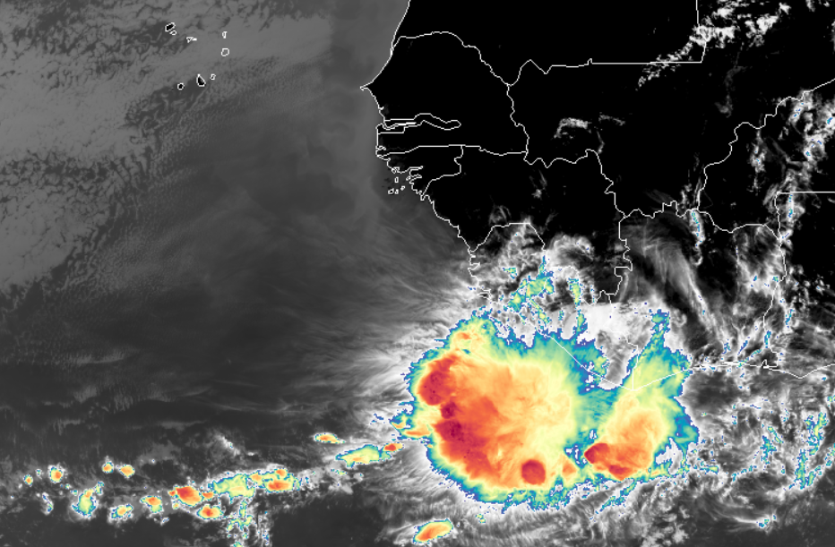
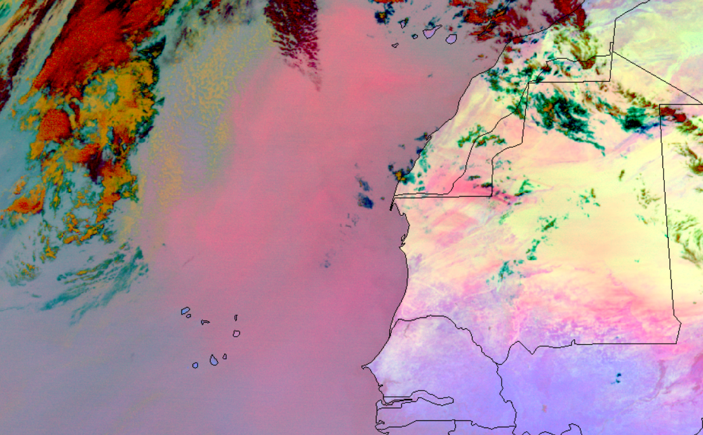
EUMETCast: near real-time access to weather info
  Satellite data processing – create new visualizations
Dust (2024-01-25)
MTG convection and lightning
MTG colorized IR clouds composite
MSG dust monitoring

Slide 6
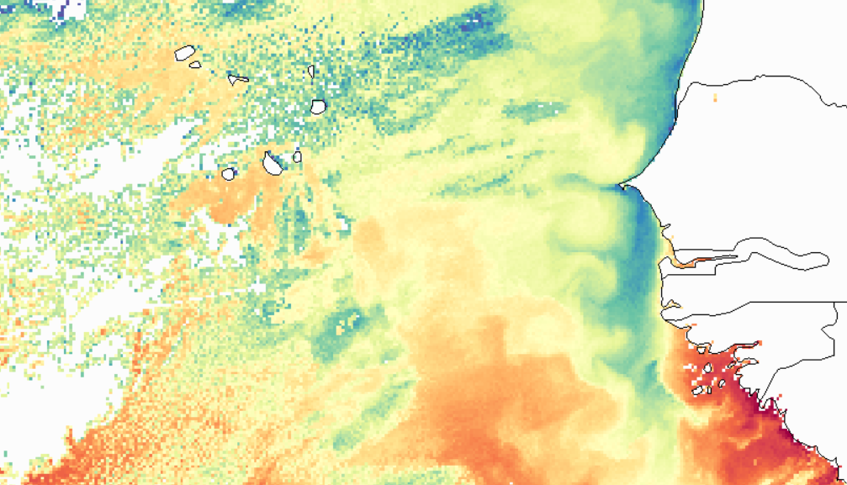
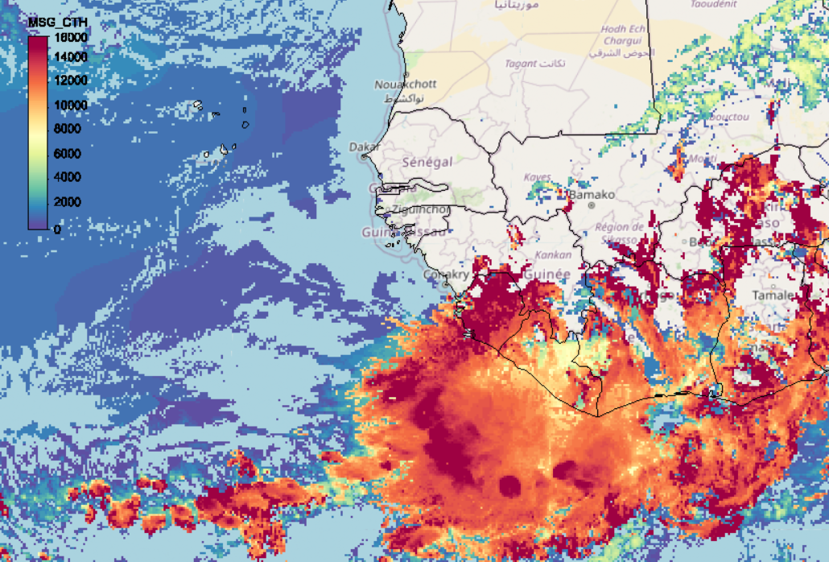
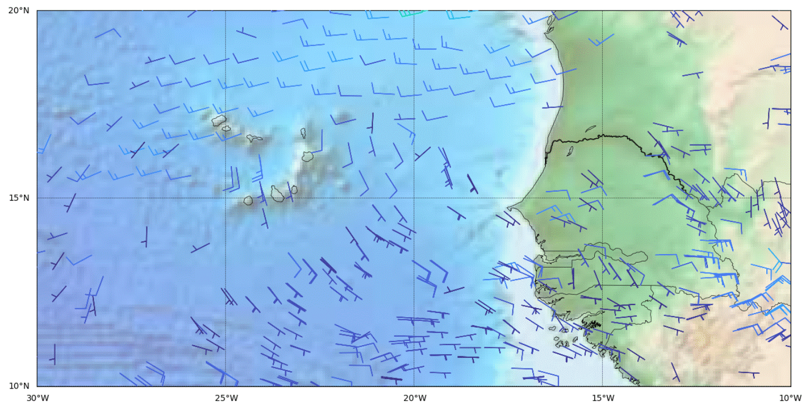
EUMETCast: near real-time access to products
  Derived products from near real time Satellite data
METOP – Sea Surface Temperature
MSG – Cloud top height
MSG – atmospheric motion vectors
For an overview of all images / products: https://navigator.eumetsat.int/

Slide 7
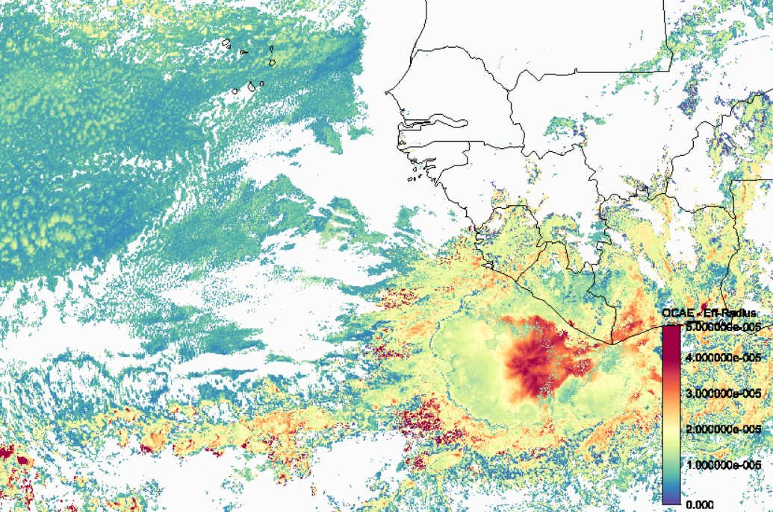
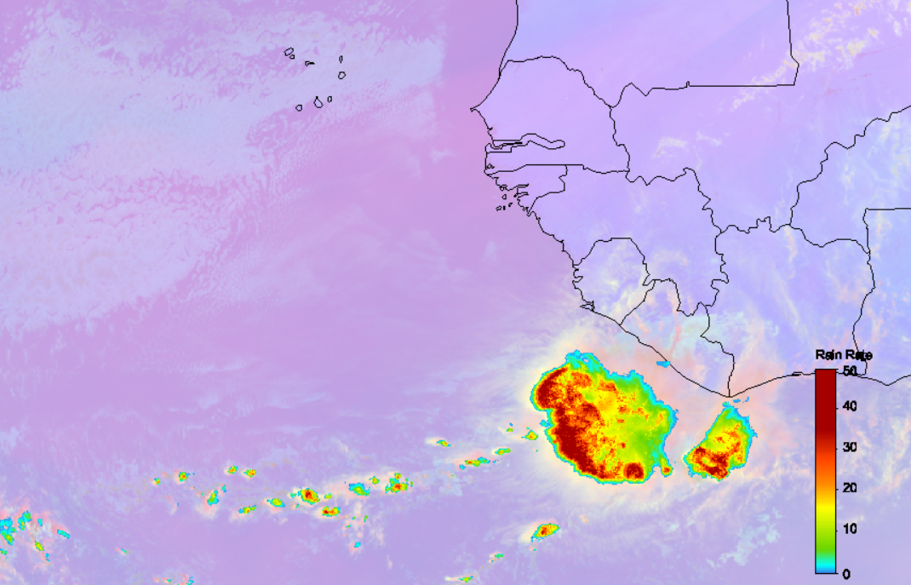
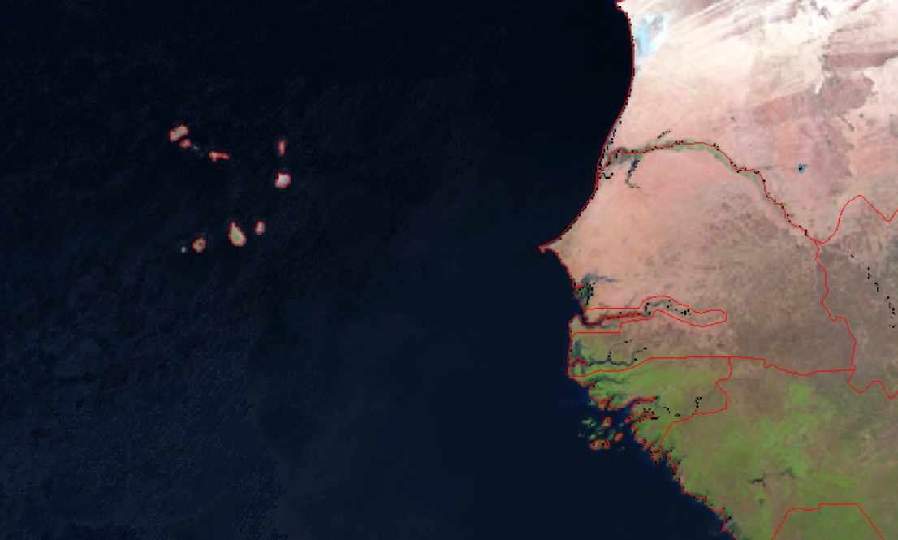
EUMETCast: near real-time access to products
OCAE: Effective radius
NWC: Convective rain rates
MPEF: Clear sky radiances

Slide 8
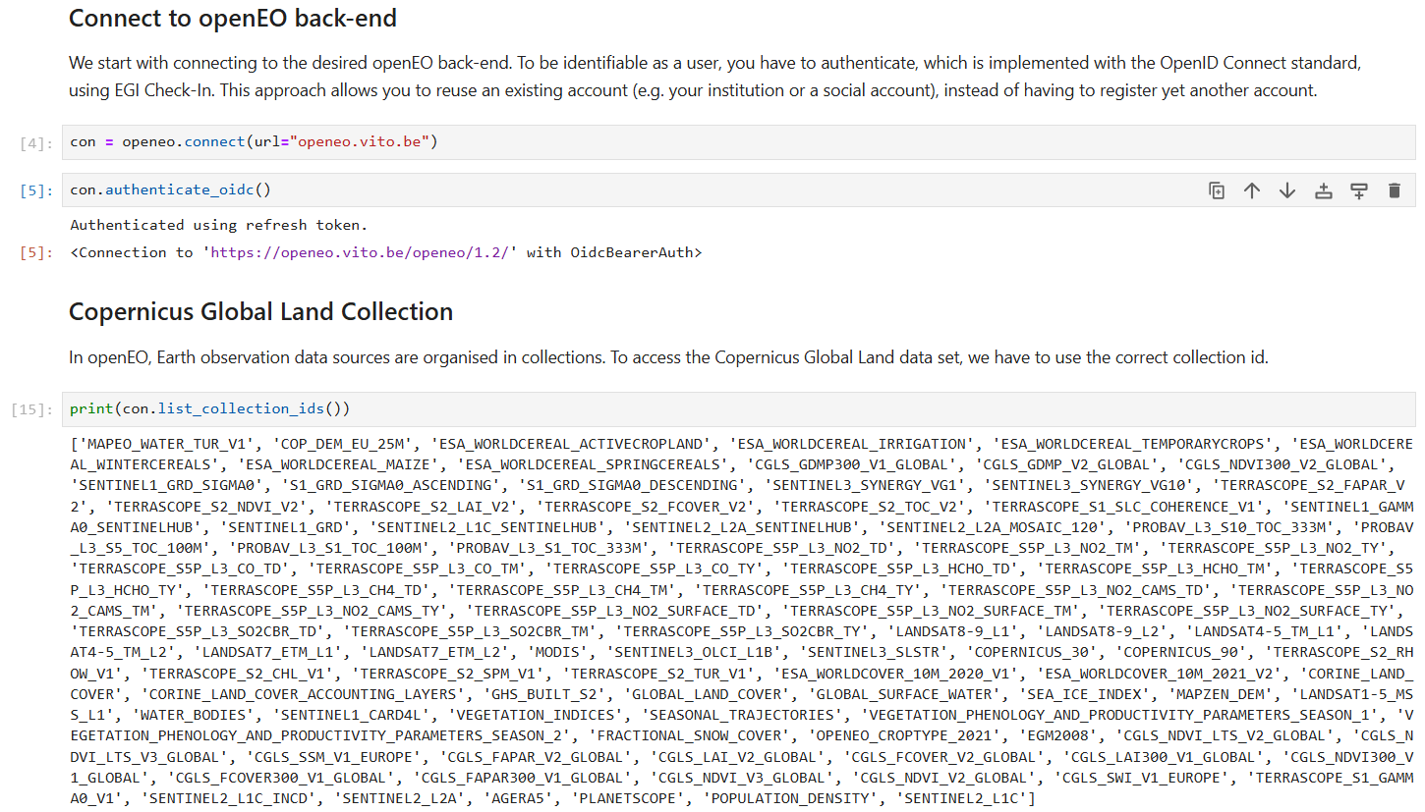
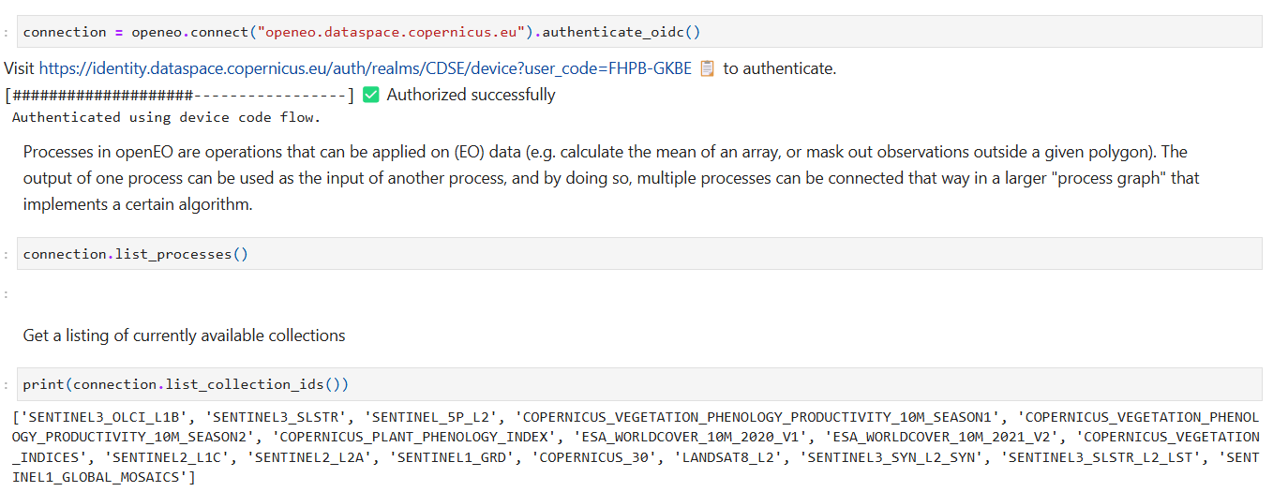

Cloud Services: access to multiple data archives containing analysis ready data
Data repository with processing resources (in the cloud):
Copernicus Data Space Ecosystem (https://dataspace.copernicus.eu/) (Python)
WEkEO (https://wekeo.copernicus.eu/) (Python)
Google Earth Engine (https://code.earthengine.google.com) (Java and Python)
Data repository only:
Copernicus Climate Data Store (https://cds.climate.copernicus.eu)
Copernicus Global Land Monitoring Service (https://land.copernicus.eu/en)
FAO – WaPOR (https://wapor.apps.fao.org/sign-in)
VITO Terrascope (https://terrascope.be/en)
OpenEO: unified access to multiple
repositories (https://aai.egi.eu/registry/)

Slide 9
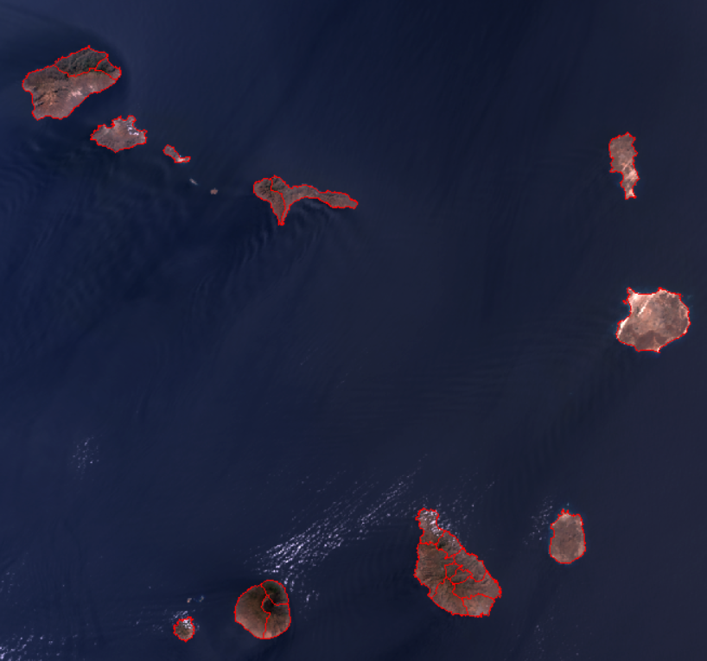
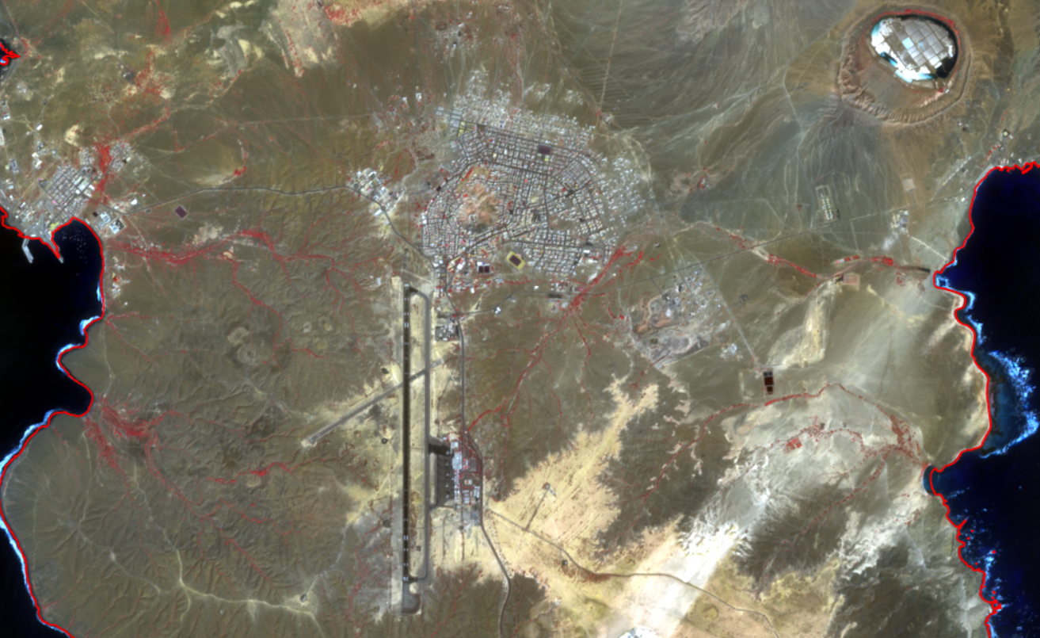
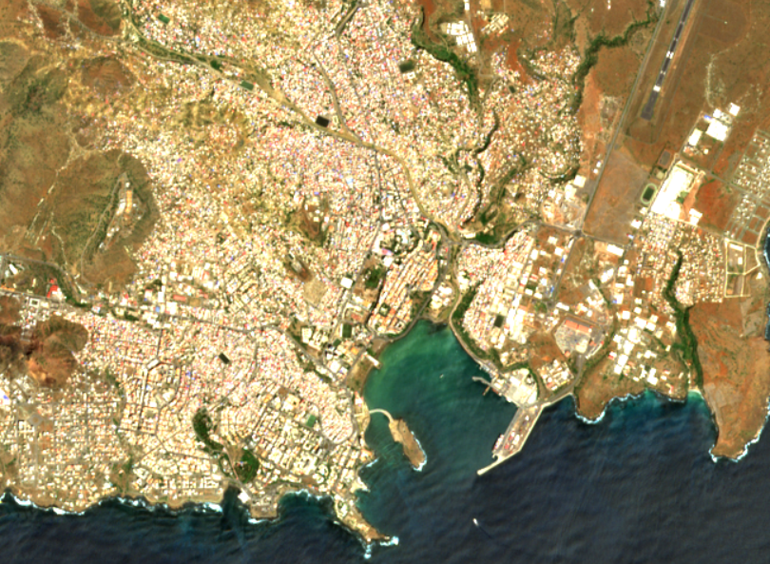
Cloud Services: higher resolution satellite data
  Archives with higher resolution time series satellite observations
Sentinel – 3 OLCI
Sentinel – 2 Cloud free composite Sal
Sentinel – 2 True color image product

Slide 10
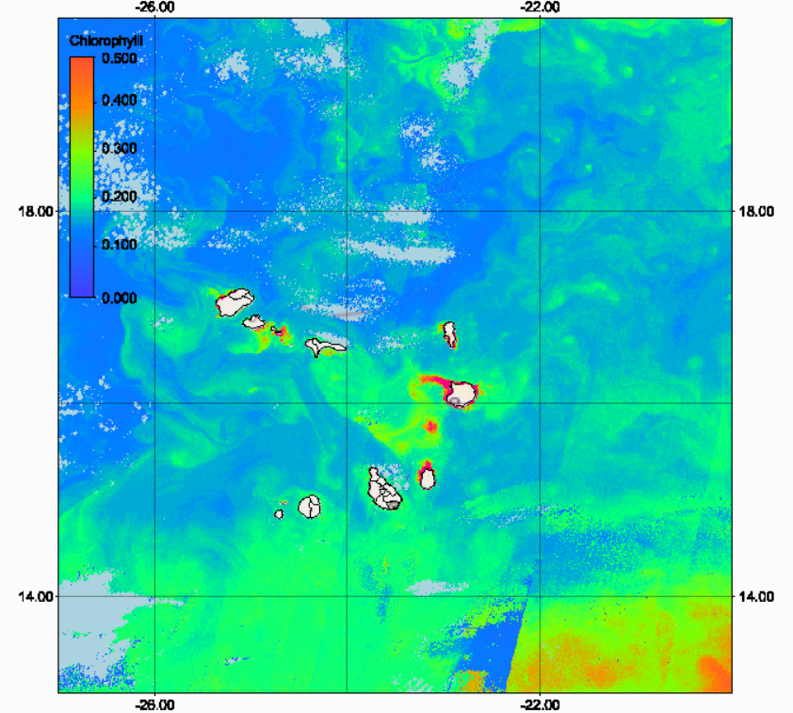
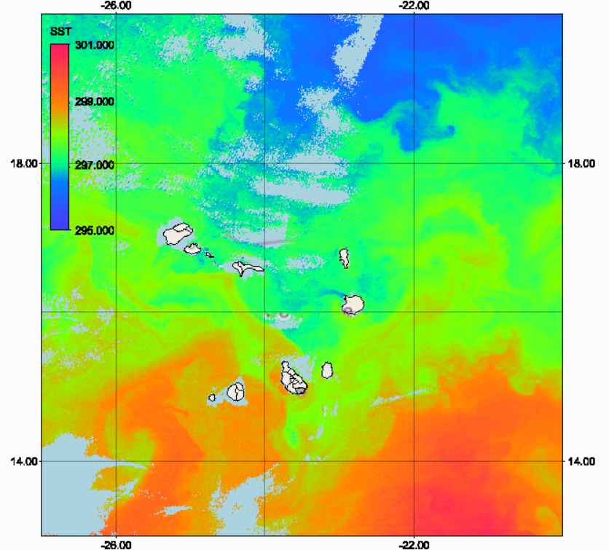
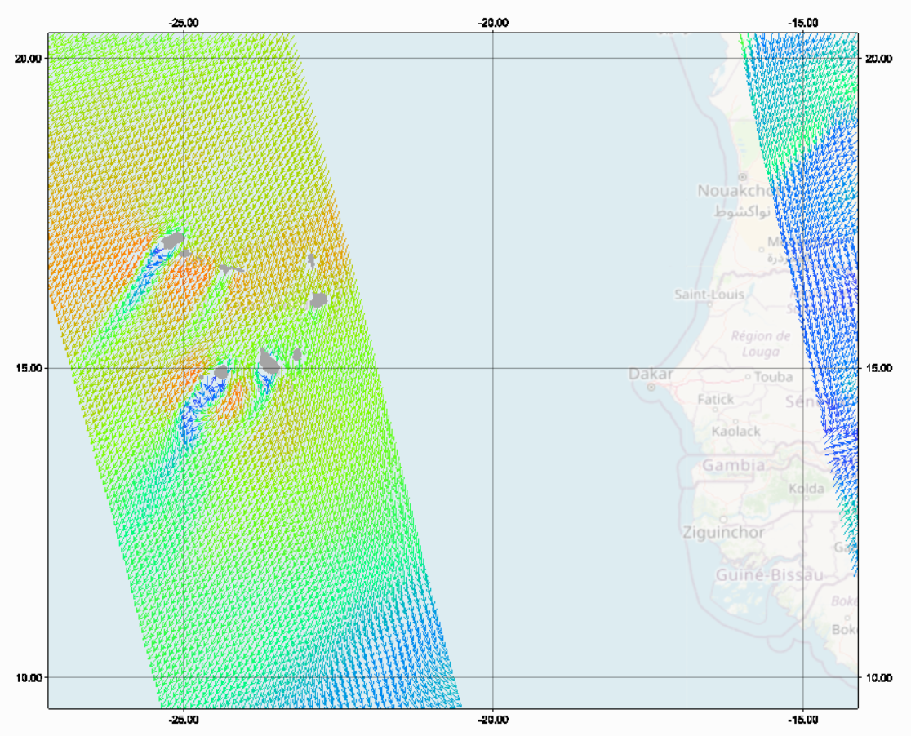
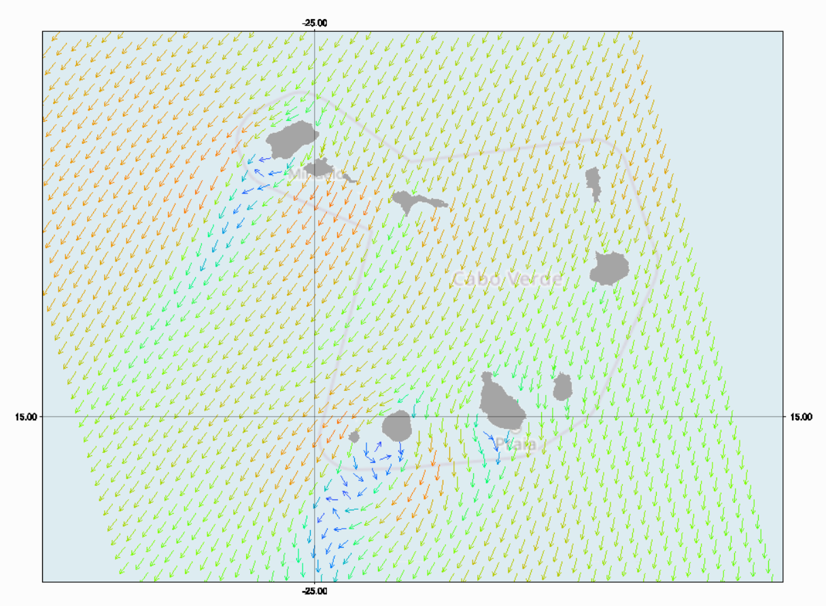
Cloud Services: EUMETSAT – Web Coverage Server
  API access to products derived from near real time satellite observations
SENTINEL 3ab-SLSTR CHL
SENTINEL 3ab-SLSTR SST
METOP – Ocean
Vector Winds

Slide 11
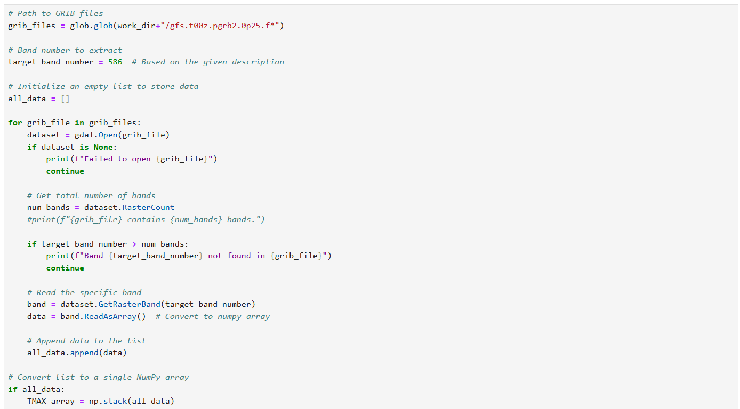
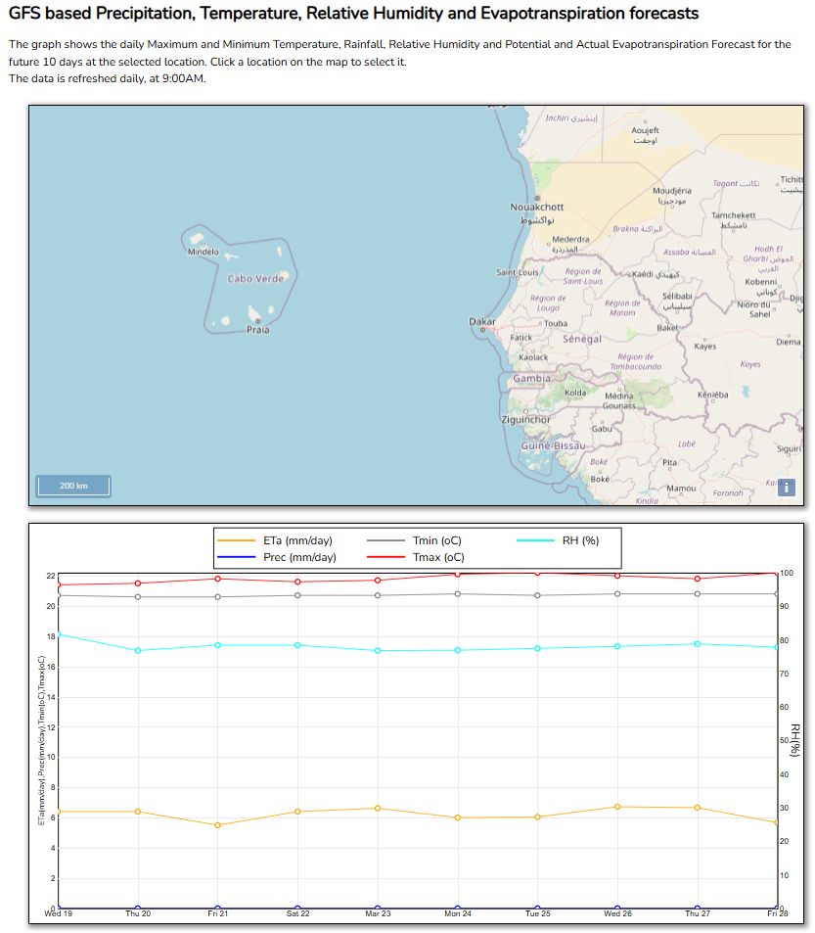
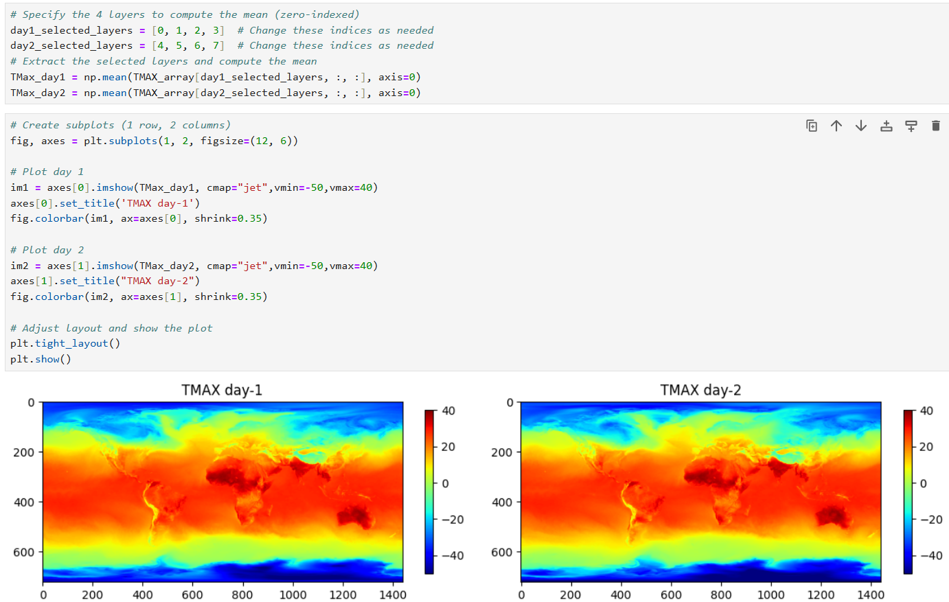
Cloud Services: automated processing data retrieved from the cloud – example forecasts
Extract data files process relevant (grib) layer
http://rsgportal.itc.utwente.nl/gfs/
Web-based Data visualization

Slide 12
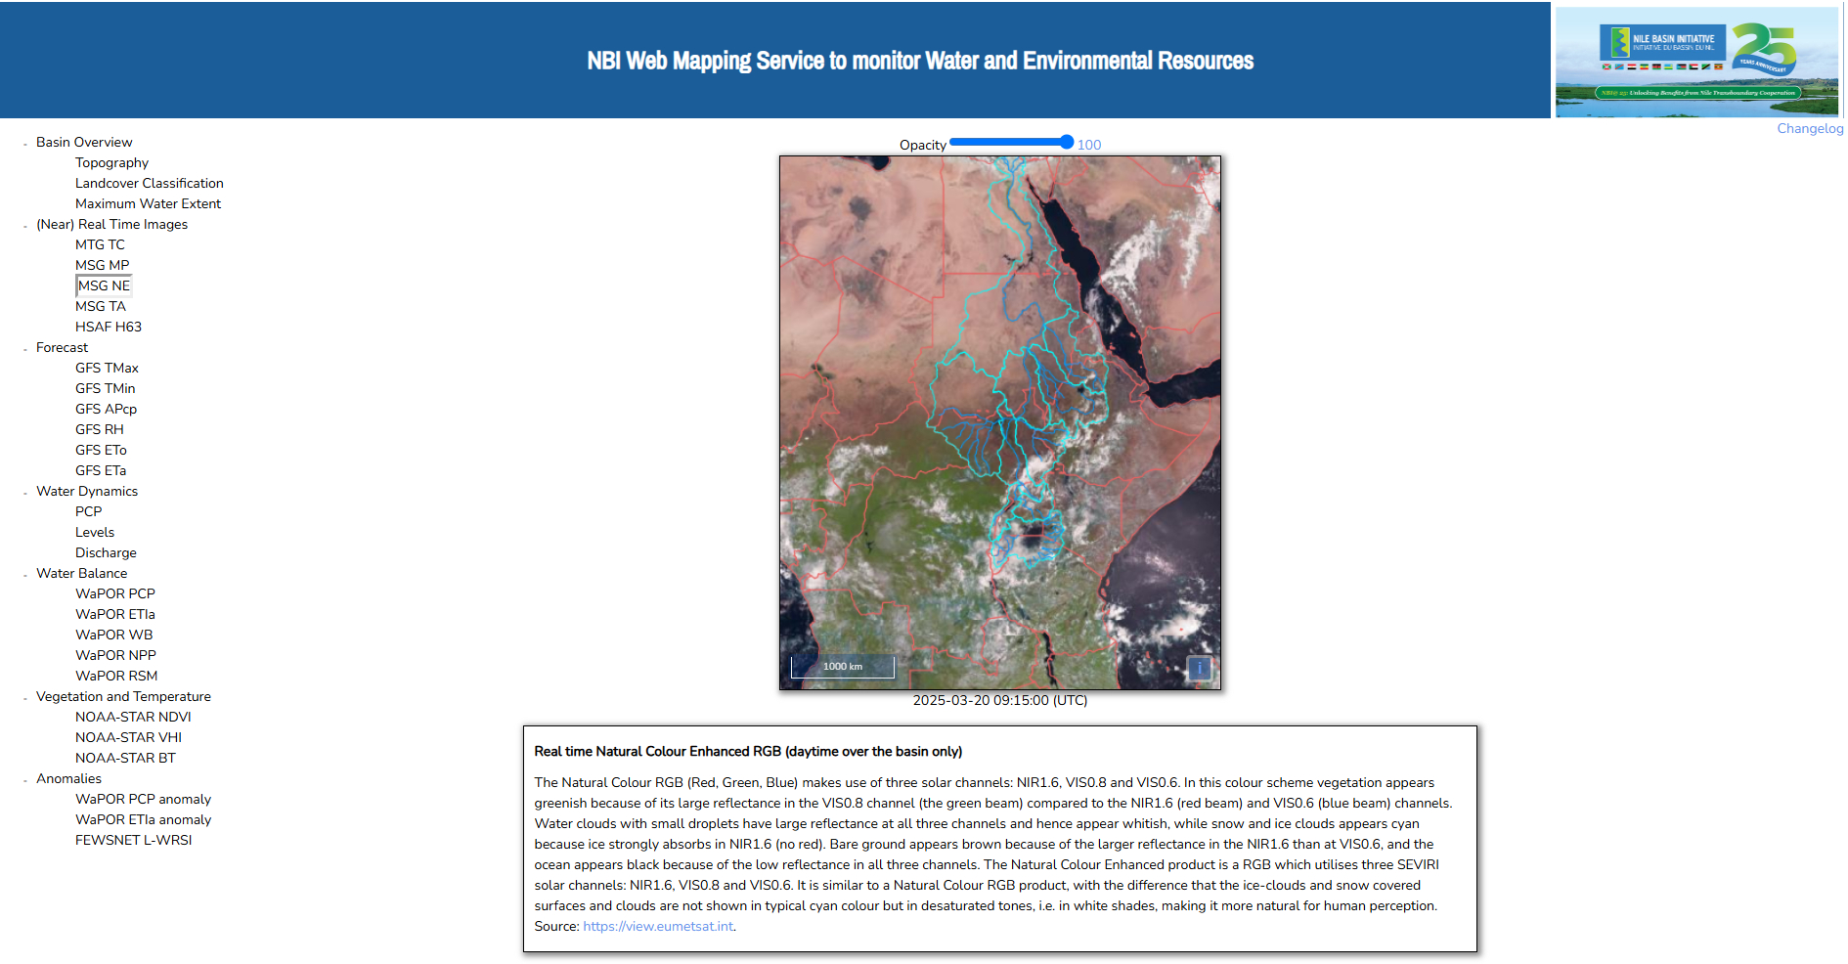
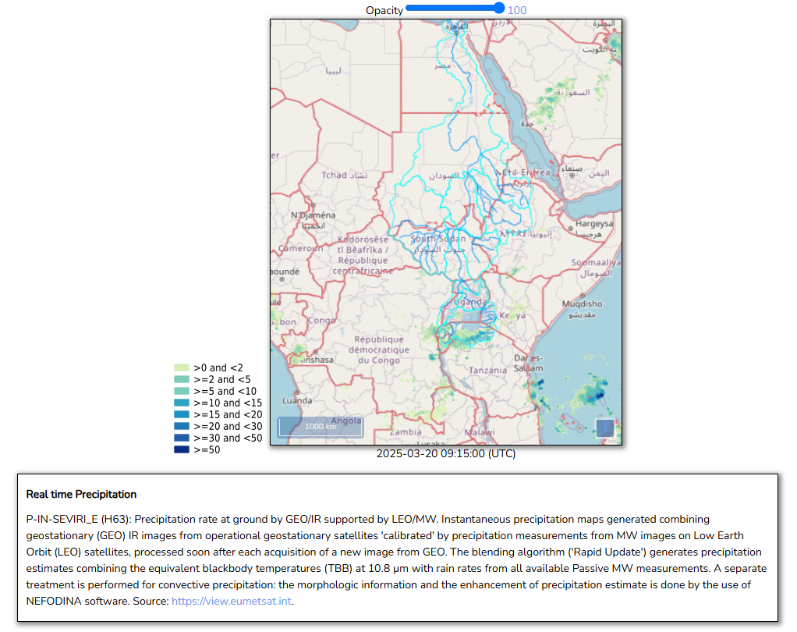
Last mile: Informing the public / non geo experts
  Use of MapServer with auto-update – example Nile Basin
Latest 15 minutes visualizations
Latest 15 minutes precipitation

Slide 13
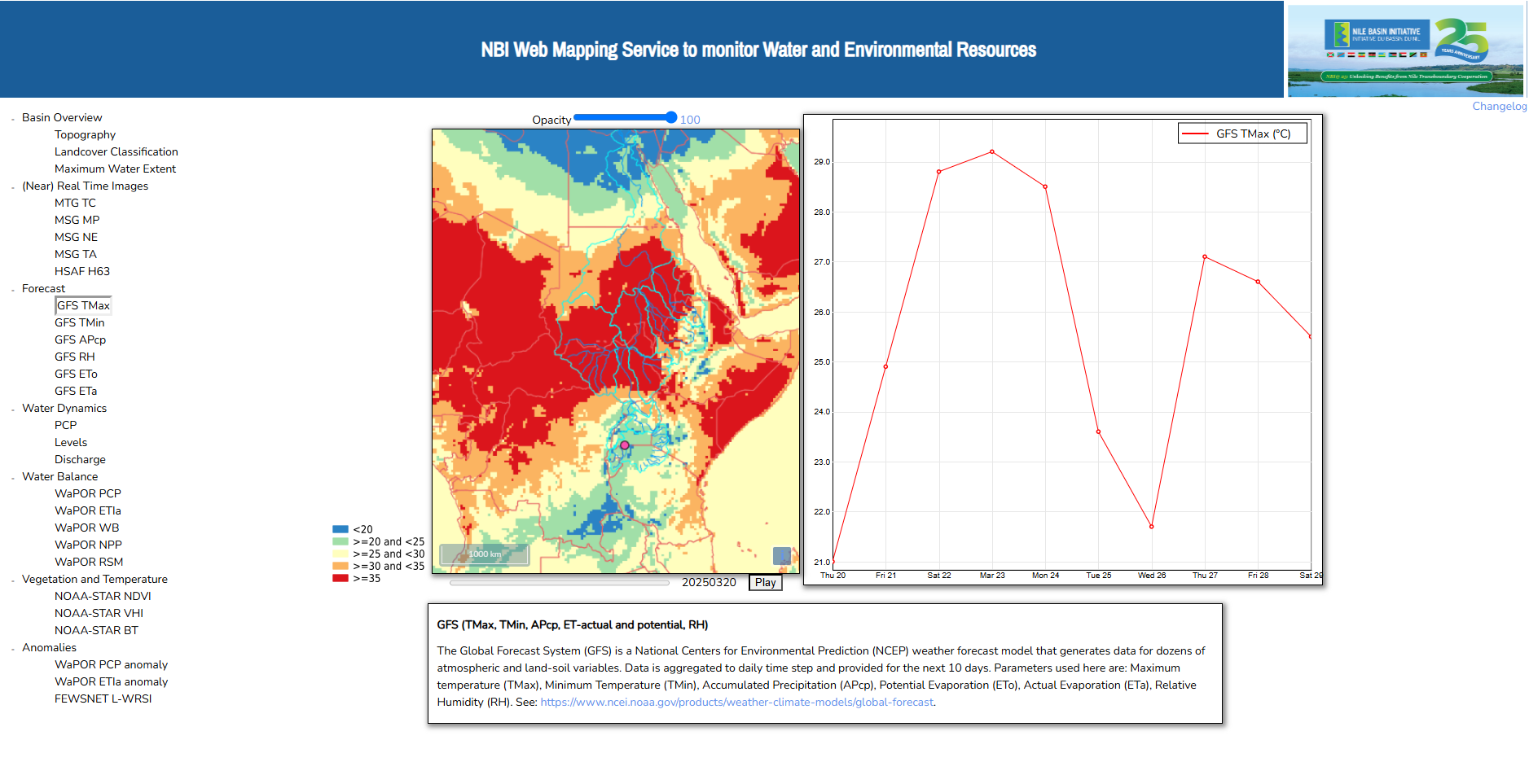
Last mile: Informing the public / non geo experts
  Simple user interface, select different products, from map to graph, animation, etc.

Slide 14
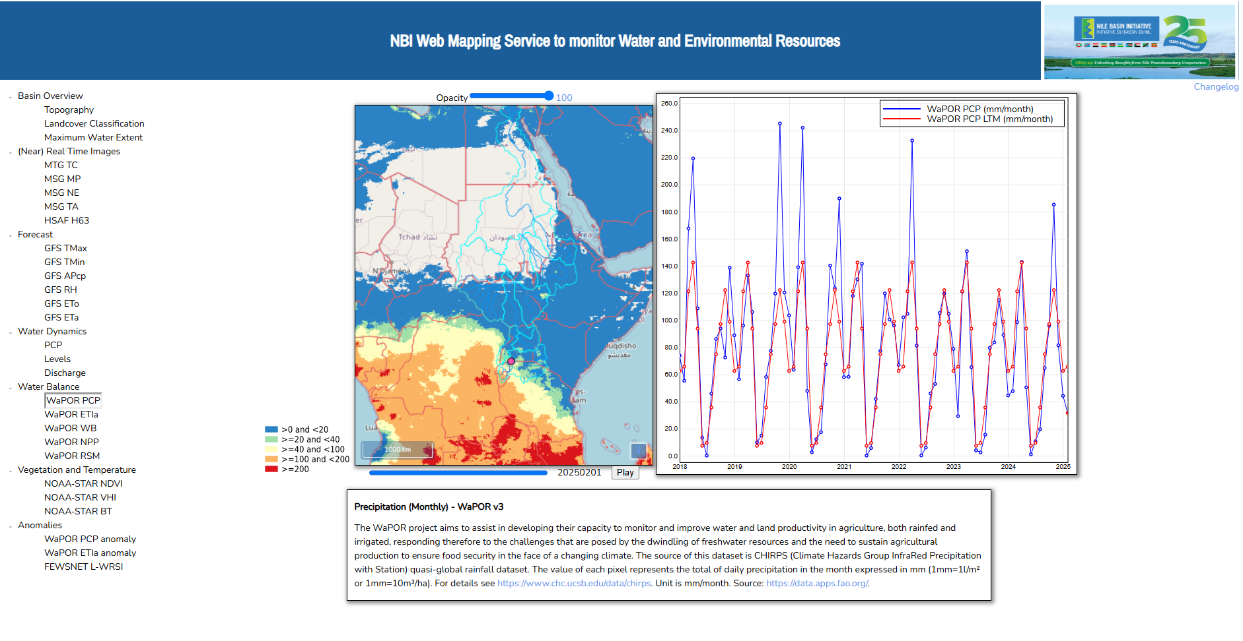
Last mile: Informing the public / non geo experts
  Plotting actual selected parameter and graphics showing climatology

Slide 15
Concluding remarks
Through EUMETCast continuously near real-time and forecast data is received, different online repositories are containing (time series of) open data on land, ocean and atmosphere;
For effective use additional Python (and Linux) knowledge is required, e.g. can be supported through establishing a Jupyter Notebook catalogue;
All data and tools are free / publicly available, registration to access portals is required;
Some cloud services are also offering free processing (using JupyterHub platform) and storage capabilities, only internet access is required;
Currently, given huge data volumes ‘bring the software to the data’, download result only;
Processed data can be provided for further research (structured database) / to the public (e.g. using MapServer).

Slide 16
Thanks for your attention / Obrigado pela sua atenção
Ben Maathuis | Dept. of Water Resources | Faculty ITC – University of Twente | b.h.p.maathuis@utwente.nl
Langezijds building Hallenweg 8 7522 NH Enschede – The Netherlands | www.itc.nl

